Slide 1

Refractory lining integrity management of furnaces and reactors in process industries
Manabendra Maity, Chief Engineer (Refractory)
Saudi Basic Industries Corporation (SABIC)
maitym@sabic.com
The information contained in this document is the confidential property of SABIC. It cannot be disclosed, copied or used for any purpose without prior approval from SABIC.

Slide 2
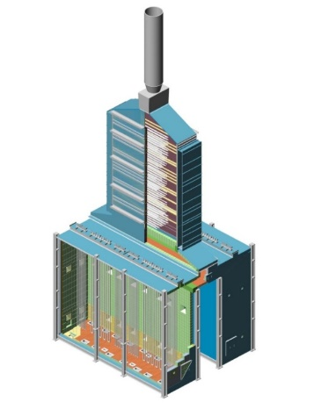
CONTENTS
Refractory lined process equipment
Importance of refractory integrity
Common problems and failures
Risks & challenges
Refractory integrity management : Requirements
Conclusion
The information contained in this document is the confidential property of SABIC. It cannot be disclosed, copied or used for any purpose without prior approval from SABIC.

Slide 3

REFRACTORY LINED PROCESS EQUIPMENT
Fired Heaters, Furnaces, Reformers, Reactors, Boilers, Incinerators, Thermal Oxidizers, etc……
Refinery & Petrochemical Plants:
Fired Heater ( 500 to 900⁰C)
Hydrogen Reformer (~1150⁰C)
Ethylene / Olefin Furnaces (~1150⁰C)
Process Reactors / Gasifiers (~1000 -1300⁰C),
MTBE Reactor (~650 to 800⁰C)
Fluid Catalytic Cracking Unit (~650 to 850⁰C)
Coke Calciner (~1150 to 1300⁰C)
Incinerator / Oxidizer
Sulphur Recovery Unit (~1600⁰C)
Carbon Black Reactor (~1500 -1900⁰C)
HRSG & Boiler
Chimney / Stack , etc.
Extreme Temperatures (~ 500 to 1900⁰C),
Extreme Pressures (~ -ve to + 70kg/cm²),
Corrosive environment:
  Gaseous / reducing / oxidizing conditions
  Aqueous phase corrosion
  Melts & slags (gasifier, incinerator)
Erosion: by flowing catalysts / gases
Shell / Casing metal Temperature limitations:
  High temperature damage: Corrosion/ HTHA….
  Low temperature damage: Dew point corrosion
Ammonia/Methanol / Syn gas Plants:
Primary Reformer (~1150⁰C)
Secondary Reformer (~1300⁰C)
WH Boilers……
SABIC Confidential

Slide 4
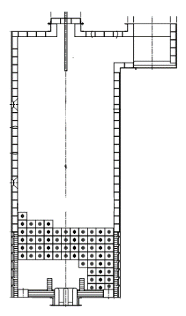
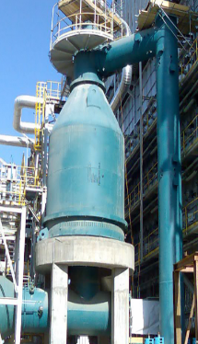

REFRACTORY LINING FOR FURNACE & REACTOR
  Refractory Functions:
  Form a container for heating & holding of molten metal, slag, glass, gases, hydrocarbons, etc. at high temperatures (for heating, melting, conversion and refining process);
  Thermal energy saving;
  Maintain furnace structural integrity against high Temperature, Corrosion, Erosion;
  Maintain safe working environment;
  Many others performance and functional requirements…..
Refractory Performance and service life controls plant economics and sustainability objectives.
Refractories offer opportunities to
  Reduce Fuel consumption;
  CO₂ & NO_{x} emissions.
Radiant Tubes
Refractory
Steel Plate
Heat Radiation from wall
Inside ~ 1100⁰C
Outside 60-100⁰C
Steel Casing
Refractory
Furnace
Reactor
SABIC Confidential

Slide 5

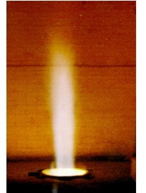
REFRACTORY : INTEGRITY & PERFORMANCE IMPORTANCES
      Process Plants continuously operated for 2-5 years without shutdown
      No / limited standby furnace / reactor equipment
      Plants and equipment are integrated- failure of any furnace may cause complete shutdown
      Refractory failures and non-performances lead to
          Hot spots, Shell overheating, structural degradation.
          Loss of containment and associated RISKS.
          Unsafe operating conditions: EHSS Risks.
          High thermal energy losses .
          Reduced efficiency / production load.
          Unplanned downtime - production losses.
          High maintenance costs…….etc.
+600ºC
Refractory failure & Hot spot +600⁰C
Refractory failure & Furnace structural damage
Loss of containment
Refractory fallen on burners-lead to Burner malfunctioning
SABIC Confidential

Slide 6
COMMON PROBLEMS / FAILURES OF REFRACTORY
SABIC Confidential

Slide 7
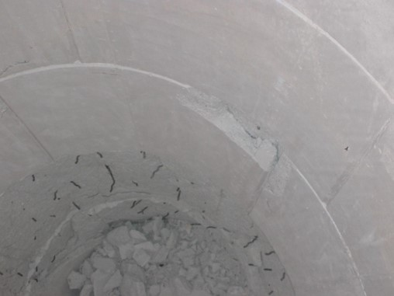
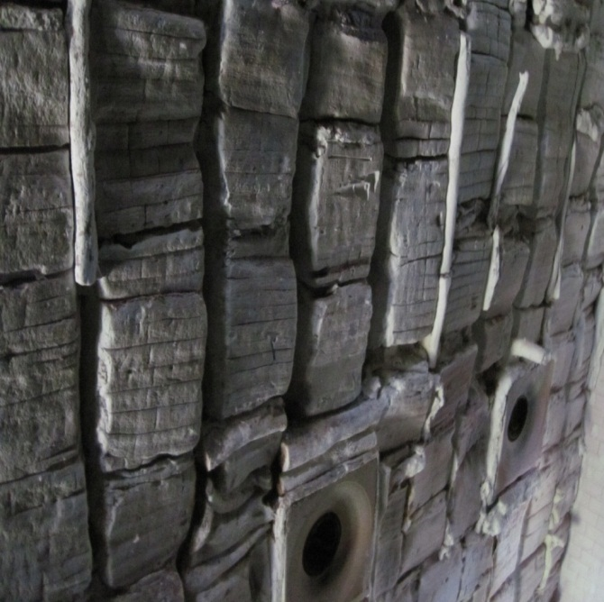
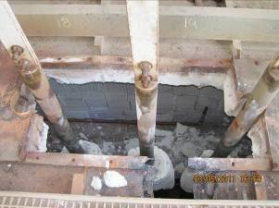

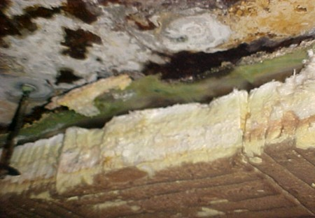
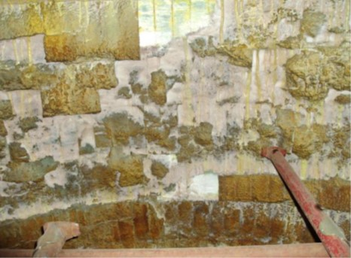
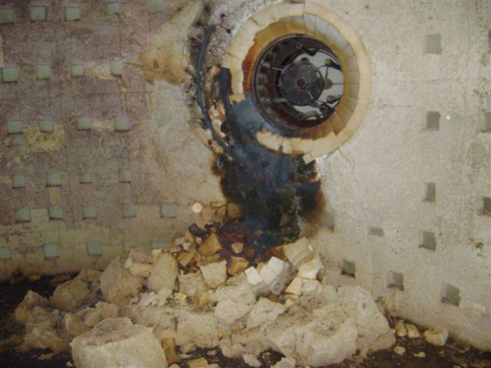
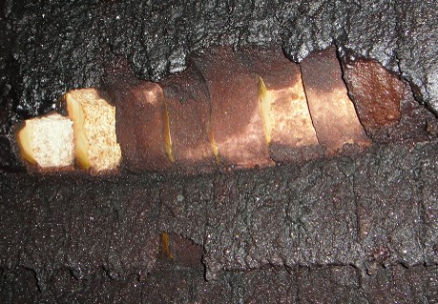
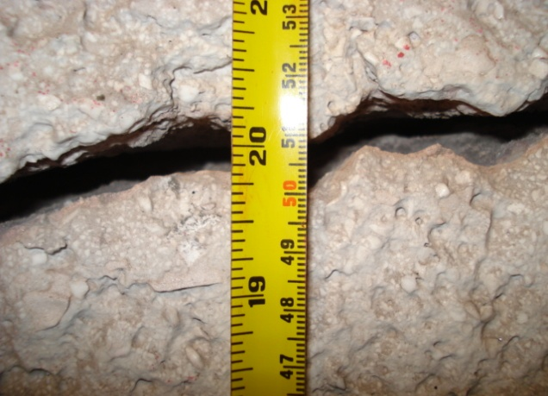
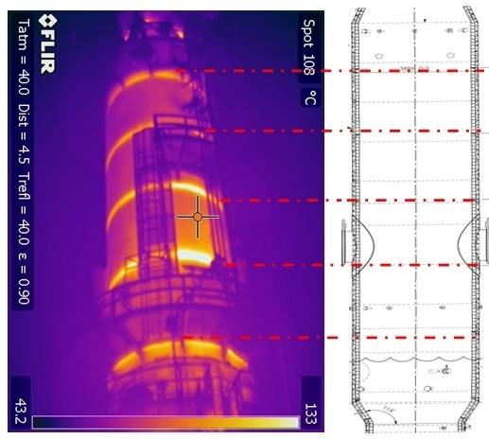
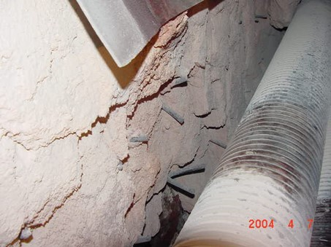
COMMON PROBLEMS / FAILURES OF REFRACTORY
Hot spot (higher casing temperature)
Cracking & deterioration
Spalling- thickness loss (thermal, mechanical, structural)
Erosion and thinning of lining
Corrosion (with slag, melts, salts gases e.g. hydrogen, CO, SO₂ / SO₃, alkalis, S, Na, V etc.)
Dew point corrosion of refractory & structures
Anchor and support failures
Melting and degradation
Shrinkage and development of gaps
Spalling & cracking during refractory dry out
Structural deformation & bulging
Miscellaneous damages & combination
Roof Refractory & Plate Collapsed
Failures / problems could occur in new furnaces & installations also
SABIC Confidential

Slide 8
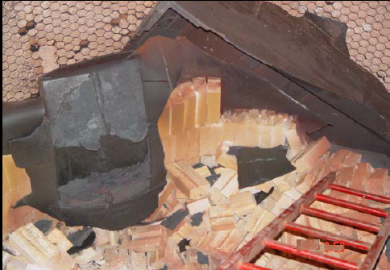
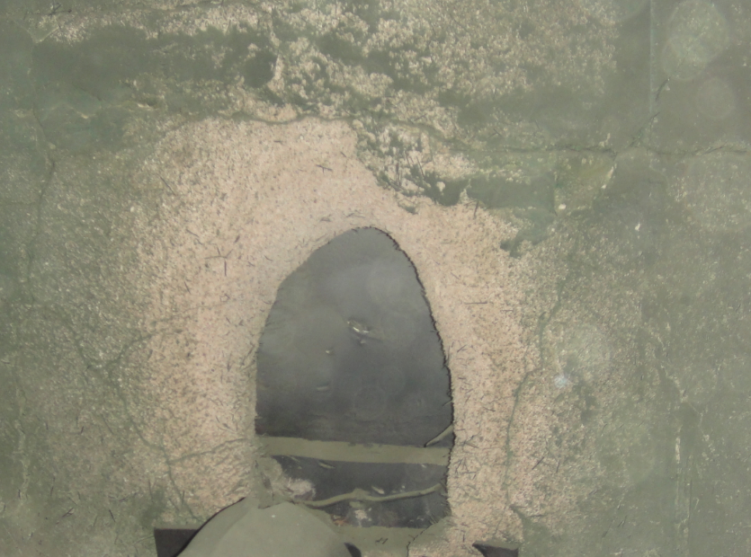
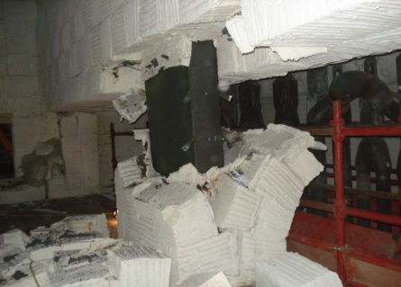

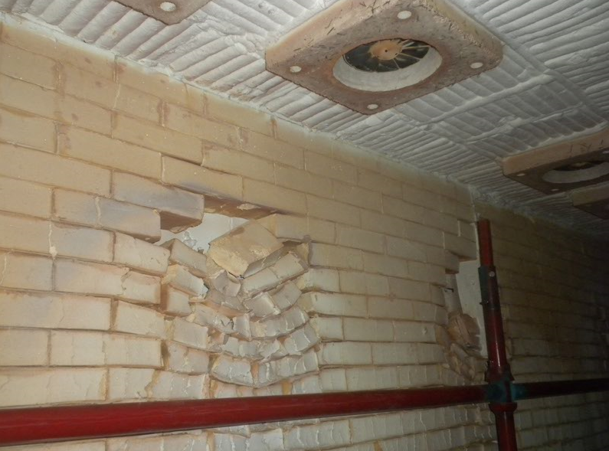
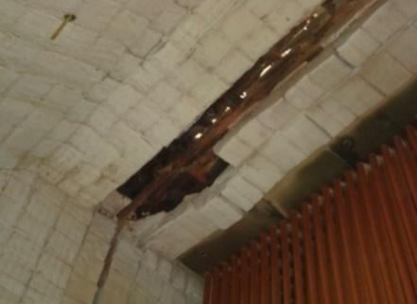
COMMON PROBLEMS / FAILURES OF REFRACTORY LINING
Failure and structural damage
Erosion and structural plate exposed
Refractory failure &
structure exposed
Anchor & refractory failure
Melted / deformed
Fallen refractory
Corrosion
Structure oxidized / perforated
Major refractory failures lead to EHSS Risks / unplanned shutdown
SABIC Confidential

Slide 9
REFRACTY PROBLEMS – Common Causes
Design Related
  Inadequate thickness
  Wrong material selection
  Shape & sizes of shaped items
  Anchor metallurgy & design
  Excess or inadequate anchors
  Expansion gap design, etc……
Refractory Materials
  Inferior material supplied & installed
  Material degradation during storage…
Installation & Workmanship inadequacies
Improper Curing & Dry-out
Operational Deviations
  Increased Load / temperature
  Mal-operation & process upsets
  Faster heating / cooling
  Flame impingement on wall
  Temperature & Pressure fluctuation
  Vibration & mechanical impact……..
Operational Stresses
  Thermo-mechanical stresses
  Corrosion- Thermo-chemical attack
  Erosion / abrasion
  Ageing …….
Other factors
  Inadequate maintenance & monitoring .
  Low cost strategy…
Design
Installation
Material quality
Dry out
Operation
Practices
Maintenance
Others
SABIC Confidential

Slide 10
REFRACTORY PERFORMANCES- KEY ISSUES

Slide 11

REFRACTORY INTEGRITY & PERFORMANCE –KEY ELEMENTS
Asset Acquisition:
Reliability in
Design & Construction
Operate & Maintain
Integrity & Reliability
Management
Technical & performance specifications / requirements
Design of furnace & refractory lining
Selection & evaluation of materials
Installation and construction – QA & QC
Heat dry out & commissioning of furnace
Inspection & monitoring practices
Operational control of key process parameters
Failure investigations & corrective measures
Maintenance & repair
Continuous improvement
Multiple Agencies:
  Plant owner
  Original Equipment Manufacturers (OEM)/ Licensor
  Engineering contractor/ PMC
  Equipment fabricator (mechanical)
  Refractory manufacturer / supplier
  Installers, Dry out agency, Third party…..
Scopes & Responsibilities
Define & Align
SABIC Confidential

Slide 12
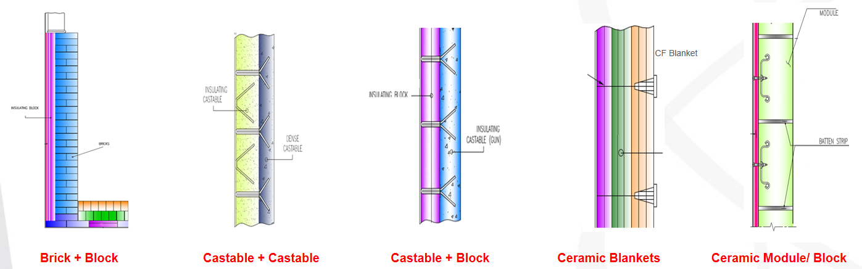
REFRACTORY DESIGN
Design
Installation
Material quality
Dry out
Operation
Practices
Maintenance
Others
  Limited standards / codes (for design and selection of materials).
  Few broad guidelines are available for some specific cases (API 560 for Heaters..).
  Lining design issues are open with multiple options and possibilities….
  Design weaknesses are a fundamental flaw : Cannot be overcome by use of either best refractories or excellent Installation.
  Typical design options
SABIC Confidential

Slide 13

REFRACTORY DESIGN - TYPICAL REQUIREMENTS
Do not generalize refractory design: Every equipment is unique and requires customized design;
OEM – Licensor’s design: Review & ensure adequacy for the specific equipment
Contractor’s proposal: Review & approve design / materials:
Consider ease of maintenance & repair;
Cost vs. performances: Balance Safety & Life Cycle Cost.
STRATEGIES
Reliability & Maintainability
Optimum Life Cycle cost
Energy Efficiency & Sustainability
Codes, EHSS & Regulatory compliance
SABIC Confidential

Slide 14

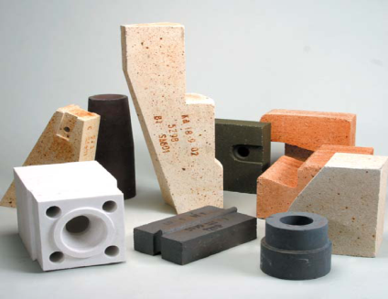
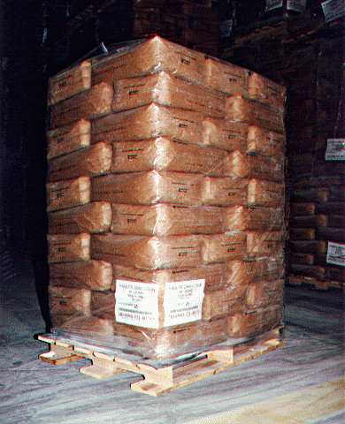
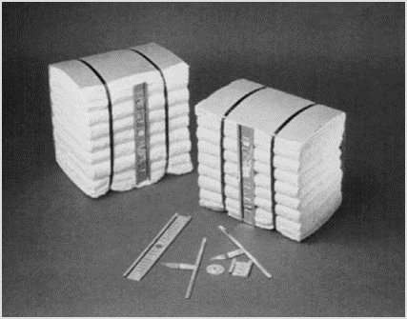
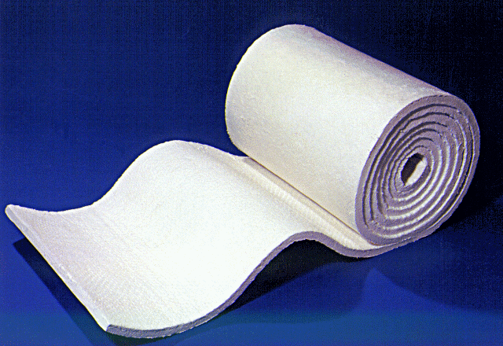
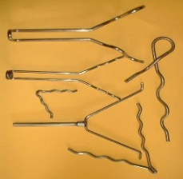
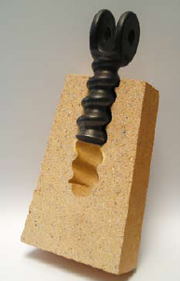
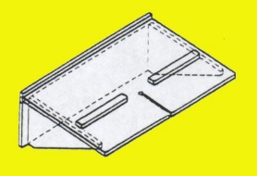
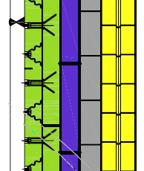
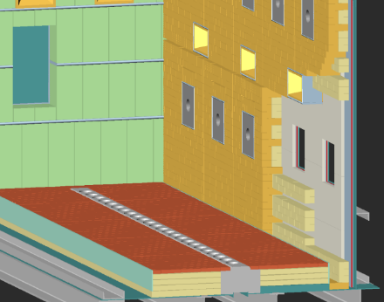
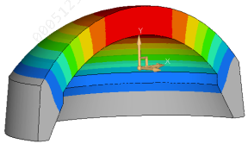
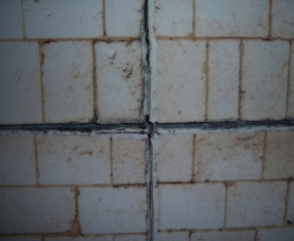
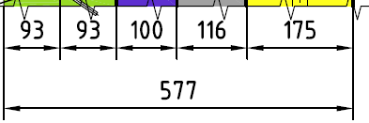
REFRACTORY DESIGN & DETAILED ENGINEERING
Refractory Type
    Brick/ Monolithic/ Fiber
    Chemical, thermal & physical Properties;
Numbers of layers;
Total Thickness;
Shape & Size of bricks, shaped items;
Anchor & Support Details;
Expansion Gaps (Vertical & Horizontal, Location & Width);
Stress Analysis (FEA & Modeling); etc.
Refractory Brick
Monolithic
Fiber Blanket & Module
Anchor & Support
Steel Shell
Vertical
movement
Horizontal movement
No. of Layers
Detailed Engineering
Refractory dome- FEA
Expansion Gaps
SABIC Confidential

Slide 15

REFRACTORY DESIGN- HEAT FLOW CALCULATION
Steel Casing
Inside
>500⁰C
Refractory
  External shell temperature
  Interface temperature
  Heat loss from surface
Refractory Brick
Castable
CF Module
CF Blanket
Layer 1: IFB, Gr. 28 Layer 2: IFB, Gr. 23 Layer 3: Block 1100°C Layer 4: Block 800°C | Layer 1: MW Concrete Layer 2: CF Board Layer 3: Block 1000°C Layer 4: Block 800°C | Layer 1: CF Modules 1430°C, 192kg/m³ Layer 2: CF Blanket 1260°C | Layer 1: CF Blankets 1430°C, 128kg/³ Layer 2: CF Blanket 1260°C
Heat Flow Calculation for: t_{AMB}=27°C, t_{INS}=1200°C, wind=0m/s, ε=0.95
t_{OUTS}=71°C q_{loss}=580 W/m² | t_{OUTS}=77°C q_{loss}=675 W/m² | t_{OUTS}=73°C q_{loss}=600 W/m² | t_{OUTS}=70°C q_{loss}=530 W/m²
Temperature Gradient
SABIC Confidential

Slide 16
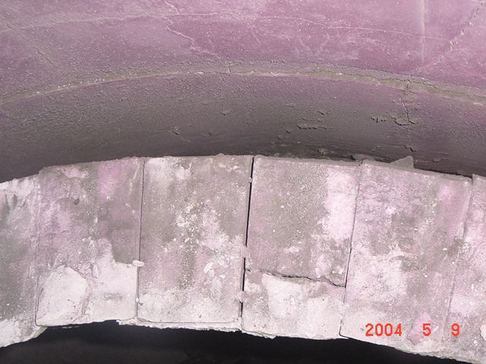
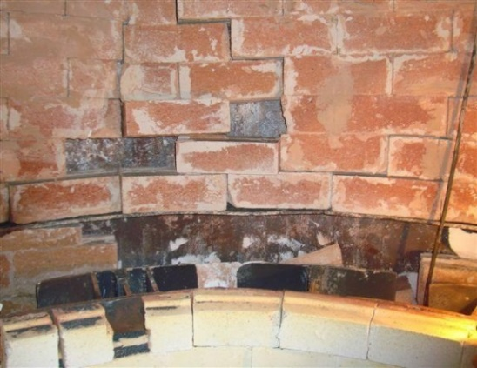
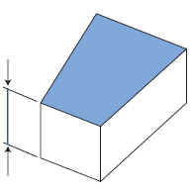
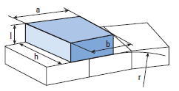
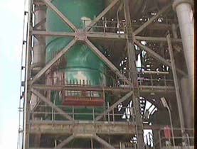
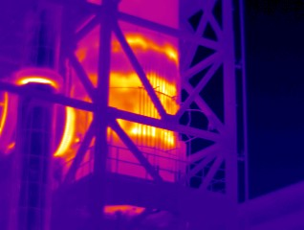
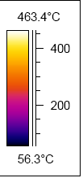
DESIGN RELATED PROBLEMS: Example
Standard Refractory Shapes for
Flat wall
Gap
Refractory wall tilted- wrong brick design
Refractory Fallen Locally due to wrong brick design
Special Refractory Shapes for
Curved wall
Discoloration
Hot Spot & Paint Discoloration
Wall Thermography
SABIC Confidential

Slide 17
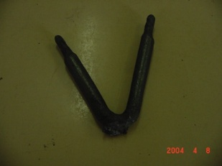
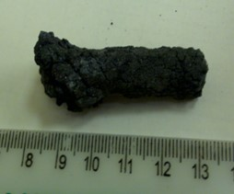

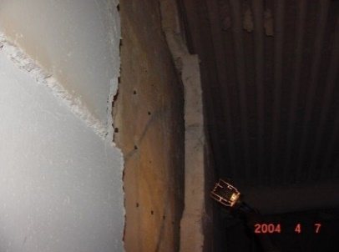
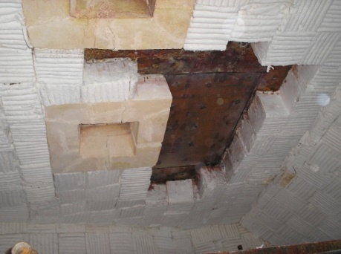
ANCHOR RELATED PROBLEMS
Inferior anchor material
Design Problems ( less height, thinner cross section)
Anchor spacing (too high / too less)
Inadequate welding
Fabrication defects…..
Anchor oxidized
Anchor failure
Brick wall tilted
Anchor failure
Castable layer detached-
Anchor failure-
Refractory fallen
SABIC Confidential

Slide 18
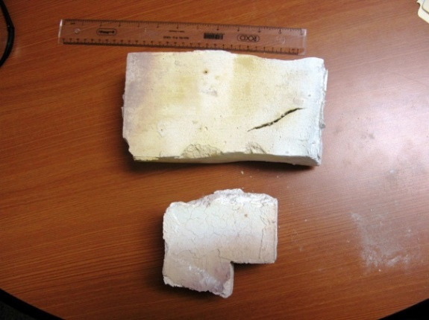
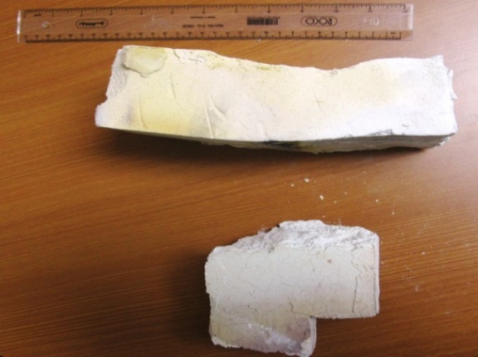
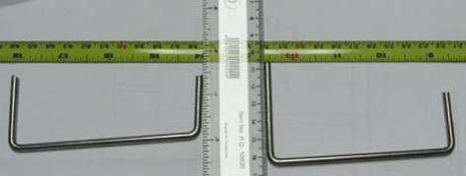
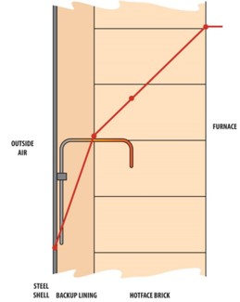
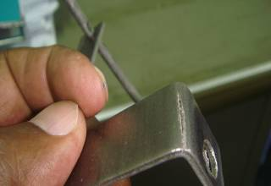
REFRACTORY MATERIAL QUALITY
Was the correct material purchased & installed ?
Design
Installation
Material quality
Dry out
Operation
Practices
Maintenance
Others
Refractory materials: Heterogeneous & non-standards products
Avoid Procurement: on basis of product datasheets or “Equivalent” principles;
Specify Guaranteed specifications: Material datasheet is not a specification and no warranty is implied
Manufacturers recommendation: Be careful, their recommendation could be biased.
Manufacturers: Check Manufacturing capabilities; (test facilities & past supply records)
Ensure inspection & testing of materials;
Specify packing & marking requirements;
Plan procurement schedule; (w.r.to shelf life & installation schedule)
Ensure materials verification / pre-qualification at site (API-936…
Material shrinkage & deformation
Wrong Brick Hook size
Crack in anchor
SABIC Confidential

Slide 19
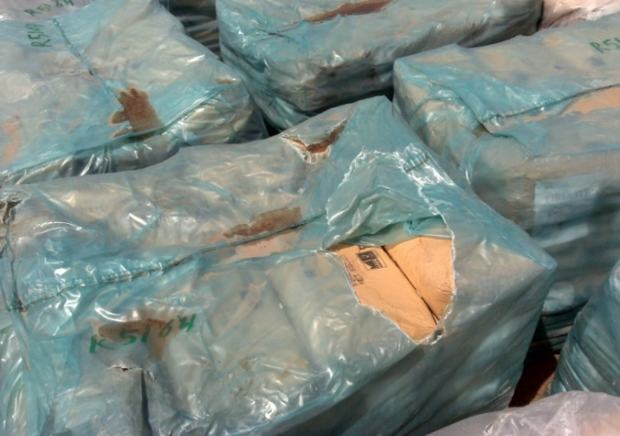
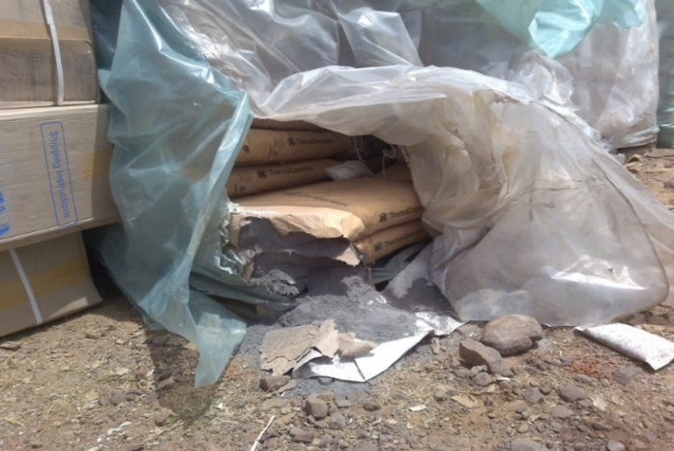

REFRACTORY STORAGE- Degradation of materials
Was the correct material stored properly?
Avoid Open Storage of refractory,
exposed to ambient conditions / rain
SABIC Confidential

Slide 20








REFRACTORY INSTALLATION quality & workmanship
Design
Installation
Material quality
Dry out
Operation
Practices
Maintenance
Others
Refractory Installation: Complex Process & Time Consuming task;
It is not a conventional civil construction;
Most Installation is a manual job : Mason (Individual or Group);
Each Installation requires specific SKILL set and equipment;
Installation quality varies depending on expertize of Mason & QC Plan;
Develop job specific installation procedures and quality plan;
Conduct Prequalification / Mock-up of installation;
Allow time for proper installation;
Implement Quality Assurance program.
Installation- quality inconsistency
Gap Between Layers
Cavities / Voids
SABIC Confidential

Slide 21







INSTALLATION PROBLEMS: Wrong Anchor Fixing
Was the refractory material installed properly ?
Anchor
Brick wall & Anchor arrangement
Anchor at wrong position
Incorrect marking and welding
SABIC Confidential

Slide 22


REFRACTORY HEAT DRY OUT
Design
Installation
Material quality
Dry out
Operation
Practices
Maintenance
Others
Installed refractory contains lot of water ( mainly monolithic concretes);
Slow and controlled removal of water is essential;
Delayed Dry-out may cause Alkali hydrolysis of Refractory;
Dry out is a Time Consuming Task;
Avoid reducing dry-out time / faster heating: risk of failures either by cracking and spalling
Uncontrolled dry out and damage of refractory
SABIC Confidential

Slide 23
operate & maintain
SABIC Confidential

Slide 24
REFRACTORY INTEGRITY MANAGEMENT – OPERATE & MAINTAIN
Refractory lining & structure subject to deteriorate over time, no matter how tough, how strong..
Timely identify problems & initiate corrective actions to prevent unpredicted failure
Condition assessment & maintenance strategies:
  Develop planned program for Periodic inspection & Monitoring,
  Avoid run to failure approach
  Address weaknesses with a scientific approach instead of "replace in-kind“ approaches
  Conduct Failure investigation for unusual failures
  Prioritize repair scope & optimize shutdown duration
  Ensure effective MOC process for operational / refractory design changes
  Develop emergency response procedures for Troubleshooting:
    Hot spot management (e.g., steam, air cooling)
Strategy
Effective Inspection & Monitoring
Identify Risks & Performance Killers
EHSS & RISK Mitigation
Run Length Extension
Continual Improvement
Maintenance Time & Cost reduction
SABIC Confidential

Slide 25







INSPECTION & MAINTENANCE PRACTICES
Inspection & monitoring of lining:
    Online / In-service Inspection-
        Thermography,
        External paint discoloration,
        Other visible changes
        Monitor process deviation/ upset - Actual vs. Design (e.g., temperature)
    Off-line Inspection (during shutdown)
Furnace- casing Thermography
Hot spot & Paint Discoloration
Wide Crack & Hot Spot
Sight door
Internal view- check abnormalities
SABIC Confidential

Slide 26



OVERHEATING & ASSOCIATED DAMAGE
Wall Temperature- Thermography
Internal
High Shrinkage, gaps & deterioration……
SABIC Confidential

Slide 27








REFRACTORY REPAIR
Compromise on repair procedure
Overlook basic technical requirements
Fundamentals of repair should not be overlooked
Don’t treat refractory installation as a civil work
Repair job should not be left to the discretion of contractor
Proper repair procedure should be developed
Challenges:
Limited shutdown time
Limited accessibility inside vessel
Non availability of resources
Budget limitations
Safety issues/ restrictions, etc.
Avoid short-cut/ cosmetic repair
Surface Defects
Surface Patch Repair
Reformer
Fallen refractory layers
Refractory Pieces blocking tubes causing operational problems by restricting process gas flow
Process Gas Boiler
SABIC Confidential

Slide 28
continuous improvements refractory IMPROVEMENT OF AGED FURNACE- OPPORTUNITIES
SABIC Confidential

Slide 29





REFRACTORY MAINTENANCE: Aged Furnaces
Improvement opportunities of aged refractory
What type of refractory shall be used:
  Original (replace-in-kind) or
  Upgraded / modified?
Partial or Full replacement / upgradation?
Identify Performance killers and inadequacies
Identify alternate design options & improvement opportunities.
Perform feasibility for implementations.
Material
superior / advanced materials
Design
Optimized / state-of the-art design
Installation
Improved installation practices & QA-QC
Work with Specialist Refractory contractor / OEM for detailed study & opportunities
SABIC Confidential

Slide 30


FURNACE WALL LINING UPGRADATION- Example
Conventional wall Lining |  |  | Alternate Lining
Layer 1: Insulating Fire Brick Gr. 28 | 115mm |  | Same | 115mm
Layer 2: Insulating Fire Brick Gr. 23 | 115mm |  | Same | 115mm
Layer 3: Insulating block, 1100ºC | 50mm |  | Same | 25mm
 |  |  | Micro-porous Block | 25mm
Total | 280mm |  | Total | 280mm
Casing Temp : 91ºC |  | 84ºC Reduced casing temperature
Heat Loss : 650 W/m² |  | 540W/m² Reduced Heat Losses
Micro-porous
Insulating Block
Brick
Furnace/ Reformer
Partial change in Material type
Micro-porous insulation- Extremely low thermal conductivity
Reduced casing temperature, Heat Losses & Fuel consumption
Sustainability…..
SABIC Confidential

Slide 31




FURNACE WALL LINING: CERAMIC FIBER MODULES
Conventional Lining
CF Module (170 kg/m³) | 230mm
Total | 230mm
Casing Temp: 97ºC
Heat Loss : 745 W/m²
Alternate Lining
CF Module (>200 kg/m³) | 205
Fibre Blanket ( 128 kg/m³) | 25
Total | 230mm
92ºC
651W/m²
High Density
Add Blanket
Shrinkage Gaps at the Joints ( High heat losses/ hotspots)
Blanket
Change in Design &Material
Add a back-up layer & Increase density of module
Reduced casing temperature,
Reduced Heat Losses & Fuel consumption
Sustainability…..
Module
Blanket
Gaps
Single Layer: Module only
Double Layer: Module & Blanket
SABIC Confidential

Slide 32

CONCLUSION
Refractory fundamentals should not be overlooked;
Refractory design, supply, installation, maintenance jobs should not be left to the discretion of OEM & contractors alone;
Inspect and monitor refractory linings periodically & timely repair;
Conduct detailed investigation of unusual failures;
Address weaknesses & problems with a scientific & practical approach instead of "replace in-kind“.
Documentation and Records keeping: Design, inspections, modifications, repairs, …..
Ensure Reliability in Design & Construction
Implement effective inspection & monitoring program for refractory
Timely identify problems and restore integrity
SABIC Confidential

Slide 33
Thank You

