Slide 1

Dissimilar metal weld cracking
Case study - Utilities plant, Yansab (A SABIC Affiliate)
Kareem Khalil – Staff Engineer, Static Equipment

Slide 2
Outlines
    Crack Figure
    Materials and Configuration
    WPS and ASME Reference
    Fault Tree Analysis
    Root Causes
    SABIC SMS & API 571 for Creep Threshold Temperatures

Slide 3
DMW (Quoted from SMS for DMW)
What is DMW?
Dissimilar metal welding is often encountered in welding, where a filler metal different in composition from the base metal is used or where two base metals different in composition are welded together. In dissimilar metal welding, the region near the fusion boundary often differ significantly from the bulk weld metal in composition and sometimes even microstructure and properties.
Brief Scientific Explanation
The composition of the bead depends not only on the compositions of the base and filler metals but also on the extent of dilution. Apparently, the second bead to be deposited on top of the first bead will have a different composition from the first bead regardless of the extent of weld pool mixing. As a result of such macro-segregation, the ferrite content (which affects the resistance to solidification cracking and corrosion) varies from one bead to another.
Recommended Practice
Generally, dissimilar welds are not recommended, and shall not be used unless no other option is available.

Slide 4
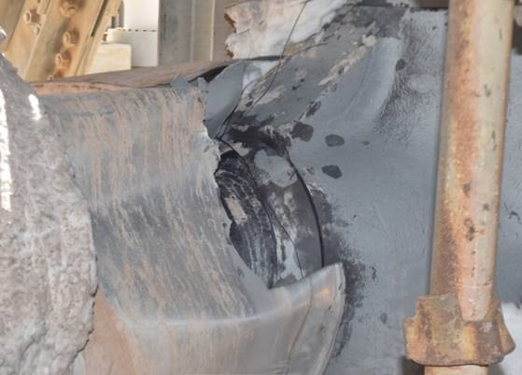
Crack figure
    The crack initiated from the toe of the weld.
    The crack propagated circumferentially.

Slide 5
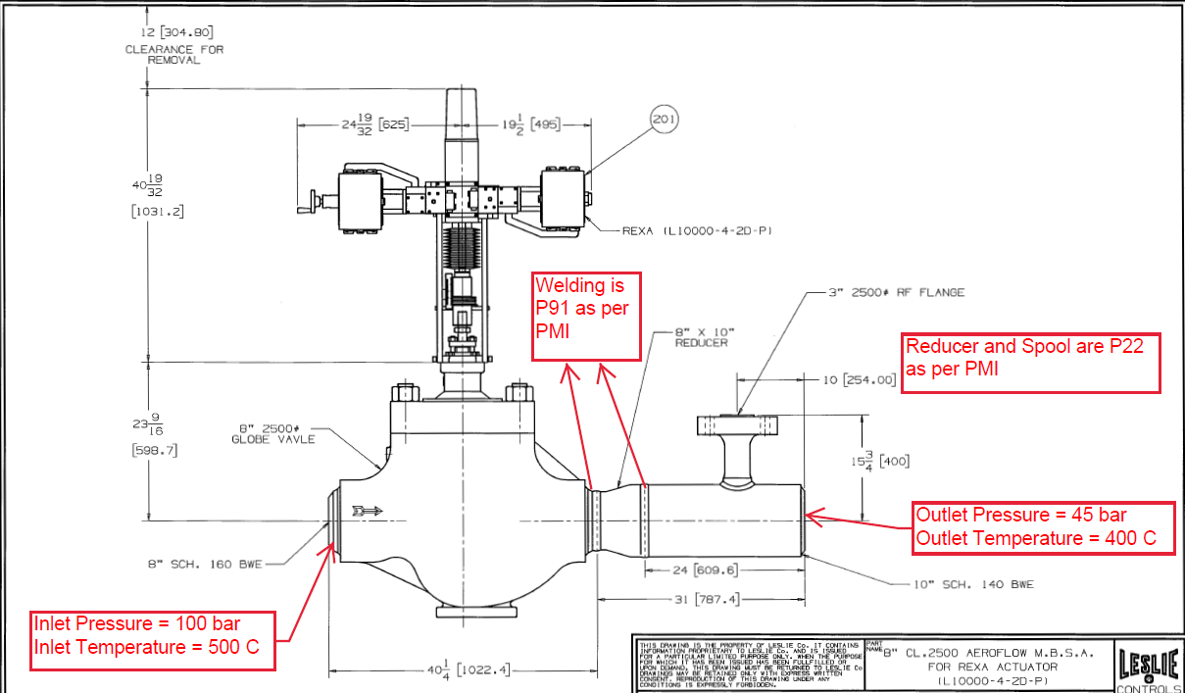
Materials and configuration

Slide 6
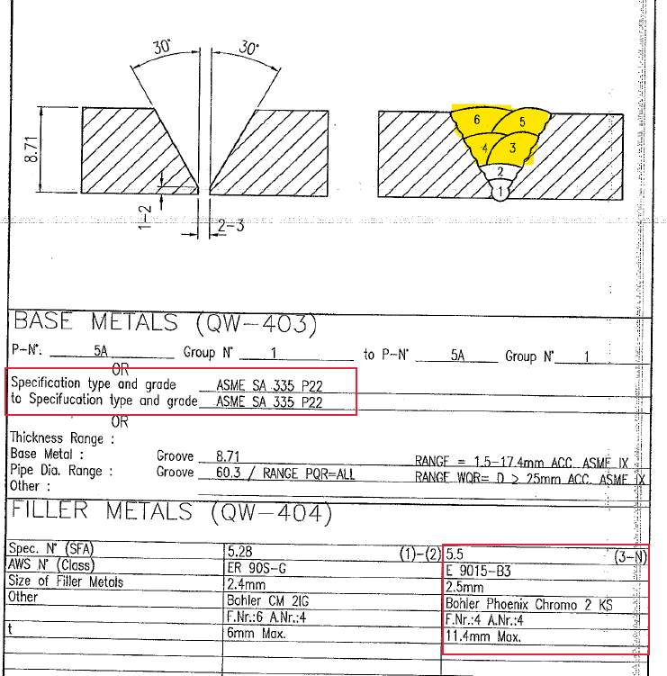
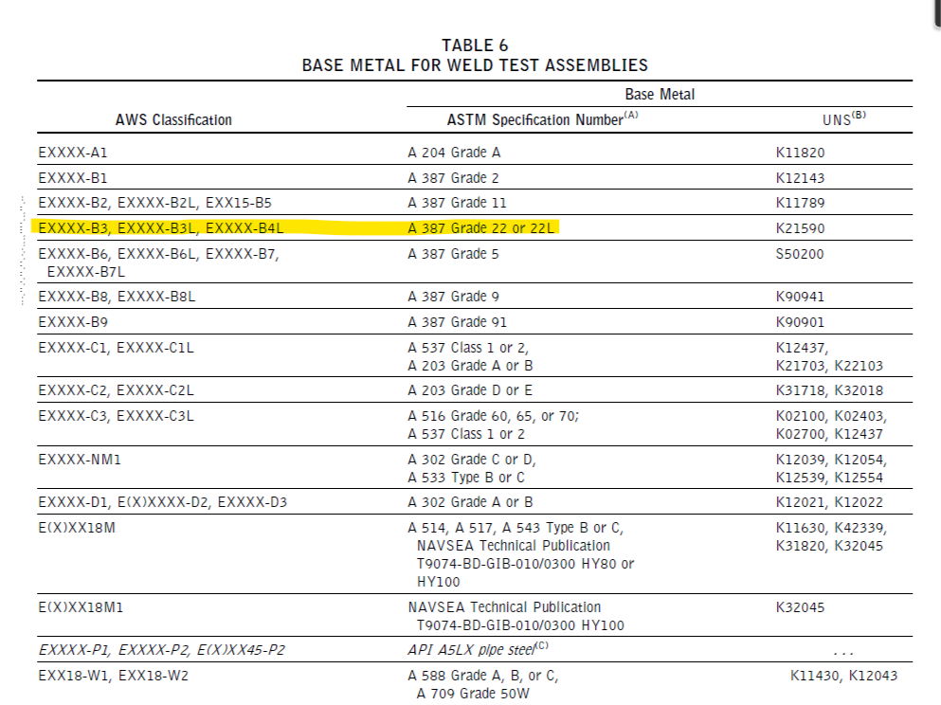
WPS and ASME Reference

Slide 7
Fault Tree analysis
HP Steam Leak from the downstream joint of 69-PV-030
Crack in the toe/HAZ of the welded joint
Metallurgical Failure
Mechanical Stress
Thermal Stress
Bending Stress
Unrelieved Stress
Improper Expansion
Over heating
Improper Vertical Support
Improper Horizontal Support
Thermal Fatigue
Creep Failure
Reduced Creep Strength due to Carbon Migration
Differential Creep Strength
Uncontrolled VHP desuperheater Water
69-TV-024 Malfunction
Spray Nozzle damage
Temperature Swing
Differential Thermal Expansion
Dissimilar Metal Weld (DMW) of P91 & P22
Inadequate Procedure

Slide 8
Root causes
This chart compares the thermal expansion coefficients of a few common grades of steel. The dissimilar weld configuration that is known to have issues at high temperature is between Low Alloy Grade 22 and Stainless Steel. On the chart one can observe that there is a significant difference in their thermal expansion coefficients. To overcome this issue in practice, it is sometimes recommended to use an intermediate spool between the SS and Grade 22 of Alloy 800 material. The chart shows how the thermal expansion coefficient of Alloy 800 falls between SS and Grade 22. Finally, comparing thermal expansion coefficients of Grade 22 and Grade 91, it is clear that there is less difference than between Grade 22 and Alloy 800. One would therefore not expect significant issues from the point of view of differential thermal expansion alone. However, it is one of the concerns.

Slide 9
Differential thermal expansion is not the only damage mode in dissimilar metal joints. Two other important factors are:
Creep strength differential
Grade 91 has significantly higher creep strength than Grade 22. With increasing time of operation at elevated temperatures, a greater magnitude of creep strain will accumulate in the Grade 22 material than in Grade 91. This could lead to a creep strain discontinuity at the dissimilar weld, which would promote the initiation of creep cracking.
Carbon migration
In dissimilar joints it has been observed that carbon will migrate from the material with lower chromium content to the material with higher chromium content, through the formation of chromium carbides. This leads to a narrow band of low carbon content next to the fusion zone on the lower alloy steel side of the joint. With carbon being an important contributor to creep strength, this leads to a narrow band of reduced creep strength material on the lower alloy side of the dissimilar joint, and the associated increased susceptibility to the formation of creep damage.

Slide 10
SABIC SMS & API 571 for Creep threshold temp
SABIC Manuf. Std. Dissimilar Metal Welds
Creep may be defined as a time-dependent deformation at elevated temperature and constant stress. It follows, then, that a failure from such a condition is referred to as a creep failure or, occasionally, a stress rupture
All P22 Materials Creep Threshold are below the operating temperature (500 C), hence 2nd and 3rd root causes took place.

Slide 11
Thank You

