Slide 1
Immature Failure in Ammonia Plant Waste Heat Boiler after Revamp Project
Basim AlSaifi
Baher Elsheikh

Slide 2
Abstract
As a part of revamp project for a Mega ammonia plant, one additional ammonia converter with downstream horizontal Waste Heat Boiler (WHB) provided. The plant under the new configuration has three ammonia converters each equipped with downstream WHB.
The plant commissioned successfully after the revamp and after few months leak observed from the new WHB. The leak detected by monitoring the ammonia presence in the produced steam.
Inspection revealed that five tubes found leaking and 65 tubes noticed with variable thickness reduction. Locations of the leak and thinned areas are located at the same portion at the top side of outlet pass of the exchanger
Hydraulic analysis revealed that new WHB operated with low BFW flow rate. The configuration and design of BFW header played a main rule in the preferential BFW to the other two WHBs.
The analysis of the BFW and steam parameters for the new WHB showed high depositions of salts /species as compared to other two WHBs.

Slide 3
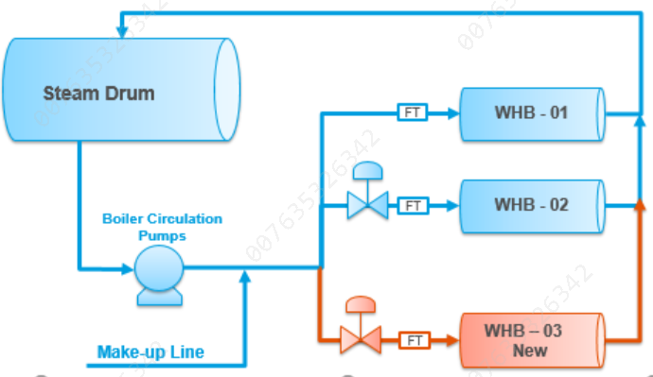
Process Flow
The heat of ammonia synthesis reaction is removed by generating high pressure steam.
There are three synthesis gas Waste Heat Boilers (WHBs), one of them (WHB-03) was added during revamp of the plant.
They are all connected to the backend steam drum. Boiler Feed water is circulated through 3 BFW forced circulation pumps (2 running and 1 stand-by). The pumps suction takes BFW from the steam drum bottom.
Make-up BFW from front end joins at BFW circulating pumps discharge to maintain the circulation flowrate and compensate for the generated steam.
The combined BFW is then supplied to the steam generators and ultimately back to the steam drum.
Equipment | WHB 01 | WHB 02 | WHB 03
Design Flow (T/h) | 343 | 353 | 328
Actual Flow (T/h) | 493 (3 pumps) 475 (2 pumps) | 366 (3 pumps) 313 (2 pumps) | 329 (3 pumps) 270 (2 pumps)

Slide 4
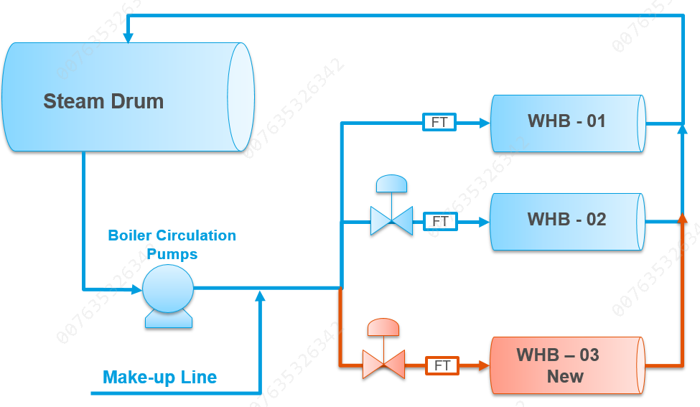
Process Flow
The heat of ammonia synthesis reaction is removed by generating high pressure steam.
There are three synthesis gas Waste Heat Boilers (WHBs), one of them (WHB-03) was added during revamp of the plant.
They are all connected to the backend steam drum. Boiler Feed water is circulated through 3 BFW forced circulation pumps (2 running and 1 stand-by). The pumps suction takes BFW from the steam drum bottom.
Make-up BFW from front end joins at BFW circulating pumps discharge to maintain the circulation flowrate and compensate for the generated steam.
The combined BFW is then supplied to the steam generators and ultimately back to the steam drum.
Equipment | WHB 01 | WHB 02 | WHB 03
Design Flow (T/h) | 343 | 353 | 328
Actual Flow (T/h) | 493 (3 pumps) 475 (2 pumps) | 366 (3 pumps) 313 (2 pumps) | 329 (3 pumps) 270 (2 pumps)

Slide 5
Construction and design conditions
Side | Shell Side | Tube Side
Medium | Synthesis converter effluent (Hydrogen service) | BFW / Steam
Operating T In / Out (C) | 459 / 377 | 326 / 330
Operating Pressure kg/cm² | 157 | 134
Material of Construction | Shell: Cr – Mo St Grade 22 (2.25Cr-1Mo) | Tubes: SS321 – Tubesheet: Cr – Mo St Grade 22

Slide 6
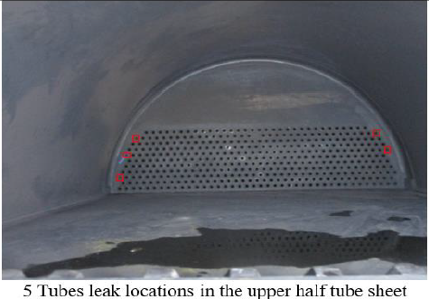
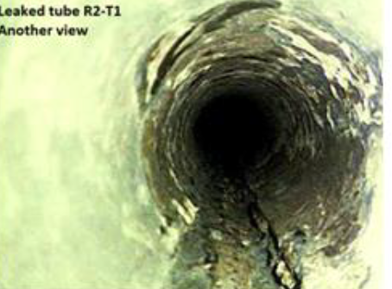
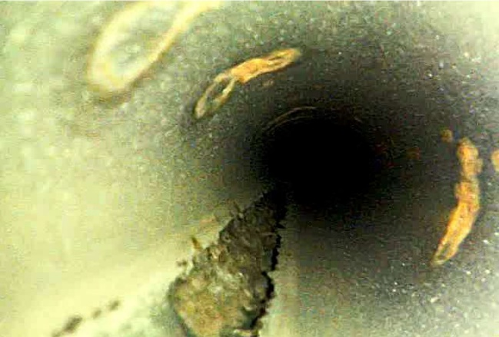
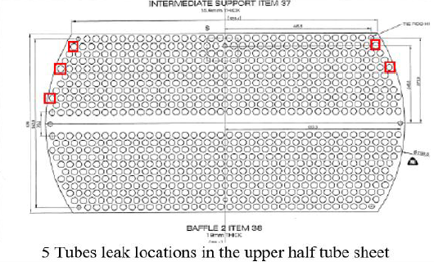
Findings
Five tubes leak within less than one year in service
Borescope inspection conducted for the leaky tubes as well another non leak tube internal deposits was noticed all around.

Slide 7
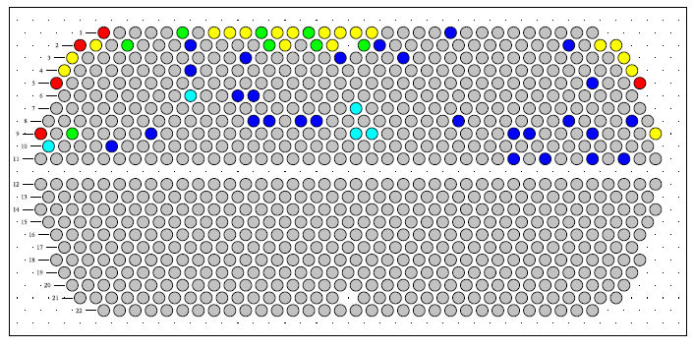
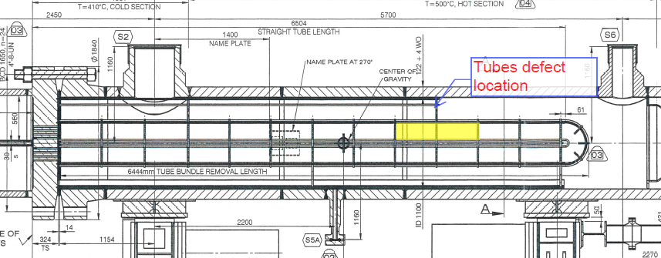
Findings – Cont’
Eddy Current Array (ECA) carried out for all the 820 tubes straight length revealed that 65 tubes with wall loss
05 tubes found with wall loss 80 %< Defect <= 100%
14 tubes found with wall loss 60 %< Defect <= 80%
08 tubes found with wall loss 40 %< Defect <= 60%
01 tubes found with wall loss 20 %< Defect <= 40%
ECA showed that thinning occurred on affected tubes at 4.5 m from tubesheet and all affected tubes are at outlet pass (top half of the exchanger)

Slide 8
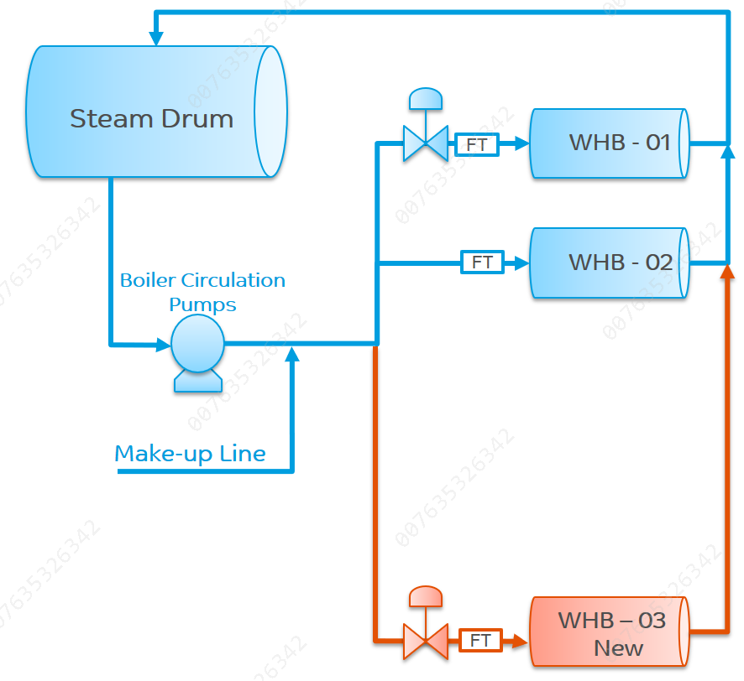
Hydraulic analysis of BFW system
Hydraulic analysis of the BFW distribution system pointed to an improper distribution of boiler water through the three steam generators. The control scheme to regulate the Boiler water through the Steam generators are not adequate.
The maldistribution of BFW to the boilers may partially be caused by the choice of pipe routing during detail engineering with much longer length compared to other boilers causing preferential flow the old boiler
Actual Flow Rates
Equipment | WHB 01 | WHB 02 | WHB 03
Design Flow (T/h) | 343 | 353 | 328
Actual Flow (T/h) | 475 | 313 | 270
$\frac{Actual Flow}{Required Flow}$ % | 138 % | 89% | 82%

Slide 9
Water chemistry
 | Unit | Inlet | Outlet
BFW flow | Kg/hr. | 329,000
pH |  | 9 | 9.42
conductivity | umlcm | 62.7 | 7.7
phosphate | ppm | 16.2 | <0.1
Ammonia | ppm | <1 | <1
silica | ppm | 0.34 | <0.1
sodium | ppm | 10.6 | 0.2
chloride | ppm | <0.1 | <0.1
sulphate | ppm | 2.2 | <0.1
BFW for the three WHBs has the same quality with average conductivity 45 µs, PO4 residual between 10-16 ppm, sodium between 6-10 ppm and sulphate between 1.6 - 2.2 ppm.
Its observed that intel and out let nearly matching in both old WHBs but not the same in the new WHB as conductivity and all the minerals phosphate, sodium and sulfate disappeared from the bulk water which indicate a possibility of precipitation in new WHB.
The possibility for mineral precipitation can only cause by the vaporization of the water due to high heat flux and capacity with respect to the low water flow rate.

Slide 10
Corrective Actions
Run the three BFW pumps simultaneously to increase the BFW flow rates and reduce te possibility of the high evaporations and localized high heat flux
Maintain BFW quality and frequent sampling and monitoring of all parameters
Flow Rats Comparison
Equipment | WHB 01 | WHB 02 | WHB 03
Design Flow (T/h) | 343 | 353 | 328
2 Pumps operation (T/h) | 475 | 313 | 270
2 Pumps operation (T/h) | 493 | 360 | 338

Slide 11
Corrective Actions – Cont’
Install additional valve at the inlet of the existing boiler to allow for proper control and distribution of the BFW to the 3 boilers
Steam Drum
FT
WHB - 01
Boiler Circulation Pumps
FT
WHB - 02
Make-up Line
FT
WHB – 03 New

Slide 12
Thank You

