Slide 1
Pinhole Leak RCA of Highly Concentrated Sulfuric Acid Tank due to Corrosion
Hassan Al-Hammad
Static Equipment Engineer
SABIC

Slide 2
Contents
Problem Statement
Process Description
Data Gathering and analysis
Time Line
Analysis (Logic Tree)
Root Causes
Observation
Resolution
Speaker Biography

Slide 3
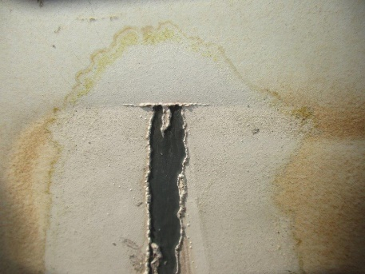
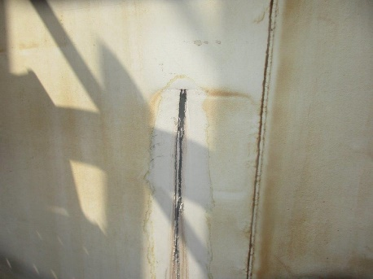
Problem Statement
It was observed that acid tank has pinhole and acid dropping from middle of the tank.
All necessary safety precautions were taken and tank repaired with Belzona coating and Carbon Steel patch plate in the area of leak (300 mmx150 mm).
Investigation team has been formed to define the root causes of this failure and state all required recommendations.

Slide 4
Process Description
tank receives 98% acid through track and inlet fluid is pumped through sulfuric acid unloading pumps
Acid tank has two pumps to supply line 1 and 2
Recycle Line 1
Nitrogen
MW
breather
Overflow line
Acid inlet from track
Acid tank
Supply Line 1
pump
Supply Line 2
pump
sump
Recycle line 2

Slide 5
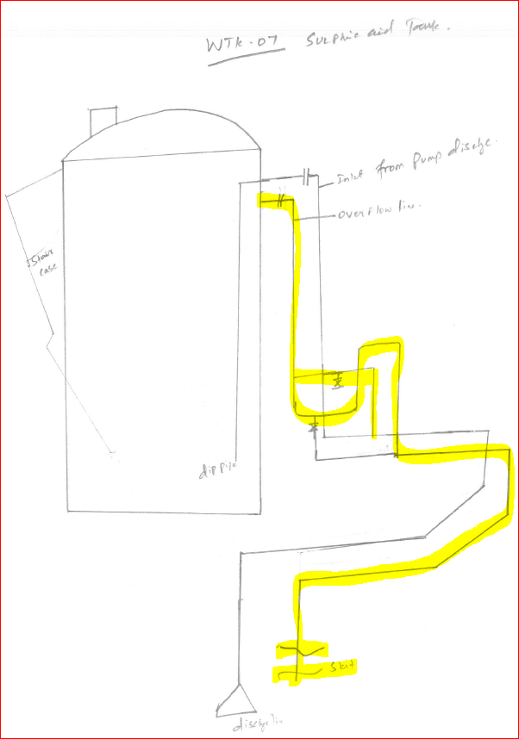
Process Description
Tank has Nitrogen blanket
Tank has breather
Tank has overflow line connected to Lime Stone Sump and sealed naturally with sulfuric acid from inlet line
Acid tank

Slide 6
Process Change Through Management of Change (MOC)
Maximum tank level strategy changed few times since installation
sulfuric acid injection pump recycle line was connected to tank directly through separate nozzle and the roof of the tank and had long dip pipe, but changed by MOC to be connected to pump suction line
Justification for MOC: recycle dip pipe wasn’t deep enough after reducing the tank level
Years | Level Range
2000-2015 | 80-90 %
2015-2019 | 30-50 %
2019 | 25-45 %

Slide 7
Data gathering
Details | Actions | Results
Moisture from N2 | Verify analyzer trends | N2 Drain line near acid tank checked and found clear from moisture.
Back flow from supply line 2 | Check the line from sulfuric acid injection pump to tank (recycle and suction) for thickness | In supply line 2 Low thickness reported and replaced in-kind, but supply line 1 shows no reduction
 | UT survey of sulfuric acid injection pump nozzle & lines | Line and Nozzle has no low thickness
 | Tank level readings trend | On 2018 acid tank level increases and temp. increased accordingly (reached around 40oC)
 | Previous backflow reports or highlights from operation | It was recorded twice in 2018

Slide 8
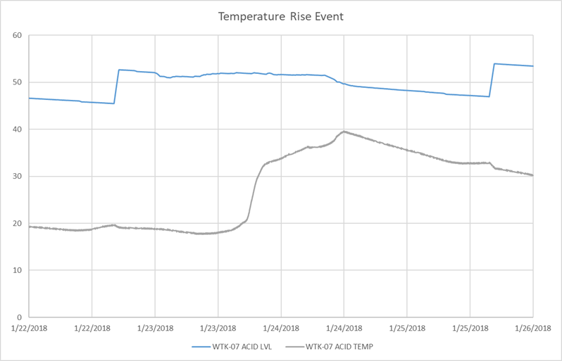
Data Gathering
Due to water backflow
Temp. increased as result of exothermic reaction

Slide 9
Data Gathering
Details | Actions | Results
Diluted acid from unloading track | Tank samples from Potable Water Pumps and check for previous records | Only special samples are taken, a sample was collected at the day of incident and found 98% acid
Loss of N2 | Pressure trend | Pressure data is recorded in bar and not mbar
 | Check overflow line seal and N2 presence in pit | Line is sealed, there is no N2 presence through this line in lime stone sump
 | check elevation of overflow line and connecting piping and valves versus tank level | Tank has overflow line connected to sump and sealed naturally with sulfuric acid from inlet line
 | Breather condition / check reports | Most of previous reports showed failed as found condition due to leak (area of concern)

Slide 10
Data Gathering
Details | Actions | Results
Summer temperature effect on tank surface | Temperature trend | Bulk temperature recorded was normal, except the event of sudden high level in tank that resulted in temperature increase to around 40oC
 | Perform thermography for tank wall | The thermography report was performed and the maximum recorded temperature around 60oC
 | Review 2018 thermography report | The thermography report was performed in winter season and the maximum recorded temperature around 30oC in the bottom of the tank
acid recycle line dip | Review scope of MOC package | Tank level decreased since 2015 but MOC implemented in 2017 (around two years operating and splashing above acid level)
 | Length and condition of dip pipe after extraction | Length less than existing supply line 1 dip pipe and above reduced level when operating with minimum height (there’s concern) Reached up to 40% of tank level from bottom

Slide 11
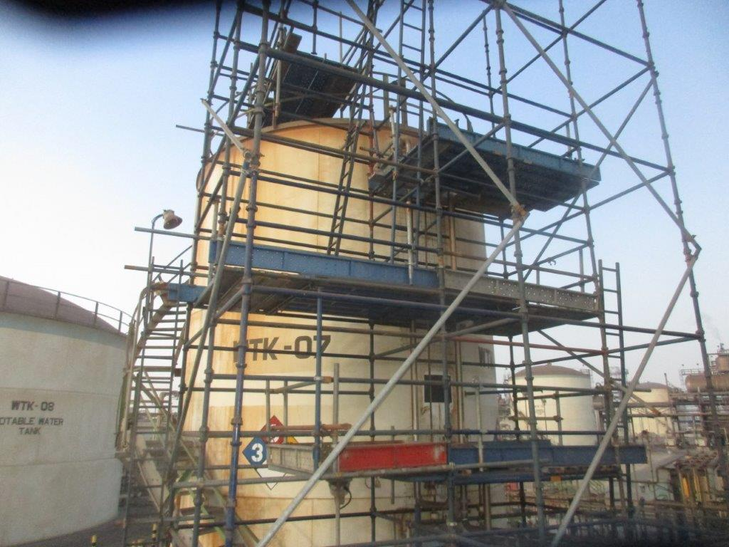
Data Gathering
Details | Actions | Results
Current dip pipe condition | Condition of current dip pipe / to discuss with NDT company | Contacted two advanced NDT vendors and they illustrated that there is no method to detect current dip situation with current configuration
 | Dimension of nozzle orientation in tank top by field verification | Location of inlet nozzle orientation on roof is close to the wall side of leak location. Also, length and integrity of dip pipe are unkown
Coating damaged | Check coating specification | Data sheet mentions 3 coats of Hempadur 85671, but it’s the external painting not internal
 | Provide mechanical drawing | received
defect during manufacturing | Inspection this area again and check manufacturing records | Same material in all over tank

Slide 12
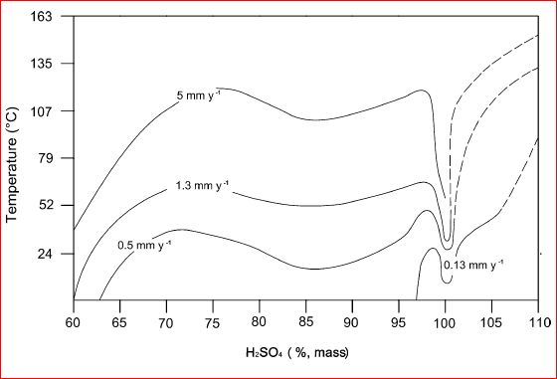
Data Analysis
Any increase in temperature will increase the corrosion rate sharply
Even if the acid concentration remain constant at 98%, having temperature of 60oC will increase corrosion rate from 0.13 mm/y to 5 mm/y
Acid Tank experienced both factors, where surface temperature recorded at 60oC and internal bulk temperature recorded at 40oC. Also, level increased due to water backflow from supply line 2

Slide 13
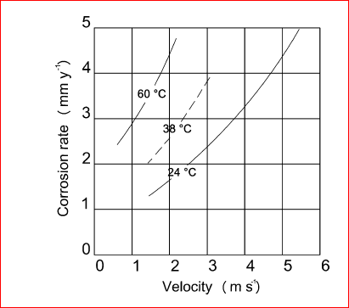
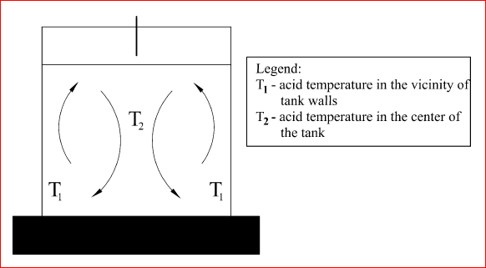
Data Analysis
Corrosion rate of a carbon steel pipeline at different temperatures and flow is affected highly be velocity
High velocity removes protective layer of FeSO4 and expose metal to sulfuric acid which increases corrosion rate
Lowering tank level reduces the thermal convection process between the bulk liquid (sulfuric acid) which has low temperature and metal of shell which has high temperature

Slide 14
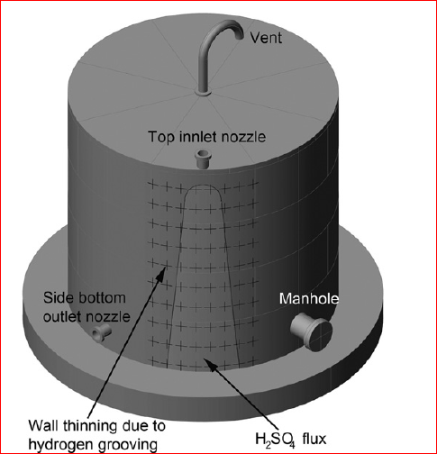
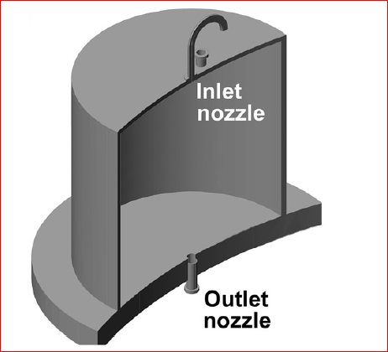
Data Analysis
Locating the nozzles near the walls increases the probability of wall damage and may introduce hydrogen grooving
Recent literatures recommended to have nozzles in the middle of tank or placed at least 1.8 m away from the sidewall of the tank, closer to the center of the roof of the tank
√

Slide 15
Time Line
2000
Tank installed (with long dip pipe for inlet and recycle)
2015
2017
MOC released for construction
Tank level reduced to 30-50 % (due to jurisdictional regulations)
Tank level 80-90 %
2014
New line installed for supply line 2 (with short dip pipe for recycle line)
MOC initiated to remove elastomer recycle dip pipe
2019
Tank level reduced to 25-45 % (due to jurisdictional regulations)
Leak incident happened in 2nd shell of tank

Slide 16
Analysis ( Logic Tree )
Sulfuric acid corrosion
Acid concentration less than 98%
acid tank shell pinhole leak
Acid splash on internal tank shell
Moisture from N2
Back flow from supply line 2
Diluted acid from unloading track
No cooling bulk media at upper level of tank
exothermic chemical reaction
Short supply line 2 dip pipe
Bad condition and corroded supply line 1 dip pipe
Tank level decreased
Location of nozzle near wall and not in middle of tank
Failure of supply line 2 backflow Protection equipment
Water ingress
Moisture from air ingress (not enough nitrogen blanket)
Lack of seal liquid in overflow line
Low N2 pressure
Breather malfunctioning
High contact surface temperature
Tank level decreased
Relative movement (splash) between the metal and acid
Water ingress to tank
Loss of FeSO4 protection layer
Localized thickness reduction
Accelerated corrosion rate
Manufacturing Defect

Slide 17
Root Causes
Tank level decreased without consideration to the impact of high contact surface temperature and less cooling bulk media at upper level of tank
Failure of supply line 2 backflow protection equipment and water ingress to tank
Nitrogen blanket is not maintained due to breather frequent frailer

Slide 18
Observations
Pressure data is recorded in bar and not mbar, it is not showing enough granularity
Seal liquid presence in overflow line
N2 isolation valve is normal opening instead of CSO
Location of nozzle near wall and not in middle of tank
Relative movement (splash) between metal and acid

Slide 19
Resolution
Install patch plate for area of identified high corrosion
Perform complete scanning of shell thickness by external AUT
Perform frequent check for the overflow seal U-pipe by crack opening and recording acid presence, then refill the overflow seal U-pipe with acid from inlet pipe
change pressure data representation to have precise measurement reading from bar to mbar
Ensure integrity of protection equipment (check valve and others) to avoid backflow to acid tank
Restore condition of supply line 1 dip pipe and breather valve

Slide 20
Speaker Biography
Hassan Al-Hammad is an Inspection & Static Equipment Engineer
Hassan graduated from KFUPM with First Honor Distinction in Bachelor of Science (BS) in Applied Mechanical Engineering and attended the Master of Science (MS) in Mechanical Engineering (Materials Science & Engineering) at KFUPM.
Hassan obtained three American Petroleum Institute (API) certificates in Piping-570, RBI-580, and Pressure Vessel-510 to have hands on international standards.
Also, Hassan has ASNT level II certificates in RT, UT, PT, MT, and VT.

Slide 21
Thank You

