Slide 1

Tube Failure in Lean Solution Cooler in Ammonia Plant
By Ibrahim Ahmed Aseri

Slide 2
Table of Content
Lean Solution Cooler – GA
Construction & Operation Details
Process Flow Diagram & Description
Problems Faced
Failure Analysis
Conclusion
Recommendations

Slide 3
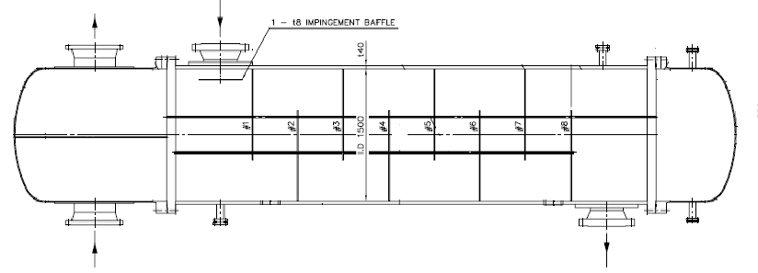
Lean Solution Cooler - GA
Lean Solution Inlet
Cooling Water Outlet
Cooling Water Inlet
Lean Solution Outlet

Slide 4
Lean Solution Cooler Details
Shell : 1968 OD x 19 thk.; SA 516-70N
No. of tubes : 4107 nos.
Dia. of tubes & Material : 19.05mm OD x 2.11mm thk. 7550 L, CS (SA210-A1)
Pitch : 25.4mm; Triangular
Tubesheet : 122mm thk; SA 266-Gr.2
Tube to tubesheet joint : Welded and expanded
Baffles : 11 Nos., SA 516 Gr.70; 16mm thk., Multi segmental
First baffle from tubesheet : 1022 mm
Odd no. baffle (1 to 11) width : 925.8mm
Second baffle from tube sheet : 1570 mm
Even no. baffle (2 to 10) : in two halves; 1860.5 OD x 666.25 wide
Impingement plate : 522 x 484mm
Inlet nozzle from tubesheet : 617mm
ID of inlet nozzle : 348.4mm; 29mm thk

Slide 5
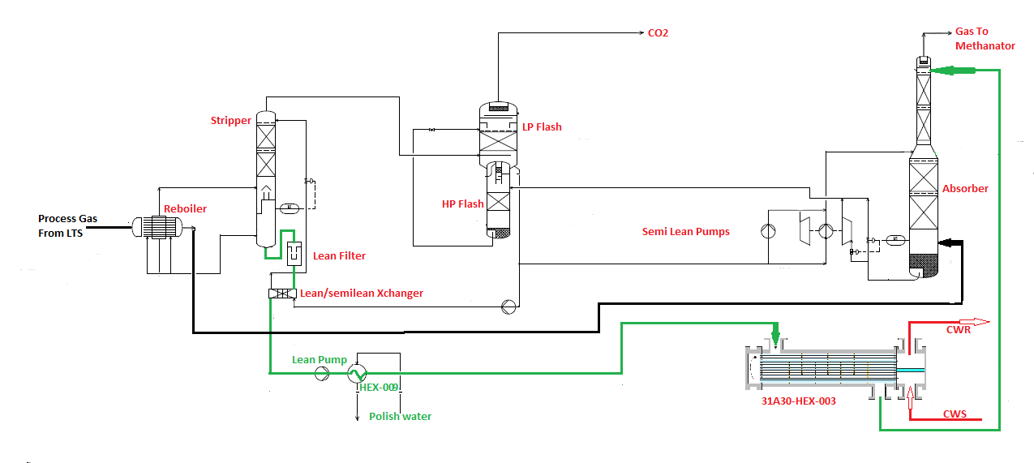
Process Flow Diagram

Slide 6
Process Description
The CO₂ Removal System in Ammonia plant utilizes BASF’s MDEA process to remove the CO₂ gas from the process stream.
This is a closed loop system consisting of a high-pressure absorber and a low-pressure stripper.
The medium utilized to absorb and strip the CO₂ from the process stream is MDEA solution with a promotor.
The circulating solution after stripping off the absorbed gasses, becomes lean but at a temperature of 115⁰C.
This has to be cooled to 45~50⁰C by closed loop cooling water system before entering the Absorber.
The cooling water is flowing in the tube side while the MDEA in the shell side. The flow rate of cooling water is 1800~2200M³/Hr while that of MDEA solution is 800~850M³/Hr

Slide 7
Problems Faced
Plant commissioned in August-2016.
First time leak:
19/12/2019 : CO₂ removal performance dropped down. MDEA concentration dropped from 37 to 18.21Mol%; One tube was plugged.
Second time leak:
18/05/2020: CO₂ removal performance dropped down. MDEA concentration dropped from 37 to 23.7Mol%. Sample analysis revealed increase of MDEA solution in cooling water stream
As a result of MDEA presence in cooling water, Backend shutdown taken
Exchanger was opened and shell side hydro test was done. One Tube Leak (R3-T28) observed
Remote Filed Eddy Current Testing (RFET) done for 55 % of the tubes (i.e. 2268 out of 4107 Tubes)
RFET showed more metal loss in the top row tubes between the tubesheet and the first baffle plate, close to the impingement plate.

Slide 8
Failure Analysis
For failure analysis, three tubes were extracted including the leaky one (R3-T28) and two more tubes (R1-T10 and R2-T4) which were found to be having 75% of wall thickness reduction as revealed in RFET testing.
Visual inspection of removed tubes revealed that the external surfaces of the tubes are suffering from corrosion. The location of leak in tube R3-T28 was spotted and the external surface observed to be badly corroded & thinned down.
One of the extracted tubes was sent to a specialized agency for further analysis from corrosion and metallurgical point of view
Lab analysis showed presence of contaminants and corrosion compounds on the external surface of the tubes ( CO₂ and Water – that is, Carbonic Acid).
The accelerated corrosion was experienced between the tubesheet and first baffle and in the vicinity of impingement plate – indicating flow induced corrosion (cavitation)
Heat Stable Amine Salts (HSAS) are within allowable limits

Slide 9
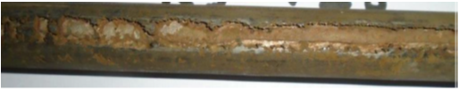
Failure Analysis

Slide 10
Failure Analysis
Further analysis at specialized laboratory has concluded:
The leaky tube showed wall loss > 50% at localized region near impingement plate.
Micro-level deformation with rounded contour evidenced cavitation-corrosion damage
  (Cavitation: Occurs when the gas bubbles form & collapse. This phenomenon is possible at MDEA inlet after the solution having dissolved CO₂ impinging on the impingement plate. The bubbles collapse promoting hammer blow at high pressure on the tube OD, resulting in erosion corrosion. These locations, where metal loss experienced show rounded depressions as per Scanning Electron Microscopy (SEM), indicating cavitation.)
Corrosion due to carbonic acid observed.

Slide 11
Analysis
Solution Chemistry & Concentration:
The Concentration of the MDEA + Piperazine (Promotor) was going down since 2018 and the %age composition of water was increasing up to Dec. 2019 when first leak was identified. Again, the same kind of phenomenon was happening from Jan. 2020 and May 2020 when the second leak was identified. This data is provided in the following table. It may be noted that the leak(s) should have happened sometime prior to the shutdown of the plant.
Sl. No. | MONTH | COMPOSITION % |  |  |  | REMARK
 |  | MDEA + PIPERAZINE |  | WATER
 |  | AVERAGE | LOWEST | AVERAGE | MAXIMUM
DESIGN |  | 40 |  | 60
1 | 2018 (BASF) | 35.44 |  |  | 67.81
2 | Oct 19 | 31.97 | 31.14 | 68.03 | 68.86
3 | Nov. 19 | 33.25 | 32.74 | 66.75 | 67.26
4 | Dec. 19 | 27.65 | 18.21 | 72.35 | 81.79 | Leak
5 | Jan 20 | 29.44 | 28.08 | 70.56 | 71.92
 | Jan (BASF) | 24.79 |  | 75.21
6 | Feb 20 | 30.41 | 28.07 | 69.59 | 71.93
7 | Mar 20 | 31.44 | 29.8 | 68.56 | 70.20
8 | Apr 20 | 31.12 | 29.72 | 68.88 | 70.28
9 | May 20 | 28.1 | 23.7 | 71.9 | 76.30 | Leak
10 | Jul 20 | 35.7 |  | 64.30

Slide 12
Analysis
The solution concentration was going down from the specified 40% (MDEA 37% + Piperazine 3%) to less than 23.7% and it was further going down. Correspondingly, the water content was on the increase.
Presence of carbonic acid identified as the corroding medium. The outer corroded surface was exhibiting rounded depressions – a phenomenon due to cavitation.
Neither MDEA nor Piperazine can corrode the carbon steel. However, as the composition of water increases in the solution, the CO₂ in the solution increases, which results in formation of carbonic acid that corrodes carbon steel.
Though the impingement plate was provided following the requirement of TEMA (ρv² actual = 4883 Kg/m.s² compared to allowable value of 2232 Kg/m.s²), the splashing velocity of the fluid as well as the possibility of formation of vortices below the impingement plate had resulted in cavitation.
Based on the above, it is concluded that the damage had taken place due to carbonic acid corrosion as well as cavitation.

Slide 13
Conclusions
MDEA concentration went down and could not be made up, as required stock was not available, resulting in external corrosion of tube.
Excessive splashed velocity that caused cavitation leading to corrosion of tubes

Slide 14
Recommendations
Increase the solution concentration to process licensor specified level of 37% of MDEA + 3% Piperazine (total 40%) and always maintain at the same level.
Replacement of the lean solution cooler by new one with improved design of perforated double impingement plate as shown below.

Slide 15
Thank You

