Slide 1
Research Works to Upgrade the Standards
of
RC Specifications
Turki Musfer AlOtaibi
Royal Commission for Jubail & Yanbu Royal Commission in Jubail

Slide 2
Presentation Outline
The climate of the Kingdom of Saudi Arabia
Research by the Royal Commission in Jubail
Specifications adopted by the Royal Commission
Conclusions

Slide 3
THE CLIMATE OF THE KINGDOM OF SAUDI ARABIA

Slide 4
Climatic Conditions in Arabian Gulf Area
Climate : is hot, humid and arid & need for control
Hot Weather: Temperature reaches higher than 45°C; high wind velocity.
Other Environmental Problems: NaCl in shallow groundwater exceeds 100,000 ppm; relative humidity reaches 100%.
Local Problems: Concrete constituents are of marginal quality; labors are semi-trained; local codes are evolving slowly.

Slide 5
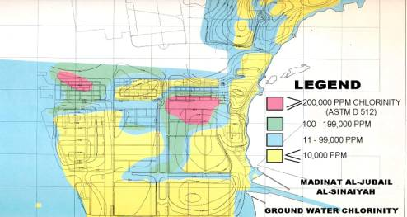
Site Corrosivity
Determining site corrosivity that are commensurate with exposures

Slide 6
Corrosion Survey of RC Buildings

Slide 7
RESEARCH
BY
THE ROYAL COMMISSION
IN JUBAIL

Slide 8
Research Tasks
Developed concrete specs based on extensive research through KFUPM.
Determined height of moisture rise in soil from groundwater (corrosion effects).
Evaluated performance of FBEC Rebar and, its effects on delaying corrosion.
Evaluated performance of proprietary concrete repair materials & methods.

Slide 9
Research Tasks (Cont’d)
Evaluated proprietary inhibitors in retarding rebar corrosion.
Conducted research on self-consolidated concrete.
Conducted research on Cl- threshold & compared against field threshold.
Revisited pozolanic concrete of older structures (superiority of poz. Concrete).
Conducted research on minimizing shrinkage of SF concrete (precautions).
Evaluated residual strength of columns repaired by patching.
Determined corrosion rates of common corrosion metals.
Continuously monitoring performance of existing structures.

Slide 10
Exposure Station (Since 2000)
To evaluate corrosion causal factors / damage extent in LOCAL environment.
using LOCAL materials
Involving LOCAL universities.
To disseminate knowledge LOCALLY & internationally.

Slide 11
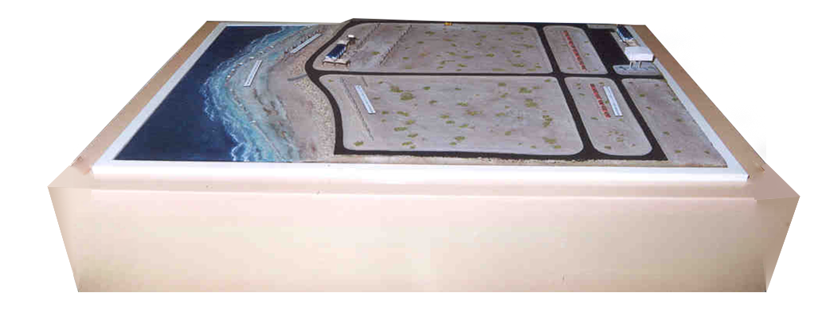
Replica Model of Exposure Station
Buried/Partially Buried Zone
Splash Zone
Atmospheric Zone
Tidal Zone

Slide 12
Research Variables at Station
Concrete: Cement (I&V); poz. (FA: SF; GGBS); rebar (reg.; rusted; FBEC; SS; GFRP; chopped FG); coatings (CTE); inhibitors; treated/potable water; curing; w/c ratios; exposure zones (3,694 specimens).
Metals: CI; Plain & galv. CS; SS; alum; brass; copper (660 specimens).

Slide 13
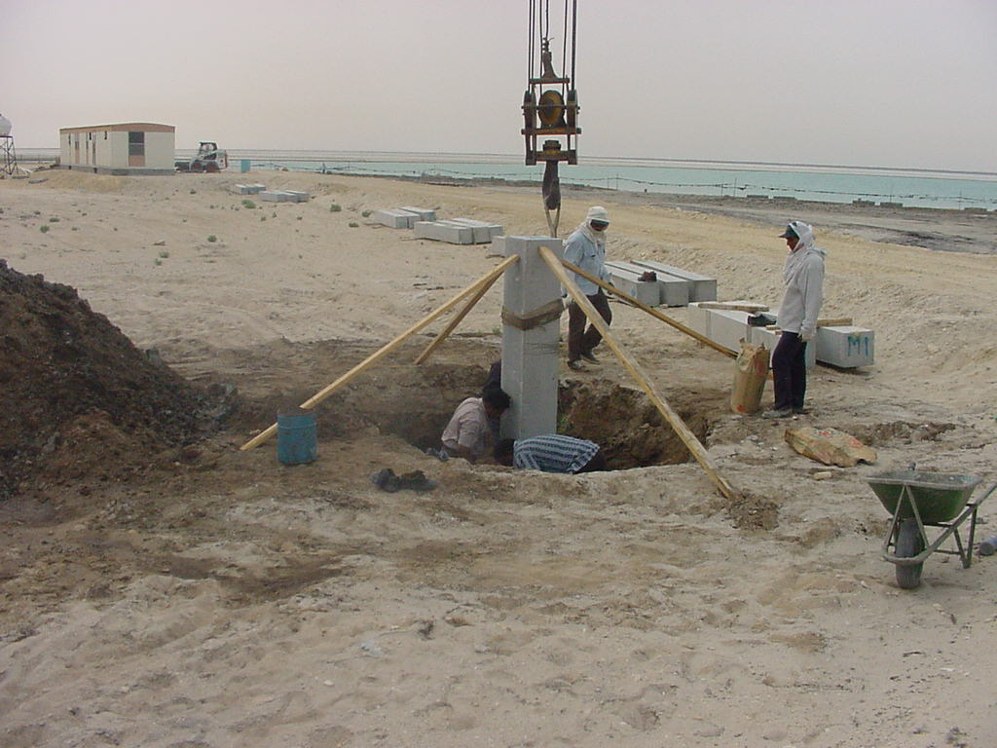
Placing Specimens at Station

Slide 14
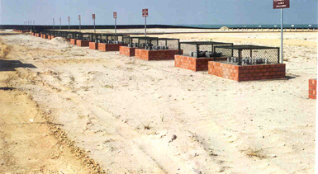
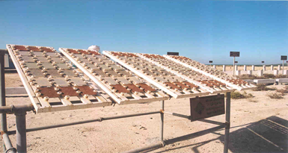
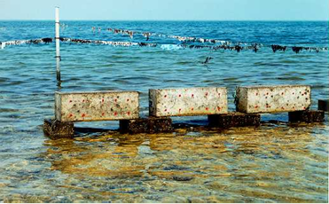
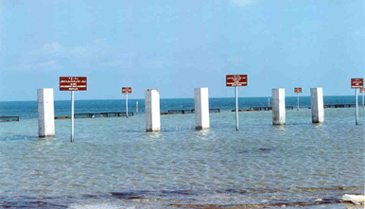
Exposure Sites at Station
Buried Zone Atmospheric Zone
Tidal Zone
Splash Zone

Slide 15
Testing at Exposure Station
Concrete Specimens: Cubes; Cylinders; beams; Columns.
Lab. Tests: resistivity; water absorp.; comp. Strength (@ 28 & 90 days)
Field Tests: potentials & visual; Cl-/S04; pH; water & Cl- perm; resistivity; water absorp; CS; S04 resistance; Carbonation (@ 28 d & 1, 2, 5, 10, 15, & 20 yrs)

Slide 16
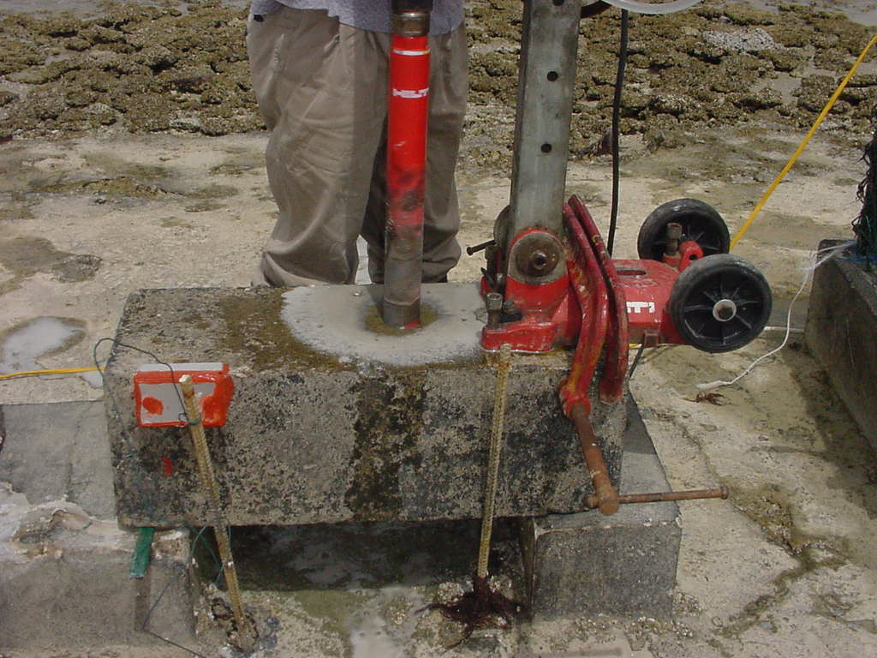
Testing at Exposure Station
Concrete Sampling
Rebar Potential

Slide 17
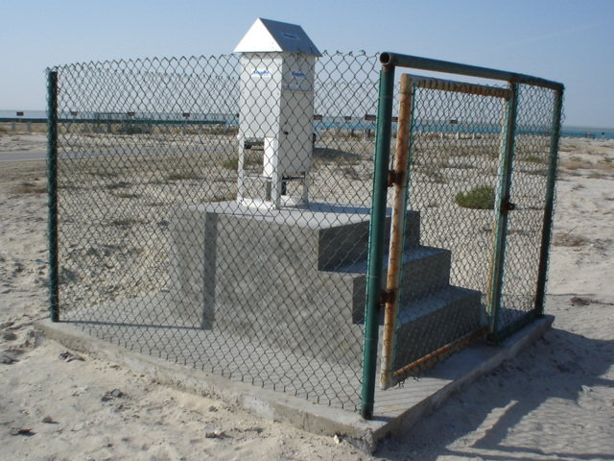
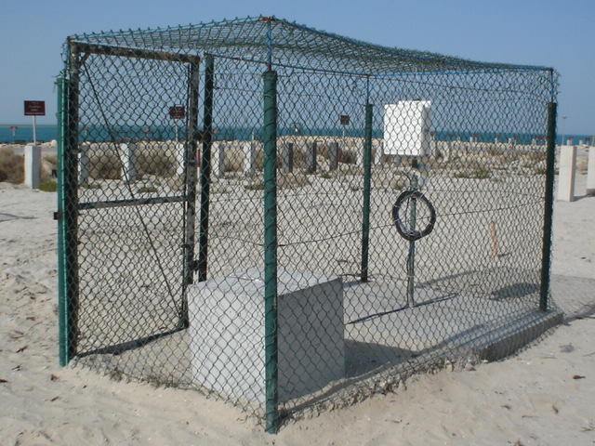
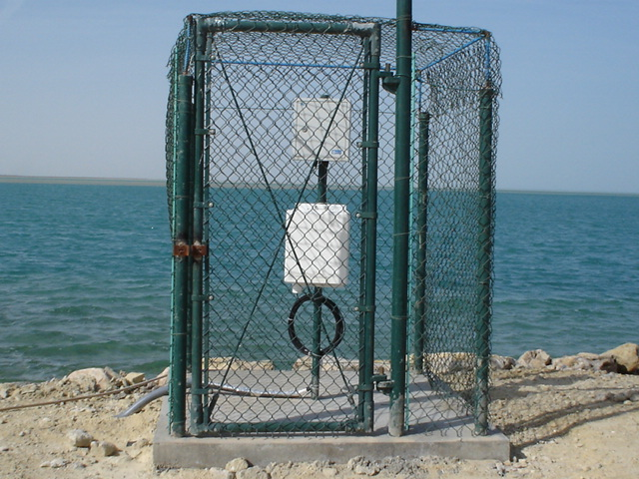
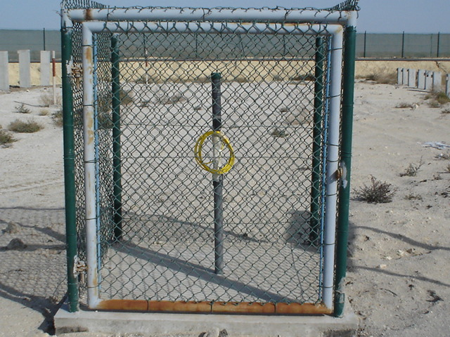
Environmental Conditions at Station
Air Sampling
Concrete Temp.
Seawater Monitoring
Groundwater Monitoring

Slide 18
ADOPTED SPECIFICATIONS
BY
THE ROYAL COMMISSION

Slide 19
RC Specs updated:
02085 “Underground Piping Materials”
02086 “FRP Pipes”
03205 “Reinforcement for Concrete”
03310-1 “Portland Cement”
03310 “Structural Concrete”
03930 “Concrete Rehabilitation”
07130 “Sheet Waterproofing”
09910 “Paints”
09960 “High Performance Coatings”
13111 “ICCP of Submerged and Buried U/G Metallic Structures”
13112 “SACP of Submerged and Buried U/G Metallic Structures”

Slide 20
Concrete Quality & Durability
Curing
Cement (Type & Content)
Cover for Rebar
Chloride Content
Consolidation
Corrosion Protection

Slide 21
Concrete Curing
Proper Curing is Essential for:
Enhances hydration of cement
Enhances pozzolanic reaction
Effects pore size & distribution
Minimizes shrinkage
Mitigates corrosion
Curing is Critical in Hot Weather Conditions

Slide 22
Effect of Curing on Cl- Permeability*
*Data courtesy of the Research Institute at KFUPM, KSA

Slide 23
Effect of Curing on Compressive Strength*
*Data courtesy of the Research Institute at KFUPM, KSA

Slide 24
Effect of Curing on Time to Corrosion*
*Data courtesy of the Research Institute at KFUPM, KSA

Slide 25
Design Considerations
Supplemental protection (waterproofing;coatings; CP; etc.)
Plain concrete
Non-metallic reinforcement
Precast construction
Irrigated areas

Slide 26
Protection against Rebar Corrosion
Protection of Concrete:
Concrete quality: design; construction practices
Sealers; penetrants; coatings; waterproofing
Protection of Steel:
inhibitors; coatings; special reinforcement; cathodic protection

Slide 27
Concrete Specifications
FBECR (ASTM A775): 100% coverage for coating continuity.
Salt Limits (ACI 201): 0.13 % Cl- acid soluble by weight of cement; 4% soluble sulphate by weight of cement (SO4).
Concrete & Tests (AASHTO T259/T277): joints; Cl- Penetration & Permeability.
CURING: 21 days for pozzolanic concrete.

Slide 28
Recommendations

Slide 29
Concluding Remarks
Evaluated severity of exposure.
Use of quality concrete & supplemental protection.
Min 7 days curing for plain cement concrete & extended curing for pozzolanic cement concrete.
Pozzolanic concrete; plain concrete; precast concrete; non-metallic pipes; coatings & waterproofing; CP for marine structures.

Slide 30
Initial Results after 15 Years Exposure
Superiority of pozzolanic concrete; use pozzolanic concrete in harsh exposures.
Salt front is developing in concrete specimens. Thus, supplemental protection is needed.
Initial results confirm site severity.

Slide 31
Concrete Specifications (Cont’d)
SUPPLEMENT PROTECTION | CEMENT (kg/cum) | W/C | REBAR COVER (mm) | EXPOSURE
NONE | Type I (350) | 0.40 | Columns & beams 50 Slabs 40 | Building Super-structures
Building Substructures; Chambers; Tanks: FBECR + Tanking / Coatings Marine: CP Culverts: Plain Concrete; GFRP Pipes | Type I +POZZ (370) | 0.40 | 75 | Building Substructures; Chambers; Tanks; Marine; Culverts

Slide 32
Performance Ranking of Concrete (15 Years)
RANK | MIX (LAB CONDITIONS) | MIX (FIELD CONDITIONS)
1 | Type I Cement; 385 Kg/M³ Cement. Mat.; 8% SF; W/C = 0.40 | Type I Cement; 441 Kg/M³ Cement. Mat.; 8% SF; W/C = 0.30
2 | TYPE I Cement; 441 Kg/M³ Cement. Mat.; 8% SF; W/C = 0.30 | Type I Cement; 385 Kg/M³ Cement. Mat.; 8% SF; W/C = 0.40
3 | Type I Cement; 370 Kg/M³ Cement. Mat.; 30% FA; W/C = 0.40 | Type I Cement; 370 Kg/M³ Cement. Mat.; 10% Super-poz. FA;W/C=0.40

Slide 33
Thank You

