Slide 1

Integrity of Fibre Reinforced Plastic Piping Systems in SABIC plants
Dr. Mahmoud Hassan, PhD, PEng, MCSCE
Dr. Abdulaziz Al-Meshari, PhD
Mr. Hussain H. Al-Wadie

Slide 2
Outline
  Introduction
  Advantages & disadvantages
  Inspection strategy
  Failure modes
  Visual defects

Slide 3
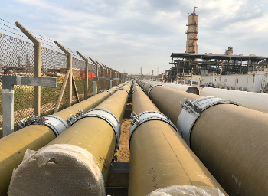
Introduction
(FRP) is Fiber Reinforced Plastic.
(GRP) is Glass-Reinforced Plastic.
This immaterial has been introduced to the market since 1935.
It can be used for various services including:
    Sea water
    Fire water
    Cooling Water
    and Chemicals.
FRP pipes are fabricated from three distinct layers:
    Liner
    filament layer
    resin coating

Slide 4
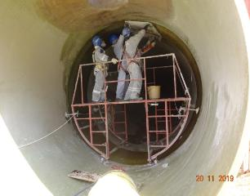
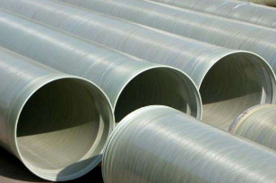
Advantages & Disadvantages
Advantages:
    Corrosion resistance
    Low maintenance cost.
    Good aging resistance.
    Good heat resistance.
    Lightweight, so convenient transportation and construct.
    Lower thermal conductivity.
Disadvantages:
  Low elastic modulus.
  Aging Ex(UV attack, mechanical stress,etc)
  Low fatigue resistance.
  Sensitivity to abrasion during handling.
  Unavailability of inspection techniques.
  Requires very stringent QA/QC during manufacturing and installation.

Slide 5
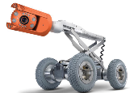
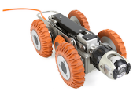
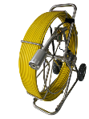
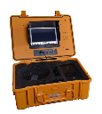
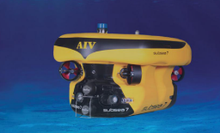
Inspection strategy
Inspection of installed FRP systems is mainly done visually.
When damage is observed, ISO-14692-4 and ASTM D2563 provide guidelines on the acceptability of defects.
Inspection of underground FRP piping can be used by:
  Man entry (Dia > 54 inch)
  ROV (Dia > 12 inch)
  Pushed camera (Dia < 12 inch)
ROV: Remote Operating Vehicle (> 12 inch)
Pushed Camera with video for small diameter FRP (less 12 inch)
ISO 14692-4:Petroleum and natural gas industries — Glass-reinforced plastics (GRP) piping — Part 4: Fabrication, installation and operation.
ASTM D2563: Standard Practice for Classifying Visual Defects in Glass-Reinforced Plastic Laminate Parts.
UUV: Unmanned Underwater Vehicle

Slide 6
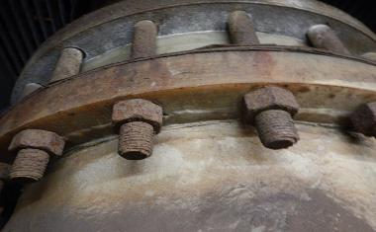
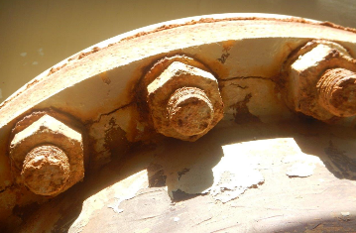
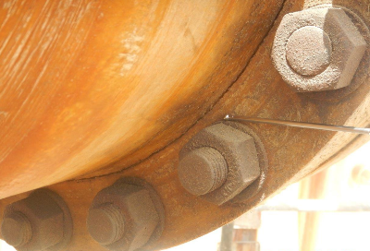
Failure modes - Cracks
large damage in the body of the flange.

Slide 7
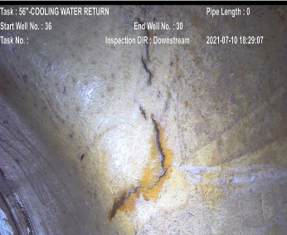
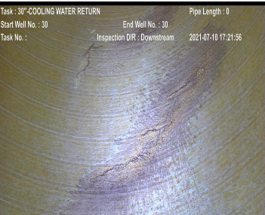
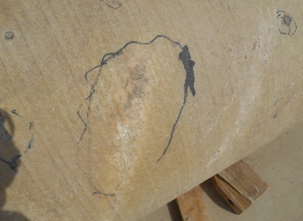
Failure modes - Cracks
Internal crack at FRP neck inspected using ROV
Internal crack in FRP pipe inspected using ROV
External crack in FRP pipe

Slide 8
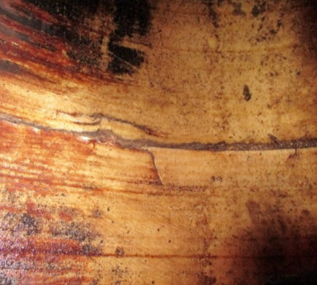
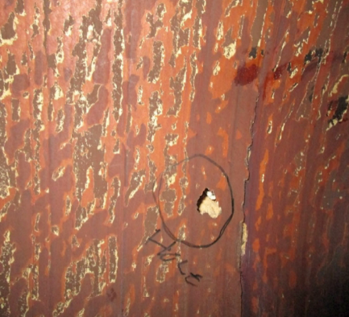
Failure modes - Cracks & pinhole
Internal crack in FRP piping
pinhole in FRP piping

Slide 9
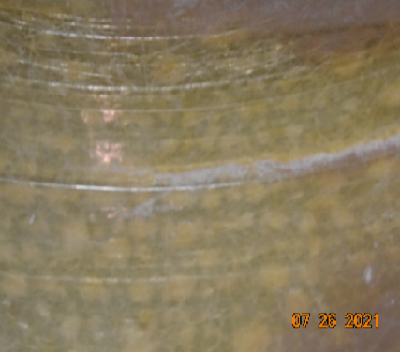
Failure modes - Blistering
Blistering

Slide 10
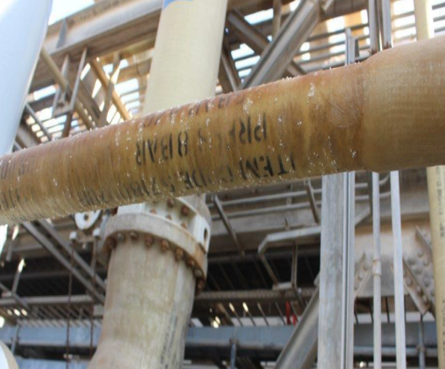
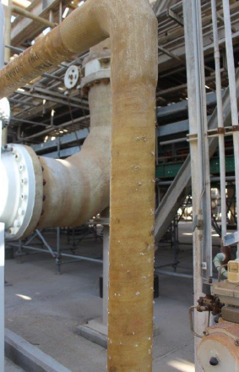
Failure modes – Weeping (deposits on the outer surface of the pipe)
Weeping observed at this line externally probably due to manufacture defects

Slide 11
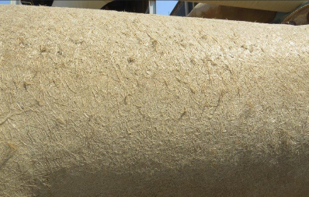
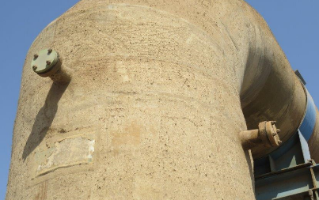
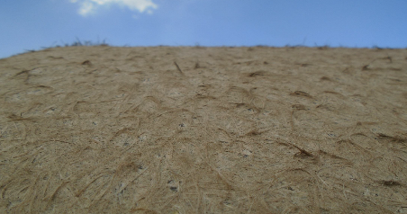
Failure modes – UV attack
Top coat has been removed and fiber exposed due to oxidation related to exposure to UV from sunlight

Slide 12
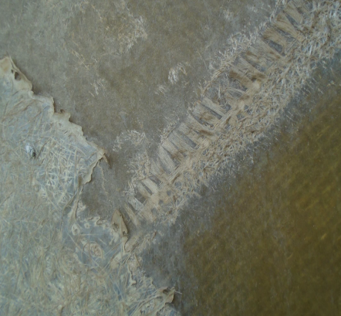
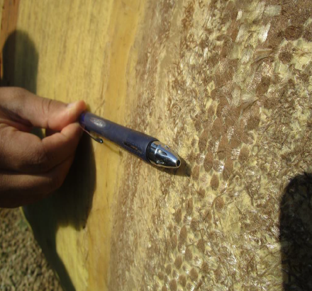
Failure modes – Fiber exposed
Structural fibers exposed
Exposed pipe fibers

Slide 13
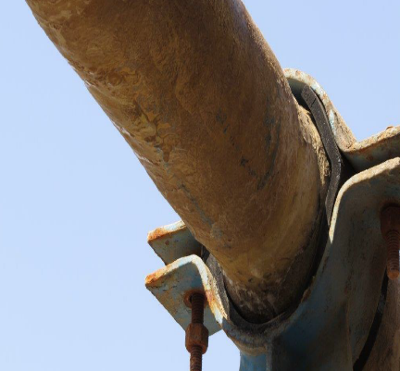
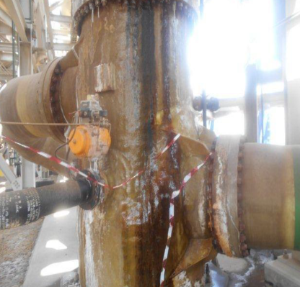
Failure modes – discoloration
Complete discoloration and removal of topcoat from FRP pipe
Discoloration of pipe due to leakage

Slide 14
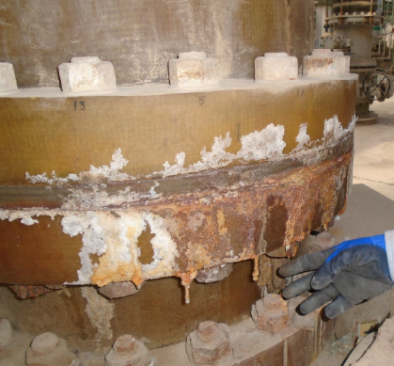
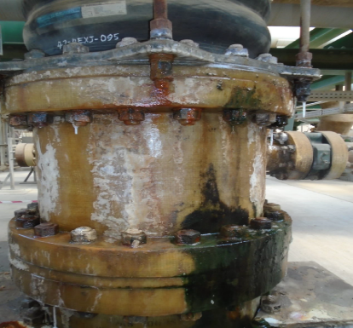
Visual inspection - salt deposit, discoloration and chemical attack
Salt deposit, discoloration and chemical attack due to leakage of gasket

Slide 15
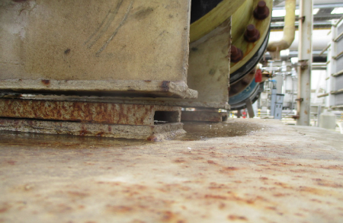
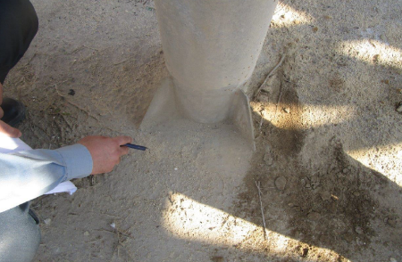
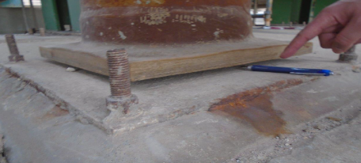
Visual inspection– soil settlement
Gap between pipe shoe and base plate
Sign of settlement i.e. foundation of the support has disappeared
Gap between FRP dummy leg and base plate

Slide 16
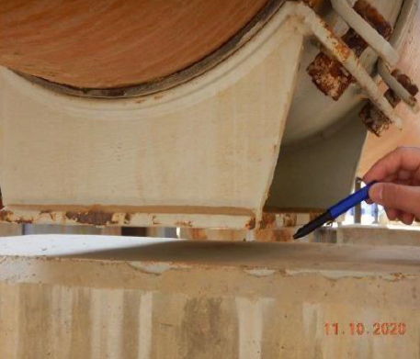
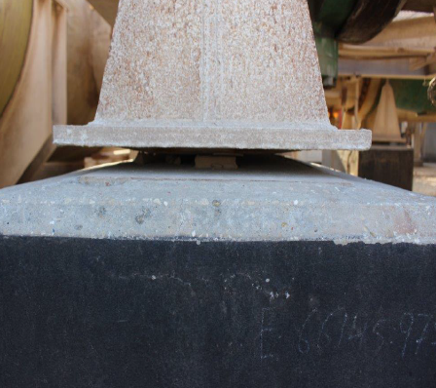
Visual inspection– soil settlement
Gap between pipe support and concrete foundation
Gap between the support and foundation (support hanging)

Slide 17
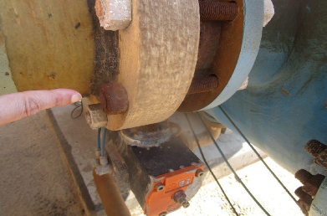
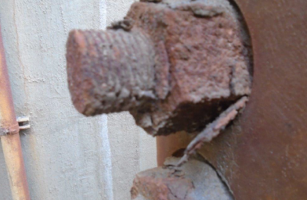
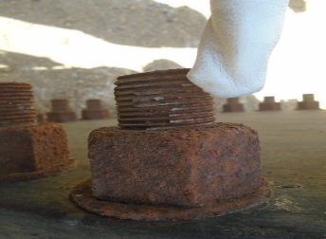
Failure modes – Corrosion & rust
Corroded nuts and bolts
Corroded nuts and bolts
Rusted nuts and bolts

Slide 18
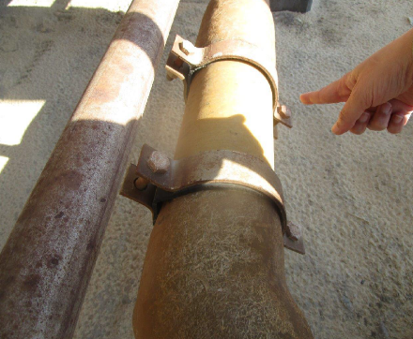
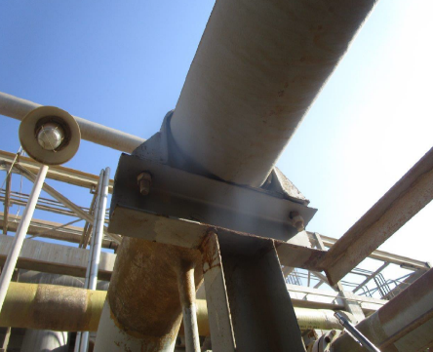
Visual defects – FRP piping touching steel or concrete
Steel clamp without neoprene sheet
Pipe directly resting on the steel structure without adequate neoprene pad

Slide 19
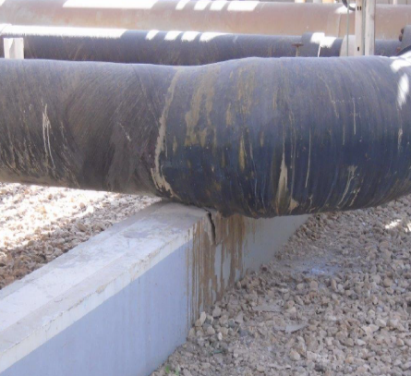
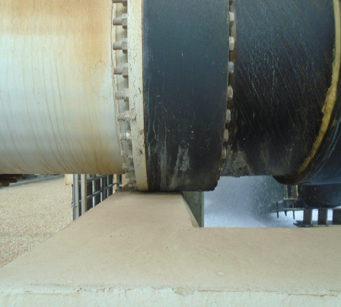
Visual defects – FRP piping touching steel or concrete
Pipe directly resting on concrete without neoprene pad
FRP pipe resting directly on the walls of cooling tower

Slide 20
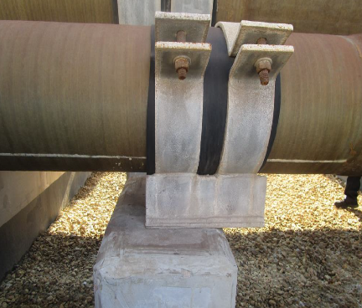
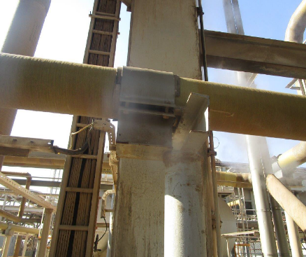
Visual defects – piping movement
Dislocation of pipe
Support completely disengaged from the structure for the pipe.

Slide 21
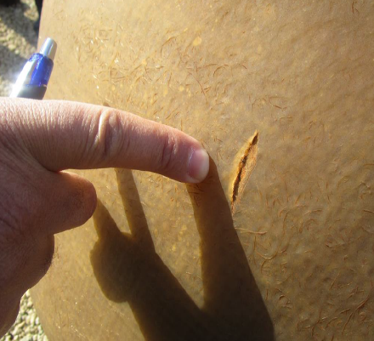
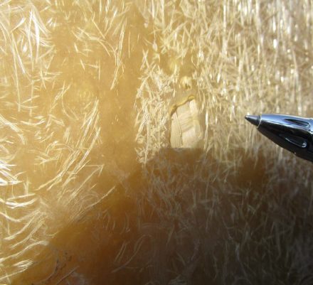
Visual defects – scratches & Chipping
Scratched pipe surface
Material chipping from main pipe body

Slide 22
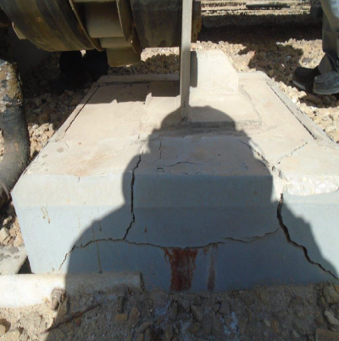
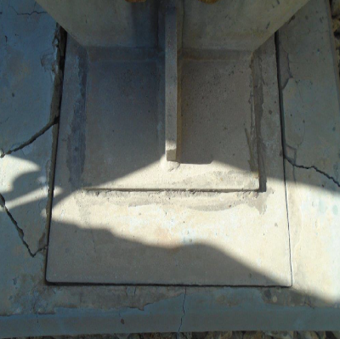
Visual inspection – concrete foundation
Cracks in foundation
Cracks in foundation

Slide 23
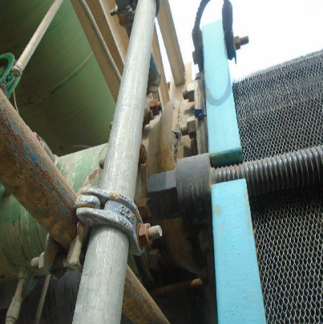
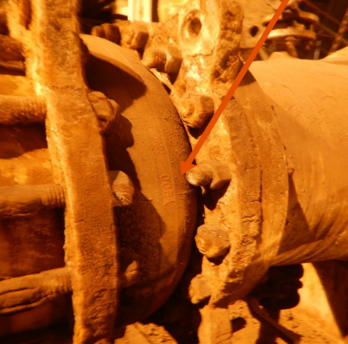
Visual inspection- bellow condition
Cracks in expansion bellow
Pit created in the body of bellow visible in the picture

Slide 24
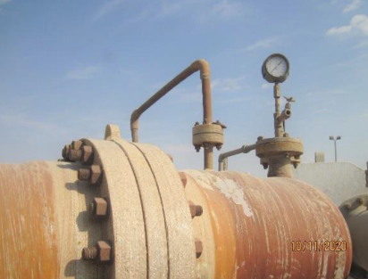
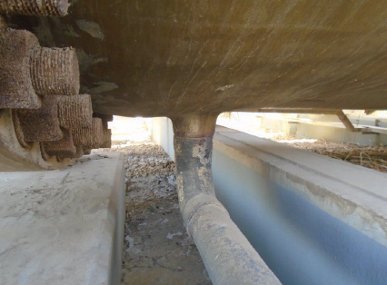

Visual inspection- small pipe diameter without stiffeners
Small pipe diameter without stiffeners plates
No reinforcement pad installed for the drain piping
Gauges with four stiffener supports

Slide 25


Visual inspection- leakage
Seawater leakage and heavily corroded bolts and nuts (washers are missing)
Leakage is visible from the connection with the pump

Slide 26


Visual inspection- corrosion of steel supports
Corrosion of steel supports
Shoe support for FRP piping bottom up view (completely corroded)

Slide 27


Visual inspection- High vibration
High vibration in the FRP pipe may be due to missing support

Slide 28


Visual inspection- road crossing
Road crossing for SW UG pipe without any sign of protection/sign boards showing load carrying capacity.
An 8-wheel vehicle parked next to the header for maintenance work

Slide 29
Thank You

