Slide 1


Corrosion Barrier Damages of FRP Pipes
Presented by:
Shamsuddeen Palliyali
Static Engineer, R&I

Slide 2
CONTENTS
INTRODUCTION
CORROSION BARRIER DAMAGES
BLISTERS
BLISTER FORMATION & PROPAGATION
INSPECTION METHODS
ROOT CAUSES
CONSEQUENCES
PATH FORWARD

Slide 3
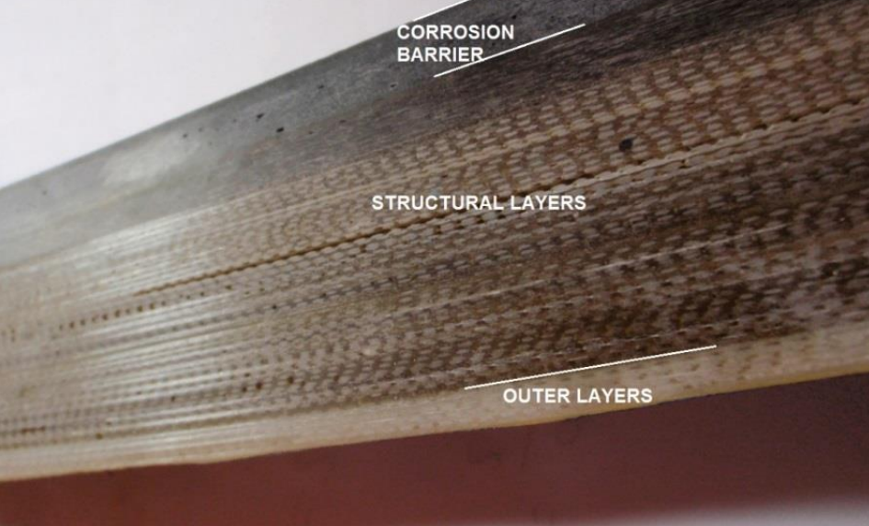
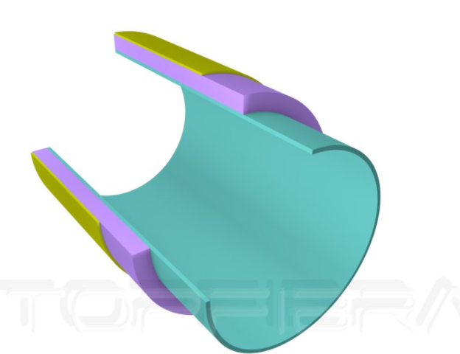
INTRODUCTION
FRP laminate consists 3 layers.
FRP subject to failures due to damages to Corrosion Barrier layer & structural laminate.
Damages reached to structural layer immediate action required.
Protective coating or chemical resistance layer
Structural laminate
60-65 % fibers
CBL = Corrosion Barrier Layer
30% Fibers
Minimum 2.5mm

Slide 4
COROSSION BARRIER DAMAGES
Blisters.
  Cracks.
  Glass transition-chemical change to resin.
  Delamination.
  Discoloration.
  Softening-thickness change.
  Abrasion –erosion.
  Scratches.
  Dry-spot.
  Wrinkles
  Lack of fill out.
  Foreign inclusion.
  Here we are focusing on blisters only since it is mainly occurring internally, gradually propagates & leads failures in future.

Slide 5
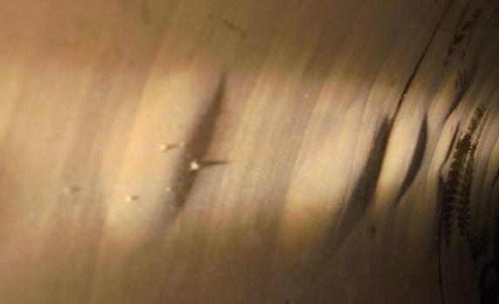
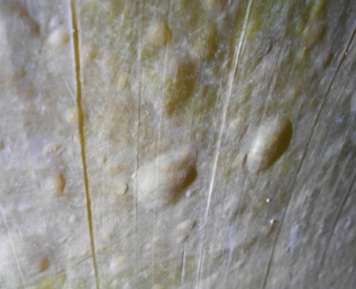
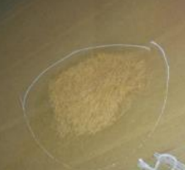
BLISTERS
Air bubbles/voids promotes blisters.
Blister increases by permeation of warm water to inner layers by osmosis.
Warm water decomposes CBL & structural layers.
Over time it reduces Mechanical strengths & leads to failures.
Blisters combine can cause crack & liner detachment.

Slide 6
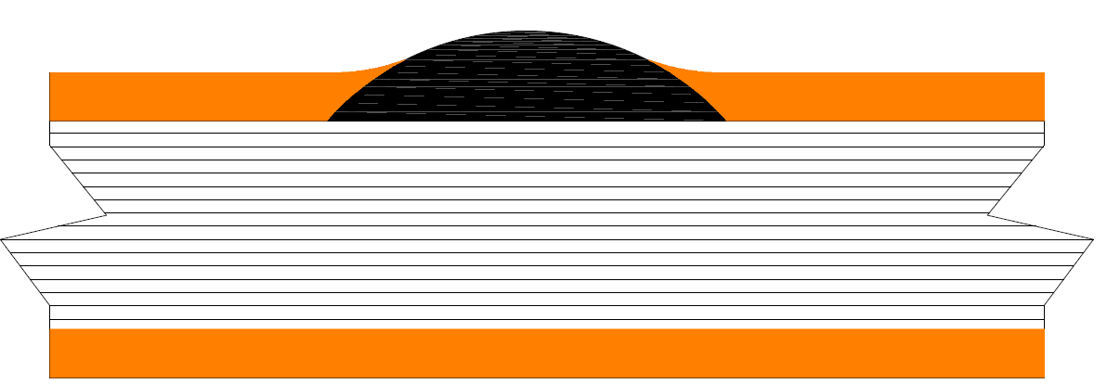
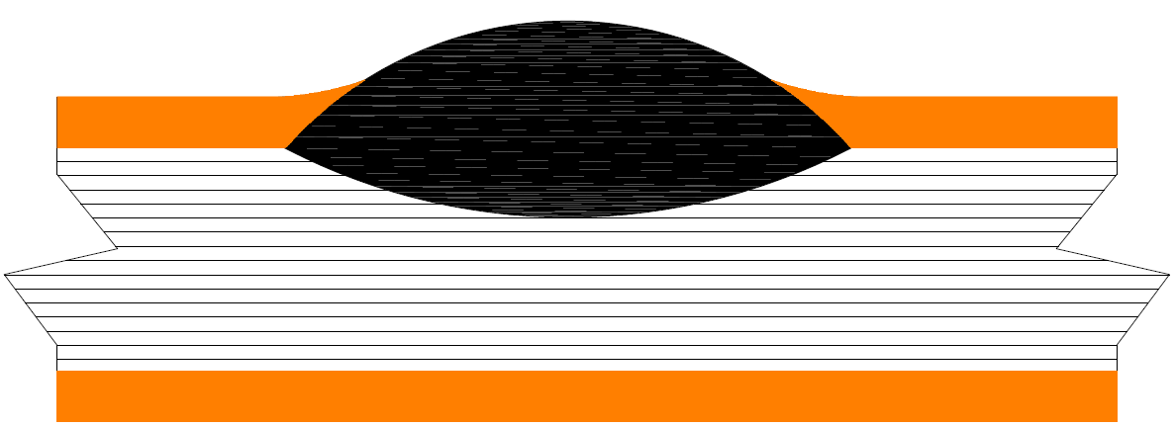
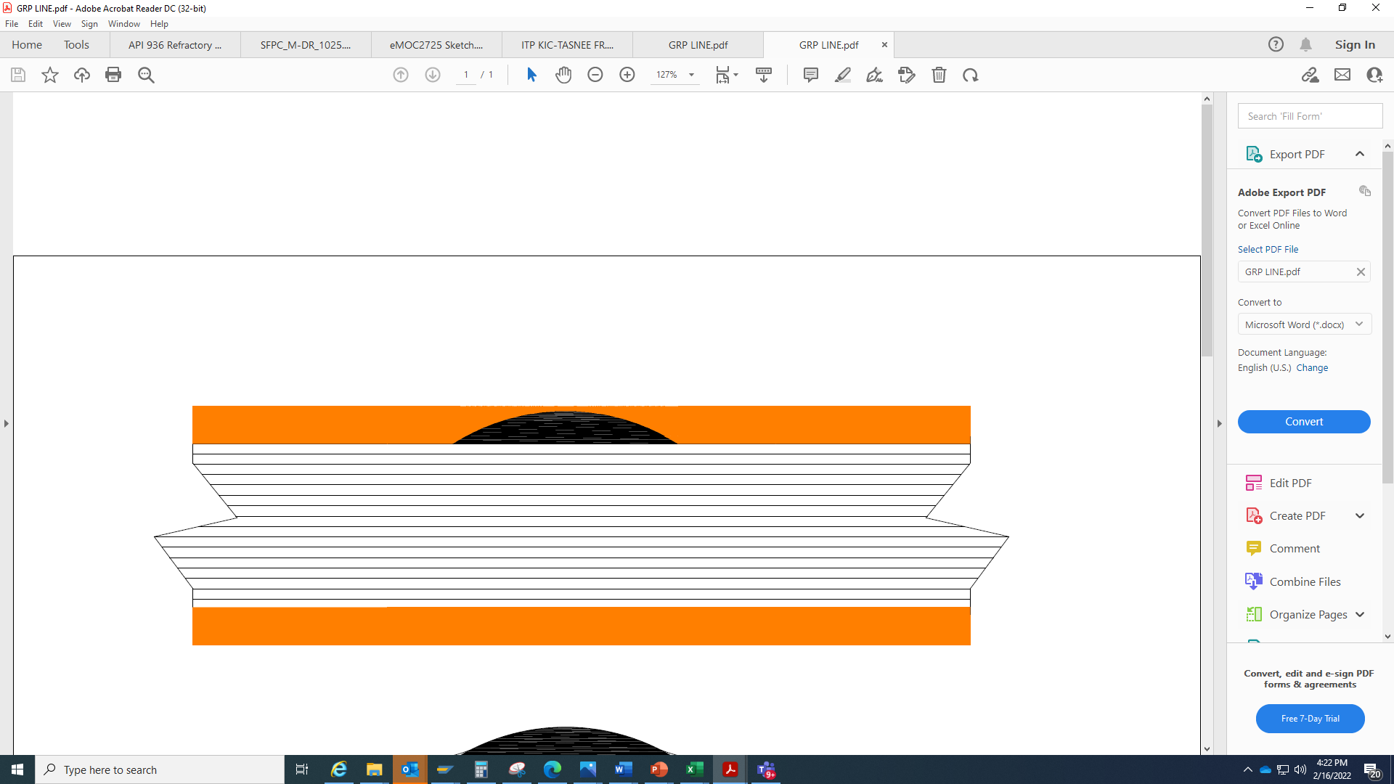
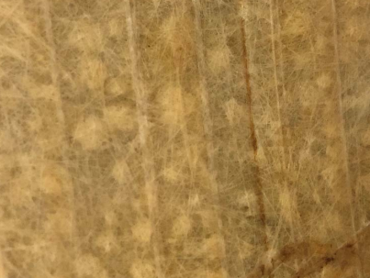
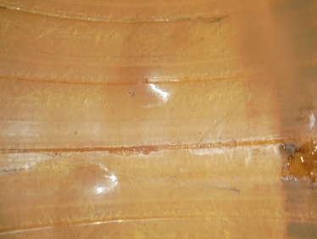
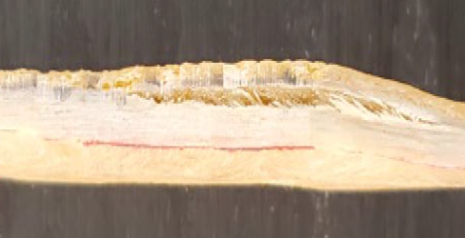
BLISTER FORMATION & PROPAGATION
Blister formation stages
Blister initial stage
Water in
Blister reached structural
Air bubbles
CBL
Structural layer
OUTER LAYER
High temperature & pressure aggravate the blisters.
Air trapped in the liner with time it can expand to blisters and crack the resin around it.
Service fluid penetrate to the blister, further increasing its size.
Internal voids and bubbles in the resin can promote blistering and potential crack initiation and propagation.
Blisters can reduce the service life of the pipe if exposed to significant or cyclic stress.

Slide 7
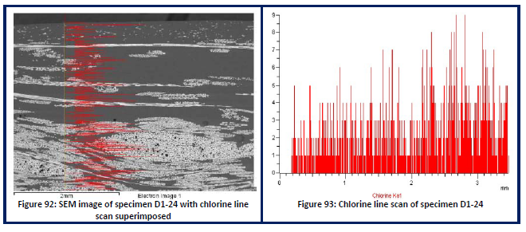
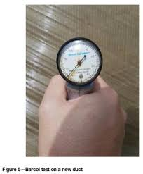
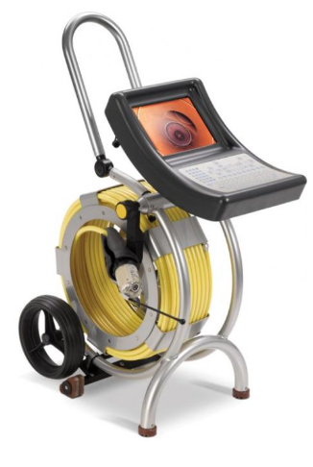
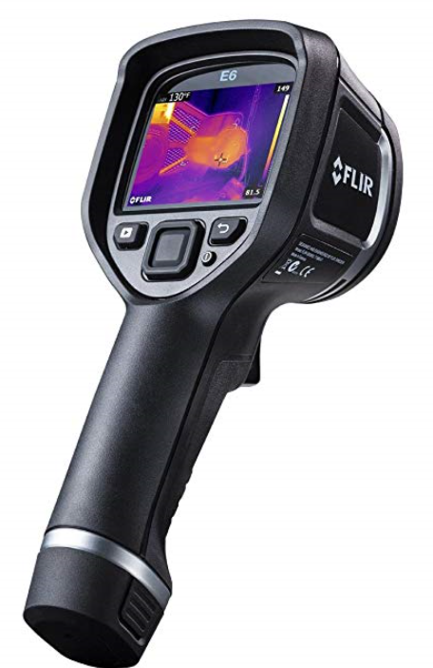
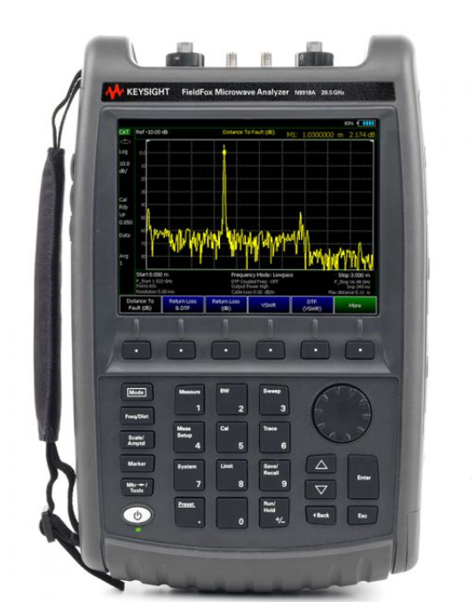
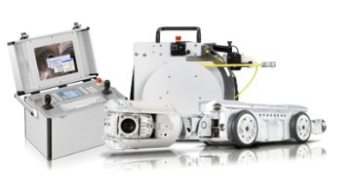
INSPECTION METHODS
  Internal & external inspection.
  Internal & external visual inspection.
  Remote Operated Vehicle (ROV)Crawler with Camera.
  Remote Operated Push Road Camera.
NDT –Non-Destructive Testings.
  Barcol hardness test.
  Infrared Thermography.
  Microwave thickness Analyzer.
  Radiographic testing.
  Acoustic emission.
Destructive testing.
  Axial Tensile test ( Axial & hoop Stress).
  Glass transition temperature ASTM D3418.
  Stiffness, Ring Differential & Deflection test as per ASTM D 2412.
  Optical Microscopy.
  Scanning Electron Microscopy (SEM Analysis).
ROV
  Remote Operated Push Road Camera.
Microwave thickness Analyzer.
  Infrared thermography

Slide 8
POSSIBLE CAUSES OF CBL DAMAGES
Manufacturing defect in the application of the liner.
Voids in the laminate allows penetration of the water by osmosis process.
Incorrect raw materials.
Resin Quality.
Mixing of resin.
Improper application of resin..
Air ingression between layers.
Chemical attack.

Slide 9
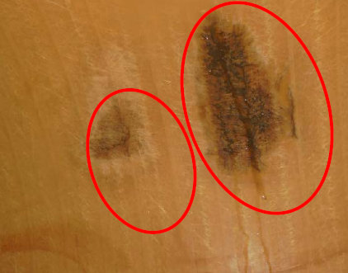
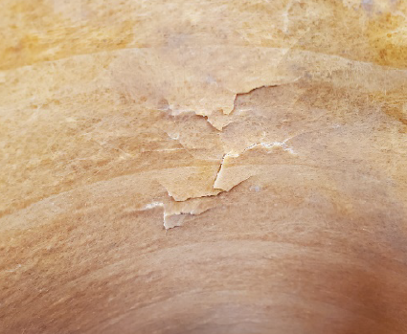
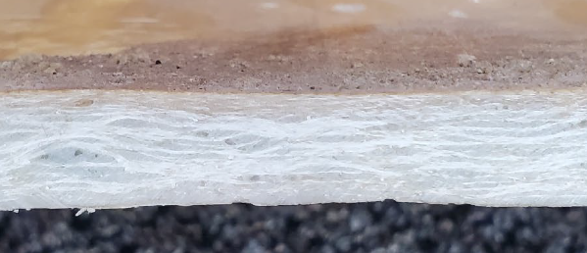
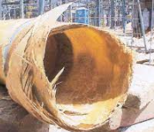
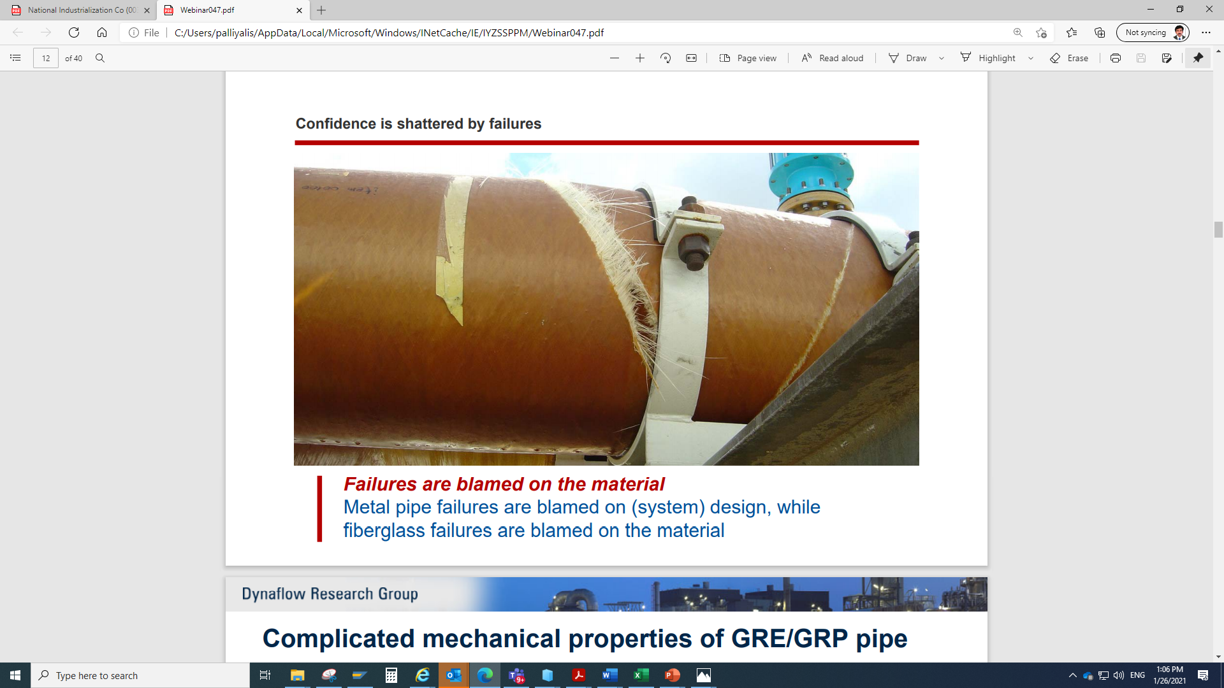
CONSEQUENCES
The voids/air bubbles reduces resin % & increases glass which lower the axial strength.
Reduction in Mechanical properties.
Through-Wall Weeping (Seepage).
Large and small closely spaced lead to rupture & crack.
Liner detach from the pipe
Internal leakage
Through wall seepage
Broken blisters
Voids in structure
FRP line rupture
FRP line rupture

Slide 10
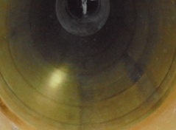
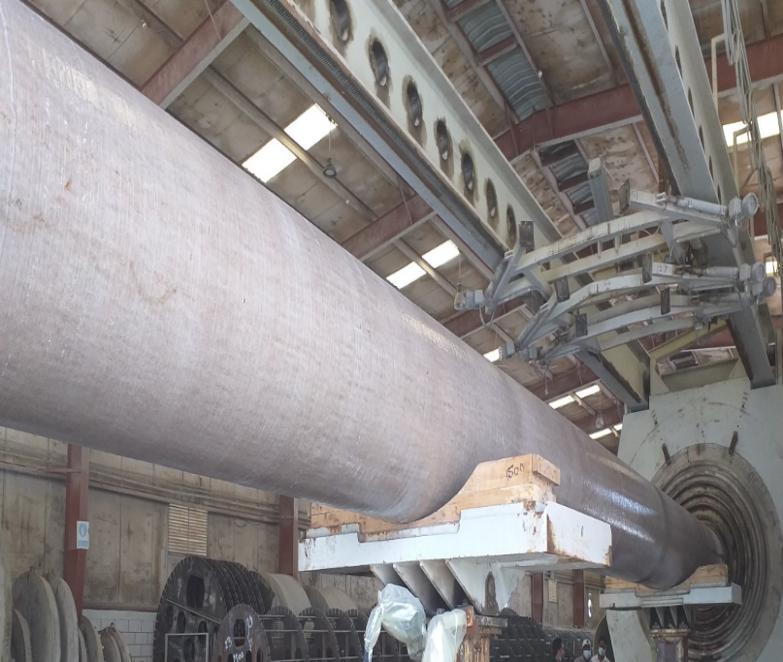
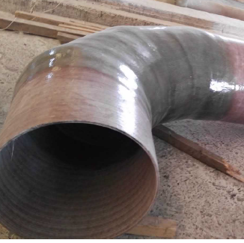
PROPOSED CONTROL MEASURES
Replacement with enhanced GRP/GRV/GRE materials as permanent.
Internal strengthening by additional lamination after grinding as temporary.
Develop & follow standards for In-process inspection & installation.
Systematic PM inspection of FRP based on damage mechanisms and failure modes & rectifications.

Slide 11
Thank You

