Slide 1

Composite Repair for Metallic Pipeline

Slide 2
Composite Repair for Metallic Pipeline
CONTENTS
Background
Composite Repair
Composite Repair Application in Marafiq
  Inline Inspection of Pipeline.
  Design of Composite Repair
  Installation of Composite Repair
  Testing of Composite Repair

Slide 3
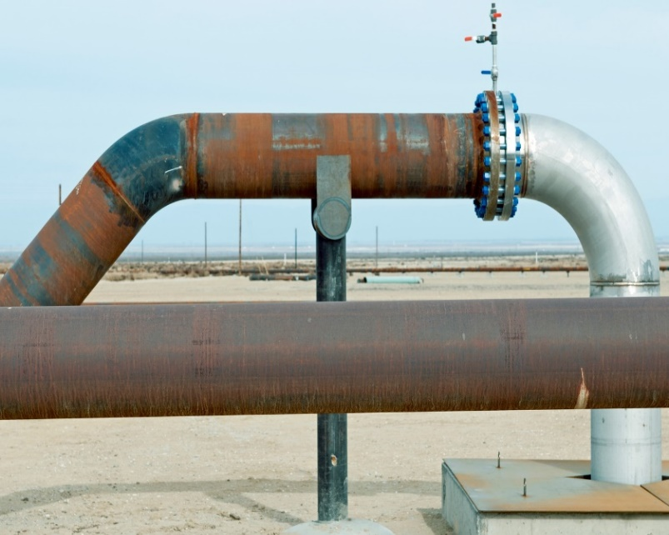
Background
INTRODUCTION
Pipelines are aging over time as they become prone to various defects and failures.
Corrosion is the deterioration of material or its properties because of chemical reaction with the environment.
Damage of pipelines may lead to product leakage, loss of lives, environmental impact, etc.

Slide 4
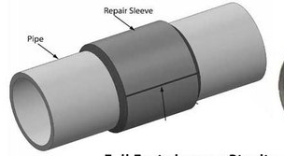
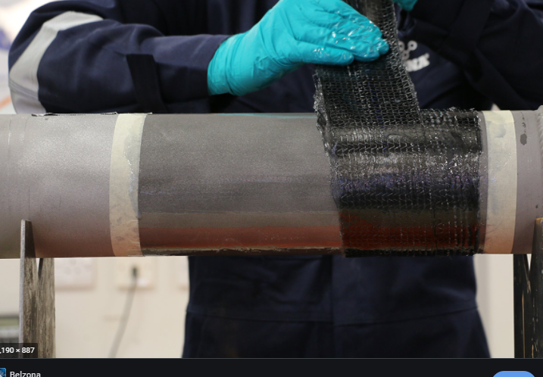
Background
REPAIR METHODS
Selection of the repair method should be evaluated based on the economics and the practicality of the repair methods.
Welding Steel Sleeve Composite Repair

Slide 5
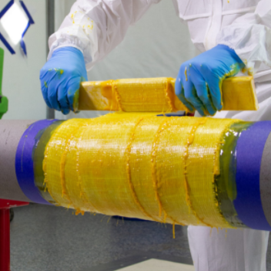
Composite Repair
COMPOSITE REPAIR
Composite repair is a repair method that is used to reinforce the pipeline by using two components; reinforcing fiber and resin. Composite repair return strength to a weakened substrate by rebuilding wall thickness.
CAN REPAIR
External corrosion
Internal corrosion
Leaks

Slide 6
Composite Repair
BENEFITS OF COMPOSITE REPAIR
Resistance to corrosion
Reinstate pipe strength compliant with ISO/ASME standards
Can be applied easily and while the pipeline is in service
Can be applied to any geometric configuration
Ease of handling and transportation
DESIGN CONSIDERATION
Pipe Diameter
Pressure
Temperature
Defect Type
Remaining Wall Thickness

Slide 7
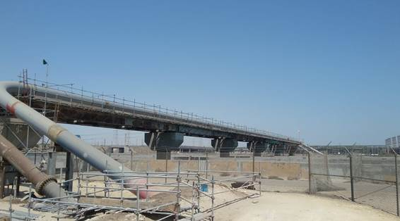
Composite Repair Application
COMPOSITE REPAIR APPLICATION IN MARAFIQ
The Marafiq gas pipeline supply’s natural gas from the Berri Metering Station to Jubail Water Power Plant (JWAP). The aboveground pipeline which is constructed above SWC outfall canal was damaged by external corrosion over a length of 160 m.
Diameter of Pipe | 36 Inch
Material of Pipe | Carbon Steel
Nominal Wall Thickness | 0.375’’
MAOP | 500 psig
Maximum Design Temperature | 65 ̊C
Product | Natural Gas

Slide 8
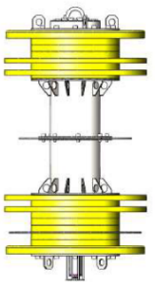
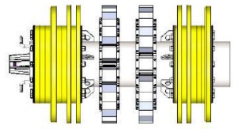
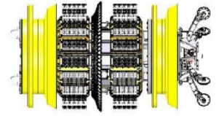
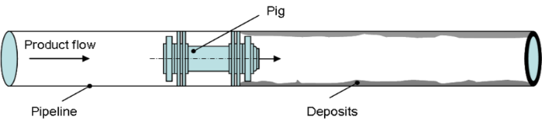
Composite Repair Application
PIPELINE INLINE CARRIED OUT AS PER BELOW SEQUENCE
Gauging Scraper Run: Gauge pig equipped with deformable aluminium gauge plates sized to 95% of the pipeline nominal internal diameter. It is used to ensure that there is not any obstruction in the pipeline.
Cleaning Run: Cleaning run carried out utility pig equipped with cups and brushes to clean the internal pipe wall and remove dirt, rust, mill scale and black powder from the pipeline.
Magnetic Flux Leakage (MFL) Tool Run: It is a tool used to inspect the wall of a pipe.
FINDING:
External corrosion was observed above ground pipeline (SWC canal crossing), length 160 meters.

Slide 9
Composite Repair Application
APPLICABLE STANDARDS
ASME PCC2 ISO 24817
TWO CRITICAL VARIABLES TO DESIGN FOR A COMPOSITE REPAIR ARE
-Repair Thickness
-Repair Length

Slide 10
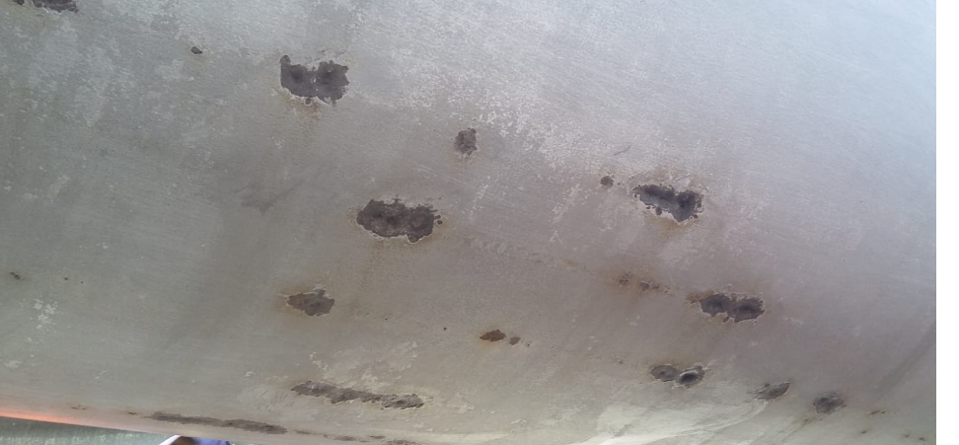
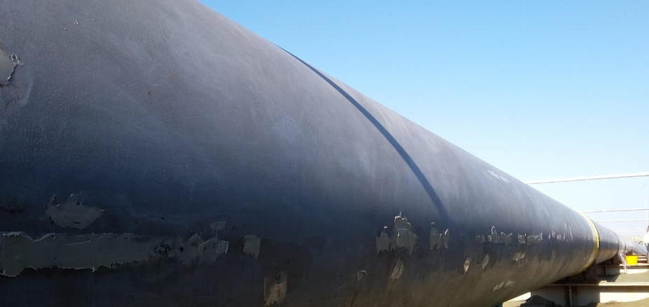
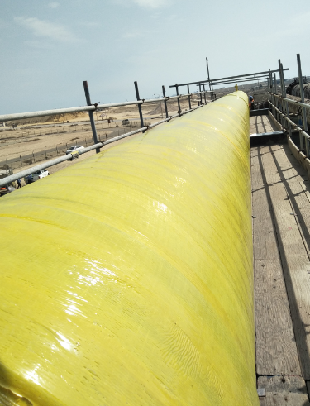
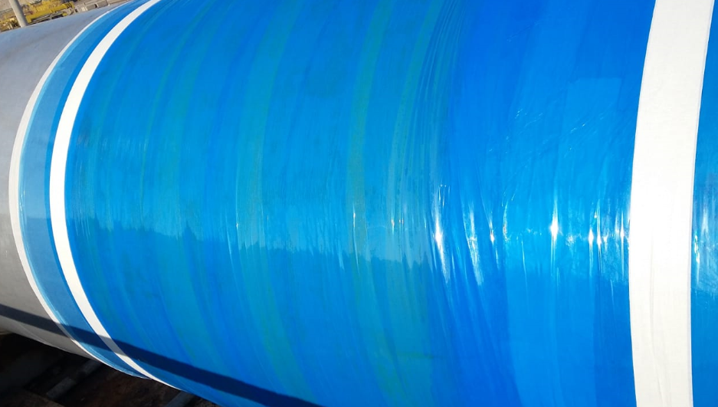
Composite Repair Application
INSTALLATION STEPS
Surface Preparation
Installation of Filler Material
Installation of Primer Material
Installation of Composite Wrap Material
Installation of Compression Film Wrap

Slide 11
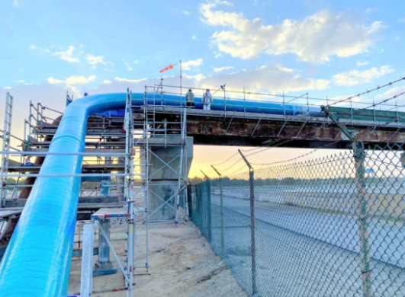
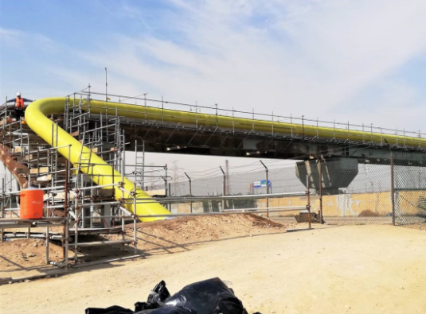
Composite Repair Application

Slide 12
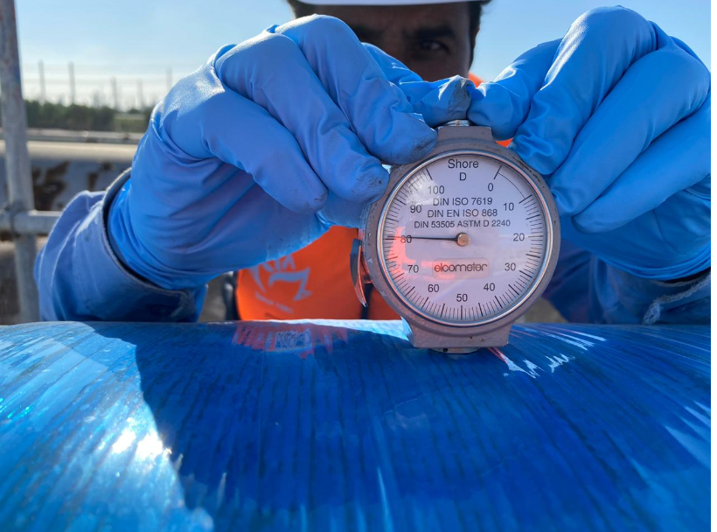
Composite Repair Application
TESTING OF COMPOSITE MATERIAL
Hardness Test
To measure surface hardness using a surface durometer.

Slide 13
Thank You

