Slide 1


Innovative FRP Clamp For failed ductile-Iron Butterfly Valve in Sea water System
Yousif Al-Dhafeery
Static Equip. Engineer
KEMYA-SABIC

Slide 2

OUTLINE
BACKGROUND
BUTTERFLY VALVE FAILURE
ANALYSIS OF REPAIR OPTIONS
FRP CLAMP SETUP
RCA
CONCLUSION

Slide 3
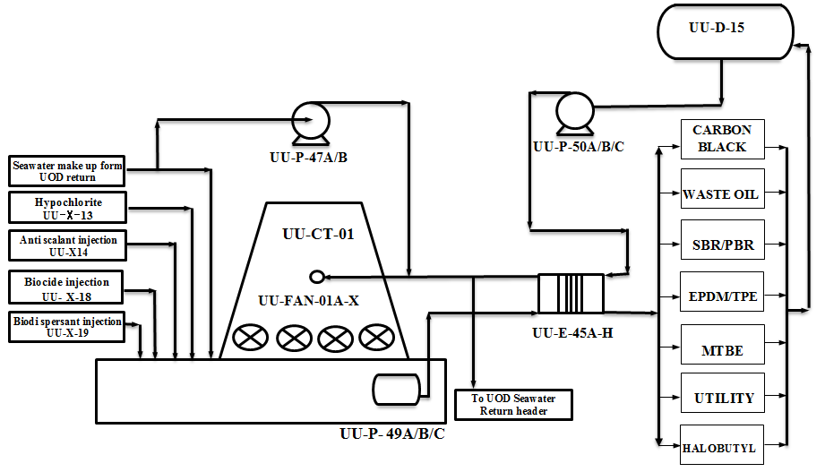
SEAWATER COOLING SYSTEM
Plant water collection drum
SeaWater Makeup
Plant water pumps
Chemical additives
Biocides,
Anti Scalant
Cooling Tower
(SeaWater)
Utility
Plants
heat exchangers
( PHE)
Cooling Fans
Butterfly Isolation Valves (inlet/outlet)

Slide 4
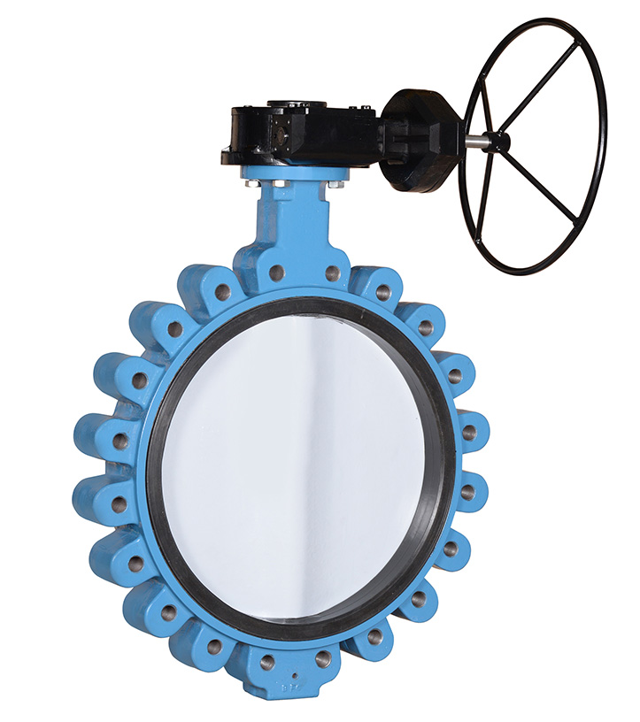
BUTTERFLY VALVES (LUG) IN SW SERVICE
8 BV connected to Sea Water Return header.
Ductile Iron body with Hypalon lining
Pipe Class: FRP
Valve size: 24 inch
Installation date : 2015

Slide 5
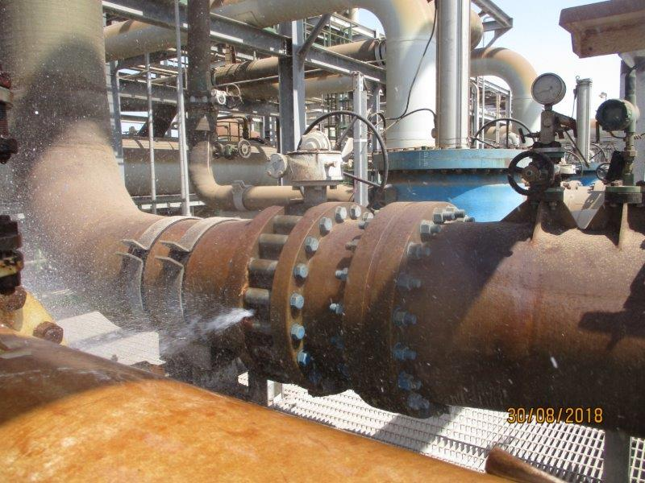
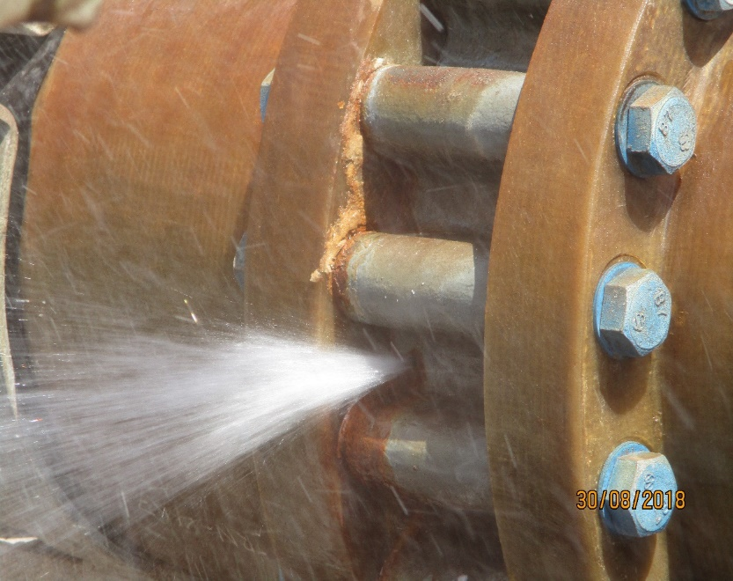
BUTTERFLY VALVE LEAK -BODY
After 4 years in service
Butterfly Valve body had ≈ 5 mm hole between middle lugs.
Line pressure 2 bar (back pressure after isolation)

Slide 6
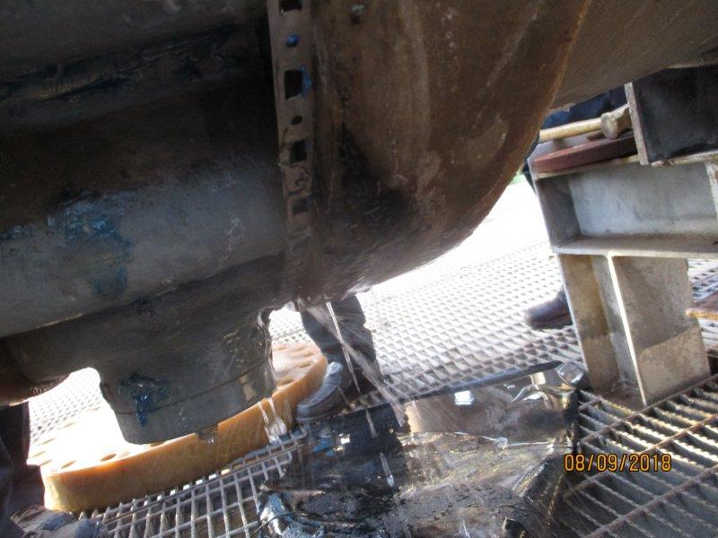
BUTTERFLY VALVE LEAK – FLANGE GAP

Slide 7
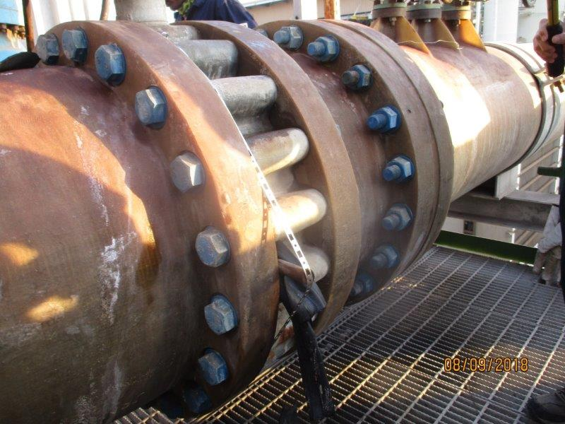
TEMPORARY MITIGATION
Peg installed with rubber sheet & Jubilee clip to arrest leak.

Slide 8
THICKNESS ASSESSMENT
Detail of thickness measurement locations
Section view
Sectionining of valve body
1
1
2
2
3
3
North
4
South
4
5
5
6
6
7
7
8
8
9
9

Slide 9
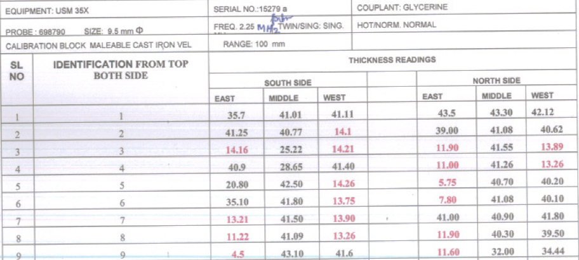
VALVE UT REPORT
Original Thickness 45 mm
UT report indicate thinning at multiple locations.

Slide 10
ASSESSMENT OF REPAIR OPTIONS
DIRECT WRAPPING WITH FRP or CARBON FIBER
  Not Possible due to water leakage which prevents curing.
METALLIC CLAMP
  Not applicable due to High pressure sealant injection that may crack FRP flanges.
FRP CLAMP FOLLOWED BY FRP WRAPPING
  Feasible and a new design was developed for a clamp to meet line pressure criteria.

Slide 11
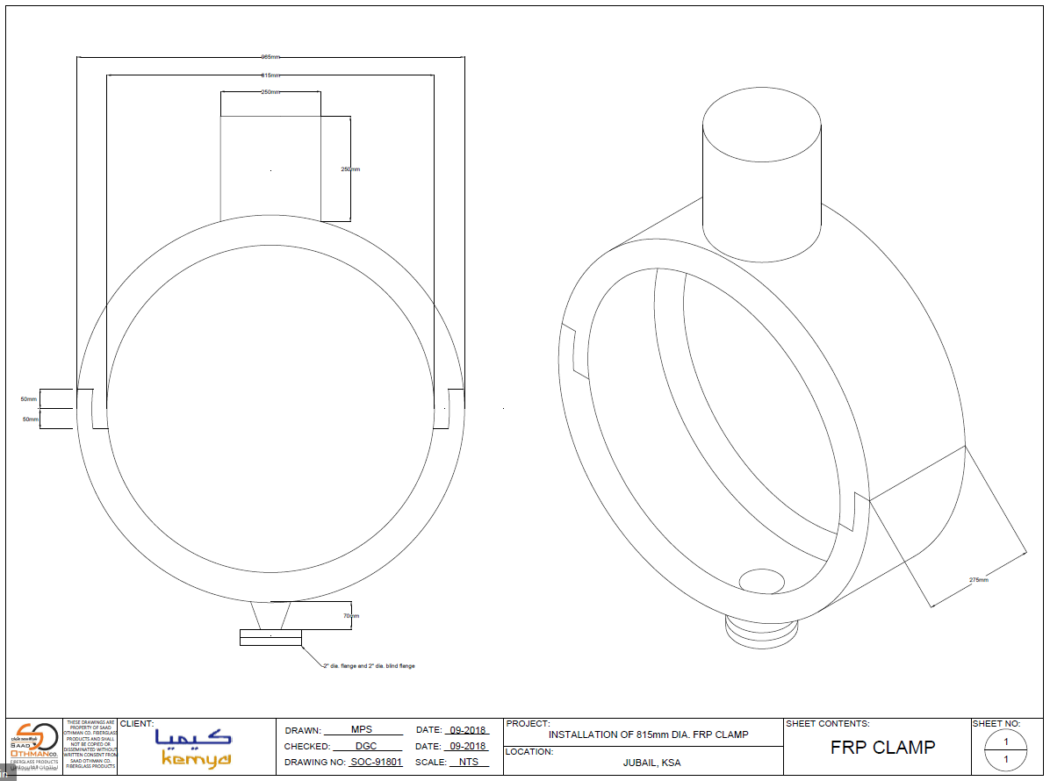
FRP CLAMP DESIGN
Special FRP clamp design was develop to resist pipeline pressure and provide long-term service life till Turn-Around.

Slide 12
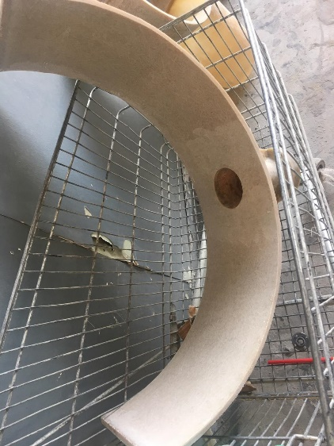
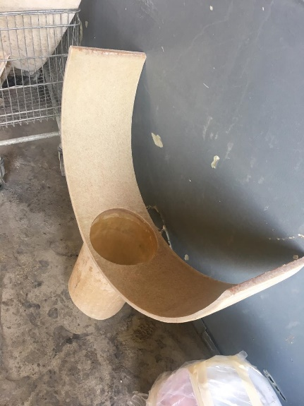
FABRICATION OF FRP CLAMP
TOP PART
BOTTOM PART
Drain connection @ bottom side
Top enclosure to cover valve stem

Slide 13
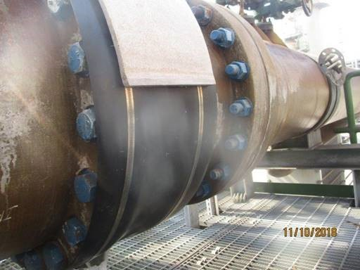
INSTALLATION PROCEDURE - 1
Initially installed Neoprene rubber sheet. Secured by clamp.

Slide 14
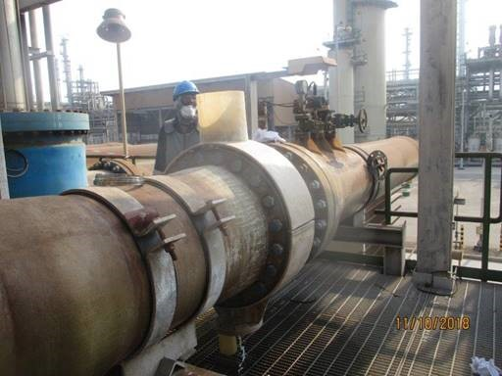
INSTALLATION PROCEDURE - 2
Verification of clamp alignment before applying FRP putty.

Slide 15
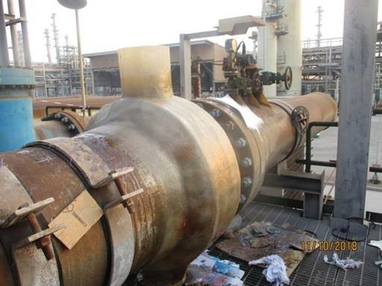
INSTALLATION PROCEDURE - 3
Initial Wrapping after putty application
Hold time to ensure full-dryness to start 2nd layer.

Slide 16
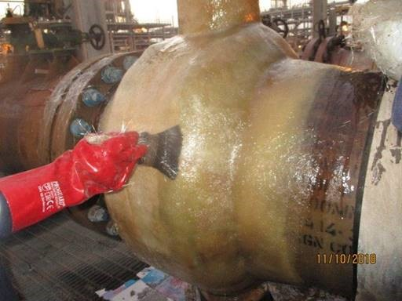
INSTALLATION PROCEDURE - 4
Final Layer of FRP wrapping with covered Gear box removal area and securing drain at the bottom.

Slide 17
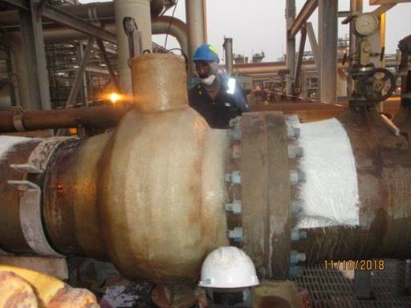
INSTALLATION PROCEDURE - 5
FRP WRAPING:
Total FRP4 layers, each layer thickness =3mm
Tot. thickness =12mm
Length : 800 mm
Hardness Test: Pass

Slide 18
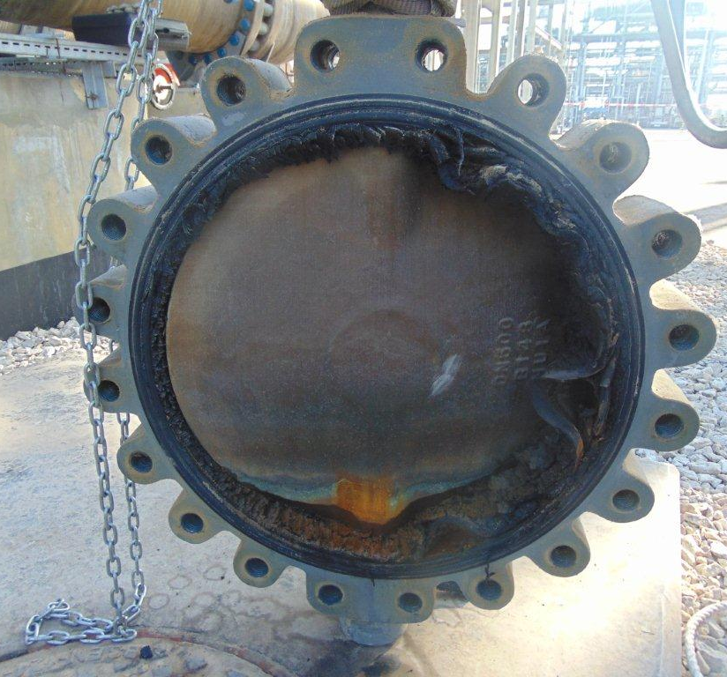
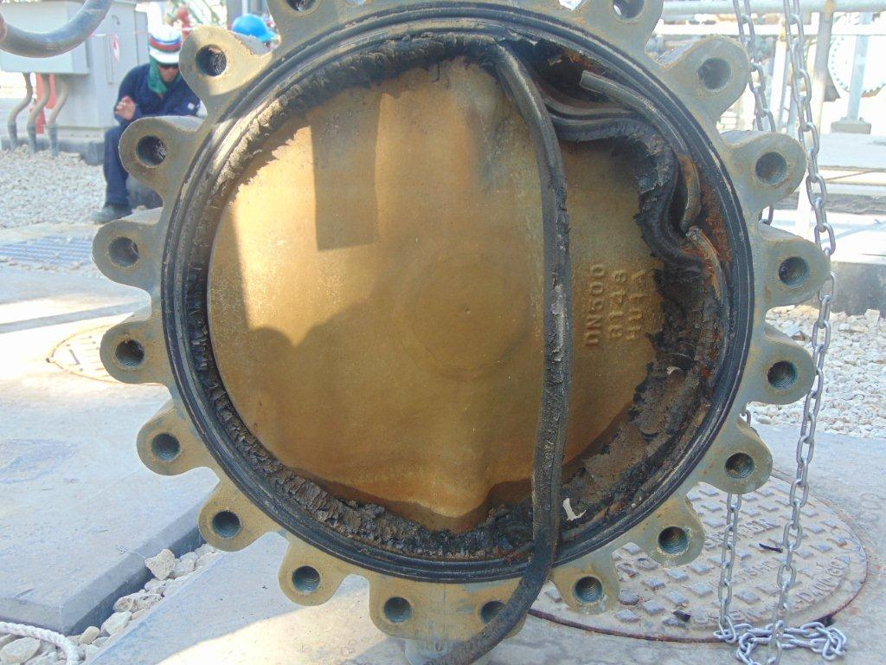
Rootcause Analysis: Historical Failure
Historical Failure of during commissioning in 2015 ( 4 years before failure)

Slide 19
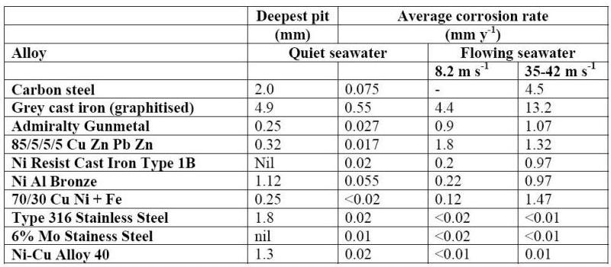
EVALUATION OF CORROSION RATE
Seawater is more corrosive than fresh water due to:
  Higher conductivity
  Penetrating power of the chloride ion through metal’s surface films
Corrosion Rate is controlled by the chloride content, oxygen availability, , temperature & seawater flow.
Highest corrosion rates at turbulence areas within valve body, approximated Corrosion rate = 10 mm per year

Slide 20
CONCLUSION
QA/QA & Proper installation of rubber-lined valves is critical.
Damage of Rubber-lined assets leads to high corrosion rates and rapid failures in seawater service.
UT is a reliable qualitative NDE method to evaluate internal corrosion of cast-iron butterfly valves.
FRP clamp is a feasible solution to avoid costly shut-downs.
Inspection Strategy for seawater valves is crucial for proactive mitigations.

Slide 21
Thank You

