Slide 1
Hadeed CML averaging thickness technique
Prepared By:-
Mohammed Nasser Al Yami – Inspection Manager

Slide 2
Agenda
HADEED CML background
Examples of CML averaging thickness technique
Creating TML group
TML group Mapping
Conclusion

Slide 3
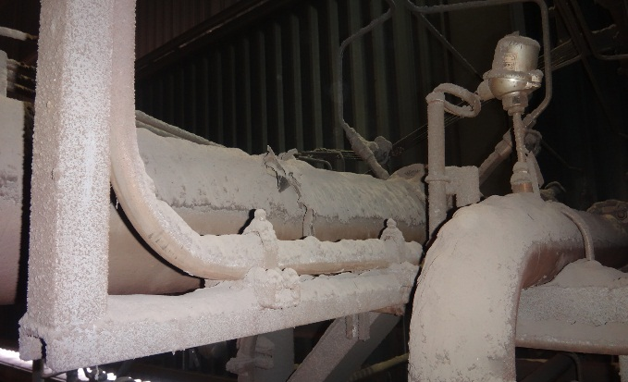
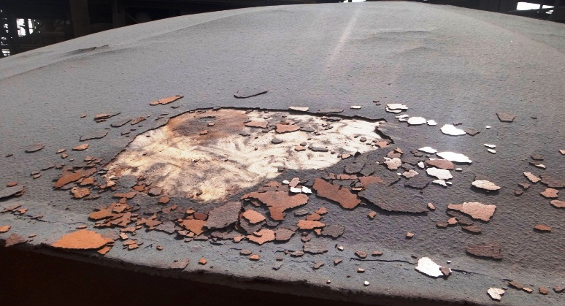
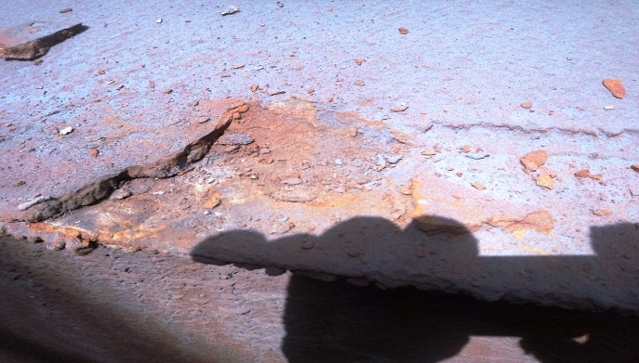
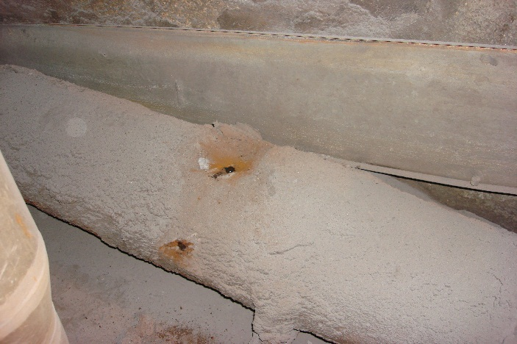
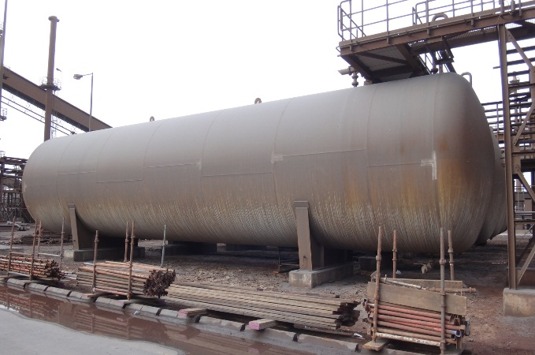
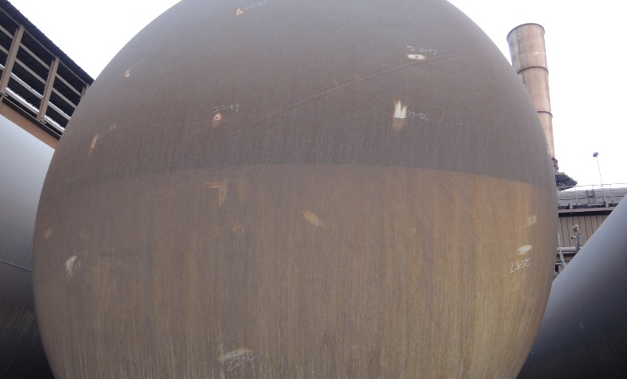
HADeed CML background
Due to the nature of production at HADEED, establishing Condition Monitoring Locations for static equipment’s was a tough task. Layers of dust gets accumulated over the equipment, as time passes by these layers gets thick and hard due to moisture from the atmosphere. During the next inspection frequency the exact location will be missed even though its marked on drawing.

Slide 4
Cont. HADeed TML background
So we came up with an averaging thickness technique for the different components of the equipment (having general corrosion not localized corrosion). This helped us to plot a trend of general corrosion of the equipment and to establish a corrosion rate based on the calculations. These averaged CMLs are entered in Meridium TML Module and linked with RBI analysis which in turn increases the quality of RBI analysis by moving from expected corrosion rate to measured CR.
The benefits from CML’s.
To calculate measured corrosion rate rather expected corrosion rate.
To perform a quantitative RBI analysis.
To calculate Remaining Life.
To plan next inspection date by getting appropriate Inspection frequency.

Slide 5
Examples of CML averaging thickness technique – taken Y2008 Inspection

Slide 6
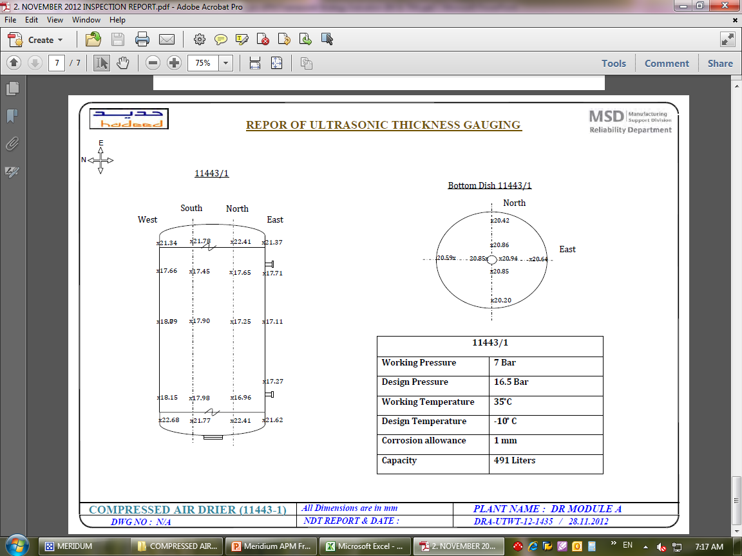
Examples of CML averaging thickness technique – for the same Equipment taken Y2012 Inspection

Slide 7
Averaging readings of COMPRESSED AIR DRIER (11443-1) shell .
COMPRESSED AIR DRIER (11443-1)
2008 |  | 2012
18.1 |  | 18.15
18.7 |  | 18.09
17.8 |  | 17.66
17.6 |  | 17.11
18.1 |  | 17.98
17.8 |  | 17.9
17.7 |  | 17.45
18 |  | 17.27
17.6 |  | 17.25
18 |  | 17.71
17.3 |  | 16.96
17.8 |  | 17.65
Average :- | 17.875 | Average :- | 17.598
Note :-
Incase of a growth in the reading during averaging, consider the initial reading as actual
This presentation is just for demonstration purpose, and only considering shell.

Slide 8
Creating the tml group
TML groups created for the Shell and Top Dish

Slide 9
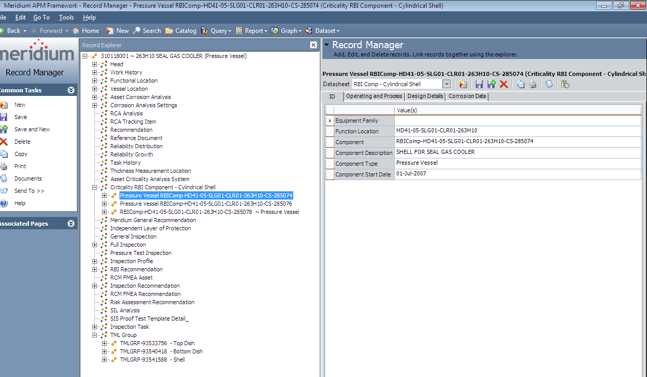
TML Group Mapping
There is three RBI Component .
There is three TML Group

Slide 10
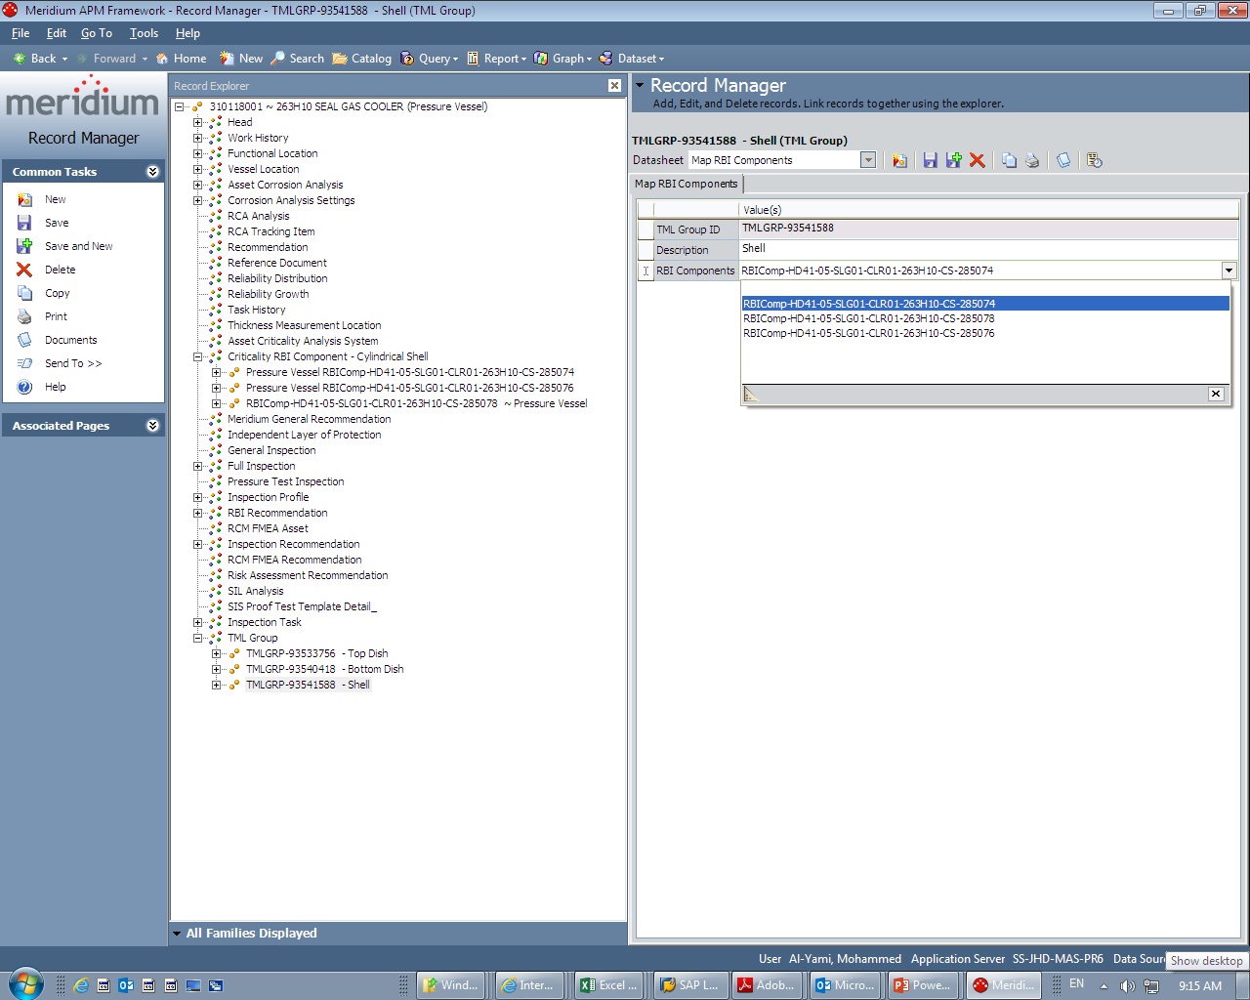
Cont. TML Group Mapping
Select TML groups need to be mapped then Select the appropriate RBI Component .

Slide 11
CONCLUSION
So CML averaging thickness technique have helps to improve accuracy of the Corrosion rate and Save time and efforts. Example saving time and efforts from searching for the CML location on the equipment . As well as entering one CML for one RBI component in CML module instate of entering multiple CML on the same component. Also it’s Increase the accuracy of the Corrosion rate which is actually based on all the Thickness measurement that have been taken on the component instate of selecting one measurement to determine the equipment Corrosion rate. And it had made identifying equipment more susceptible to general corrosion more easier ,which eventually helped determining next inspection date and frequency in more realistic measurement.

Slide 12
Questions ??
END OF TML averaging thickness technique

Slide 13
Thank you
Notes:
To select different Thank You options, go to HOME tab and click Layout button.

