Slide 1

Magnetic and robotic inspection

Slide 2
Content
Goals and deliverable
Deliverable value and limitations of the technique.
Magnetic crawler inspection.
Full tank assessment summary.
Conclusions.

Slide 3



Goals and deliverable.
Project Goals:
Assessment of the Fire water & Potable water tanks by performing smart inspection by doing RMS & Robotic inspection with comply of API653 API575 .
Deliverable value:
1
3
Integrity
EHSS
Cost
2
Tank Life Assessment
Complies with RBI
UT measurements.
No confined Space Entry required.
No environmental risk from discharging the tank
No dewatering or tank Isolation.
minimize the scaffolding requirement inside the tank
proper planning of the rectification.
Cost effectiveness of the repair.
Budget control.

Slide 4
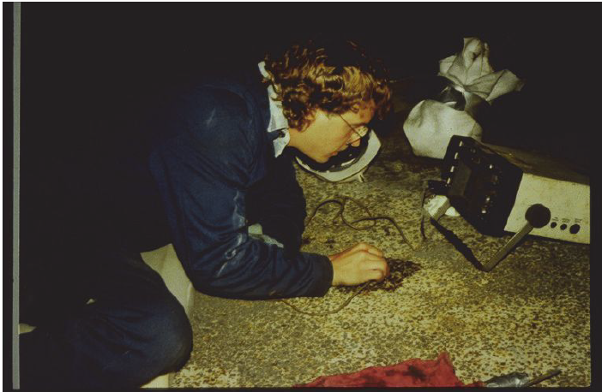
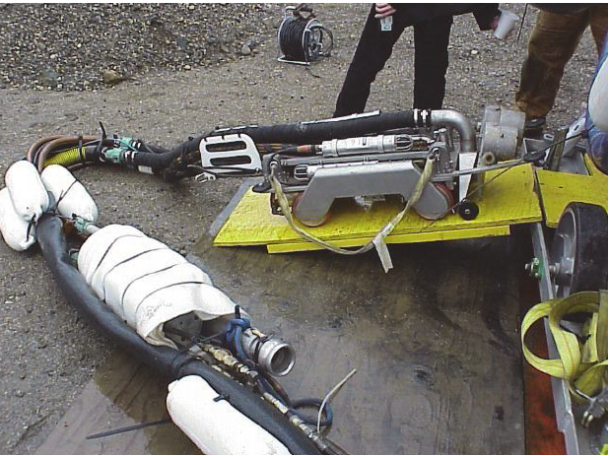
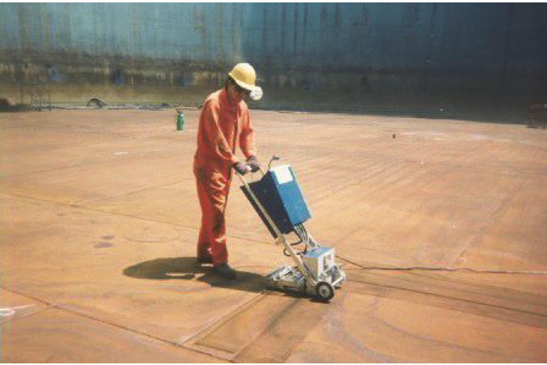
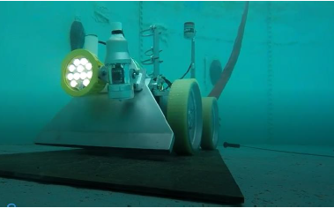
Robotic inspection.
Smart technique utilized to perform UT measurements & Data Analysis to calculate T-min of the bottom plate for MRT calculations based on API653 formulas with Real-time data streaming.

Slide 5
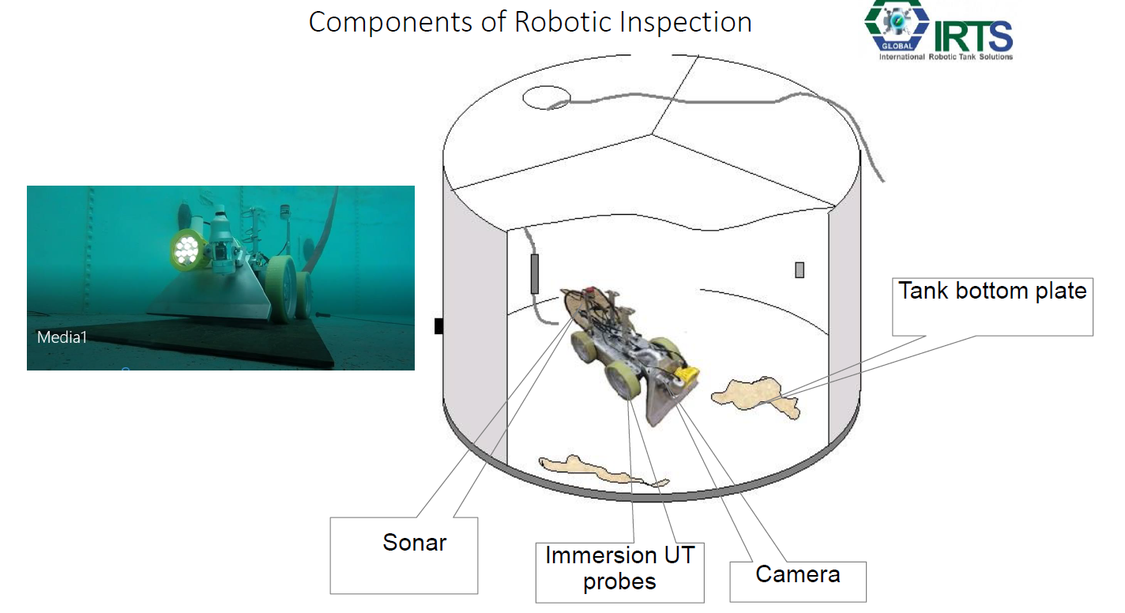
Robotic inspection

Slide 6
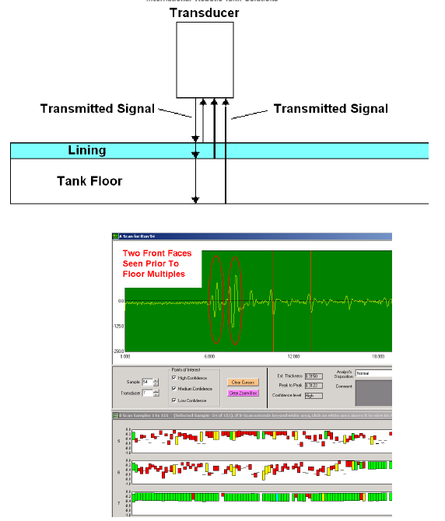
Robotic inspection.
Immersion Technique, Thousands of thickness data points per run.
Real time data streaming & Saving Data on A,B,C scans.
UT measurements & Data Analysis to calculate T min of the bottom plate for MRT calculations based on API653 formulas.
The system is used to take thickness measurements based on UT Zero degree principal.
Detected process side or soil side corrosion by the assessment of water path.
Lining detection lining type is a factor to determine the capability of applying the technology, eg limitation of UT on several composites of RFP linings).

Slide 7
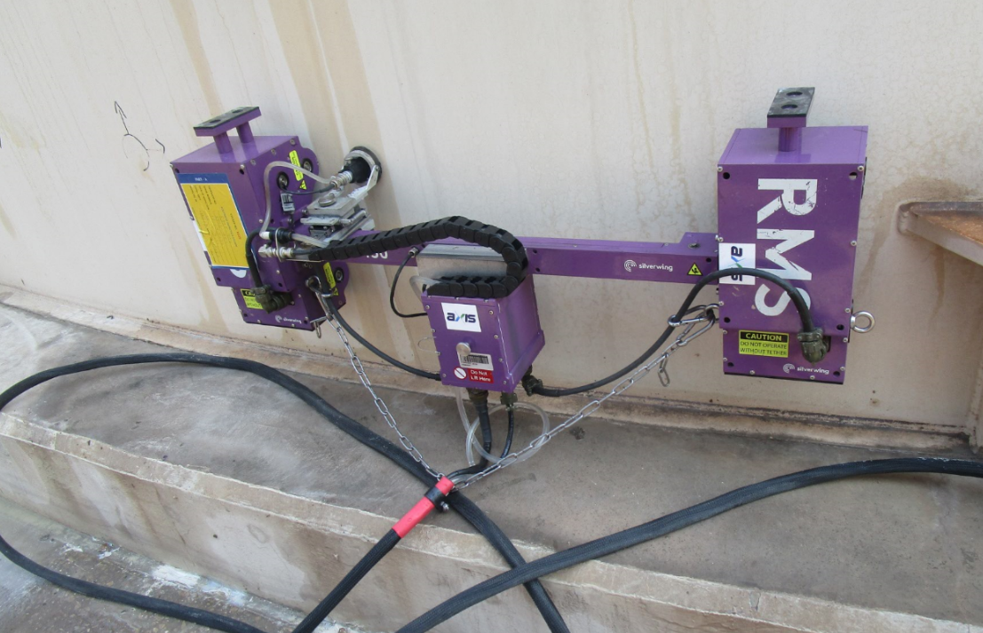
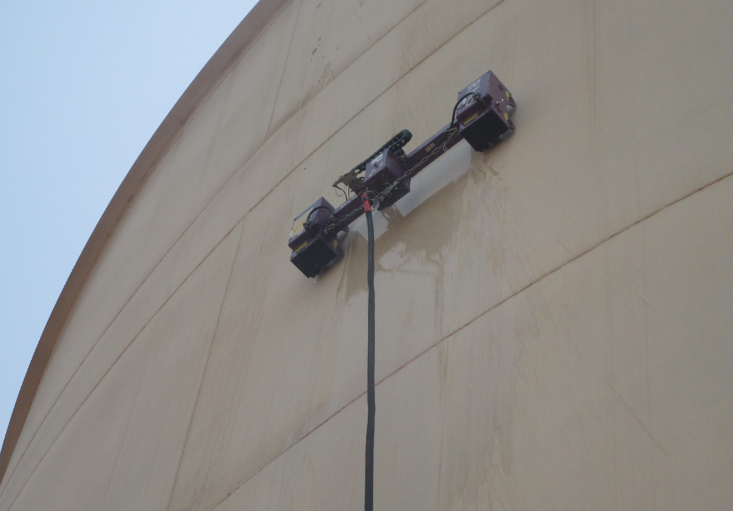
Magnetic crawler inspection.
RMS Phased-Array:
Advanced NDT technique utilized to perform corrosion mapping in the shell of the pipe & tanks externally in order to identify the API653 API575 damaged mechanism (General corrosion, Erosion, Flow accelerated corrosion, Microbiologic-Induced Corrosion (MIC), Hydrogen Blistering (HB), Laminations & Internal coating failures or disbanding).

Slide 8
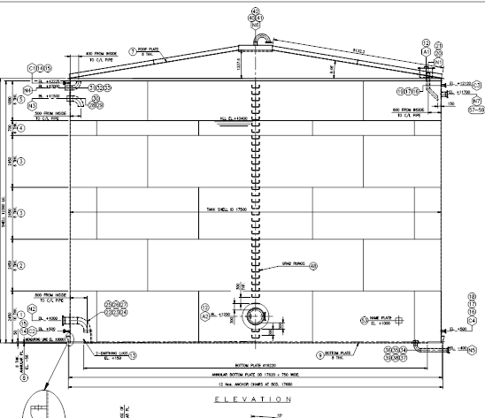
Full tank assessment summary
Top Roof
Conventional UT spot measurements from external and Vapor inspection by robotic.
Shell
Full scanning of the shell by RMS externally and internal by robotic inspection.
Annular ring
SRUT scanning for metal loss
Bottom floor
Robotic inspection of the bottom floor and MRT measurements of the bottom floor.

Slide 9
Benefits and limitations
Benefits
Limitations
UT Inspection and Remaining Life Assessment for Tank bottom.
Complies with RBI programs.
No Downtime of the tank.
No need for alternate storage.
Projection of Tank Repairs.
No confined Space Entry.
Certified system as per international standards.
No environmental risk from discharging the tank.
No dewatering or tank Isolation.
minimize the scaffolding requirement inside the tank
proper planning of the rectification.
Cost effectiveness of the repair.
Budget control.
      Limitation of slug vacuum cleaning if the quantity huge which impact the
      Arrangement of crane for the robot deployment.

Slide 10
API 653
All tanks shall have a formal internal inspection conducted at the intervals defined by 6.4.2 or 6.4.3. The authorized inspector who is responsible for evaluation of a tank must conduct a visual inspection and assure the quality and completeness of the NDE results. If the internal inspection is required solely for the purpose of determining the condition and integrity of the tank bottom, the internal inspection may be accomplished with the tank in-service utilizing various ultrasonic robotic thickness measurement and other on-stream inspection methods capable of assessing the thickness of the tank bottom, in combination with methods capable of assessing tank bottom integrit. If an in-service inspection is selected, the data and information collected shall be sufficient to evaluate the thickness, corrosion rate, and integrity of the tank bottom and establish the internal inspection interval, based on tank bottom thickness, corrosion rate, and integrity, utilizing the methods included in this standard. An individual, knowledgeable and experienced in relevant inspection methodologies, and the authorized inspector who is responsible for evaluation of a tank must assure the quality and completeness of the in-service NDE results. After an effective RBI assessment is conducted, the results can be used to establish a tank inspection strategy and better define the most appropriate inspection methods, appropriate frequency for internal, external and on-stream inspections, and prevention and mitigation steps to reduce the likelihood and consequence of a tank leak or failure.
API 653 provides criteria for condition based inspection and scheduling of tanks utilizing internal and external visual inspection results and data from various NDE techniques (also refer to 6.2). API 653 also recognizes the use of alternative inspection methodologies. For example, robotic inspection is one possible approach to perform an assessment of the tank bottom and other internal components without personnel entry. The application of risk-based inspection (RBI) procedures to determine inspection intervals may result in longer or shorter inspection intervals (refer to 6.3, API 580, and API 581).

Slide 11
API 575
Tools for internal tank inspection used while the tank is in service have been developed. These robotic crawler devices are designed for total immersion in liquids and have been successful in providing ultrasonic thickness information on tank bottoms in clear finished product storage such as gasoline, naphtha, jet fuel, No. 4 and No. 6 fuel oils, condensate, and some crude oil. This equipment needs to be used under carefully controlled circumstances and within API safety guidelines for work on tanks in service. See Figure A.4 for an example of a robotic inspection tool.
The technology has been utilized in a wide variety of products including, but not limited to, crude, diesel, jet, gasoline, lube oil, benzene, hexane, boiler feed water, and chemicals. Of course, the owner/user needs to conduct a review of safe operating procedures prior to performing robotic inspection. The robotic inspection process can acquire a large density of measurements over an analyzed area, which can total hundreds of thousands of ultrasonic thickness measurements.
This enables an evaluation using statistical methods to extrapolate the thinnest remaining metal of
the entire bottom. Some robotic equipment can also perform adequate inspection on other portions of the tank and accessories (bottom settlement, a visual inspection of the vapor space, and a visual inspection of the tank bottom).

Slide 12
Thank You

