Slide 1
CHLORIDE STRESS CORROSION CRACKING
Author : MOHAMMED ABDUL NAFAY Inspection Engineer SABIC Agri-Nutrients

Slide 2
CONTENTS
Definition and Morphology
Overview
Chloride Stress Corrosion Cracking (API-581)
Susceptibility to Cracking (API-581)
Flow chart for DF of Cl-SCC (API-581)
Inspection Findings
Prevention / Mitigation

Slide 3
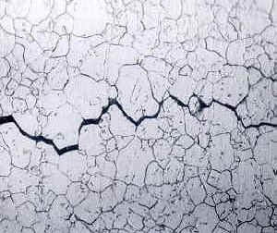
Definition & Morphology
Chloride stress corrosion cracking (CSCC) is a type of intergranular and transgranular corrosion. Chloride stress corrosion involves selective attack of a metal along its grain boundaries. It occurs in austenitic stainless steel under tensile stress in the presence of oxygen, chloride ions and high temperature.
Typical Morphology

Slide 4
Overview
CSCC can attack highly resistant austenitic stainless steel. In the formation of the steel, a chromium-rich carbide precipitates at the grain boundaries, leaving these areas low in protective chromium, and thereby, susceptible to attack. It has been found that this is closely associated with certain heat treatments resulting from welding. This can be minimized considerably by proper annealing processes.
A stainless steel that has been attacked by CSCC often has a web-like array of tiny surface cracks. In extreme cases, cracking is so pervasive that the metal can be broken off by hand. This pattern of corrosion occurs because the corrosion tends to follow the direction of highest residual tensile stress, but the actual cracking tends to locally relieve that stress.
CSCC can be controlled by maintaining low chloride ion and oxygen content in the environment and the use of low-carbon steels. Environments containing dissolved oxygen and chloride ions can readily be created in auxiliary water systems.
Nickel controls susceptibility to chloride stress corrosion cracking. Materials with little or no nickel (duplex stainless steels and ferritic stainless steels) and those with high nickel content (superaustenitics and nickel-base alloys) have significantly better resistance to stress cracking

Slide 5
Chloride Stress Corrosion Cracking (API-581)
ClSCC of austenitic stainless steels can occur in a chloride-containing aqueous environment. The susceptibility to ClSCC is dependent on the concentration of the chloride ions, the temperature, It should be emphasized that the chloride concentration in water within wetting and drying conditions can be higher than the concentration measured in the bulk solution due to partial water vaporization. Such vaporization can increase ClSCC susceptibility. ClSCC is more likely to occur at metal temperatures above 66 °C (150 °F).
Examples of common sources of chlorides in refineries and petrochemical plants are as follows.
a) Chloride salts from crude oil, produced water, and ballast water.
b) Water condensed from a process stream (process water).
c) Boiler feed water and stripping system.
d) Catalyst.
e) Insulation.
f) Residue from hydrotest water and other manufacturing operations.
g) Fumes from chemicals containing either organic or inorganic chlorides

Slide 6
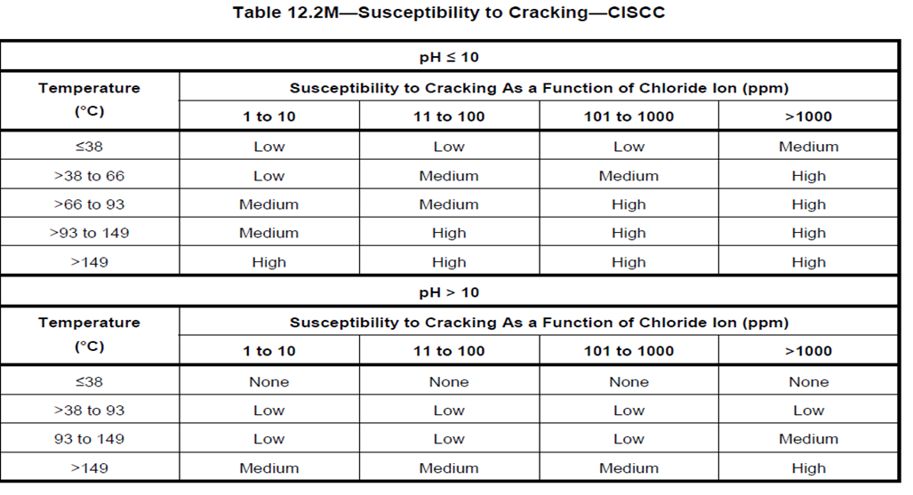
Susceptibility to Cracking

Slide 7
Chloride stress corrosion cracking (API-581)

Slide 8
Inspection findings
Bottom plate was replaced as per the plan for Urea storage tank (SS 304 L) material and all the NDE were performed as per API-653.
After all the repairs and welding activities the tank was released for the fill test during the filling of the tank which was up to 5% of the tank Nine minor leaks were observed on the first shell course around 40 mm to 50 mm above from the toe weld of corner weld joint.
DPT carried out during Fill Test for the first shell course of the tank after complete buffing and cleaning activities and 09 minor cracks (leaking during fill test),
Fill test was increased to 80 % of height static head and no further leaks were observed.

Slide 9
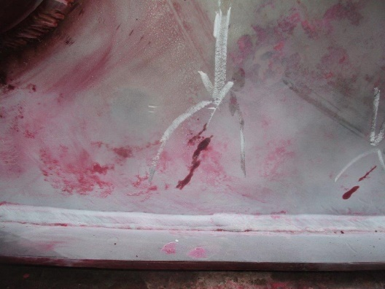
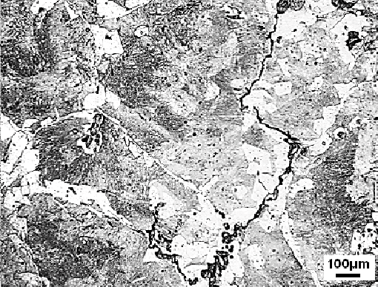
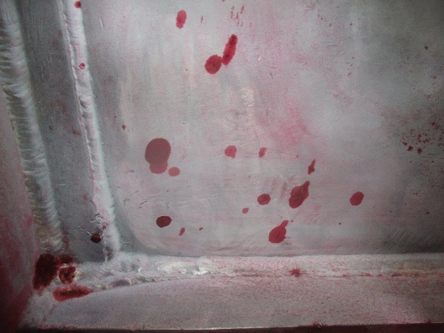
DPT & In-situ Metallography Images
Fig: The microstructure consists of ferrite, pearlite. Micro-and macro cracks observed under optical microscope. 4% natal

Slide 10
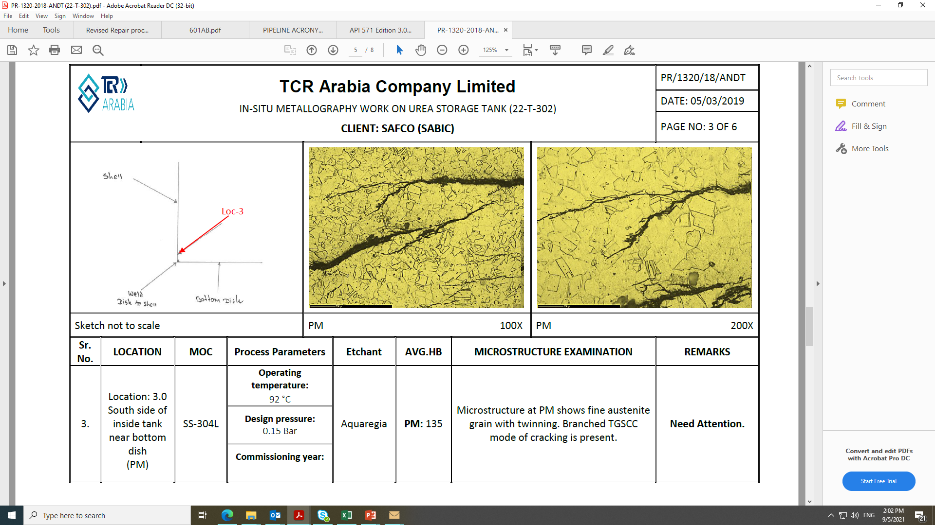
Insitu-Metallagrophy

Slide 11
Prevention / Mitigation
Materials of construction resistant to Cl− SCC should be used. Carbon steels, low-alloy steels, and 400 series SS are not susceptible to Cl− SCC.
b) When hydro testing, low-chloride-content water should be used, followed quickly by thorough dry out.
c) A suitable coating should be applied to stainless steel piping and equipment prior to insulating.
Shrink-wrapped PVC labels, coatings, or label adhesives with high levels of chlorides or other halogen
ions should be avoided.
d) Avoid designs that create stagnant regions where chlorides can deposit or concentrate.
e) Although not a standard or common refining industry practice, a suitable high-temperature stress relief of 300 series SS after fabrication will reduce residual stresses. However, consideration should be given to the
possible effects of sensitization that may occur, increasing susceptibility to PTA SCC possible
distortion problems, and the potential for stress relaxation cracking (SRC)
f) Avoid exchanger designs with 300 series SS steel tubes and a high delta T between the shell and tube side
where localized condensation can occur on or in the tubes.
g) Avoid contact with high-chloride water run-off that can occur with the use of salts for snow and ice melting.

Slide 12
Thank You

