Slide 1
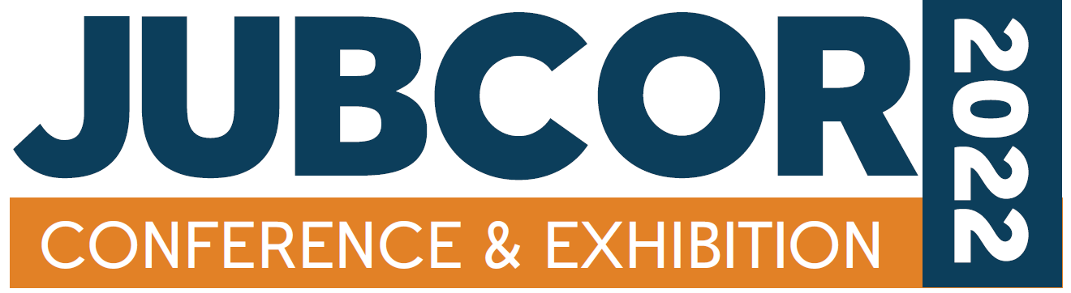
The Challenges of Conducting Failure Investigations in the Oil & Gas and Petrochemical Industries
Mohammed Al Muaisub
Consulting Services Department (CSD)
Saudi Aramco

Slide 2
The Challenges of Conducting Failure Investigations in the Oil & Gas and Petrochemical Industries
Introduction
Why do failures happen?
Why do they recur?
The goal here is to discuss the different causes and challenges that can sometime negatively impact the failure analysis process.

Slide 3
The Challenges of Conducting Failure Investigations in the Oil & Gas and Petrochemical Industries
Personnel Training Needs:
Some investigators in our industries may lack mandatory qualifications for running and conducting failure investigations. Such qualifications need to be achieved through training or mentoring. An organization may also lack understanding of training needs for personnel to perform failure investigations effectively.

Slide 4
The Challenges of Conducting Failure Investigations in the Oil & Gas and Petrochemical Industries
Untracked Records:
There may be a lack of a centralized system/database that has the required documents in terms of failure history, equipment datasheets and any changes in the equipment design or materials.
There may be personnel attrition or changes in the number of qualified employees who are handling and maintaining the records.
Improper utilization of RBI reports and corrosion control documents (no evergreening).

Slide 5
The Challenges of Conducting Failure Investigations in the Oil & Gas and Petrochemical Industries
Working in Silos and Turf Wars!
Employees may work in “silos,” which can sometimes lead to “turf wars.” This challenge can be in the form of intentional non-cooperation between various teams/groups/organizations that are impacted. This internal practice is a defense mechanism in the form of blame shifting to avoid any responsibilities relevant to the failures. In extreme cases, the involved parties might omit or distort some info/data or possibly delay providing them to avoid responsibility for the failure and the repercussions or the aftermath.

Slide 6
The Challenges of Conducting Failure Investigations in the Oil & Gas and Petrochemical Industries
The Unwritten Rules
Avoid blaming organizations or individuals, or shifting responsibility to someone else or another group.
The nature of the business, i.e., “firefighting mode” vs. the “proactive mode” may be related to not having enough resources to perform or make the transition between the two modes.

Slide 7
The Challenges of Conducting Failure Investigations in the Oil & Gas and Petrochemical Industries
Multiple Leaders of the Same Incident/Failure
The process/operation teams issue their findings, and the inspection staff issue their findings separately. There may be no coordination and so conflict is possible or even certain.

Slide 8
The Challenges of Conducting Failure Investigations in the Oil & Gas and Petrochemical Industries
Leaning/Focusing on the Common Causes and Neglecting or Never Speculating about New Causes
Investigators may only focus on typical causes and not consider the possible defects resulting from product processing or defects in the raw material. This can lead to inaccurate conclusions.

Slide 9
The Challenges of Conducting Failure Investigations in the Oil & Gas and Petrochemical Industries
Time Urgency vs. Quality
Treating the failure investigation as a task that must be completed quickly rather than a critical project with deliverables that should be treated responsibly.

Slide 10
The Challenges of Conducting Failure Investigations in the Oil & Gas and Petrochemical Industries
The “Create Additional Procedures/Best Practices” Syndrome!
The more documents you have, the more unaware people will become of potential risks because of the sheer volume of documents in the organization.

Slide 11
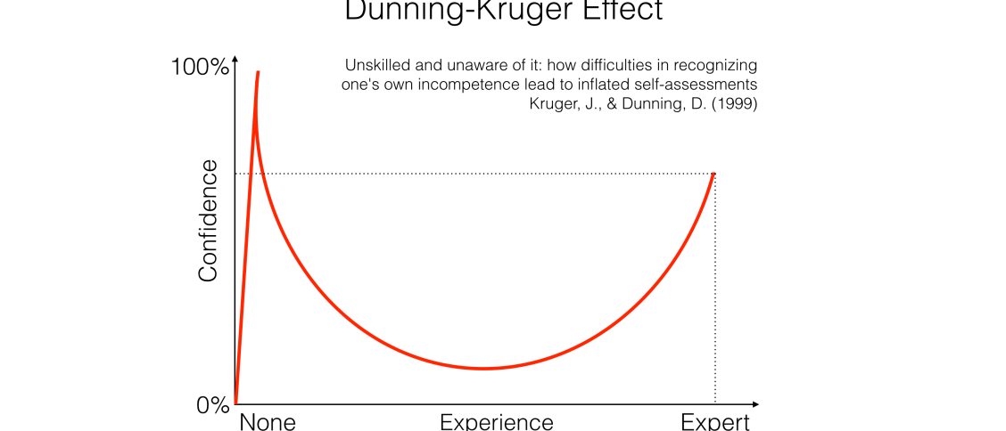
The Challenges of Conducting Failure Investigations in the Oil & Gas and Petrochemical Industries
The Confidence vs. Experience Stand-off! The Dunning-Kruger Effect
Less experienced personnel vs. the experienced ones!

Slide 12
The Challenges of Conducting Failure Investigations in the Oil & Gas and Petrochemical Industries
The Third-party Investigation Team
A third party may be motivated by the need for customer satisfaction to finish an investigation quickly. This can negatively impact the added value of the failure analysis report.

Slide 13
The Challenges of Conducting Failure Investigations in the Oil & Gas and Petrochemical Industries
The “Hiding” Syndrome
Picking the most convenient/suitable findings and ignoring the “cannot be explained” findings.
Potentially critical findings that have been ignored by the investigators may be the cause of major incidents.

Slide 14
Thank You

