Slide 1

TUBE FAILURE IN MAIN ACID COOLERS IN SULFURIC ACID PLANTS BY: SELVARAJAN ZACHARIAH

Slide 2
Process description
Construction & Opration details
Operation details
Failure statistics
Problems faced
Failure of tubes from OD
Failure due to vibration
Failure due to erosion of passive layer
Failure due to cavitation
Failure due to Anatrol system
Failure of tubes from ID
Continuous & Shock chlorination
Bacteria sampling
Failure due to bacteria
Failure due to intergranular cracking
Fouling due to Travelling Band Screen failure in SW system
Fouling due to in-line filter failure
Conclusion
Recommendation

Slide 3
There are 3 Trains of Sulfuric Acid Plants with a production capacity of 5,000 MTPD each, in MPC.
The produced acid will be at around 110⁰C and will be cooled in the coolers to around 60⁰C in co-current shell and tube heat exchangers.
These coolers are anodically protected.
SW is used as cooling medium. The SW is chlorinated at the pumping area at the sea front and de-chlorinated at the plant battery limit.
The tubes & tubesheet are made of super SS (Ciramet) material and the shell & baffles are made of SS 304L material.

Slide 4
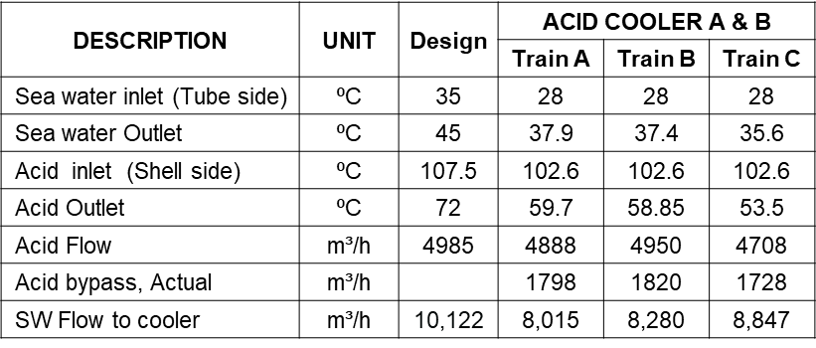
ACID COOLER – CONSTRUCTION & OPERATION DETAILS
Sl. No. | DESCRIPTION | UNIT | VALUE
1 | No. of Cooler per Train | no. | 2
2 | Shell dia | mm | 1702
3 | Design Pr.: Shell / Tube | kPa / kPa | 600 / 600
4 | Design T: Shell / Tube | ⁰C / ⁰C | 135 / 95
5 | Overall length | mm | 12979
6 | SW Inlet / Outlet | mm / mm | 800 / 800
7 | Acid Inlet /Outlet | mm / mm | 700 / 700
8 | Tube dia x thickness | mm x BWG | 19 x 18
9 | Tube length | mm | 9144
10 | No. of tubes | no. | 1760
11 | Shell material | SS 316L
12 | Tube material | Ciramet (20-22-5Mo)
13 | Baffle material | SS 304L

Slide 5
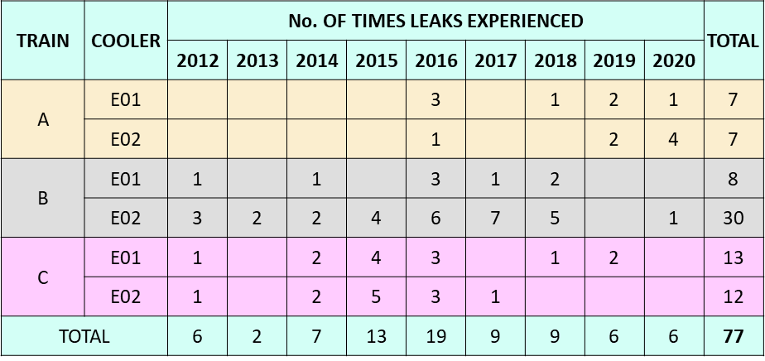
FAILURE STATISTICS

Slide 6
PROBLEMS FACED
Failure of tubes from OD (from acid side)
Failure of tubes from ID (from SW side)
NOTE: As the problem was chronic, the total system was
studied to eliminate the problem

Slide 7
FAILURE OF TUBES FROM OD (FROM ACID SIDE)

Slide 8
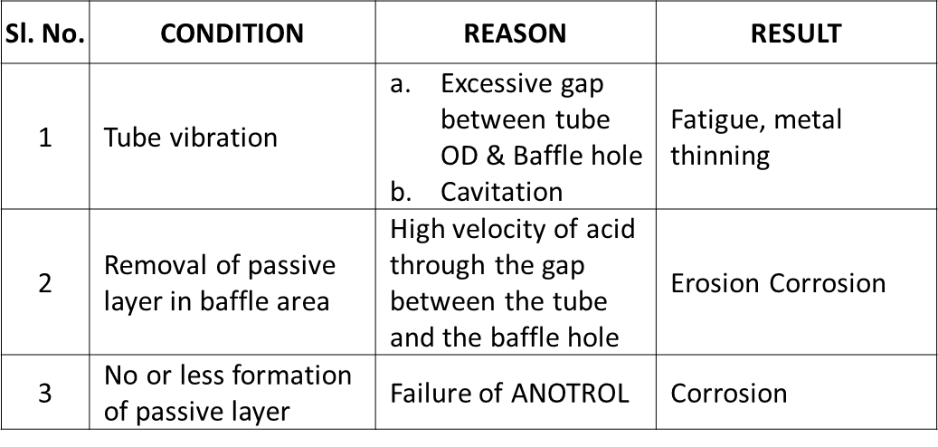
FAILURE OF TUBES FROM OD

Slide 9

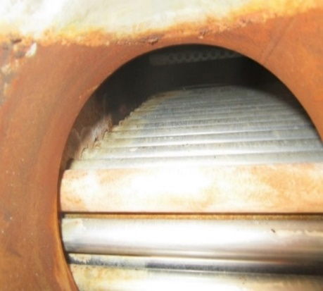
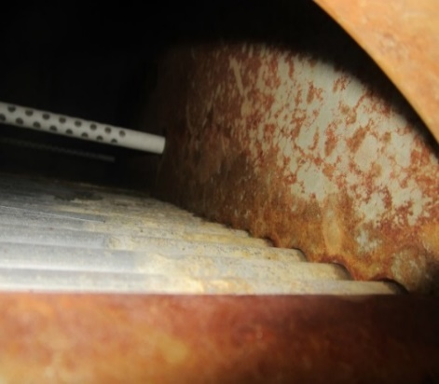
FAILURES DUE TO VIBRATION
Gaps between tubes & holes in baffles
Gaps between tubes & holes in baffles

Slide 10
EROSION OF PASSIVE LAYER
REMEDIAL MEASURE:
This happens in the baffle hole area.
To eliminate this problem, the ∆P across the baffle to be as minimum as possible. Presently it is very high.

Slide 11
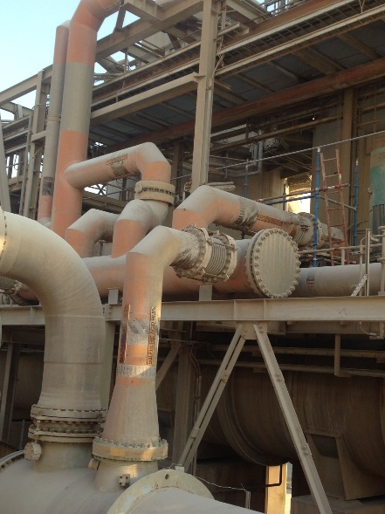
CAVITATION DUE TO PIPING CONFIGURATION
Air/ Gas venting
Pump Discharge
Header
Down comer
Acid Cooler

Slide 12
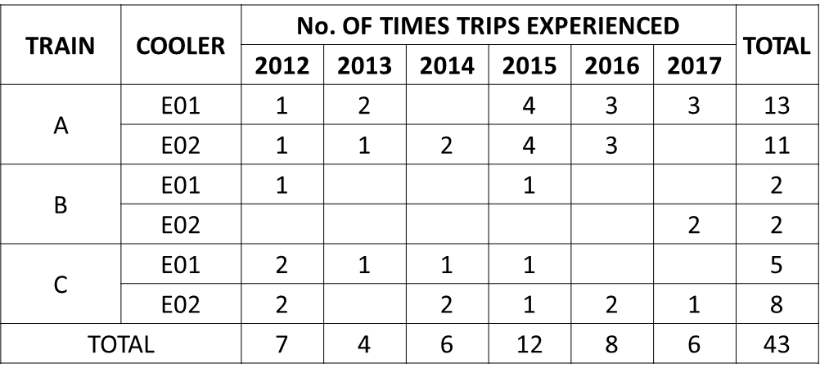
ANOTROL SYSTEM
FAILURE STATISTICS OF ANOTROL SYSTEM

Slide 13
ANOTROL SYSTEM, contd.
THIS HAPPENS DUE TO EITHER:
Failure of Anotrol system
Switching off Anotrol system for a long time
REMEDIAL MEASURE:
Any system problem shall be solved within say, 12 hrs.
The system shall be continuously “ON” and the current settings to be maintained as provided by OEM as shown in the Table below:
Sl. No. | DESCRIPTION / SETTING | UNIT | VALUE
1 | Control set point | mV | 300
2 | Control high alarm | mV | 450
3 | Control low alarm | mV | 150
4 | Outlet potential RA~RD high alarm | mV | 650
5 | Band | mV | 100

Slide 14
FAILURE OF TUBES FROM ID (FROM SW SIDE)

Slide 15
CONTINUOUS & SHOCK CHLORINATION
Sl. No. | CONDITION | REASON | RESULT
1 | Continuous & Shock Chlorination (OSBL)
 | Less/ Nil | Deviation from Design requirement | Pitting
 | High Chlorination |  | Intergranular cracking
2 | Dechlorination (ISBL)
 | Less/ Nil | Deviation from Design requirement | a. Bio filming leading to pitting b. Intergranular cracking
3 | Cooler Tubes
 | High tube temperature | a. Less SW flow b. Bio-fouling c. Tube blocking | Intergranular cracking/ Pitting
BACTERIA COUNT (DESIGN VS ACTUAL)
DESCRIPTION | DESIGN | TRAIN
 |  | A | B | C
Continuous chlorination | 15/ CC, Max. | 10 to 29 | 12 to 50 | 10 to 32
Shock chlorination | 5/CC, Max. | 4 to 7 | 5 to 10 | 5 to 6

Slide 16
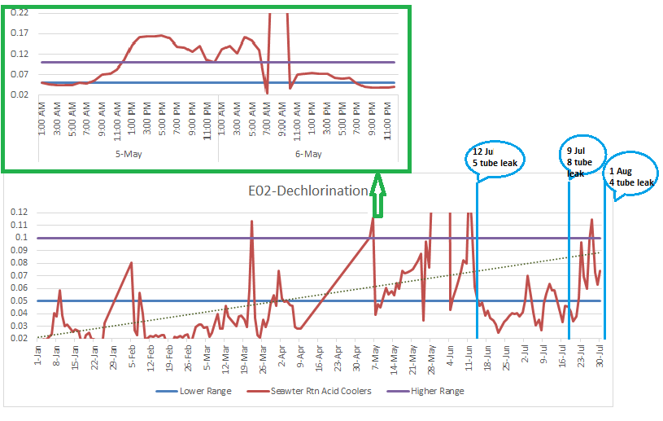
DECHLORINATION DURING CONTINUOUS CHLORINATION - TREND
REQUIREMENT (at cooler outlet – as per Design)
Sl. No. | CONDITION | CHLORINE LEVEL ppm
1 | Continuous chlorination | 0.05 to 0.1
2 | Shock chlorination | 0.8 to 1.1

Slide 17
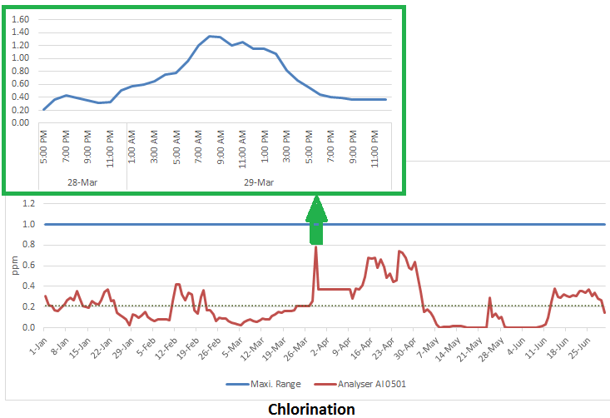
DECHLORINATION DURING SHOCK CHLORINATION - TREND

Slide 18
BACTERIA SAMPLING (Bacteria/cc) & BIO FILM
DESCRIPTION | DESIGN | VALUE
 |  | TRAIN A | TRAIN B | TRAIN C
Continuous chlorination | 15/ CC, Max. | 10 to 29 | 12 to 50 | 10 to 32
Shock chlorination | 5/CC, Max. | 4 to 7 | 5 to 10 | 5 to 6

Slide 19
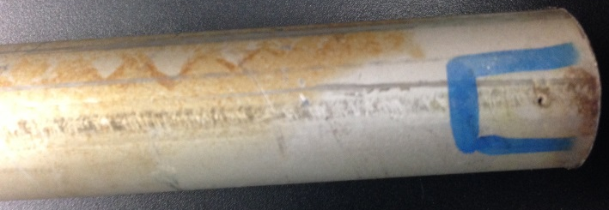
FAILURE DUE TO INTERGRANULAR CRACKING & PITTING
Intergranular cracking
Pin hole due to pitting

Slide 20
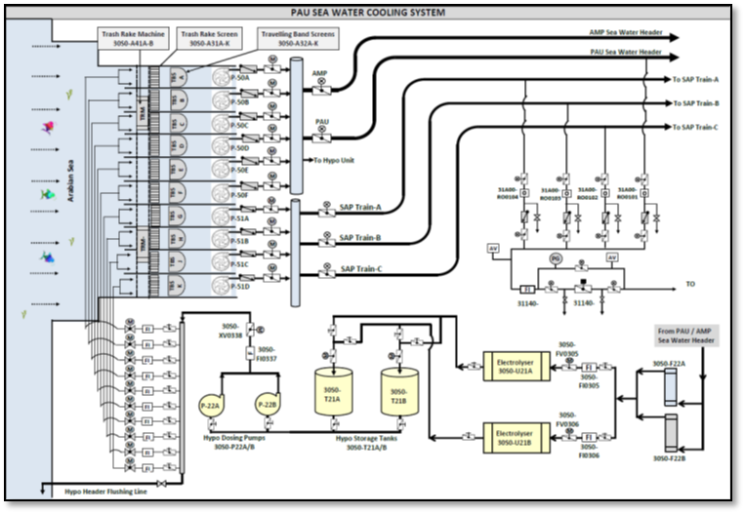
SEAWATER PUMPING SYSTEM
SAP SW Pumps

Slide 21
Sl. No. | DESCRIPTION | VALUE
1 | Type | Dual Flow
2 | Material | Polypropylene carbonate
3 | Mesh size | 5 mm
4 | Immersion height
 | a. @ HWL | 9.48m
 | b. @LWL | 7.38m
5 | Width | 4560mm
6 | No. of mesh panels | 52
7 | Size of each panel | 4165 x 634 mm

Slide 22
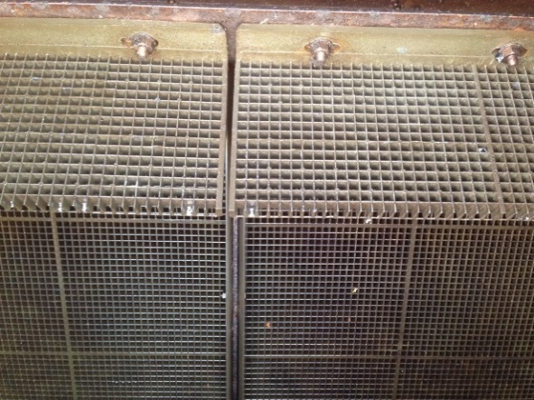
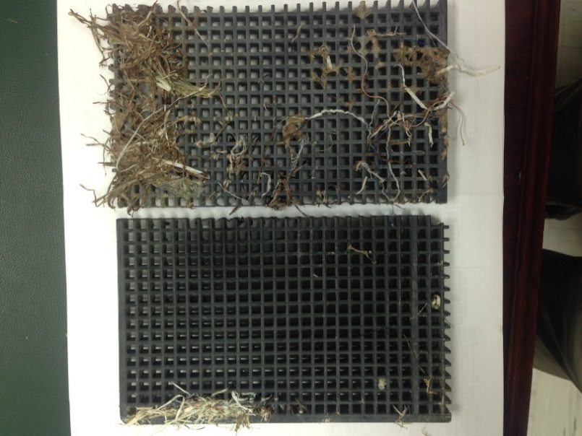
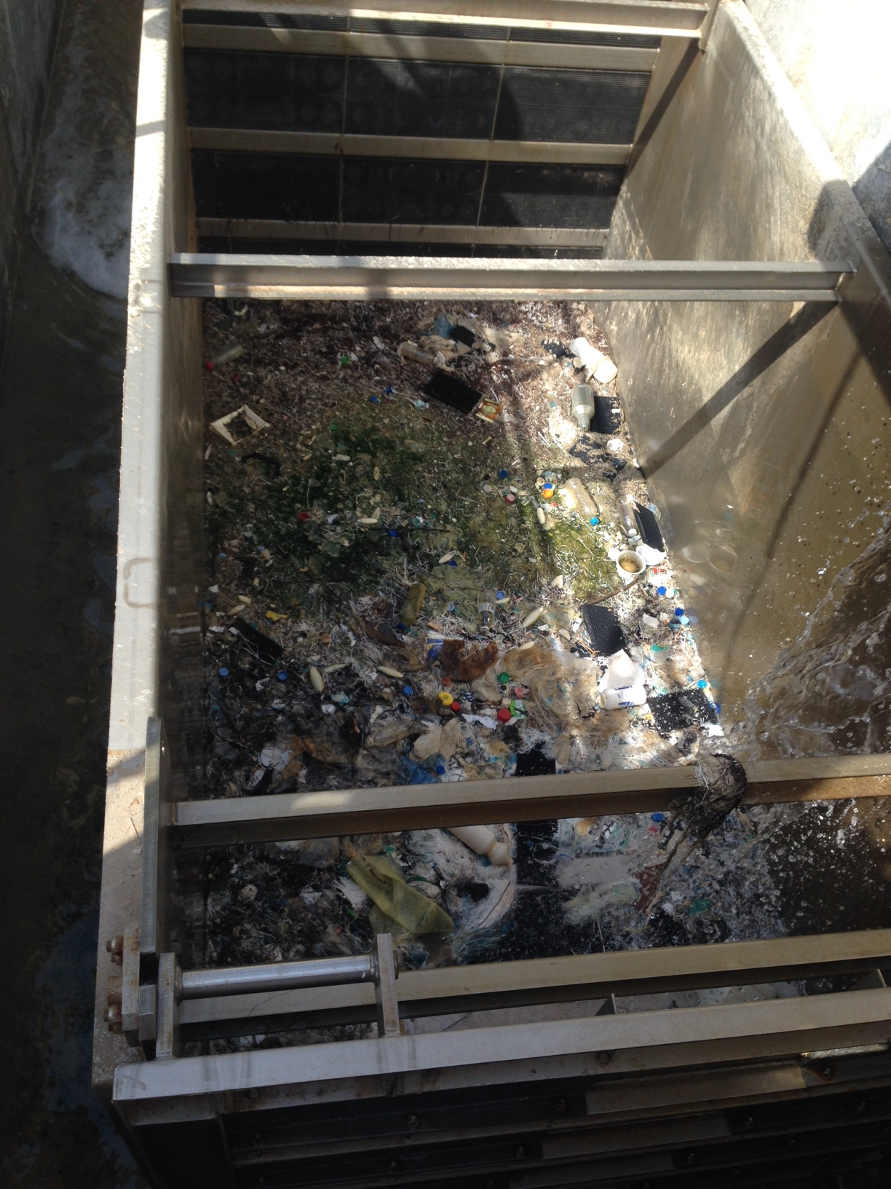
PROBLEMS ASSOCIATED WITH TRAVELLING BAND SCREEN (TBS)
Screen element
Broken screen element
Trash from TBS

Slide 23
ISSUES WITH IN-LINE FILTER IN EACH TRAIN
DESIGN:
It is a conical filter with 5mm opening
Provided with a rotary scraping arm, driven by externally mounted drive system
Debris removed by in-flowing water; flow established due to ∆P between supply & return SW
PROBLEM:
The drive system failed & operated manually
SW is continuously wasted to the tune of 600 to 700m³/hr.
Debris of size ˂ 5 mm escape into the cooler and get deposited in low flow regions, resulting in pitting corrosion
Filter chocking results in less water flow to the cooler and results in high temperature in the tubes.

Slide 24
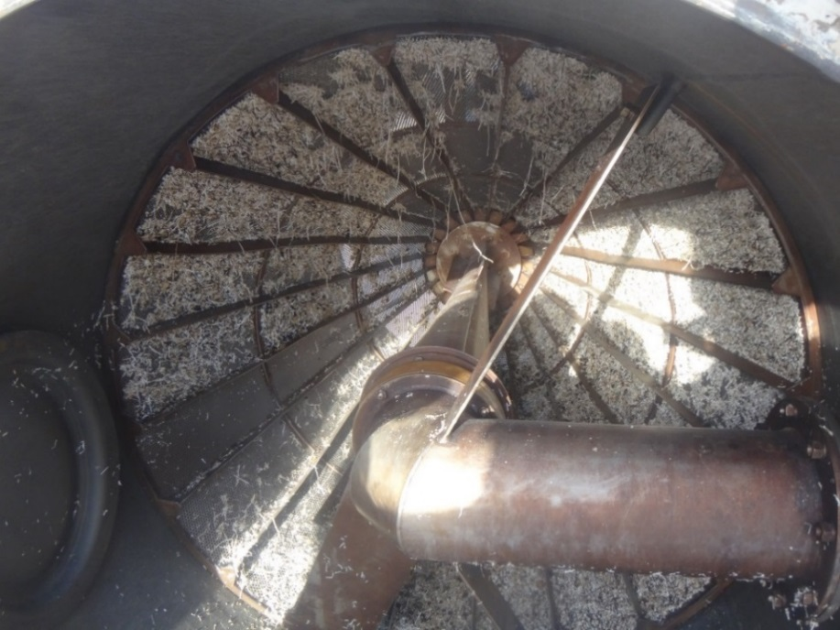
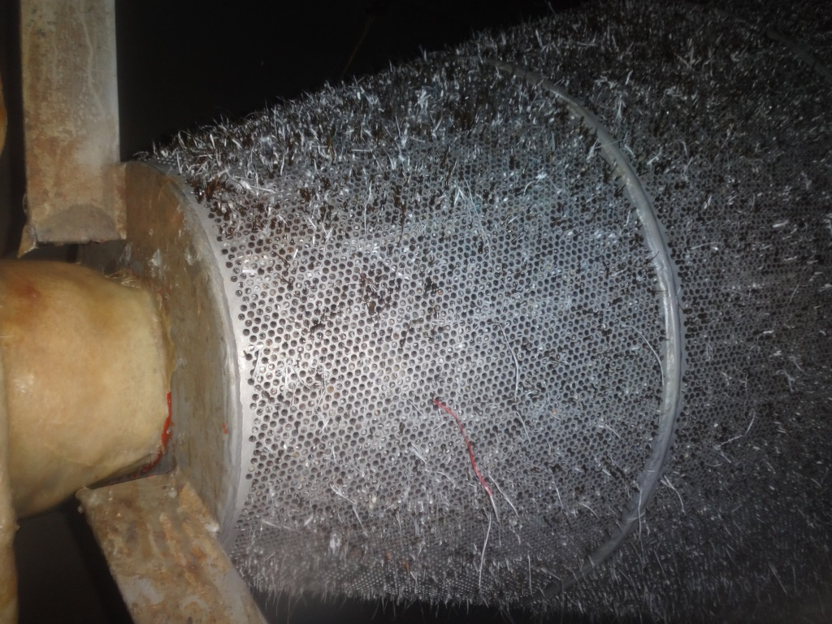
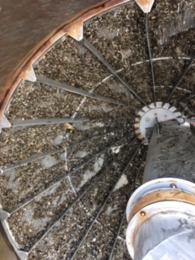
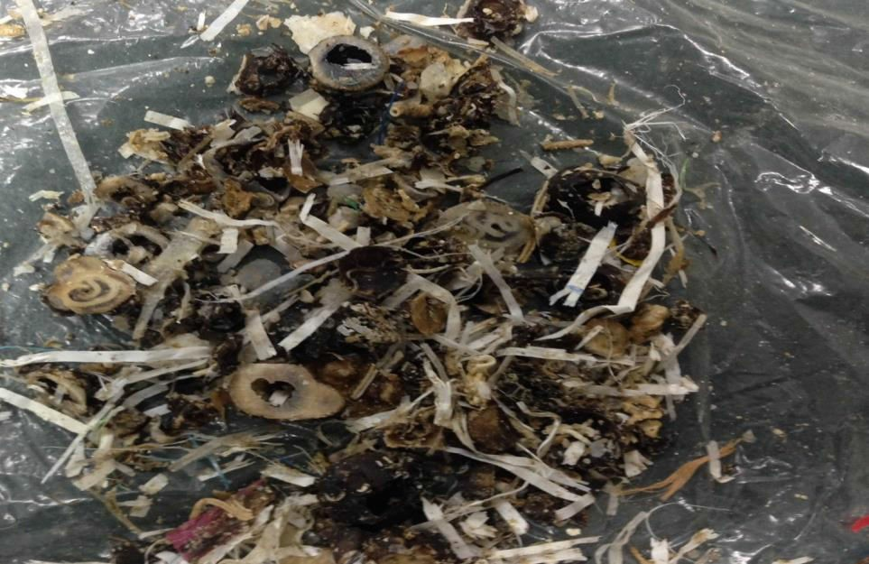
CHOCKED IN-LINE FILTER IN THE PLANT

Slide 25
CONCLUSION
Tube vibration resulting in fretting in the baffle locations
Erosion corrosion due to high velocity of acid flow through the baffle holes
Excessive uniform corrosion on the OD due to improper maintenance of anodic protection system
Improper chlorination, shock chlorination & dosage of SBS, result in intergranular corrosion
Pitting due to under deposit corrosion (MIC – Microbiologically Induced Corrosion)
Plugging of tubes due to failure in TBS / in-line filter. Results in high temperature in the affected tube(s), leading to accelerated Inter Granular Corrosion (IGC) as well as bio-film formation
Immediate non plugging of leaking tubes leads to tube to tubesheet (outlet) corrosion
No venting of entrapped gasses in the acid pipe downstream of acid pumps, which leads to cavitation in the acid coolers
Wastage of approx. 600m³/hr per train of SW from the self-cleaning of filters, which could be advantageously used in cooling the acid

Slide 26
RECOMMENDATION

Slide 27
Thank You

