Slide 1


Investigation on Fire Tube Boiler Failure from CO2 Generation Unit in Jubail Plant
Eng. Abdulrahman Alenazi
Corrosion department

Slide 2
Content
Introduction
Experiment procedure
Distractive and non distractive test
Analysis results
Conclusion
Recommendations

Slide 3
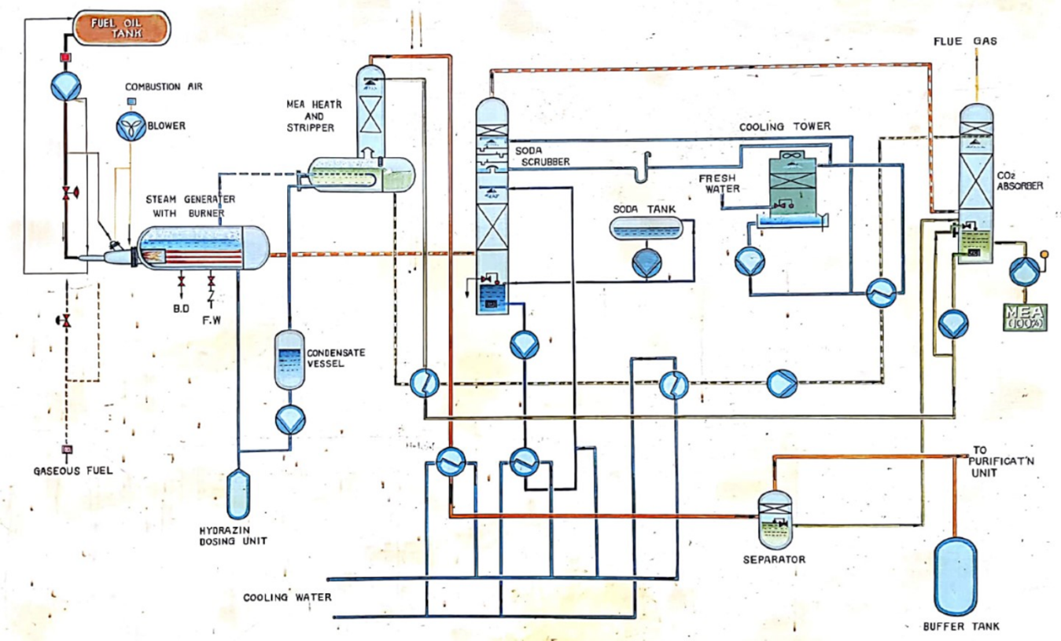
Introduction
The objective of the plant was to generate high purity CO2 for product water post treatment.
The generated pure CO2 combined with distillate water to give the desirable amount of calcium carbonate hardness in the blending station.
Schematic drawing of CO₂ generation plant

Slide 4
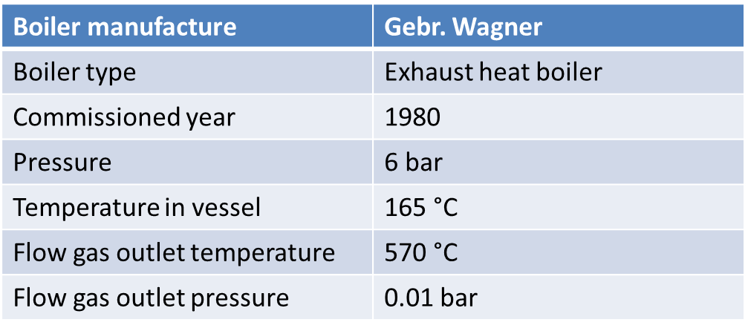
Introduction
Retubing of steam generator was carried out on 2013.
Inspection was carried out on 2014.
They found hard internal deposits with corrosion on the internal surfaces of the old tubes.
Technical and design specifications of Boiler

Slide 5
Experimental procedures
Non destructive test (NDT) include:
Visual examination and a magnifying glass.
Destructive test (DT) include:
Chemical composition
Microstructure
Mechanical properties
SEM-EDX
Electrochemical study.

Slide 6
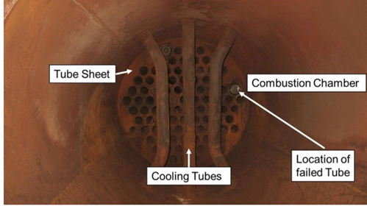
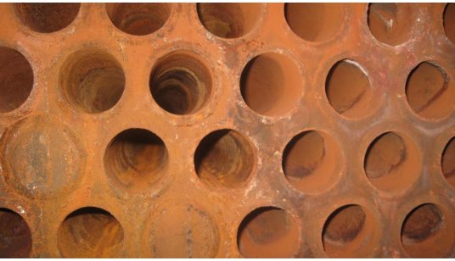
Visual examination
Burner area (Combustion Chamber, Cooling Tubes & Tube Sheet).
Close view of tubes & tube sheet.
Figures show the burner area (combustion chamber, Cooling Tubes & Tube Sheet) taken during the plant visit.
The figures showed reddish color cover the area of combustion
chamber.
The right figure show Close view of tubes & tube sheet.

Slide 7

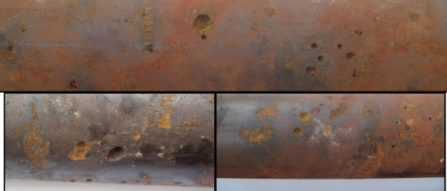
Visual examination
Tube in as received condition
The long tube was cut into two tubes (Burner side & far away from the burner)
Close view of Pitting Corrosion in received tube
Many pits were observed in the tube.

Slide 8
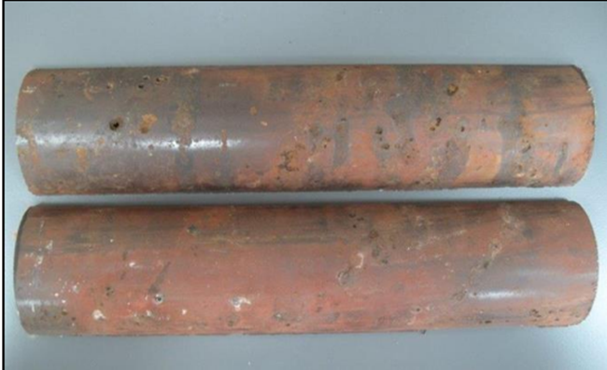
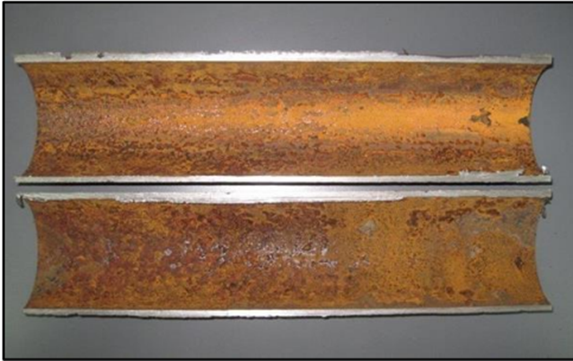
Visual examination
Pitting & Corrosion aspects of external tube surface after split
Corrosion aspects of internal tube surface after split
Some pits has sharp edges and covered by reddish brown color. This pits covered with the deposits of corrosion product indicates the remaining activity of these pits.
The internal surface indicate oxide layer as it covers with Yellowish brown thin layer while the external surface shows the widespread of pitting over the tube surface.

Slide 9
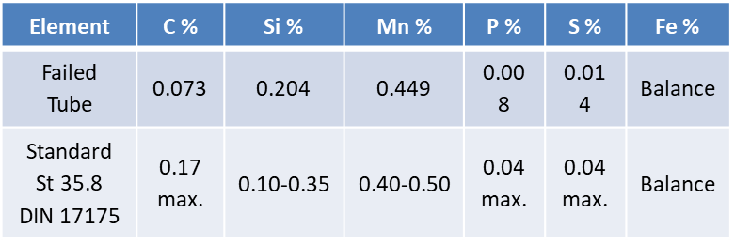
Chemical composition
Material Composition of Failed tube boiler by OES & CS.
The Table shows the results of the analysis which is typically St 35.8 DIN 17175 seamless boiler tube alloy steel.

Slide 10
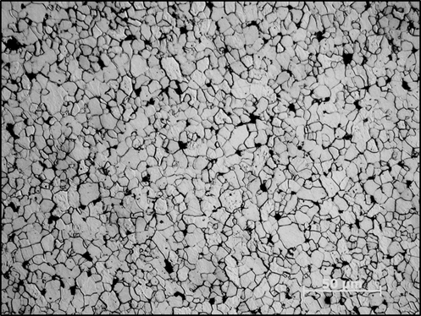
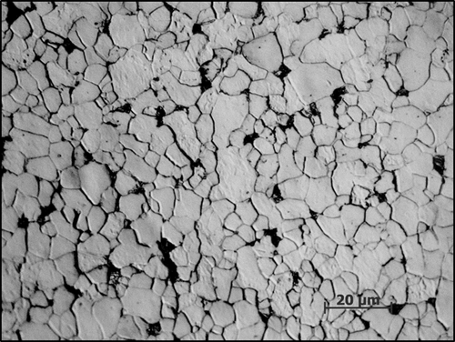
microstructure
Microstructure of failed tube at 500 x magnification
Microstructure of failed tube at 1000 x magnification
Figures shows the microstructure obtained from failed tube.
The microstructure is a ferrite matrix (nearly pure iron) with pearlite structure with advance degradation of pearlite lamellar.

Slide 11
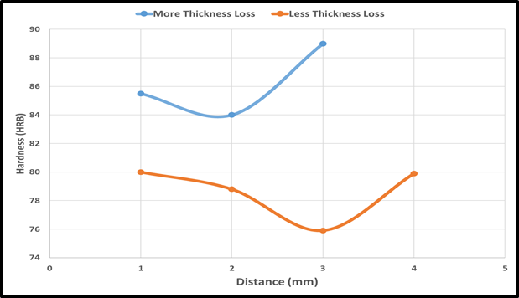
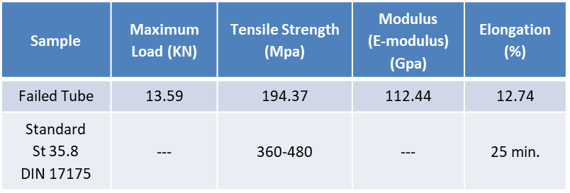
Mechanical properties
Mechanical Properties of fire tube boiler
Mechanical Hardness of failed tube from internal to external surface
The hardness of the cross-section samples at the edges was higher than the center region.
The hardness was higher in the sample contains more pits that can be linked to microstructure.

Slide 12
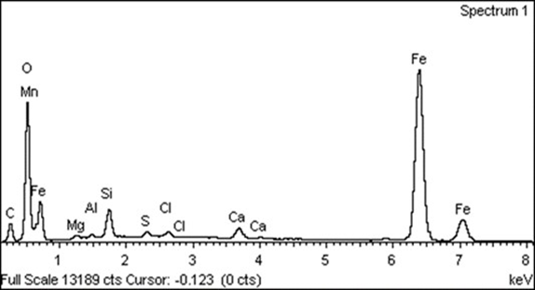
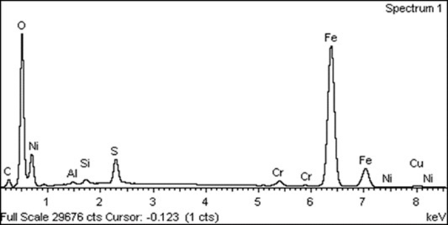
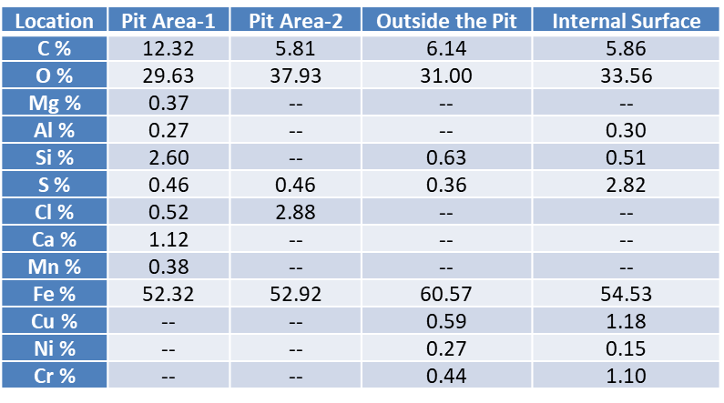
SEM-EDX
SEM-EDX Spectrum obtained in the pit area-1
SEM-EDX Spectrum obtained in the internal surface of the tube
Elemental composition analysis by SEM-EDX

Slide 13
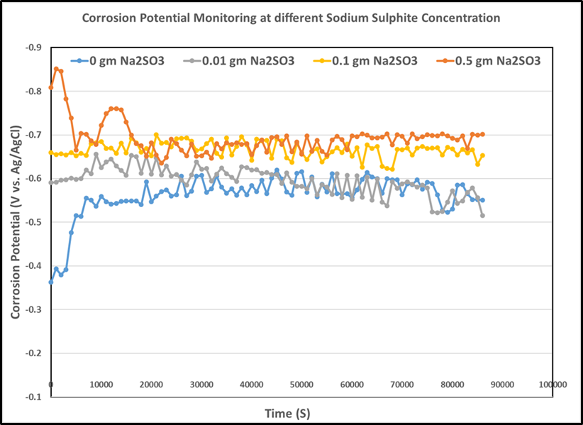
Electrochemical
Free Corrosion Potential with time for St 35.8 DIN 17175 steel grade immersed in different concentration of sodium sulphite.

Slide 14
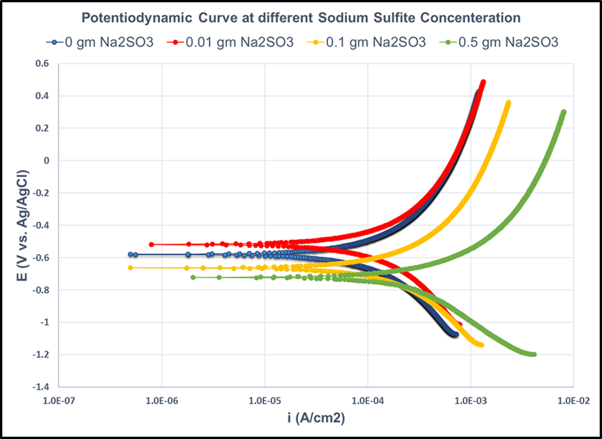
Electrochemical
Potentiodynamic Polarization curves for St 35.8 DIN 17175 steel grade immersed in different concentration of sodium sulphite.

Slide 15
CONCLUSION
The mode of the failure was oxygen pitting corrosion.
The improper dosage of sodium sulphite as oxygen scavenger and presence of chloride in the feed water accelerate the corrosion process.
The preservation of the boiler during long outage was not properly followed.
The root cause of the boiler tubes failure is the wrong preservation of the boiler during outage period.

Slide 16
Recommendations
Optimum dosing of the sodium sulphite need to be maintain during start-up & normal operation to suppress the effect of dissolved oxygen in boiler feed water.
The correct lay-up procedure of the boiler during outage need to be followed as recommended by manufacturer.

Slide 17
Thank You

