Slide 1
Erosion corrosion of HastelloyC-276 Piping in residue service
Presented by:
Vijaykumar Bhuva
Static Engineer, R&I

Slide 2
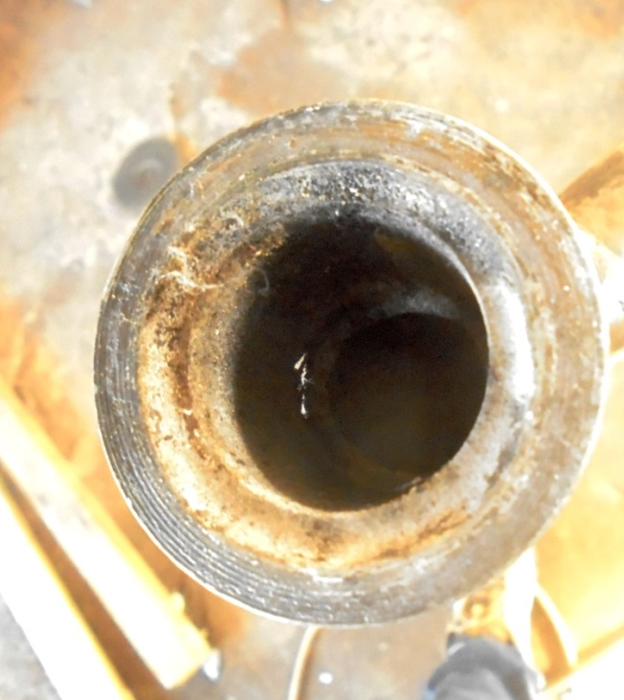
CONTENTS
INTRODUCTION
HASTELLOY C-276
RESIDUE SYSTEM
INSPECTION FINDINGS
FAILURE ANALYSIS
DAMAGE MECHANISM
ENHANCEMENT ACTION
RESULTS SUMMARY

Slide 3
INTRODUCTION
Piping handling hazardous Residue services
Any leakage- leading EHSS concerns, stoppage of unit
Piping material: Hastelloy-C276
Piping material having issue with corrosion, these Leading frequent leakages
Frequent leakages reported from Piping components in past
Detailed study had been conducted for frequent leakages

Slide 4
RESIDUE SYSTEM
1” Min. Circ. line,
DT: 205 °C, OT: 105-115°C,
DP: 10 bar, OP: 6 bar
FO
Residue Vessel
Heavy Residue
H2SO4
(5-15%)
Acetic acid
Water
Other HC
2” Discharge
Residue Transfer Pump

Slide 5
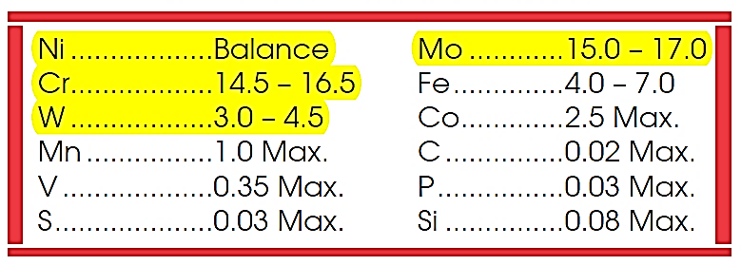
HASTELLOY C-276 MATERIAL
Hastelloy C-276
UNS N10276
Excellent corrosion resistant
Proven- Aggressive process

Slide 6
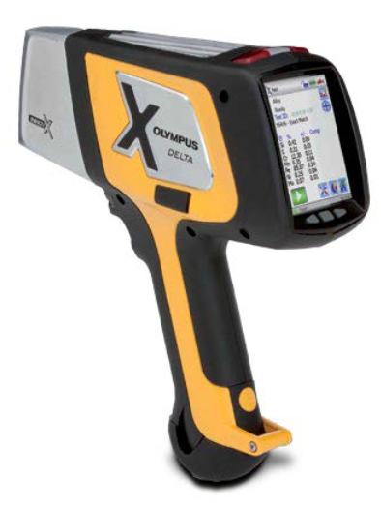
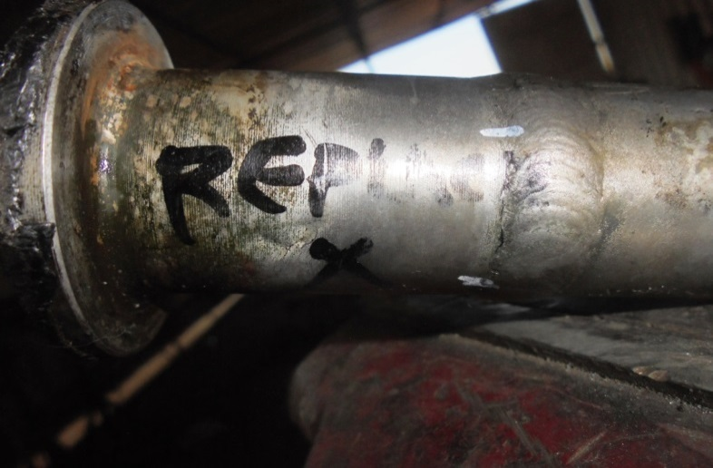
INSPECTION FINDINGS
Severe Corrosion
Leakages
PMI
Highest corrosion rate 0.60 mm/year

Slide 7
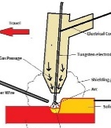
FAILURE ANALYSIS- HYPOTHESIS
NON-SPEC. MATERIAL
WELDING ISSUE
CORROSION
EROSION CORROSION
PMI Testing & MTC
Material as per speciation
Improper Welding-
QA/QC procedure
PWHT
Solution annealing procedure
Corrosion
Observed on similar service piping
Further Analysis Required
Ruled out
Possible
Ruled out
Possible

Slide 8
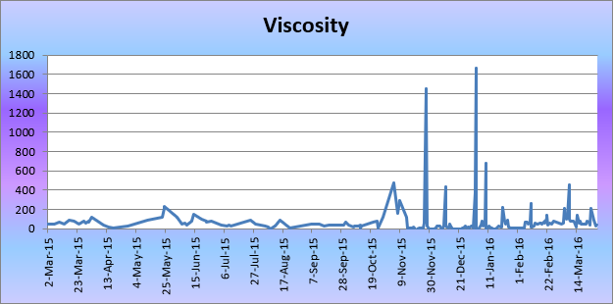
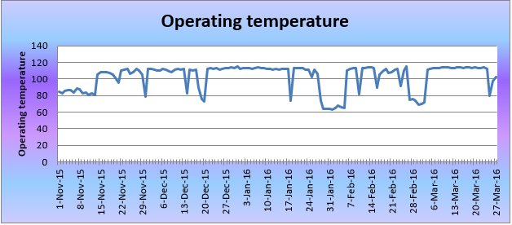
DAMAGE MECHANISM
High Velocity
Flushing practice
Line Size 1”,
FO Has been removed
Erosion Corrosion
& Corrosion
Chocking issue
LP and MP steam utilized for de-chocking
Varying fluid viscosity
Operating Fluid
Specification: 40 CP
Actual range- 17 to 1667 CP
105-115°C
5-15% Sulfuric acid

Slide 9
DAMAGE MECHANISM
Operating window

Slide 10
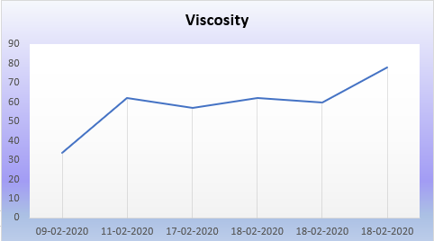
ENHANCEMENT ACTION
Improve Operation
Control Viscosity
Range of 20-80 CP by additional acetic acid for dilution
Flushing practice
Avoid steam flushing
Utilization of Hydrokinetic technique for cleaning
Resizing
(Design)
Resized from 1” to 2”
Involved Licenser for feasibility
Resizing calculation
Velocity calculation
Hydraulic calculation
Proper FO size calculation
PWHT treatment
Solution annealing treatment for Hastelloy material to reduce corrosion
Material Upgradation
PTFE lined
1. Liner Failure
2. Electrical tracing limitation
3. Chocking of lines
Tantalum
1. Very Expensive
2. No Experience
3. Chances of Hydriding
Zirconium
1. Less Expensive
2. Proven Experience
Operating temperature reduction
X

Slide 11
RESULTS SUMMARY
No erosion corrosion after Resizing with Zirconium
Improve integrity of piping system
Zero leakage goals have been achieved.
Note:
Special attention to be given for Acid service material selection while designing any plant equipment or piping
Only minor change in concentration, chemical composition or temperature will affect equipment material selection

Slide 12
Thank You

