Slide 1

INSPECTION & REFURBISHMENT OF
SOIL-TO-AIR CONCRETE CYLINDER PIPE (CCP)
Author : MOHAMMED IMTIYAZ ALI
Inspection Engineer
SABIC Agri-Nutrients

Slide 2
CONTENTS
BACKGROUND
PROBLEM STATEMENT
INSPECTION & FINDING
REFURBISHMENT APPROACH AND STAGES
ACHIEVEMENTS

Slide 3
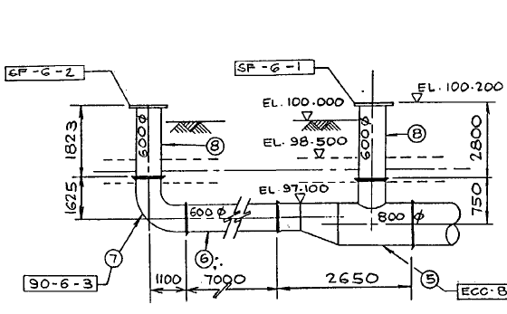
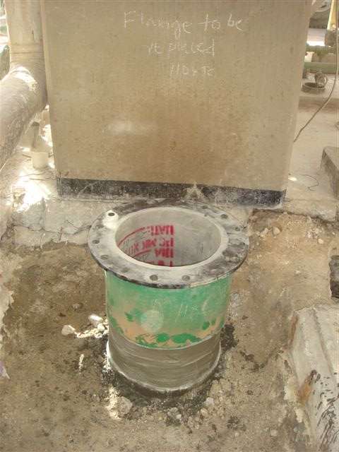
Background of Seawater and Cooling water CCP Lines
Constructed (30+ years ago) Plant Underground Seawater and Cooling water Network is of CONCRETE CYLINDRICAL PIPE (CCP), connected to above ground Equipment's for Supply & Return system through Elbows & TEE components at Soil to Air Interface (below ground to above ground). These are Pipe STUB’s

Slide 4
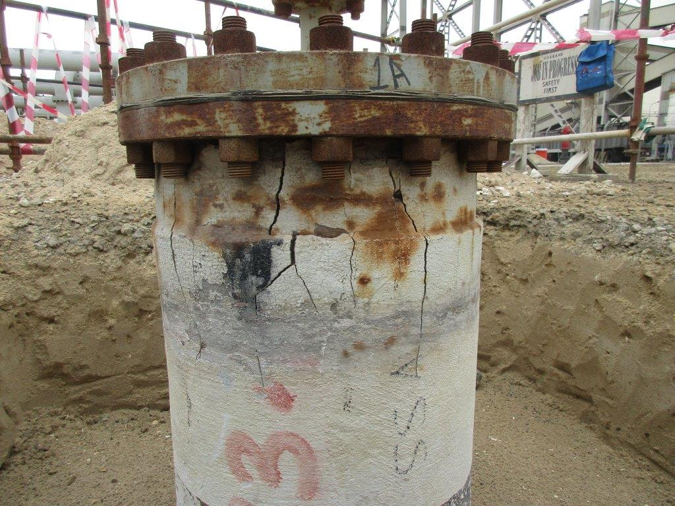
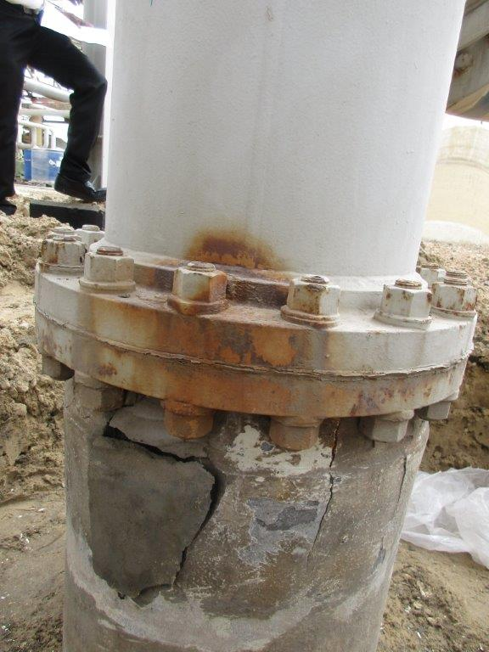
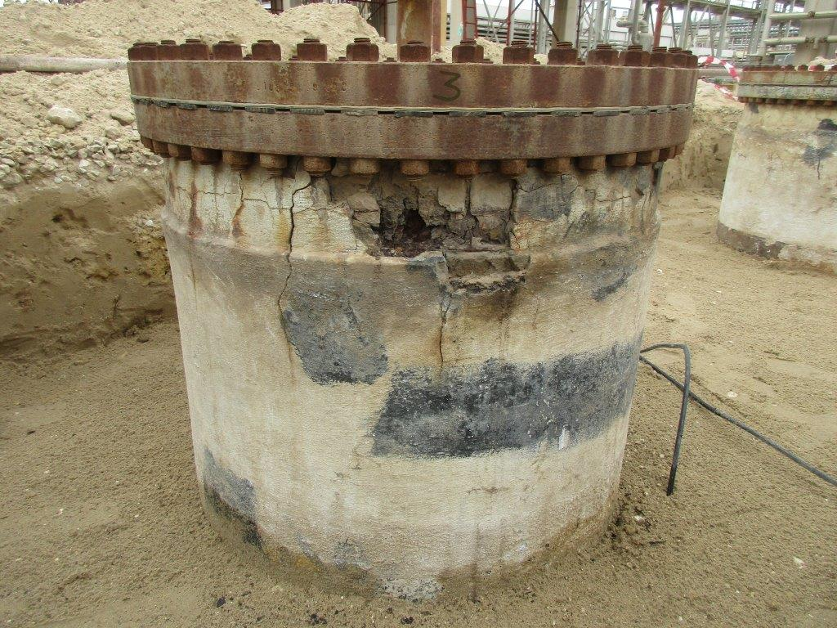
PROBLEM STATEMENT
Plants aging and the STUBs were in service from the commissioning of the plant in supplying the Sea Water and Cooling Water to plant Equipment's, over a period of time some of the STUBs transition zone (Soil to Air) were under severe external weathering effects, as a result developed deteriorations in external cement lining and caused the lining to crack and spall exposing the CS cylindrical, rusting and posing the risk of PIPE RUPTURE.

Slide 5
Inspection & Findings in Cement Lining of Stubs
STUB’s External Inspection Strategy
  Exposed by excavation 800mm Pipe stub at Soil-to-Air Interface.
  Conduct Hammer tap survey for surface Cement lining and mark cracks & delamination.
  Chip-out to expose the Pipe CS cylinder of Delaminated Cement lining.
Typical Inspection observations as below.
  Exposed CS cylinder external surface observed Rusted. Corrosion extended below ground for a depth of 100-500 mm and Carbon steel cylinder thickness loss.
  STUBs Carbon steel cylinder were found with holes large enough to Pipe Rupture.
  Further Internal Cement lining were found with cracks & pitting.

Slide 6
Refurbishment stages & Methodology.
Step-1
Grit blast cleaned the exposed external Corban steel cylinder and perform CS Thickness measurement
Step-2
If CS thickness loss >10% : Apply Ceramitech CR/HG putty or equivalent to re-profile CS cylinder external surface
Step-3
If CS thickness total loss and created pinholes: Weld patch plate 4 mm thick extended up to health CS surface.
Step-4
Weld Crimped wire mesh (50X100X2.6mm) over the re-profiled Carbon steel cylinder.
Step-5
Apply 20-25 mm thick Cement mortar lining over external CS cylinder with welded mesh.
Step-6
Apply 6mm thick FRP lamination after curing of Cement lining

Slide 7
Achievements:
Comprehensive Inspection provided an overview of the CCP Pipe STUB condition.
Extensive repair of the Pipe STUB has extended the integrity.
Shared with SABIC-ATC as a part of Knowledge sharing at Civil-CP Domain meeting.
SABIC-ATC with concerned Affiliate Civil Engineers conducted workshop and developed a unified procedure for Inspection and Repair of CCP STUB’s and Pipeline Pits in OFFLINE and ONLINE condition.
Developed Inspection & repair procedure for STUBs is implemented in every TA to strengthening the plant Seawater Pipe Stubs integrity.
Developed & implement Inspection PM plan for STUB’s External and Internal Inspection every TA.

Slide 8
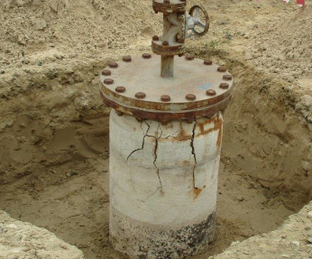
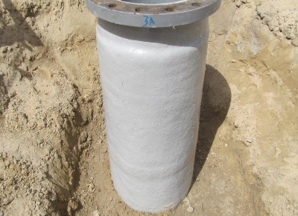
Achievements
STUB
from Risk of Rupture to Reliable condition
after Inspection & Refurbishment
BEFORE
AFTER

Slide 9

Thank You

Slide 10
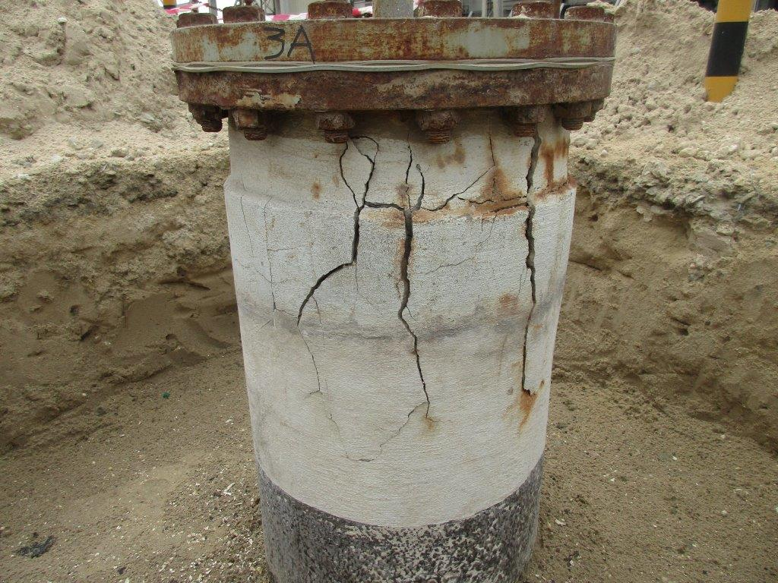
External Cracks Soil-to-Air

Slide 11
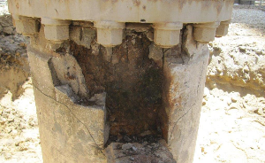
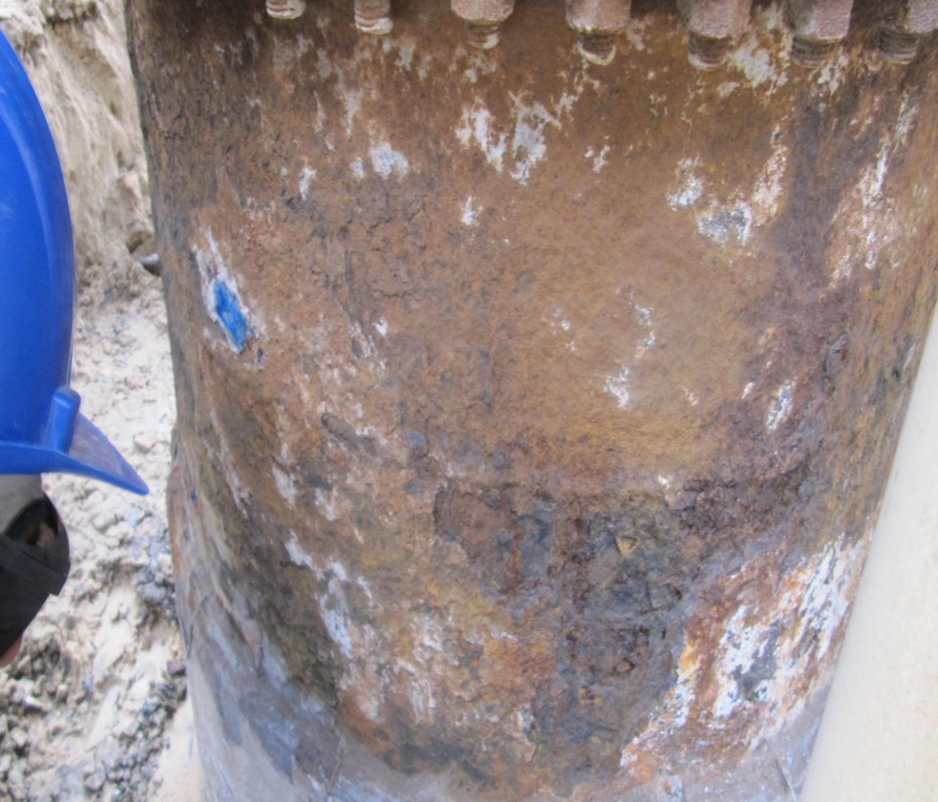
CS Cylinder with Corrosion
Inspection & Refurbishment of Soil to Air CCP Stubs – SAFCO - IMA
Classification: General Business Use

Slide 12
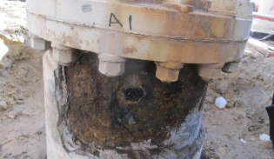
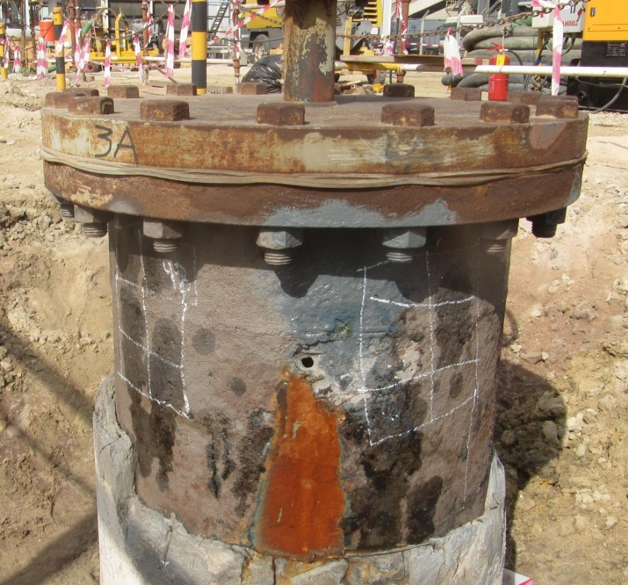

Hole in Carbon Steel Cylinder
Inspection & Refurbishment of Soil to Air CCP Stubs – SAFCO - IMA
Classification: General Business Use

Slide 13
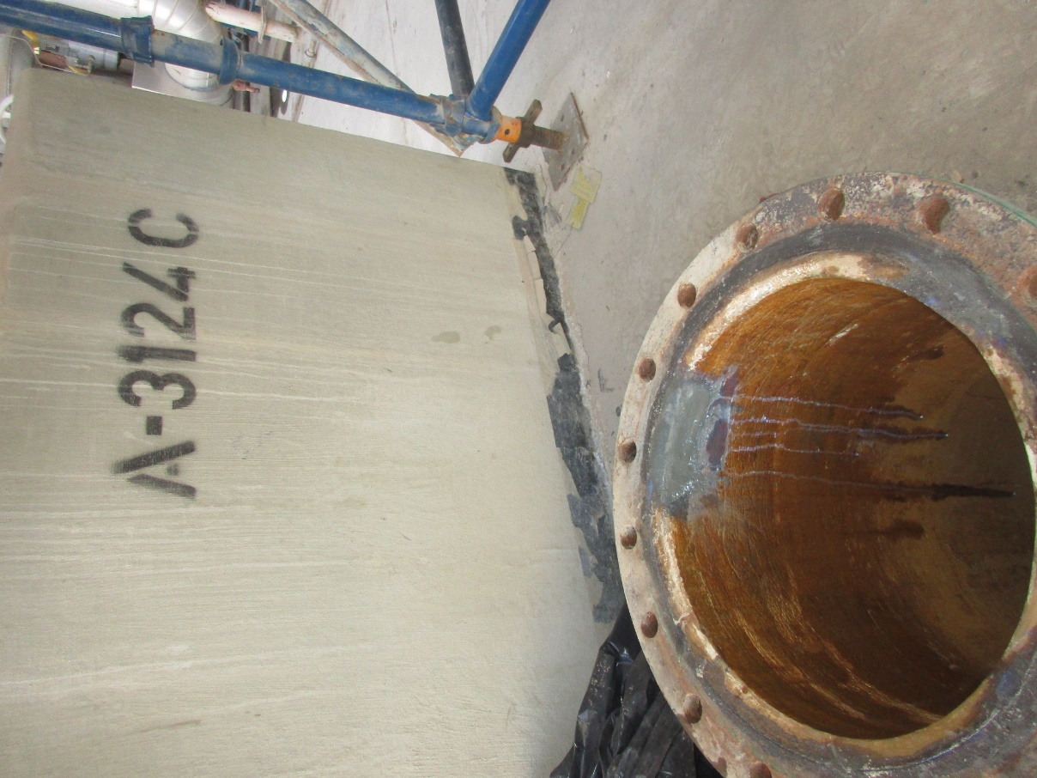
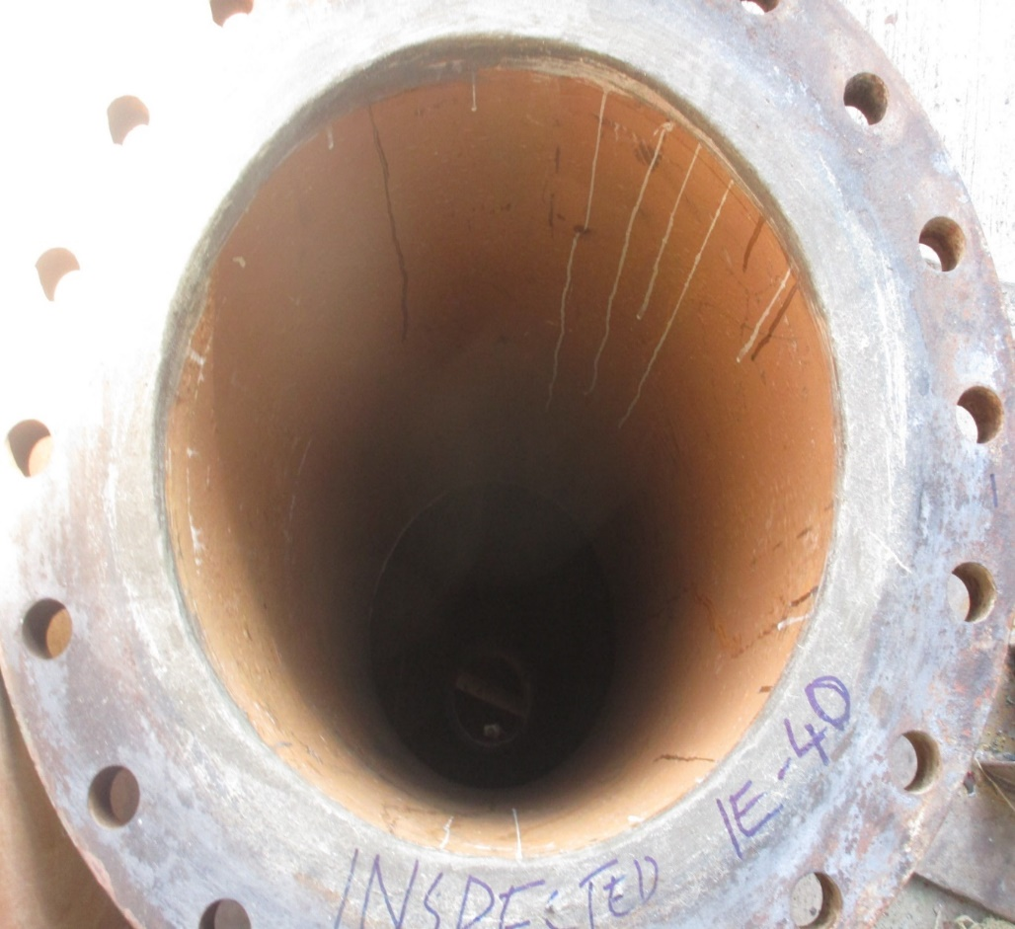
Internal Inspection
Inspection & Refurbishment of Soil to Air CCP Stubs – SAFCO - IMA
Classification: General Business Use

Slide 14
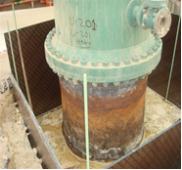
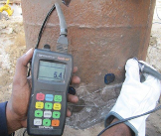
Thickness Measurement
Inspection & Refurbishment of Soil to Air CCP Stubs – SAFCO - IMA
Classification: General Business Use

Slide 15
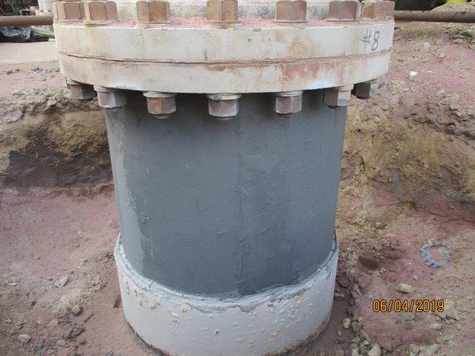
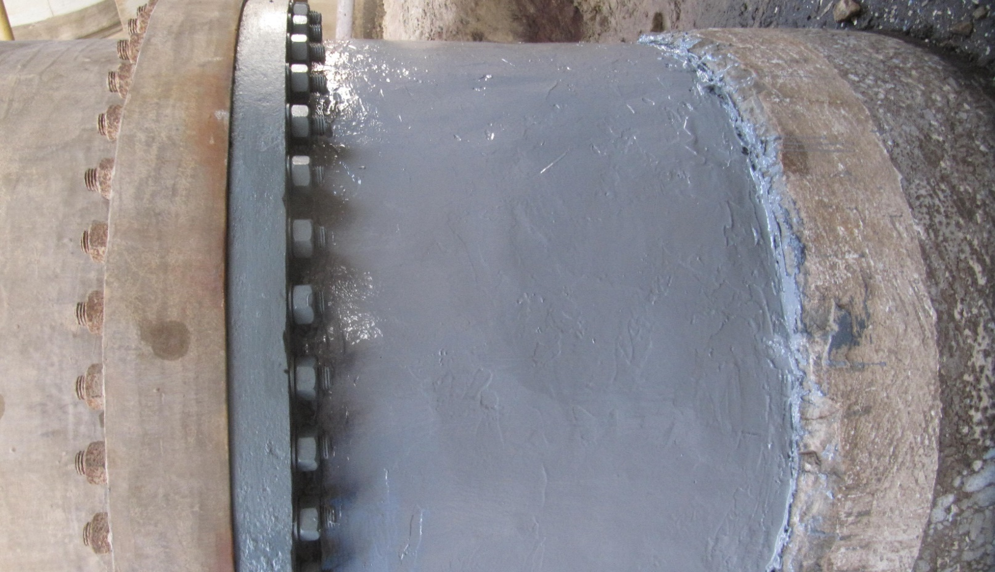
CS surface Re-profiling
Inspection & Refurbishment of Soil to Air CCP Stubs – SAFCO - IMA
Classification: General Business Use

Slide 16
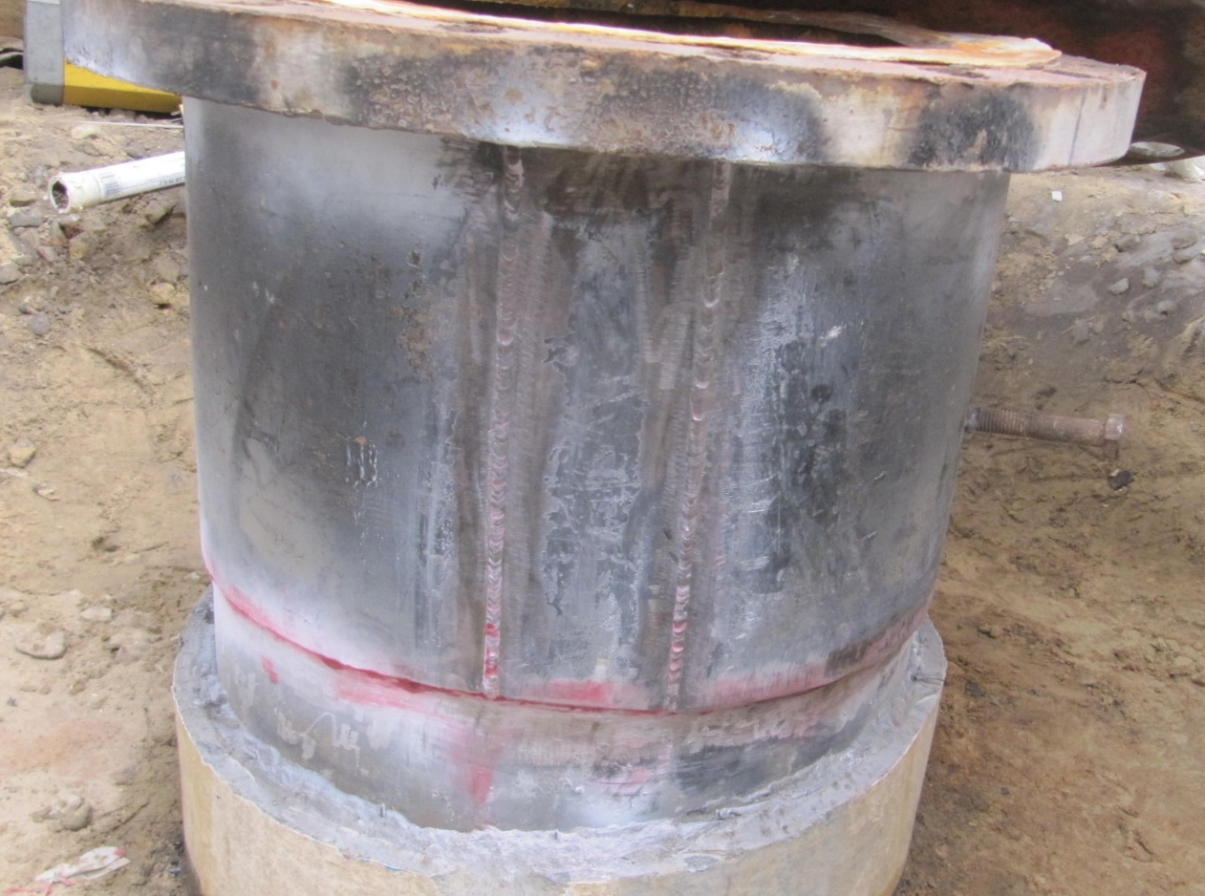
Patch Plate Weld
Inspection & Refurbishment of Soil to Air CCP Stubs – SAFCO - IMA
Classification: General Business Use

Slide 17
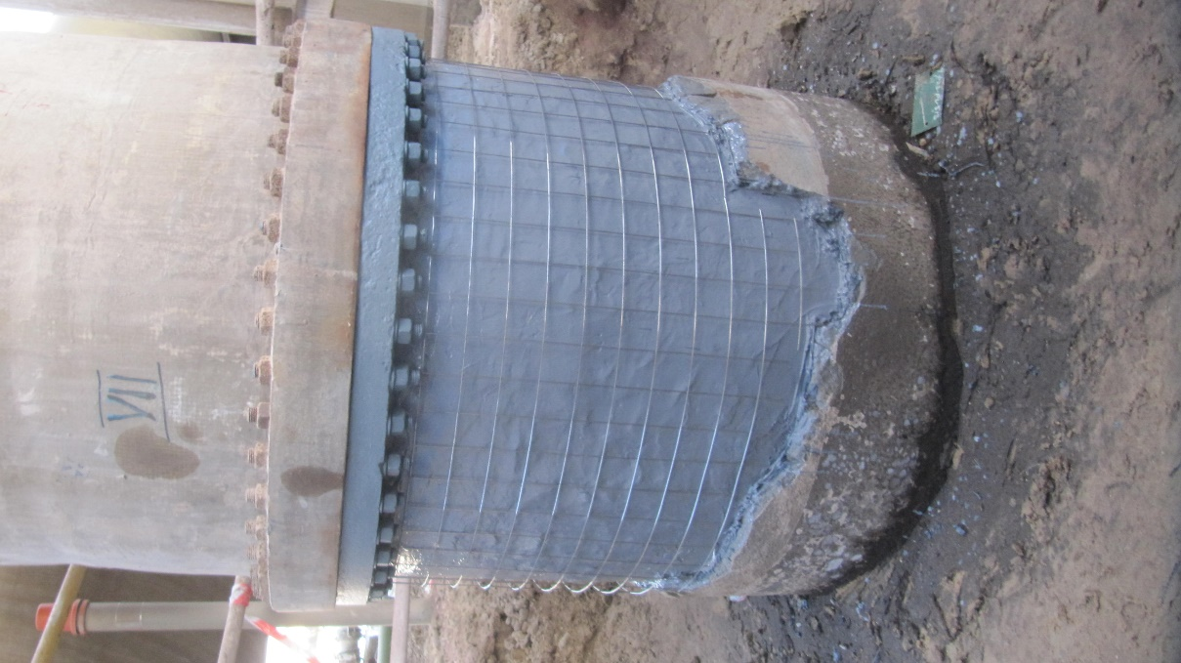
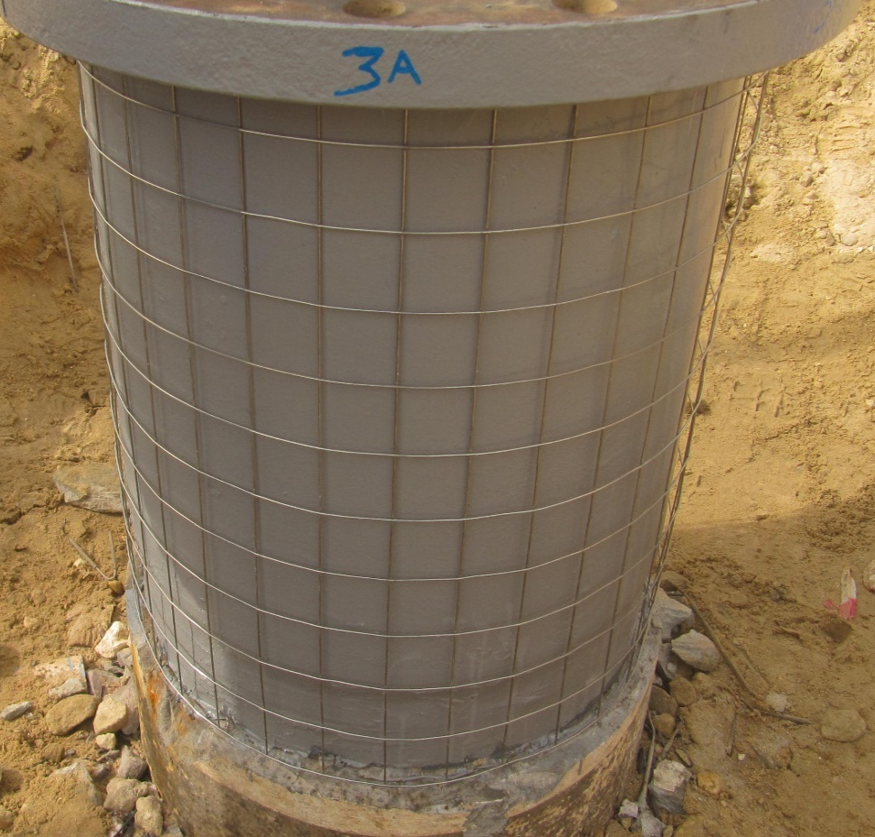
Crimped Wire Mesh
Inspection & Refurbishment of Soil to Air CCP Stubs – SAFCO - IMA
Classification: General Business Use

Slide 18
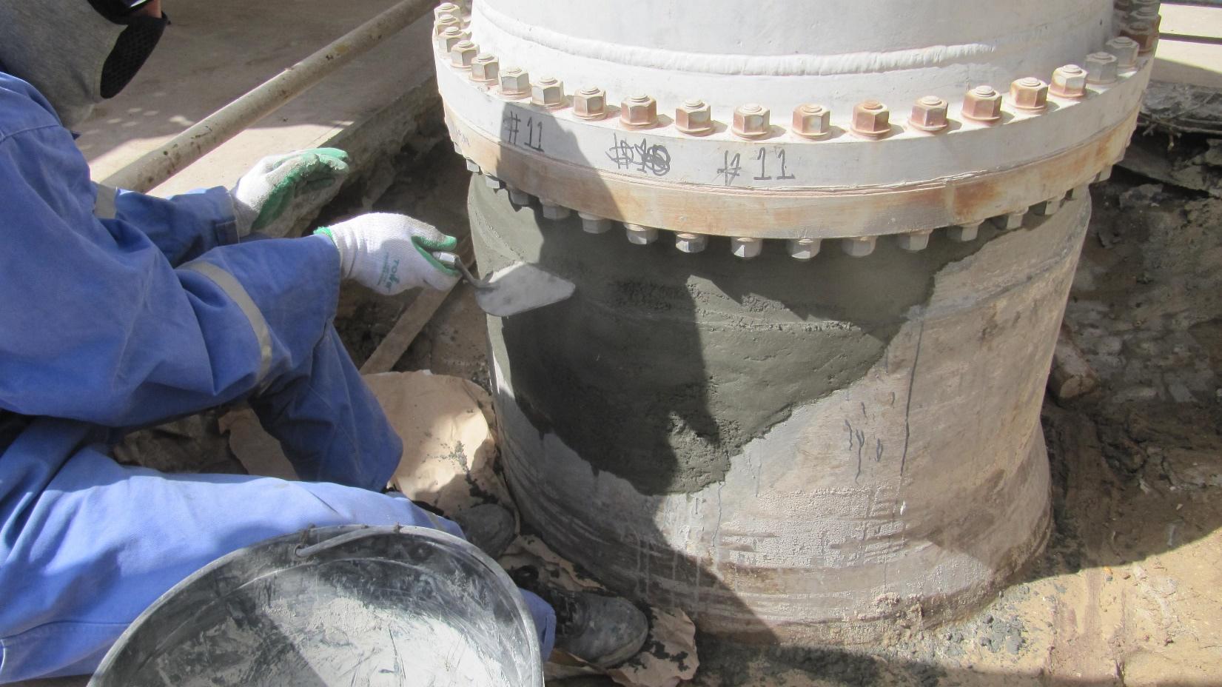
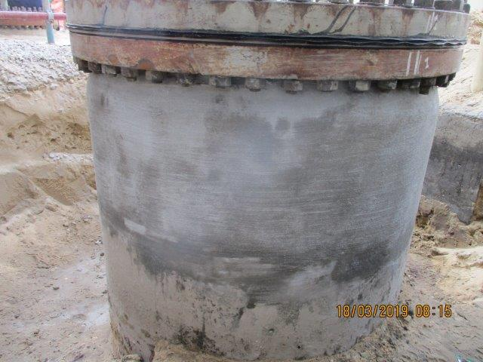
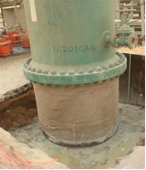
Cement Lining and Curing
Inspection & Refurbishment of Soil to Air CCP Stubs – SAFCO - IMA
Classification: General Business Use

Slide 19
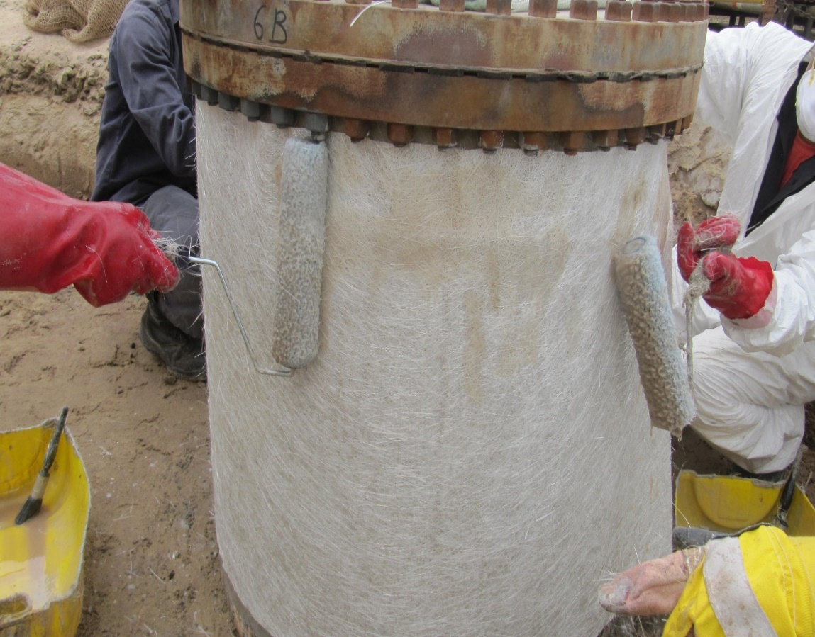
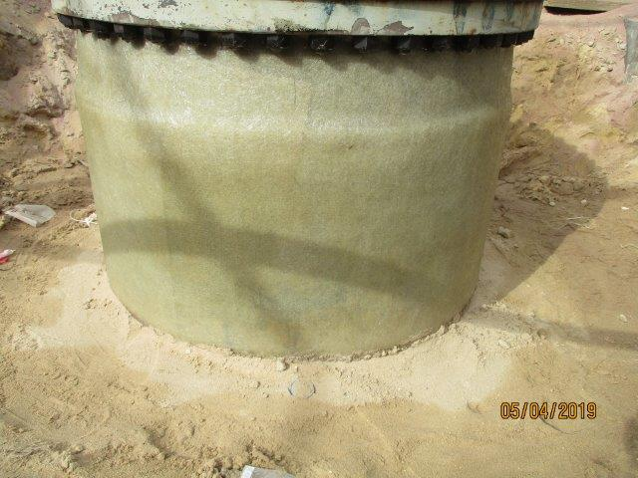
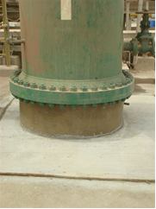
FRP Wrapping and Area Restoration
Inspection & Refurbishment of Soil to Air CCP Stubs – SAFCO - IMA
Classification: General Business Use

Slide 20
Thank You

