Slide 1


FLANGELESS PIPING TO AVOID LEAKS FROM TOXIC AND ACID SERVICES
Ashok Kumar Ramchand
Static Equipment Engineer
SABIC

Slide 2


BACKGROUND

Slide 3
Apprehension:
Most of acid and toxics piping are subject to internal lining with external metallic piping including flange connections. More than 70 percentage flange joints are subjected to leak due to Below reasons:
Over torqueing,
Aging
Fabrication defects,
Misalignments
Wrong installation and
Creep/cold flow
Which results in severe EHSS, business effects as well as impacting the continuity of safe and reliable operation

Slide 4
COMMON FINDINGS & OBSERVATIONS

Slide 5
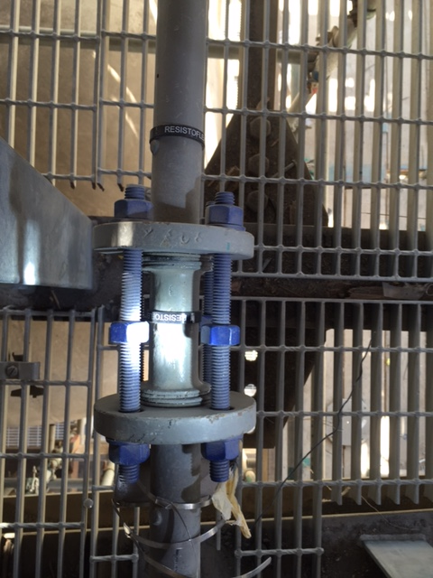
EXAMPLE 1:
Wrong and improper installation can be seen from flange alignment
Two different studs link by one nut
Image / Information source: SABIC internal for demonstration purpose only”.

Slide 6
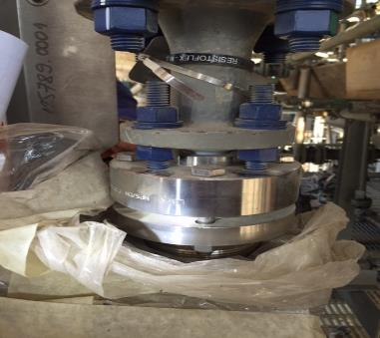
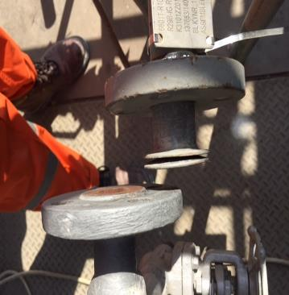
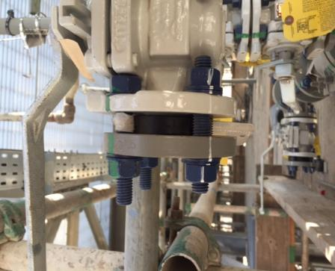
EXAMPLE 2:
Line Misalignment
Nuts useless
Poor design of the line and nuts installation
Washer 2 or 3
Image / Information source: SABIC internal for demonstration purpose only”.

Slide 7
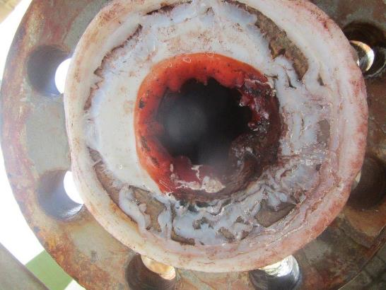
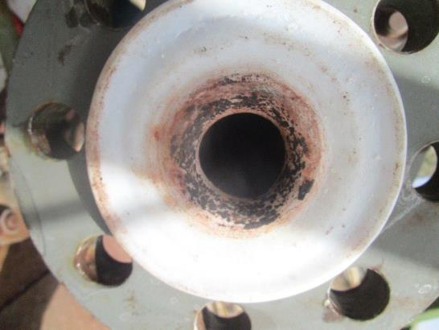
EXAMPLE 3:
Over torqueing resulting damage in gasket and liner. Resulting acid leaked and deteriorated the liner and flange

Slide 8
CASE FOR ACTION

Slide 9
CASE FOR ACTION:
Leaks from most toxic, acidic and pyrophoric service having material of construction as PVDF (Polyvinylidene fluoride or polyvinylidene difluoride) lined flanged piping.
Failure Results /Impacts : EHSS/Business: Most of the Risk fall under C1 and C2 consequence with business impact
Maintenance impact/Rectification: its takes >1 month due to complexity of lined piping installation, process and operation.

Slide 10
WHAT IF!
WE DON’T HAVE FLANGE JOINTS
Let`s understand the technology

Slide 11
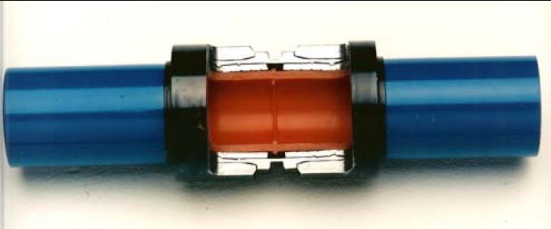
CONCEPT OF FLANGELESS PIPING
The flangeless piping system are Plastic-Lined Piping Products is designed to eliminate from 50 to 99% of flanged connections in plastic-lined piping system to address the Process Industry’s need for minimizing flange leaks (loss of containment) and/or controlling fugitive emissions

Slide 12
CONCEPT OF FLANGELESS PIPING
Flangeless Piping uses just swaged pipe whereby the steel pipe is precisely decreased down (Swaged) onto the plastic liner, in this manner bestowing a compressive power on it. This compressive stress better opposes:
liner movement as the liner is not prone to shrinkage due to tensile stresses.

Slide 13
CONCEPT OF FLANGELESS PIPING
Joint Fabrication Manually Cut-Back
  Cutback by using Wheeler Rex threading machine Method
  Rigid Roller cuter Method

Slide 14
CONCEPT OF FLANGELESS PIPING
Installation at site.
  Before site installation need to ensure for sufficient clearance for installation tools.

Slide 15
CONCEPT OF FLANGELESS PIPING
Installation at site For Liner Plastic Fusion
After Successful plastic fusion. Each joint to be bubble tested to check for leaks.

Slide 16
CONCEPT OF FLANGELESS PIPING
LOCKRING COUPLING INSTALLATION

Slide 17
These pictures representing condition of flangeless piping after 25 years

Slide 18
BENEFITS

Slide 19
Conclusion & Benefits
With flangeless piping below are the main advantages:
Elimination of EHSS incidents
Environmental protection for toxic or acidic release
Reduction in business impact: Benefit to cost ratio is satisfying the study.
Project life more than 20 years
Low maintainability cost (if any)
High reliability and operability of plant.

Slide 20

Thank You
Ashok Kumar Ramchand
Engineer, Static Equipment
Technical, Inspection

