Slide 1
Corrosion control of post indicator valve - buried portion
Mohammed Riyaz Hasainar
Static Equipment Engineer
SABIC

Slide 2
Corrosion Control of Post Indicator Valve - Buried Portion
CONTENT
INTRODUCTION
CORROSION PREVENTION
POST INDICATOR VALVES – CP SYSTEM
FIELD OBSERVATIONS/FINDINGS
ANALYSIS OF FAILURE
CONTROL OF MEASUREMENT
RESOLUTION

Slide 3
Corrosion Control of Post Indicator Valve - Buried Portion
What Is Corrosion ?
Corrosion is an electrochemical process involving the flow of electrons and ions. In general we can say deterioration of substance or its properties as a result of an undesirable reaction with the environment.
Most metals occur naturally in the form of oxides and are usually chemically stable. When exposed to oxygen and other oxidizing agents, the refined metal will try to revert to its natural oxide state. In the case of iron, the oxides will be in the form of ferrous or ferric oxide, commonly known as rust.
How to prevent corrosion ?
Corrosion can be prevented with the following methods,
1. Coatings
Covering the surface of an object, to prevent contact with environment.
2. Corrosion inhibitors
Its an chemical compound that, when added to a liquid or gas, decreases the corrosion rate of a material.
3. Cathodic protection.
Cathodic protection is a technique used to control the corrosion of a metal surface by making it the cathode of an electrochemical cell. Types of Cathodic Protections are
Sacrificial (Galvanic) Anodes Cathodic Protection (SACP).
Impressed Current Cathodic Protection System (ICCP)

Slide 4
Corrosion Control of Post Indicator Valve - Buried Portion
Post Indicator Valves - Sacrificial Anodes Cathodic Protection (SACP).
Sacrificial Anode Cathodic Protection (SACP):
A Cathodic protection system in which the external electromotive force is supplied by a galvanic anode.
In the application of passive Cathodic protection, a galvanic anode, a piece of a more electrochemically "active" metal (more negative electrode potentail), is attached to the vulnerable metal surface where it is exposed to an electrolyte. Galvanic anodes are selected because they have a more "active" voltage than the metal of the target structure (typically steel).
There are four basic components of a galvanic anode Cathodic protection system:
(1) the anode,(2) the anode backfill, (3) a means of connecting the anode to the structure, (4) and the structure.
PIV Switch
Big Finks
Structure (S)
Anode (A2)
Test Cable (T)
RTR/FRP Piping
Anode (A1)

Slide 5
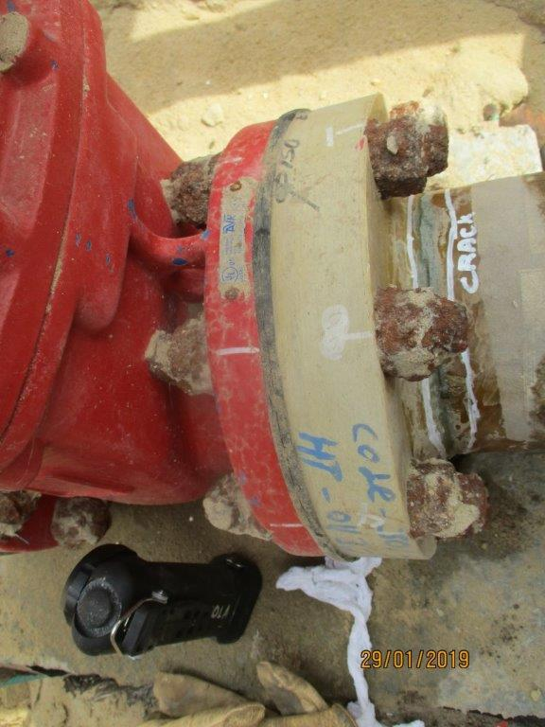
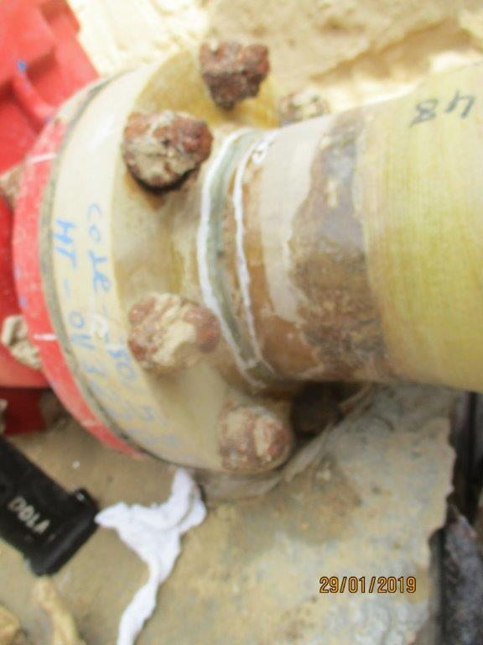
Corrosion Control of Post Indicator Valve - Buried Portion
PIV’s Investigation Findings
No Electrical Continuity b/w PIV’s body, bolts & nuts.
PIV to Piping Flange Bolts found with corrosion

Slide 6
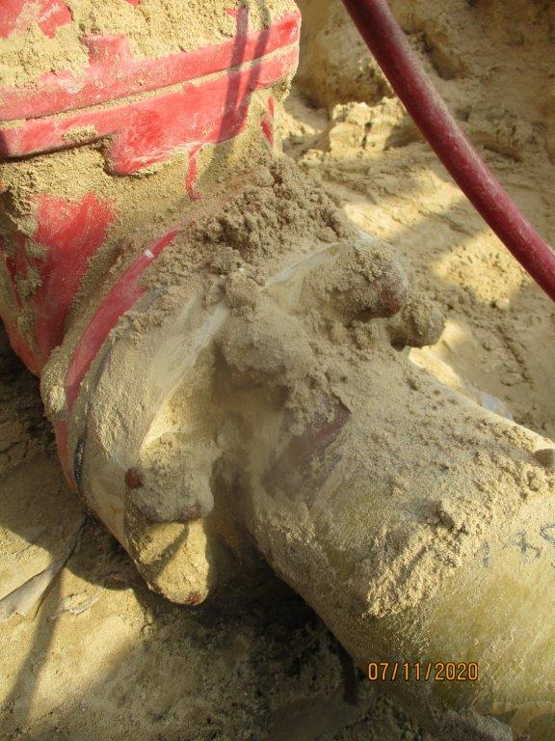
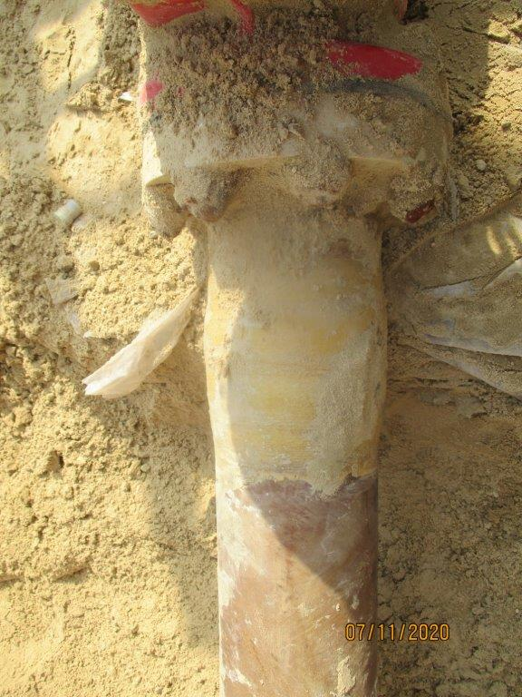
Corrosion Control of Post Indicator Valve - Buried Portion
ANALYSIS:
During the underground FRP piping leak repair, we also inspected the post indicator valve to confirm the mechanical integrity. The Post Indicator Valve was protected by SACP system. As per visual inspection it was observed that the near by post indicator valves flange bolts and nuts (buried portion) were severely corroded and checked electrical continuity between the valve body flange and fasteners found there is no continuity.

Slide 7
Corrosion Control of Post Indicator Valve - Buried Portion
Post Indicator Valves plays very major role in the plant safety in terms of EHSS . Failure of post indicator valve impact plant safety. Consequence of underground flange leak will have huge impact for the repair in terms of cost .
Post Indicator Valves failure results in both EHSS and Business consequence.
Rectification: its takes >1 month due to excavation, piping and CP repair.
Reason For Failure :
Improper electrical continuity between the flanges , Bolt & Nuts.
Bolt and nuts coating had premature failure due to poor manufacturing/installation.
Control Measurement :
Material Grade has to be same as Flange specification / SES# P04-S01
Proper electrical continuity between Flange, bolt & nuts.
Don’t use zinc coated bolt & nuts. Zinc will act has a anode.
As a PIV’s Cathodic Protection enhancement, For proper electrical connection, Required separate electrical cable from the valve to post body flange. Bolts/nuts Cathodic protection, Separate circular metallic plate throughout the bolt circumference and connected with main valve body through electrical cable.

Slide 8
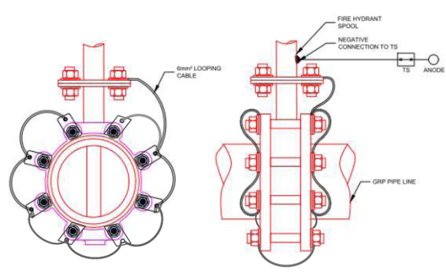
Corrosion Control of Post Indicator Valve - Buried Portion
Resolution - Bolts / Nuts with electrical continuity:
Bolts/nuts Cathodic protection by circular metallic plate throughout the bolt hole circumference and connected with main valve body through electrical cable

Slide 9
Corrosion Control of Post Indicator Valve - Buried Portion
How to prevent corrosion of PIV
Ensure that all buried metallic parts (valves, piping, bolts & nuts are all electrical continues and in contact (common electrolyte and common cathode connection) with the CP system.
Check the resistivity of soil and use anode materials and quantity appropriate for the soil (in most cases magnesium anodes are the best choice)
Use bolts that are corrosion resistant and are coated (for example Fluro polymer / Teflon coated)
Advantages :
Elimination of EHSS incidents
Extended PIV’s reliability
Reduction in business impact: Benefit to cost ratio is satisfying the study.
Low maintainability cost (if any)
High reliability and operability of plant.

Slide 10
Thank You

