Slide 1
Tank Floor Integrity Assurance Using VpCI
Highlight the significance of soil-side corrosion and most common challenges contributing to soil-side corrosion in the GCC & Middle East.
Briefly introduce Vapor Phase Corrosion Inhibitors working mechanism and typical application methodologies.
Latest progress and updates with international standards related to this technology.
Share some of the long-term performance assessment case studies related to this technology and introduce some examples of cost benefit analysis.

Slide 2
Tank Floor Integrity Assurance Using Vapor Phase Corrosion Inhibitors
February 28, 2022
Notes:
Good morning Everyone. I am excited today to take you through part two of Mastering CorroLogic AST training series

Slide 3
Outline
Soil-side corrosion
Vapor phase corrosion inhibitors
International standards
Long term performance
Cost-benefit analysis example

Slide 4
Soil-side Corrosion On Storage tanks
A main cause of storage tank failure.
Leads to metal loss and perforations in the tank floor
Imposes a major challenge and risks.
Soil-side corrosion rate greater than 40 mpy (equal 1 mm/yr )
Notes:
Before we start to learn about CorroLogic AST solution, it is important to recognize the significance of the problem that we are trying to solve.
Soil-side corrosion is a principal cause of storage tank failure as it leads to plate thickness loss, holes in the tank floor and eventually leaks which impose a major environmental risks operational challenges to tank owners and operators who aim to find and an effective control method for this type of corrosion during the complete life cycle of the tank.

Slide 5
Soil-side Corrosion On Storage tanks
Tanks taken out of service before their 1st scheduled inspection due to leaks
Tanks rejected before end of their design life
High cost of repair because of Corrosion for ASTs
Requires effective control during the complete life cycle of the tank.
Notes:
Before we start to learn about CorroLogic AST solution, it is important to recognize the significance of the problem that we are trying to solve.
Soil-side corrosion is a principal cause of storage tank failure as it leads to plate thickness loss, holes in the tank floor and eventually leaks which impose a major environmental risks operational challenges to tank owners and operators who aim to find and an effective control method for this type of corrosion during the complete life cycle of the tank.

Slide 6
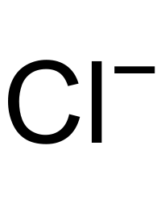
Soil-side Corrosion On Storage tanks Common Challenges
Ring Wall Interface
Gap
Void created by
‘Oil Canning’ Effect
Overlap Crevice
Void created by
Soil Settlement
Very Dry
Sand
Bitumen
Layer
X
X
X
X
X
X
I_{CP}
I_{CP}
I_{CP}
I_{CP}
I_{CP}
I_{CP}

Slide 7
Vapor Phase Corrosion Inhibitor Technology

Slide 8
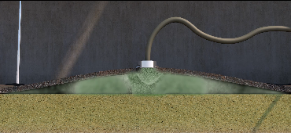
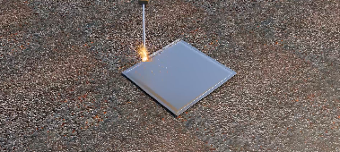
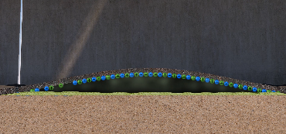
Application Methodologies Through Tank Floor
Injection holes
Fogging VPCI Powder
Patch welding
Protective layer Formation

Slide 9
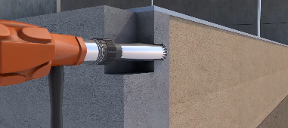
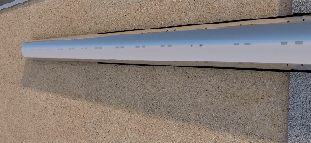
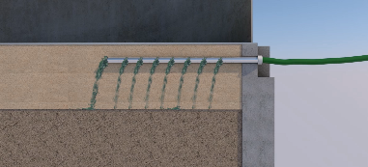
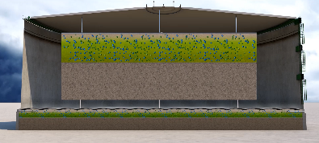
Application Methodologies Through Ring Wall
Core Drilling
Perforated PVC pip
Injection of VpCI Slurry
Protective layer Formation

Slide 10
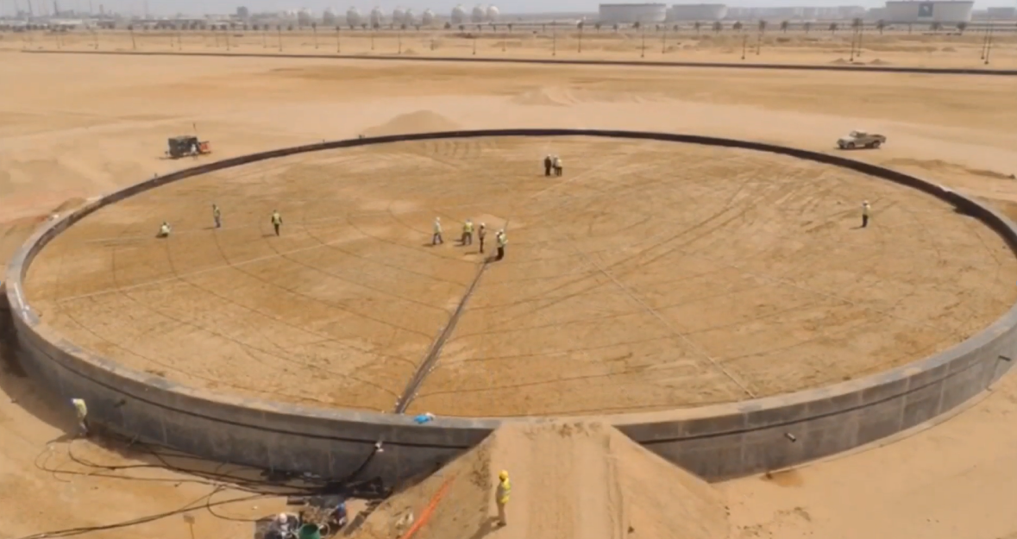
Application Methodologies Integrated Dispensing System (New tanks)

Slide 11
Industry Standards
Department of Environmental Protection
Department of Environmental Protection in Florida approved the use of VpCI in 2003 for tanks where CP retrofit is rather infeasible.
The State of Florida has identified that VCI can be used in tandem with CP or a standalone solution, for more than 6 years.
API 2610
“Design, Construction, Operation, Maintenance, and Inspection of Terminal and Tank. outlines the use of VpCI in section 12.5
State of Florida
API TR 655
NACE STG 543
Technical Report on the use of vapor phase corrosion inhibitors on storage tank bottoms
Standard for External Corrosion Control of On-Grade Carbon Steel Storage Tank Bottoms will be out in 2022
2003
2013
2018
2021
2021

Slide 12
Vapor Phase Corrosion Inhibitors are used for:
Switch from time-based inspection to RBI
Defer scheduled out of service inspection, safely, when needed
Extend next inspection interval
Prepare cost effective repair plan and minimize future maintenance
Increase service life
Reduce storage tank OPEX by 30%

Slide 13
Four-Year Study for Distillate Tank
Client: A terminal in GCC
Tank size: 38 m diameter
Tank service: distillate products
Tank Construction Date: 2010
Tank foundation: HDPE liner, sand, no ICCP
First T&I : 2016
Second T&I: 2020

Slide 14
Tank Floor Condition in 2016
Soil-side corrosion up to 1.17 mm/yr
Several plates with through holes
More than 80 plates have less than 6 mm thickness

Slide 15
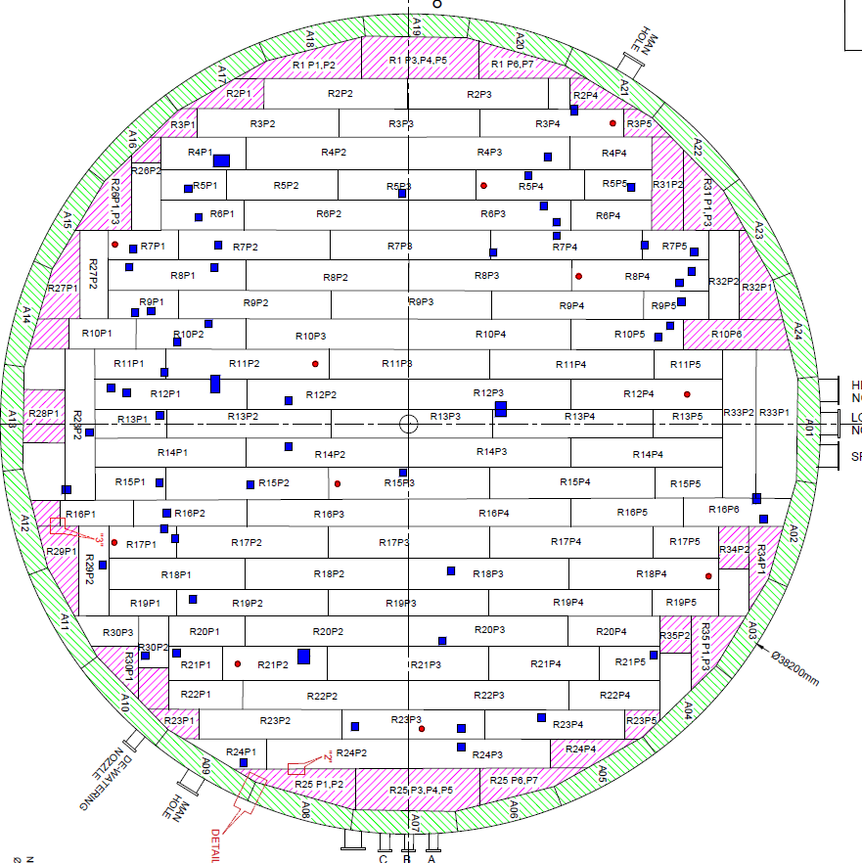
Repair plan 2016
Patch Repair
Injection of CorroLogic Powder through tank floor
Note:
Average corrosion rate is 0.24 mm/yr
Next inspection interval is 8.8 years, without considering the effect of CorroLogic AST solution

Slide 16
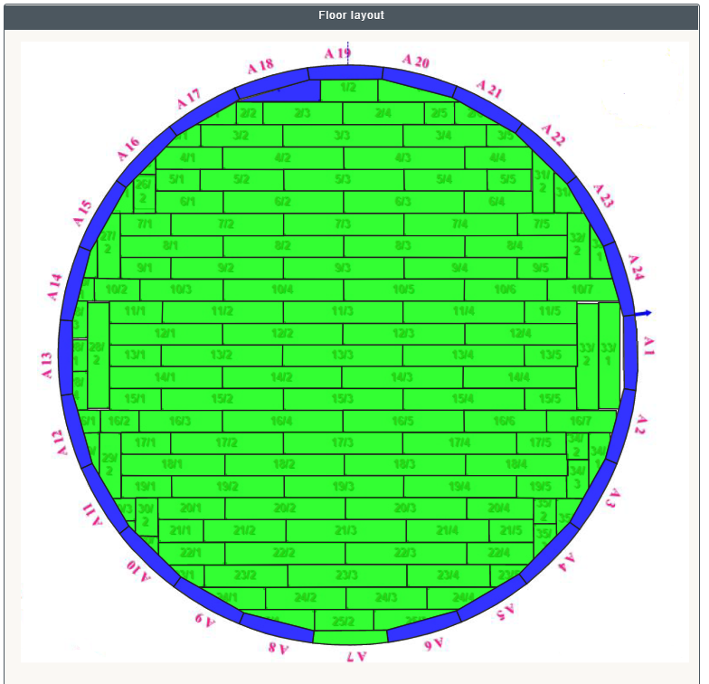
Tank Floor Condition in 2020
Soil-side corrosion was reduced from 0.24 mm/yr to 0.034 per year, 86% reduction
No repair was required
Tanks was boxed up quickly and next inspection interval were extended to more than 10 years

Slide 17
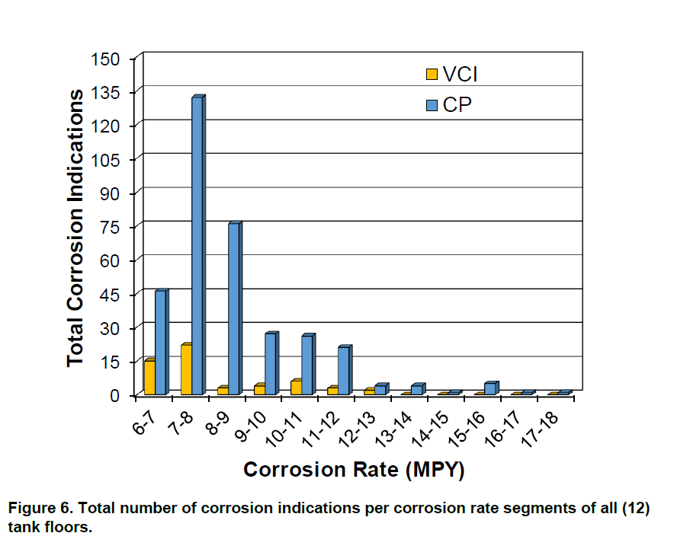
Comparison Of VCI And CP Performance Using Floor Scan Data From Several 10-year AST Floors
NACE Paper No. C2020-15056.
12 tanks at 3 different stations had new floors between the year 2006 and 2011.
5 tanks had the new floor on top on the existing one separated with new sand (double bottom tank) and protected with CorroLogic Powder
7 tanks had their floor replaced with a new one and new sand with HDPE liner (single bottom tank)

Slide 18
Final Highlights
Reduces tank OPEX by 30%
Synergistic with cathodic protection
Can be monitored using electrical resistance Probes
Proven long term performance based on tank floor scan data

Slide 19
Q&A
Abdullatif Balwi
abalwi@cortec-me.com
Mob: +966503088829

Slide 20
Thank You

