Slide 1

Steam Quality and Water Treatment Analysis
Dr. Ahmed Aboforn

Slide 2
Content
Boiler steam water Background
Steam and Water Analysis System (SWAS)
Boiler Steam System Performance
Philosophy of Monitoring Boiler Parameters
General Sampling Guidelines & Methodology
Steam water analysis sheet for lab & analyzer
Volatility of amines used for water treatment in steam generating systems

Slide 3
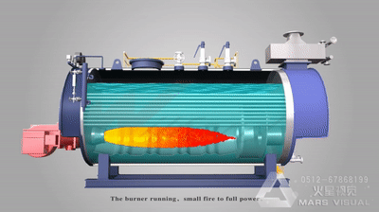
Boiler steam water Background
This paper looking for and discus the factors which affected on the water & steam quality and analysis of (Boiler feed water, pre-heated, super-heated) in different stages of steam generation processing.

Slide 4
Boiler steam water Background
STEAM is a vital and critical part in producing the final product; therefore Steam Quality should be one of the main measurable points in producing a product in today’s manufacturing facility.
All heat transfer components (Turbine, Boilers, Polisher, shell/tube, plate/frame, plate/coil, and tracing, with all operation assets) base performance calculations on 100 % steam quality.
Online / offline steam purity monitoring is considered standard practice in different industries as petrochemical and thermal power plants with steam turbines to enable the rapid identification of out of specification steam purity that could lead to turbine or reboilers damage.

Slide 5
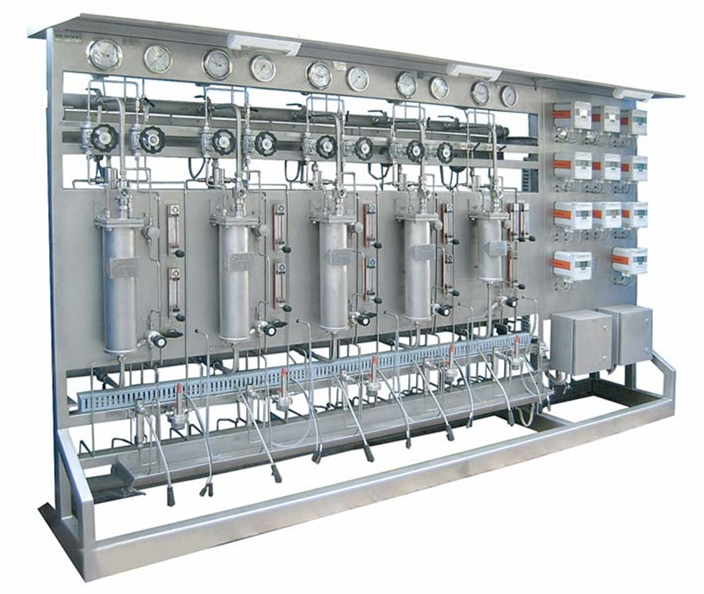
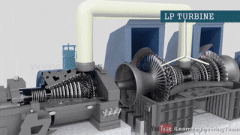
Steam and Water Analysis System (SWAS)
Steam and Water Analysis System (SWAS) are designed for continuous monitoring and control of steam water purity in the boiler plant cycle and at other important analysis points.
The analyzer outputs signals shall be used for continuous monitoring of various parameters like analysis of pH, Specific Conductivity, Cation Conductivity, Degassed Conductivity, Sodium, Silica, Dissolved Oxygen, Phosphate, Chlorides, TOC etc.

Slide 6

Steam and Water Analysis System (SWAS)
In the steam boiler and water cycle of different industry plants we find the following locations for monitoring and control the steam and water samples;
Boiler Feed water (BFW)
Demi Water
Condensate
Superheated Steam

Slide 7
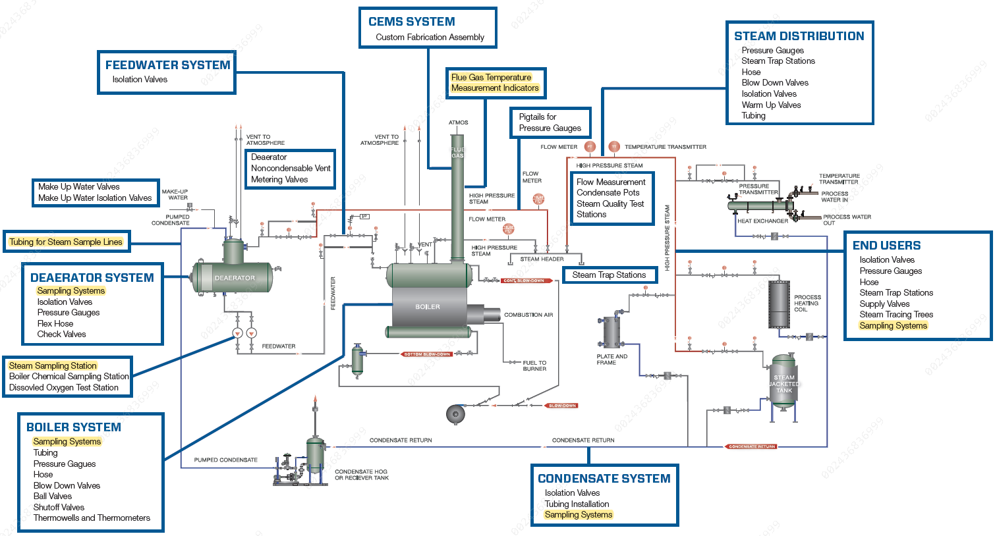
Boiler Steam System Performance

Slide 8
General Sampling Guidelines
Careful sampling is necessary to ensure the success of modern analytical techniques. The accuracy of any test will be sacrificed if the sample is contaminated or deteriorates before the test can be performed.
sampling techniques assure analytical accuracy, representative analysis, personal safety and correct boiler system control.

Slide 9
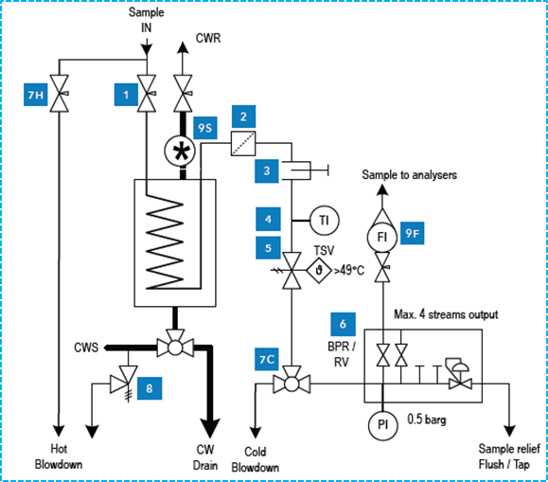
General Sampling Guidelines
ASTM D1066 Standard Practice for Sampling Steam
ASTM D3370 Standard Practices for Sampling Water from Flowing Process Streams
ASTM D5540 Standard Practice for Flow Control and Temperature Control for On-Line Water Sampling and Analysis
Typical P&ID Steam Sample Conditioning System

Slide 10
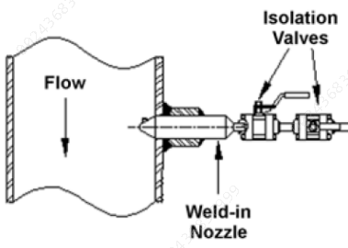
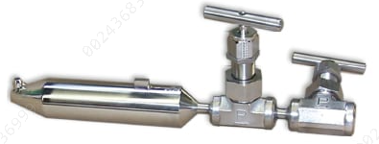
General Sampling Guidelines (Isokinetic Sampling Technique)
Sampling nozzles recommended by the ASTM and ASME have been in use for many years. The nozzles have ports spaced in such a way that they sample equal cross sectional areas of the steam line.
Instructions for these nozzles can be found in ASTM D 1066, "Standard Method of Sampling Steam" and ASME PTC 19.11.
Field steam studies have shown that sampling nozzles of designs other than these often fail to provide a reliable steam sample.
Diagram of Isokinetic sampling
weld-in Nozzle
single-port isokinetic sampling nozzle

Slide 11
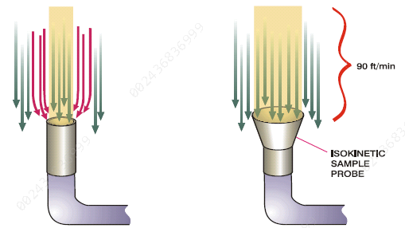
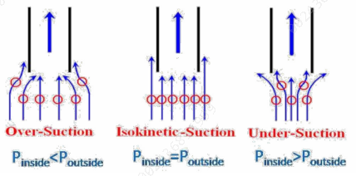
General Sampling Guidelines (Isokinetic Sampling Technique)
Isokinetic flow is established when steam velocity entering the sampling nozzle is equal to the velocity of the steam in the header.
This condition helps to ensure representative sampling for more reliable test results.
Flow visualization of isokinetic conditions
Working principle of isokinetic sampling probe

Slide 12
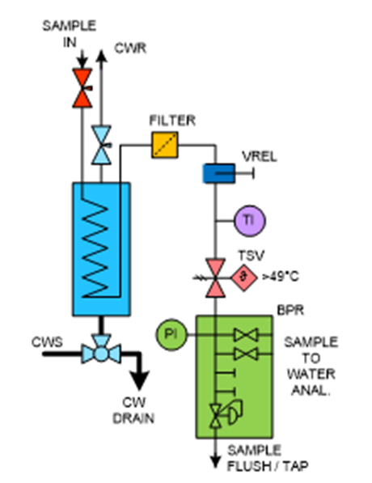
General Sampling Guidelines
Accurate sampling of superheated steam presents problems not encountered in saturated steam sampling.
The solubility of sodium salts in steam decreases as steam temperature decreases.
If a superheated steam sample is gradually cooled as it flows through the sample line, solids deposit on sample line surfaces.
To eliminate this problem, the steam can be de-superheated at the sampling point.
Steam and Water Sample Conditioning

Slide 13
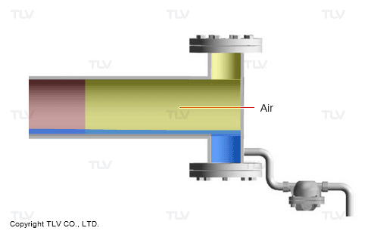
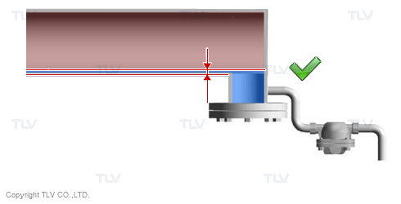
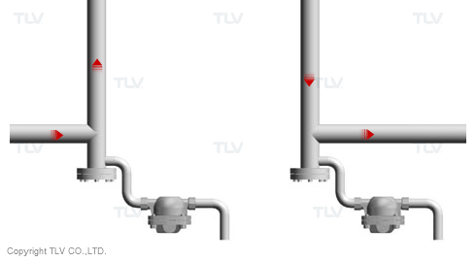
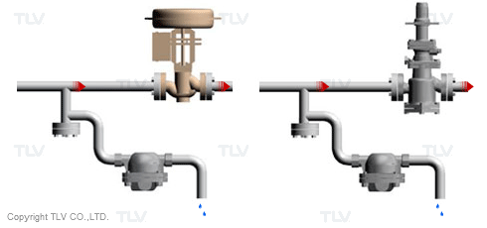
Steam and Water Sample Conditioning
As such industrial steam with high gas content can be difficult to sample without suitable sample venting arrangements to separate non-condensable gas from the condensed steam followed by active degassing methods to remove any remaining dissolved gases (this is usually easily managed as shown in figures.
when undertaking manual grab sampling, but can be particularly problematic for online analysis)

Slide 14
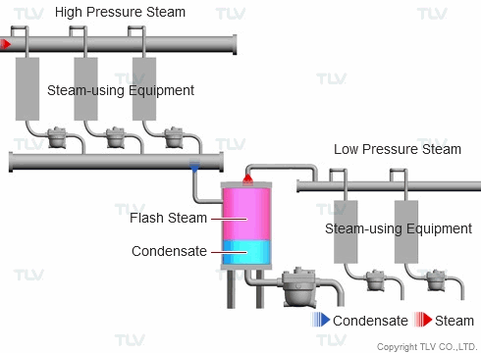
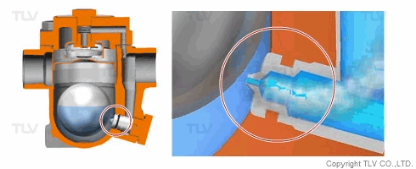
Steam and Water Sample Conditioning

Slide 15
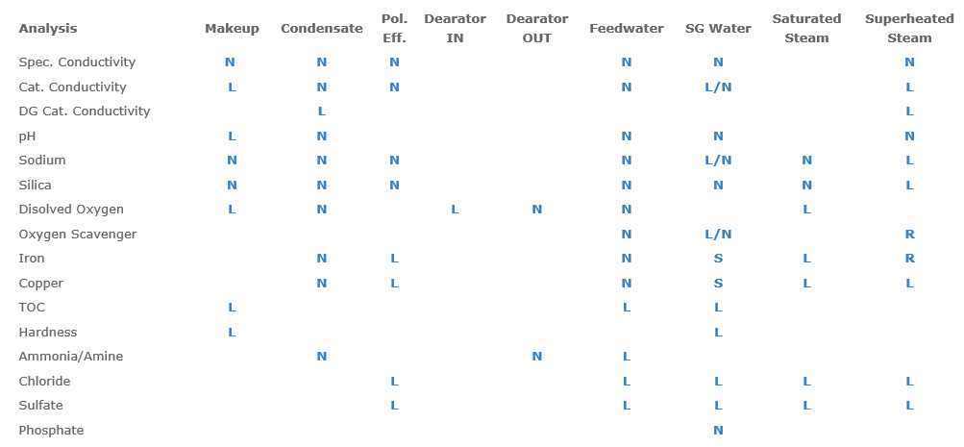
Steam water analysis recommendation sheet LAB & Online Analyzer
N = Normal, recommend continuous flow for online analyzer
L = Less common, recommend sharing online analysis or with portable analyzer
R = Rare or occasional, recommend measurement with portable analyzer
S = Less common except at startup, recommend measurement with portable analyzer

Slide 16
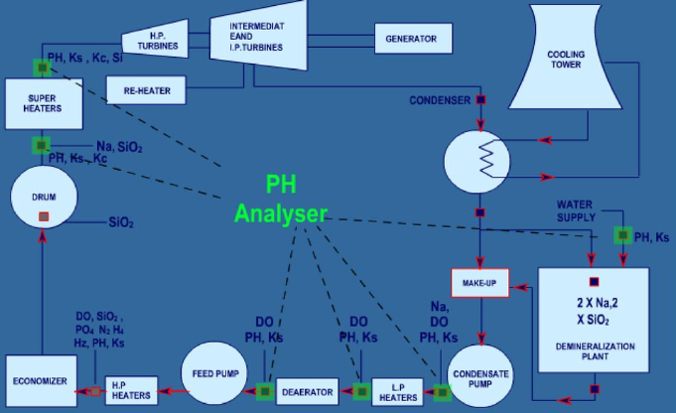
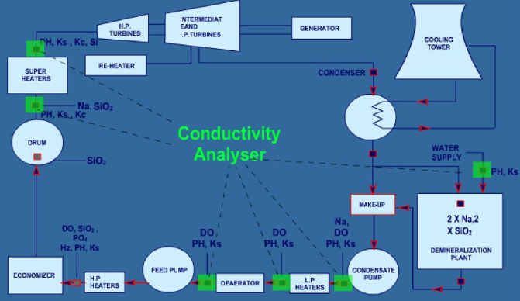
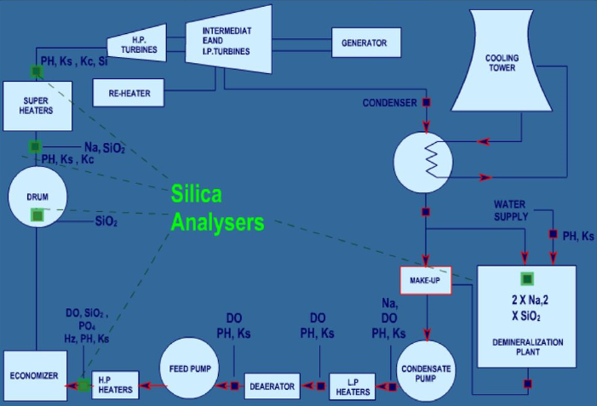
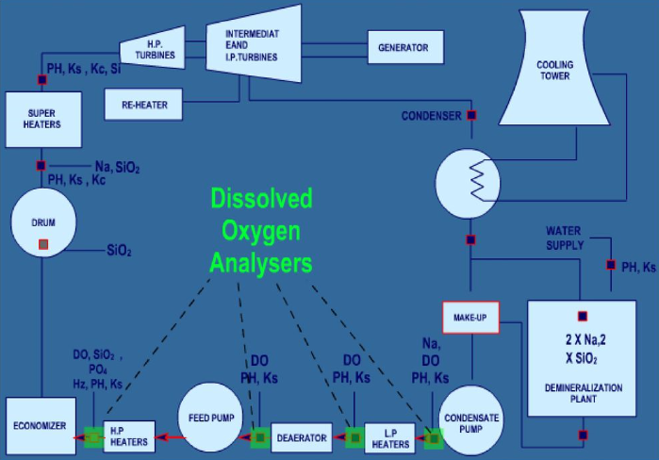
Sample Points selection – Analysis required

Slide 17
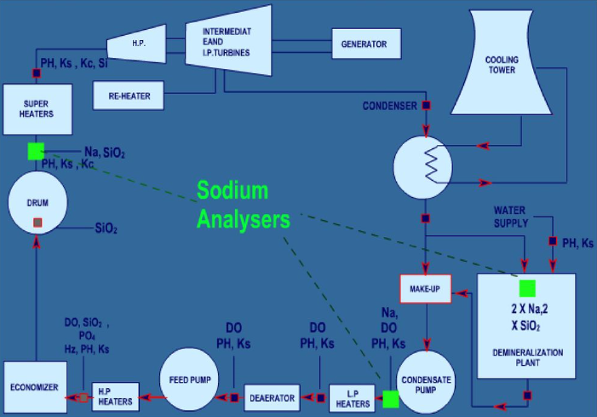
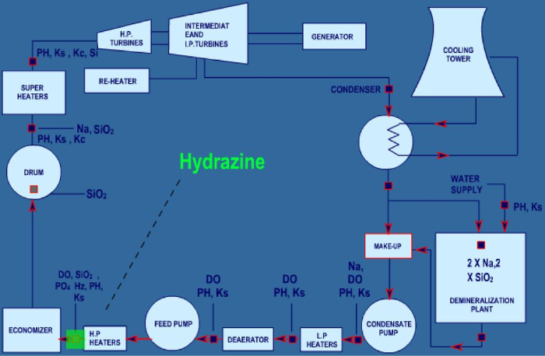
Sample Points selection – Analysis required

Slide 18
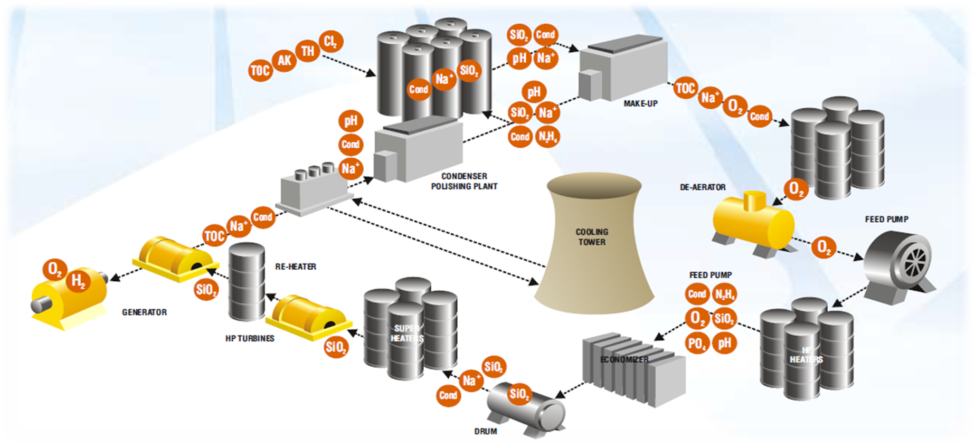
Philosophy And Importance Of Monitoring Boiler Test Parameters

Slide 19
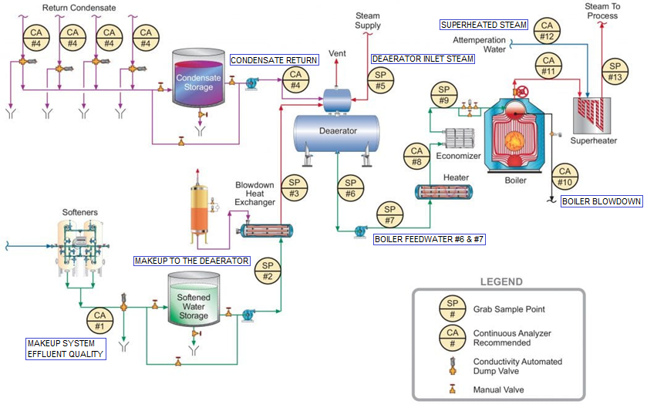
General schematic of recommended sample points for industrial process steam flow and condensate return.

Slide 20
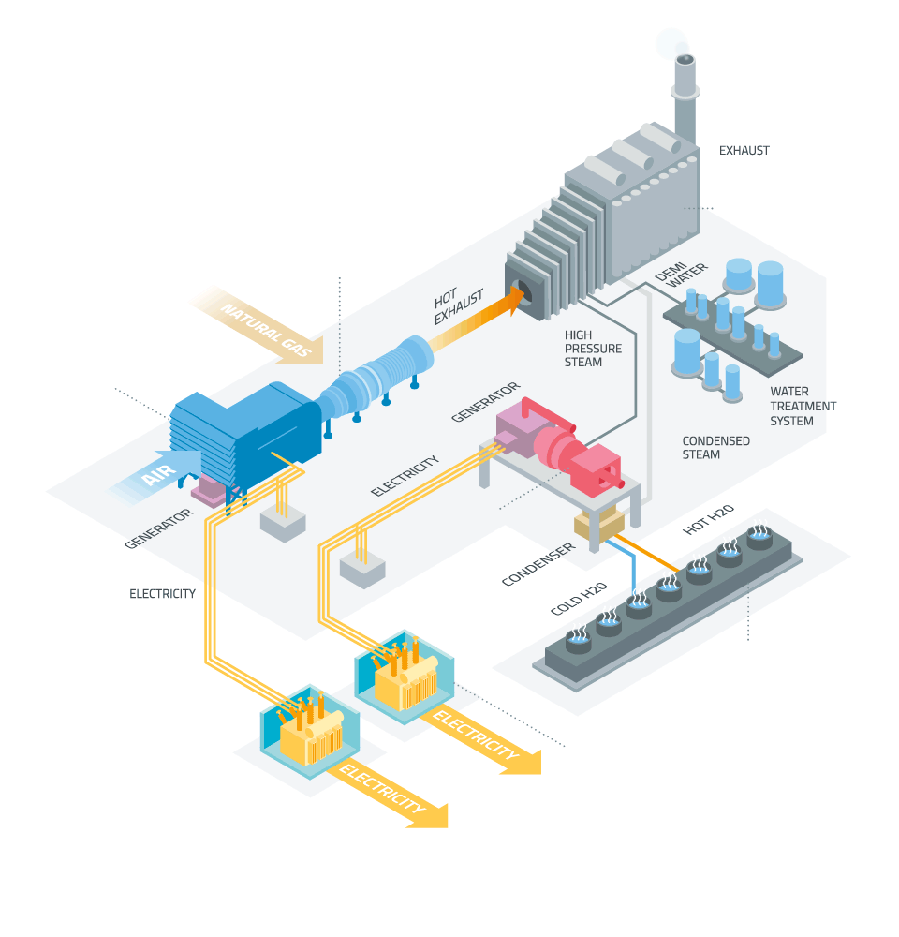
Guidelines developed by the Electric Power Research Institute (EPRI), the International Association for the Properties of Water and Steam (IAPWS) and others recommend a feed-water pH above 9.0, and typically at least in a mid-9 range, for power plant units.

Slide 21
BOILER FEEDWATER
Steel corrosion is greatly reduced at these alkalinity levels. While Table 1 suggests a pH range of 8.3–10.0 for industrial boilers, the lower limit can probably be raised, preferably towards the ranges recommended for power units and indicative of the data shown.
Influence of pH and temperature on iron dissolution from carbon steel

Slide 22
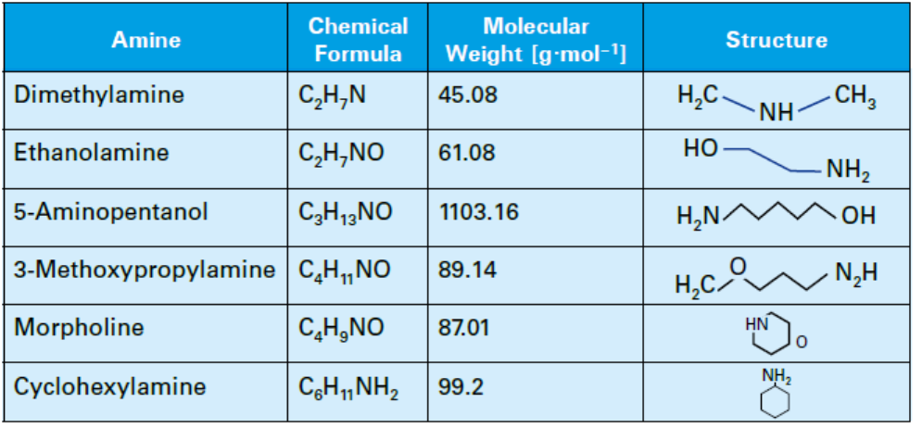
Amine compunds
Developing the best program for comprehensive system protection has sometimes been difficult with these compounds, as each has a different basicity and distribution ratio.
Common neutralizing amines

Slide 23
Volatility of amines used for water treatment in steam generating systems;
(case study)
The relative volatilities of cyclohexylamine and morpholine in dilute aqueous solution have been measured in the temperature range 150 to 300 °C at the corresponding equilibrium vapor pressure of the solution.
Cyclohexylamine strongly prefers the steam phase while morpholine has a relatively volatility close to that of water.
In both cases an azeotrope of the amine and water, with a vapor pressure higher than that of either component, must exist; however, with morpholine and water azeotrope formation only occurs above 175 °C. The concentration dependence of the distribution between the steam and solution phases of both amines is explained in terms of their partial ionization in solution.

Slide 24
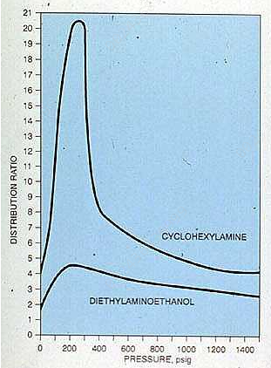
Volatility of amines used for water treatment in steam generating systems;
(case study)
Distribution of Cyclohexylainine between steam and water
Distribution of Morpholine between steam and water

Slide 25
Thank You

