Slide 1

REPETITIVE FAILURE OF STAINLESS STEEL VESSELS DUE TO CONSTANT FLOW PULSATION - CASE STUDY
BADER ALSALLUM

Slide 2
FATIGUE CRACKING
DESCRIPTION OF MECHANICAL FATIGUE CRACKING
A mechanical form of degradation that occurs when a component is exposed to cyclical stresses for an extended period, e.g. from dynamic loading due to vibration, water hammer, or unstable fluid flow, often resulting in sudden, unexpected thru-wall cracking.
These stresses can arise from either mechanical loading or thermal cycling and are typically well below the yield strength of the material.

Slide 3
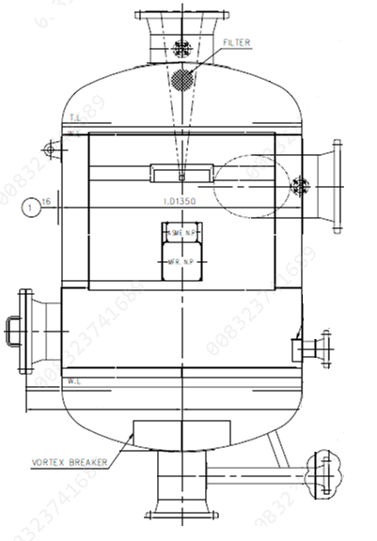
CASE STUDY
EQUIPMENT DETAILS
SEPERATOR VESSEL OF RECLAIM COMPRESSOR – ETHYLENE GLYCOL PLANT
OPERATING PRESSURE (kg/cm2g) | 2.66 – 2.81
OPERATING TEMPERATURE (˚C) | 44
MATERIAL OF CONSTRUCTION | SS304
PROCESS MEDIA | Mixed gases
YEARS IN-SERVICE | 10

Slide 4
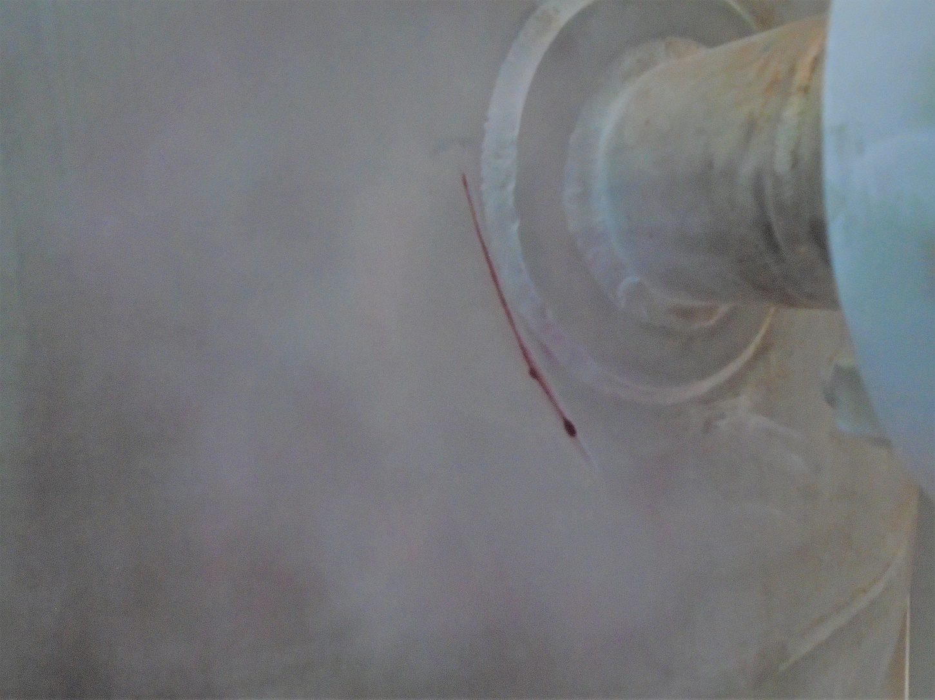
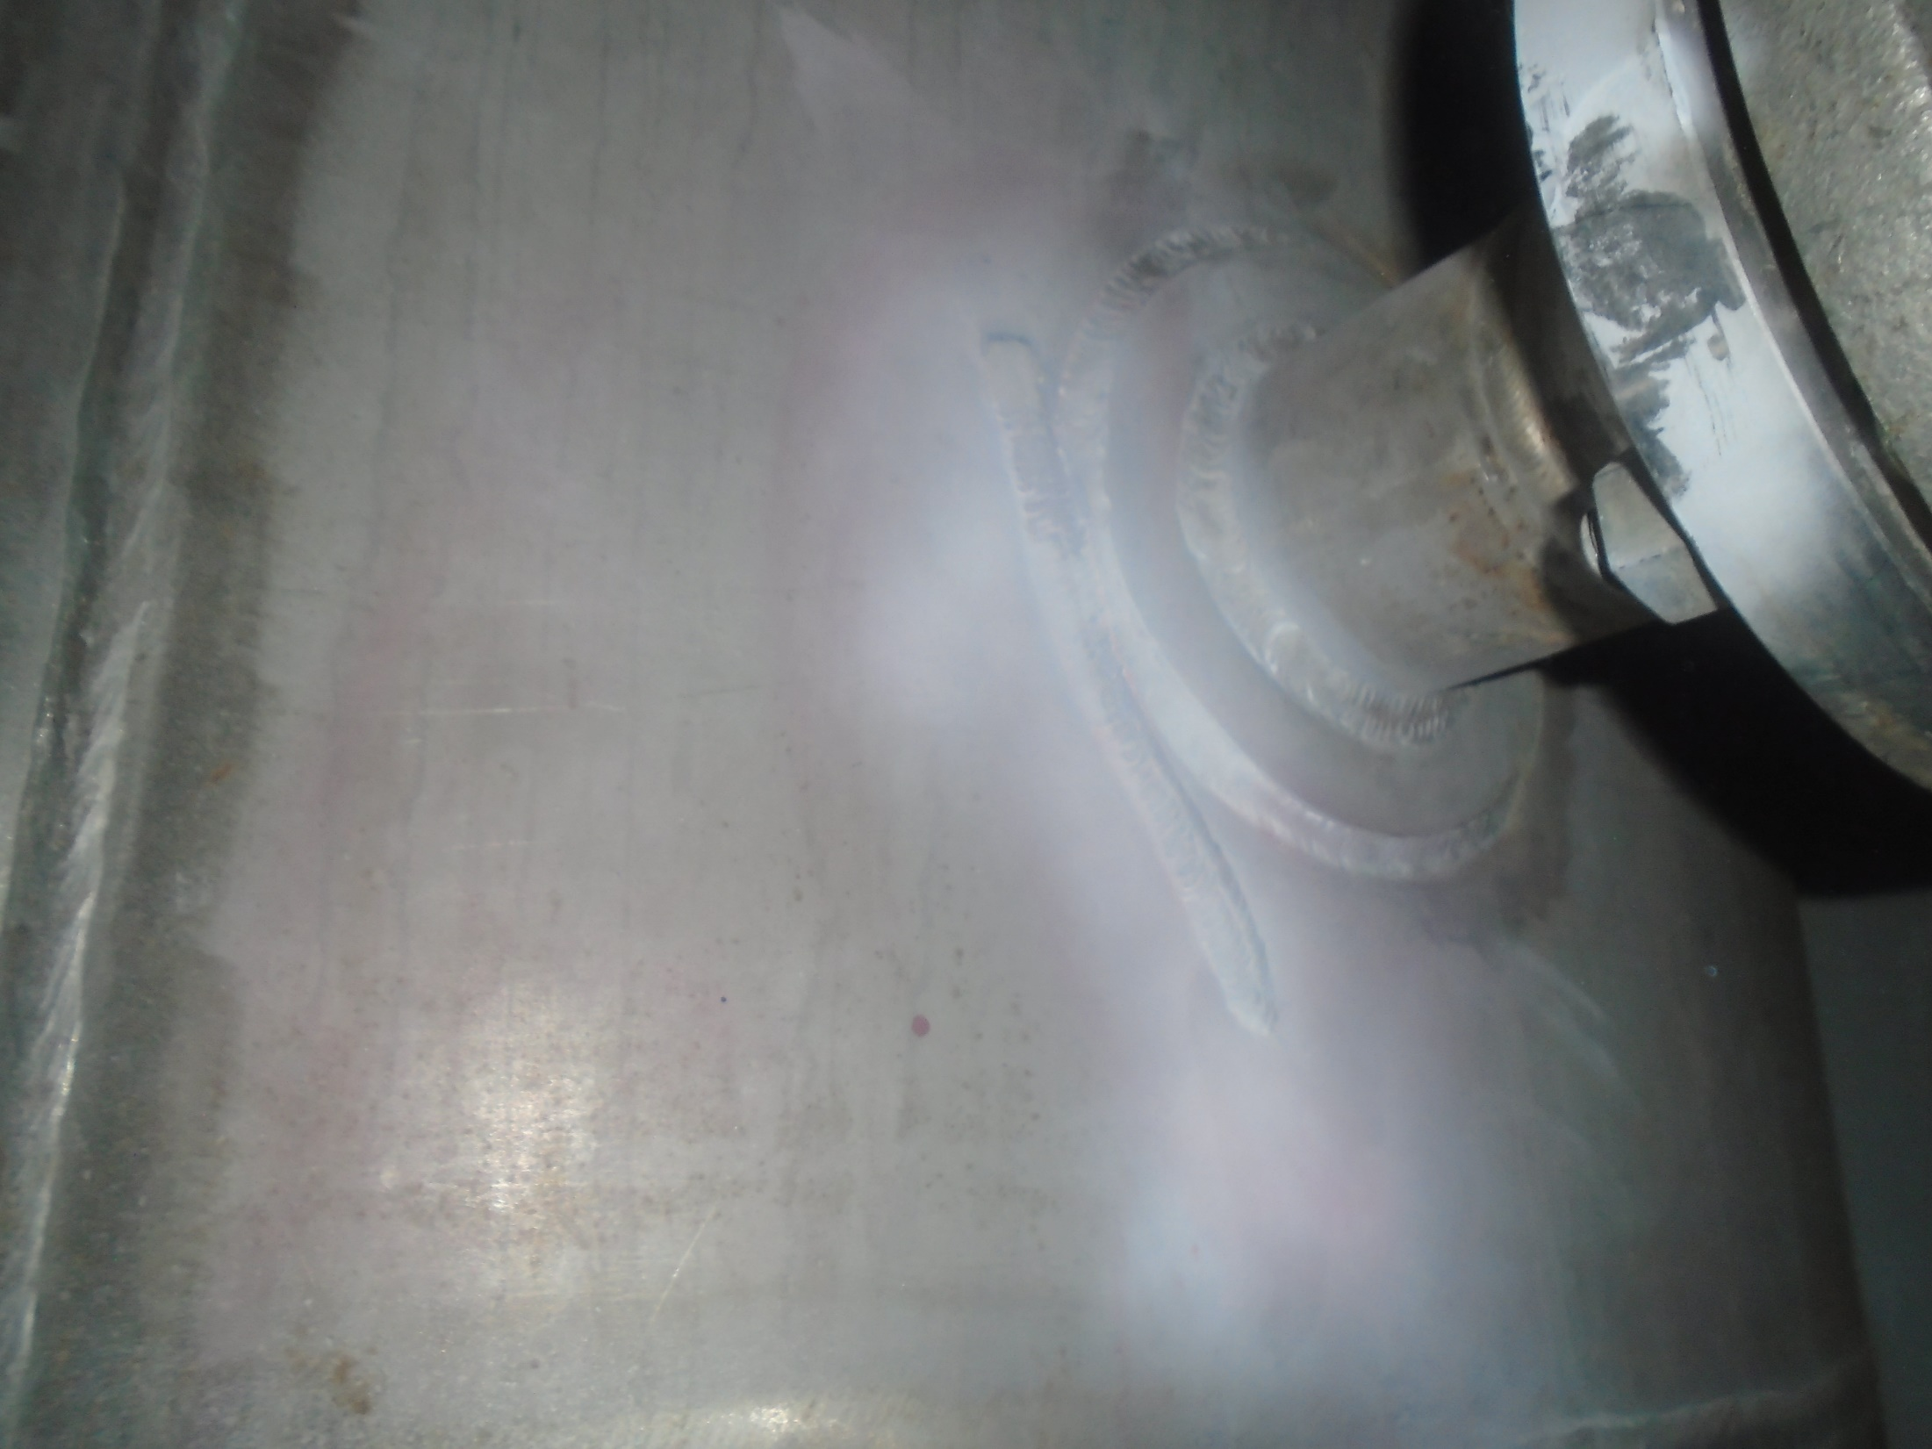
LOSS OF CONTAINMENT
IN-SERVICE LEAKAGE
A longitudinal crack was observed (approx. 1.5”) on the right side of N9, on the shell of the vessel and adjacent to the RF pad of the nozzle.
ACTION TAKEN
The extremes of existing crack (80~100mm long) located near the N3 nozzle were marked after Dye penetration examination.
Crack propagation was terminated by drilling both extremes
Cracks were grinded through the thickness of the vessel to ensure no cracks left.
Root was fused by super root followed by root pass, hot pass & final pass dye penetration examination.
The location was examined by in-situ metallography on 5th of November and confirmed there was no presence of CI-SCC.

Slide 5
FAILURE INVESTIGATION
Internal view of crack initiation location

Slide 6
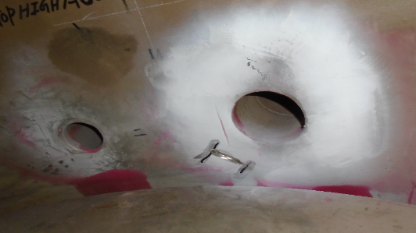
FAILURE INVESTIGATION
ROOT CAUSE
The initiation of the in-service crack on observed from the weld toe of half pipe, located on Instrumentation Nozzles (N9). This crack was initiated due to malfunction of compressor suction valve, cause constant pulsation on the flow which induced continuous vibration on the half pipe causing initiation of cracks.

Slide 7
LESSONS LEARNED
Good design is the best defense to minimize stress concentration of components in cyclic service
Effective monitoring of flow-controlling devices functionality is essential to prevent asset deterioration.
Allow for a generous radius along edges and corners

Slide 8
REFERENCES
1. J.M. Barsom and S.T. Rolfe, Fracture and Fatigue Control in Structures, American Society for Testing and
Materials, West Conshohocken, PA.
2. ASTM STP1428, Thermomechanical Fatigue Behavior of Materials, American Society for Testing and
Materials, West Conshohocken, PA.
3. ASTM MNL41, Fracture and Fatigue Control in Structures: Applications of Fracture Mechanics, ASM
International, Materials Park, OH, 1995.
4. “Environmental Effects on Components: Commentary for ASME Section III,” EPRI NP-5775, Project 1757-
61, Final Report, EPRI, 1998.
5. API Recommended Practice 581, Risk-Based Inspection Technology, American Petroleum Institute,
Washington, DC, Second Edition, 2008.
6. API 579-1/ASME FFS-1, Fitness-For-Service, American Petroleum Institute, Washington, DC.

Slide 9
Thank You

