Slide 1

Chloride Stress Corrosion Cracking Phenomena in VCM quench bottom associated piping due to process excursion
Presented by: Joan Franco (Petrokemya South)

Slide 2
Introduction
EDC cracking unit in VCM plant is fed with dry EDC coming from the EDC purification system that goes into the Cracking furnace to convert EDC into VCM. After cracking reaction the product is fed into the Quench Column to reduce the temperature in order to stop further reaction and also separate remaining non converted EDC from the VCM stream. These stream are very rich in Chloride compounds (such as HCl) handled in dry condition which do not create major corrosion issues, but if there is presence of free water Chloride ions will be present and corrosion will take place.
On march 2019, during the inspection of EDC Cracking Unit piping, four locations were found with cracks near to the welds. All of them were areas with stagnant flow.
Quench bottom lines are Stainless Steel 316L, which is susceptible to pitting and Cl- SCC in presence of moisture and chloride.
These lines were in service for about 13 years with no previous failures.
Process parameters records show that moisture excursion beyond 25ppm occurred during November 2018 and March 2019.

Slide 3
Evaluation Of 1” Drain Sample (Dead Leg)
DPT was performed in this pipe, showing three (03) very fine cracks with the next characteristics:
- One transversal in the middle of the pipe length.
- Two starting from the opposite welds and propagate with a certain angle along the pipe (see image 1).
The internal surface of the sample after the cut showed several craze cracks matching with the cracks observed from the outside. (See image 2).
Image 1. Sample (1”) showing external cracks
Image 2. Sample(1”) showing internal cracks

Slide 4
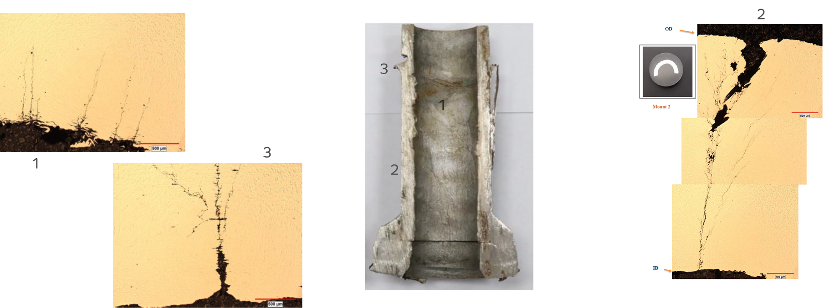
Evaluation Of 1” Pipe Sample (Dead Leg)
Metallographic examination confirms the presence of cracks along the thickness of the pipe (see Image 3 detail 2).
Also confirmed that cracks are initiated from the inside (see Image 3 details 1-2).
Image 3. Metallographic examination 1” drain pipe

Slide 5
Evaluation Of 1” Drain Sample (Dead Leg)
The interior was filled with coke, analysis to this material revealed high concentration of chlorides.
Coke deposits are mainly Organic and Inorganic Carbon from cracking reaction.
Other major elements found are Iron and Chromium oxides, related to corrosion products.

Slide 6
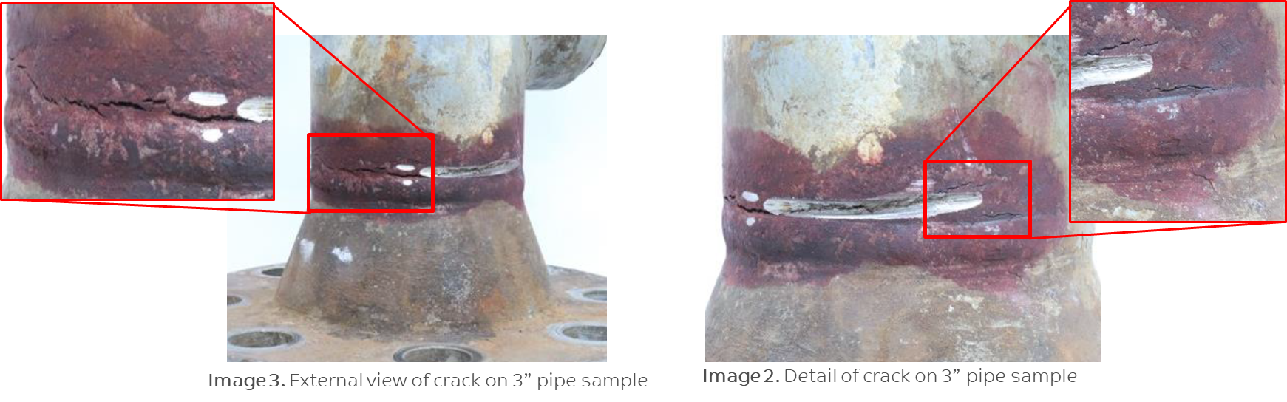
Evaluation Of 3” Pipe Sample (Dead Leg)
Through-material crack with next characteristics can be observed in image 4 and 5:
-Cracks are mostly aligned to the weld and develops in the HAZ.
-Tear up appearance indicating final rupture zone suggest the crack initiated from the inside.
-The outside surface of the piping section has coating and there is no pitting or crack evidence.
During the handling and cutting of the sample a portion of the crack was grinded by mistake.
Image 4. External view of crack on 3” pipe sample
Image 5. Detail of crack on 3” pipe sample

Slide 7
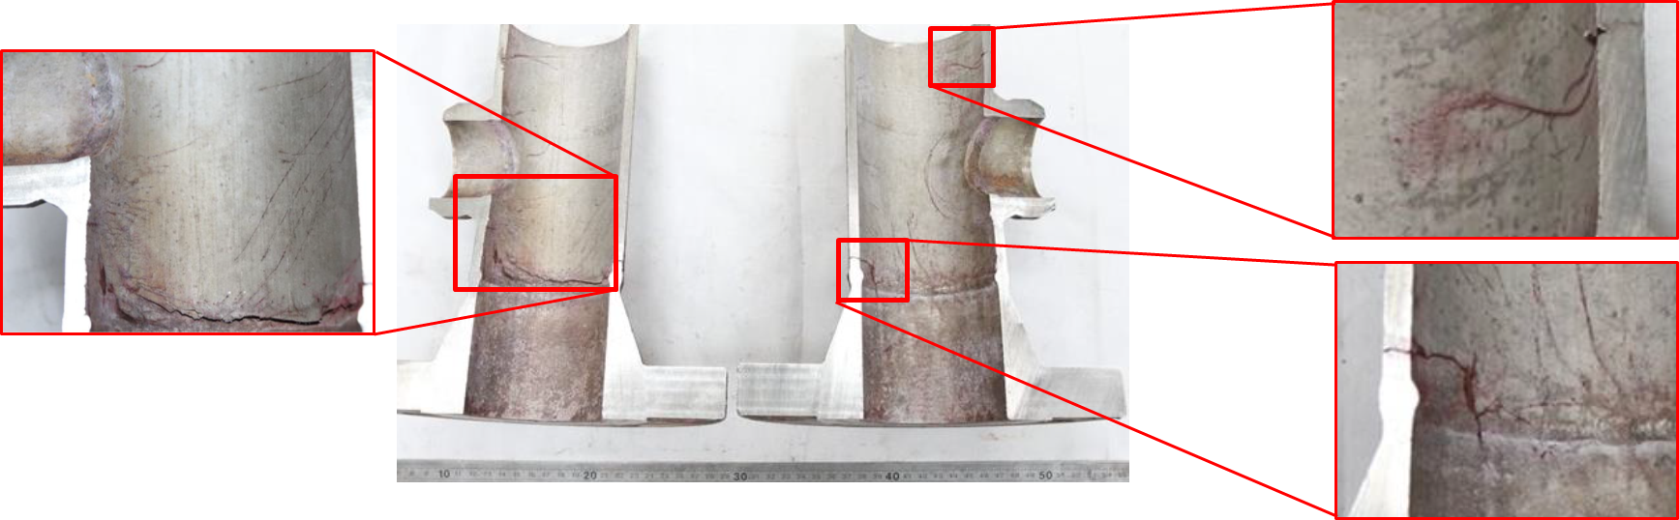
Evaluation Of 3” Pipe Sample (Dead Leg)
DPT was performed in this pipe (internally and externally) showing several cracks with the next characteristics (see Image 6):
-Several fine cracks from the inside surface and many disperse pitting, some of them aligned through cracks.
-Most of the cracks are aligned with the welds and develops in the HAZ.
-In the inside surface of the flange there is some small metal scales, this area is a machined surface.
-One crack suddenly changes its path 90degrees and goes perpendicular through the weld and takes approximately 3mm of the material of the flange. This is the only crack found on flange base material.
Image 6. Internal view of crack on 3” pipe sample

Slide 8
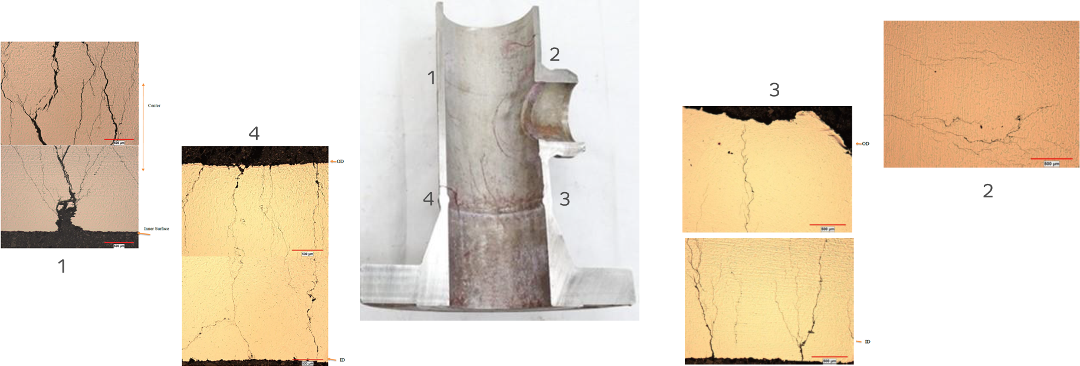
Evaluation Of 3” Pipe Sample (Dead Leg)
Metallographic examination confirms the presence of cracks along the thickness of the pipe (see Image 7 detail 4).
Also shows that most of the cracks are initiated from the inside (see Image 7 detail 1 & 3).
Image 7. Metallographic examination 3” pipe

Slide 9
Results
The damage mechanism is confirmed to be CL-SCC (Chloride Stress Corrosion Cracking), from the craze cracks seen on the cut samples and from the metallographic analysis showing branches mostly intergranular, typical of this phenomenon. Also transgranular cracking was observed on some locations.
Most of the cracks on both samples initiate from the inside, indicating that the process fluid promoted the damage mechanism.
This damage mechanism is only possible in presence of water (Moisture), but the content of water (Moisture) in the stream by design should be less than 25 ppm. This finding matches with the process excursions reported in November 2018 and March 2019, which led to an increase in the water levels (Moisture) in the system.
Dead legs get filled with process deposits such as coke causing the concentration of corrosive species like Chlorides, which in presence of moisture create the appropriate environment for accelerated corrosion mechanisms such as Cl-SCC.

Slide 10
Conclusions - Recommendations
Material Compatibility
Under the designed operating conditions the actual material (SS 316L) is suitable for the service as proven by its 15 years of service with no previous failure until this process excursion.
If the water ingress (Moisture) is present beyond current design limits during normal operation for extended periods, then the material can be upgraded to Monel (alloy 400) Ni-Cu alloy, which is more resistant to this damage mechanism due to its high Ni content.

Slide 11
Conclusions - Recommendations
Corrosion Mitigation Actions
Control of moisture through IOW’s.
Process parameters which exceed the defined Integrity Operating Window will trigger a series of actions to verify the accuracy of the reading, troubleshoot the excursion, evaluate the impact and conduct proper inspection of the lines related the affected circuit to restore the normal condition and keep a safe and continuous operation.
Flushing of low points/dead legs is an operational practice that minimizes coke deposition and stagnation that creates an adequate environment for water settlement and Chloride Stress Corrosion Cracking to develop.

Slide 12
Conclusions - Recommendations
Inspection Scope
Early stage cracks are not easily detectable by RT, it will be able to identify crack once networks already developed. (Applicable for SBP deadlegs).
DPT can be performed externally in order to identify cracks generated by SS-CUI (External Cl-SCC), or through thickness cracks already breaking to the surface. (Applicable for all components to identify external Cl-SCC).
Ultrasonic scanning (C Scan / Mapping) can be used to identify internal pitting originated by HCl corrosion, and as these are initiation points for cracks it can help on the early detection of cracks related to Cl-SCC. (Applicable for non-SB
Sampling
In order to identify damage at early stage sampling and testing might be required after major moisture excursion to supplement the conventional inspection techniques.
It is very important to preserve the failed components in the “as received” condition and do not damage the evidence.

Slide 13
Thank You

