Slide 1
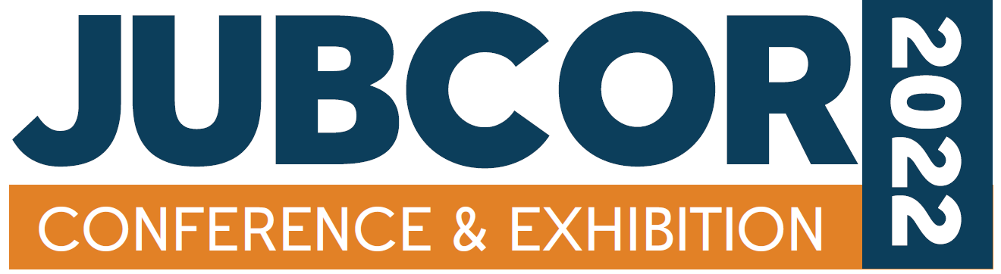
Application of a New Boiler Corrosion & Scale Control Automation
Mohammad Al-Shaikh
Industry Technical Consultant @ Nalco Water

Slide 2
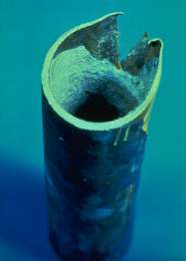
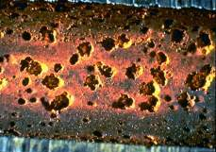
Primary Water Related Challenges when Operating a Boiler
Mineral Scale/Deposition
  Forms as a result of dissolved minerals in the feedwater exceeding solubility
  Scalants are magnesium, calcium, iron, silica based salts
  Forms insulating material
  Impedes heat transfer
  Can result in equipment damage / boiler shutdown / loss of production
Corrosion
  It causes metal loss in one area of a boiler system, which reduces asset life
  Causes iron deposits (another type of scale) on boiler tubes (energy losses)
  Shutdown, production loss and safety issues

Slide 3
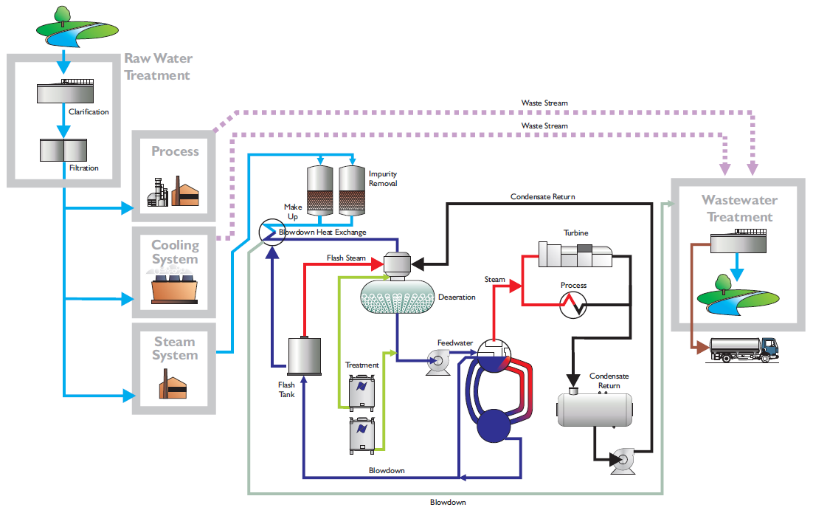
Steam system: A Holistic approach
We look beyond a single unit operation

Slide 4
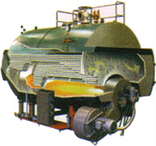
Steam System Treatment
Pre-treatment
(oxygen scavengers)
Internal Treatment
(scale & corrosion control)
Condensate Treatment
(corrosion control)
Proper boiler water treatment prevents deposits and corrosion ensuring reliable and safe production of steam at reduced energy and water consumption and greenhouse gas levels.

Slide 5
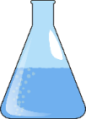
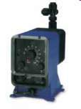
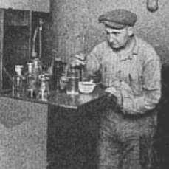
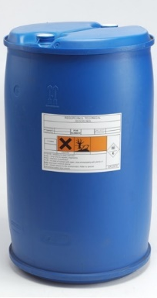
Overall, The Basic Approach To Controlling Boiler Feedwater Chemistry Hasn’t Changed Much In 50 Years
“Test & adjust” approach
  Gather sample
  Test
  Adjust chemical feed
  “Repeat as necessary” ∞
1
3
2
(wasted chemical)
USL
LSL
Equipment damage / efficiency loss / production loss

Slide 6
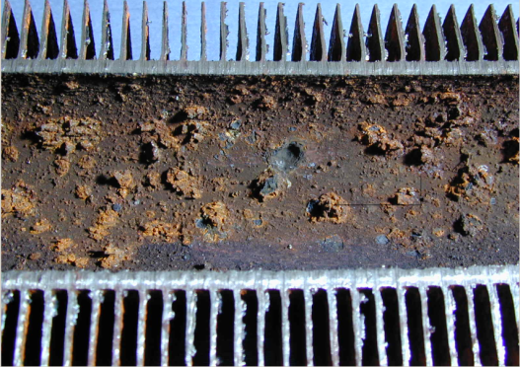
Current monitoring practice
Grab sampling and/or on-line methods
  Grab sampling only provides snapshots
Use of indirect methods for determining corrosivity
  pH
  Conductivity
  Dissolved oxygen
  Iron
  Reductant residuals
Notes:
Traditional measurements such as pH, product residuals and dissolved oxygen measurements, are indirect methods used for estimating the corrosivity of the boiler feedwater. The industry pays special attention to dissolved oxygen measurement as the key indicator for corrosive conditions.
Please note that historically we referred to reductants as “oxygen scavengers”. With the new technology described on the next slides we now know that reductants do more then scavenge oxygen alone! Therefore we refer to the terminology “reductant”.
Moreover, corrosion products are released every time there is a thermal, chemical, or hydraulic shock to the system, and current iron monitoring practices often lead to questions on the validity and interpretation of the data produced. Grab sampling only provides a snapshot, but if the full extent of the events could be made visible, responses could be developed to minimise corrosion and iron transport to critical heat transfer surfaces.
The traditional measurements are still important as they relate to boiler manufacturers specifications or industry standards.

Slide 7
…And Is Still Largely Centered Around Testing The Water After It Is In The Boiler
An event taking place here….
…could take hours or days to show up here!
By then, its far too late to detect or remedy

Slide 8
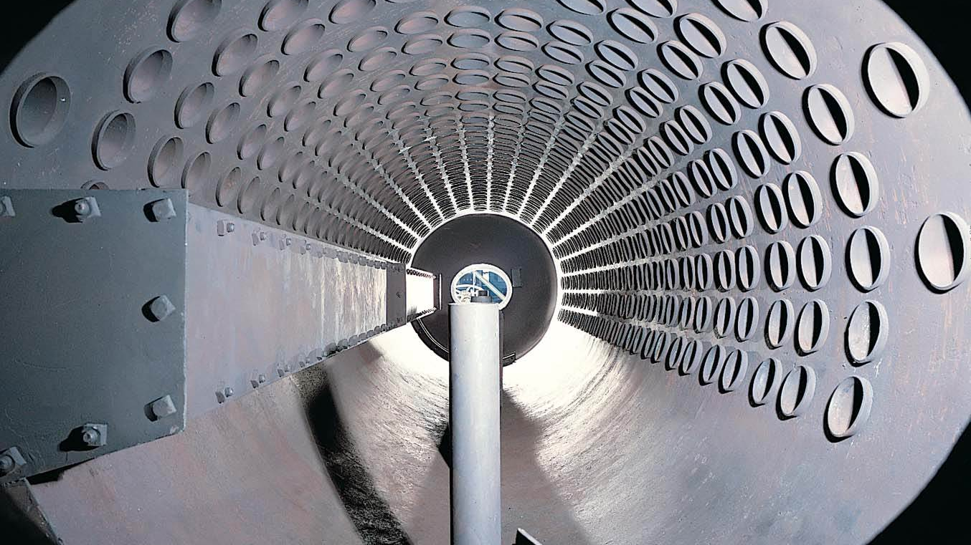
Causes of Boiler System Failures
Note that BFW Quality is considered to be the cause of most boiler system failures
Other
Chemical
Control
Condensate
Corrosion
Poor BFW
Quality

Slide 9
Pre-boiler Corrosion
Chemical Factors
pH
Scavenger
Residual
Pre-boiler corrosion
Other
Contaminants
O₂
Temperature
DA
Performance
Retention
Time
Fluid
Velocity
FW
Demand
Metallurgy
Outages
Measuring the Oxidation Reduction Potential (ORP) in the bulk water is measuring the corrosivity of the system
@T ORP is the key performance measurement
Mechanical & Operational Factors
Notes:
In understanding preboiler corrosion it is important to realize that this can be a complicated ‘space’ (topic) with many variables. Also many of these topics are not simply confined to preboiler corrosion but really apply to all corrosion phenomena in the boiler water, and other water industries.

Slide 10
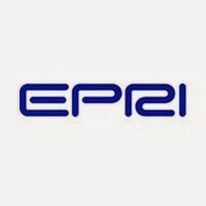
EPRI Cycle Chemistry Guidelines for Fossil Plants:
Phosphate Continuum and Caustic Treatment, Jan 2004, Appendix B.
“Thus ORP should be used to control the oxidizing power of the feedwater in all-ferrous systems or, and more importantly, the reducing power of the feedwater in mixed-metallurgy feedwater systems.”
“The future direction should be to develop the technology to measure ORP in-situ in feedwater, and to extend the mixed-potential model for use at the elevated temperatures, where components are actually in contact with high temperature water, such as in the boiler.”

Slide 11
BFW Oxidation / Reduction Potential (ORP) Monitoring
ORP correlates to the corrosion stress of the aqueous environment
    More oxidizing - can be more corrosive
    Potential difference between measuring and reference electrodes
    More reducing – can be more passive
ORP is influenced by temperature, pH, O2, dissolved solids, etc.
ORP = Oxidation / Reduction Potential.
+
0
-

Slide 12
@T ORP vs RT ORP
(at Temp vs Room Temp –from economizer outlet)
ORP Cell Internal Configuration
Notes:
So why not use regular ORP measurements on a cooled feedwater sample (“Room Temperature ORP”)
KEY TAKEAWAY: @T ORP (black line) is fast and very sensitive to system changes even when compared to RT ORP. Notice with the room temperature ORP (red line) barely detected the redox event. Highlight the small bump with your laser point.
RT ORP means the sample stream is cooled, then measured using the same type of ORP instrument that is commonly used for biocide control in CW systems.
This slide discusses a trial in a 200MW coal-fired power plant and shows how @T ORP responds to oxygen ingress upon startup after a trip.
During that time we not only optimized the Elimin-Ox feed to maintain the optimum ORP setpoint as the graph shows, and successfully manage the stress of the startup, but the plant has also set records for speed of unit start-up after a trip. It now takes only 5 hours to come up to full load with no holds on silica or TDS. It normally took 2-3 days (48-72 hours). This translates to approximately $134,000 savings per trip based on the cost differential between this customer’s generating costs and the cost of replacement power.

Slide 13
LOOKING INSIDE Without Opening Your Boiler
ORP@T patented sensor allows us to DIRECTLY MEASURE Feed Water CORROSIVENESS
High
Low
+300
Regular
control
+200
Pitting
+100
Feed water corrosiveness
0
Reductant feed
NCSM control
-100
Feed Water Corrosion Stress Monitor (mV)
Close to Pitting Zone
High General Corrosion Rate
-200
-300
-400
Low General Corrosion Zone
-500
Low
High
High
-600
Notes:
NCSM = Nalco Corrosion Stress Monitor

Slide 14
Scale and deposit control
Ions and particles in the boiler feedwater concentrate in boiler and can form scale and deposits resulting in lower efficiency and possible tube failure
Treatment program contains unique inert, fluorescent tracer
Can be used to measure and control the level of Antiscalant in the system
Excitation
Filter
Emission
Filter
TRASAR
Detector
Light
Source
Flow
Cell
Sample Water
Notes:
By preventing deposition of corrosion products and hardness scale, clean heat transfer surfaces are assured, resulting in operational efficiency and reduced risk on waterside corrosion. Heat losses via the blowdown are minimised by improved blowdown practices.
Nalco programmes can contain an inert trasar that can be used for controlling the feed of the internal treatment program and for determining the cycles of concentration.

Slide 15
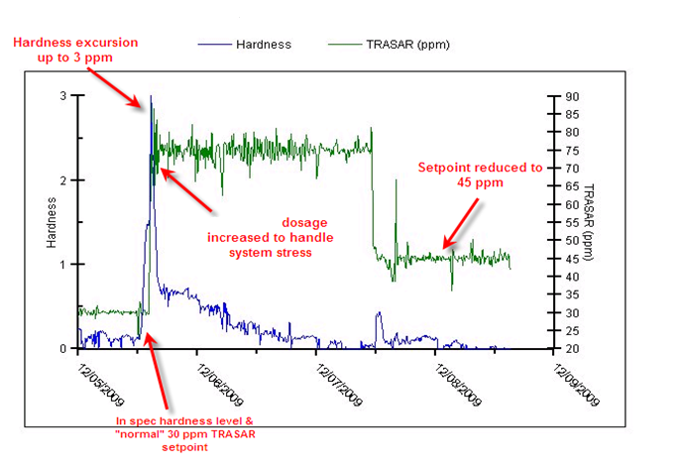
Real time Internal Treatment Control
Realtime hardness excursion over the weekend.... and takes swift action to handle the system stress.

Slide 16

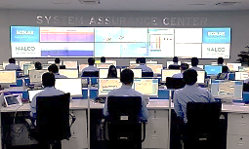
Condensate
Process
DCS
Deaerator
Boiler
Blowdown
Feed water
Integrated solution
Integrated solutions
bring more value.
BFW
Analyzer/Controller
Boiler Water
Analyzer/Controller
Oxygen Scavenger
Internal treatment
System Assurance Center
The most effective means of Energy and Water Optimization is Automated Cycle Control

Slide 17
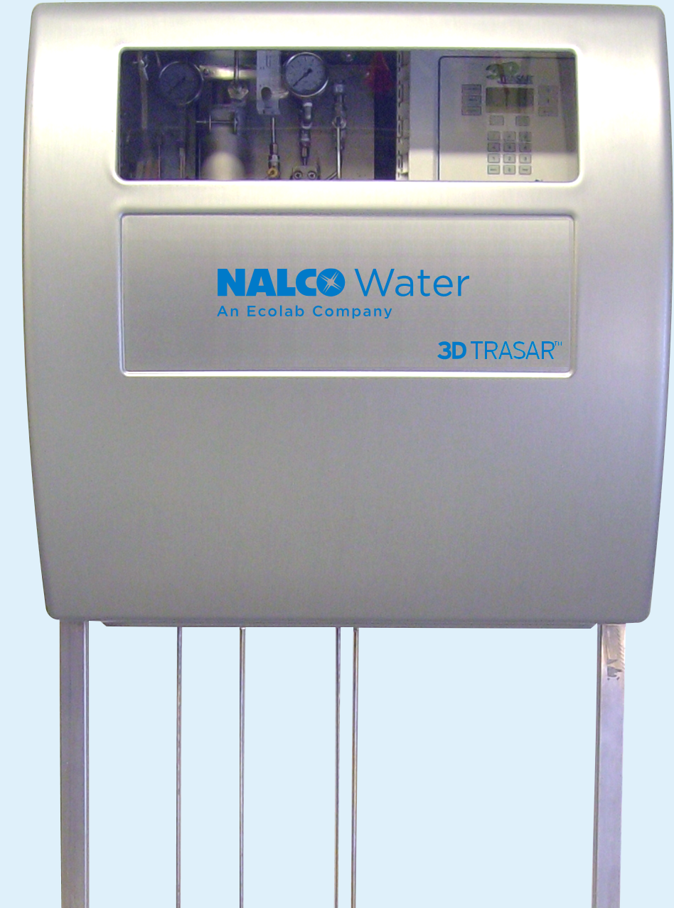
Sample conditioning
Corrosion treatment
Scale treatment
Digital
PI
PI
Chemistry
Oxygen scavenger chemistry
Monitor
Corrosion stress with ORP@T in feedwater
Control
Chemistry dosage in deaerator
Chemistry
internal treatment chemistry
Monitor
TRASAR with Fluorometer in feedwater
Control
Chemistry dosage in feedwater
Communication
Wireless gateway
Website
dashboard and historical data
Remote experts
System Assurance Center
24/7/365
pH, conductivity
Fluorometer

Slide 18

Overcoming Steam Generation challenges
Challenge
Root Cause
Real Time/Automation
Energy cost, carbon footprint
Scaling, low cycles
Continuous advanced monitoring and control of internal treatment and oxygen scavenger chemistry prevents scaling and corrosion, maximizes heat transfer, allows higher cycles, protects assets and operators, prevents stops.
Remote expert monitoring and alarming by System Assurance Center & Web based platform
Water usage
Low cycles
Repair cost, production stop, operator safety
Tube ruptures due to scale and corrosion

Slide 19

MINIMIZE Water
Make-up water intake
MAXIMIZE Results
Energy usage, carbon footprint
Steam production
Reliability and safety
OPTIMIZE Costs
Operation
Energy, water
Assets, repairs
14.2M
GJ
785k
tonnes CO₂
11.4M
m³
ENERGY
AIR
WATER
Saved in 2020

Slide 20
Thank You

