Slide 1

TANK ROOF FAILURE DUE TO BUTADIENE POLYMERIZATION
Presented by:
Rajesh Hemachalam
Sr. Inspection Engineer

Slide 2
Contents
Introduction
Problem Statement
Butadiene Undesirable Reactions
Roof Failure
Extent of Polymer damage
Preventive Actions

Slide 3
Introduction
Butadiene Storage tank at the port is designed to API-620 Annex-R (Covers tank operating from -51°C to 4°C
Subject single wall insulated tank operates at -6°C with a design pressure of 2PSI
Elevated tank with insulation under bottom plate, over shell & Roof.
MOC - ASTM A537 Cl-1
Insulation analysis revealed thermal conductivity increase of 58.4% compared to new insulation
Tank due for inspection and was in preparation for decommissioning.

Slide 4
Problem Statement
During area surveillance leak observed through portable gas detector around shell manway & roof compression ring
Leak from manway temporarily repaired by non metallic wrapping to continue tank decommissioning process
Further inspection performed to investigate roof leak through Acoustic emission & IR Fugitive emission camera.
Leak concluded around 2nd ring of roof under the insulation through IR camera and temporarily repaired to continue tank decommissioning process
Insulation removal at the leaking location revealed a ~250mm long roof lap weld joint rupture

Slide 5
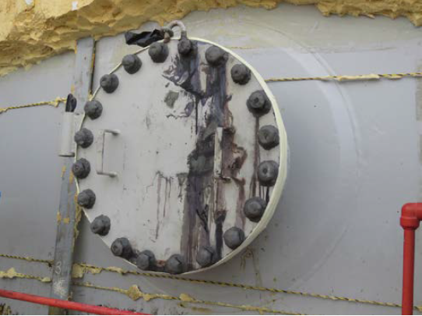
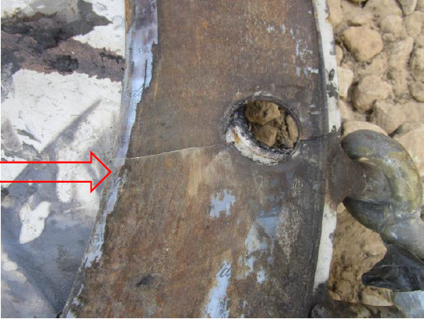
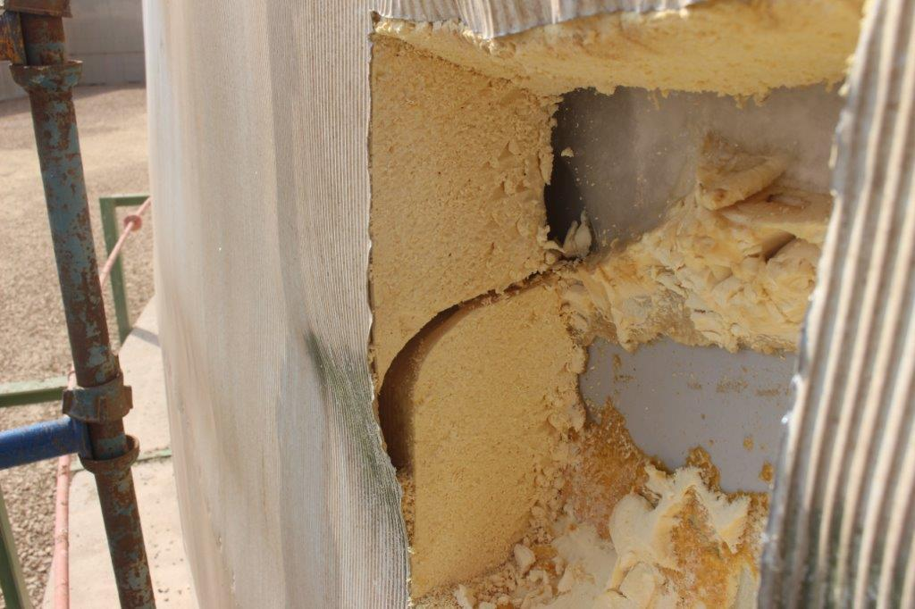
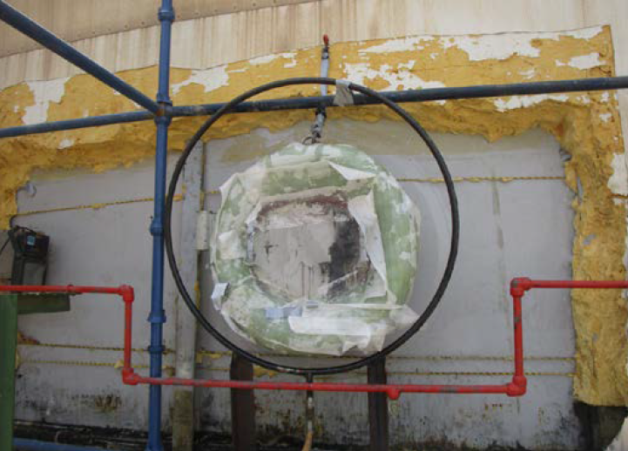
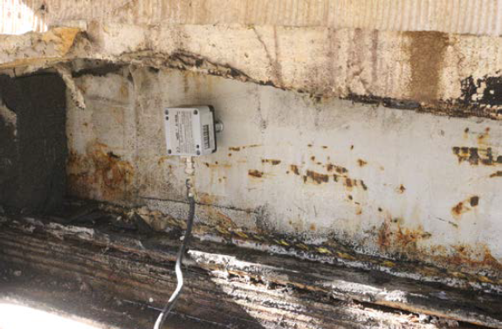
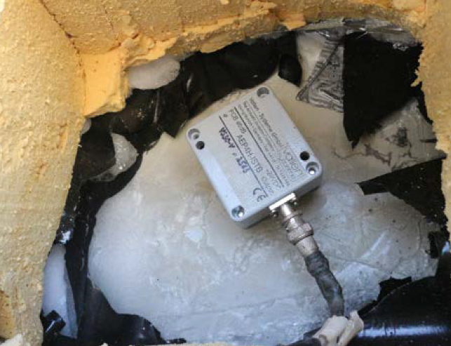
Observations

Slide 6
Butadiene Undesirable Reactions
Some of the undesired reactions involving Butadiene that can occur during manufacture, storage, handling, distribution and use are,
  Butadiene peroxide formation
  Popcorn polymer formation
  Rubber (or plastic) polymer formation
  Dimerization
  Reaction from butadiene overcharge
  Butadiene incompatibilities

Slide 7
Butadiene Peroxide & Popcorn formation
Butadiene and oxygen readily react to form thermally unstable butadiene peroxide which is explosive, sensitive to heat, and can initiate rapid polymerization.
Mechanical shock can also result in the explosive decomposition of these peroxides.
Butadiene peroxide is believed to play a primary role in the formation of butadiene popcorn polymer
In a confined space, the growth of popcorn polymer can cause sufficient pressure build-up to rupture pipes, condenser shells, valve bodies and other metal parts.

Slide 8
Butadiene Peroxide & Popcorn formation
Popcorn polymer is most likely to form in vapor spaces where the concentration of conjugated diene is high.
The oxygen that participates in the formation of popcorn polymer usually comes from air or peroxides.
However, rust and water can enable it to form even in the absence of air. Rust (iron oxides) alone may even have some ability to initiate popcorn polymer in the absence of water.
Once formed, popcorn polymer seeds can propagate on their own due to internal stresses which generate new free radical sites within the polymer matrix with which more monomer can then react.
Popcorn polymer is so reactive that it may auto-ignite when exposed to air (spontaneous combustion).

Slide 9
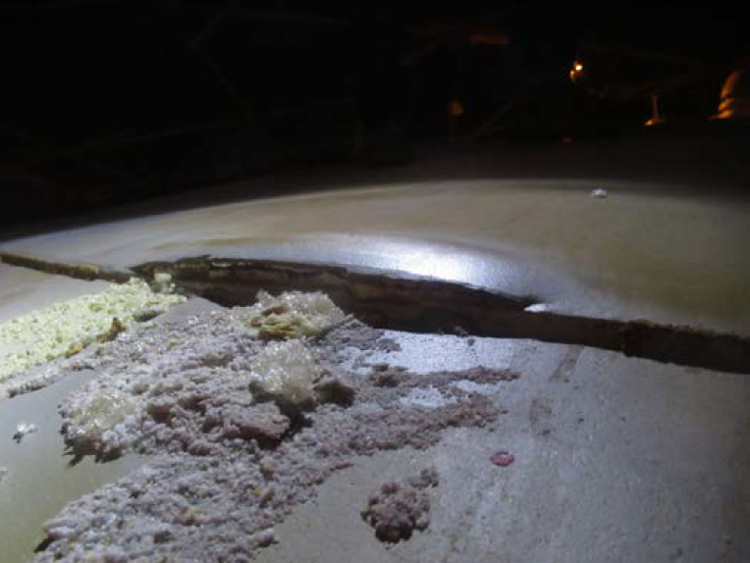
Roof Failure

Slide 10
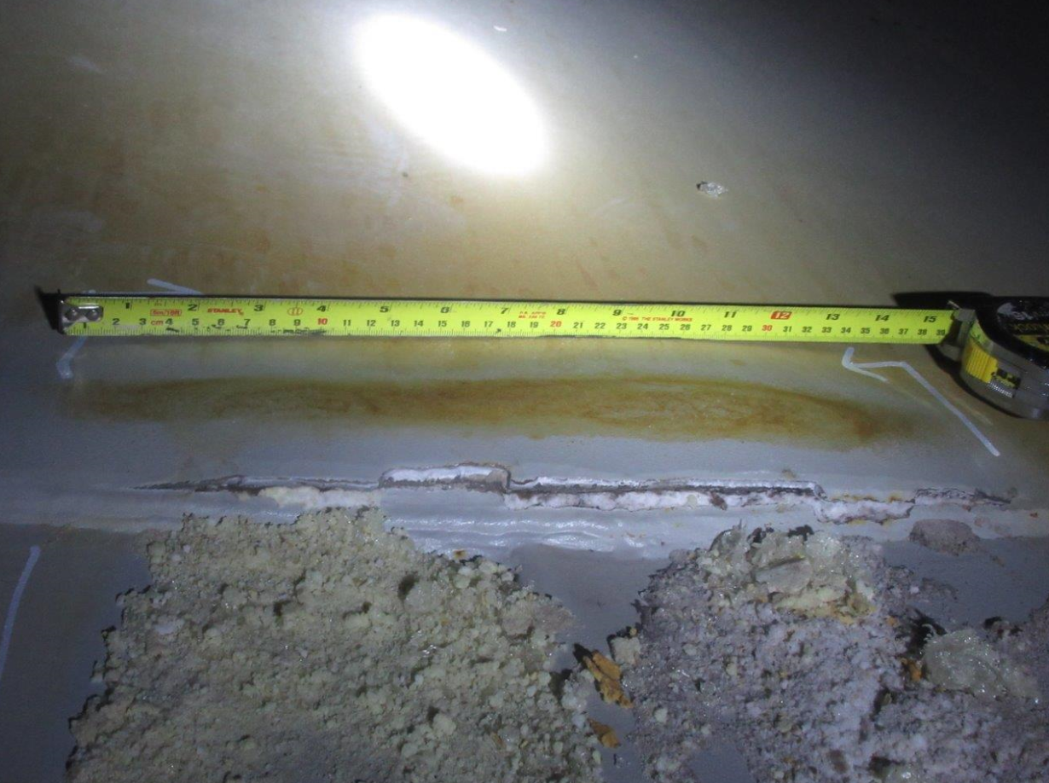
Roof Failure

Slide 11
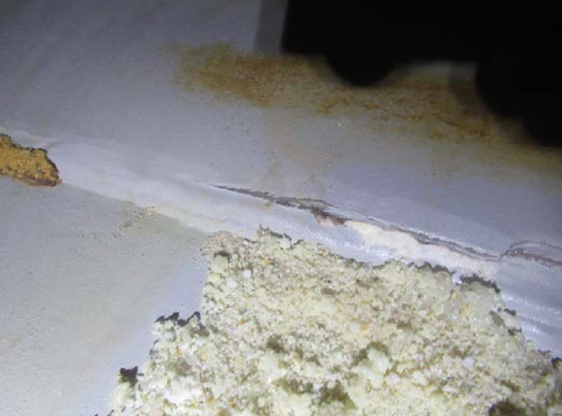
Roof Failure

Slide 12
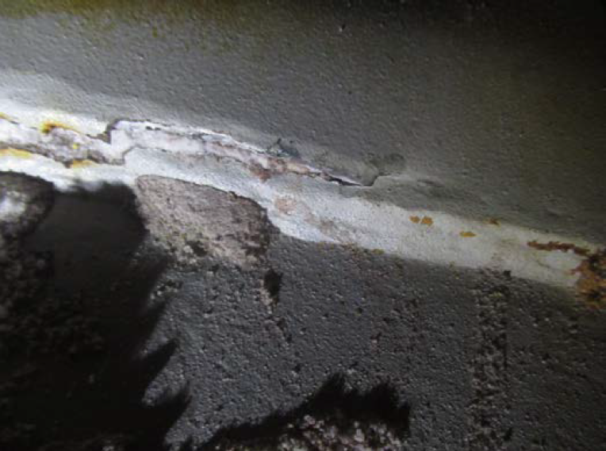
Roof Failure

Slide 13
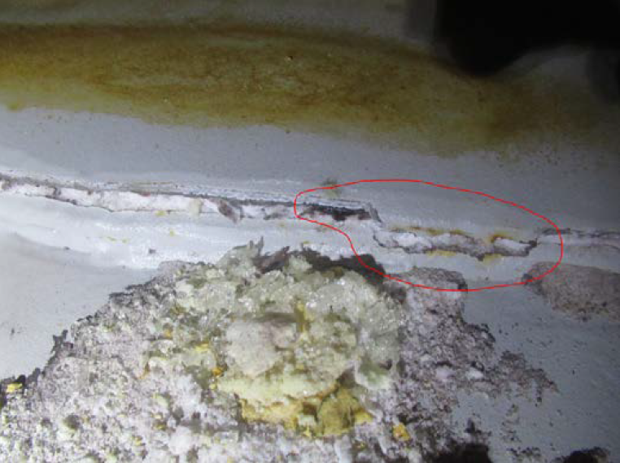
Roof Failure

Slide 14
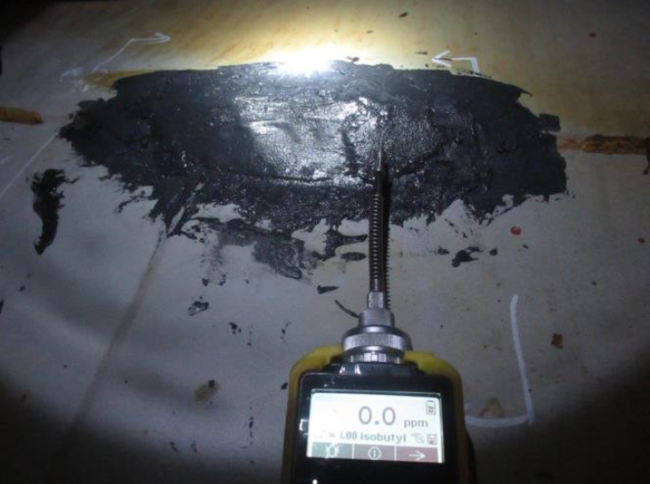
Roof Failure

Slide 15
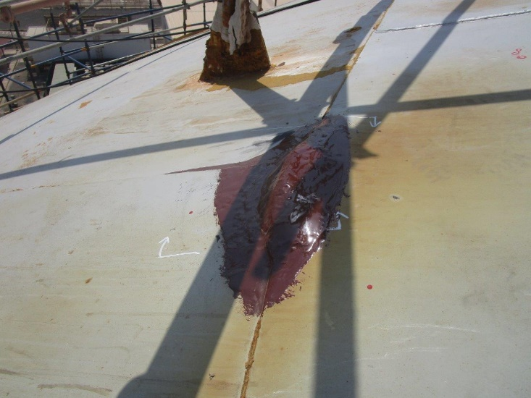
Roof Failure

Slide 16
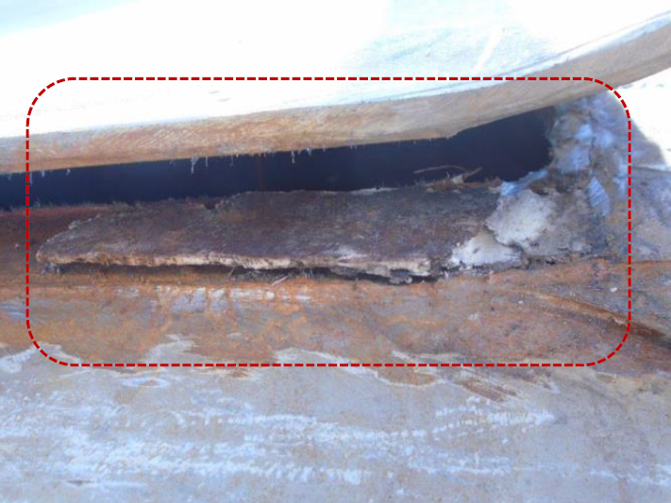
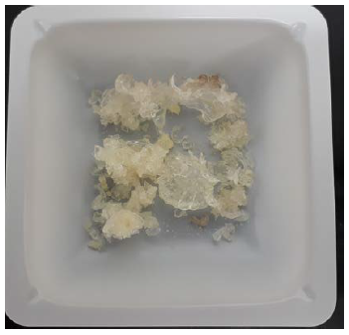
Roof Failure

Slide 17
Extent of Polymer damage
DPT over entire roof internal lap weld joints revealed 338 rounded indications
All indications were grinded to verify if it is a through hole and concluded 9 holes
All the weld joints around 9 holes were cut, polymer observed, cleaned & rewelded entire section of the weld until next intersection
Portion of the Roof plate where the lap weld joint ruptured were replaced by in kind butt welded insert plate

Slide 18
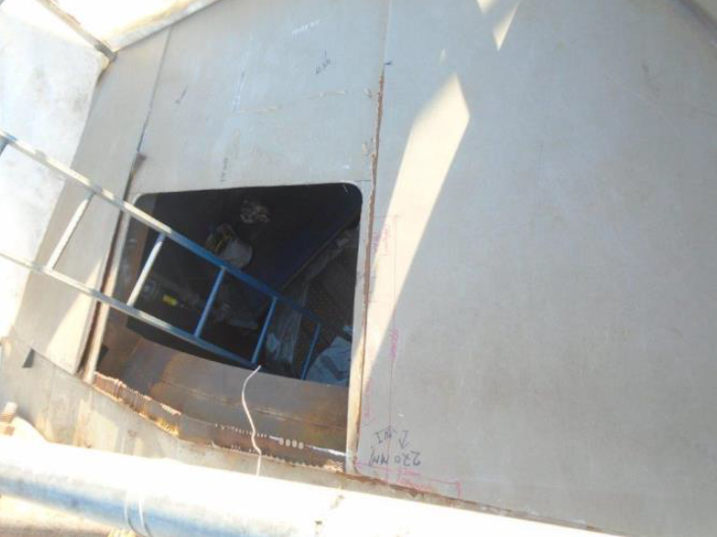
Notes

Slide 19
Preventive Action
Peroxide Formation:
Exclusion of Oxygen from the process equipment
Adding inhibitors such as TBC & diethylhydroxylamine (DEHA) to scavenge oxygen
Avoiding dead legs & low spots if unavoidable then ensuring bleeds in design so that the phase separation doesn’t occur
Cleaning Strong caustic solutions will destroy peroxides) & Inspection of lines
Popcorn Formation:
Thorough removal of popcorn polymer found in equipment will minimize potential for seeds to initiate further growth when equipment is returned to service.
New equipment or equipment being returned to service should be purged to remove oxygen and can be acid-cleaned and then treated with a hot sodium nitrite solution (However, solutions greater than 5% and/or pH less than 7 Forms spontaneously combustible product) to remove rust and "passivate" the metal surface in order to reduce the tendency to form diene polymers.
Periodic, controlled venting of all high points in vapor spaces will minimize oxygen accumulation. Other preventive measures include minimizing "dead" vapor spaces, keeping peroxide levels low, and minimizing low points and "dead" legs in the piping systems.

Slide 20
Thank You

