Slide 1

HYDROPHOBIC AND ANTIMICROBIAL COATINGS FOR HVAC WATER COOLING TOWERS

Slide 2
Outline
Antifouling and Antimicrobial Coating
Ytterbium Oxide and Titanium Dioxide
SEM, EDS and Hydrophobic Testing Before Field Placement
Water Cooling Towers Field Placement
Testing Results After Field Placement
Conclusion and Recommendations
HVAC Water Cooling Towers Systems
Notes:
First, I will start by small introduction with brief background about Antifouling and Antimicrobial Coating

Slide 3
ANTIFOULING AND ANTIMICROBIAL COATING

Slide 4
Introduction
Water cooling tower fouling is consider as global problem for cooling and HVAC systems.
It has economic and environmental impacts.
One of primary solution is to use hydrophobic and anti-bacterial coating
Hydrophobic coating and antibacterial coating especially photocatalytic are expected to improve this issue.
Designing surfaces preventing fouling and biofilms structure of bacteria.
Notes:
Water cooling tower fouling, the undesired growth of algae and bacteria on submerged and splash zone surfaces, are a global problem for cooling and HVAC systems.
It has economic and environmental impacts.
The primary strategy for water cooling tower fouling is to use hydrophobic and anti-bacterial coating. Science and technology towards intensive study for proper and economical selection.
The combination of ceramic coating along with hydrophobic coating and antibacterial coating especially photocatalytic are expected to have a significant impact on the development of these coating systems.
In designing surfaces preventing fouling due to common reasons such as to proteins, bacteria, and marine organisms have forked approaches. It is widely accepted that bacteria survive by imputation to surfaces, in biofilms structured, where they can persevere for long periods.

Slide 5
Antifouling Coating Types
The antifouling coating have many different types and functions. Some of them are generally used and others for specific functions. The increase of saving row materials and focusing in long life span materials enhance technological service to develop new many coating types (2). Antifouling and antibacterial coating are rapidly involved essentially in applicable surfaces (3). This classifying based on the coating mechanisms in delivering its functions (3).

Slide 6
Antifouling Coating Types
Release approach
Antibacteria agent release
Passive
Active
Bacteria Triger
Non-release approach
Contact killing
Anti adhesion bacteria repelling
Controlled release
Notes:
The antifouling coating have many different types and functions..
This classifying based on the coating mechanisms in delivering its functions (3).
EXPLAIN GRAPH
Passive → strong but short life
Active → good but long life
Bacteria → good but may be toxic
The increase of saving row materials and focusing in long life span materials enhance technological service to develop new many coating types (2). Antifouling and antibacterial coating are rapidly involved essentially in applicable surfaces (3).

Slide 7
Antimicrobial Mode of Action/Biofilm Formation
Anti-fouling and Bacteria-Repelling are under this type of coating. One of the best advantage is the function type of this coating is to used nontoxic compounds. It is targeting the biofilm formation which is consider the initial step (4). In the beginning, physicochemical interactions between the media and the surface, this considers as reversible. Secondly, after the completion of the first stage, the bacteria proteins start to adhere to surface (2). However, surface topography consider as one of effective factor in succeeding the coating but it is multifaceted (5).

Slide 8
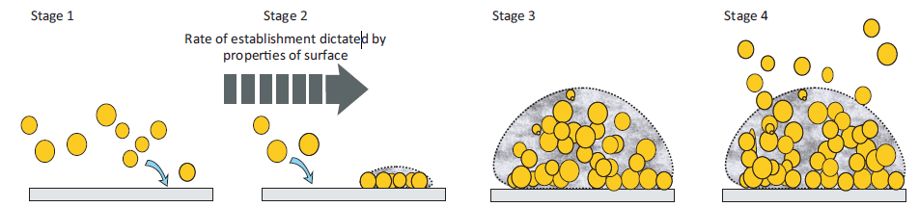
Antimicrobial Mode of Action/Biofilm Formation
Mechanisms of biofilm formation [Green, J-B.D. et al. (2011)]
Notes:
Before explaining this graph,
Anti-fouling and Bacteria-Repelling are under this type of coating. One of the best advantage is the function type of this coating is to used nontoxic compounds. It is targeting the biofilm formation which is consider the initial step (4).
Stage 1
The first step involve in understanding the initiation of bacteria formation on the surface is attachment and monolayer formation. The trigger for this step is the physiochemical forces, such as hydrophobic interactions and van der Waals forces and polar and ionic interactions [6].
Stage 2 (check image)
The bacteria start to present in the surface forming colonization in localized areas. This formation of microcolonies build up to form multilayers and led to next stage [7].
Stage 3
Colonization after colonization, the bactria start to develop structure like. maturation stage is regulated and biofilm formation can consider a mature to continue [6].
Stage 4
When biofilm formation structure is formed, the structure become multi layers of microcolonies. Due to that, the bactiria have sufficient main colonization and start to deactach causing infection

Slide 9
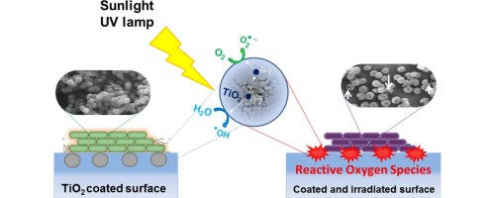
Photocatalytic Coating
Contains photocatalysts as ingredient
Photocatalytic coating is energized by the presence of light.
Mode of action of photoactivated against bacteria is due to oxidative damage
Notes:
A photocatalyst coating is a coating that contains photocatalysts as ingredient
Photocatalytic coating is energised by the presence of light. The excitation of the photocatalyst causes a number of reactions at the surface of the coating.
Photocatalytic activity is a function of the surface morphology of the coating
Aslo, it is disinfection has been proposed for creating antimicrobial building materials, medical devices and packaging films among a wide variety of materials and applications
There is a clear evidence that the mode of action of photoactivated TiO2 against bacteria is due to oxidative damage

Slide 10
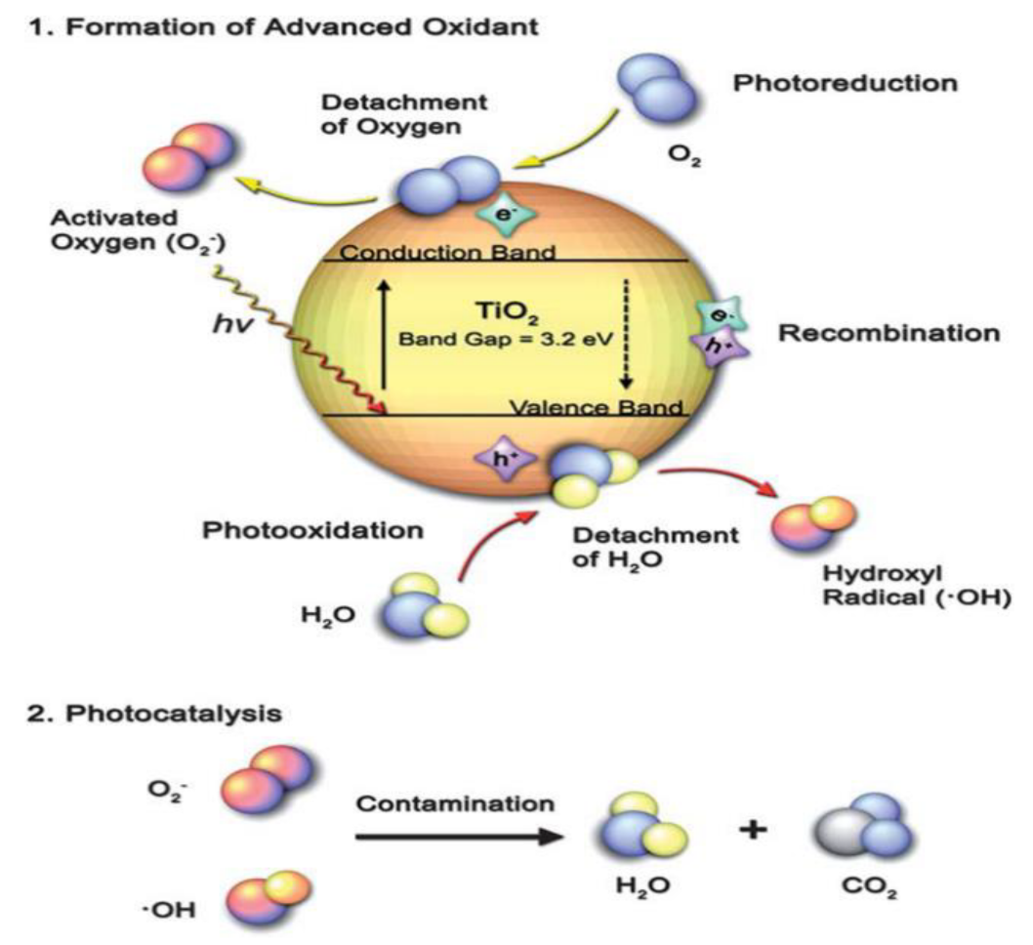
Photocatalytic Coating
Notes:
A photocatalyst coating is a coating that contains photocatalysts as ingredient
Photocatalytic coating is energised by the presence of light. The excitation of the photocatalyst causes a number of reactions at the surface of the coating.
Photocatalytic activity is a function of the surface morphology of the coating

Slide 11
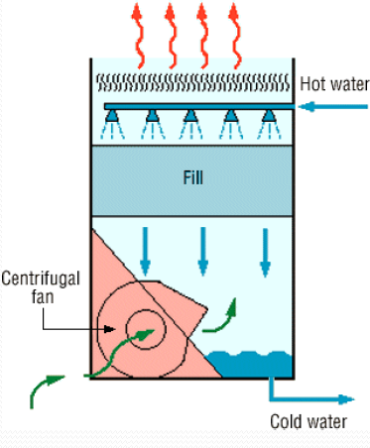
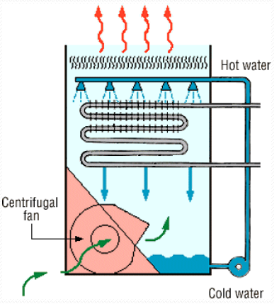
HVAC Water Cooling Towers
A cooling tower is a heat rejection device.
Two major types: mechanical and natural draft
Depends on Wet Bulb Temperature
Notes:
A cooling tower removes heat from the water that is discharged from a condenser. The discharged water is then recycled back into the plant to be used to cool the system again, or discharged into the environment
Picture

Slide 12
Bacteria in HVAC Water Cooling Towers
Cooling tower is the perfect environment for bacteria growth.
Most common bacteria type is Legionella bacteria.
OSHA recommends cleaning cooling tower at least twice a year to prevent the growth of bacteria.
Several methods are used in cleaning HVAC water cooling towers
Cost and time obligate the operation of these systems
Notes:
Cooling tower is the perfect environment for bacteria growth
Legionella grows easily in the water, especially if algae and scale are present which is Most common bacteria.
cooling towers operating properly requires regular cleaning and maintenance to prevent microorganism growth.
The United States Occupational Safety and Health Administration (OSHA) recommends cleaning cooling tower at least twice a year to prevent the growth of bacteria.
Several methods are used in cleaning HVAC water cooling towers:
Chlorinate
Disinfect Tower Basin and Fan Housing
Open and Clean the Distribution Pans
Etc.
Cost and time obligate the operation of these systems

Slide 13
Objective
  To evaluate Ytterbium oxide (Yb₂O₃) Titanium dioxide (Tio₂) performance in cooling and HVAC systems
  Ytterbium oxide (Yb₂O₃) with two different bond coatings Chromium oxide (Cr₂O₃), Yttria-stabilized zirconia (YSZ).
  Same environment is used for certain duration.
  Effects of factors such as thickness and sunlight in the coating performance
Notes:
The main objective of this study is to measure different coating system used as hydrophobic and antimicrobial coatings for HVAC water cooling towers.
To evaluate Ytterbium oxide (Yb₂O₃) Titanium dioxide (Tio₂) performance in cooling and HVAC systems
The Ytterbium oxide (Yb₂O₃) has two different bond coatings which are Chromium oxide (Cr₂O₃), Yttria-stabilized zirconia (YSZ).
Sample is placed in same environment for certain duration
Finally, to measure factors such as thickness, sunlight and other inferred are understood.

Slide 14
YTTERBIUM OXIDE AND TITANIUM DIOXIDE

Slide 15
The base metal is SS-304 with thickness of 3mm
Three coating systems:
Coating System No.1: 1st coating is Cr₂O₃ and top coat is Yb₂O₃
Coating System No.2: 1st coating is YSZ and top coat is Yb₂O₃
Coating System No.3: TiO₂ and TiO₂ with Cu as single type of coating
Notes:
Before jumping to the experiment set-up, I want to explain the material and coating system used in this experiment.
The base metal is SS-304 with thickness of 3mm
Sample Material have three coating systems:

Slide 16
Coating Materials Used
Samples have different properties:
Coating System | No.1 |  |  |  | No.2 |  |  |  | No.3
Sample | A |  | B |  | C |  | D |  | E |  | F
Base | SS-304 | 3 (mm) | SS-304 | 3 (mm) | SS-304 | 3 (mm) | SS-304 | 3 (mm) | SS-304 | 3 (mm) | SS-304 | 3 (mm)
1st coating | Cr₃O₃ | 100 (μm) | Cr₃O₃ | 100 (μm) | YSZ | 100 (μm) | YSZ | 100 (μm) | TiO₂ | 100 (μm) | TiO₂ +Cu | 100 (μm)
Top coating | Yb₂O₃ | 20 (μm) | Yb₂O₃ | 50 (μm) | Yb₂O₃ | 20 (μm) | Yb₂O₃ | 50 (μm)
Notes:
YZS is one of the common materials used as top coating as thermal barrier coating. It has an excellent properties, such as low thermal conductivity, phase stability to high temperature and good erosion resistance [29].
Cr2O3 is used usually in wear resistance and abrasion applications. It is one of the most used ceramic coating. [30].
Yb2O3 as a rare-earth doping host material [18]. In recent years, Yb2O3 got major attention to be used as environmental barrier coatings. It considers also as superhydrophobic coating. [31].
Tio2 considered adding photocatalytic properties and hydrophilic to the surface. Tio2 has strong oxidation power under UV light illumination. It has chemical and physical stability, non-toxicity [32].

Slide 17
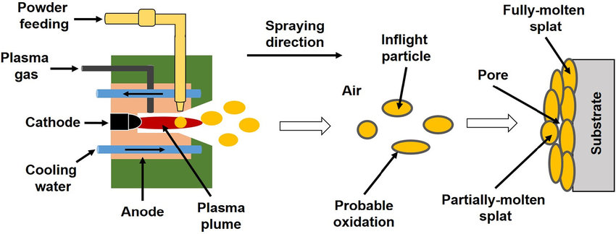
Plasma Spray Processes
Thermal spray processes is used to achieve performance and cost objectives of bulk materials, coatings which used to optimize surface.
Plasma spraying process (PSP) is consider as one of the consistent methods to manufacture TBCs
The sample used in this study is manufacture by using PSP with two layers
Plasma spraying the coatings thickness buildup is very slow
Notes:
Thermal spray processes is used to achieve performance and cost objectives of bulk materials, coatings which used to optimize surface. One of process that provide specification seekers with great flexibility is thermal spray coatings. Thermal spray processes is used commonly in advance and precise application to enhance surface properties such as and limited to turbine aircraft engines and medical implants to workhorse applications for papermaking equipment, boilers, and printing presses
Plasma spraying process (PSP) is consider as one of the consistent methods to manufacture TBCs
The sample used in this study is manufacture by using PSP.
With plasma spraying the coatings thickness buildup is very slow, deposition efficiency also low. Spraying has to be done at short distances (30-40mm), so substrate temperature management is challenging. Therfore, in my case the first ceramic (YSZ or Cr2O3) coat from powder provide us with quick layer formation, and also with a level of initial large scale roughness. These materials are more wear resistant.
This follow by the solution plasma spray, to create thin superhydrophobic surface layer.

Slide 18
SEM, EDS AND HYDROPHOBIC TESTING BEFORE FIELD PLACEMENT

Slide 19
Preliminary Examination Results
The preliminary done on the sample before placing it on the service as fellow:
Cross section SEM and EDS analysis
Material composition of the surface
Hydrophobic testing for coating system No.1 and No.2
Notes:
Detailed study and examinations done on the samples intended in this experiment as Preliminary examination. Including;
cross section SEM and EDS analysis. It is an important step to understand the changes over the experiment period.
Material composition of the surface
Hydrophobic Test for coating system No.1 and No.2

Slide 20
1. Cr₂O₃ (20 μm)

Slide 21
Sample – A, Cr₂O₃ (20 μm)
Spectrum | O | Cr | Yb
P1 | 18.45 | 0.64 | 80.91
P2 | 39.11 | 60.89

Slide 22
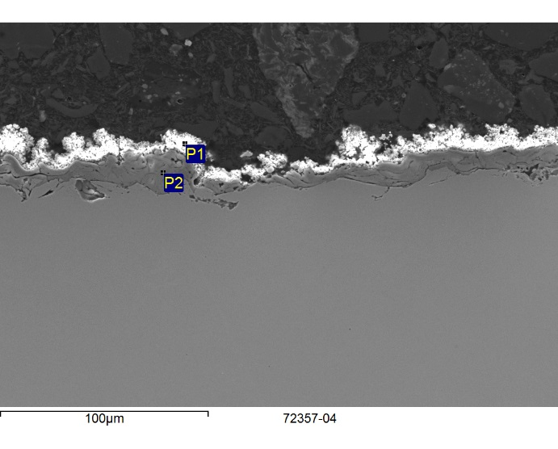
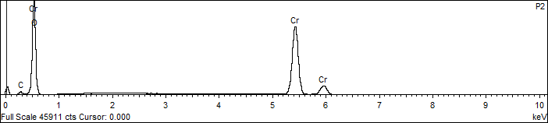
1. Cr₂O₃ (20 μm)
Spectrum | O | Cr | Yb
P1 | 18.45 | 0.64 | 80.91
P2 | 39.11 | 60.89

Slide 23
2. Cr₂O₃ (50 μm)

Slide 24
Sample – B, Cr₂O₃ (50 μm)
Spectrum | O | Cr | Zn | Yb
P1 | 18.17 |  |  | 81.83
P2 | 37.54 | 62.46
P3-black line | 15.51 | 82.75 | 1.74

Slide 25
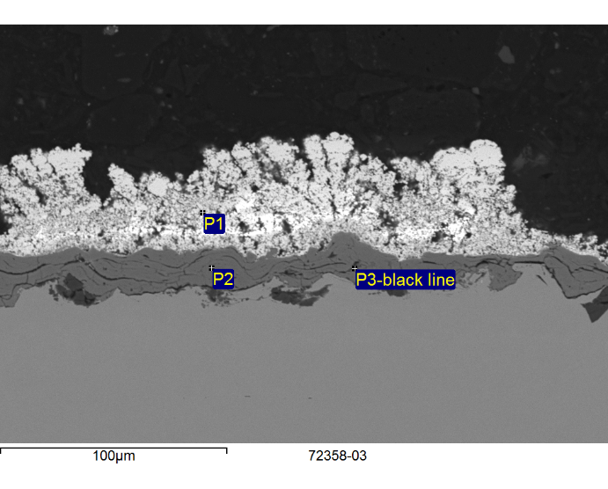
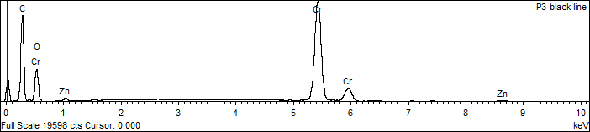
2. Cr₂O₃ (50 μm)
Spectrum | O | Cr | Zn | Yb
P1 | 18.17 |  |  | 81.83
P2 | 37.54 | 62.46
P3-black line | 15.51 | 82.75 | 1.74

Slide 26
3. YSZ (20 μm)

Slide 27
Sample – C, YSZ (20 μm)
Spectrum | O | Y | Zr | Yb
P1 | 17.61 |  |  | 82.39
P2 | 37.63 | 3.78 | 58.59

Slide 28
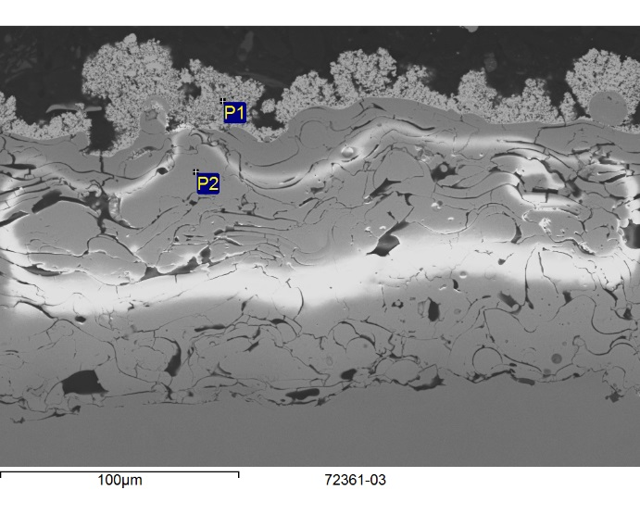
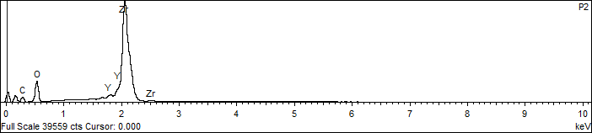
3. YSZ (20 μm)
Spectrum | O | Y | Zr | Yb
P1 | 17.61 |  |  | 82.39
P2 | 37.63 | 3.78 | 58.59

Slide 29
4. YSZ (50 μm)

Slide 30
Sample – D, YSZ (50 μm)
Spectrum | O | Y | Zr | Yb
P1 | 20.61 |  |  | 79.39
P2 | 33.67 | 3.59 | 62.74

Slide 31
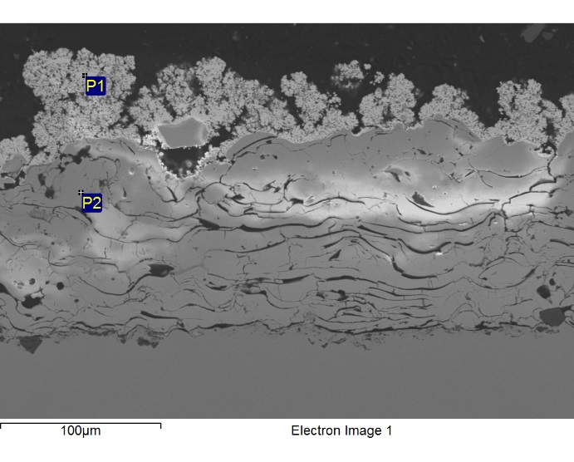
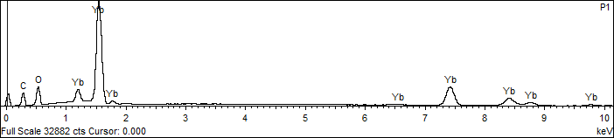
4. YSZ (50 μm)
Spectrum | O | Y | Zr | Yb
P1 | 20.61 |  |  | 79.39
P2 | 33.67 | 3.59 | 62.74

Slide 32
5. TiO₂

Slide 33
Sample – E, TiO₂
Spectrum | O | Al | Ti
P1 | 55.19 | 43.37 | 1.44
P2 | 47.10 |  | 52.90

Slide 34
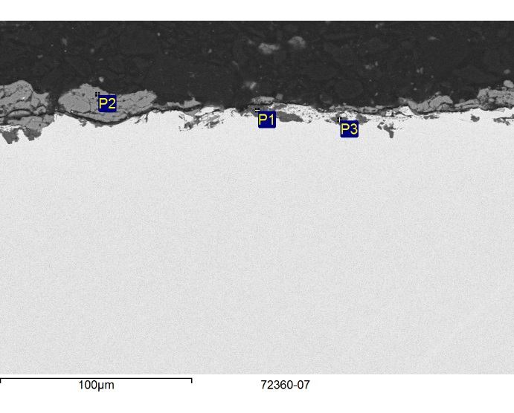
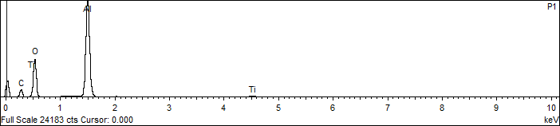
5. TiO₂
Spectrum | O | Al | Ti
P1 | 55.19 | 43.37 | 1.44
P2 | 47.10 |  | 52.90

Slide 35
6. TiO₂ + Cu

Slide 36
Sample – F, TiO₂ + Cu
Spectrum | O | Al | Ti
P1 | 55.19 | 43.37 | 1.44
P2 | 47.10 |  | 52.90

Slide 37
6. TiO₂ + Cu
Spectrum | O | Al | Ti
P1 | 55.19 | 43.37 | 1.44
P2 | 47.10 |  | 52.90

Slide 38
Material Composition of the Surface
Point# | Element (Wt%)
 | O | Yb
Spectrum 1 | 18.9 | 81.1
Spectrum 2 | 14.3 | 85.7
Point# | Element (Wt%)
 | O | Yb
Spectrum 1 | 12.7 | 87.3
Spectrum 2 | 18.2 | 81.8
Sample – A, Cr₂O₃ (20 μm)
Sample – B, Cr₂O₃ (50 μm)
Point# | Element (Wt%)
 | O | Yb
Spectrum 1 | 20.6 | 82.4
Spectrum 2 | 10.9 | 89.1
Point# | Element (Wt%)
 | O | Yb
Spectrum 1 | 20.7 | 79.3
Spectrum 2 | 10.3 | 89.7
Sample – C, YSZ (20 μm)
Sample – D, YSZ (50 μm)
Point# | Element (Wt%)
 | O | Ti | Fe | Cu | Mn | Si
Spectrum 1 | 47.1 | 49.5 | 0.6 | 0.9 | 1.7 | 0.2
Spectrum 2 | 56.1 | 39.2 | 1.5 | 1.1 | 1.9 | 0.2
Point# | Element (Wt%)
 | O | Ti | Fe | Cu | Mn | Si
Spectrum 1 | 49.1 | 33.2 | 23.3 | 1.1 | 0.3 | 0.2
Spectrum 2 | 30.2 | 26.4 | 41.1 | 2.0 | 0.2 | 0.1
Sample – E, TiO₂
Sample – F, TiO₂ + Cu
Notes:
For coating system No.1 and No.2, the composition is almost similar. O is around 18 wt% and Yb is 82 wt% in many points

Slide 39

Hydrophobic Test
$$\cos{θ_{flat}= \frac{γ_{sv}−γ_{sl}}{γ_{lv}}}$$
Notes:
Young [23] introduced equation (2.1) which relates liquid drops contact angle on homogenous and smooth surface with the specific interfacial energies of solid-gas, solid-liquid and liquid-gas.
PICTURE

Slide 40
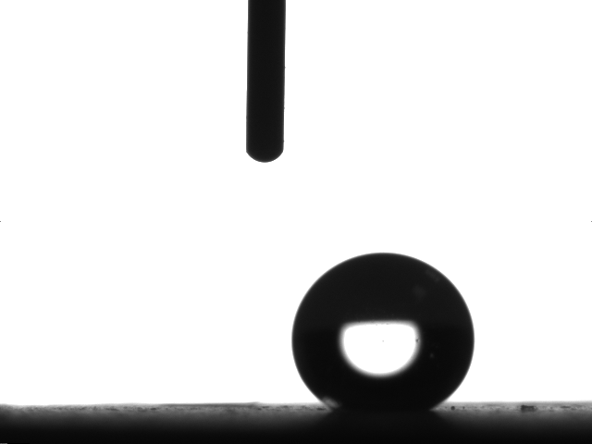
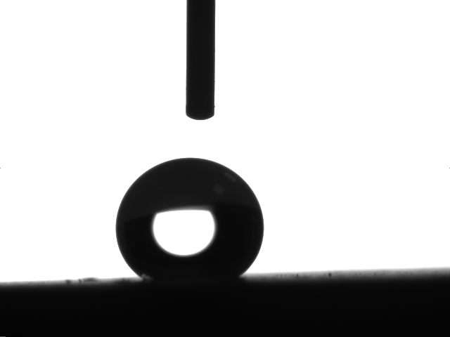
Hydrophobic Test - Coating System No.1
Cr₂O₃ (20 μm)
140.46 °
Cr₂O₃ (50 μm)
148.04 °
Notes:
One important test is required when dealing with hydrophobic surfaces. The contact angle is given indication how the surface it is categories.

Slide 41
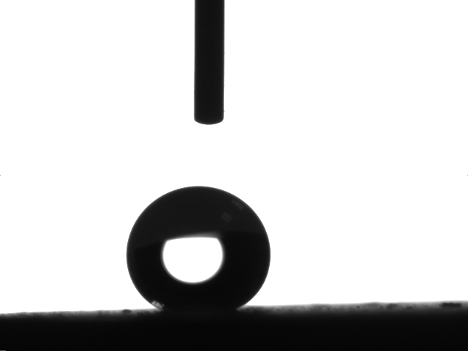
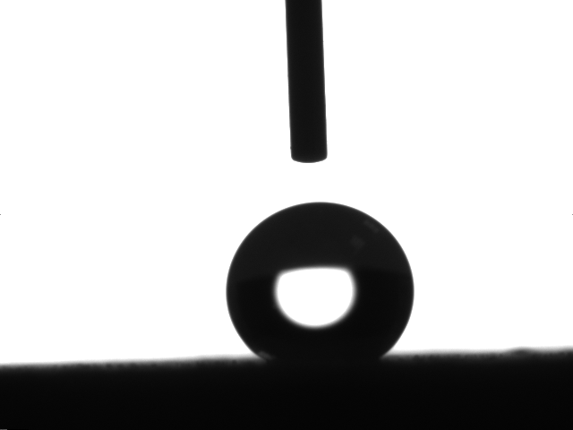
Hydrophobic Test - Coating System No.2
YSZ (20 μm)
142.04 °
YSZ (50 μm)
140.74 °

Slide 42
Hydrophobic Test Results
Sample | 1st run ( ° ) | 2nd run ( ° ) | 3rd run ( ° ) | Average ( ° )
Cr₃O₃ (20 μm) | 137.00 | 140.46 | 141.36 | 139.61
Cr₃O₃ (50 μm) | 143.18 | 148.04 | 140.37 | 143.86
YSZ (20 μm) | 138.42 | 142.04 | 138.84 | 139.77
YSZ (50 μm) | 138.84 | 140.74 | 140.74 | 140.11

Slide 43
WATER COOLING TOWERS FIELD PLACEMENT

Slide 44
Water Cooling Towers Field Placement
The location was selected in the same hot and wet environment.
The location was in water cooling HVAC building.
One set of samples was placed in shade and the other set placed in direct to sunlight.
All samples were in water splash zone to have sufficient water and should have some air flow to not be submerged all the time.
Samples have been placed on Oct. 2018 and collected on Apr. 2019 (6 months) which is considered as two seasons.
Notes:
- The effectiveness of the coating study is not considered in the study

Slide 45
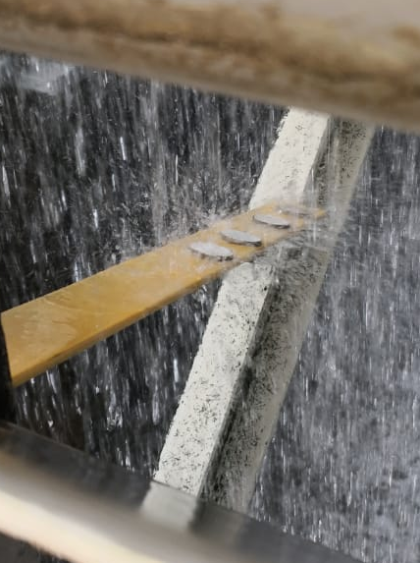
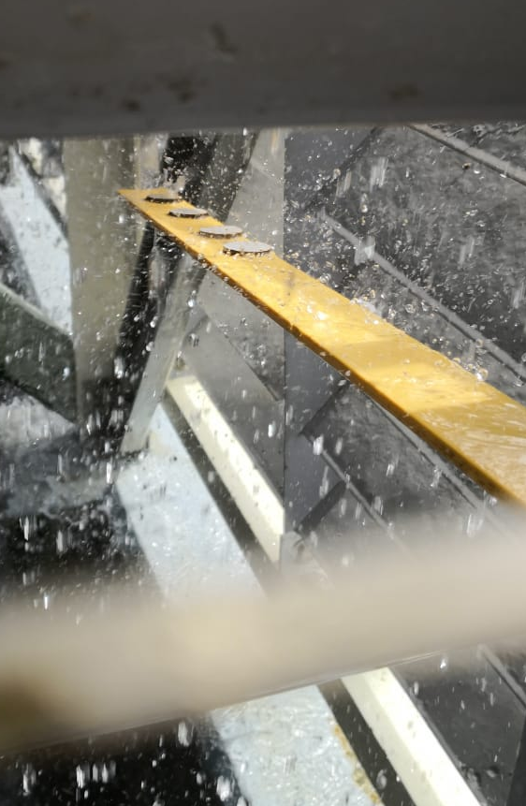
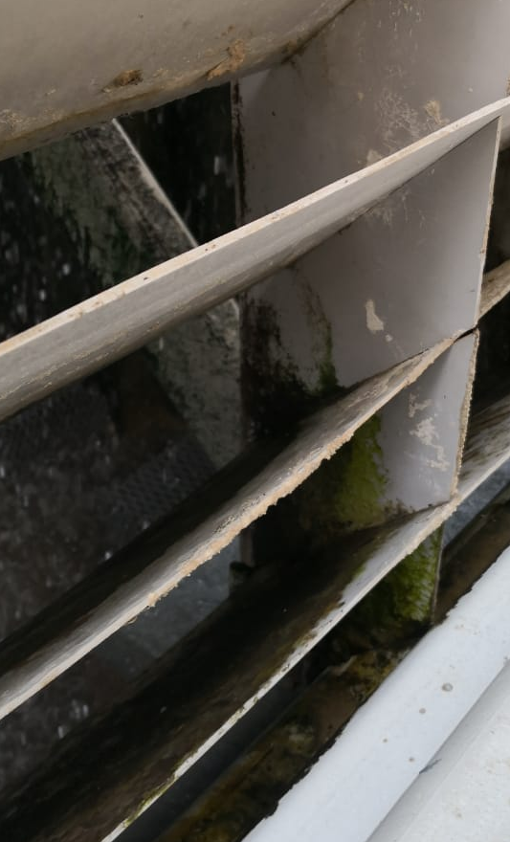
Water Cooling Towers Field Placement

Slide 46
Sample Abbreviation
Sample name | Coating system | Description
Sample name | Coating system | Location | Description
Sample-A | No.1 | Cr₂O₃ -20μm
Sample#1 | No.1 | Shade | Cr₂O₃ -20μm
Sample#5 | No.1 | Sunlight | Cr₂O₃ -20μm Sunlight
Sample-B | No.1 | Cr₂O₃ -50μm
Sample#2 | No.1 | Shade | Cr₂O₃ -50μm Shade
Sample#6 | No.1 | Sunlight | Cr₂O₃ -50μm Sunlight
Sample-C | No.2 | YSZ-20μm
Sample#3 | No.2 | Shade | YSZ-20μm Shade
Sample#7 | No.2 | Sunlight | YSZ-20μm Sunlight
Sample-D | No.2 | YSZ-50μm
Sample#4 | No.2 | Shade | YSZ-50μm Shade
Sample#8 | No.2 | Sunlight | YSZ-50μm Sunlight
Sample-E | No.3 | Tio₂
Sample#9 | No.3 | Location A | Tio₂
Sample#11 | No.3 | Location B | Tio₂
Sample-F | No.3 | Tio₂ + Cu
Sample#10 | No.3 | Location A | Tio₂ + Cu – A
Sample#12 | No.3 | Location B | Tio₂ + Cu – B
Notes:
To make the tracking for the result and discussion,
below table describe the material abbreviation used in this document

Slide 47
TESTING RESULTS AFTER FIELD PLACEMENT

Slide 48
Results
SEM and EDS analysis were performed to assist in evaluation the performance of the coating over the experiment period.
Separate results were studied in point of interest

Slide 49
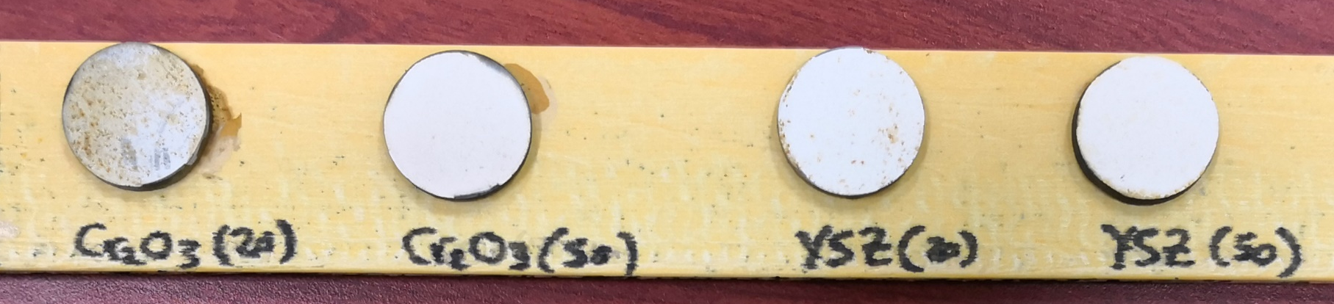
Sample After the Collection (Shade)

Slide 50
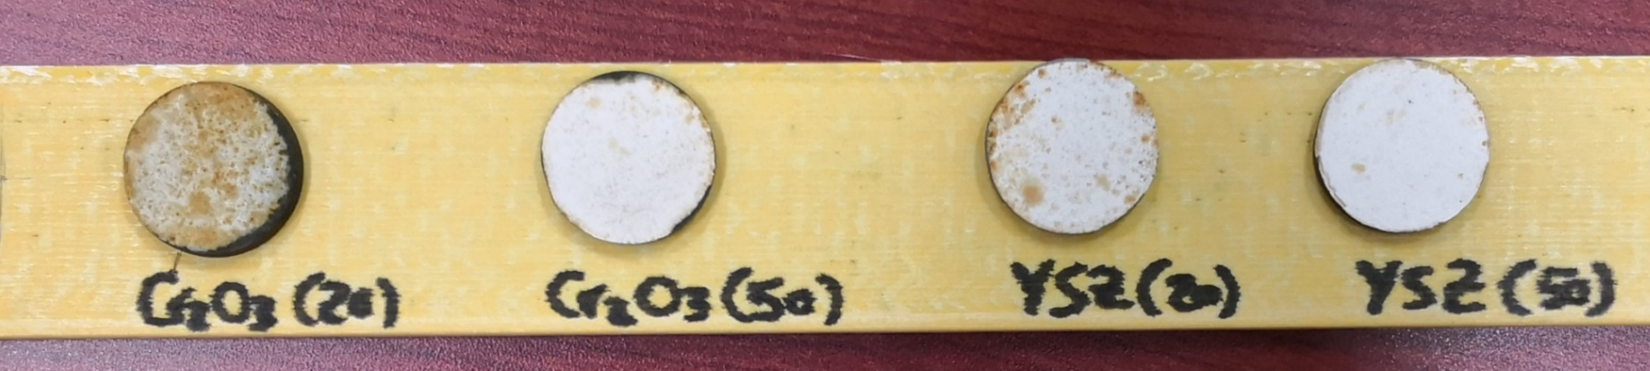
Sample After the Collection (Sunlight)

Slide 51

Sample After the Collection
Location – A
Location – B

Slide 52
Sample#1
(Sample – A in Shade Cr₂O₃-20μm)
Dark brown location
Light brown location
White location
Notes:
Comparing the condition of Smple#1 to the original condition, the results show a delamination in the top coating. The cluster in top coating surface has less percent in dark brown locations as shown in Figure 29. However, the coating cluster appear more in the light and white locations. For the element presence and by referring to Table 3 and Table 11, the Yb wt% is reduce along with more Oxygen wt%in dark locations. Overall, the composition in the other locations, light brown and white location are almost the same with no effect.

Slide 53
Sample#1
(Sample – A in Shade Cr₂O₃-20μm)
Location | Point# | Element (Wt%)
 |  | O | Yb | Fe | Cr
Dark Brown | Spectrum 1 | 63.4 | 34 | 1.4 | 1.3
 | Spectrum 2 | 60 | 36.5 | 3.5
 | Spectrum 3 | 61.8 | 25.4 | 1.9 | 11
 | Spectrum 4 | 64.5 | 33.7 | 1.4 | 0.4
Light Brown | Spectrum 7 | 13.9 | 84 | 1.3 | 0.8
 | Spectrum 8 | 14.2 | 84.2 | 1 | 0.7
 | Spectrum 9 | 14.4 | 83.9 | 1.1 | 0.6
White | Spectrum 10 | 12.6 | 87 |  | 0.4
 | Spectrum 11 | 14.4 | 85.6
 | Spectrum 12 | 9.7 | 90 |  | 0.3
Point# | Element (Wt%)
 | O | Yb
Spectrum 1 | 18.9 | 81.1
Spectrum 2 | 14.3 | 85.7
Sample – A, Cr₂O₃ (20 μm)
Sample – 1, Cr₂O₃ (20 μm)

Slide 54
Sample#2
(Sample – B in Shade Cr₂O₃-50μm)
Light brown location
White location
Notes:
The SEM and EDS analysis results are showing no effect in the top coating during the sample placement in the experiment environment. The element wt% is the same by comparing Table 4 and Table 12.

Slide 55
Sample#2
(Sample – B in Shade Cr₂O₃-50μm)
Location | Point# | Element (Wt%)
 |  | O | Yb | Fe | Cr
Light Brown | Spectrum 1 | 12.7 | 87.3
 | Spectrum 2 | 9.3 | 90.7
 | Spectrum 3 | 13.5 | 86.5
White | Spectrum 4 | 12.4 | 87.6
 | Spectrum 5 | 31.2 | 68.8
 | Spectrum 6 | 15.4 | 84.6
Point# | Element (Wt%)
 | O | Yb
Spectrum 1 | 12.7 | 87.3
Spectrum 2 | 18.2 | 81.8
Sample – B, Cr₂O₃ (50 μm)
Sample – 2, Cr₂O₃ (50 μm)

Slide 56
Sample#3
(Sample – C in Shade YSZ-20μm)
Light brown location
Dark brown location
White location
Notes:
Considering no major effect to the cluster as shown in SEM images of Figure 34, Figure 35 and Figure 36, the EDS analysis demonstrate different results only in dark location. First, by comparing the Yb wt% in Table 5 and Table 13 it goes minorly less concertation generally. Nevertheless, dark locations show presence of iron in the EDS analysis. Moreover, insignificant existence of chloride and phosphate.

Slide 57
Sample#3
(Sample – C in Shade YSZ-20μm)
Location | Point# | Element (Wt%)
 |  | O | Yb | Fe | Cr | Other
Light Brown | Spectrum 1 | 12.7 | 87.3
 | Spectrum 2 | 13.2 | 86.8
 | Spectrum 5 | 8 | 90.9 | 1.1
Dark Brown | Spectrum 7 | 15.5 | 79.2 | 4.1 | 0.5 | Cl=0.6
 | Spectrum 8 | 2.7 | 93 | 4.3
 | Spectrum 9 | 4.1 | 86.3 | 8.0 | 1.2 | Cl=0.2, P=0.2
 | Spectrum 11 | 7.7 | 86.6 | 4.9 | 0.5 | Cl=0.3
 | Spectrum 12 | 15.4 | 79.5 | 4.0 | 0.6 | Cl=0.5
White | Spectrum 13 | 12.1 | 87.9
 | Spectrum 14 | 2.7 | 97.0 |  |  | Cr=0.3
Point# | Element (Wt%)
 | O | Yb
Spectrum 1 | 20.6 | 82.4
Spectrum 2 | 10.9 | 89.1
Sample – C, YSZ (20 μm)
Sample – 3, YSZ (20 μm)

Slide 58
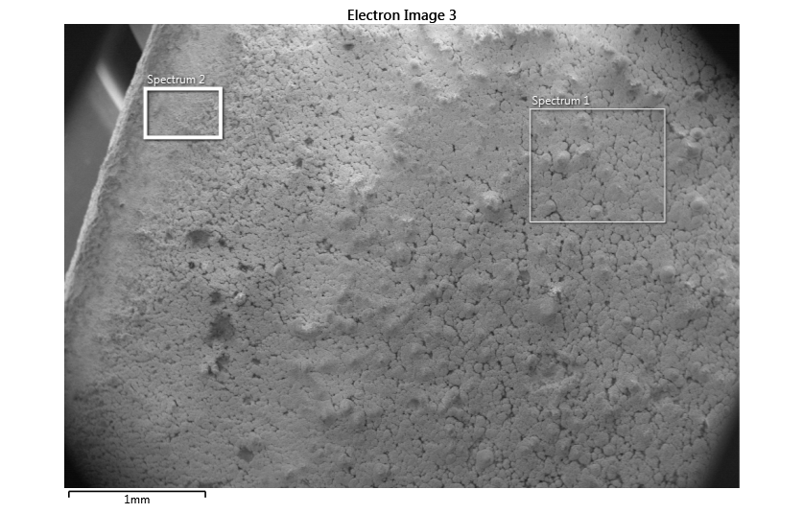
Sample#4
(Sample – D in Shade YSZ-50μm)
Light brown location
Dark brown location
Edge location
Notes:
By analyzing the SEM images in Figure 37 and Figure 38, there is no major deformation in the surface coating. In contrast, the dark brown location shows existence of small wt% of Cl, Na, Cr, K and S in dark locations. Moreover, in the edges Zr from the mid coating has appeared in the EDS analysis as of Figure 39 and Table 14, Sample#4 EDS Table 14

Slide 59
Sample#4
(Sample – D in Shade YSZ-50μm)
Location | Point# | Element (Wt%)
 |  | O | Yb | Fe | Cr | Other
Light Brown | Spectrum 1 | 12.3 | 87.7
 | Spectrum 2 | 3.2 | 86.9
 | Spectrum 3 | 11.9 | 88.1
Dark Brown | Spectrum 4 | 14.9 | 83.5 | 1.3 |  | Cl=0.4
 | Spectrum 5 | 10.9 | 87.5 | 1.2 |  | Cl=0.3
 | Spectrum 6 | 13.3 | 85.4 | 1.0 |  | Cl=0.2
 | Spectrum 7 | 18.3 | 69.6 | 4.2 |  | Cl=3.7 Na=2.2 Cr=0.68 K=0.6 S=0.5
 | Spectrum 8 | 23.9 | 75.4 |  |  | Cl=0.7
 | Spectrum 9 | 15.4 | 83.4 | 0.8 |  | Cl=0.5
Edge | Spectrum 4 | 60.8 | 39.2
 | Spectrum 5 |  | 86.1 | 3.1 |  | Zr=10.8
Point# | Element (Wt%)
 | O | Yb
Spectrum 1 | 20.7 | 79.3
Spectrum 2 | 10.3 | 89.7
Sample – D, YSZ (50 μm)
Sample – 4, YSZ (50 μm)

Slide 60
Sample#5
(Sample – A in Sunlight Cr₂O₃-20μm)
Dark brown location
Light brown location
White location
Notes:
The top coating Yb₂O₃ almost gone in dark location. This is clear from SEM image in Figure 40. Also, by reviewing the elements wt% in Table 15, many element are founded in small quantities and mainly salts such as Na, Cl, P, Si and K. In addition to that, the iron wt% is increasing and this is an evidence of coating deterioration. In light brown location, the Yb₂O₃ content decreased compare to the original concertation stated in Table 3.

Slide 61
Sample#5
(Sample – A in Sunlight Cr₂O₃-20μm)
Location | Point# | Element (Wt%)
 |  | O | Yb | Fe | Cr | Other
Dark Brown | Spectrum 1 | 23.3 | 23.1 | 4.2 | 44.4 | Na=1.9 Cl=1.4 P=0.9 Si=0.5 K=0.3
 | Spectrum 2 | 24.4 | 22.8 | 4.4 | 44.2 | Na=1.5 Cl=1.0 P=0.7 Si=0.4 Mo=0.4 K=0.2
 | Spectrum 3 | 15.4 | 14.7 | 3.8 | 32.8 | Na=12.4 Cl=17.4 P=0.6 S=0.5 Mo=0.4K=1.3
Light Brown | Spectrum 5 | 21.0 | 63.9 | 2.8 | 12.2
 | Spectrum 6 | 16.1 | 80.5 | 1.9 | 0.2 | Si=1.3
 | Spectrum 7 | 17.5 | 77.9 | 2.9 | 0.3 | Si=1.3
 | Spectrum 8 | 22.7 | 68.5 | 4.3 | 1.5 | Si=2.2 P=0.7
White | Spectrum 9 | 10.6 | 66.6 | 0.8 | 22.1
 | Spectrum 10 | 13.8 | 84.5 | 0.9 | 0.8
 | Spectrum 11 | 17.2 | 82.2 |  | 0.5
 | Spectrum 12 | 11.6 | 87.3 | 0.6 | 0.4
Point# | Element (Wt%)
 | O | Yb
Spectrum 1 | 18.9 | 81.1
Spectrum 2 | 14.3 | 85.7
Sample – A, Cr₂O₃ (20 μm)
Sample – 5, Cr₂O₃ (20 μm)

Slide 62
Sample#6
(Sample – B in Sunlight Cr₂O₃-50μm)
Light brown location#1
Light brown location#2
White location
Notes:
By analyzing the SEM images in Figure 44 and Figure 45 there is no major deformation in the surface coating. In contrast, the light brown location#1 shows presence of small wt% of Cr and iron which indicate to the exposure of the mid coating.

Slide 63
Sample#6
(Sample – B in Sunlight Cr₂O₃-50μm)
Location | Point# | Element (Wt%)
 |  | O | Yb | Fe | Cr | Other
Light Brown#1 | Spectrum 1 | 12.8 | 86.6 |  | 0.6
 | Spectrum 2 | 13.5 | 86.5
 | Spectrum 3 | 7.0 | 93.0
Light Brown#2 | Spectrum 4 | 16.3 | 82.7 | 0.7 | 0.3
 | Spectrum 5 |  | 99.7 |  | 0.3
 | Spectrum 6 | 17.1 | 82.8 |  | 0.1
White | Spectrum 7 | 10 | 90
 | Spectrum 8 | 15.5 | 84.5
 | Spectrum 9 | 12.2 | 87.8
Point# | Element (Wt%)
 | O | Yb
Spectrum 1 | 12.7 | 87.3
Spectrum 2 | 18.2 | 81.8
Sample – B, Cr₂O₃ (50 μm)
Sample – 6, Cr₂O₃ (50 μm)

Slide 64
Sample#7
(Sample – C in Sunlight YSZ-20μm)
Dark brown location
Light brown location
White location
Notes:
Top coating cluster is not visible in dark brown location as of Figure 46. However, in other SEM images Figure 47 and Figure 48 it is clear. In one location, there is small presence of Mg.

Slide 65
Sample#7
(Sample – C in Sunlight YSZ-20μm)
Location | Point# | Element (Wt%)
 |  | O | Yb | Fe | Cr | Other
Dark Brown | Spectrum 2 | 64.3 | 34.7 | 1.0
Light Brown | Spectrum 4 | 67.4 | 30.8 | 1.7
White | Spectrum 6 | 62.8 | 37.2
 | Spectrum 7 | 29.2 | 68.8 |  |  | Mg=1.9
Point# | Element (Wt%)
 | O | Yb
Spectrum 1 | 20.6 | 82.4
Spectrum 2 | 10.9 | 89.1
Sample – C, YSZ (20 μm)
Sample – 7, YSZ (20 μm)

Slide 66
Sample#8
(Sample – D in Sunlight YSZ-50μm)
Light brown location
White location
Notes:
The SEM and EDS analysis results are showing no effect in the top coating during the sample placement in the experiment environment. The element wt% is the same by comparing Table 6. However, some slats are found in small wt%.

Slide 67
Sample#8
(Sample – D in Sunlight YSZ-50μm)
Location | Point# | Element (Wt%)
 |  | O | Yb | Fe | Cr | Other
Light Brown | Spectrum 1 | 18.6 | 81.4
 | Spectrum 2 | 11.4 | 86.6
 | Spectrum 3 | 12.9 | 86.8 |  |  | Cl=0.4
White | Spectrum 4 | 10.8 | 89.2
 | Spectrum 5 | 19.8 | 74.8 | 1.1 |  | Si=4.4
 | Spectrum 6 | 10.7 | 89.3
Point# | Element (Wt%)
 | O | Yb
Spectrum 1 | 20.7 | 79.3
Spectrum 2 | 10.3 | 89.7
Sample – D, YSZ (50 μm)
Sample – D, YSZ (50 μm)

Slide 68
Sample#9
(Sample – E Tio₂) Location-A
Black location
Dark green location
Gray location
Notes:
By comparing the EDS anlysis before and after as of Table 7 and Table 19, the wt% are not differ in any significant way. This is apply to all locations; black, dark green and gray. However, there are many elements such as Mg, Ni, Al, K …etc as of Table 19. This indicate an aggregation in the coating surface.

Slide 69
Sample#9
(Sample – E Tio₂) Location-A
Location | Point# | Element (Wt%)
 |  | O | Ti | Fe | Mn | Cu | Si | Other
Black | Spectrum 5 | 51.0 | 31.6 | 6.6 | 0.9 | 0.7 | 3.6 | Mg=1.6 | Cr=1.3 | Al=1.1
 |  |  |  |  |  |  |  | P=0.6 | Zn=0.4 | K=0.2
 |  |  |  |  |  |  |  | Ni=0.2 | Cl=0.1 | S=0.1
 | Spectrum 6 | 48.0 | 46.5 | 0.6 | 1.9 | 0.6 | 0.8 | Al=0.5 | Mg=0.4 | Zn=0.2
 |  |  |  |  |  |  |  | Na=0.2 | P=0.2 | K=0.1
 | Spectrum 7 | 45.1 | 1.2 | 17.8 | 0.2 | 1.6 | 17.4 | Mg=8.3 | P=2.7 | Al=2.5
 |  |  |  |  |  |  |  | Zn=0.9 | Ni=0.7 | K=0.7
 |  |  |  |  |  |  |  | Na=0.6 | Cl=0.3
Dark green | Spectrum 8 | 46.3 | 47.4 | 1.3 | 2.0 | 0.7 | 0.6 | Al=0.5 | Na=0.3 | P=0.3
 |  |  |  |  |  |  |  | Mg=0.2 | K=0.2 | Cl=0.1
 | Spectrum 9 | 46.3 | 45.0 | 1.4 | 2.2 | 0.7 | 2.7 | Al=0.7 | Na=0.2 | P=0.3
 |  |  |  |  |  |  |  | Mg=0.2 | S=0.1 | Cl=0.1
 | Spectrum 10 | 48.9 | 43.2 | 0.8 | 4.2 | 1.0 | 0.3 | Al=0.3 | V=0.4 | P=0.3
 |  |  |  |  |  |  |  | Zn=0.2 | K=0.1 | Na=0.3
 | Spectrum 11 | 47.1 | 47 | 1.3 | 2.3 | 0.7 | 0.5 | Al=0.4 | P=0.3 | K=0.1
 |  |  |  |  |  |  |  | Mg=0.2 | S=0.1 | Cl=0.1
Gray | Spectrum 11 | 29.4 | 11.4 | 34.2 | 0.8 | 1.1 | 0.6 | Cr=10.1 | Al=3.9 | Ni=2.3
 |  |  |  |  |  |  |  | Na=1.8 | Cl=1.5 | P=1.4
 |  |  |  |  |  |  |  | Zn=0.5 | Mg=0.4 | S=0.3
 | Spectrum 13 | 6.4 | 4.1 | 59.1 | 1.7 |  | 0.4 | Cr=16.8 | Ni=6.1 | Al=5.0
 |  |  |  |  |  |  |  | Cl=0.2 | P=0.1 | S=0.1
 | Spectrum 14 | 10.8 | 6.9 | 51.6 | 1.5 | 0.5 | 0.6 | Cr=14.7 | Al=5.7 | Ni=5.2
 |  |  |  |  |  |  |  | Na=1.2 | Cl=0.5 | P=0.3
 |  |  |  |  |  |  |  | Mg=0.3 | S=0.2
Point# | Element (Wt%)
 | O | Ti | Fe | Cu | Mn | Si
Spectrum 1 | 47.1 | 49.5 | 0.6 | 0.9 | 1.7 | 0.2
Spectrum 2 | 56.1 | 39.2 | 1.5 | 1.1 | 1.9 | 0.2
Sample – E, TiO₂
Sample – 9, TiO₂

Slide 70
Sample#10
(Sample – F Tio₂ + Cu) Location-A
Black location
Green location
Notes:
The dark locations has no changes over the experiment by comparing the elements wt% in Table 8 and Table 20. In comparison, the green area has other elements presence with small wt%.

Slide 71
Sample#10
(Sample – F Tio₂ + Cu) Location-A
Location | Point# | Element (Wt%)
 |  | O | Ti | Fe | Cl | Cu | P | Other
Black | Spectrum 1 | 29.4 | 4.0 |  | 11.8 | 53.0 | 1.8
 | Spectrum 2 | 32.1 | 6.5 |  | 10.9 | 48.6 | 1.9
 | Spectrum 3 | 29.9 | 0.4 | 0.5 | 12.8 | 50.6 | 2.0 | Br=2.0 | Si=1.8
 | Spectrum 4 | 5.3 | 9.8 | 0.8 | 5.1 | 76.6 | 2.4
Green | Spectrum 6 | 36.4 | 36.1 | 0.5 | 0.9 | 21.9 | 0.3 | Na=1.2 | Al=0.7 | Si=0.7
 |  |  |  |  |  |  |  | Mn=0.5 | Mg=0.4 | K=0.2
 | Spectrum 7 | 49.0 | 2.5 | 1.1 | 1.9 | 4.9 | 0.4 | Si=22.9 | Al=8.0 | Mg=1.2
 |  |  |  |  |  |  |  | K=1.0 | Mn=0.1 | Na=6.9
 | Spectrum 8 | 9.9 | 1.1 |  | 0.4 | 88.4 |  | Si=0.3
 | Spectrum 9 | 37.9 | 50.2 | 0.3 | 0.3 | 7.8 | 0.4 | Mn=2.0 | Na=0.5 | Si=0.2
 |  |  |  |  |  |  |  | Al=0.2 | K=0.2 | S=0.1
Point# | Element (Wt%)
 | O | Ti | Fe | Cu | Mn | Si
Spectrum 1 | 49.1 | 33.2 | 23.3 | 1.1 | 0.3 | 0.2
Spectrum 2 | 30.2 | 26.4 | 41.1 | 2.0 | 0.2 | 0.1
Sample – 10, TiO₂ + Cu
Sample – F, TiO₂ + Cu

Slide 72
Sample#11
(Sample- E Tio₂ -B)
Brown location
Black normal location
Light black gray location
Notes:
All locations has deposits with small wt% in the coating surface. The elements if compared originally with Table 7, it has no changes.

Slide 73
Sample#11
(Sample- E Tio₂ -B)
Location | Point# | Element (Wt%)
 |  | O | Ti | Fe | Mn | Cu | Si | Other
Brown | Spectrum 1 | 46.5 | 48.3 | 1.2 | 2.3 | 0.8 | 0.3 | P=0.3 | Al=0.3
 | Spectrum 2 | 44.5 | 51.5 | 0.5 | 2.1 | 0.7 | 0.2 | P=0.2 | Al=0.3
 | Spectrum 3 | 47.9 | 46.2 | 1.4 | 2.5 | 1.2 | 0.2 | P=0.4 | Ni=0.3
 | Spectrum 4 | 47.2 | 46.6 | 1.5 | 2.3 | 0.8 | 0.4 | P=0.4 | Al=0.4 | Mg=0.2
Black normal | Spectrum 5 | 45.5 | 48.3 | 0.9 | 2.5 | 0.8 | 0.3 | Na=0.7 | Al=0.4 | Cl=0.3
 |  |  |  |  |  |  |  | P=0.3 | Mg=0.2
 | Spectrum 6 | 46.6 | 44.2 | 0.9 | 4.8 | 1.3 | 0.3 | Na=0.8 | Al=0.2 | Cl=0.4
 |  |  |  |  |  |  |  | P=0.3 | Mg=0.2
 | Spectrum 7 | 42.9 | 49.8 | 1.4 | 2.1 | 0.9 | 0.4 | Na=0.7 | Al=0.6 | Cl=0.5
 |  |  |  |  |  |  |  | P=0.3 | Mg=0.2 | K=0.2
 | Spectrum 8 | 45.4 | 48.9 | 0.6 | 2.1 | 0.7 | 0.3 | Na=0.5 | Al=0.3 | Cl=0.3
 |  |  |  |  |  |  |  | P=0.2 | Mg=0.2 | Zn=0.4
Light black gray | Spectrum 9 | 44.9 | 46.9 | 0.6 | 2.4 | 0.7 | 0.2 | Na=0.6 | Al=0.3 | Cl=0.2
 |  |  |  |  |  |  |  | P=0.2 | Mg=0.2
 | Spectrum 10 | 46.1 | 52.0 | 0.3 | 0.7 |  | 0.2 | Al=0.4 | P=0.2
 | Spectrum 11 | 44.6 | 49.5 | 0.6 | 3.0 | 0.7 | 0.2 | Na=0.7 | Cl=0.3 | K=0.1
 |  |  |  |  |  |  |  | P=0.3
 | Spectrum 12 | 51.5 | 45.5 | 0.4 | 1.4 | 0.3 |  | Na=0.6 | Cl=0.1 | P=0.2
Point# | Element (Wt%)
 | O | Ti | Fe | Cu | Mn | Si
Spectrum 1 | 47.1 | 49.5 | 0.6 | 0.9 | 1.7 | 0.2
Spectrum 2 | 56.1 | 39.2 | 1.5 | 1.1 | 1.9 | 0.2
Sample – E, TiO₂
Sample – 11, TiO₂
Notes:
All locations has deposits with small wt% in the coating surface. The elements if compared originally with Table 7, it has no changes.

Slide 74
Sample#12
(Sample- F Tio₂ +Cu -B)
Black location
Green location
Notes:
The dark locations has no changes over the experiment by comparing the elements wt% in Table 8 and Table 20. In comparison, the green area has other elements presence with small wt%.

Slide 75
Sample#12
(Sample- F Tio₂ +Cu -B)
Location | Point# | Element (Wt%)
 |  | O | Ti | Fe | Cl | Cu | P | Other
Light blue | Spectrum 1 | 41.4 | 46.6 |  |  | 10.2 | 0.2 | Mn=1.1 | Al=0.3 | Si=0.2
 | Spectrum 2 | 38.8 | 44.4 |  | 0.2 | 15.2 | 0.3 | Mn=0.5 | Al=0.3 | Si=0.3
 | Spectrum 3 | 37.8 | 47.4 | 0.7 | 0.3 | 11.6 | 0.5 | Mn=0.6 | Al=0.5 | Si=0.2
 |  |  |  |  |  |  |  | Mo=0.4
 | Spectrum 4 | 38.9 | 38.7 | 0.5 | 0.6 | 17.7 | 0.4 | Mn=0.6 | Al=0.7 | Si=0.9
 |  |  |  |  |  |  |  | Na=0.4 | Mg=0.4
Black | Spectrum 5 | 32.1 | 36.2 | 0.3 | 0.3 | 29.4 | 0.3 | Mn=0.7 | Al=0.4 | Si=0.3
 | Spectrum 6 | 28.4 | 32.1 | 1.2 | 0.3 | 37.2 | 0.3 | Mn=0.3 | Si=0.2
 | Spectrum 7 | 46.6 | 39.3 |  | 0.5 | 10.9 | 0.3 | Mn=1.3 | Al=0.6 | Si=0.5
 | Spectrum 8 | 44.2 | 48.1 |  | 0.8 | 5.3 | 0.2 | Mn=0.5 | Al=0.3 | Si=0.3
 |  |  |  |  |  |  |  | Mg=0.3
Sample – 12, TiO₂ + Cu
Point# | Element (Wt%)
 | O | Ti | Fe | Cu | Mn | Si
Spectrum 1 | 49.1 | 33.2 | 23.3 | 1.1 | 0.3 | 0.2
Spectrum 2 | 30.2 | 26.4 | 41.1 | 2.0 | 0.2 | 0.1
Sample – F, TiO₂ + Cu

Slide 76
RESULTS DISCUSSION

Slide 77
Coating sys. No.1 Sample-A, Cr₂O₃-20μm
  The top coating Yb₂O₃ dark brown locations (10%) in shade (Sample#1) and (40%) in sunlight (Sample#5)
  The mid coating Cr₂O₃ appears in high concentration.
  In light brown locations (70% in sampel#1 and 50% in sample#5) of top coating Yb₂O₃ still almost the same of clean sample (Sample-A).
  However, white locations (20% in sampel#1 and 10% in sample#5) the composition is same and, in several locations, shows no effects during the test.
Overall
Dark brown locations coverage is higher for Sample#5 which indicate the appearance of mid coating Cr₂O₃. However, the sun exposure has major contribution in these results and affects the coating performance. This can be clear from visual examination also in EDS analysis.

Slide 78
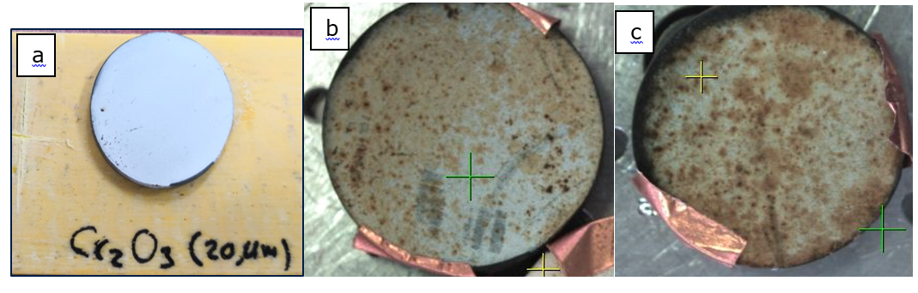
Coating sys. No.1 Sample-A, Cr₂O₃-20μm
(a) Sample-A, (b) Sample#1 and (c) Sample#5
Notes:
The results has been gathered and discussed base on coating and sample system. In this will give better understanding to the overall performance. So started
dark brown locations (10%) in shade (Sample#1) and (40%) in sunlight (Sample#5)
light brown locations (70% in sampel#1 and 50% in sample#5) of top coating Yb₂O₃ still almost the same of clean sample (Sample-A).
However, white locations (20% in sampel#1 and 10% in sample#5) the composition is same and, in several locations, shows no effects during the test.
The mid coating Cr₂O₃ appears in high concentration in dark and light brown
More dark brown in Sample#5 and less white and light brown

Slide 79
Coating sys. No.1 Sample-B, Cr₂O₃-50μm
  No Dark brown locations in both samples
  The mid coating Cr₂O₃ appears in minor concentration in smaple#6
  In light brown locations (5% in sampel#2 and 18% in sample#6) of top coating Yb₂O₃ still almost the same of clean sample (Sample-B).
Overall
Sample#2 has not changed over the experiment and EDS analysis confirm that no changes to Sample-B. Only few locations of light brown appeared. Even sample#6 which has higher coverage of light brown locations shows minor changes. The sunlight has affect smaple#6 but with minimum effect.
Notes:
No Dark brown locations in both samples
The mid coating Cr₂O₃ appears in minor concentration in smaple#6
In light brown locations (5% in sampel#2 and 18% in sample#18) of top coating Yb₂O₃ still almost the same of clean sample (Sample-A).
Overall
Dark brown locations coverage is higher for Sample#5 which indicate the appearance of mid coating Cr₂O₃. However, the sun exposure has major contribution in these results and affects the coating performance. This can be clear from visual examination also in EDS analysis.

Slide 80
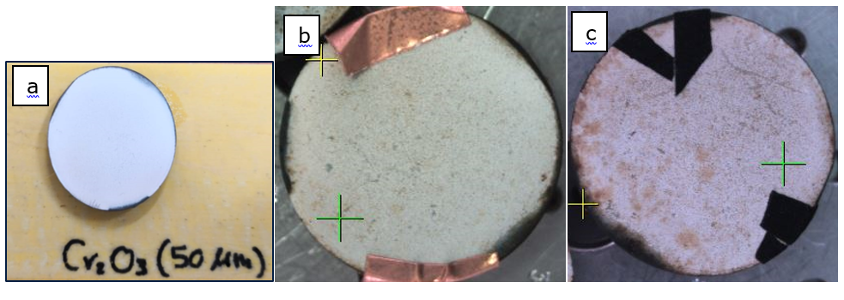
Coating sys. No.1 Sample-B, Cr₂O₃-50μm
(a) Sample-B, (b) Sample#2 and (c) Sample#6
Notes:
No Dark brown locations in both samples
The mid coating Cr₂O₃ appears in minor concentration in smaple#6
In light brown locations (5% in sampel#2 and 18% in sample#18) of top coating Yb₂O₃ still almost the same of clean sample (Sample-A).
Overall
Dark brown locations coverage is higher for Sample#5 which indicate the appearance of mid coating Cr₂O₃. However, the sun exposure has major contribution in these results and affects the coating performance. This can be clear from visual examination also in EDS analysis.

Slide 81
Coating sys. No.2 Sample-C, YSZ-20μm
  Dark brown locations (3% - sample#3 and 5% in sample#7 )
  In sample#3 Appearance of iron (Fe) and chromium (Cr) in smaple#3. This indicate the base metal has exposed. The unexpected that the mid coating Yttria-stabilized zirconia (YSZ) is not appearing
  In light brown locations (12% in sampel#3 and 14% in sample#7) of top coating Yb₂O₃ still almost the same of clean sample (Sample-C).
Overall
In white and light brown locations both sample#3 and 7 shows similar results. However, the major difference are in dark brown locations. In sample#3, the wt% of iron are higher than smaple#7. Conversely, the dark brown locations are higher in sample#7 than sample#3.
Notes:
Dark brown locations (3% - sample#3 and 5% in sample#7 )
In sample#3 Appearance of iron (Fe) and chromium (Cr) in smaple#3. This indicate the base metal has exposed. The unexpected that the mid coating Yttria-stabilized zirconia (YSZ) is not appearing
In light brown locations (12% in sampel#3 and 14% in sample#7) of top coating Yb₂O₃ still almost the same of clean sample (Sample-C).
Overall
In white and light brown locations both sample#3 and 7 shows similar results. However, the major difference are in dark brown locations. In sample#3, the wt% of iron are higher than smaple#7. Conversely, the dark brown locations are higher in sample#7 than sample#3.

Slide 82
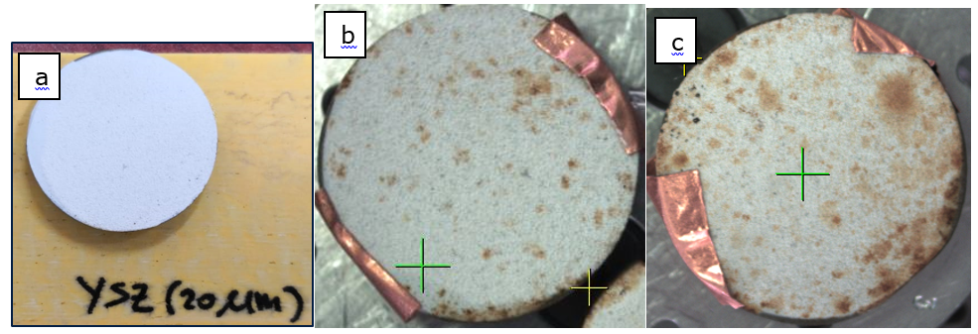
Coating sys. No.2 Sample-C, YSZ-20μm
(a) Sample-C, (b) Sample#3 and (c) Sample#7
Notes:
Dark brown locations (3% - sample#3 and 5% in sample#7 )
In sample#3 Appearance of iron (Fe) and chromium (Cr) in smaple#3. This indicate the base metal has exposed. The unexpected that the mid coating Yttria-stabilized zirconia (YSZ) is not appearing
In light brown locations (12% in sampel#3 and 14% in sample#7) of top coating Yb₂O₃ still almost the same of clean sample (Sample-C).
Overall
In white and light brown locations both sample#3 and 7 shows similar results. However, the major difference are in dark brown locations. In sample#3, the wt% of iron are higher than smaple#7. Conversely, the dark brown locations are higher in sample#7 than sample#3.

Slide 83
Coating sys. No.2 Sample-D, YSZ-50μm
  Dark brown locations (1% - sample#4 and 3% in sample#8)
  In light brown locations (3% - sample#4 and 5% in sample#8)
  Almost no changes in the coating
  Zirconia founded in EDS with high concentration.
Overall
In white and light brown locations both sample#4 and #8 shows similar results. However, the major differences are in dark brown locations. In sample#4, iron is founded. Also, the dark brown locations are higher in sample#8 than sample#4.
Notes:
Almost no changes in the coating
Dark brown locations (1% - sample#4 and 3% in sample#8)
In light brown locations (3% - sample#4 and 5% in sample#8)
Zirconia founded in EDS with high concentration.
Overall
In white and light brown locations both sample#4 and #8 shows similar results. However, the major differences are in dark brown locations. In sample#4, iron is founded. Also, the dark brown locations are higher in sample#8 than sample#4.

Slide 84
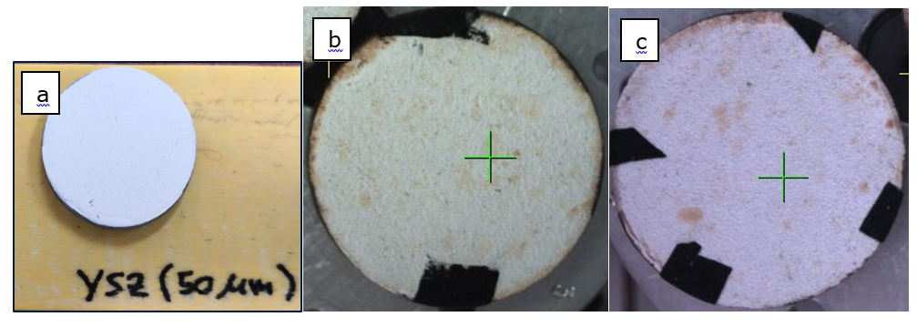
Coating sys. No.2 Sample-D, YSZ-50μm
(a) Sample-D, (b) Sample#4 and (c) Sample#8
Notes:
Almost no changes in the coating
Dark brown locations (1% - sample#4 and 3% in sample#8)
In light brown locations (3% - sample#4 and 5% in sample#8)
Zirconia founded in EDS with high concentration.
Overall
In white and light brown locations both sample#4 and #8 shows similar results. However, the major differences are in dark brown locations. In sample#4, iron is founded. Also, the dark brown locations are higher in sample#8 than sample#4.

Slide 85
Coating System No.3 Sample-E (Tio₂)
In general, smaple#9 and 11:
- having no major changes in the composition compared to the clean sample (Sample-E)
- Many elements in less concentration which are mainly salt components are founded.
Sample#9 Tio₂-A
- The gray locations near the edge has less content of Ti.
Notes:
In general, smaple#9 and 11:
- having no major changes in the composition compared to the clean sample (Sample-E)
- Many elements in less concentration which are mainly salt components are founded.
Sample#9 Tio₂-A
- The gray locations near the edge has less content of Ti.

Slide 86
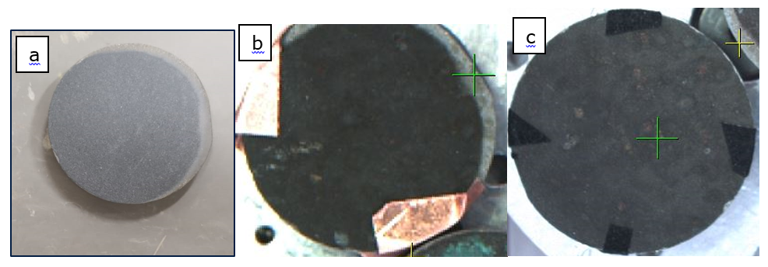
Coating System No.3 Sample-E (Tio₂)
(a) Sample-E, (b) Sample#9 and (c) Sample#11
Notes:
In general, smaple#9 and 11:
- having no major changes in the composition compared to the clean sample (Sample-E)
- Many elements in less concentration which are mainly salt components are founded.
Sample#9 Tio₂-A
- The gray locations near the edge has less content of Ti.

Slide 87
Coating System No.3 Sample-F (Tio₂+ Cu)
In general, smaple#10 and 12:
- having no major changes in the composition compared to the clean sample (Sample-F)
- Many elements in less concentration which are mainly salt components are founded.
Sample#10 Tio₂ + Cu –A
- in the blue/green areas the Cu content is lower than locations
Sample#12 Tio₂ + Cu –B
- The gray locations near the edge has less content of Ti.
Notes:
In general, smaple#10 and 12:
- having no major changes in the composition compared to the clean sample (Sample-F)
- Many elements in less concentration which are mainly salt components are founded.
Sample#10 Tio₂ + Cu –A
- in the blue/green areas the Cu content is lower than locations
Sample#12 Tio₂ + Cu –B
- The gray locations near the edge has less content of Ti.

Slide 88
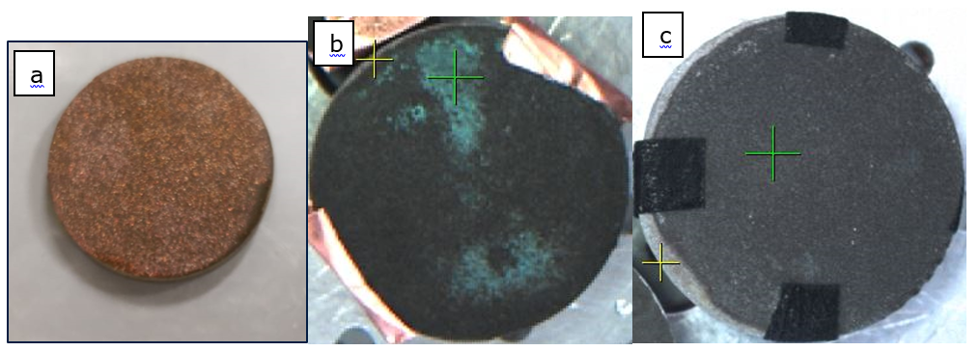
Coating System No.3 Sample-F (Tio₂+ Cu)
(a) Sample-F, (b) Sample#10 and (c) Sample#12
Notes:
In general, smaple#10 and 12:
- having no major changes in the composition compared to the clean sample (Sample-F)
- Many elements in less concentration which are mainly salt components are founded.
Sample#10 Tio₂ + Cu –A
- in the blue/green areas the Cu content is lower than locations
Sample#12 Tio₂ + Cu –B
- The gray locations near the edge has less content of Ti.

Slide 89


Hydrophobic Test Results
Coating system | Sample # | 1st run ( ° )
No. 1 (Shade) | 1 | 48
 | 2 | 46
No. 2 (Shade) | 3 | 0
 | 4 | 0
Notes:
All samples lost the hydrophobic properties and become hydrophilic. However, coating system No. 1 in shade and sunlight has the lowest impact

Slide 90


Hydrophobic Test Results
Coating system | Sample # | 1st run ( ° )
No. 1 (Sunlight) | 5 | 47
 | 6 | 0
No. 2 (Sunlight) | 7 | 0
 | 8 | 0
Notes:
All samples lost the hydrophobic properties and become hydrophilic. However, coating system No. 1 in shade and sunlight has the lowest impact

Slide 91
Results Discussion
The low thickness samples exhibit less performance than high thickness
Hydrophobicity degradation by peeling test for Yb₂O₃, only two peeling cycles cause hydrophobicity degradation
Stains marks in many locations of samples especially in samples placed in sunlight which induced rapid growth of water-born algae.
Cu addition in coating system No.3 affect the bacterial cellular enzymes.
Notes:
So, as summary:
Some of top coating is subjected to the wear and tear, The low thickness samples exhibit less performance than high thickness
By performing peeling test for Yb₂O₃, only two peeling cycles cause hydrophobicity degradation. The affect mainly occurred in columnar structures which gave the coating it’s hydrophobicity characteristic It got 10% damages in only one peeling cycles and 60% after five peeling cycles [22]
stains coverage area is due to exposure of natural sunlight which induced rapid growth of water-born algae. The stain marks cover more area due alga formation. The exposure direct sunlight is induced fast granulation of algal-bacterial almost two times faster than indirect sunlight [33]
Cu addition in coating system No.3 affect the bacterial cellular enzymes.

Slide 92
CONCLUSION AND RECOMMENDATIONS

Slide 93
Conclusion
Effect of thickness
The variation of top coating thickness for all coating systems and in the experiment show a major effect. As thicker top coating, less area of mid coating got exposed. The effect is similar in both coating systems.
Effect of sunlight
The sunlight shows significant effect and can be clear. The samples exposed to sunlight has shown more stain marks. The behavior is similar in the two coating systems No.1 and No.2
Notes:
We have many factors playes major roles in the coating performance durng the sample placement in HVAC cooling tower blades.
Thickness of top coating, sunlight and Cu addition.

Slide 94
Conclusion
Copper addition in coating system No.3
Coating system No.3 shows constancy results in both samples (A and B). However, the copper shows major contributor in reducing the presence of many elements. Ultimately, the copper is conserving the titanium layer.

Slide 95
Conclusion
Coating system No.2 shows better result and performance:
  Less area of stain (brown area).
  No exposure the mid coating in all SEM and EDS results.
Coating system No. 1:
  Hydrophilic propitiates not deteriorated over the field placement time. Hence,
  several locations show top coating were gone.
One major point can be observed, it is clear that 1ST coatigan layer is participating in the final performance and behavior of the top coating.
Notes:
Coating system No.2 shows better result and performance. It has less area of stain (brown area). In addition, no location shows the mid coating in all SEM and EDS results.
In contracts, the coating system No. 1 hydrophilic propitiates not deteriorated over the experiment time. Hence, several locations show top coating were gone.
One major point can be observed, it is clear that mid coatigan is participating in the final performance and behavior of the top coating.

Slide 96
Recommendations
As per this study and experiment, many point need to address in order to have thorough. Future research should:
The Ytterbium Oxide thickness should be increase based on results.
Utilize more samples to have several interval for pattern evaluation.
Focus on evaluating the tribological performance on coating system No.1 and No.2.
Perform microbial test in samples.

Slide 97
Thank You

