Slide 1
Superior Corrosion Protection & Integrity Assurance By Use Of Innovative Coating Solutions

Slide 2
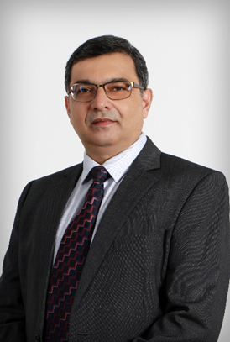
Presenter - Introduction
Munzir Khan
Regional O&G Segment Manager Middle East
I’m an Asset Integrity, Corrosion & Coating Professional
Possess over 25 years of excellent work background in the field of corrosion protection, protective coatings and linings
Over 10 years experience in Upstream, Midstream as Subject Matter Expert in O&G company.
Prior experience in Asset Integrity of offshore assets (topside, subsea, flowlines) and island-based plant facilities for ZADCO (now ADNOC Offshore)

Slide 3
Abstract
Advancement in the Coating Industry has given opportunities to Asset Owners for the selection of enhanced Protective Coating system which provides techno-commercial advantages and improves the Integrity & HSE assurance parameters.
Advanced resin technology & innovative application technique provides cost effective solution, which is one of the pillar for KPI for any Asset Owners.
Existing practises and the maintenance philosophy can be revised to accommodate fewer number of coats, rapid return to service for equipment, extended durability and coating solutions that continue to cure under water for coastal or offshore asset.

Slide 4
Thank You

