Slide 1
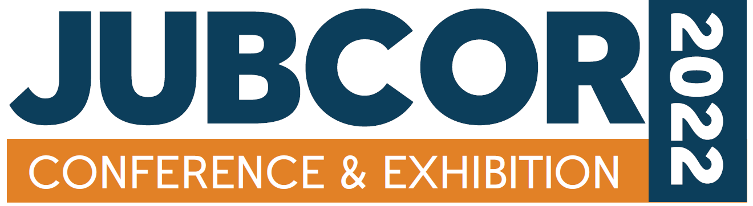
Impact of Process Excursion on Dead Leg Integrity Management.
BY
AMIT JAIN, PETROKEMYA

Slide 2
Impact of Process Excursion on Dead Leg Integrity Management.
CONTENTS
Introduction
Problem Statement
Analysis
Conclusion
Mitigation Actions
Key Learning

Slide 3
Impact of Process Excursion on Dead Leg Integrity Management.
INTRODUCTION
Dead Leg Integrity management is very important part of Plant Reliability. Corrosion in dead legs represents a significant threat to the integrity of hydrocarbon production facilities.
High rates of degradation are readily observable at susceptible locations, where corrosion rates of millimeters per year are possible.
One of the dead leg of vapor drum outlet line to convection section of furnace observed with leak. Further investigations has been carried out to find out the cause of leakage and avoid the recurrence in future.
This paper presents the impact of process excursion on dead leg Integrity management and methods to prevent / mitigated the significant threat.

Slide 4
Impact of Process Excursion on Dead Leg Integrity Management.
PROBLEM STATEMENT
One of the dead leg of vapor drum outlet line to convection section of furnace observed with leak.
The drain point which had leak has coke deposits in it
EDC (Ethylene Di-Chloride) feed to furnaces has a Moisture specification of less than 25 ppm in the process stream.
Dead Leg Material: Din 2458 – 1.0425 seamless (equivalent to A-106 Grade B)
Internal inspection revealed choking of entire drain by service deposit / coke and severe corrosion as deep grooving in weld at pipe internal.
Internal view of Damaged Dead Leg

Slide 5
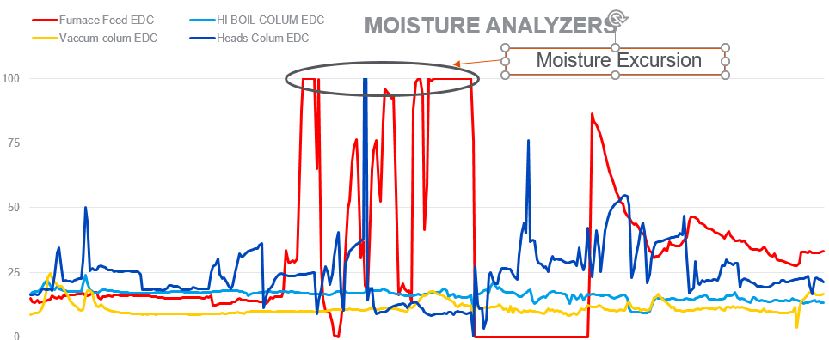
Impact of Process Excursion on Dead Leg Integrity Management.
ANALYSIS & CONCLUSION
Further review of process parameters revealed that there is moisture excursion happen in the system above the limit.
Following conclusion has been made after conducting the metallurgical analysis of failed sample.
Cause of Failure
  Moisture ingress which intensified the under deposit corrosion phenomenon.

Slide 6
Impact of Process Excursion on Dead Leg Integrity Management.
Further investigation of failed dead leg sample revealed the following:
Weld and Base Metal is severely damaged from inside and containing small pinhole as well.
Internal Thickness reduction also noticed. Corrosion was more severe at bottom portion of dead leg.
External surface of dead leg doesn’t indicate any major finding. Only rust are there.
Material of Dead Leg found as per Piping Specification.
DAMAGE MECHANISM: Under Deposit Corrosion
These coke and service deposits easily attach the metal base and cause damage and thinning which led to Under Deposit Corrosion. Negatively charged chloride ions tend to migrate under the deposit to balance the positively charged metal ions produced there.
The high concentration of chloride ions causes the area under the deposit to become more acidic compared to the bulk solution, further enhancing the corrosion under the deposit due to moisture ingress.

Slide 7
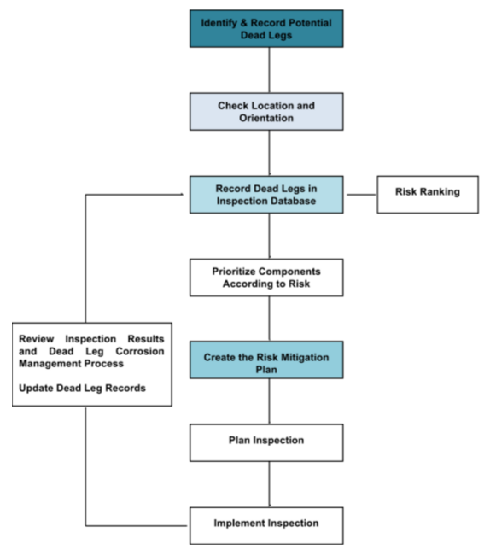
Impact of Process Excursion on Dead Leg Integrity Management.
MITIGATION ACTIONS
Identify the equipment and piping / dead legs which were suspected for corrosion due to moisture ingress and perform the inspection.
All the dead legs with low thickness shall be replaced during nearest opportunity.
Dead legs which are not required as per OPER need to be removed by fulfilling MOC requirements.
Source of moisture need to be identified and mitigated.
Any excursion of the moisture ingress are to be communicated for Reliability methodology re-assessment to trigger the inspection strategy and SOP to updated accordingly.
Dead Leg Integrity Management System Process- Flowchart

Slide 8
Impact of Process Excursion on Dead Leg Integrity Management.
KEY LEARNING
After moisture excursion, corrosion rates are accelerated and unpredictable hence inspection is required to ensure the actual condition of equipment's / piping's.

Slide 9
Thank You

