Slide 1

SULFATE REDUCING BACTERIA
ALI ALKENANI

Slide 2
AGENDA
INTRODUCTION
ANALYTICAL
CONCLOSION

Slide 3
MICROBIOLOGY INDUCED CORROSION
Corrosion is a costly phenomenon found in several industries as it often leads to detrimental infrastructure breakdowns, i.e. pipeline failures and eventual spills.
The annual global cost of corrosion is estimated to be 3 % to 4 % of each country’s Gross Domestic Product (GDP), or $2.5 trillion.

Slide 4
MICROBIOLOGY INDUCED CORROSION
When corrosion of the material occurs through the participation of microorganisms called Bio corrosion or microbiology induced corrosion (MIC ) .
(MIC), describes a form of pitting considered
    to be due to the action of microbes.

Slide 5
MICROBIOLOGY INDUCED CORROSION
The importance of microorganism in corrosion of metals has been recognized for over 80 years, since the first report in 1934 by Volzogen Kuhr and van der Vlught .
MIC occurs in environment such as soil ,fresh water and sea water and account by 30% of all corrosion damaged of metal .

Slide 6
ENVIRONMENTAL GROWTH FACTORS
Oxygen
Water
pH
Temperature
Pressure
Dissolve solid
No WATER
NO MIC
NO CORRSION

Slide 7
TYPE OF BACTERIA CAPABLE OF CAUSING CORROSION
The most commonly known bacteria that cause MIC are :
        Sulfate reducing bacteria (SRB )
        Sulphur-oxidizing bacteria (SOB )
        Iron –oxidizing bacteria (IOB)

Slide 8
SULPHATE REDUCING BACTERIA
Sulphate reducing bacteria (Anaerobic ) generate H2S and FeS .
There are two type of SRB :
      Plank tonic which is free floating in the system
      Sessile Bacteria which is adherent and attached to surface

Slide 9
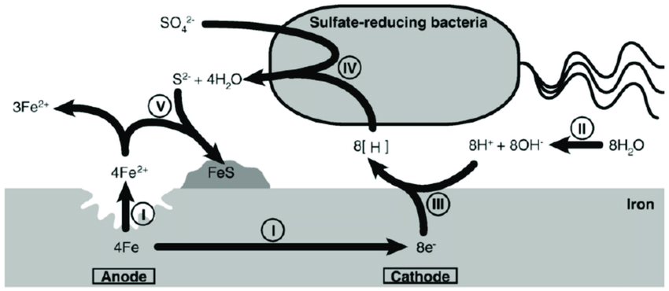
SULPHATE REDUCING BACTERIA

Slide 10
SAMPLING EQUIPMENT
Most sample collection container are glass or plastic sterile , individually wrapped supplies may be purchased from most pharmacies all scientific supply stores
Sterile plastic bags are usually ordered in bulk and the interiors remain sterile until opend

Slide 11
SRB SULFATE REDUCING BACTERIA FOR SOIL SAMPLES
Background
One of the request which has received , H2S liberating from the ground floor in the administration building.
Analytical objectives
To do Microbiology analysis ( SRB sulfate reducing bacteria ) for soil samples and water samples ,the results may help to know the source of smell

Slide 12
METHODOLOGY
ASTM 4412-2
Reagents
    Sodium lactate (C3H5NaO3)
    Ammonium chloride (NH4Cl)
    Dipotassium, hydrogen orthophosphate (K2HPO4)
    Magnesium sulfate (MgSO4H2O)
    Sodium sulfate (Na2SO4)
    Calcium chloride (CaCl2 2H2O)
    Thioglycollic acid
    Ammonium ferrous sulfate or ferrous.
Adjust the pH 7.2
Sterilization

Slide 13
METHODOLOGY
SRB KIT
  Sani-Check SRB Kit
  Sulfate Reducing Bacteria, SRB-BAR

Slide 14
SRB SULFATE REDUCING BACTERIA FOR SOIL SAMPLES
Prepare the sample:
  The samples were soils and, firstly, were immerged into sterile water .
  Prepare the culture and observe the growth.
  Repeat the analysis by using SRB Kits

Slide 15
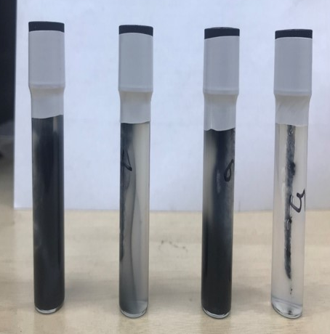
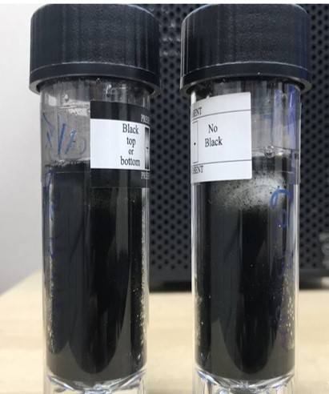
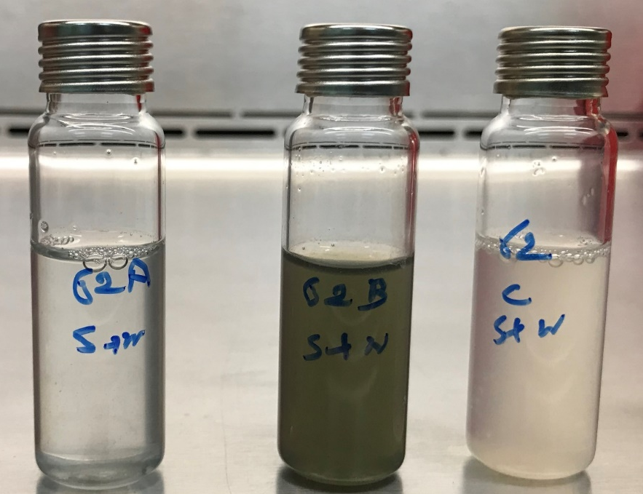
RESULTS

Slide 16
CONCLOSION
  Huge growth of SRB in all soil and water samples, with generation of H2S gas.
  All real-life samples showed up to be positive for SRB
  Blanks were negative showing that experimental conditions were sterile.

Slide 17
REFERENCES
Inc., D. C. (n.d.). Document center. ASTM-D4412 | Standard Test Methods for Sulfate-Reducing Bacteria in Water and Water-Formed Deposits | Document Center, Inc. Retrieved February 23, 2022, from https://www.document-center.com/standards/show/ASTM-D4412
Schematic illustration of microbiologically influenced ... (n.d.). Retrieved February 23, 2022, from https://www.researchgate.net/figure/Schematic-illustration-of-microbiologically-influenced-corrosion-MIC-via-the-cathodic_fig1_326953241
Chen, H., Kimyon, Ö., Ramandi, H. L., Craig, P., Gunawan, C., Wu, S., Manefield, M., Crosky, A., & Saydam, S. (2022). Microbiologically influenced stress corrosion cracking responsible for catastrophic failure of cable bolts. Engineering Failure Analysis, 131, 105884. https://doi.org/10.1016/j.engfailanal.2021.105884
Microbiology influence bacteria Corrosion clinic provide by Dr.qiu.

Slide 18
Thank You

