Slide 1

COVID-19 Pandemic changing Digital Transformation to speed up the implementing technologies projects
Faisal Abdulaziz Althobaiti

Slide 2
Agenda
Introduction
Problem Statement
Business Impact
Proposed solutions
Benefits

Slide 3
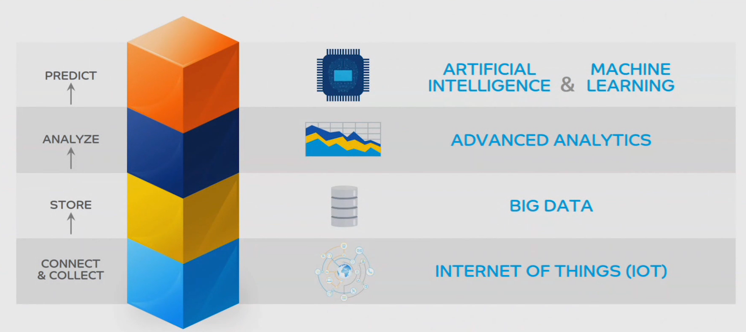
Introduction
SABIC has implemented digitalization transformation to support achieving company’s strategy.
Connecting all its affiliates to a central historian data.
Provision of initialization tool to clients for data collection & storage (Affected by COVID 19).
Advanced analysis to a huge data is performed with special techniques.
Artificial intelligence and machine learning generate smart recommendations.

Slide 4
Problem statement
Existing technology has many challenges to overcome to achieve business value
  Auto data collection is not activated and connected with all employees.
  COVID 19 has slowed the digitalization transformation projects.
Practices to manage current technology
  Manually, collecting, analyzing and sharing the data with others using Internal network.
  Using process historian data technology for the purpose of data collection and sharing, which helps in avoiding physical contact with others during COVID19 pandemic period.

Slide 5
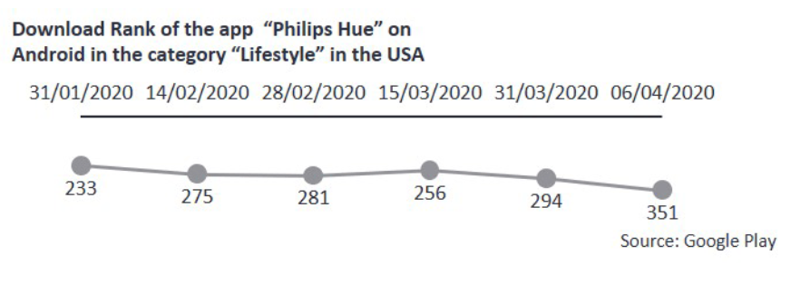
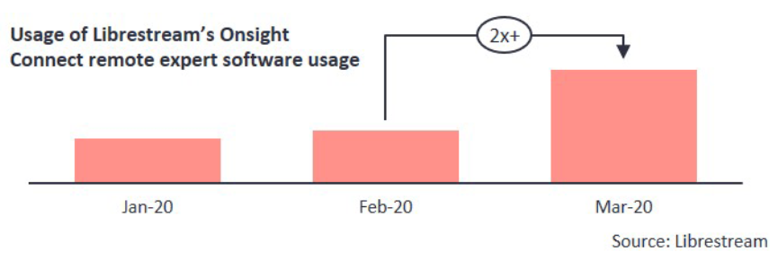
Business Impact
Increase the interest in consumer “internet of things” devices
Although consumers are spending considerable time at home, it appears as though they do not go out and buy personal “internet of things” devices at a large scale.
Remote asset access becomes more important
Conferencing tools like “Zoom, Skype etc.” are booming because they connect people together remotely. In a similar fashion, remote asset access tools are also strongly growing because they connect the people with their machines and assets.

Slide 6
Proposed solutions
Solutions
  Make “Pi vision” program available and accessible to all employees
  Activation of remote access to speed up the “DT project”.
Design
  Improve the digitalization implementation during the COVID19 pandemic.
  Decrease the time of installing and delivering the technologies using remote access.
Methodology
  Use the data collected from the affiliates, remotely.
  Analyze and configure those data to make them ready for implementation.
  Implementation will take place followed by updating connection between central historian data and clients (synchronization).

Slide 7
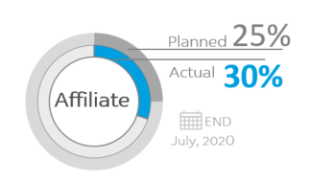
Benefits
Remote support enables businesses to gain access to expertise without having someone on-site and the complications of social distancing and COVID-19.
Remote support helps people in multiple locations.
Speed up the digitalization foundation progress.

Slide 8
Thank You

