Slide 1
Civil Structures Abstract
First time of Berths piles
inspection and Repair
Utilizing NDT and diving methodologies

Slide 2
CONTENTS
Project introduction
Project Scope
Challenges And Solution
Findings And Actions
Completion Statistics
Conclusion

Slide 3
INTRODUCTION
The objective of this project is to conduct major inspection and repair for Berth 36/37 (piles, CP Systems, steel and concrete structure).
Steel Structures maintenance is required for safe and reliable operation of the Berth as it is directly affected by seawater and marine growth, which cause corrosion to all structures. Wrapping and coating of berth structure is essential as protection manner

Slide 4
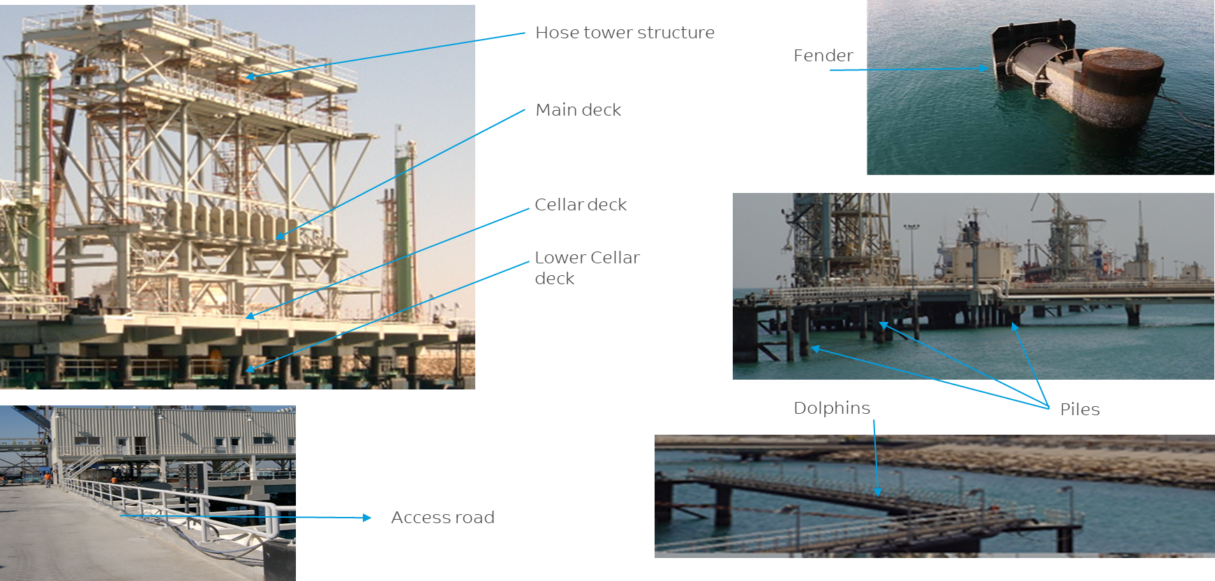

Slide 5
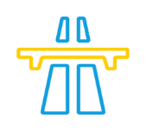
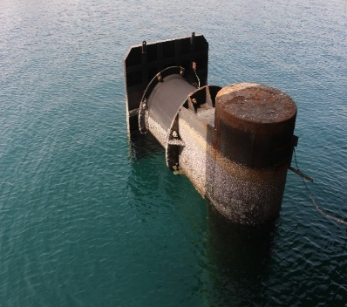
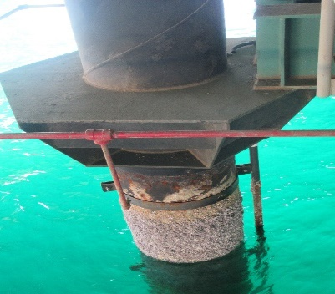
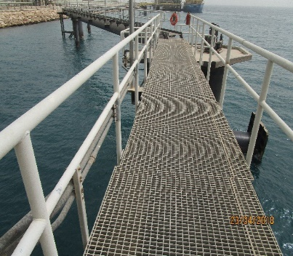
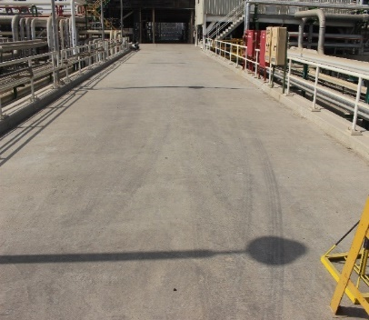
SCOPE OF WORK
Rubber & Wooden Fender
Piles
Steel Structure
Concrete Deck
Removing
Cleaning
Coating
Reinstalling
Blasting
UT Thickness
Share Wave
Wrapping
Cleaning
Inspecting
Repairing
Coating
Cleaning
Inspecting
Repairing
Coating

Slide 6
PROJECT CHALLENGES & SOLUTION
Challenges | Adopted Control Measure
Risky Activities (Diving and inspecting underwater) | Developing and executing quality JSA and Rescue Plan Introducing backup Boat for any emergency Assign 2 safety officers for 20 manpower Dedicated SABTANK Inspection engineer Replaced SCUBA diving by Surface supply diving technic (as per IMCA)
No previous experience in SABIC (1st time done) | Benchmarking with Port Authorities, Yanbu and Vopack and developed comprehensive scope accordingly Extensive Technical Evaluation carried out for with 16 contractors to assure quality selection (Getting References, interviews, detail technical evaluation for previous jobs…etc) Arranging Theoretical and practical training by STOPAQ given to SABTANK Employee for applying new wrapping application.
Berth Window availability | Detail segregation of critical and non critical zones activities Effective planning to avoid business impacts. Effective utilization of giving windows
Delay to get boat permit from coast guard and KFIP Missing some window due to business demand | Introducing new technology for cleaning (Cavi blaster) Assure availability of full required quantities all materials at site to avoid any delay Increase the number of divers to meet the target date
Working in restricted Areas | Alignment and coordination with Port authority and Coast Guards Fulfilling the requirements and securing the approval
Pile Protection (Wrapping) Reliability | Introducing new method for Piles protection (wrapping)

Slide 7
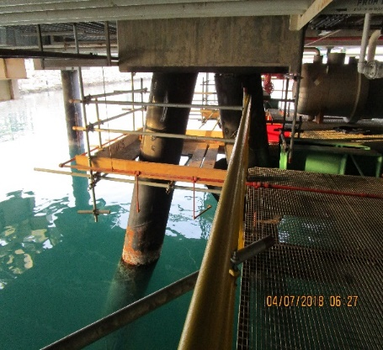
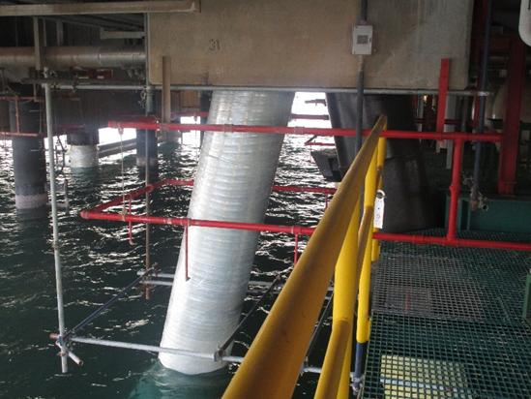
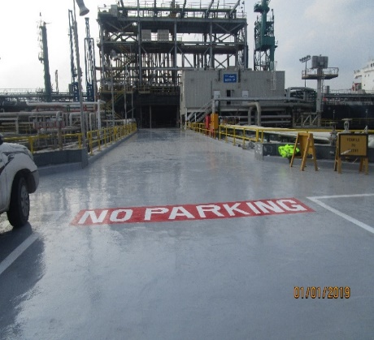
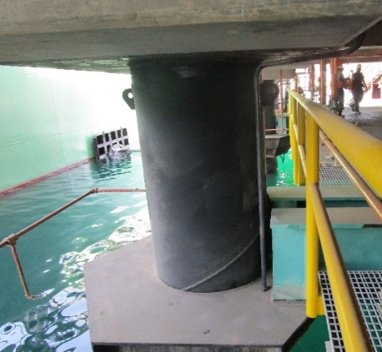
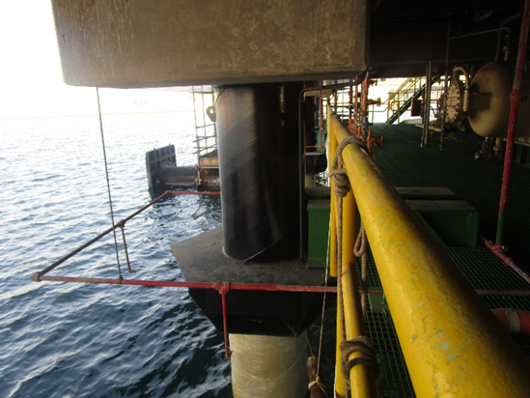
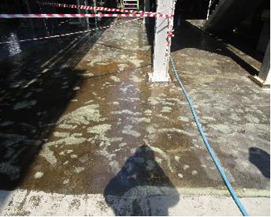
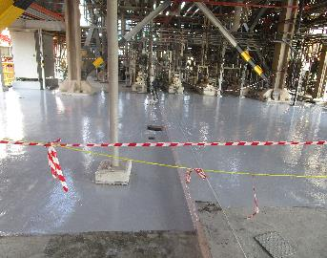
FINDINGS AND ACTIONS
Before
After
Before
After
Before
After
Before
After

Slide 8
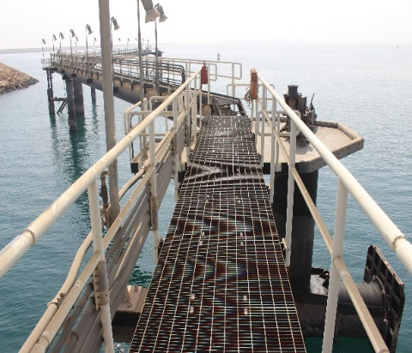
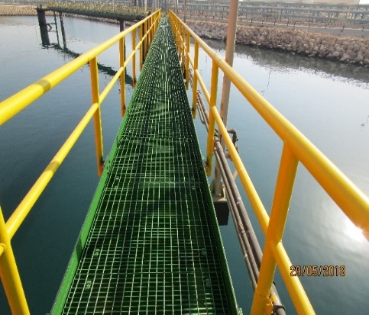
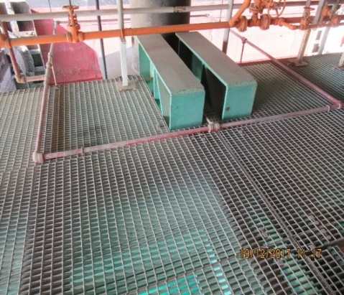
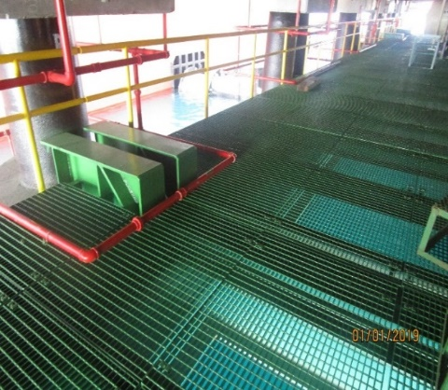
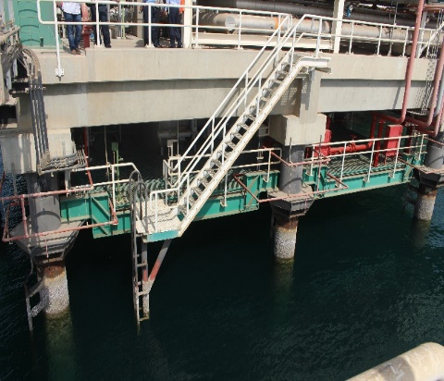
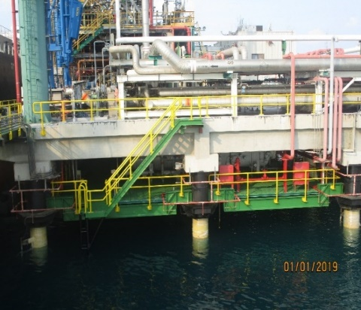
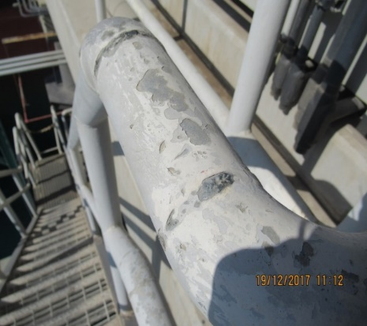
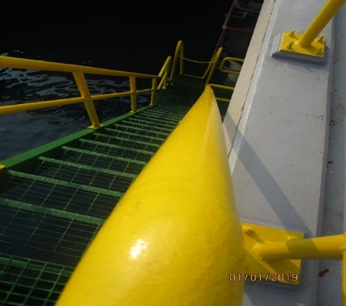
FINDINGS AND ACTIONS
Before
After
Before
After
Before
After
Before
After

Slide 9
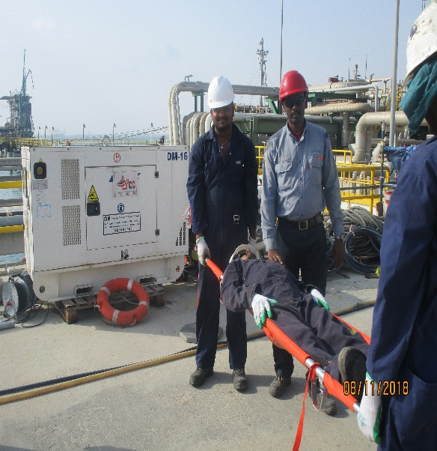
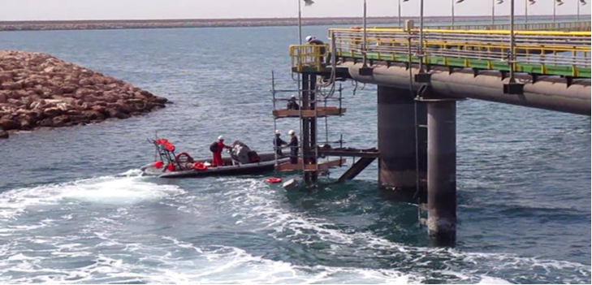
Completion Statistics
High Quality
Rescue plan and JSA
0
120k
358
42
1st time in SABIC
Supervision
Full time Supervision
EHSS
SHER
Safe-Man Hour
Tool Box meeting
Drill
121
Piles
26
CP systems
4440 M²
Structural
4000 M²
Concrete Deck
9
2 from SABTANK
Technical
Inspected
Cleaned
Wrapped
Revamped
Inspected
Cleaned
Coated
Inspected
Cleaned
Coated
Training & certifications
0
Business
Business Interruption

Slide 10
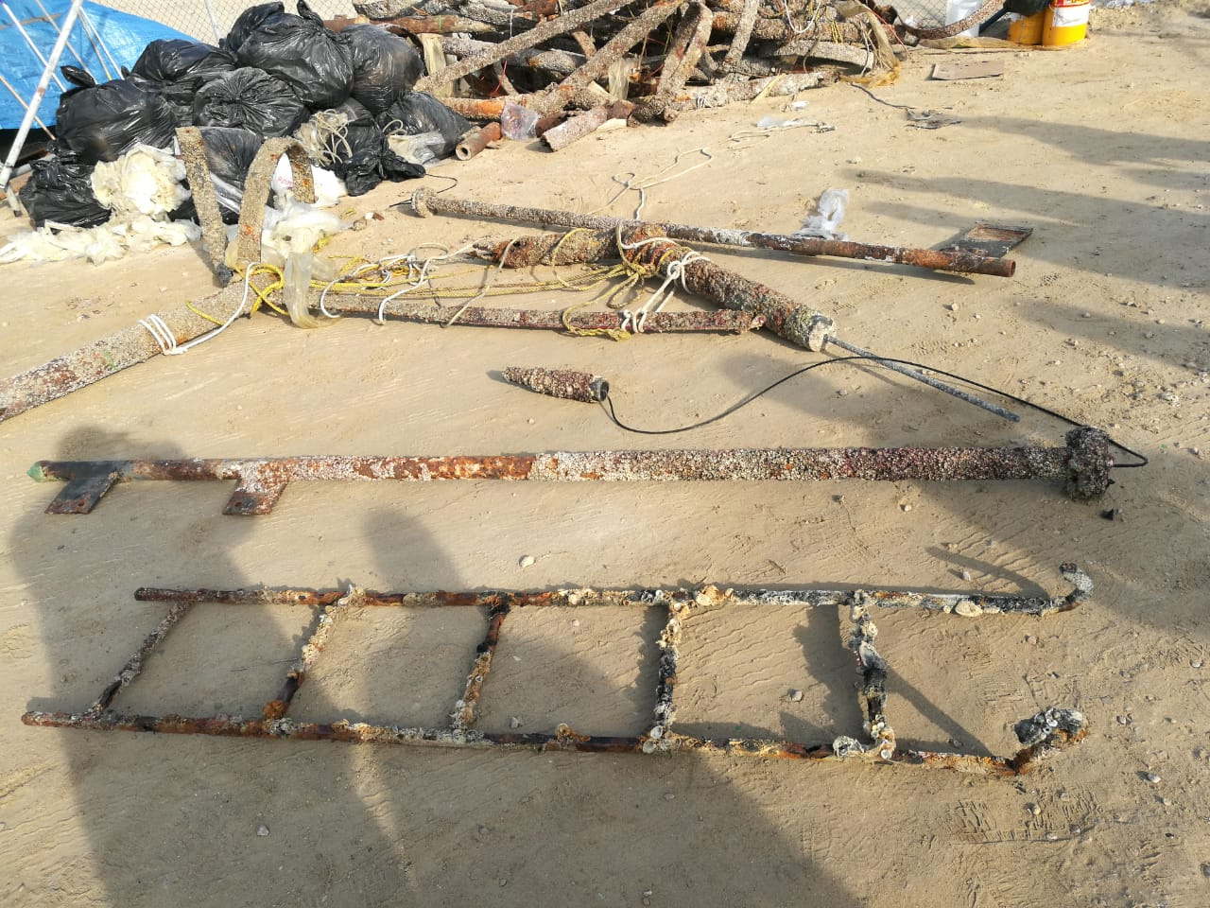
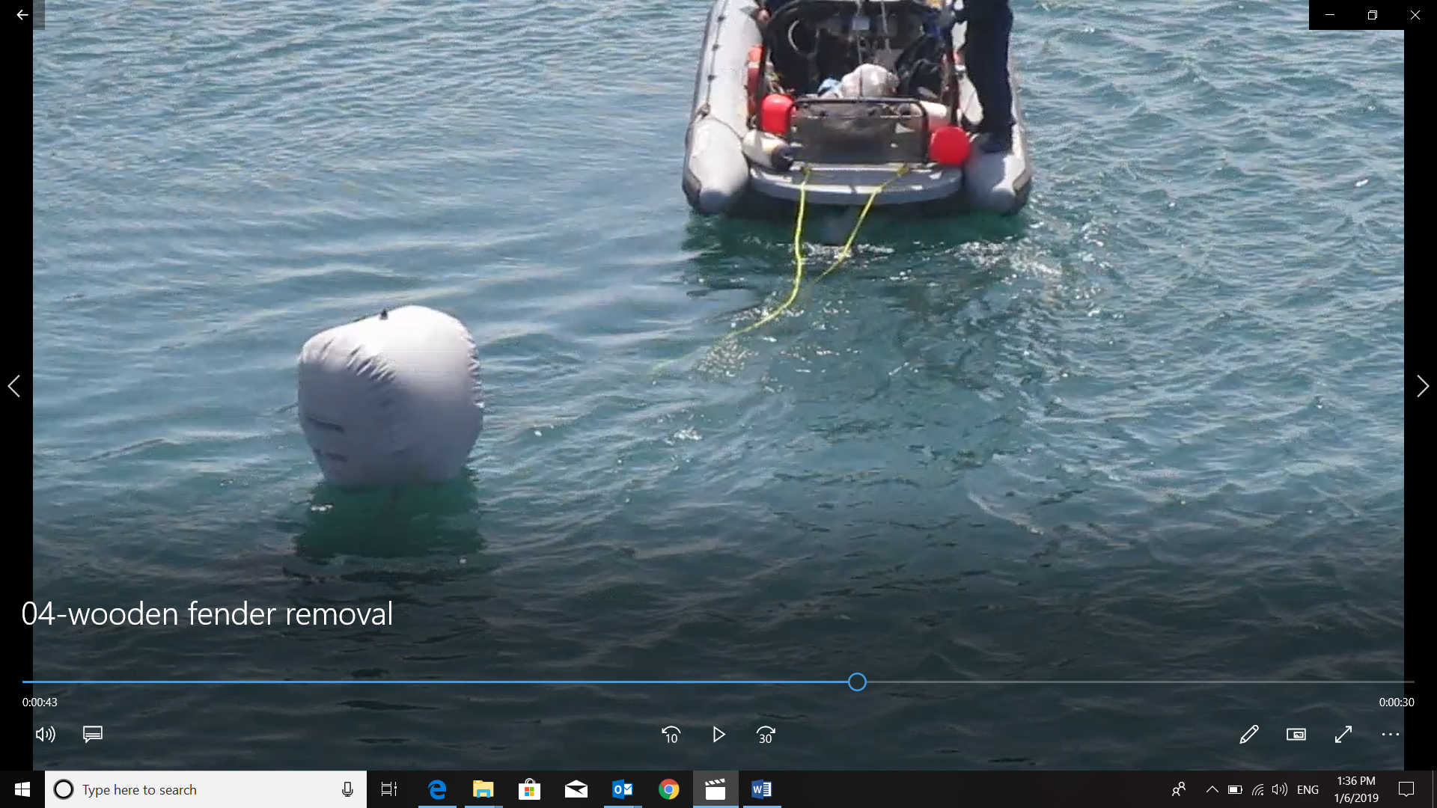
OPPORTUNITIES CAPTURED
Sea Housekeeping
Using balloon for lifting the scraps

Slide 11
CONCLUSIONS
Hidden risk on the piles under the sea level identified during the inspection , which was under poor condition, may lead to incident and loss business continuity.
Complete revamp of assets including concrete structure, steel structure and CP system eliminate the risks by insuring the healthiness of it and increase the protection layers which increase the life span of the assets and keep it available 100% for business needs.

Slide 12
Thank You

