Slide 1

Investigation of Heavy Accumulated Coke in Storage Area Flare

Slide 2
Background
At one of SABIC affiliates, During inspection a storage area flare was isolated for tip replacement as it was operating with smoky flare. After opening the flare drum and raiser it was observed a heavy accumulation of coke and solid particles.
In order to determine the source of the coke found and to prevent any environmental or safety issues, a sample from the coke collected and sent to Metallurgical & Corrosion Analysis (MCA) group, KSA Analytical Science, for characterization.

Slide 3
Analytical objectives
Characterization of material.
Initiate analysis report.
Milestones completed
Visual Examination and Photography.
Material Chemical Composition Determination
Thermogravimetric Analysis TGA
Phases Determination
GC-MS Analysis
Business Impact:
SAR 600,000 to 1,200,000 SAR as per e-TSR request.

Slide 4
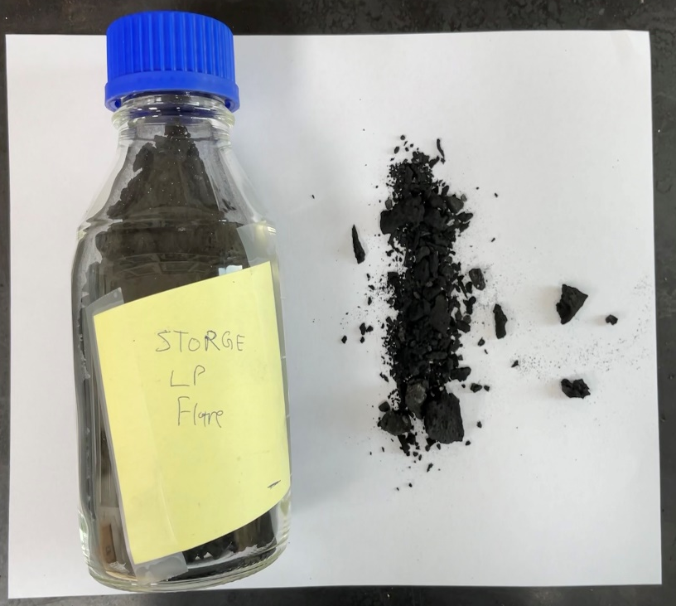
Visual examination
Black solid particles.
Sample preparation, crushing.
Coke material
Coke sample as received.

Slide 5
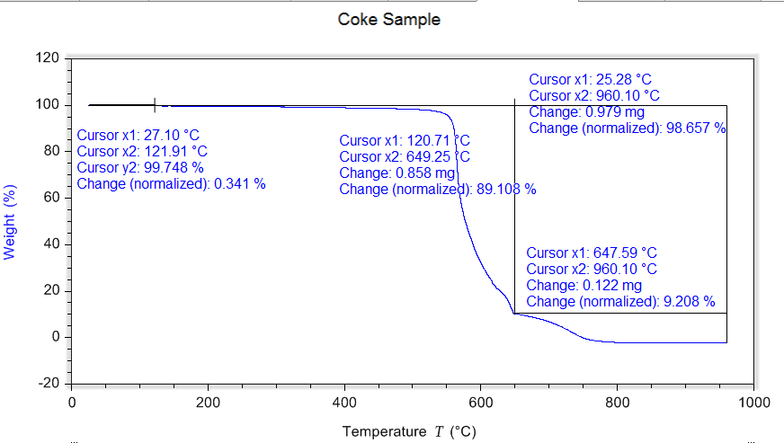
Thermogravametric Analysis (TGA)
Studying the material combustion characteristics
X-Ray Flounces and Carbon-Sulphur analysis have been for compositional analysis
Compositional analysis
Formula | C | Si | P | Fe | Al | S | Ca | Mg | Cl | Pb | Ni | Cr | Cu | Mo | Zn
Conc. (%) | 98.1 | 0.74 | 0.40 | 0.25 | 0.14 | 0.1 | 0.074 | 0.07 | 0.05 | 0.03 | 0.008 | 0.008 | 0.006 | 0.006 | 0.002

Slide 6
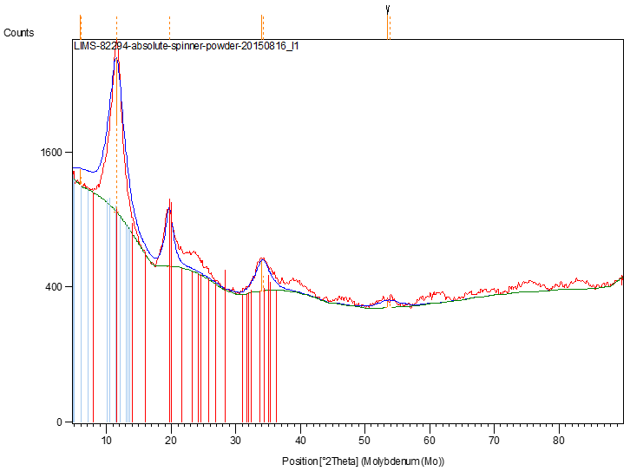
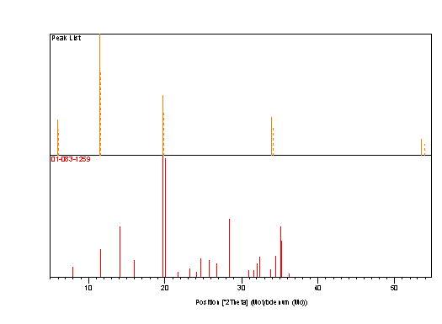
X-Ray Diffraction (XRD)
Phases of crystalline materials can be detected by XRD.
One major phase has been detected which is Iron Silicon.
List of the Identified Phases
Visible | Ref. Code | Compound Name | Chemical Formula
Major Phase | 01-083-1259 | Iron Silicon | Fe₂Si

Slide 7
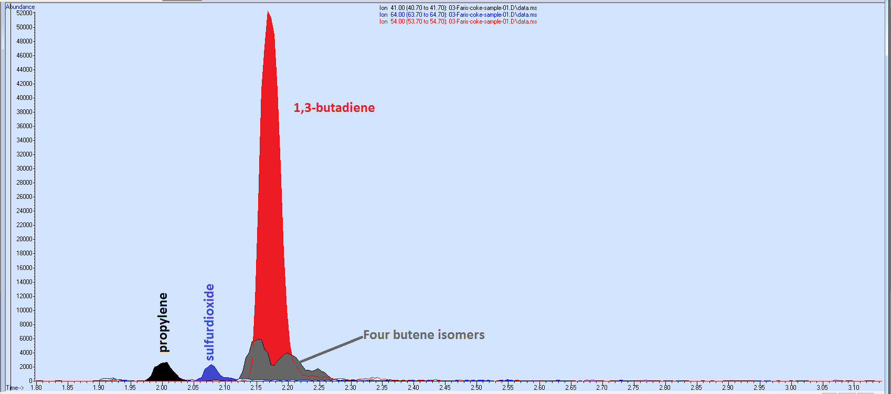
Gas chromatography–mass spectrometry (GC-MS)
Used to identify different substances in the material.
1,3 butadiene was the major substance with highest peak.
The formation of Butadiene (C4H6) can be caused by heating materials like Polyethylene.
Butadiene was the cause of coke formation on the flare walls.

Slide 8
Conclusion
From the analysis performed:
  Compositional analysis shows that the major elements presented are C, Si, P, and Fe.
  Total weight loss as shown by TGA analysis for the coke sample is 98.7%.
  XRD Analysis shows that the major phase presented is Iron Silicon (Fe2Si).
  GC-MS chromatogram shows that 1,3-butadiene has the most abundance.
The analysis helped in troubleshooting, and the source of the coke was determined to be from the flare tankage.
Solutions:
  More cooling has been done on the tankage to decrease formation butadiene gas.

Slide 9
Thank You

