Slide 1

Combustion Ion Chromatography
Essential Analytical Technique for
Material Investigation

Slide 2
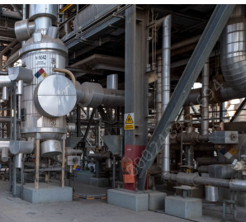
Analytical technique are essential
Industrial process are controlled – Analytical results are the indicator of controllability
Analytical Techniques
Pressure drop
Corrosion issue
Fouling
Catalyst deactivation
Water / waste water
Process upset

Slide 3
Samples and Challenges
Sample can range from
Matrix
Analyte – Trace level
Limited sample size ( 10mg)
Mixture of Organic / inorganic
Gases
C2 to C4
Liquid
Cooling water
DM Water
Solid
mixture

Slide 4
Ion chromatography
Typical Ion Chromatographic System - Anion Analysis
NaOH/ MSA
Eluent
Regent Out
Suppressor
Regen In
Pump
Suppressed Conductivity
Conductivity Cell
Sample Injection
Guard Column
Chromatography Software
Data Handling and Instrument Control
Ion Exchange Separation
Analytical Column

Slide 5
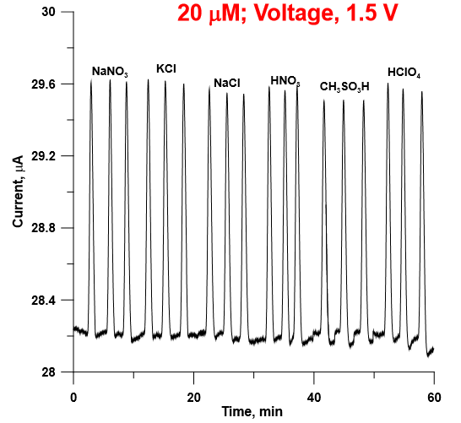
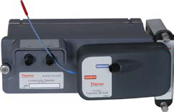
Charge Detector (QD)
Detector respond to ionic species at a fixed voltage generating current
Response is proposal to charge – Hence it can be used for universal calibration
Current drawn is directly propositional to ionic strength
Weakly dissociate ions have better response
Compliments the conductivity detector, with additional information of interference & better
sensitivity for weak dissociated ions ( formate, acetate, bromate, pyruvate)
S/N ratio is higher compared to that of conductivity
Dissociation of water is responsible for the background noise
Applied voltage impact the Signal and Noise

Slide 6
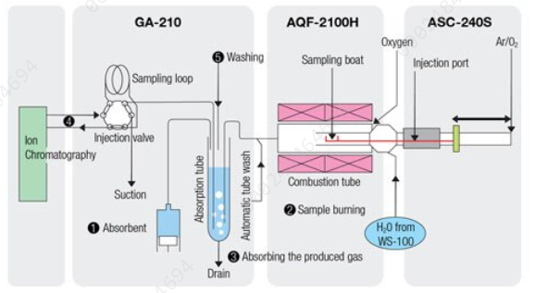
Instrumentation:Combustion IC

Slide 7
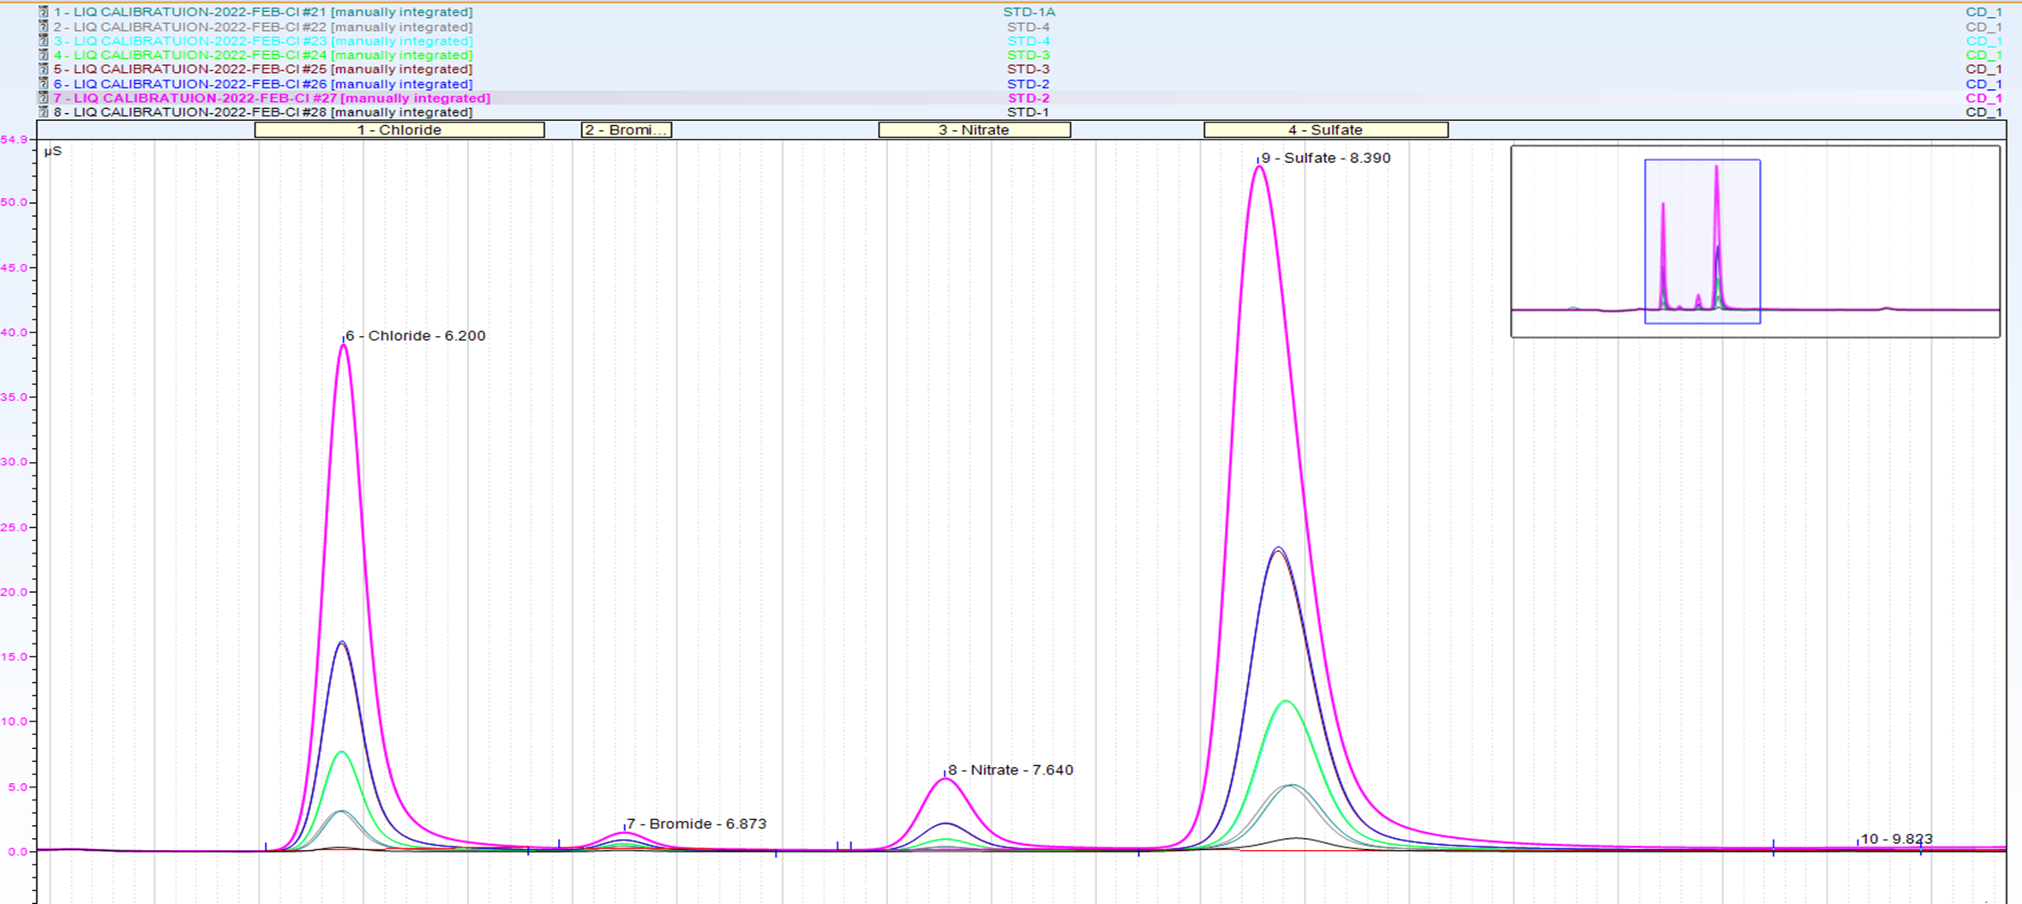
Standard or Sample preparation
Calibration standard
  EDC / Br-cresol / Benzothioazo
  Solvent used –Methanol
  Injected volume -90µL

Slide 8
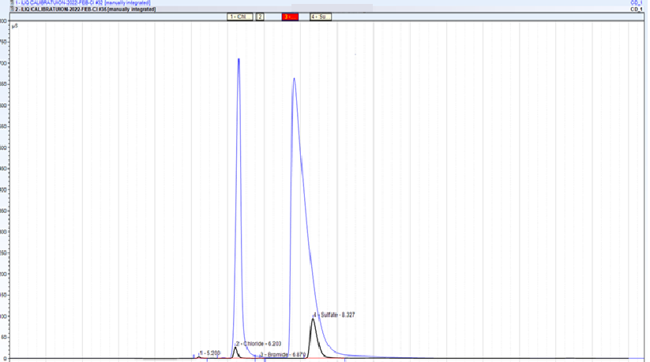
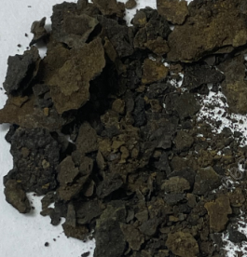
Corrosion material
First run
Sample preparation
With SiO2- solid mix

Slide 9
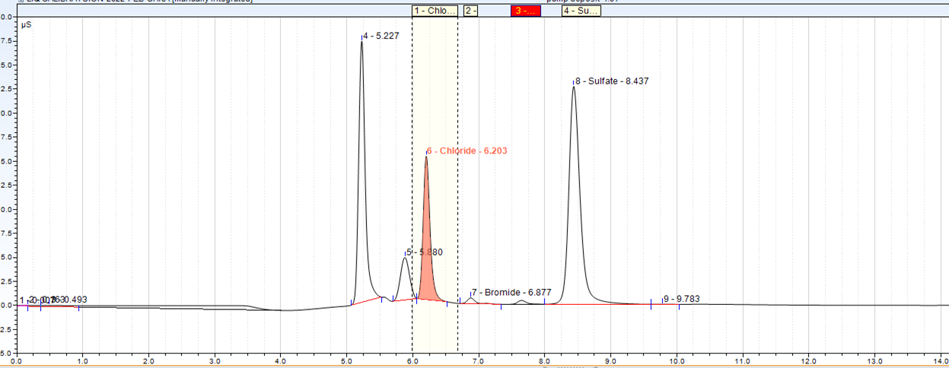
Water pump deposit
White deposit in the pump was provided to know the type
Sample around 0.2g provided for analysis – insoluble in water
unknown

Slide 10
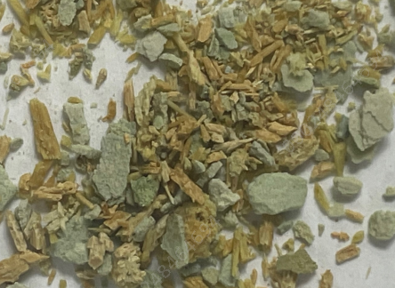
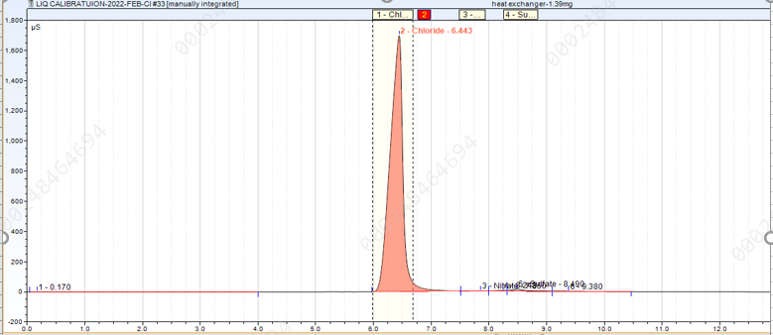
Heat exchanger sample
Where the cooling process water side having
Major deposit
Deposit the FeCl3

Slide 11
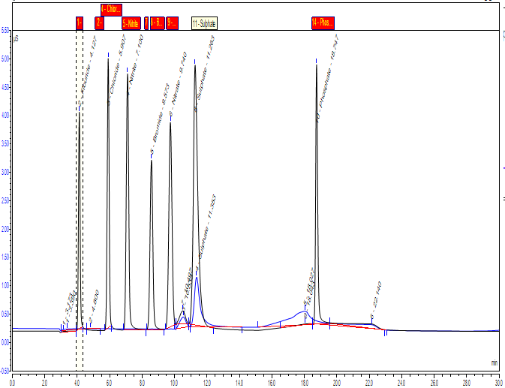
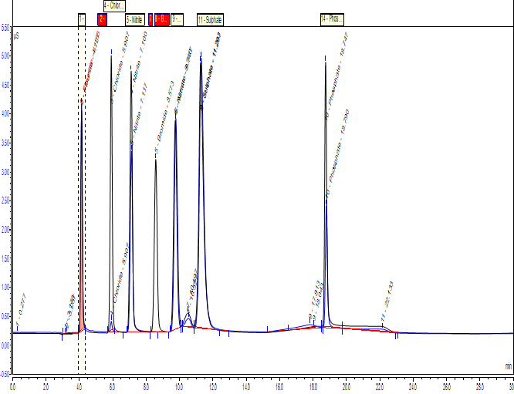
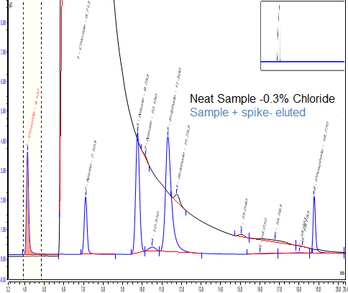
SAMPLES with High Conductivity
Anion standard -All seven anion tested
on SPE adsorbed all anions- 5mL
Standard –Neat
Standard eluted
through SPE
F: 0.5ppm
Cl: 2.5ppm
Br:2.5ppm
NO2-:3.5ppm
NO3: 3.5ppm
SO4: 3.5ppm
PO4: 3.5ppm
Second Trial on same SPE shows 5 anions
removal of Chloride and Bromide ( 5mL)
Third Trial shows 3 anions > 80% recovery & 50% for Nitrite & Phosphate ( 5mL ) removal of Chloride and Bromide-
Standard –Neat
Standard -SPE
Fourth Trial shows 3 anions shows> 90% recovery & 50% for Nitrite & Phosphate removal of Chloride and Bromide
Neat standard +
Overlay all repeats
Overlay of standards for all four repeat
Sample + Anion standard eluted through
SPE
Production sample are expected

Slide 12
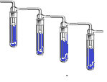
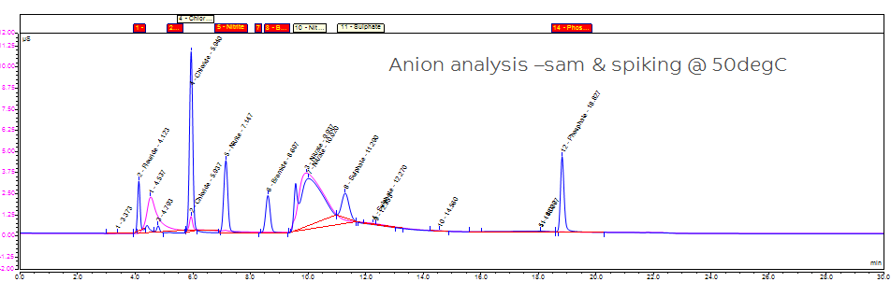
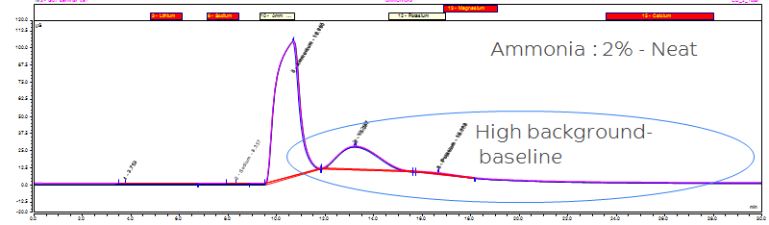
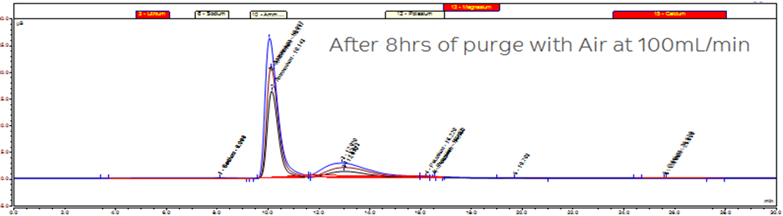
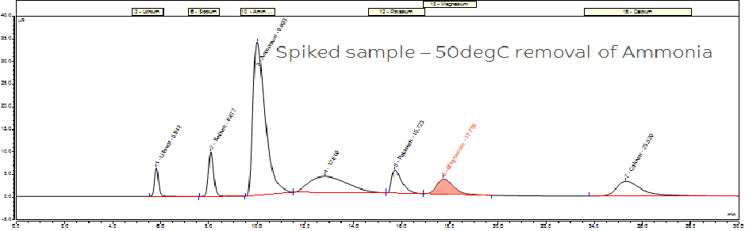
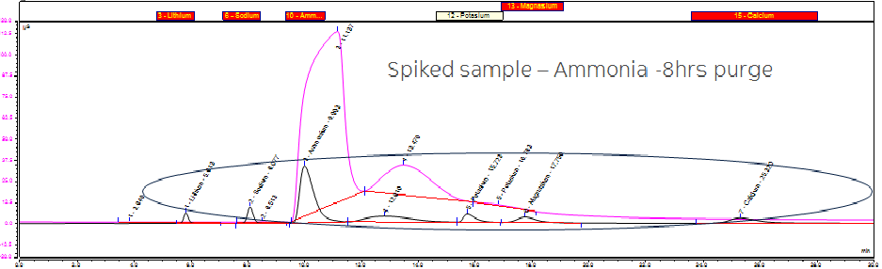
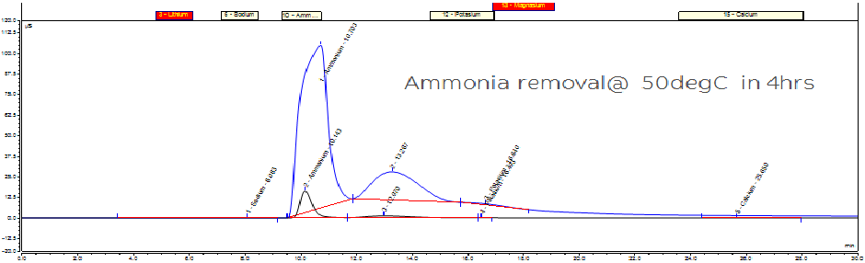
Anions in High Ammonia sample
Sample preparation
Ammonia as Matrix
Sample Range: 0.1 - 2%
Requirement is for analysis of trace anion and Cation:
Physical properties :NH₃ boils at −33.34 °C (−28.012 °F) at a pressure of one atmosphere, so the liquid must be stored under pressure or at low temperature. Ammonia or ammonium hydroxide is a solution of NH₃ in water.
Air /N2
Vent
Water
Ammonia
Ammonia
HCl
Base
NH3 (Aq) NH3 (gas)

Slide 13
Thank You

