Slide 1


Soil Corrosivity Survey Techniques and Analysis
Abdallah Hammoud

Slide 2
OVERVIEW
Soil Resistivity
Measurement techniques and applications
1
Terrain
Soil types, water table, different terrains, drain characteristics
2
Soil Chemistry
Laboratory testing and acceptable limits. pH, Sulfates, Sulfides, Chlorides, etc..
3
Q&A
4

Slide 3
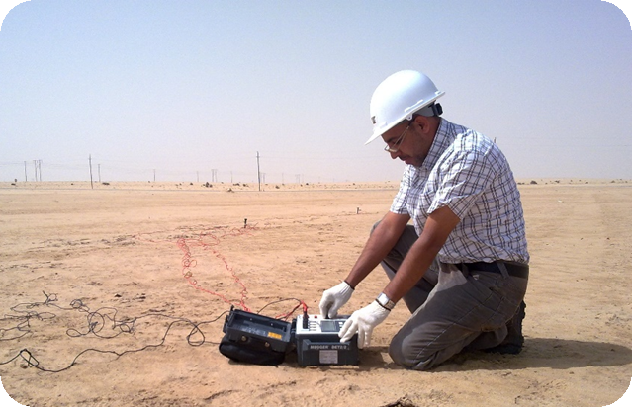
SOIL RESISTIVITY
Measurement Techniques
Corrosiveness Classification
Data Management

Slide 4
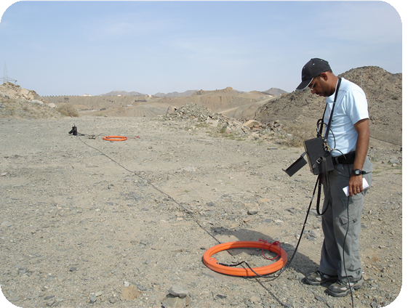
SURVEY TECHNIQUES
Electromagnetic
Wenner 4-pin
Collin’s Rod
High Power Meters
Monitored Resistivity for other uses

Slide 5
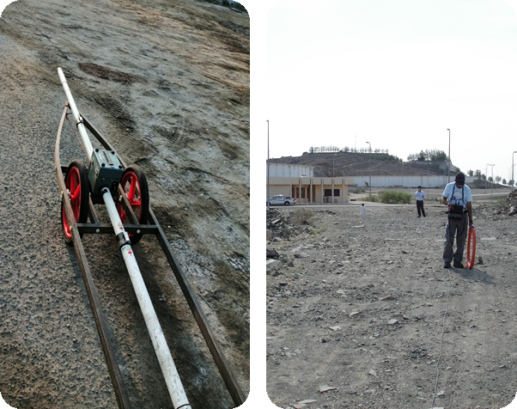
ELECTROMAGNETIC METHODS
Transmitter coil Tx produces a magnetic field
The magnetic field induces an eddy current in the soil
Electrical current generates a magnetic field that can be measured by a receiver coil Rx
Control Box calculates conductivity in units of millisiemens/meter
Contact less with earth
Efficient in rocky or high resistivity areas
Shallow and Deep layers

Slide 6
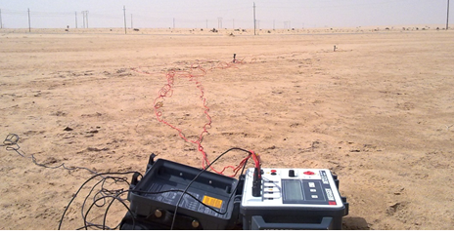
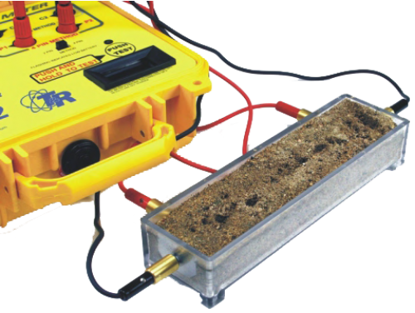
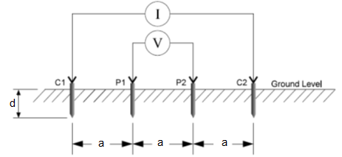
WENNER 4-PIN METHOD
Ground contact – steel rods
Equally spaced rods
Rods’ spacing indicates measured layer depth
Current is injected on outer pins and earth potential is measured on inner pins
Ohm’s law is used for resistance calculation
Resistivity is a function of calculated resistance and rods’ spacing
ρ=2πaR
Water can be used at pins to enhance ground contact
Less efficiency in high resistivity areas
Can be used in a size calibrated soil box configuration

Slide 7
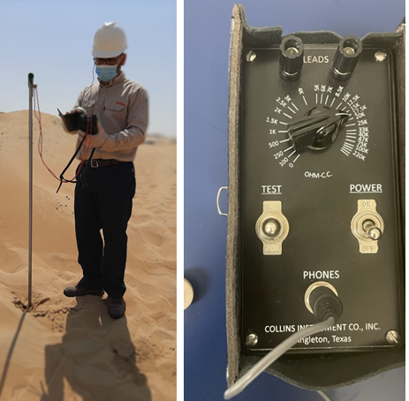
COLLIN’S ROD
Single rod / two pins
Light weight, easy to operate
Rod tip isolated from rod body
Used for spontaneous tests; near pipe surface
Low accessibility areas (street shoulders)
Can reach a depth of 2-3 meters.
AC Soil resistivity bridge meter is used to determine resistivity
AC resistance between the tip and body of rod is determined by balancing bridge and soil resistivity

Slide 8
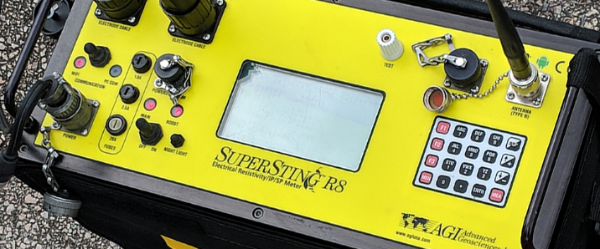
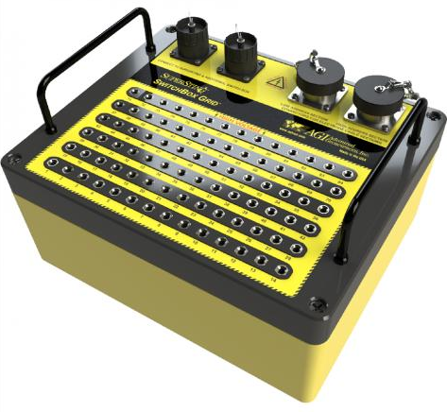
HIGH POWER METERS
Used for big areas and higher depths
Can be used in AC Interference Mitigation designs
Suitable for modelling earth layers accurately
High power compared to regular conductivity meters
Up to 84 rods can be involved

Slide 9
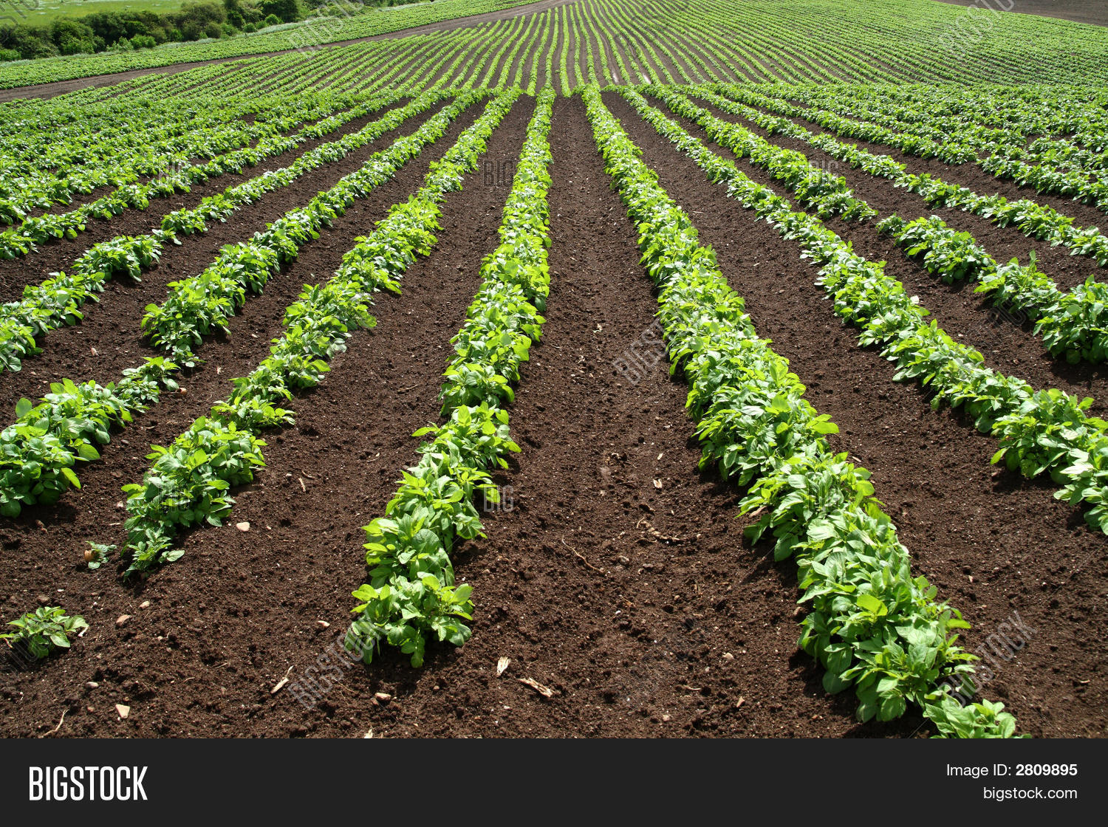
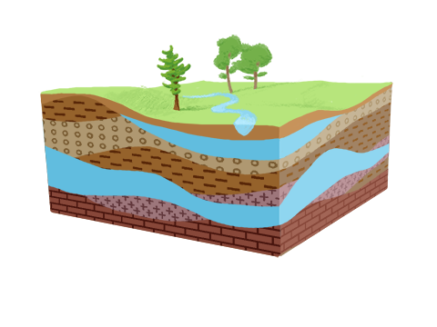
OTHER USES
Permanent Soil Resistivity Setup
Remotely monitored or locally logged
Creates trend graphs showing change in environment
Resistivity is essential for monitoring crop fields for forestry and precision agriculture applications
Dam leak detection
Cavity detection
Water aquifers detection
Metal detection

Slide 10
CORROSIVITY CLASSIFICATION BY RESISTIVITY
In accordance to API-651
Resistivity Range | Potential Corrosion Activity
<500 Ω-Cm | Very Corrosive
500 – 1,000 Ω-Cm | Corrosive
1,000 – 2,000 Ω-Cm | Moderately corrosive
2,000 – 10,000 Ω-Cm | Mildly corrosive
>10,000 Ω-Cm | Progressively less corrosive

Slide 11
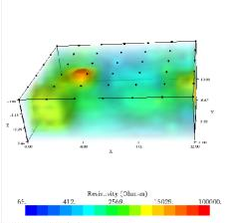
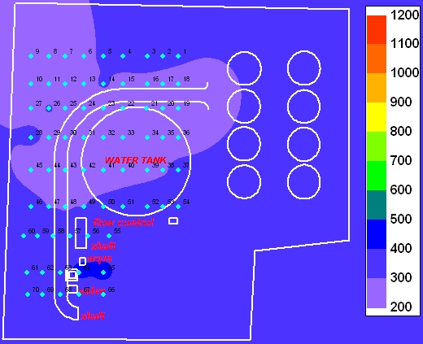
DATA MANAGEMENT
2D & 3D presentation using special third party software (heat maps)
Continuous soil resistivity profile along pipelines
Layer resistivity calculation using Wenner method and Barnes layer analysis

Slide 12
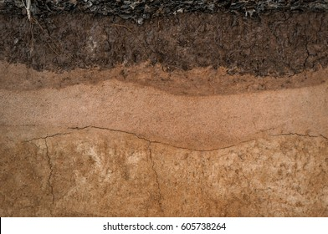
TERRAIN AND SOIL FORMATION
Soil Types
Soil Drain Test
Terrain Types
Water Table

Slide 13
SOIL TYPES
Poorly graded Sand
Poorly Graded Sand with Silt
Silty Sand
Clayey Sand
Sandy Silt
Silt
Fat silt
Well graded sand
Well graded sand with silt
Well graded sand with silt & gravel
Coral
Conglom
Lean Clay
Fat Clay
Silty Clay
Sandy lean clay
Poorly graded sand with clay
Asphalt
Fill
Gypsum
Boulders
Poorly graded gravel
Well graded gravel
Silty gravel
Gravel with silt and sand
Well graded gravel with silt
Clayey gravel
Limestone
Siltstone
Mudstone
Sandstone
Basalt
METAMG
METAFG
IGNSCG
IGNSMG

Slide 14
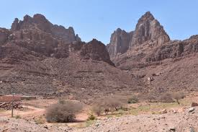
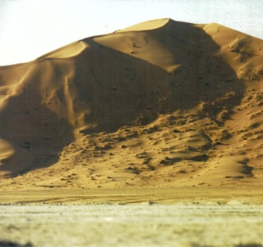
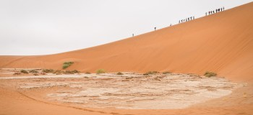
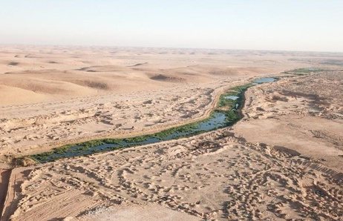
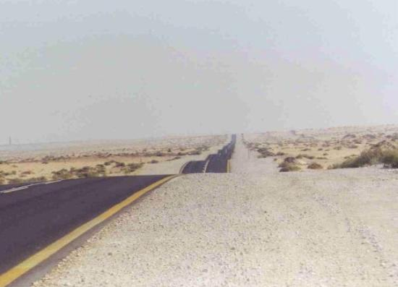
TERRAINS
Rocky Mountains
Hills
Sand Dunes
Wadi’s
Plain Deserts

Slide 15
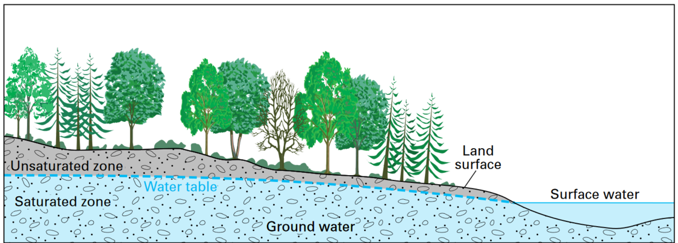
WATER TABLE
Impacts soil resistivity
Many methods for detection
Ground Penetrating Radar
Bore holing

Slide 16
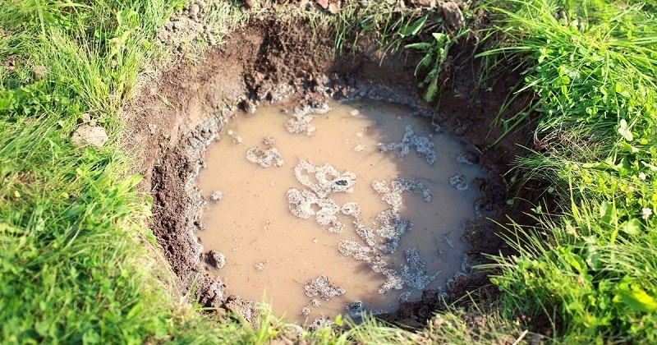
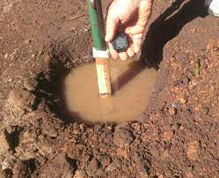
SOIL DRAINAGE PROPERTIES
Ability to hold/drain water
Impacts soil resistivity (seasonally)
Different types of soils have different drainage properties
Clay soils drain poorly and sandy soils drain rapidly.
Soil drainage infiltration test can be done

Slide 17

SOIL CHEMISTRY
REDOX POTENTIAL
SOIL CHEMICAL COMPONENTS
ACCEPTABLE RANGES

Slide 18
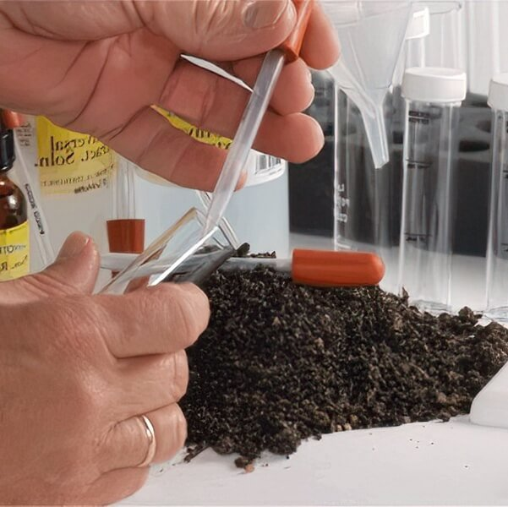
SOIL CHEMICAL COMPONENTS
Soil pH Test
Geo-chemical analysis on soil to determine:
Soluble salts (Chloride, sulfates, and bicarbonates),
microbial analysis,
soil moisture content

Slide 19
SOIL CHEMICAL COMPONENTS
Soil Moisture – The higher the soil moisture content, the greater the anticipated rate of corrosion. Moisture contents can range from 1% (very dry sands) to 40% (clays holding a great deal of moisture). Typical values are 10 to 15% with over 20% moisture considered high.
pH – Acid soils and groundwater are more conductive to galvanic corrosion of ferrous materials than alkaline soils. Where soil or groundwater pH is less than 5.0, the current requirements for cathodic protection may be higher.
Sulfate Ion Concentration – Any detectable concentrations of sulfide ions are indicative of anaerobic conditions that may support high rates of metal dissolution due to microbiology induced corrosion.
Chloride Concentration – Chloride ions are cathode depolarizers which enhance the rate of corrosion. The higher the concentration, the greater the rate of corrosion. Many soils have chloride concentrations less than 10 ppm. Concentrations over 50 ppm are significant.

Slide 20
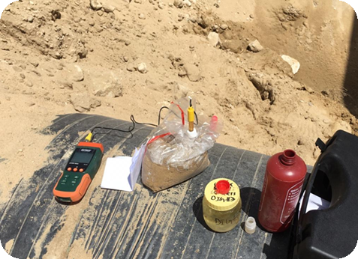
REDOX POTENTIAL
Redox potentials measure the tendency of an electrolyte to transfer electrons between its chemical species
One key use of a redox potential measurement is to determine if a particular soil has the propensity to support microbiologically influenced corrosion (MIC)
ORP Meter
 | Negative Potential | High probability of MIC attack
 | 0mV to +99mV | Moderate possibility of MIC
 | Equal or greater than +100mV | MIC attack unlikely

Slide 21
Thank You

