Slide 1

Application of Hybrid Technology in Industrial Wastewater Treatment: A challenge in Wastewater Management
Dr. Muhammad Saleem
Associate Professor, Dept. of Civil Engineering
Jubail University College
(e-mail: saleemm@ucj.edu.sa)

Slide 2
Discussion Topics for Today Presentation
Introduction
Problem Statement
Solution to the Problem
Case Study
Conclusions
References

Slide 3

Introduction
Water
A unique characteristic of earth is the presence of water
Water is essential for life
In looking for signs of life in other solar systems and galaxies, we often search for liquid water
Is Water Scarce ?

Slide 4
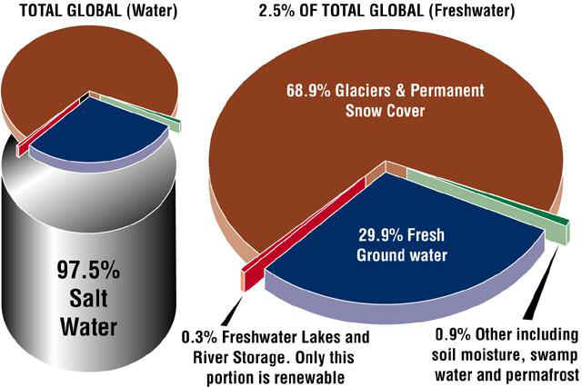
Water Balance of the Earth
Distribution of Water Volume

Slide 5


Available reserves are limiting due to
  Increase in population
  Rapid industrial growth
  Contamination of water resources
  Mismanagement in water distribution
Typical Contaminants Present in Industrial Wastewater
+
-
INORGANICS
ORGANICS
PARTICLES / COLLOIDS
MICROORGANISMS
DISSOLVED
GASES

Slide 6
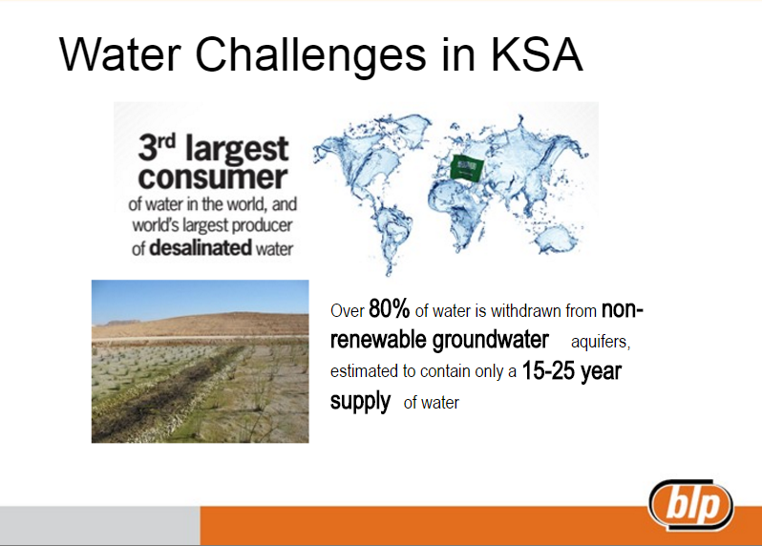
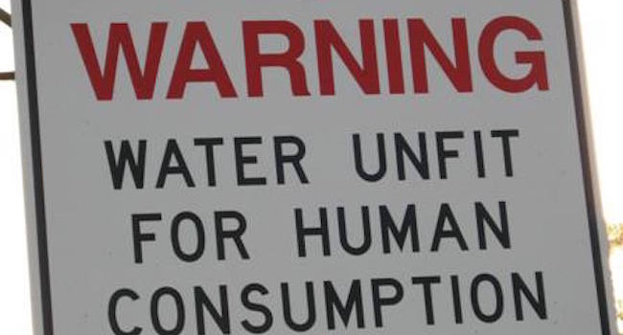
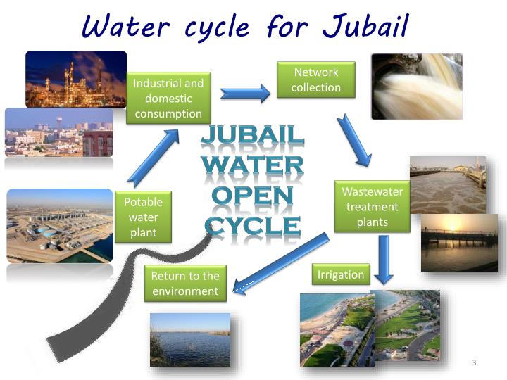

Slide 7

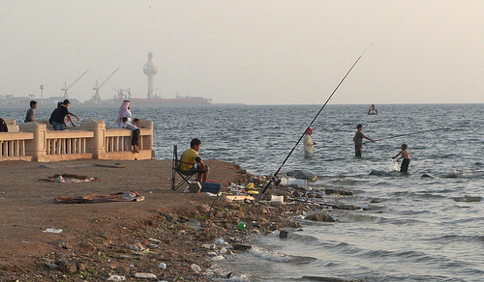
In order to Improve the
Quality of Life
Health, depletion of
resources, such as
Water
We Need Energy
Need to build Power Plants
& Other Industries
Environmental Pollution
(Air, Soil, Water)

Slide 8


Solution to the Problem
Solution
to protect public and environment and meet the legislations
Treatment for Reuse
Treatment for Discharge
Disposal
What is the Solution ?

Slide 9
Do we have Decontamination Methods/Technologies

Slide 10
Gravity Settling
Coagulation/flocculation (chemical, polymers)
Sand Filtration (Slow or Rapid)
Aeration (oxidation)
Adsorption (AC or polymers)
Ion Exchange (resins)
Disinfection (Chemical, Energy)
Advanced Filtration (Membranes)
Natural/artificial bioremediation
Electrochemical
Phytoremediation
Gas Striping
Pump and treat method etc.
Treatment Methods/Technologies
  In order to restore the water and groundwater aquifers/resources a number of methods are devised.
  Some are old/conventional and some are advanced and modified
  For example

Slide 11
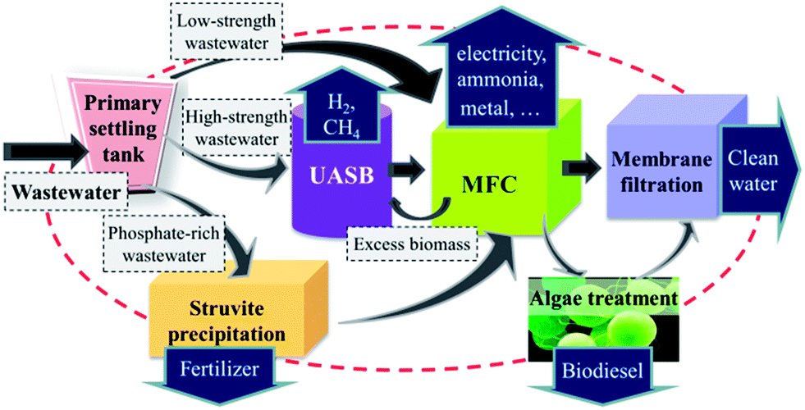
Application of Hybrid Treatment System
What are the Basis to Select a Suitable Method?
  Whether the method is practically applicable?
  Whether it can provide required degree of treatment?
  Is it Cost effective?
May We Use Any Method for Any Type of Contaminant?
NO
Most of the time, these methods are specific for specific type of contaminant.
A suitable method needs to be design for each case.
The hybrid system is the combination of two or more treatment methods, either two or more of the Biological unit processes, chemical unit processes and physical unit operations.

Slide 12
Case Study
Petrochemical wastewater is a threat to biological health. Phenolic compounds have toxic effects on all organisms.
Methyl tert-butyl ether (MTBE) is highly persistent in the environment and is frequently found in contaminated groundwater (Levchuk et al., 2014).
It is classified as a health hazard by the US EPA and has a maximum allowed concentration in drinking water (40 µg/L) in the United States and Germany (Van Afferden et al., 2011).
MTBE has sorption partition coefficient (K_{oc} is 1.035 to 1.091).
MTBE are often present with other compounds in contaminated water makes its removal more difficult (Wang and Deshusses, 2007).

Slide 13
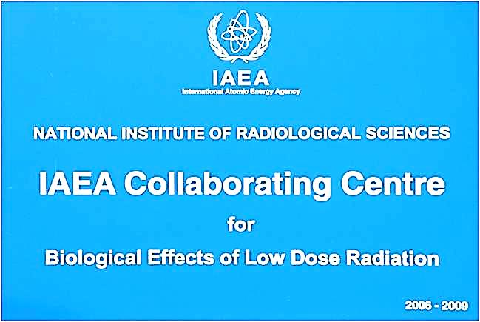
  IAEA Coordinated Research Project
Introduction
Considerations:
Pharmaceuticals wastewater treatment.
Emerging chemicals of concern.
Biosolids/sludge treatment.
RO Retentive Treatment.
Agricultural Production – food and water.
Economic models development.
Salinity and agricultural practices.
Innovative wastewater treatment processes
Introduction
The International Atomic Energy Agency (IAEA) promotes and supports research on radiation treatment of liquid effluents.
During 2006 various collaborative research projects started with member states.

Slide 14

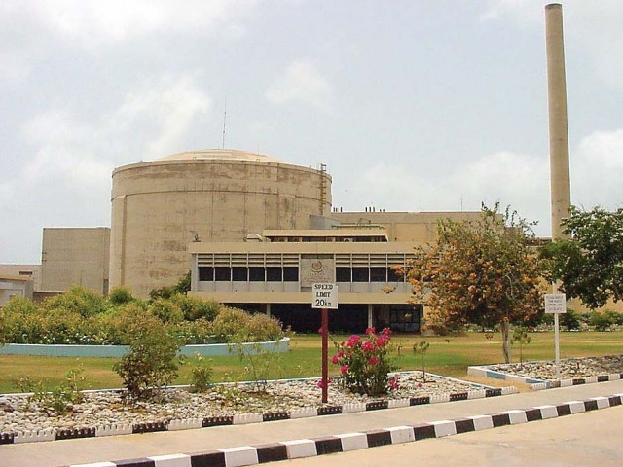

  IAEA Coordinated Research Project
Introduction
A Collaborative Research Project (CRP) on Remediation of Polluted Waters and Wastewater by Radiation started early 2006 at Karachi Institute of Power Engineering (KINPOE).
Various targeted pollutants studied in different phases.
(IAEA-TECHDOC-1407)

Slide 15
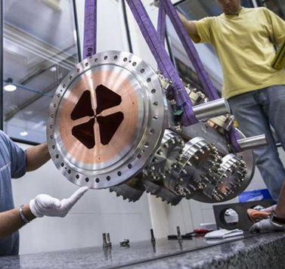
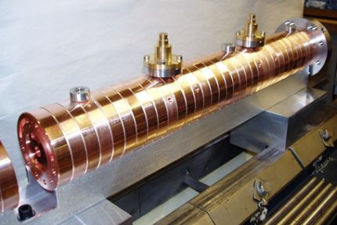
  IAEA Coordinated Research Project
Rational of Using E-Beam
The most efficient process for generating hydroxyl radicals and defining reactive species for Advanced Oxidation Processes (AOPs)
No need of additives – only the electrons
Solids do not interfere with the process
Aqueous radiation chemistry is well defined.
H₂O \/\/\/\/\/→ 2.7 •OH + 0.6 •H + 2.6 e⁻
+ 0.45 H₂ + 0.7 H₂O₂ + 2.6 H⁺
Equipment is reliable – with Insulated Core Transformers (ICTs) having 98 – 99 % uptime
Mobile trailer may be utilize.
No residuals – e.g. sludge's etc.
Economical than most of the treatment methods.

Slide 16
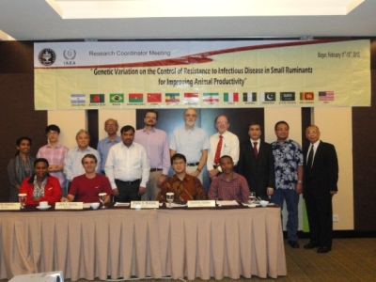
  IAEA Coordinated Research Project
Aim:
Utilize conventional and E-Beam technology to decontaminate petrochemical wastewater having general pollutants and targeted pollutants (e.g. MTBE, Current study).
Program was aimed to establish optimal treatment methodologies (Use of Hybrid System)
Approach of the Study:
Characterize the targeted wastewater.
Select the treatment processes for the removal of
Contaminants (basis of laboratory investigation).
Use standalone and hybrid systems.
Finally select the most suitable treatment scheme.

Slide 17
How to Treat (Various conventional & Advance Methods Reviewed)
  Physical treatment (sedimentation, filtration etc.)
  Chemical treatment (coagulation, flocculation,
  chemical oxidation, etc.)
  Biological treatment (biological oxidation,
  microbial assimilation, etc.)
  Advanced treatment (Microfiltration, E-beam, AOP
  photo-Fenton, etc.)
  After detailed study a physicochemical treatment scheme along with electron beam treatment was selected.

Slide 18

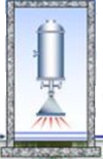

Proposed Treatment Scheme
Physicochemical
Sand Filtration
E-Beam
Treatment
Coagulation
Flocculation
Sedimentation
Stage I
Stage II
Stage III

Slide 19
  IAEA Coordinated Research Project
Methadology:
Alum, FeCl3 & FeSO4 (Coagulants)
Slow sand filtration (Filtration media)
A 50 KeV E-Beam (WASIK-A, Japan ).
MTBE contaminated wastewater brought from a petroleum refinery at Karachi area in sealed containers.
E-Beam doses 1.22 kGy to 8.97 kGy.
Treatment time 15 sec/gallon.
25 experimental runs were performed with wastewater. (US-EPA-524.2, 1992, GC/MS, EPA Method 5030/8260B (purge-andtrap/GC/MS)

Slide 20

  IAEA Coordinated Research Project
Objectives of E-Beam treatment
Efficiency of each process and Hybrid process to remove general pollutant specially MTBE.
System/Process Reliability.
Check Reuse Option.
Cost estimation.
Safety Consideration.

Slide 21
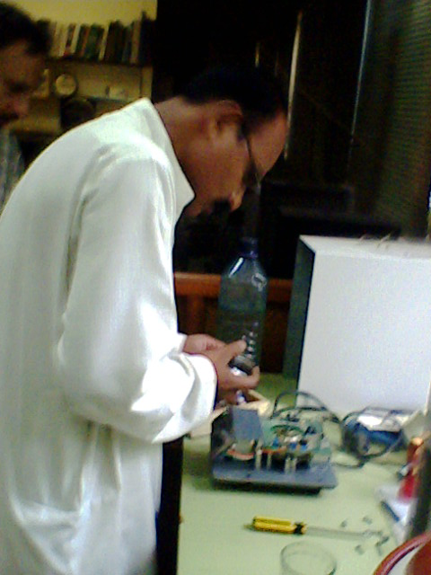
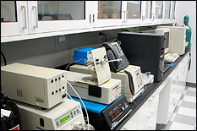
Table 1: Charecteristics of Petrochemical Wastewater
Serial No | Parameters | Units | Value Range
1 | pH | - | 6.49 ± 0.3
2 | TSS | (mg/l) | 700 ± 4
3 | TDS | (mg/l) | 236 ± 2
4 | TS | (mg/l) | 1236 ± 6
5 | COD | (mg/l) | 898 ± 8
6 | BOD₅ | (mg/l) | 170 ± 3
7 | Color | (Pt-Co Units) | Brownish
8 | Amonia-N | (mg/l) | 40.6 ±0.5
9 | NO₃-N | (mg/l) | 3.2 ± 0.3
10 | Total phosphate | (mg/l) | 28.3 ±1.1
11 | Total Coliform | MPN (#/100 ml) | 120 ± 4
12 | MTBE | (mic-g/l) | 310± 5
13 | Turbidity | (NTU) | 42.7 ± 1.2

Slide 22

  IAEA Coordinated Research Project
Mechanism
CV-1
Pump
Lead Shielding
E-Beam Scanner
E-Accelerator
Exposure Chamber
Strainer
Influent WW-Sump
Magnetic Coils
Insulated Core Transformer
RCC Shielding
CV-2
Monitoring Console
Effluent
Safety Consideration:
up to 0.02 mSv near nuclear installation sites
world-wide average to all workers is 0.7 mSv.
Radiation level all the time was below background level (0.014-0.017 mSv)

Slide 23
Results
Table 2: Comparison of effluents after chemical treatment
Parameters
Raw Wastewater
Effluent Quality After Chemical Treatment
Alum
FeCl₃
FeSO₄
pH
6.5
7.1
9.3
9.5
Color
Brownish
Light brown
Yellowish Brown
Gray-brown
TDS
236
136.2 (42)
142.6 (40)
144.5 (39.5)
TSS
700
147.7 (78.9)
231.2 (67.1)
163.1 (76.7)
BOD
173
112.8 (34.8)
119.2 (31.2)
116.8 (32.5)
COD
898
461.6 (48.6)
501.1 (44.2)
609.7 (32.1)
Turbidity
42.7
8.9 (79.2)
16.4 (61.5)
14.8 (65.3)
MTBE
312
-
--
--
¹ Alum, ² FeCl3 & ³ FeSO4. All units are in mg/l except color, pH, and turbidity. Percentage removal is in parenthesis.

Slide 24
Results (Cont.)
Table 3: Effluent after chemical and sand filtration
Parameters
Raw Wastewater
Effluent After Chemical Treatment
After Sand Filtration
Alum
pH
6.5
7.1
6.9
Color
Brownish
Light brown
Light brown
TDS
236
136.2
98.7 (27.5)
TSS
700
147.7
3.4 (97.7)
BOD
173
112.8
38.8 (65.7)
COD
898
461.6
216.9 (52.9)
Turbidity
42.7
8.9
2.7 (69.6)
MTBE
312
-
227.8 (27)
All units are in mg/l except color, pH, and turbidity

Slide 25
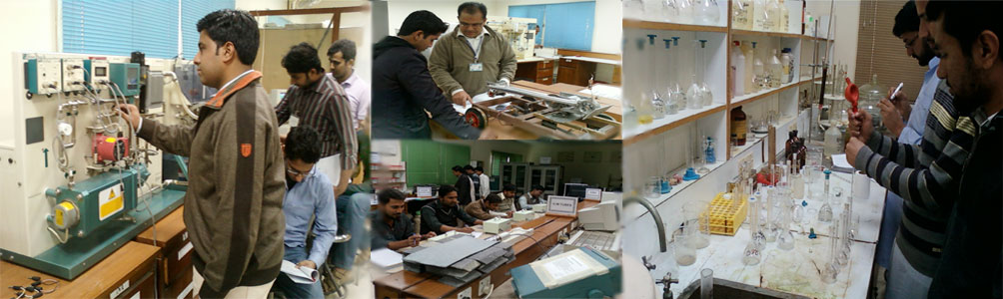
Results (Cont.)
Table 3: Charecteristics of Wastewater After Chemical, Filtration & Irradiation: Comparison with Various Reuse Standards (Reuse Consideration)
Parameters
Raw Wastewater
Final Effluent After E-Beam Treatment
Saudi Arabian Standards
US-EPA (1992)
California (2009)
ªMA
^{b}PME
^{c}RCJY
pH
6.9
6.49 ± 0.3
6.0-8.4
6.0-8.4
6.0-8.4
6-9
6-9
Color (Pt-Co)
Brownish
Color less
--
--
--
--
--
TDS (mg/l)
236
19.8 ± 0.5
--
--
--
--
--
TSS (mg/l)
700
3.3 ± 0.1
20
15
15
5.0
15.0
BOD (mg/l)
173
9.4 ± 0.3
20
25
50
10.0
20.0
COD (mg/l)
898
24 ± 0.5
--
150
--
30.0
25.0
Turbidity (NTU)
42.7
2.7 ± 0.2
1.0
75
5.0
1.0
1.0
MTBE (mic-g/l)
312
6.2 ± 0.3
--
--
--
20
13
ª MA 1989, ^{b} PME, 2002,
^{c} RCJY, Env. Regulations, 2015.

Slide 26
Results (cont.)

Slide 27
  IAEA Coordinated Research Project
Results

Slide 28
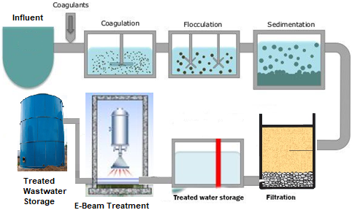
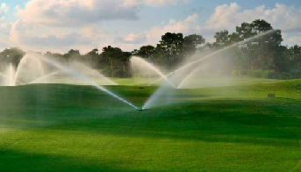
Suggested process flow diagram for complete treatment of wastewater to be reused
Reuse

Slide 29
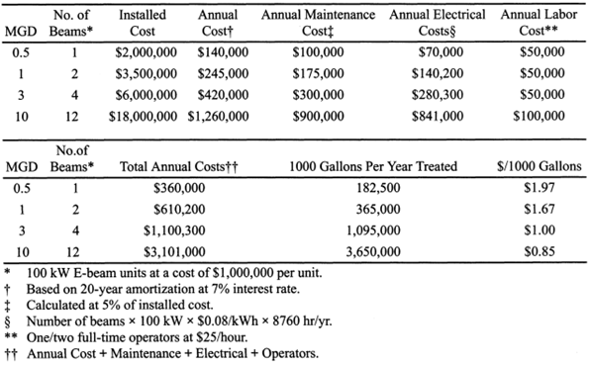
  IAEA Coordinated Research Project
Cost analysis for E-Beam treatment of wastewater

Slide 30
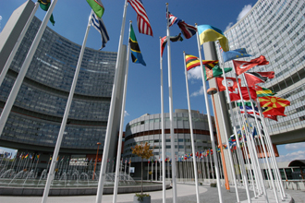
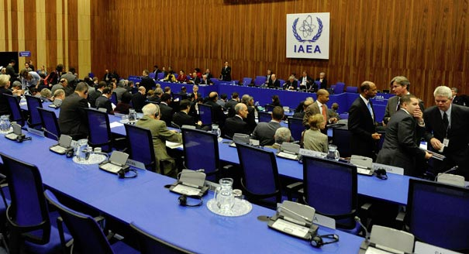
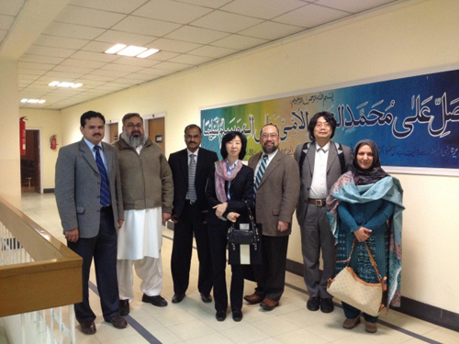
Conclusions
Petrochemical wastewater with high MTBE can be treated efficiently with hybrid combination of chemical, physical and E-Beam method.
Efficiency of E-Beam to disintegrate MTBE was found to be more than 95 % at a dose of 5kGy .
System availability was up to 99%.
All other quality parameters were within allowable limit of irrigation water.
Treated wastewater quality compared with various standards for reuse and a treatment scheme is suggested.
Continuous monitoring of radiation levels shows that the radiation is within permeable limits and process is safe.
Cost analysis shows that for 10MGD cost is $0.85/1000 G.

Slide 31
Some References:
Saleem, M. (2014). “Electron Beam Treatment of MTBE Contaminated Wastewater for Reuse Application”. The Royal; Commission International Conference on Latest Technologies of Industrial Waste Recycle & Reuse’ scheduled on 3th and 4th December, 2014” at Jubail Industrial City, Jubail, Saudi Arabia, December 3-4, 2014
Saleem, M., and Essa, M.H. (2010). Suitability for sustainable reuse of secondary effluent: A case study in Saudi Arabia. NED University Journal of Research, 4(1), pp. 23-34-50.
Saleem, M. (2009). Wastewater reuse potential in Pakistan: Guidelines for environment and public health protection. International J. of Environmental Engineering 1(3), pp. 306-320
Saleem, M. Hussain, A. and Samo, S.R. (2009). “Water Scarcity and Wastewater Reuse Guidelines for Environment and Public Health Protection in Pakistan”. 1st International Conference on Energy and Environment: Role of Energy Resources in Sustainability of Environment Organized by Energy and Environment Engineering Department In collaboration with Higher Education Commission (HEC) at Quaid-e-Awam University of Engineering Science and Technology, Nawabshah, Pakistan, February 26-29, 2009
Saleem, M., M. A. Zia, and M. A. Baig. "Characterization of thin films using time of flight mass." Frontiers of advanced engineering materials (faem-06). 2006.
Levchuk, I., Bhatnagar, A., & Sillanpää, M. (2014). Overview of technologies for removal of methyl tert-butyl ether (MTBE) from water. Science of the Total Environment, 476, 415-433.
van Afferden, M., Rahman, K. Z., Mosig, P., De Biase, C., Thullner, M., Oswald, S. E., & Müller, R. A. (2011). Remediation of groundwater contaminated with MTBE and benzene: the potential of vertical-flow soil filter systems. Water research, 45(16), 5063-5074.
Wang, X., & Deshusses, M. A. (2007). Biotreatment of groundwater contaminated with MTBE: interaction of common environmental co-contaminants. Biodegradation, 18(1), 37
Kim, Tak-Hyun, Jae-Kwang Lee, and Myun-Joo Lee. "Biodegradability enhancement of textile wastewater by electron beam irradiation." Radiation Physics and Chemistry 76.6 (2007): 1037-1041.
El-Motaium, R. A. "Application of nuclear techniques in environmental studies and pollution control." Proceedings of the 2ndEnvironmental Physics Conference. Alexandria, Egypt. pp. 2006.

Slide 32
Thank You

