Slide 1
JUBCOR
2024
CONFERENCE & EXHIBITION
INNOVATIVE SOLUTIONS FOR CORROSION CHALLENGES
Reliability and Assets Integrity
Costly Mistakes and Misconceptions
Presented By: Mosaed Al-Garni

Slide 2
What is Our Focus Today?
1
Importance of Reliability and Key Requirements For its Sustained Success
2
A Sample of The Main Misconceptions and Mistakes About Reliability and Integrity of Assets?
3
The Adverse Consequences of Those Misconceptions and Mistakes

Slide 3
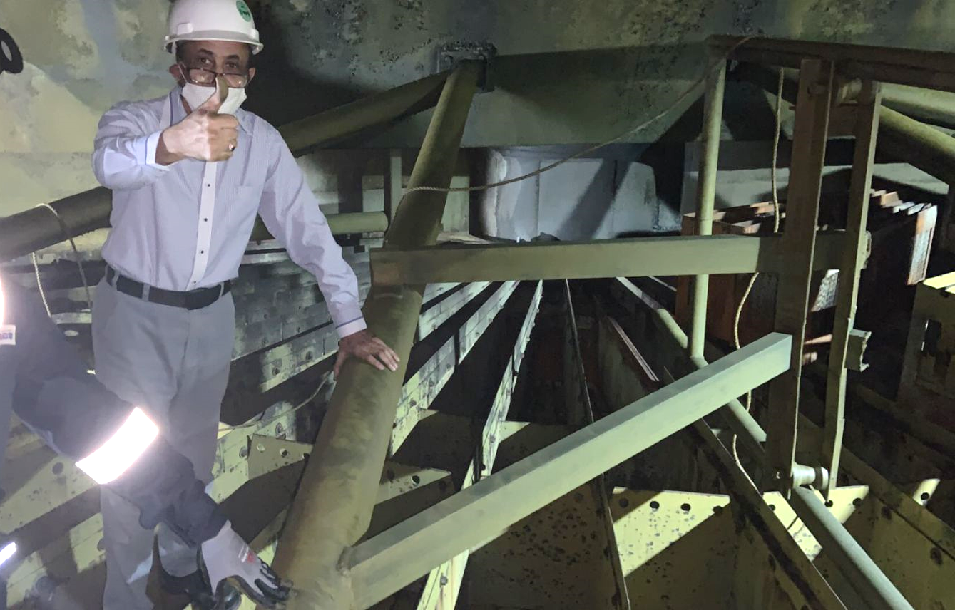
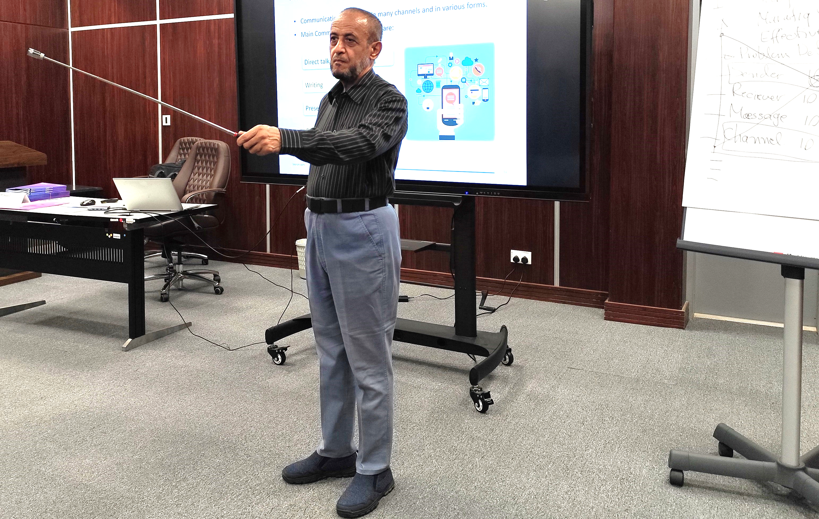
Content Background
1
Extensive field experience and hands-on practice.
2
Rich interaction and corresponding with leading experts.
3
Comprehensive reading of relevant books and studies.
4
Consultation and training activities.

Slide 4
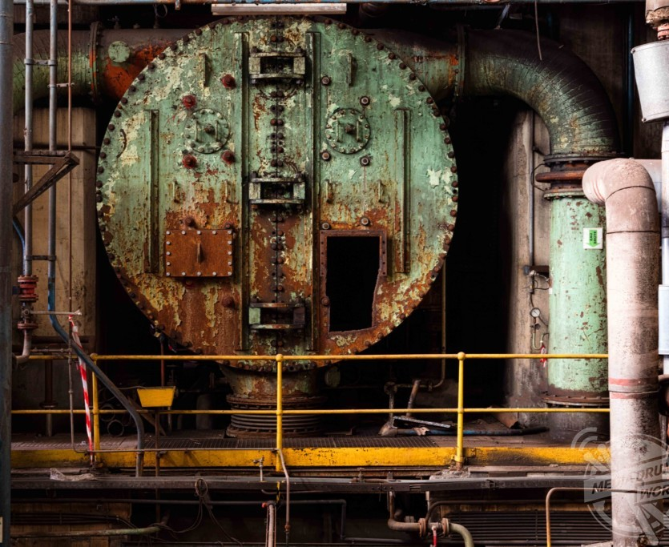
Exciting Claims!
Many industrial plants become less reliable after implementing Reliability and Asset Care programs than before they implement them!
More than 60% of these programs do fail
fully or partially!

Slide 5
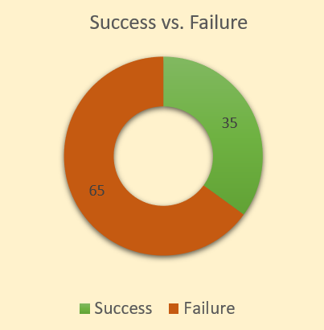
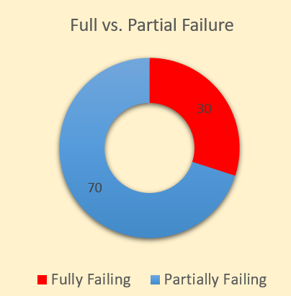
Exciting Claims!
Studies show that more than 60% of all reliability initiatives do fail, fully or partially!

Slide 6
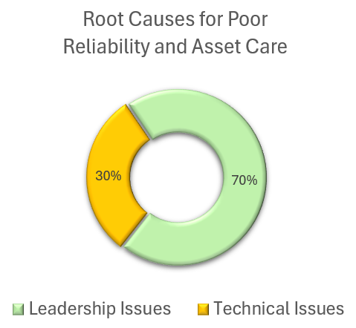
Who We Are Addressing In This Workshop?
Business Leaders
and Decision Makers
Experts and Technical Teams

Slide 7
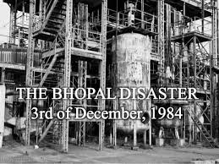
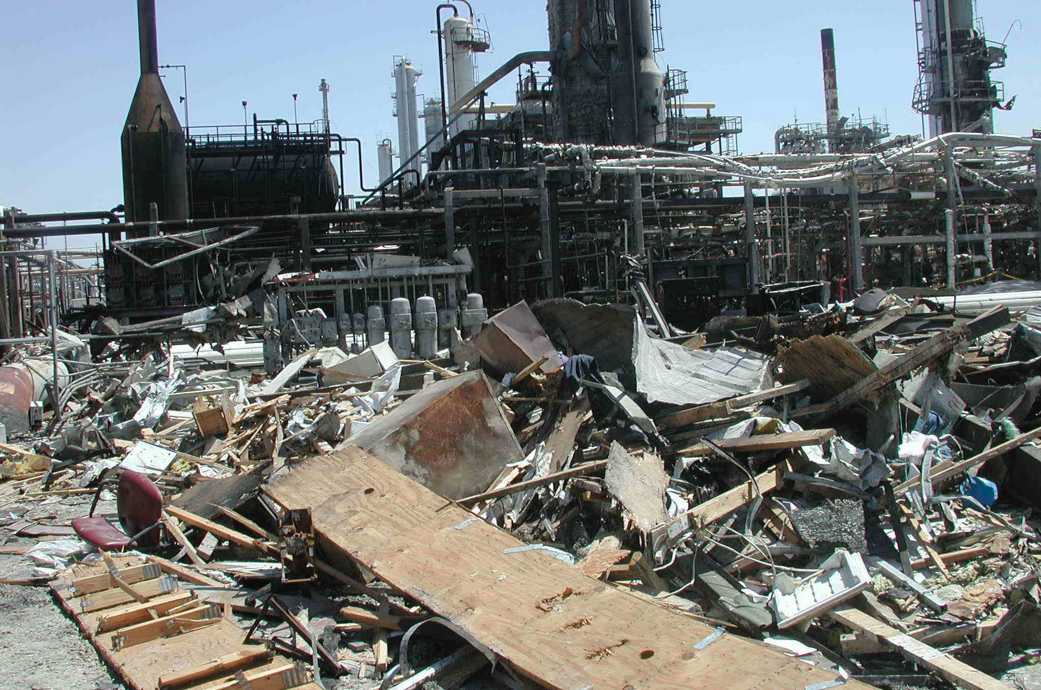
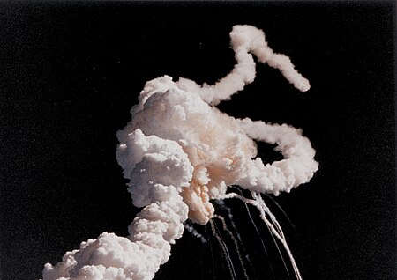
How Important Is Reliability and Asset Care?
Bhopal Disaster, India, 1984
Over 500,000 people exposed to very toxic gas release (MIC).
Immediate death toll of 2,259 people.
Injuries exceeded 500,000, more than 30% very serious.
Total death toll estimates exceeded 20,000 people.
BP Texas Disaster, USA, 2005
15 workers killed.
180 others injured
Refinery severely damaged and production stopped for 2 years.
Total financial impact estimates exceeded $5 billions.
NASA Space Shuttle Challenger, USA, 1986
7 crew members killed.
The space shuttle Challenger fully destroyed.
The USA space programs halted for several years.
Total financial impact estimates exceeded $3.5 billions.

Slide 8
What are The Key Elements Needed For Successful Initiatives?
Mindset
Governance
Vision
Methodology
Strategy
Team
Plan
Enablers
Setup
Time

Slide 9
Costly Mistakes and Misconceptions

Slide 10
Costly Mistakes and Misconceptions
Mistakes and misconceptions adversely impacting the initiatives of Reliability and Asset Care are classified into 2 main categories:
Leadership Related (70%)
Technical Related (30%)

Slide 11
Costly Mistakes and Misconceptions
Leadership Related (70%)

Slide 12
1. Safety is More Important Than Reliability
Process Safety
Occupational Safety
Reliability
Safety
Poor Reliability Causing Poor Safety
Poor Safety Causing
Poor Reliability
Safety
Reliability

Slide 13
1. Safety is More Important Than Reliability: Consequences
Lowering level of importance
Limited power and resources
Frequent failures and damage of assets
Localized and delayed attention
Frequent outages and production losses
Limited tools and systems
Losing valuable customers
Less build up of skills and expertise
Severe process safety accidents

Slide 14
2. Reliability is Just Another Project
+
Desired End State of Project
Impact on Performance
Time
_

Slide 15
2. Reliability is Just Another Project: Consequences
+
Desired End State of Project
Impact on Performance
Time
Decay State
_

Slide 16
2. Reliability is Just Another Project: Consequences
Addressing Reliability Only as a Project
Decline of ownership
Frequent failures and damage of assets
Absence of a mature and sustained culture
Frequent outages and production losses
Back to fire-fighting culture
Losing valuable customers
Confusion and disappointment
Severe process safety accidents

Slide 17
3. Full-Fledge Reliability is Very Costly
In an average plant with 4-5 MTPY throughput, initial investment in a robust and sustainable reliability culture should be SR 15-20 million (2020 estimate).
Subsequently, average yearly investment should be SR 3-5 million (2020 estimate).
Human capacity (head count) (50%)
Tools, systems, and facilities (20%)
People development (20%)
Change management and converting into a strong culture (10%)

Slide 18
3. Full-Fledge Reliability is Very Costly
Losses
Gains
investment
Average payback from mature reliability culture > 5 times the investment!
Adverse financial impact for poor reliability > 7 times the perceived savings!

Slide 19
3. Full-Fledge Reliability is Very Costly: Consequences
Poor Investment in Reliability
Limited power and resources
Frequent failures and damage of assets
Delayed and superficial attention
Frequent outages and production losses
Limited tools and systems
Severe process safety accidents
Less build up of expertise
Frustration and morale decline

Slide 20
4. Building A Robust Reliability Culture Takes 1-3 years!
1. Identifying and understanding the scope
2. Establishing adequate structure and authority
3. Build up capacity of required human resources
4. Acquiring adequate tools, enablers, and systems
5. Development of proper skills and expertise
6. Developing detailed action plans and review & measurement schemes
7. Faithfully implementing the detailed action plans
8. Faithfully reviewing and improving implementation
Change Management
Establishing and sustaining a mature CULTURE for Reliability and Assets Care requires 7-10 years!

Slide 21
4. Building A Robust Reliability Culture Takes 1-3 years!
Example: RCM (Reliability Countered Maintenance)
(Reliability-Centered Misery)
Per the Standard SAE JA 1011, RCM process must insightfully follow these 8 steps:
Time (proper) | Time (traditional) | RCM Steps
5-10 | Rush | Define operational context and the assets functions
5-10 | Rush | Define the desired standards of performance
5-10 | Rush | Determine how an asset can fail to fulfill its functions (functional failures)
15-20 | Rush | Define the causes of each functional failure (failure modes)
15-20 | Rush | Describe what happens when each failure occurs (failure effects)
15-20 | Rush | Classify the consequences of failure (failure consequences)
20-25 | Rush | Determine what should be performed to predict or prevent failure (tasks and intervals)
5-10 | Rush | Decide if other failure management strategies may be more effective (one-time changes)
85-125 | 20-30 | Total time (minutes)
30,000 x 10% >>> 3000 x 100 >>> about 3 years!

Slide 22
4. Building A Robust Reliability Culture Takes 1-3 years: Consequences
Rushing The Evolution and Implementation of Reliability Programs
Limited power and resources
Frequent failures and damage of assets
Superficial analysis and conclusions
Frequent outages and production losses
Scattered attention and shallow strategies
Severe process safety accidents
Poor build up of skills and expertise
Losing valuable customers

Slide 23
5. Most Reliability Deficiencies Are Asset Related (Physical)!
Where do the Leaders mostly focus?
Traditional Attention (Average %)
60%
25%
10%
5%
Proper Attention (Average %)
15%
20%
25%
40%
Physical
Human
Systems, Tools, and Procedures
Philosophy, Mindset, and Culture

Slide 24
5. Most Reliability Deficiencies Are Asset Related: Consequences
Not Considering Deeper Than Asset Physical Reliability
Superficial analysis and conclusions
Frequent failures and damage of assets
Normalizing with Failures and Deficiencies
Frequent outages and production losses
Scattered attention and shallow strategies
Severe process safety accidents
Poor build up of skills and expertise
Losing valuable customers

Slide 25
6. Sophisticated Tools and Enablers Are Enough!
Many leaders focus on buying sophisticated tools and enablers.
Many consider these tools and enablers to be enough for establishing sound and sustainable reliability culture.
Poor training and lack of serious development of technical capabilities render these tools and enablers to be more of a burden that help!

Slide 26
6. Sophisticated Tools and Enablers Are Enough: Consequences
Only buying tools and enablers
Poor attention to the more critical elements
Frequent failures and damage of assets
Poor inputs/output to/from these tools and enablers
Frequent outages and production losses
Poor build up of skills and expertise
Severe process safety accidents
Huge cost for an underutilized facility
Frustration and decline
of morale

Slide 27
Costly Mistakes and Misconceptions
Technical Related (30%)

Slide 28
1. Adequate Analysis Without Complete & Accurate Data
Data is the most valuable resource for conducting proper reliability and integrity analysis.
The sad reality: many plants lack complete data, or accurate data, or both!
Design
Fabrication
Installation
Commissioning
Operation
Inspection
Maintenance
Modifications (MOC)

Slide 29
1. Adequate Analysis Without Complete & Accurate Data: Consequences
Conducting Analysis with Poor Data and Asset History
Frequent failures and damage of assets
Analysis based on rough guessing
Frequent outages and production losses
Misleading & shallow technical conclusions
Severe process safety accidents
Poor technical recommendations
Frustration and decline
of confidence & morale

Slide 30
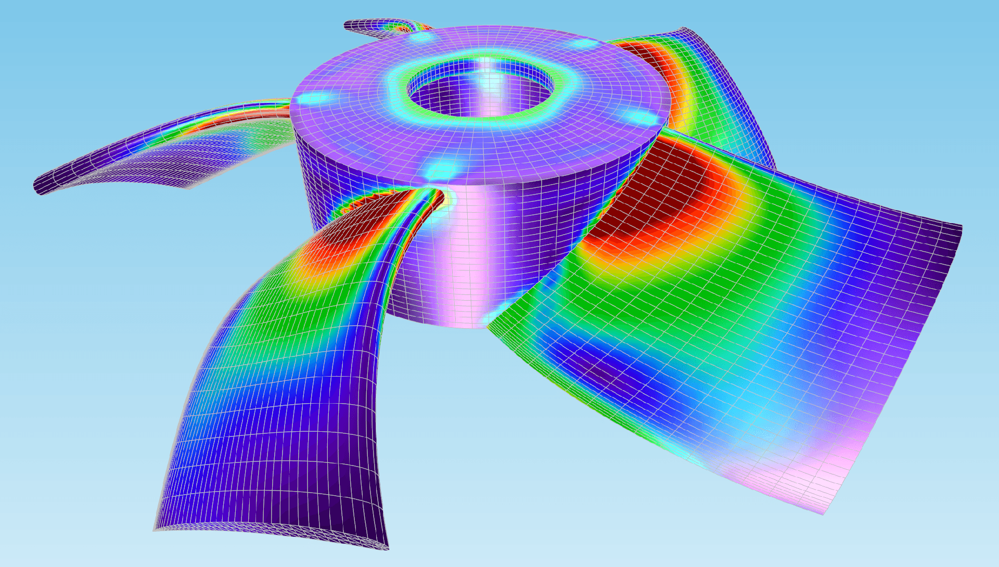
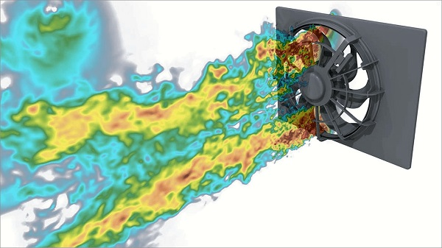
2. Advanced Analysis Techniques are Highly Accurate and Dependable
Among the most famous techniques are:
Fitness For Service, FFS
Remaining Life Assessment, RLA
Reliability, Availability, & Maintainability analysis, RAM
Finite Element Analysis, FEA
Computational Fluid Dynamics analysis, CFD
Accuracies of these techniques are rarely more than 50%.
Impressive graphics but could be highly misleading!
Extremely costly.

Slide 31
2. Advanced Techniques are Highly Accurate and Dependable: Consequences
Considering These Techniques To Be Highly Accurate & Dependable
Unpredictable failures and damages of assets
Unjustifiable Huge Cost of Analysis
Severe outages and production losses
Misleading & shallow technical conclusions
Severe process safety accidents
Poor technical recommendations
Frustration and decline
of confidence & morale

Slide 32
3. Most Failures Are Asset Related (Physical)!
How deep do we go when conducting RCA?
Preventing Reoccurrence of Failure (Average %)
15%
40%
70%
85%
Physical
Human
Systems, Tools, and Procedures
Philosophy, Mindset, and Culture

Slide 33
3. Most Failures Are Asset Related: Consequences
Not Considering Deeper Than Physical Reliability of the Assets
Frequent reoccurrence of failures and damages
Superficial analysis and conclusions
Frequent outages and production losses
Misleading & shallow technical conclusions
Severe process safety accidents
Poor technical recommendations
Frustration and decline
of confidence & morale

Slide 34
Awakening Facts!
Many industrial plants become less reliable after implementing Reliability and Asset Care programs than before they implement them!
More than 60% of these programs do fail
fully or partially!

Slide 35
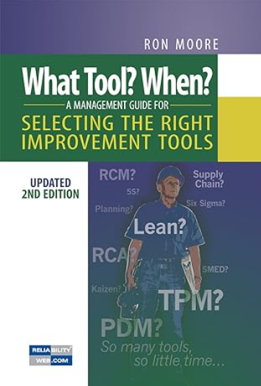
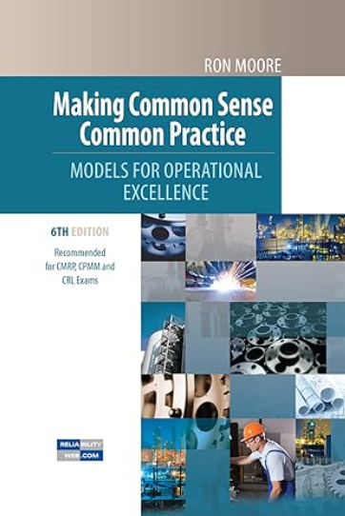
A Final Advice!

Slide 36
JUBCOR
2024
CONFERENCE & EXHIBITION
INNOVATIVE SOLUTIONS FOR CORROSION CHALLENGES
THANK YOU
https://www.linkedin.com/in/mosaedgarni/
Q & A
Calle Cualquiera 123, Cualquier Lugar

