Slide 1
JUBCOR
2024
CONFERENCE & EXHIBITION
INNOVATIVE SOLUTIONS FOR CORROSION CHALLENGES
Presented By: Kareem Khalil
Preheaters Erosion Case Study
Troubleshooting, Analysis and Recommendations

Slide 2
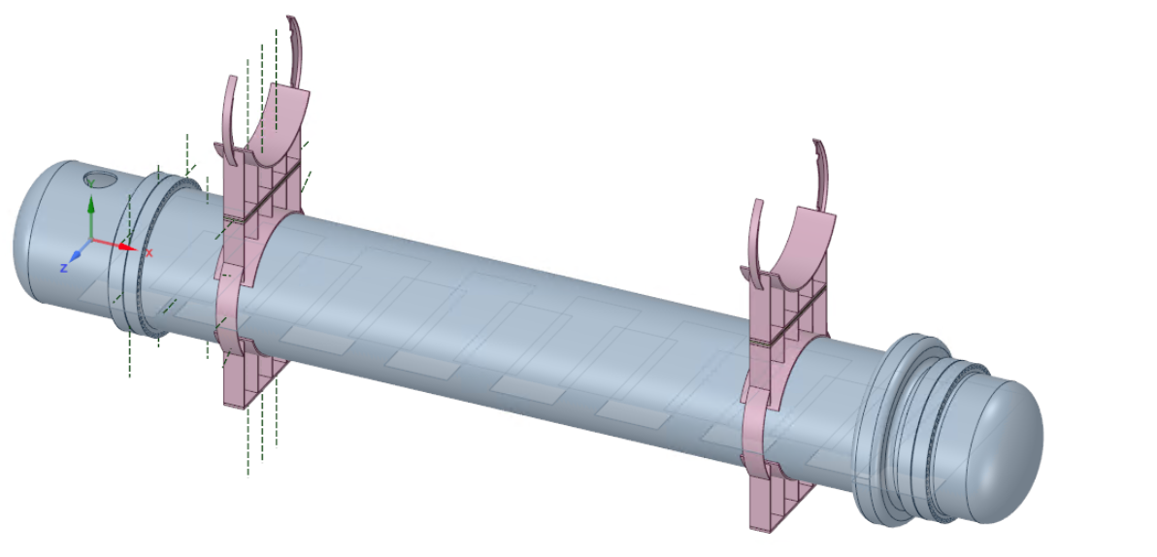
Outline
Process Description
Equipment Design
2018 DBN Changes
Findings
Short Term Solution
HTRI Analysis
Long Term Recommendations

Slide 3
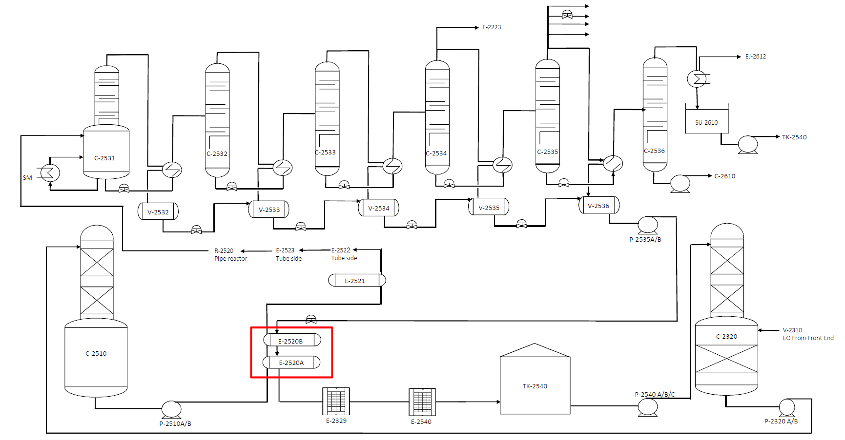
Process description
Prior to entering the glycol reactor, the EO-water solution goes through four (4) pre-heaters in order to reach the desired temperature (90 C) of the reaction to convert all the EO to glycol. In the first stage pre-heater (E-2520A/B), the process goes through the tube side and gets heated by the hot condensate in the shell side coming from the sixth effect re-boiler condensate drum (V-2536) through the evaporator condensate pump (P-2535A/B).

Slide 4
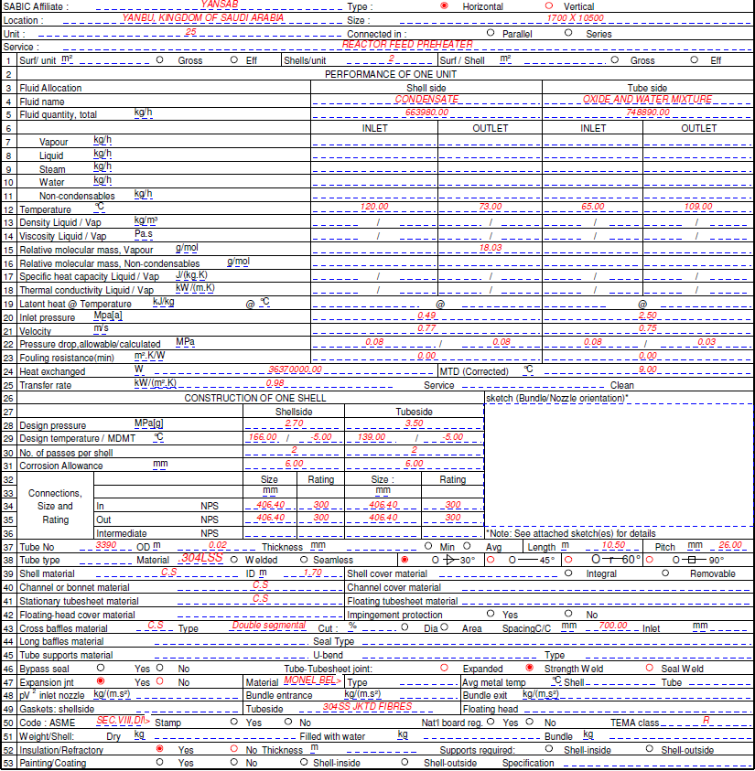
Exchanger datasheet
Item (Shell Side) | Value
Process | Condensate
Inlet Pressure | 392 kPa
Inlet Temperature | 120 C
Inlet Nozzle | 16 “ 300 #
Shell Material | CS
Corrosion Allowance | 6 mm

Slide 5
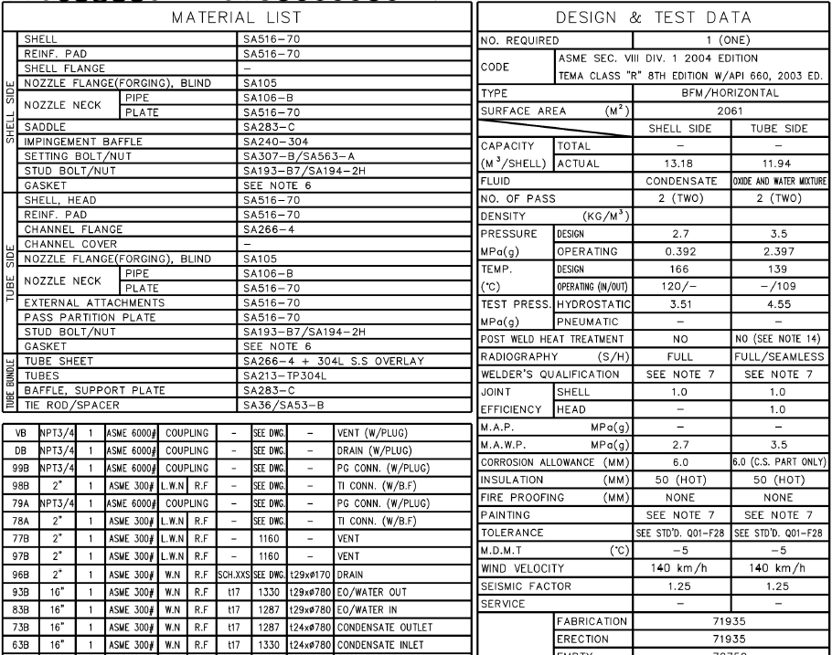
Design details
Item | Value
Shell Material | SA-516 Gr 70
Shell Thickness | 24 mm
Nozzle Material | SA-105
Nozzle Neck Material | SA-106 Gr B
Nozzle Neck Thickness | 17 mm
Design Pressure | 27 barg
Design Temperature | 166 C
Joint Efficiency | 1.0
Insulation Thickness | 50 mm

Slide 6
2018 DBN
Observations of the changes before and after the DBN:
The pump design pressure was increased from 506.0 to 667.4 Kpa(g) which represents 32% increase in the discharge pressure.
The pump capacity increased from 775 M³/hr to 951.5 M³/hr which represents 22% increase in the discharge pressure.
Pump actual discharge flow increased by 75 T/hr which is 11.1% higher, comparing 125% and 140% plant load.
Pump actual discharge pressure increased from 480 kpa(g) to 790 Kpa(g) which is %65 higher, comparing 125% and 140% plant load.
No noticeable difference observed in the operating temperature.
Preliminary findings:
Higher flow (+11.1%) and higher pressure (+65%) in E-2520 shell side after the DBN are the major findings that could have increased E-2520 A/B erosion rate.
Before the DBN:
After the DBN:

Slide 7
Trends (E-2520 Operating Parameters before and after dbn).

Slide 8
Findings (Erosion observed at shell side)

Slide 9
Findings (Erosion observed at shell side)

Slide 10
Findings (Erosion observed at shell side)

Slide 11
Findings (Erosion observed at shell side)

Slide 12
Findings (Erosion observed at shell side)

Slide 13
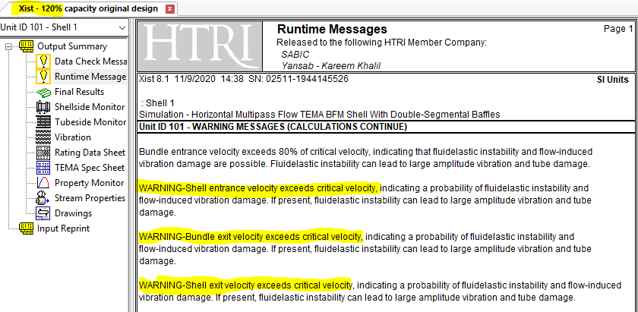
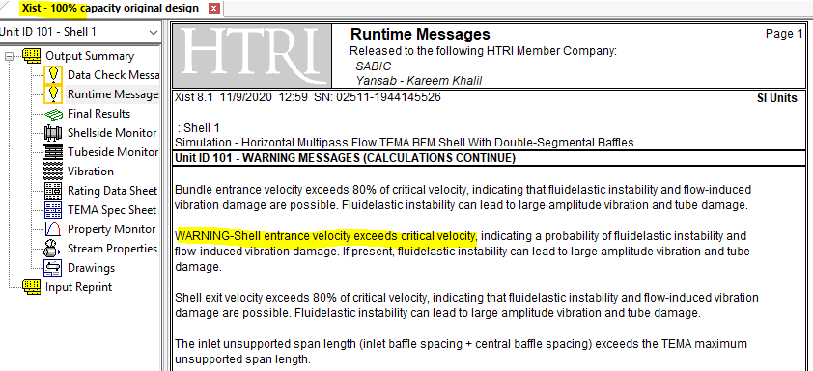
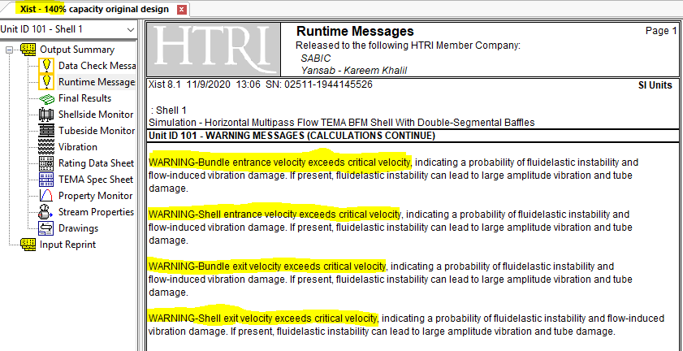
HTRI Load Comparison
Simulation by HTRI done in-house. Warning message: Shell entrance velocity exceeds critical velocity, indicating a probability of fluid elastic instability.
Calculations show that the exchanger is designed to a maximum of 85% of plant capacity.

Slide 14
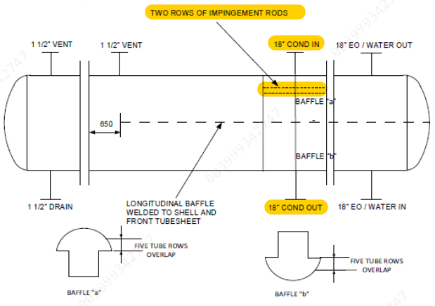
Recommendations
Change the material for both exchangers shell inlet and outlet nozzles for (E-2520A&B) from carbon steel (SA516-70) to stainless steel (SA304).
Remove the current impingement plate for both exchangers.
Make the top first three (3) rows of the tubes for each exchanger as impingement rods.

Slide 15
New datasheet
Item (Shell Side) | Changes
Process | Condensate
Inlet Pressure | 392 kPa
Inlet Temperature | 120 C
Inlet Nozzle | 18” 300#
Shell Material | SS
Corrosion Allowance | None

Slide 16
JUBCOR
2024
CONFERENCE & EXHIBITION
INNOVATIVE SOLUTIONS FOR CORROSION CHALLENGES
THANK YOU
Reach out.
Calle Cualquiera 123, Cualquier Lugar
phone
email

