Slide 1

JUBCOR
2024
CONFERENCE & EXHIBITION
INNOVATIVE SOLUTIONS FOR CORROSION CHALLENGES
DAMAGE MECHANISMs affecting STATIC EQUIPMENT in REFINING and PETROCHEMICALS Process INDUSTRY
Cold EQUIPMENT PROCESS SAFETY
BRITTLE FRACTURE
Presented By:
Yogendra Reddy, Kauluri
Chief Engineer, Stationary Equipment
KEMYA

Slide 2
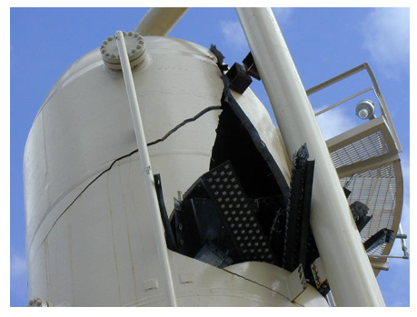
Opening thoughts: GLASS Vs. STEEL
  What do we know generally? how can we differentiate between GLASS & STEEL?
      Glass is Delicate, weaker – habitually we ‘HANDLE WITH CARE’
      Steel is Stronger and Tougher
  Glass break(or fail) in the form of sharp cracks, with no physical deformation (no sectional geometry change)
  Can material Steel behave(or fail) same like Glass ?
    big YES when conditions do favor

Slide 3
Brittle FRACTURE (BF)
CONTENT
  Brittle Fracture - simple understanding
  Brittle fracture - damage description
  Susceptible materials
  Critical factors
  CET, MDMT, MAT, MDMT
  MSOT curve, Operating within a safe pressure/temperature window.
  Affected units, equipment
  Morphology of damage
  Remediation methods
  Prevention and Mitigation
  Inspection, and Monitoring
  Brittle fracture – more Industry examples

Slide 4
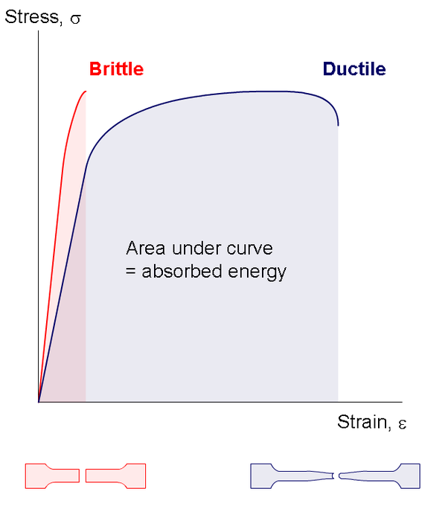
Brittle Fracture
Brittle fracture(BF) is the sudden rapid fracture under stress (residual or applied), where the material exhibits,
  Little or no evidence of deformation
  No noticeable sign of corrosion or loss in thickness
In contrast, material Ductile failure is usually preceded
  by large deformation - can result in leak before rupture which may be of lower consequence.
In-service brittle fracture of a pressure vessel or other pressurized equipment can have high EHSS/Business consequence.

Slide 5
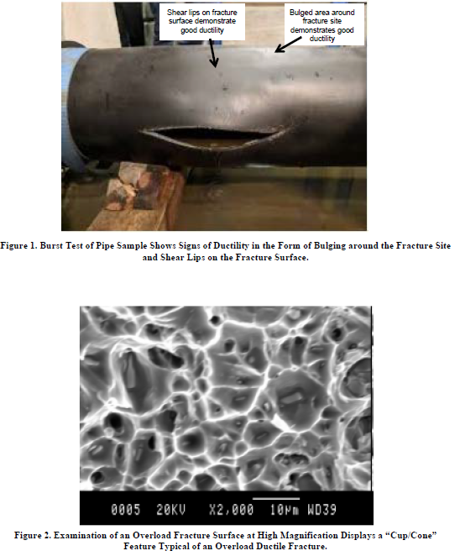
Fracture – ductile vs. brittle
DUCTILE FAILURE
Fracture occurs when loads result in stresses that exceed the tensile strength of the material. This is commonly referred to as an overload failure, which typically displays significant plastic deformation and ductility at the fracture site.
Figure shows the rupture of a large-diameter pipe section during a hydrotest. This photo demonstrates that the fracture is ductile because of the observed deformation in the form of bulging around the fracture site and the appearance of shear lips on the fracture surface.
A ductile overload fracture with characteristics as displayed in Figures 1 and 2 occurs when unanticipated high loads are imposed on a component. E.g., during upsets when large and rapid temp. changes, it could result in stresses exceed the tensile strength of the material.

Slide 6
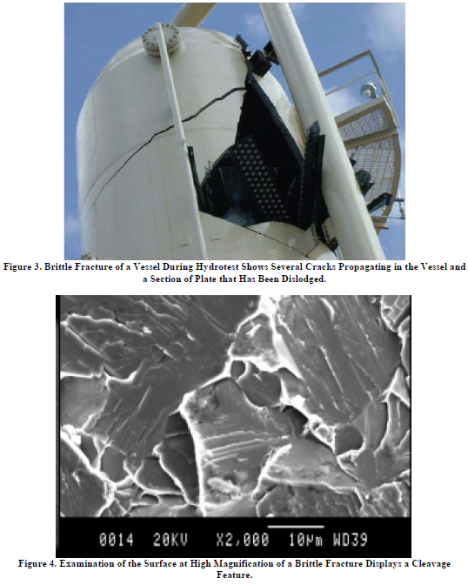
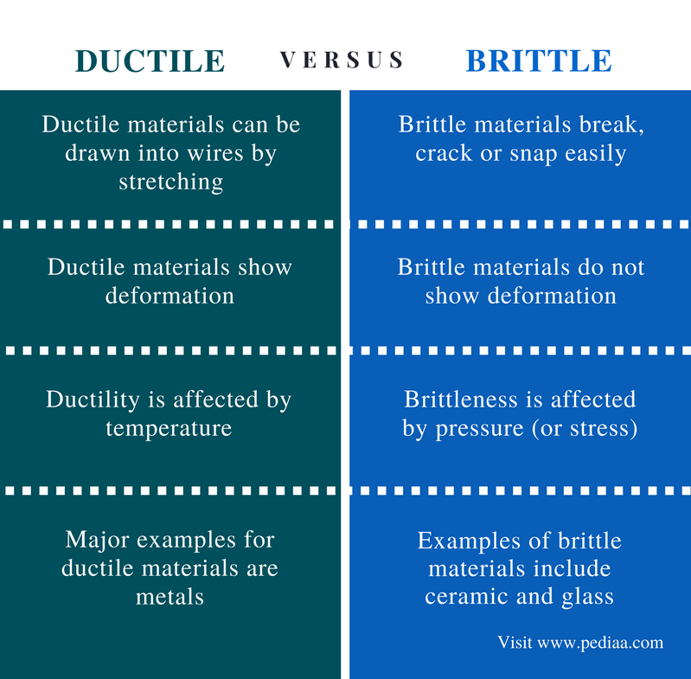
Fracture – ductile vs. brittle contd.
BRITTLE FRACTURE On the other hand,
  Fracture can also occur at lower loads below the tensile strength when the material has poor fracture toughness. This is commonly referred to as Brittle Fracture (BF).
  Figure shows a typical example of brittle fracture in which there are several cracks that display very little deformation.

Slide 7
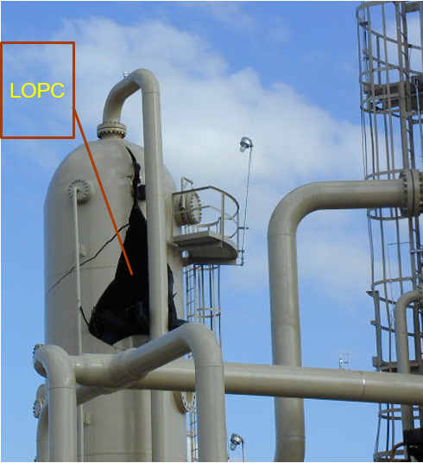
Brittle fracture damage mechanism
  Brittle fracture occurs quickly and without warning, if the right combination of conditions exist.
  This means that instead of a tank, pipe, exchanger or pressure vessel bulging, cracking and then leaking, they could fail without any previous warning, in similar way to smashing glass.
  The consequence of brittle fracture is usually a large and sudden release of the vessel contents resulting in a high risk of fire and/or explosion.
  Despite being well understood, and despite our ability to design equipment to resist brittle fracture, there are still several high profile events in industry each year.
  Most of these events occur because the equipment operation moves outside of its safe pressure / temperature envelope.
  And from an operating viewpoint, the greatest likelihood of brittle fracture exists when the temperature of carbon and low alloy steel equipment becomes “too cold”.

Slide 8
Susceptible materials
1. Carbon and low-alloy steels are more susceptible to brittle fracture when the material exposure temperature is reduced to a level below the Brittle-to-Ductile transition temperature. Of prime concern are particularly older steels,
  Strain aging is a form of metallurgical damage found mostly in older (pre-1980) carbon steels and C-½Mo low alloy steels that were not fully deoxidized as more modern steels are. It is associated with older steel-making processes such as the Bessemer and open hearth processes, which use air instead of oxygen to remove carbon. Strain aging occurs in a susceptible steel under the combined effects of deformation and aging at an intermediate temperature. This results in an increase in hardness and strength with a reduction in ductility and toughness. Strain aging is a concern because it increases the chances of brittle fracture.
  Temper embrittlement is the reduction in fracture toughness due to a metallurgical change that can occur in some low-alloy steels as a result of long-term exposure in the temperature range of about 345 °C to 575 °C. This change causes an upward shift in the ductile-to-brittle transition temperature as measured by Charpy impact testing. Although the loss of toughness is not evident at operating temperature, equipment that is temper embrittled may be susceptible to brittle fracture during start-up and shutdown.

Slide 9
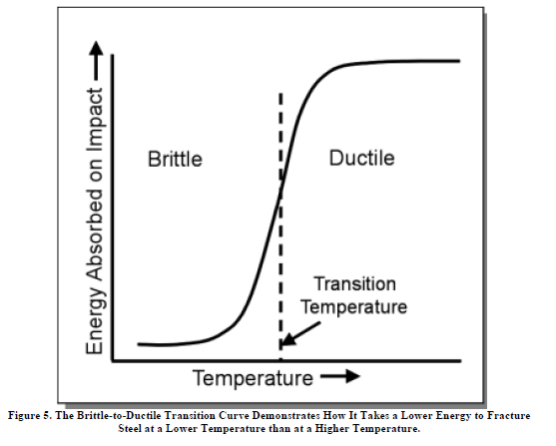
Brittle-to-ductile transition temperature curve

Slide 10
Susceptible materials
  In addition, materials susceptible to an embrittling mechanism (embrittlement is a loss of ductility and fracture toughness due to a metallurgical change) that can occur in some stainless steels containing a ferrite phase as the result of exposure in the temperature range 315 °C to 540 °C. The embrittlement can lead to cracking failure.
      400 series Martensitic stainless steels such as 405, 409, 410, 410S, 430, and 446.
      Duplex (Austenitic-Ferritic) stainless steels such as alloys 2205, 2304, and 2507.
      300 series Austenitic stainless steel weld metals, which normally contain up to about 10 % ferrite phase to prevent hot cracking during welding.
  400 series Martensitic stainless steels are generally susceptible even not embrittled.
  Titanium hydriding is a metallurgical phenomenon in which hydrogen diffuses into the titanium and reacts to form an embrittling hydride phase. This can result in a complete loss of ductility and fracture toughness, potentially enabling brittle fracture.

Slide 11
Critical Factors aiding brittle fracture occurrence
Three critical factors are needed in sufficient quantity
(1) Stress:
Big Factors are Pressure / Static Head in tanks and residual stress from welding
BF can occur if all three are sufficient to close the triangle
(2) Toughness:
Big factors are metal temperature and type of steel.
(3) Defect:
Big factors are cracks and notches due to poor welding or stress corrosion cracking.

Slide 12
(1) Stress
Stress can arise from many sources - pressure, thermal, welding, wind, shock/impact, weight etc.
  Pressure is the most important, and the one designers and operators have some control over. If the pressure stress is less than 25% of design, BF is unlikely.
  Other stresses such as residual welding or weight stress can increase the risk of BF even if the pressure is low. Normally this is only considered if the temperatures is much colder than minimum design. Residual stresses can be reduced significantly by Post Weld Heat Treatment.
  Thermal stress can also cause BF. E.g. if a large temperature gradient occurs between the two sides of a heat exchanger while one side is cold, or if a sudden change causes a thermal shock. The Longford HEX failure is an example of this. As illustrated, the tube side has become cold due to an upset. When hot oil is then added to the shell, thermal stresses occur in the channel which is still cold. This was the Longford incident and the resulting failure was catastrophic.

Slide 13
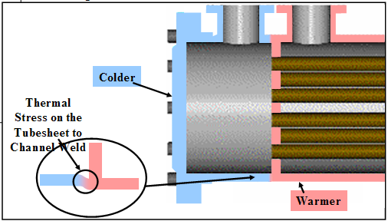
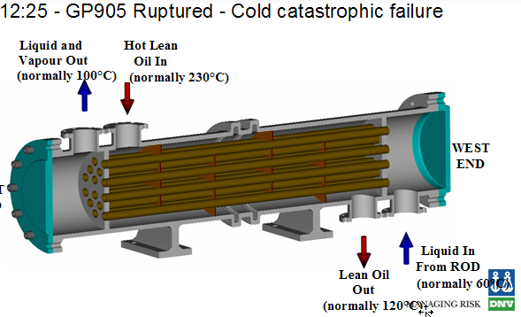
Longford incident illustration

Slide 14
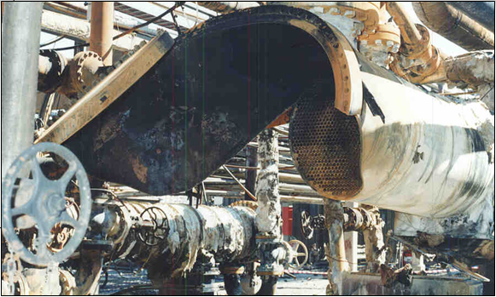
Longford incident illustration
The thermal stress started the brittle fracture, and the channel unzipped, helped by the tubeside pressure stresses.

Slide 15
(2) TOUGHNESS
Toughness is a mechanical property of the steel or weld. The most important influence is operating temperature.
Carbon steel(CS) becomes less tough at lower temperature. The colder the temperature, the lower the toughness and the greater the likelihood of BF.
The minimum temperature for CS can vary between -50°C and +50°C. Each equipment is unique. However BF needs increased consideration for pressurised equipment colder than 0°c.
Alloy steels are tougher at lower temperature than CS.
        Nickel steels can be use to around -100°C.
        Stainless steel is normally regarded as resistant to BF for all our very cold processes, though there are some exceptions (when material is embrittled).
Thicker steels (pressure vessels) are more likely to fracture than thinner ones. Equipment less than ½” (13mm) thick is less likely to suffer BF – Because piping is usually thin, it is less likely to fracture unless shocked or cooled well below its minimum design temperature.

Slide 16
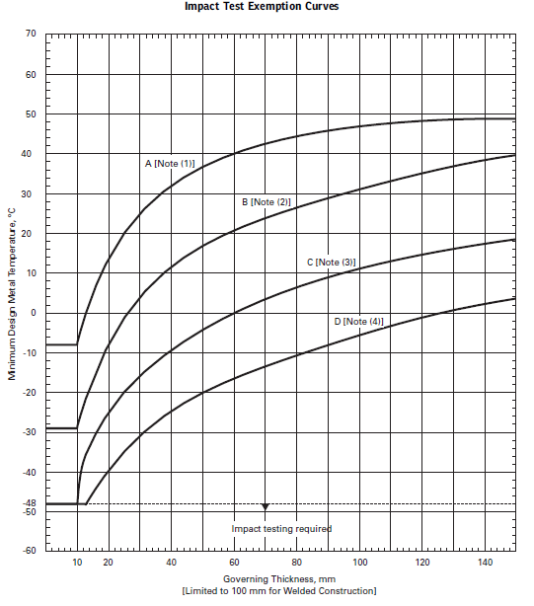
How Toughness is Measured Charpy Impact Test

Slide 17
Charpy Toughness For Carbon Steel

Slide 18
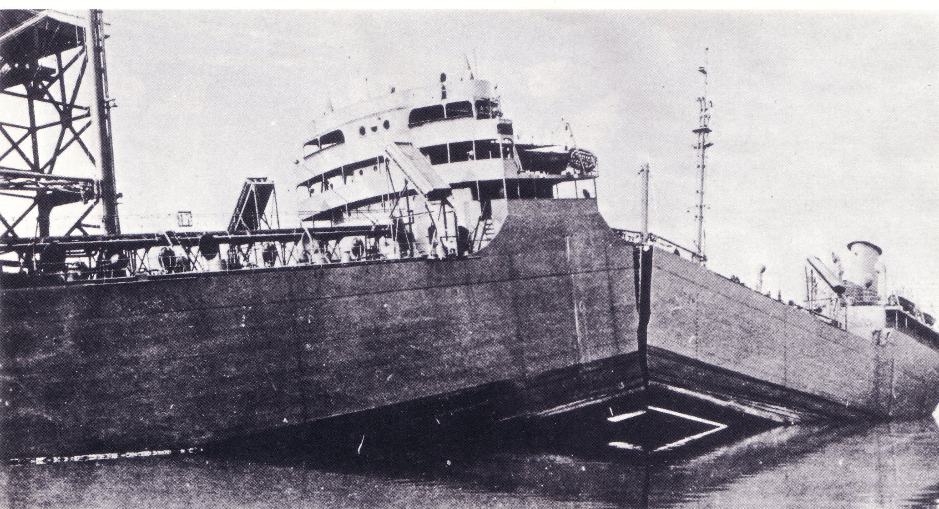
Brittle fracture can occur solely due to a change in toughness. This picture shows a ship during WW 2 which split in half while tied to the dock. The ship steel was of relatively poor toughness, and became inadequate when cooled during cold weather. The combination of poor toughness, cold weather and a stress concentration from a deck hatch weld caused the catastrophic failure.

Slide 19
(3) defect
  Most defects are already present and occur in welds during fabrication. Cracks and sharp defects like notches are more likely to cause BF than blunt ones like corrosion.
  Defects can also develop in service due to stress corrosion, or fatigue from vibration, pressure or thermal cycling.
  Defects need to be sufficiently large to cause BF. Equipment which has been PWHT’d can tolerate larger defects.
  Defects from fabrication or repairs can result in BF during shop or field hydrotest. Hydrotest must be conducted warmer than the “minimum design temperature” to compensate.

Slide 20
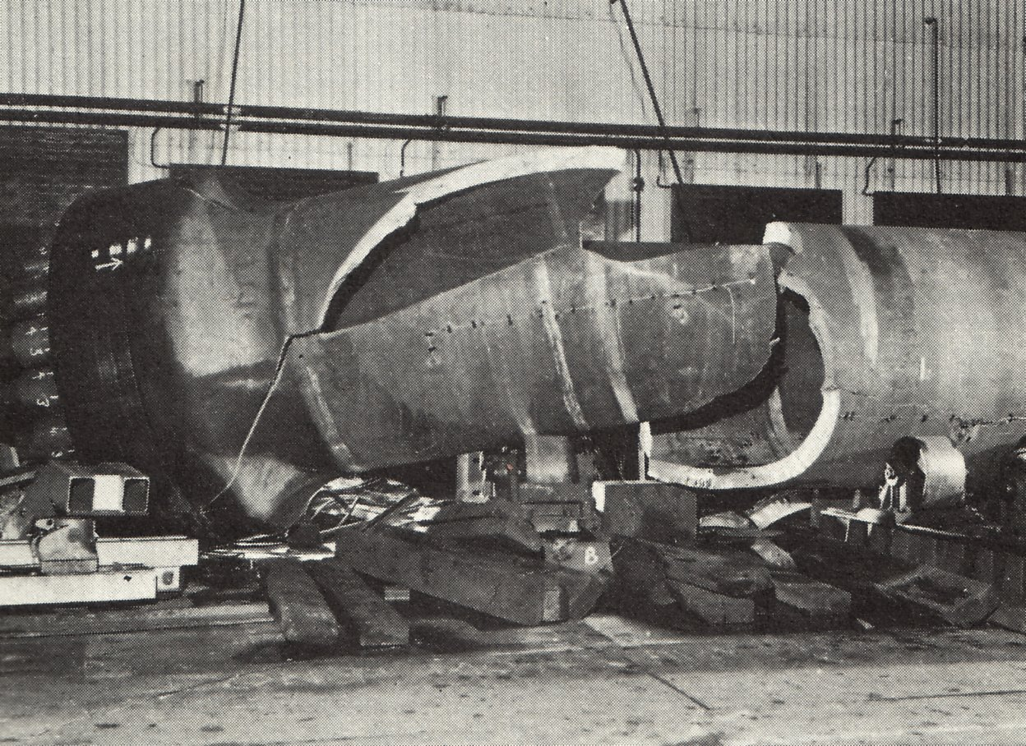
Hydrotest failure – During hydrotest the risk of BF can be significant because the vessel is “cold”, the stress “high” and there is the possibility of weld defects. The figure illustrates a thick walled vessel BF during its first hydrotest.

Slide 21
CET, MDMT, MAT, MSOT
  These abbreviations are often used in operating procedures and brittle fracture mechanical assessments.
Critical Exposure Temperature (CET)
CET is the Minimum temperature that the equipment would be expected to be exposed to under a wide range of operating conditions. CET is normally set by the colder of :
      The minimum (one day mean) ambient temperature
        or
      The lowest predicted process temperature (during startup, shutdown, normal or any upset abnormal operation) defined by an envelope of temperatures and pressures(at or above 25% of DP).
Is defined by the Process Engineer. Relates to expected process conditions during initial design, or if revised as a result of HAZOPs.
The CET should be shown on the P&ID and on the vessel nameplate.

Slide 22
CET, MDMT, MAT, MSOT contd.
Minimum Design Metal Temperature (MDMT)
MDMT is the single minimum temperature that an equipment or piping can be safely operated at 100% of its Design pressure(DP) or Maximum allowable working pressure(MAWP) whichever is higher.
MDMT can only be defined when “as built” info (viz. steel type, thickness, design stress and PWHT…) is known. MDMT is usually stamped on the vessel nameplate.
  Generally, MDMT of new equipment will be colder than the CET. However it’s possible in older plants, the original CET may not have considered all possible scenarios identified in modern HAZOPs(or periodic re-do hazops). This means that in special cases some MDMT’s are not colder than the “new” CET. So, a special startup or operating procedures may be required for operating such equipment lower than MDMT(or MAT).
  Minimum Allowable Temperature (MAT) is the lowest (coldest) permissible metal temperature for a given material and thickness based on its resistance to brittle fracture. It may be a single temperature, or an envelope of allowable operating temperatures as a function of pressure.

Slide 23
CET, MDMT, MAT, MSOT contd.
Minimum Safe Operating Temperature (MSOT)
The MSOT is a curve that defines the brittle fracture safe operating envelope, expressed in terms of pressure and temperature. The first point on the curve is the MDMT.
The MSOT curves shows to what extent temperatures colder than the MDMT are tolerable so long as the pressure is correspondingly lower than design pressure.
The MSOT curve represents a “safe” region because it assumes the stress reduces with pressure. This is taken to imply that the probability of catastrophic BF is “practically impossible” under this curve green region.
The MSOT curves should be available to the operating crew to troubleshoot plant problems, unusual chilling scenarios.

Slide 24
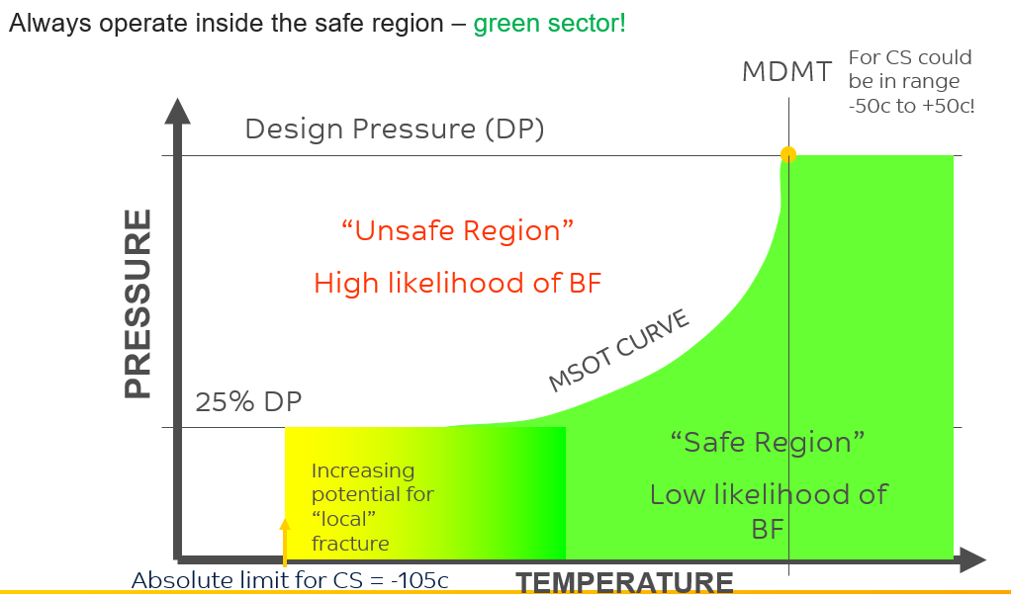
Minimum Safe Operating Temperature (MSOT)

Slide 25
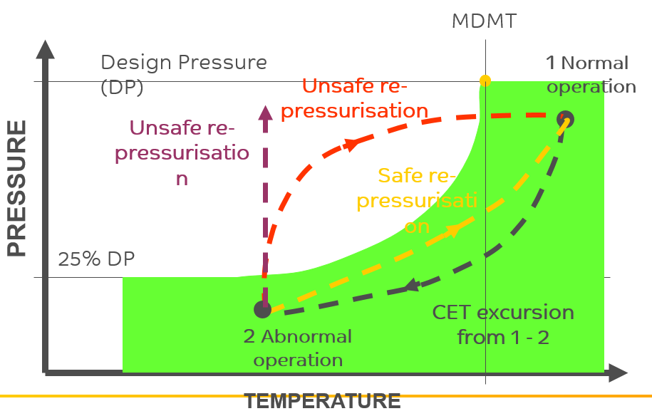
CET Excursion Scenario
CET excursions are the most likely cause of brittle fracture

Slide 26
Sources/scenarios of CET excursions and operations role
A multi discipline team is used to identify scenarios that could result in brittle fracture concerns from CET excursions. Operations personnel play a vital role in this process. Areas to address :
  Lowest temperature from normal operations.
  Deviations from agreed operating procedures (normal & emergency)
  Abnormal feeds / abnormal composition operations
  Plant start up or recommissioning equipment after maintenance
  Re-pressurisation when equipment pipe is cold following a de-pressurisation.
  Shock chilling - introduces large additional stresses
  Hydrostatic testing of equipment with cold water or when vessel wall is at cold ambient temp
Operator awareness of the areas of vulnerability within their plants.
  Bypassing low temperature cut outs & controls .
  Safety critical alarms to warn if an operation has moved away from a safe condition to the onset of BF concerns

Slide 27
Affected Units and Equipment
  Equipment manufactured to the ASME Boiler and Pressure Vessel Code (BPVC) Section VIII, Division 1, prior to the December 1987 Addenda, had no Code-required restrictions on notch toughness for vessels operating at cold temperatures.
  Most processes run at elevated temperature, so the main concern is for brittle fracture during start-up, shutdown, or hydrostatic /tightness testing. Thick walled equipment in particular should be evaluated.
  Brittle fracture resulting from an auto-refrigeration event should be considered in units processing light hydrocarbons such as methane (CH4), ethane/ethylene, propane/propylene, or butane. This includes alkylation units, olefin units, and polymer plants (polyethylene and polypropylene). Storage bullets and spheres for light hydrocarbons may also be susceptible.
  Brittle fracture can occur during ambient temperature hydrostatic testing due to high stresses and low toughness at the testing temperature.

Slide 28
Appearance or Morphology of Damage
  Through-wall cracks. Cracks will typically be straight, non-branching, and largely devoid of any associated plastic deformation, although fine shear lips may be found along the free edge of the fracture, or localized necking around the crack may occur.
  The fracture surface, if undamaged after the initial fracture, will exhibit visible “chevron markings” that point back to the crack origin point. These markings can be helpful in locating the initiating cause of the brittle fracture.
  Microscopically, the fracture surface will be composed largely of cleavage, with limited or no intergranular cracking and very little microvoid coalescence.

Slide 29
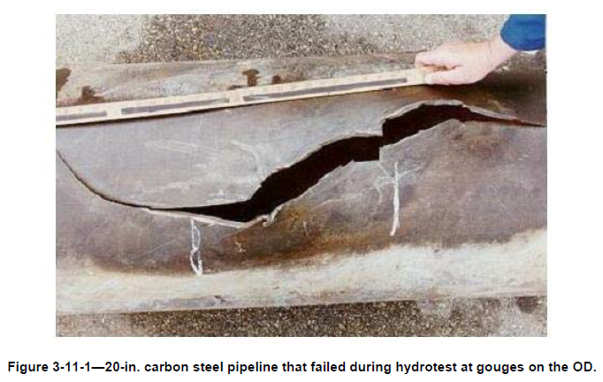
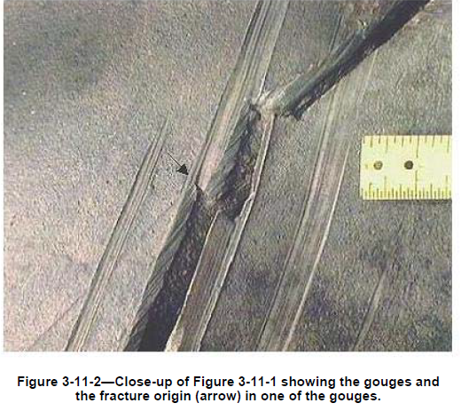
Failed photos

Slide 30
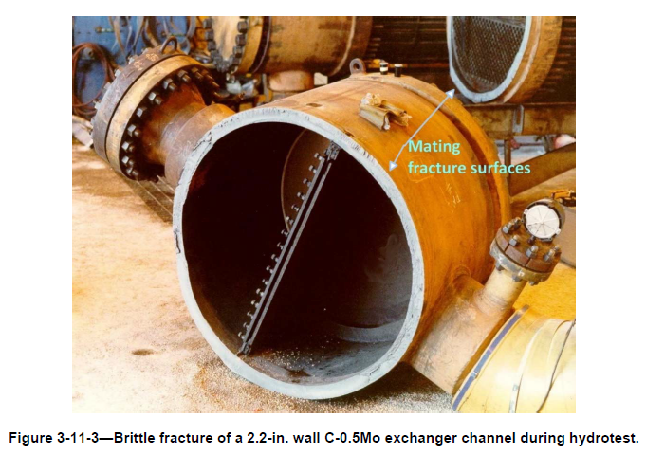
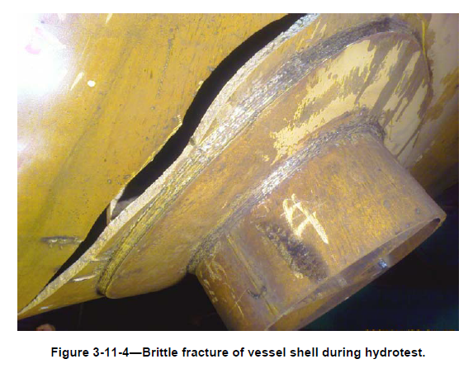
Failed photos

Slide 31
API 579 Remediation methods - and how to use ?
  Limiting operating conditions to within the acceptable operating pressure-temperature envelope is the simplest type of remediation effort. The most successful, and effective, technique for limiting operation has been to implement a controlled start-up procedure.
  Post Weld Heat Treatment (PWHT) may be performed to enhance the damage tolerance to crack-like flaws and resistance to brittle fracture.
  Hydrostatic Test may be performed to enhance the damage tolerance to crack-like flaws and resistance to brittle fracture. The beneficial effect of a hydrotest is that crack-like flaws located in the component are blunted resulting in an increase in brittle fracture resistance.
  Rerate using a lower design margin stress ratio in a Level 2 evaluation to lower MAT.
  Reduce the future corrosion allowance of material components to the required operation life interval to lower stress ratio in a Level 2 evaluation to lower MAT.
  Replace the components or entire pieces of equipment that fail to meet brittle fracture requirements with an acceptable metallurgy and/or impact tested to meet CET requirements.
  External heating (heating sources for e.g., steam tracing, electrical tracing, etc.) may provide adequate protection from potential brittle fracture scenarios, even if temporarily until a permanent mitigation can be implemented.

Slide 32
Prevention/Mitigation - what we can do ?
  Know what equipment on your unit may be susceptible to brittle fracture. And ensure that you have an MSOT curve for such equipment.
  If temperature is lower than MDMT, DO NOT pressurise equipment above the MSOT. If in doubt keep pressure less than 25% DP during start-up.
  Ensure pressure and temperature due to depressurisation / auto-refrigeration stays in the green sector of the MSOT curve.
  Do not re-pressurise equipment following auto-refrigeration if the resultant pressure takes you outside the green zone.
  Don’t do anything that can thermally shock or water hammer equipment while cold.
  Think about the possibility of BF during hydrotesting or following weld repairs.
  Bear in mind that process temperatures can change (rise) quickly but the steel can remain colder for longer periods - process thermocouples may be misleading (unless thermocouples installed to monitor metal temperature).
  Report concerns and check uncertainties with the Inspection engineer. BF is complex and trained specialist are often needed to help confirm safe operation.
  And remember - Brittle Fracture can result in catastrophic failure

Slide 33
Inspection and Monitoring
Typically, inspection of equipment cannot be considered as a mitigation or for monitoring fracture. Because, fracture occurs rapidly, inspection for fracture provides little or no benefit.
Instead, inspection for cracks that could initiate fracture is typically performed at the following times:
  During fabrication, inspection for cracks is typically performed as required by design codes and the requirements of the equipment owner, engineering contractors, and fabricators.
  If it is possible for cracks to form during service exposure (internal/external environmental cracking damage mechanism), inspection is performed to ensure cracks that could promote fracture are not present. For example, equipment in services that could result in stress corrosion cracking, fatigue cracking, or hydrogen embrittlement.
In some situations, metal temperatures are monitored on equipment (Thermocouples to monitor metal temperature) to ensure they are either not below a temperature at which the metal has poor resistance to brittle fracture or not above a temperature at which an overload failure is possible.

Slide 34
More Examples of Brittle Fracture
2001 - Brittle Fracture Damages Nitrogen Piping Causing Rupture (Port Dickson)
  20-meter section of a nitrogen header piping failed. Pieces and fragments of the failed piping were thrown around the area as far as 20 meters away
  Nitrogen vaporizers overloaded during a period of sudden high demand allowing entrainment of very low temperature liquid nitrogen (-150 deg C). Piping contraction + lack of piping flexibility and possibly thermal shock caused a section of piping to fracture. No overpressure was detected.
  Be Careful: Most CS piping is good to -29⁰C and will often survive C3 auto refrigeration to around -50⁰C. However if the pipe is not flexible enough to allow contraction, or if its subject to thermal shock, or cooled to very low temperatures, then BF could occur.

Slide 35
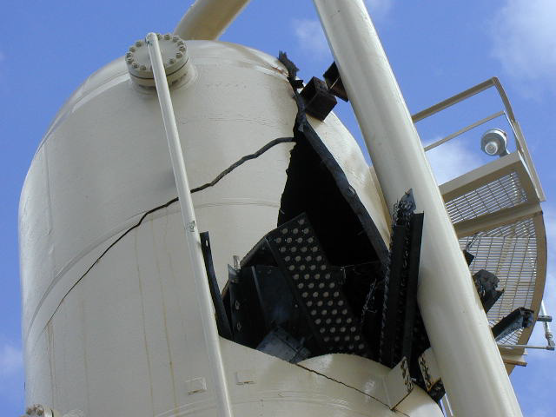
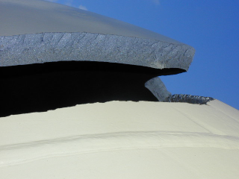
2002- North America :
  Brittle fracture during a Hydrotest of a pressure vessel at ambient temperature
  Be careful: water temperature can be critical for vessels with a high MDMT
  The metal temperature during hydrotest should be at least 17°C above Minimum Design Metal Temperature. Check with the fixed equipment engineer.

Slide 36



JUBCOR
2024
CONFERENCE & EXHIBITION
INNOVATIVE SOLUTIONS FOR CORROSION CHALLENGES
THANK YOU
Reach out.
+966 (13) 357 6747
reddyky@kemya.sabic.com

