Slide 1





JUBCOR
2024
CONFERENCE & EXHIBITION
INNOVATIVE SOLUTIONS FOR CORROSION CHALLENGES
"Navigating the Unseen”
Corrosion/Erosion in Refining ,petrochemical & Chemical industries
Presented By: Abhishek Agrawal

Slide 2


INDEX
Statement of problem
General assembly drawing
History
Retubing Activity
Unique failure
What went wrong
Code information of strength weld
Lesson Learned

Slide 3



Statement of problem
Detection ,Managing and Solution of unique failure in static equipment is a great challenge for inspection and NDT personnels.
Unique failure have been predominantly linked with harsh operating condition, non availability of qualitative NDE methodology & unclear guiding in code & Standard for QA/QC.
Inadequate maintenance strategies, Inappropriate Material of construction of equipment leads to unplanned shutdowns and costly repairs.

Slide 4
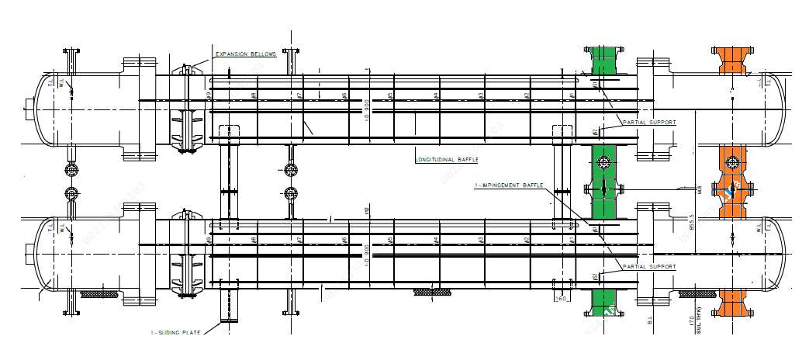
General Assembly drawing
Condensate Inlet
P= 11.2 Kg/cm2
T= 188 C
BFW Outlet
P= 71.38 Kg/cm2
T= 165 C
Condensate Outlet
P= 11.2 Kg/cm2
T= 127 C
BFW Inlet
P= 71.38 Kg/cm2
T= 105 C

Slide 5
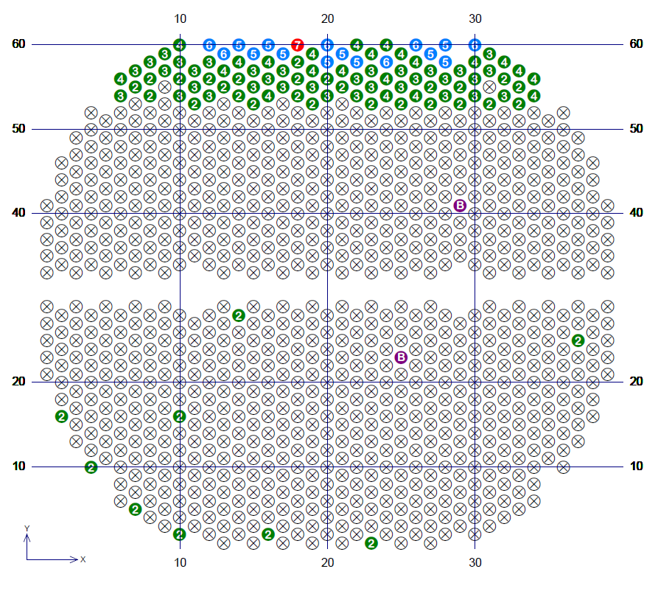




History
SECT test revealed top 06 rows had suffered with severe erosion damage
Most defected tubes pulled & found damages were located specifically below the implement plate
Retubing decision postponed due to TAM frequency
Top 03 rows were plugged followed with HT and boxed up

Slide 6
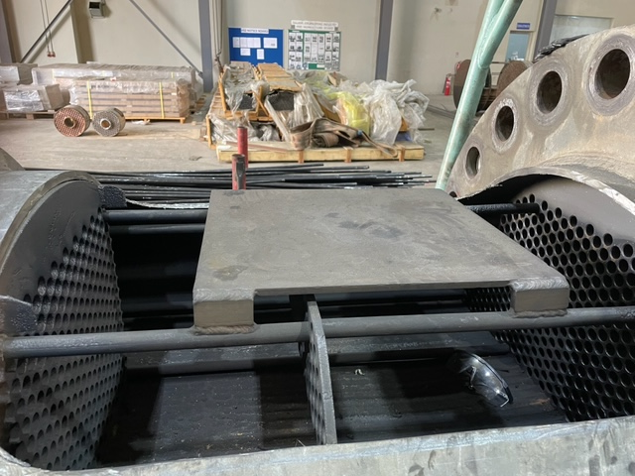
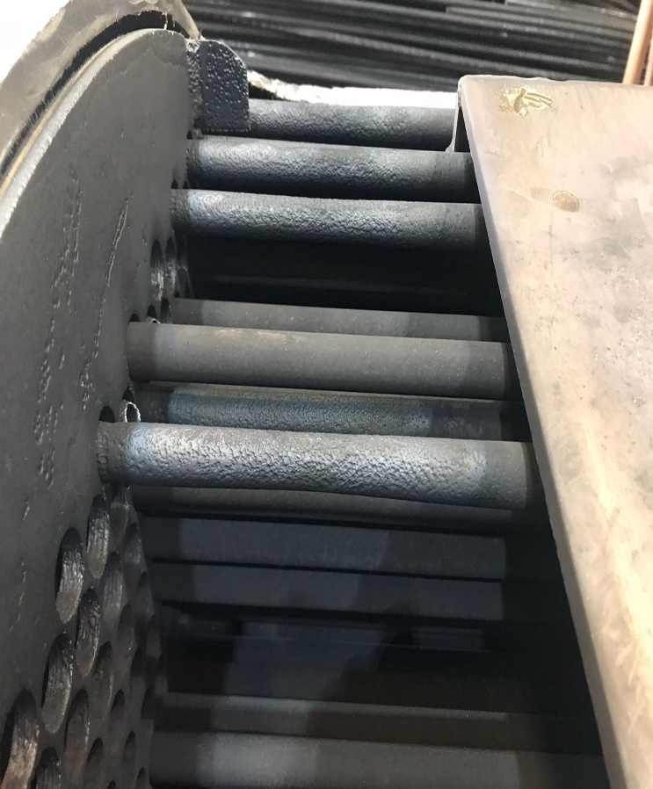
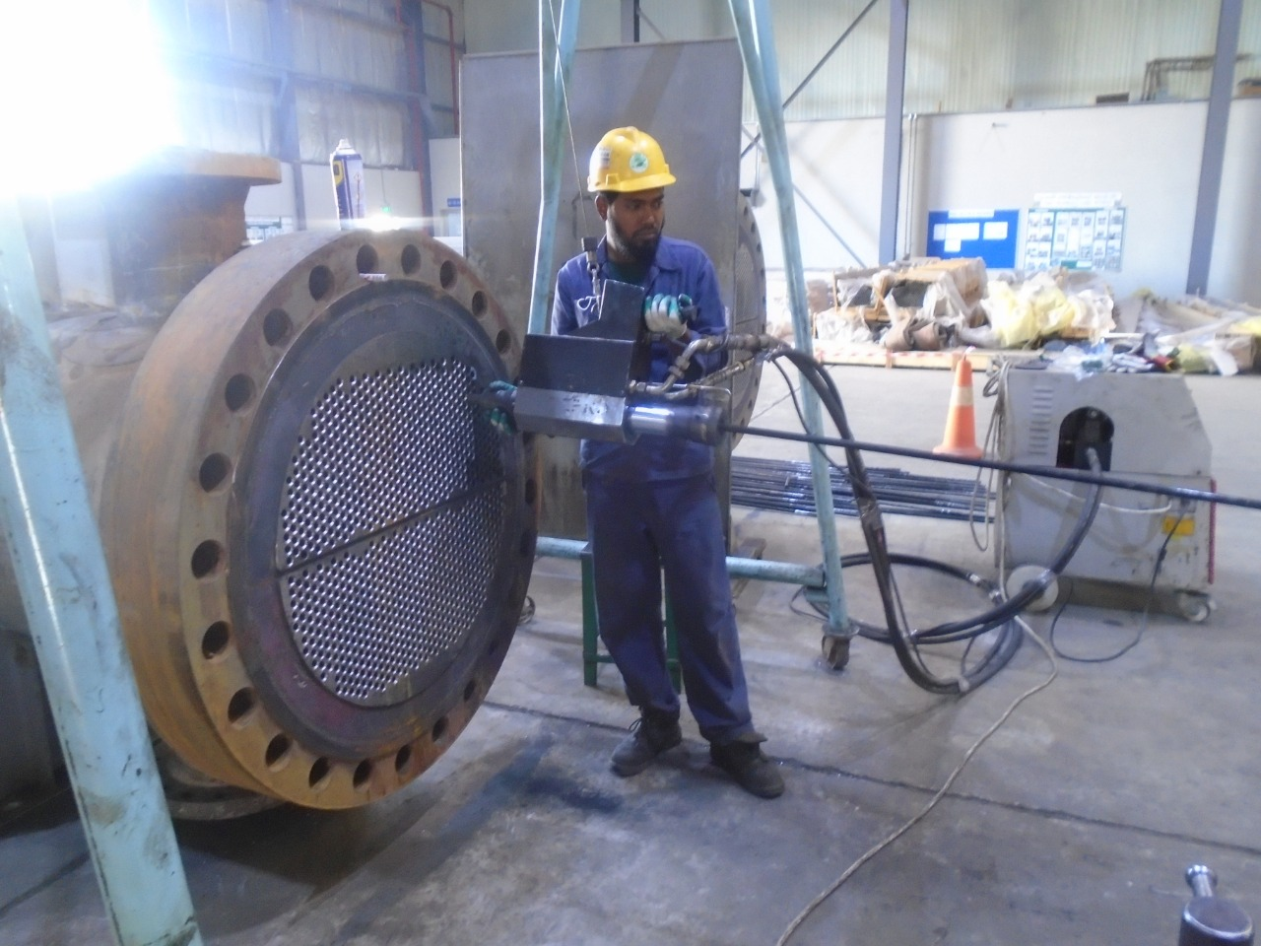
Retubing activity
217 mm
Impingement plate condition was found satisfactory
Pressure boundary inspected
Tube sheet thickness

Slide 7
Timeline (06 Month after Re tubing)
Impact noticed sustainability data
within 03 month
Suspected leakage from BFW preheater
Increased BFW consumption
Planned for Emergency Shutdown and opened heat Exchanger

Slide 8
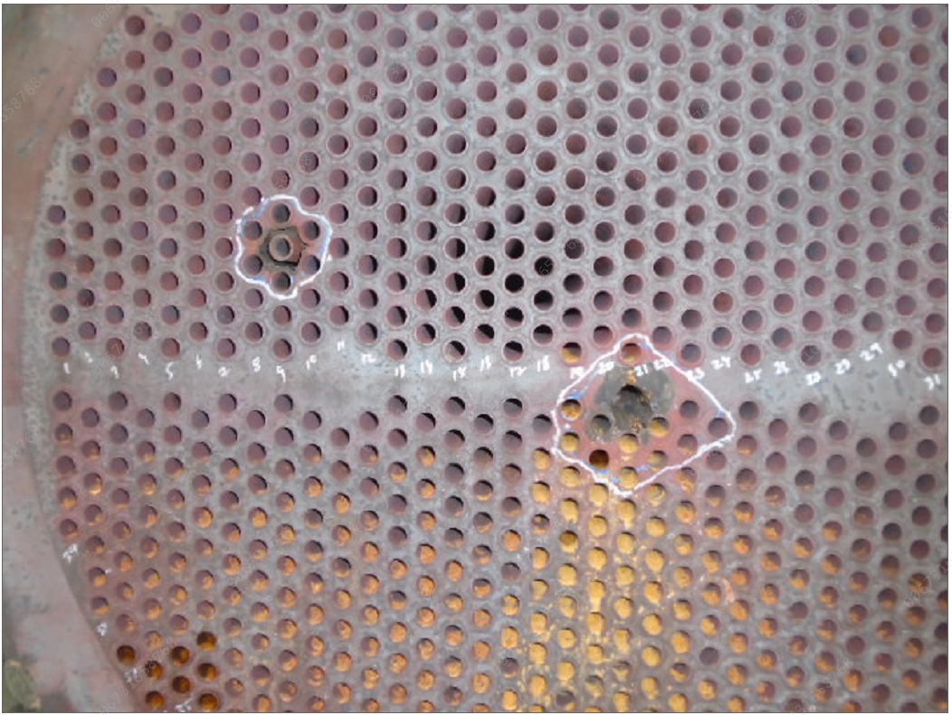
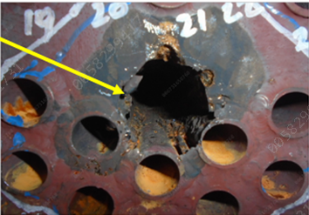
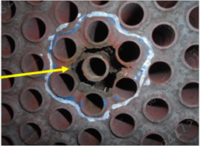
Unique failure
Hole observed on tube sheet in one of the preheater
Approximate 30 mm diameter through hole in one location
50~70% Tube sheet thickness eroded

Slide 9
Tubes condition
Tubes near by hole were severely thinned
Broken tubes around the hole
Cross section area of broken tubes around the hole

Slide 10

What went wrong
Tube side
Tube sheet
Shell side
Tube
Expansion area 201 mm
3 mm
13 mm

Slide 11
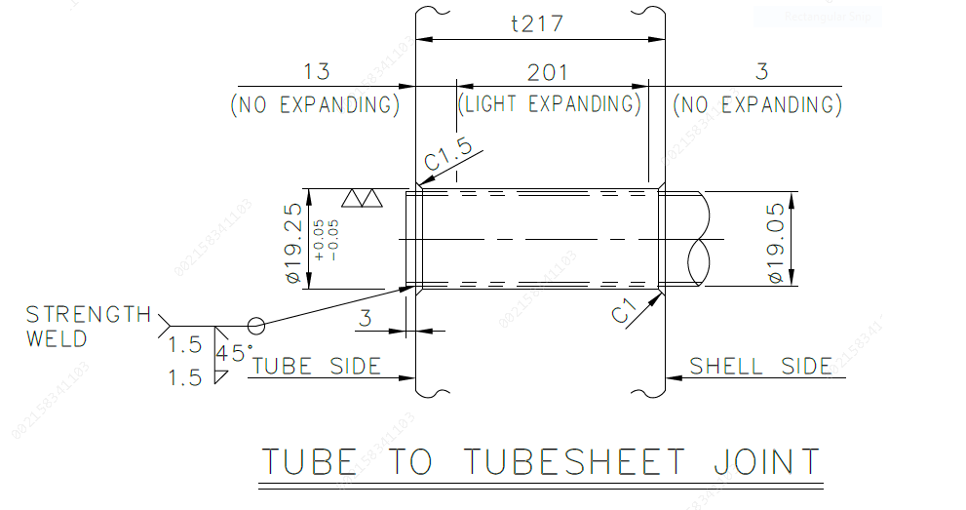
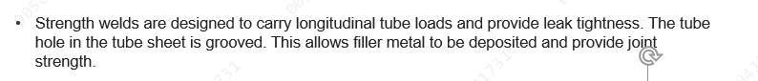
Code information of strength weld

Slide 12
Lesson Learned
No any specific guideline available in code/standard for QA of TTSJ .
No any quantitative NDE available to verify TTSJ except VI,DPE, PT & HT
It is advisable to perform Pneumatic test after first expansion during retubing.
DP Examination to be performed after first pass TTSJ weld joint .
Only full defect free TTSJ shall be acceptable to avoid such issues industry .
Stringent inspection scope to be defined ,in case of hiring the TPI/ASME inspectors .

Slide 13




JUBCOR
2024
CONFERENCE & EXHIBITION
INNOVATIVE SOLUTIONS FOR CORROSION CHALLENGES
THANK YOU
Abhishek Agrawal
+966-594326457
Agrawalay@sabic.com

