Slide 1




JUBCOR
2024
CONFERENCE & EXHIBITION
INNOVATIVE SOLUTIONS FOR CORROSION CHALLENGES
Comparative Study of Heat Exchanger Tubes Failure Analysis Using ECT and IRIS
Presented By:
Engr. Mohamed Fayas Saffiudeen M.E,M.B.A.,
Lecturer -Department of Mechanical Skills
Jubail Technical Institute, Royal Commission for Jubail and Yanbu,
Jubail, Kingdom of Saudi Arabia
saffiudeen_m@RCJY.EDU.SA

Slide 2


Authors Contribution
Conceptualization: Engr. Mohamed Fayas Saffiudeen M.E,M.B.A.,
Methodology: Engr. Fasil T. Mohammed, M.E.,& Engr. Abdullah Syed M.Sc.,
Investigation: Engr. Fasil T. Mohammed, M.E.,& Engr. Abdullah Syed M.Sc.,
Resources:Engr. Khalid Al Sayed B.S& Engr. Mohamed Fayas Saffiudeen M.E,M.B.A.,
Research supervision: Dr. Yassir A. Alamri
Project administration:Engr. Khalid Al Sayed B.S & Dr. Yassir A .Alamri

Slide 3
CONTENTS
ABSTRACT
INTRODUCTION
EXPERIMENTAL PROCEDURE
IRIS INSPECTION
ECT INSPECTION
COMPARATIVE STUDY
RESULTS & DISCUSSION
CONCLUSIONS
REFERENCES

Slide 4
ABSTRACT
This research describes the comparative study of selected advanced tubing inspection nondestructive testing (NDT) methods of eddy current testing(ECT) & internal rotating inspection system (IRIS)for heat Exchanger equipment in the petrochemical industry.
Generally, all the heat exchanger tubes in various plants are subject to various biological, chemical and physical stress causing several defect mechanisms such as erosion, pitting, corrosion, damages, fouling, crack, vibrational damage and other forms of material loss to occur.
In this research tube material was seamless nickel iron chromium alloy of straight tubes and tubesheet material was nickel-iron- chromium alloy.
By utilizing two advanced tubing inspection methods of reporting, we can make adjustments to the process and extend the life of the heat exchanger by plugging tubes or retubing individual tubes or partial retubing or full retubing.

Slide 5
ABSTRACT
It also provides a process for choosing the best set of approaches to get accurate inspection findings by using real-world case studies of completed fieldwork. The following data compares the suitability of ECT and IRIS for inspecting heat exchanger tubes.
The capabilities of the considered NDT methods for tube inspections are presented in the study.
Because of their high detectability and quick examination, nonferromagnetic materials like inconel should be tested by ECT.
IRIS is ineffective on non-ferromagnetic materials like inconel based on experimentation and testing.

Slide 6
INTRODUCTION
Design :Floating head type.
Tube material :Inconel 800 H .
Tube sizes:19.05 mm OD x2.11 mm thickness x5000 mm length.
Tubesheet Material : Inconel 800H .
Tubesheet thickness:95 mm.
Tube pitch :25.4 mm
Ligament :6.15mm
Tubesheet Hole Pattern :90 ° Square pitch
Tube Projection:3 mm
TTS Specification :Strength welding +Light Expansion
MAWP:1.05 MpaG at temp 605°C.
MAWP:1.02 MpaG at temp 450°C
MDMT:3 °C at 1.05 MpaG

Slide 7
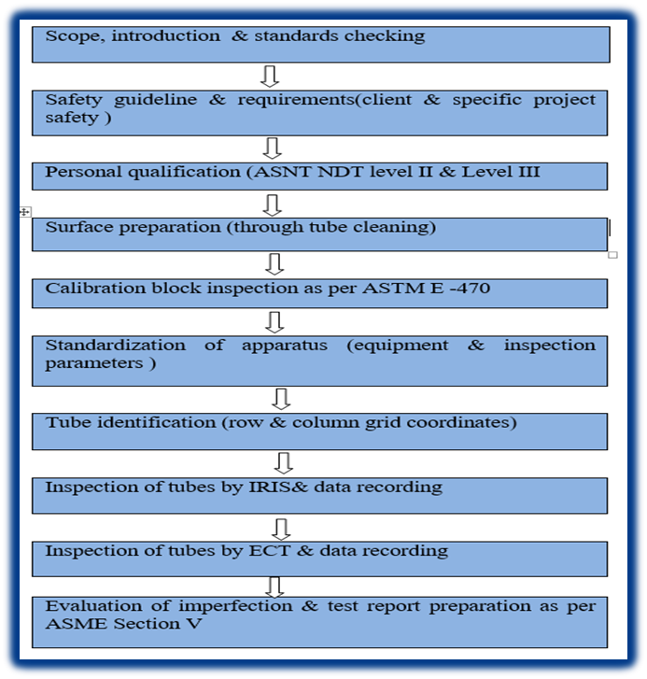
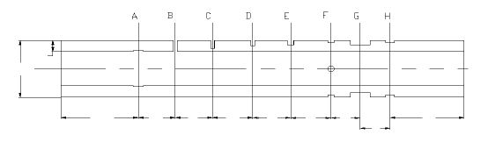
EXPERIMENTAL PROCEDURE
There are 10 stages of inspection procedure required for IRIS & ECT as shown below.
A methodical approach to guaranteeing safety, quality, and compliance throughout the inspection process is outlined in the Comprehensive Procedure for Tube Inspection. The process starts with a study of safety regulations and industry standards and highlights how crucial surface preparation, people qualifications, and calibration are to precise outcomes. The inspection process is streamlined by the standardization of equipment and tube identification techniques, and data accuracy is guaranteed by comprehensive instructions for conducting inspections utilizing IRIS and ECT technologies. A comprehensive framework for interpreting inspection findings is provided by the assessment of flaws and the creation of test reports in accordance with ASME Section V standards.

Slide 8
IRIS INSPECTION
Inspection was carried out from South side of the exchanger and marking was done from south side tube sheet side.
IRIS inspection report indicates that out of 286 tubes, wall thickness loss of 61% to 80% reported in 21 tubes, wall thickness loss of 41% to 60% reported in 53 tubes, wall thickness loss of 21% to 40% reported in 26 tubes and wall thickness loss of 1% to 20% reported in 8 tubes. Rests of tubes (178) were observed in satisfactory condition
Defective tubes=108 tubes.
S.No. | Parameters
 | Wall Loss (%) | No of Tubes | (%)Tube Inspected
1 | No defect | 178 | 62.20%
2 | 1- 20% | 8 | 2.80%
3 | 21% - 40% | 26 | 9.10%
4 | 41% - 60% | 53 | 18.50%
5 | 61% - 80% | 21 | 7.30%
6 | 81% - 100% | 0 | 0.00%
7 | Plugged | 0 | 0.00%
8 | Obstructed | 0 | 0.00%

Slide 9
ECT INSPECTION
Inspection was carried out from South side of the exchanger and marking was done from south side tube sheet side.
Out of 286 tubes, 285 were inspected, and one was restricted. Out of 285 tubes, 34 tubes were observed with wall loss of 81% to 100%, 32 tubes marked with wall loss of 61% to 80%, 30 tubes were kept with wall loss of 41% to 60%, 38 tubes observed with wall loss 21% to 40% and 19 tubes with 0% to 20%. Rests of tubes were observed in satisfactory condition.
Defective tubes=153.
S.No. | Parameters
 | Wall Loss (%) | No of Tubes | (%)Tube Inspected
1 | No defect | 132 | 46.15%
2 | 1- 20% | 19 | 6.6%
3 | 21% - 40% | 38 | 13.3%
4 | 41% - 60% | 30 | 10.5%
5 | 61% - 80% | 32 | 11.2%
6 | 81% - 100% | 34 | 11.9%
7 | Plugged | 0 | 0.00%
8 | Obstructed | 1 | 0.35%

Slide 10
Result code Statistics
NDT | IRIS |  | ECT
Defects | Total tubes | Total defects | Total tubes | Total defects
Bulge | 0 | 0% | 0 | 0%
Corrosion | 7 | 2.4% | 0 | 0%
Cracking | 0 | 0% | 0 | 0%
Dented | 0 | 0% | 0 | 0%
Erosion | 0 | 0% | 0 | 0%
Through-hole | 0 | 0% | 0 | 0%
Corrosion(Internal) | 0 | 0% | 0 | 0%
Pitting (Internal) | 0 | 0% | 0 | 0%
Incomplete test | 0 | 0% | 0 | 0%
No defect(NDD) | 178 | 62.2% | 132 | 46.1%
No access | 0 | 0% | 0 | 0%
Obstructed(Plug) | 0 | 0% | 0 | 0%
Corrosion(External) | 0 | 0% | 0 | 0%
Pitting (External) | 0 | 0% | 0 | 0%
Pitting (PIT) | 101 | 35.3% | 122 | 42.7%
Restricted | 0 | 0% | 1 | 0.3%
Stress cracking | 0 | 0% | 0 | 0%
Wear | 0 | 0% | 0 | 0%
Long thk loss | 0 | 0% | 30 | 10.5%
Short thk loss | 0 | 0% | 1 | 0.3%
Taper thk loss | 0 | 0% | 0 | 0%
Total | 286 | 100% | 286 | 100%
The total number of imperfections found for this heat exchanger utilizing IRIS and ECT are shown in Table 7 below. This table, which started as "result code statistics data," will be helpful for retubing procedures and more studies on failed tubes. IRIS result code statistics inspection report indicates that 101 tubes (35.31%) with pitting defects and 7 tubes (2.45%) with corrosion defects. Balance 178 tubes (62.23%) tubes found without wall thickness loss. ECT result code statistics inspection report indicates that 122 tubes (42.66%) with pitting defects and 31 tubes (10.84%) with wall thickness loss defects. Balance 132 tubes, (46.15%) tubes found without wall thickness loss.

Slide 11
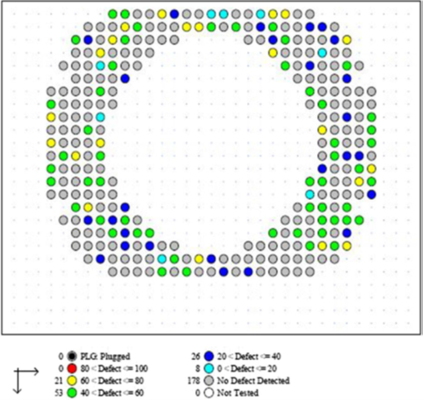
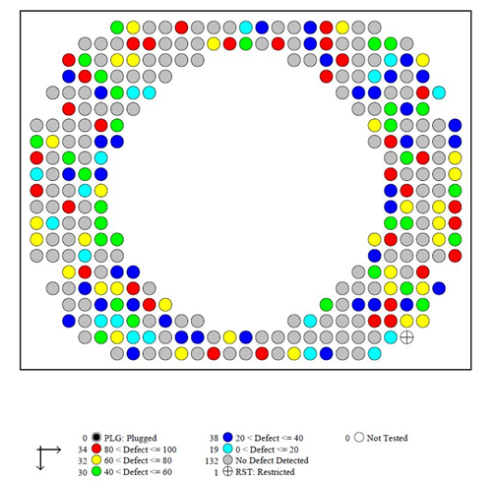
Comparative Study
Inspection summary of row 1 (17 tubes)
S.No. | Parameters
 | Wall Loss (%) | No of Tubes | (%)Tube Inspected
1 | No defect | 132 | 46.15%
2 | 1- 20% | 19 | 6.6%
3 | 21% - 40% | 38 | 13.3%
4 | 41% - 60% | 30 | 10.5%
5 | 61% - 80% | 32 | 11.2%
6 | 81% - 100% | 34 | 11.9%
7 | Plugged | 0 | 0.00%
8 | Obstructed | 1 | 0.35%
As per the tube sheet layout, the first row had 17 tubes and the detailed wall thickness loss result is described in Table.
According to IRIS inspection out of 17 tubes from row 1, 3 tubes observed with wall thickness loss of 61% to 80%, 2 tubes observed with wall thickness loss of 41% to 60%,1 tube observed with wall thickness loss of 21% to 40% and 3 tubes with 1% to 20% wall thickness loss. Also no tubes within the range of 81%-100% wall thickness loss. Rests of tubes (8) were observed in satisfactory condition.
According to ECT inspection out of 17 tubes, 2 tubes were observed with wall thickness loss 81% to 100%, 2 tubes observed with wall thickness loss of 61% to 80%, 1 tube observed with wall thickness loss of 41% to 60%,2 tubes observed with wall thickness loss of 21% to 40% and 1 tube with 1% to 20% wall thickness loss. Rests of tubes (9) were observed in satisfactory condition

Slide 12
Comparative Study
Defect range statistics of the combined inspection report
IRIS result code statistics inspection report indicates that 101 tubes (35.31%) with pitting defects and 7 tubes (2.45%) with corrosion defects. Balance 178 tubes (62.23%) tubes found without wall thickness loss.
ECT result code statistics inspection report indicates that 122 tubes (42.66%) with pitting defects and 31 tubes (10.84%) with wall thickness loss defects. Balance 132 tubes, (46.15%) tubes found without wall thickness loss
It is clear that both IRIS inspection and ECT inspection on the heat exchanger reported different results of wall thickness loss on each tube
NDT | IRIS |  | ECT
Defect | Tubes | Tubes(%) | Tubes | Tubes(%)
0%(No defect ) | 178 | 62.2% | 132 | 46.1%
1-20% | 8 | 2.8% | 19 | 6.6%
21-40% | 26 | 9.1% | 38 | 13.3%
41-60% | 53 | 18.5% | 30 | 10.5%
61-80% | 21 | 7.3% | 32 | 11.2%
81-100% | 0 | 0% | 34 | 11.9%
Plugged | 0 | 0% | 0 | 0%
Restricted | 0 | 0% | 1 | 0.3%
Total | 286 | 100% | 286 | 100%

Slide 13
Results & Discussion
The inspection speed of IRIS and ECT is 2 m/s and 0.02 m/s. ECT takes only 4.5 hours to set up and continue the inspection on the heat exchanger but IRIS inspection takes 10 hours to complete the inspection due to extensive tube cleaning requirements.
IRIS provided the data of remaining wall thickness and ECT provided the data of Defect depth (%) as per detailed individual IRIS and ECT tube inspection report.
It is clear that both IRIS inspection and ECT inspection on the heat exchanger reported different results of wall thickness loss on each tube described in figure. After carefully evaluating both the results, it can be concluded ECT was a better method to identify the defective tubes since 800 H inconel heat-exchanger tubes.

Slide 14
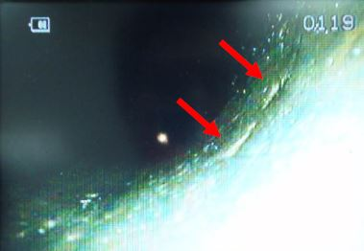
Results & Discussion
The reliability of the ECT technique during an in-service inspection was evaluated by random boroscopic inspection addressed in Figure for tube (Row 21, Column 2).
IRIS inspection confirms no defect and ECT inspection confirms pitting in which boroscopic inspection also endorse tube pitting. Therefore, ECT inspection was acceptable to proceed retubing and maintenance.
Also by a retubing of the heat exchanger using this ECT report and proceeded with 3 hydro tests successfully without any leak (shell side, tube side and floating heat hydro test). ECT proven to show a better capability in defect detection then IRIS inspection. Incase retubing is carried out based on IRIS report leads to failure of tube side hydro test reflects the loss of time, man hours and cost.

Slide 15
Conclusion
Internal Rotating Inspection System(IRIS) and Eddy Current Testing(ECT) were carried out on the heat exchanger. ECT has a relatively high inspection speed compared to IRIS examination.
It was concluded that non-ferromagnetic material like inconel, stainless steel, titanium etc. should be inspected only by ECT. IRIS is suitable only for ferromagnetic materials like carbon steel.
IRIS's detection of faults capacity utilization (in non-magnetic materials) is lower than ECT's because IRIS is less able to identify minor flaws than ECT. IRIS is not a measuring instrument for ECT indication verification and utilized only for tube wall thickness loss estimation.
The selection of the best advanced tubing inspection and its execution are significantly affected by QA/QC departments (including Engineers and Inspectors). Depending on the inspector's expertise, a wide range of findings might be anticipated. Understanding the advanced inspection methods properly, as well as their benefits and drawbacks, is crucial.

Slide 16
Note
In light of the potential misinterpretation and application of the results presented in this study, it is imperative to emphasize that the findings are highly specific to the conditions under which the experiments were conducted. The results should not be generalized beyond the specific tube size, material, design pressure & temperature and damage mechanisms studied here.
Therefore, any application of these results should be carefully considered within the context of the precise experimental conditions described. Inspectors and practitioners should not use these findings as a general guideline for test procedures or data analysis without thoroughly evaluating the applicability to their specific circumstances.

Slide 17
References
[1]Rajiv Mukherjee, Practical thermal design of shell‐and‐tube heat exchangers. ISBN : 1567002056 (2004)
[2]Shah, Ramesh K., and Dusan P. Sekulic. Fundamentals of heat exchanger design. John Wiley & Sons ( 2003)
[3]Kakaç, Sadik, Hongtan Liu, and Anchasa Pramuanjaroenkij. Heat exchangers: selection, rating, and thermal design. CRC Press( 2020)
[4]Saffiudeen, Mohamed Fayas, Fasil T. Mohammed, and Abdullah Syed. "A case study on procedure standardization of heat exchanger retubing in KSA oil and gas industries." Journal of Failure Analysis and Prevention 20, 1451-1455 (2020)
[5]Abd, Ammar Ali, Mohammed Qasim Kareem, and Samah Zaki Naji. "Performance analysis of shell and tube heat exchanger: Parametric study." Case studies in thermal engineering 12 (2018): 563-568.
[6]Thekkuden, Dinu Thomas, Abdel-Hamid I. Mourad, Abdel-Hakim Bouzid, and Tariq Darabseh. "Impact of expansion pressure on wall thinning and contact pressure for hydraulically expanded tube-to-tubesheet joints: Numerical analysis." In 2020 Advances in Science and Engineering Technology International Conferences (ASET), pp. 1-6. IEEE, 2020.
[7]Gut, Jorge AW, Renato Fernandes, José M. Pinto, and Carmen C. Tadini. "Thermal model validation of plate heat exchangers with generalized configurations." Chemical Engineering Science 59, no. 21 (2004): 4591-4600.
[8]Thekkuden, Dinu Thomas, Abdel-Hamid Ismail Mourad, and Abdel-Hakim Bouzid. "Failures and leak inspection techniques of tube-to-tubesheet joints: A review." Engineering Failure Analysis 130 (2021): 105798.
[9]Ali, Murad, Anwar Ul-Hamid, Luai M. Alhems, and Aamer Saeed. "Review of common failures in heat exchangers–Part I: Mechanical and elevated temperature failures." Engineering Failure Analysis 109 (2020): 104396.
[10]Azevedo, C. R. F., and G. S. Alves. "Failure analysis of a heat-exchanger serpentine

Slide 18
References
[11]Saffiudeen, Mohamed Fayas, Abdullah Syed, and Fasil T. Mohammed. "Failure Analysis of Heat Exchanger Tubes." Journal of Failure Analysis and Prevention (2023): 1-6.
[12]Vincent, Brady T., Marwan A. Hassan, and Robert J. Rogers. "A probabilistic assessment technique applied to a cracked heat exchanger tube subjected to flow-induced vibration." Journal of pressure vessel technology 131, no. 3 (2009).
[13]Ni, Tong-Wei, Jing-Lu Fei, Sheng-Hui Wang, Yi Gong, and Zhen-Guo Yang. "Failure analysis on unexpected perforation of heat exchanger tube in methacrylic acid reboiler of speciality chemical plant." Engineering Failure Analysis 108 (2020): 104267.
[14]Gong, Yi, Chao Yang, Cheng Yao, and Z‐G. Yang. "Acidic/caustic alternating corrosion on carbon steel pipes in heat exchanger of ethylene plant." Materials and Corrosion 62, no. 10 (2011): 967-978.
[15]Kain, V., K. Chandra, and B. P. Sharma. "Failure of carbon steel tubes in a fluidized bed combustor." Engineering Failure Analysis 15, no. 1-2 (2008): 182-187.
[16]Saffiudeen, M.F., Mohammed, F.T. & Syed, A. Standardized Repair Procedure for Failures in Heat Exchangers. J Fail. Anal. and Preven. (2023). https://doi.org/10.1007/s11668-023-01709-5
[17]Thekkuden, Dinu Thomas, Abdel-Hamid Ismail Mourad, Tholkappiyan Ramachandran, Abdel-Hakim Bouzid, Ravi Kumar, and Ahmed Alzamly. "Combined effect of tungsten inert gas welding and roller expansion processes on mechanical and metallurgical characteristics of heat exchanger tube-to-tubesheet joints." Journal of Materials Research and Technology 21 (2022): 4724-4744.
[18]Gong, Yi, Fu-Qiu Ma, Yun Xue, Cai-Shan Jiao, and Zhen-Guo Yang. "Failure analysis on leaked titanium tubes of seawater heat exchangers in recirculating cooling water system of coastal nuclear power plant." Engineering Failure Analysis 101 (2019): 172-179.
[19]S. Al-Shahrani, A. Al-Meshari, G.N. van Zyl, S. Ahmad, Failure analysis of a heat exchanger shell. J. Fail. Anal. Prev. 13, 20–25 (2013)
[20]Mukhrish, Yassar E., Muhammad Asad, Muhammad Azhar Ali Khan, and Faramarz Djavanroodi. "Experimental investigations on wire arc additive manufacturing process using an Inconel 625 alloy wire." Mechanics of Advanced Materials and Structures (2023): 1-12.

Slide 19
References
[21]Saffiudeen, M.F., Mohammed, F.T. & Syed, A. Comparative study of tube to tubesheet welding qualification on heat exchanger. J. Eng. Appl. Sci. 69, 57 (2022). https://doi.org/10.1186/s44147-022-00099-z
[22]Rezaei, Milad, Zeynab Mahidashti, Sajad Eftekhari, and Ehsan Abdi. "A corrosion failure analysis of heat exchanger tubes operating in petrochemical refinery." Engineering Failure Analysis 119 (2021): 105011.
[23]Adnyana, D.N. Failure Analysis of Stainless Steel Heat Exchanger Tubes in a Petrochemical Plant. Journal of Failure Analysis and Prevention 2018, 18, 413–422, doi:10.1007/s11668-018-0422-8.
[24]Subramanian, Chidambaram, Debashis Ghosh, Dasari Sukumar Reddy, Debasmita Ghosh, Rampradesh Natarajan, and S. P. Velavan. "Stress corrosion cracking of U tube heat exchanger used for low pressure steam generation in a hydrogen unit of petroleum refinery." Engineering Failure Analysis 137 (2022): 106245.
[25]Usman, A., and A. Nusair Khan. "Failure analysis of heat exchanger tubes." Engineering Failure Analysis 15, no. 1-2 (2008): 118-128.
[26]Shahrani, S., and S. Al-Subai. "Failure analysis of heat exchanger tubes." Journal of failure analysis and prevention 14, no. 6 (2014): 790-800.
[27]Peltola, H., and M. Lindgren. "Failure analysis of a copper tube in a finned heat exchanger." Engineering Failure Analysis 51 (2015): 83-97.
[28]Liu, Xiaofei, Haiyan Zhu, Chenyang Yu, Haozhe Jin, Chao Wang, and Guofu Ou. "Analysis on the corrosion failure of U-tube heat exchanger in hydrogenation unit." Engineering Failure Analysis 125 (2021): 105448.
[29]Jahromi, S. A. J., M. M. AliPour, and A. Beirami. "Failure analysis of 101-C ammonia plant heat exchanger." Engineering Failure Analysis 10, no. 4 (2003): 405-421.
[30]Huttunen-Saarivirta, E.; Honkanen, M.; Lepistö, T.; Kuokkala, V.-T.; Koivisto, L.; Berg, C.-G. Microbiologically Influenced Corrosion (MIC) in Stainless Steel Heat Exchanger. Appl Surf Sci 2012, 258, 6512–6526, doi:10.1016/j.apsusc.2012.03.068.

Slide 20



JUBCOR
2024
CONFERENCE & EXHIBITION
INNOVATIVE SOLUTIONS FOR CORROSION CHALLENGES
THANK YOU
Reach out.
+966542880964
saffiudeen_m@RCJY.EDU.SA

