Slide 1




JUBCOR
2024
CONFERENCE & EXHIBITION
INNOVATIVE SOLUTIONS FOR CORROSION CHALLENGES
Presented By: Ahmed Alharbi
Jubcor Presentation
End to End Thermoplastic Corrosion
Protection Solutions- A boom to the
industry

Slide 2
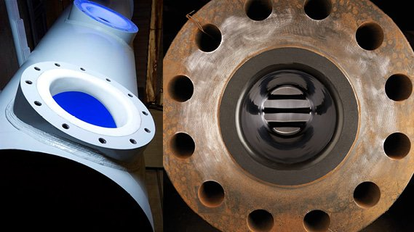

Outline of Presentation
About USTS
Introduction of Bondaliner™
Introduction of Tite Liner®
Life Cycle Cost
Review Selection of Case Studies
Conclusion

Slide 3




United Special Technical Services (USTS) Arabia Company Limited
OMAN
UAE
BAHRAIN
KUWAIT
SAUDI ARABIA
NORTH AFRICA
QATAR
Piping and Pipelines
Fittings and Vessels

Slide 4
Introduction To Bondaliner™
Internal Lining Pipes, Fittings, Tanks & Vessels

Slide 5
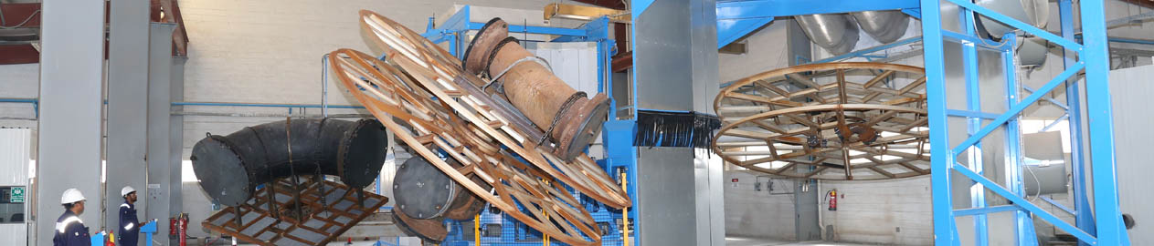
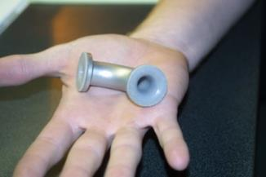
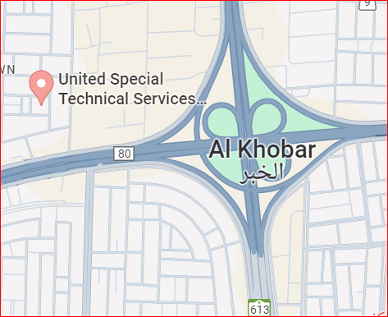
Bondaliner™– A Reliable Method for Fittings and Vessels
Unique Technology and highly Engineered Materials
State of the Art Facility at Al-Khobar, KSA
One of the largest facilities in the world
1-inch to 60-inch diameter x 4-meter length (5000 Kgs.)
Lined more than 3000 fittings for various customers in GCC

Slide 6
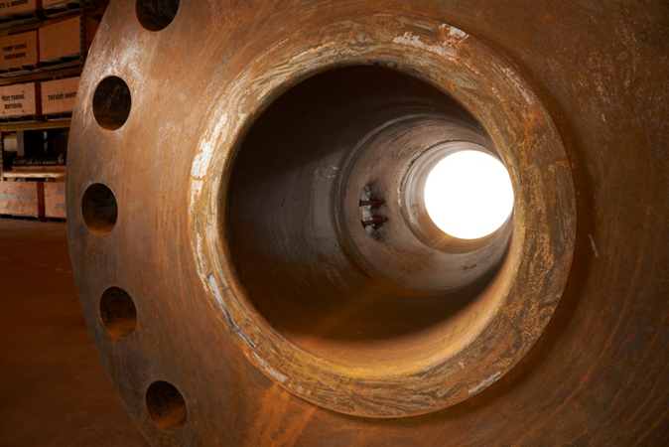
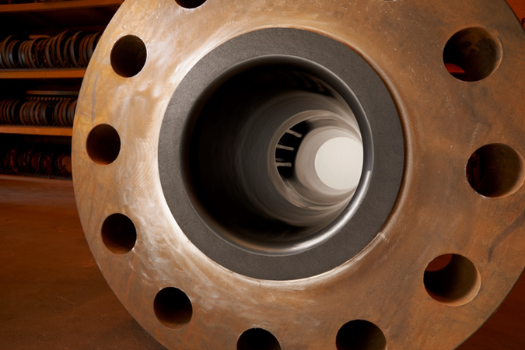
Bondaliner™– A Reliable Method for Fittings and Vessels
Long Lasting Internal Corrosion Protection Solution.
Greatly Reduce Cost, especially when lifetime operating and maintenance costs.
Uniform Thermoplastic Liner
Fully bonded liner can withstand full vacuum.
Easily line complex structures
Using High Performance Thermoplastic Materials
Rust
Robust

Slide 7
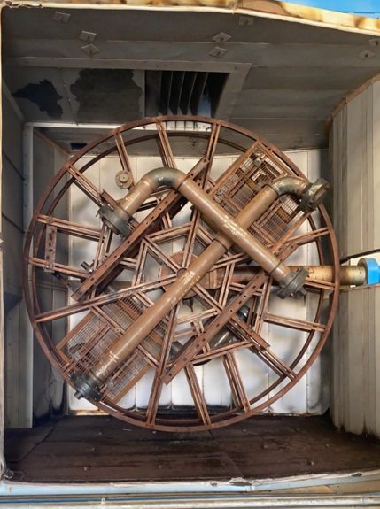
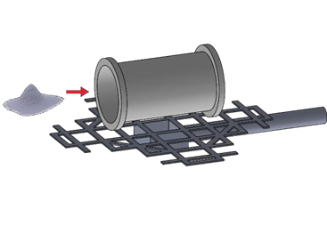
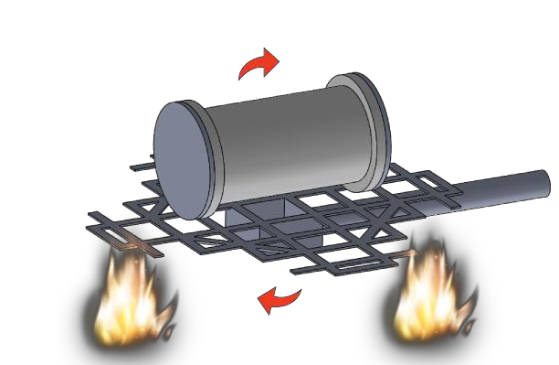
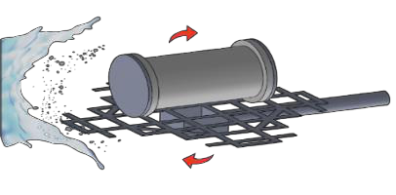
Rotational Lining “Bondaliner™” Process
The first step of the process is to prepare the interior surface of the structure (pipe fittings/vessels/tanks) to white metal. Next, the structure is mounted to a multi-axis rotational lining machine. Polymer resin is placed inside the structure to be lined and all openings are covered.
The structure is heated in the oven while simultaneously rotating about tow perpendicular axes for a define period, until all the polymer powder are melted and adhered to the fitting.
The rotational lining heating cycle is completed, fittings then goes through a cooling process till the thermoplastic material has been solidified

Slide 8
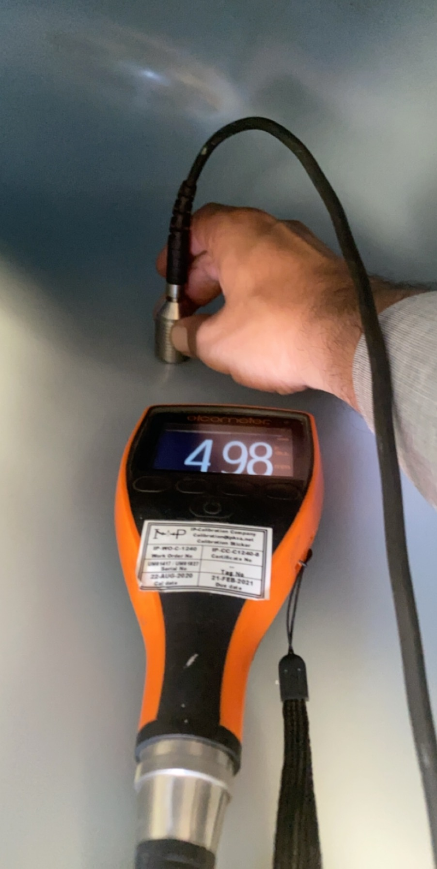
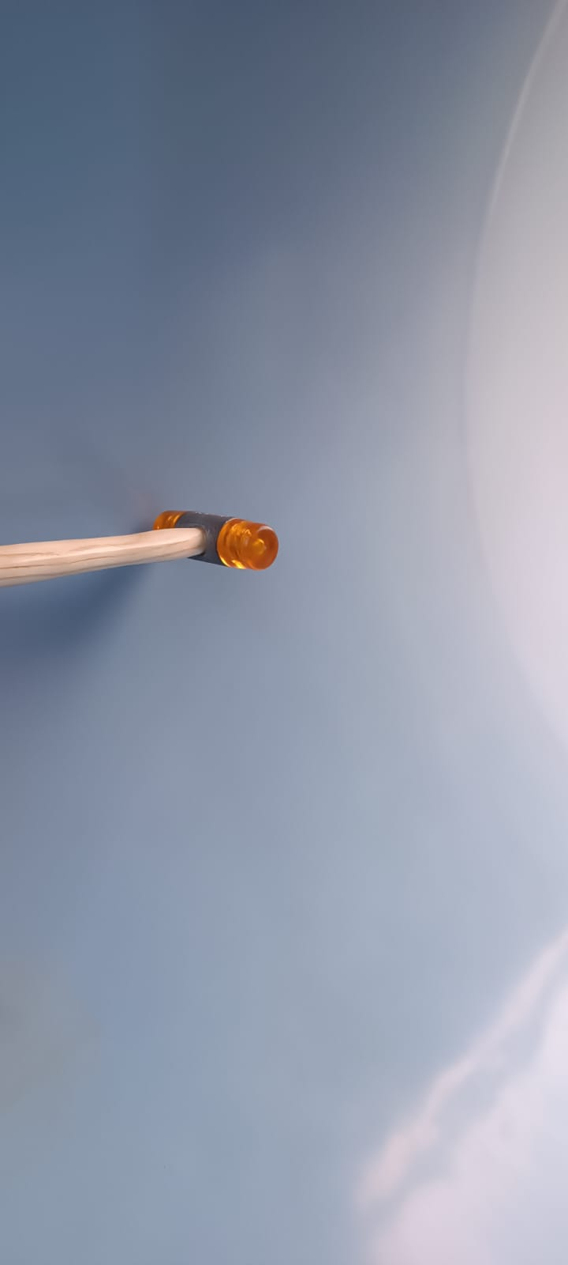
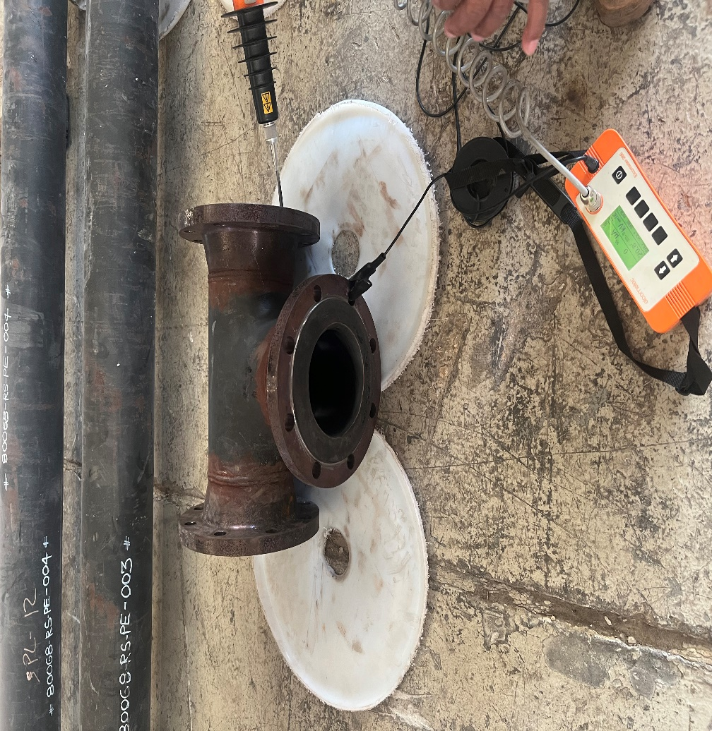
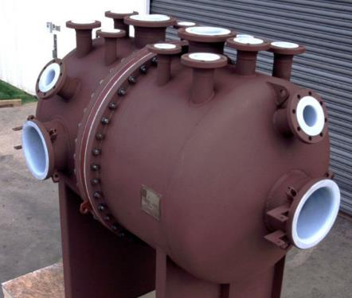
Quality Control
Visual Inspection
Lining Thickness
Holiday detection Test ( Spark test) up to 27,0 Kv
Tap Testing
Hydrotesting at ambient and elevated temp before and after lining

Slide 9
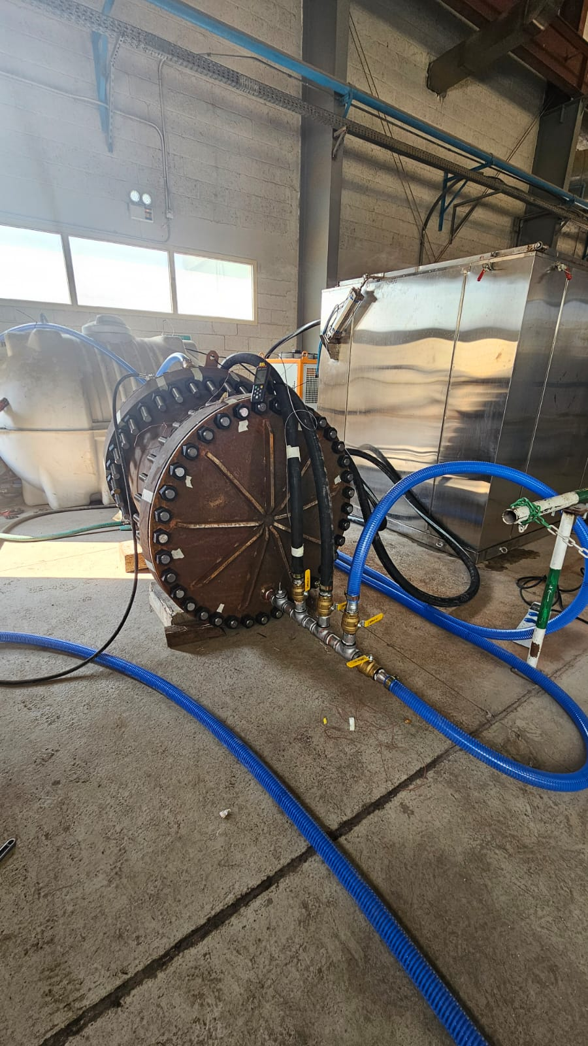
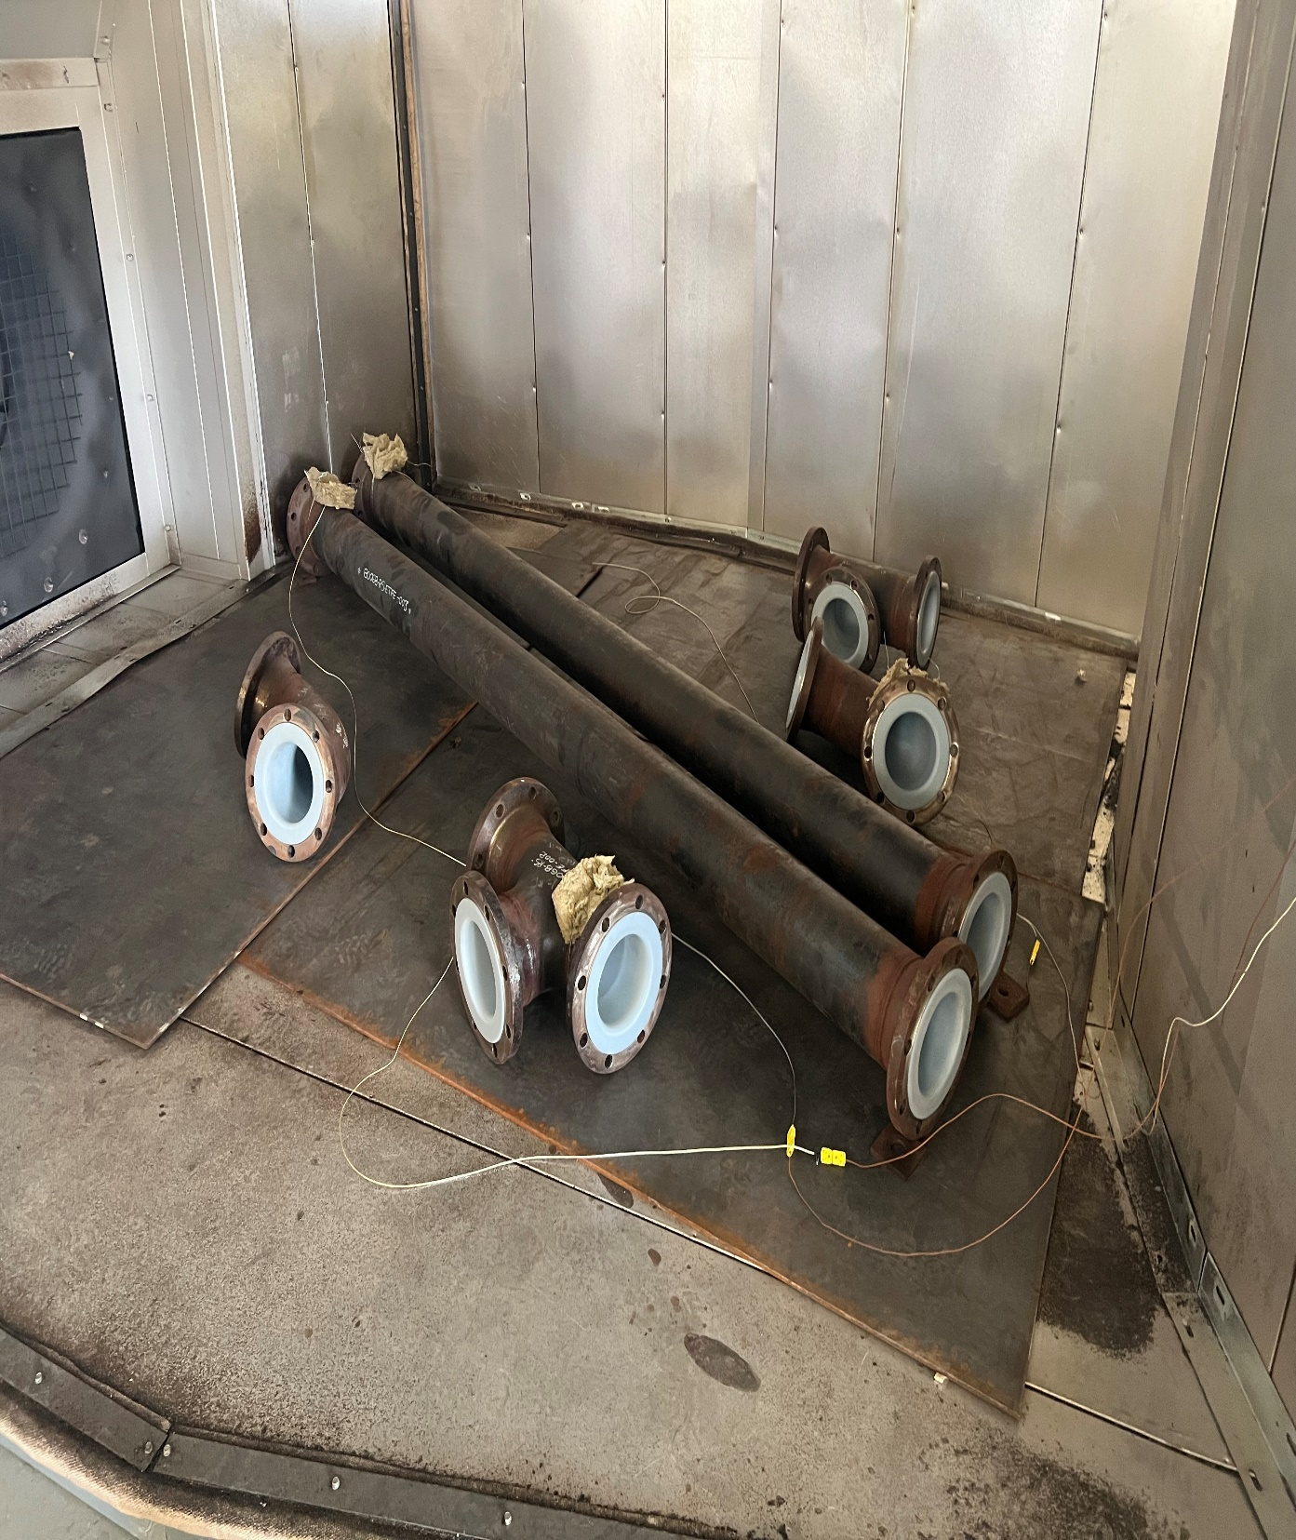
Testing Material
ASTM F1545 Plastic-Lined Ferrous Metal Pipe, Fittings, and Flanges
  High-Temperature Test
  Low-Temperature Test
  Vacuum Testing
  Steam-Cold Water Cycling
  Test

Slide 10
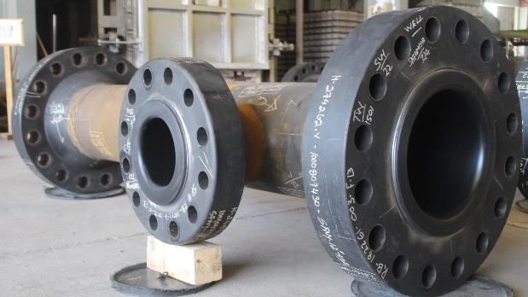
Bondaliner™– Material Selection
PE- Polyethylene
Good up to 180 F
Commonly used brine, salt or seawater applications.
Good with low temperature acids and slurries.
Above average abrasion resistance
Can be lined to 12.0 mm. Nominal lining thickness (8.0 mm typical)
Liner can withstand vacuum

Slide 11
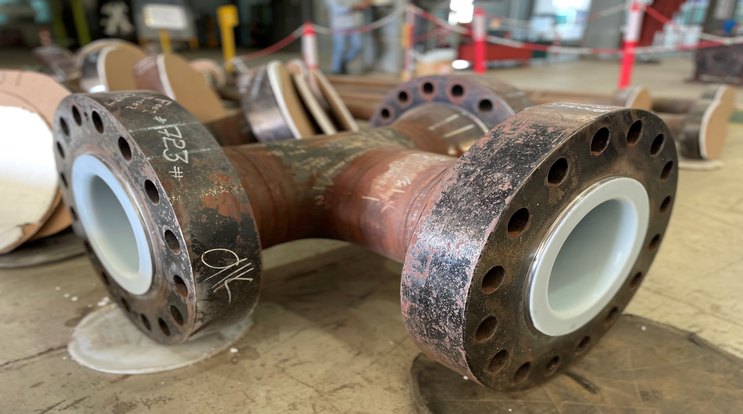
Bondaliner™– Material Selection
ETFE- Ethyelne tetrafluoroethylene
Good for temperature up to 300 F
Greater for higher temperature acid, base, and solvent services.
Above average abrasion resistance
Lower permeability compared to PTFE
Nominal lining thickness 5.0 mm
Liner can withstand full vacuum

Slide 12

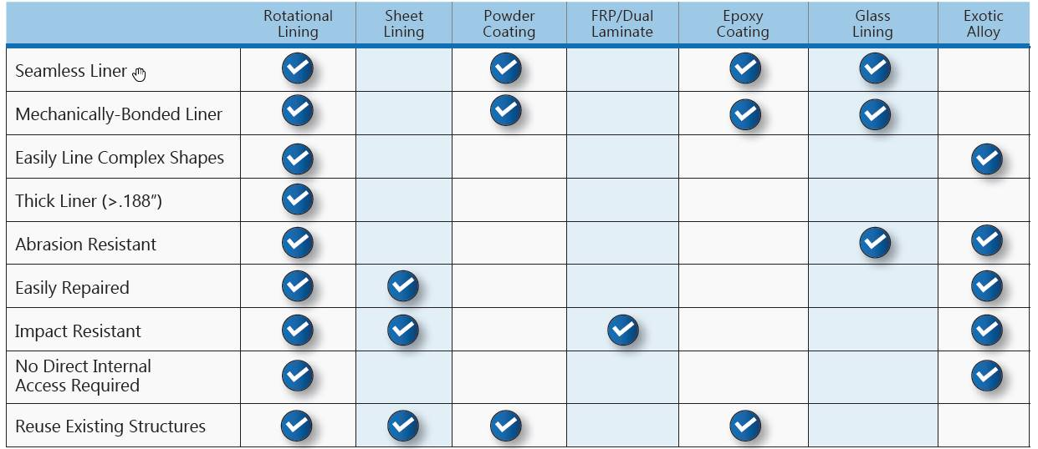
Rotational Lining “Bondaliner™” Compared To Alternative Lining Methods
Additional Key Advantage: Rotational Lining Available Locally In Khobar KSA. Quick turn around, personalized service and technical support.

Slide 13
Introduction To Tite Liner® System
Protect Pipelines From Internal Corrosion and Abrasion

Slide 14
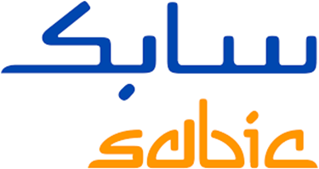
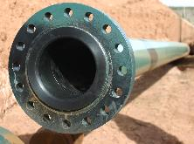
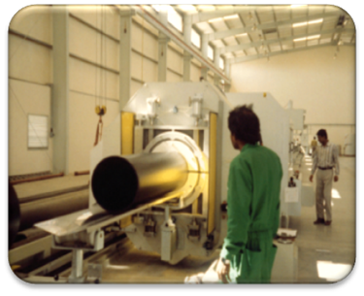
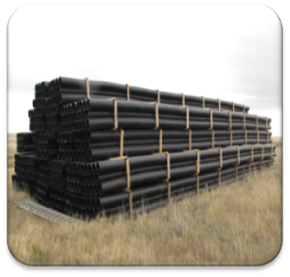
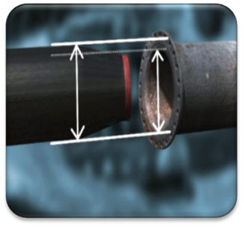
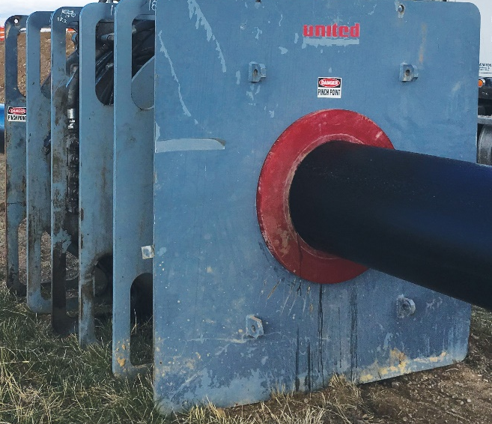
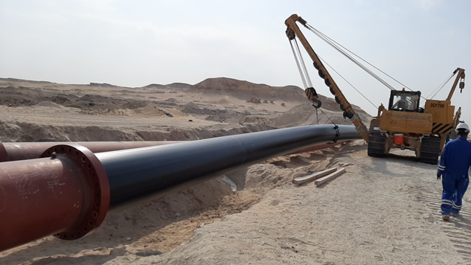
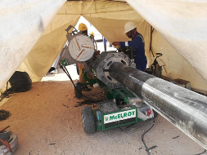
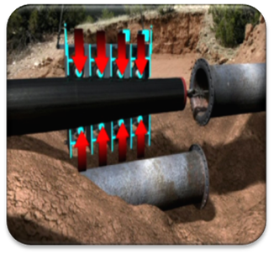
Tite Liner® Process Overview
Liner Raw Material
Liner Pipe
Liner Fusion
Roll Down
Liner Installation
End Fittings

Slide 15
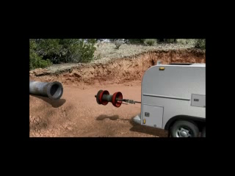
HDPE Liner Installation Schematic

Slide 16
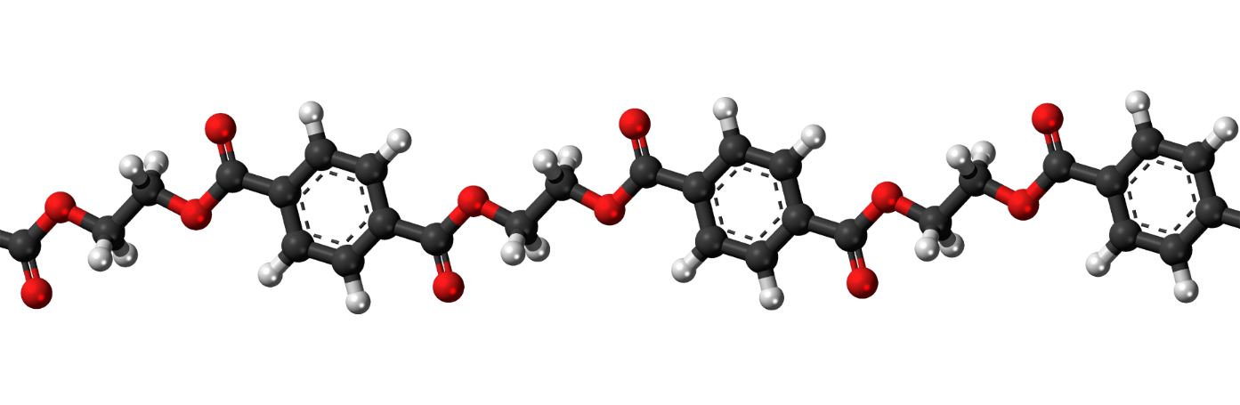

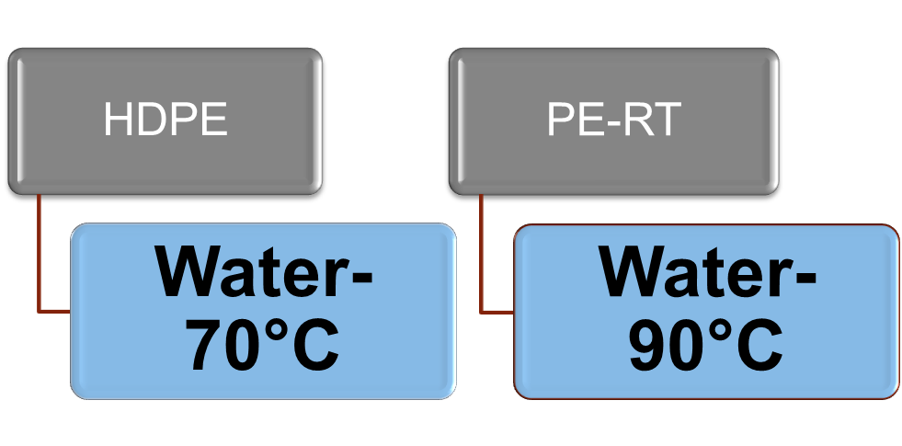
Thermoplastic Liner Materials
  Liner Material selection based on Fluid Conditions
  Corrosion & Chemical Resistance
  Highly engineered polymers will provide longevity for the Solution

Slide 17
Life Cycle Cost-HDPE Lined Pipelines-ISO 15663-2021
CAPEX-1
LOST REVENUE
LIFE CYCLE COST
CAPEX-2
OPEX
ENV. COST
$
$
100%
$
$
$
$
0
60%
0
¢
$
Bare CS Pipe
CS + HDPE

Slide 18
Review of Selected Case Studies in O&G, Chemical Industries

Slide 19
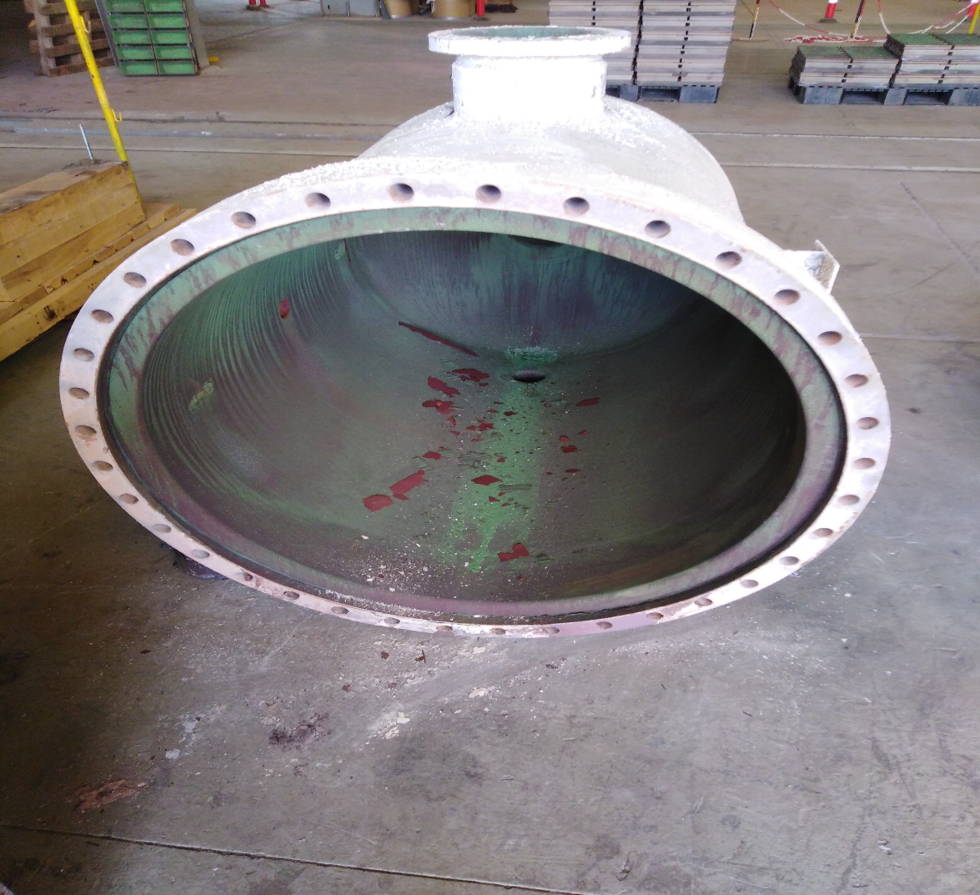
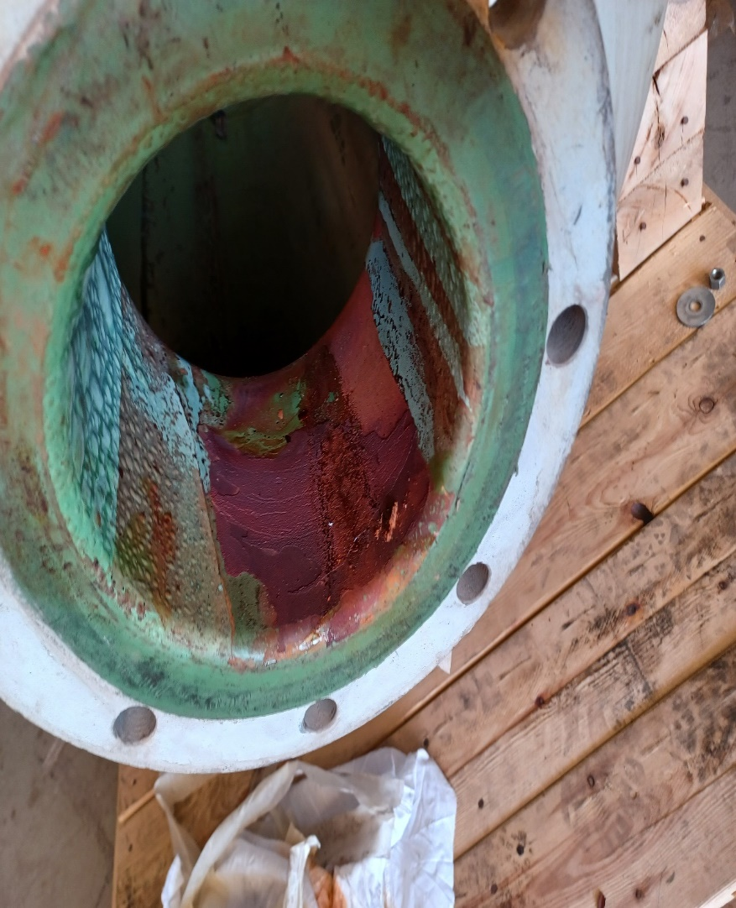
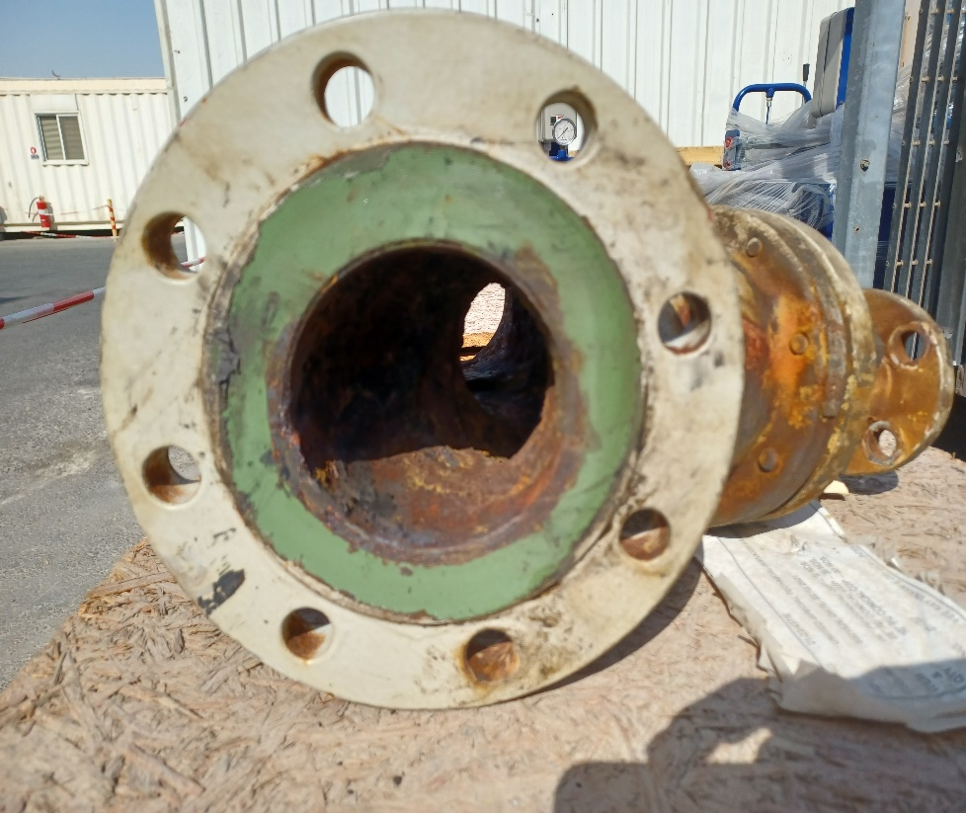
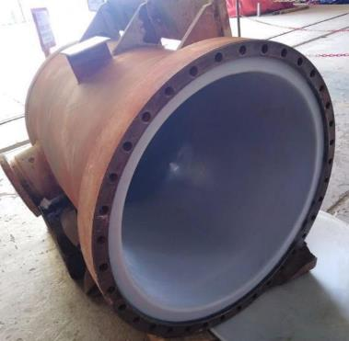
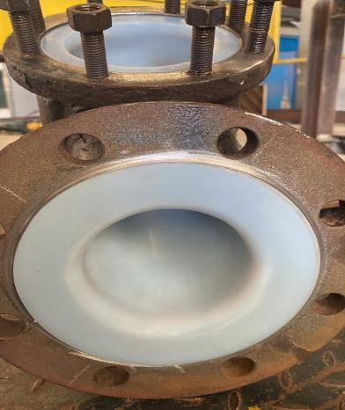
Case Study – Rehabilitation of Vessel and Strainer for Petrochemical Plant
Severe Corrosion due to highly corrosive fluids.
Existing coating damaged and pitting corrosion.
Requires replacement of entire vessel at very short intervals
ETFE is selected as a lining material owing to fluid conditions.
After thorough cleaning and surface preparation.
Complete lining activity completed in 48 hours.
Both the items are back to service and operating without any issues.
Before Lining
After Applying Bondaliner™ Solution

Slide 20
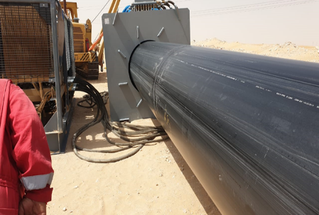
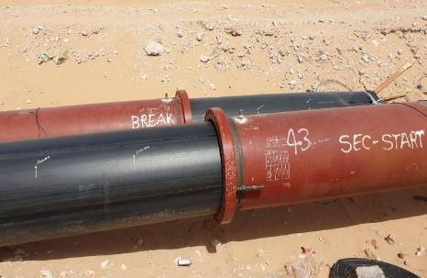
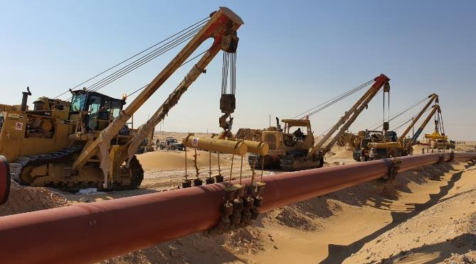
Case Study – Large Diameter Pipeline in the GCC with Tite Liner®
Largest and Longest pipeline with Titeliner® Project in GCC
Sea water Injection line
42” Diameter, 37 KMs in Total with multiple sections
Many Firsts
  The biggest Titeliner ®pipe ever produced in the region
  The longest single section of this diameter ever pulled globally (approximately)1KM

Slide 21
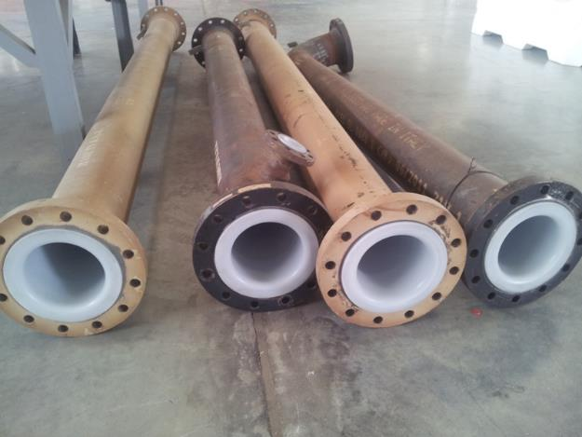
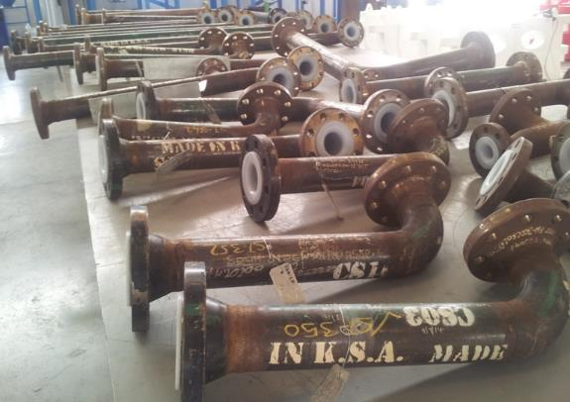

Case Study-Rotational Lining For Brine Handlining at Petrochemical Plant
Petrochemical Complex suffering with heavy corrosion issues
Sizes 3-8”, Fluid – Braine Water
Most cost-effective solution was Thermoplastic Lining
Sabic’s HDPE was Selected as a liner material
System including Fittings which were Roto lined
The total Job was completed in record time

Slide 22
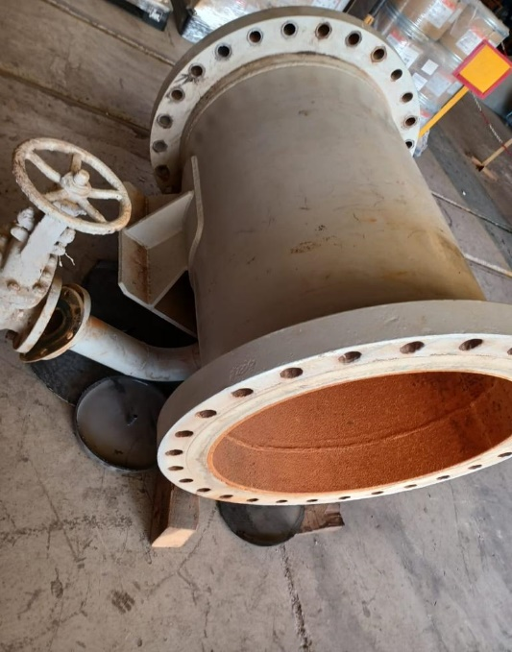
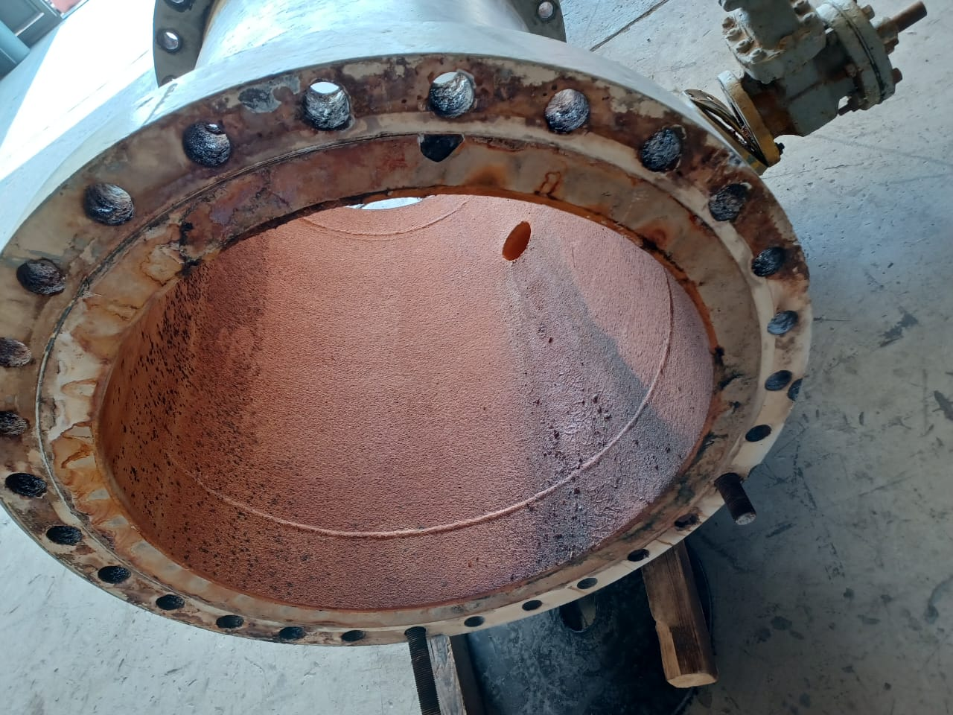
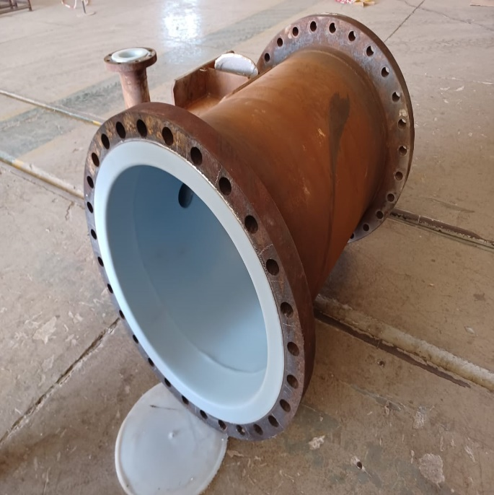
Case Study-Rotational Lining For Sea Water Plant
Sea water plant suffering with heavy corrosion issues
Sizes 24”X 16” & 30” Spools
Discharge and section lines
Plan to inspect the spools after 12 months of operation
There are no visible changes in its appearance even after 16 months of continued and successful operation.

Slide 23
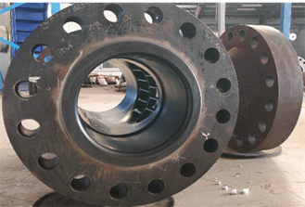
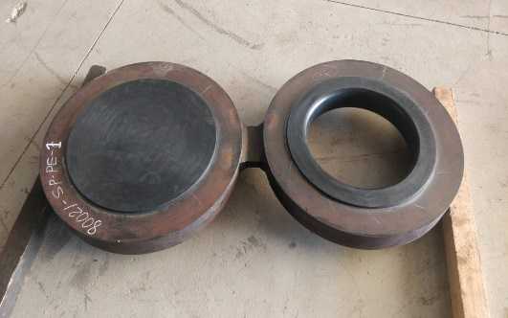
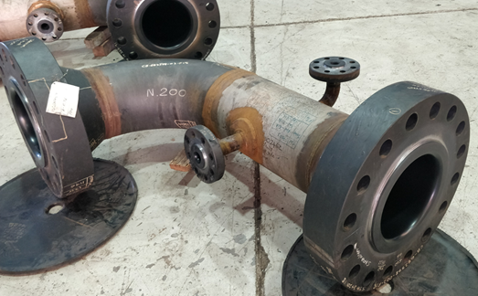
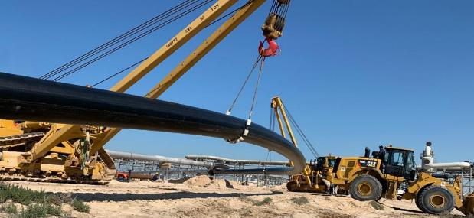
Case Study-Case Study End to End Corrosion Protection Solutions
The whole pipeline is divided into 86 number of sections with a maximum pull of 788 meters.
900+ fittings
Special tools are designed to install liners into the pipes on the racks and at confined locations.
Very less turnaround time .
100% holiday testing is being done on all the fittings.
Stringent quality checks by all the parties involved.

Slide 24
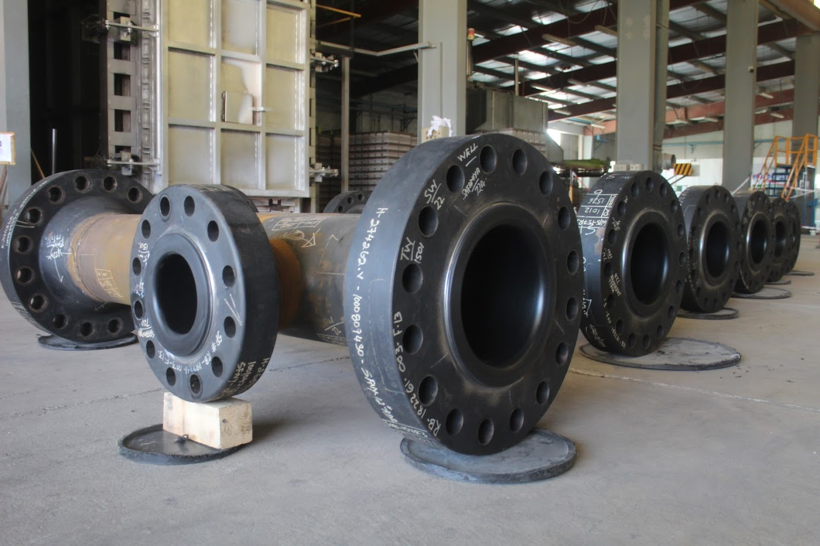
Conclusion
Over 45,000 KMs of Tite Liner® installed across the global have proven it’s robust, cost effective, and sustainable solution to protects pipelines from internal corrosion and abrasion.
Thousands of Bondaliner™ solutions have been installed over the last 30 years and many are still in the service today.
Fast Installation, less turnaround time, & installed in new or existing infrastructure

Slide 25



JUBCOR
2024
CONFERENCE & EXHIBITION
INNOVATIVE SOLUTIONS FOR CORROSION CHALLENGES
THANK YOU
Ahmed Alharbi
USTS
+966555793225
aalharbi@unitedsts.com

