Slide 1





JUBCOR
2024
CONFERENCE & EXHIBITION
INNOVATIVE SOLUTIONS FOR CORROSION CHALLENGES
Presented By: Muhammad H. Raza
Principal Engineer – Water Treatment
Jubcor Presentation
Evaluation of Water Quality For
Waste Heat Boiler’s Tubes Failures Investigation

Slide 2
OUTLINE:
Background and Problem Statement
CoE’s Support and Role
Waste Heat Boiler Design Data
Water Quality and Trends
Evaluation of Water Data
Recommendations and Conclusion

Slide 3
BACKGROUND
&
PROBLEM STATEMENT
In July 2022, site’s process team suspected internal leak of Waste Heat Boiler.
Site decided to run the equipment until next turnaround and continued running with suspected internal leak till end of May 2023.
The internal leak was confirmed during equipment internal inspection and hydro testing in June 2023.
The equipment had been in service since 2019.
About one liter of deposit in the form of lumps was found at the hot end of the boiler shell side.
The steam drum was found clean as well as cold end didn’t have any solids / deposits accumulation.
Continuous Blowdown (CBD) rate was maintained ~ 2 - 3 t/h during operation as claimed by the site.
Intermittent Blowdown (IBD) was conducted once per week, however there was no option available for conducting IBD from the hot end due to design limitations.

Slide 4
CoE’s SUPPORT & ROLE
Site approached CoE to evaluate Polished, Boiler Feed and Boiler Water quality as a potential contributor to this leak and recommend areas of improvement.
Multiple meetings were conducted with site and vendor’s teams on this subject to gather / discuss additional information, background and findings.
Detailed water analyses, other operating and designed data collected during the engagements were thoroughly reviewed by CoE’s Water Treatment SME.
OEM and licensor also got engaged during the investigation - their provided limits and some design limitations were discussed and evaluated.

Slide 5
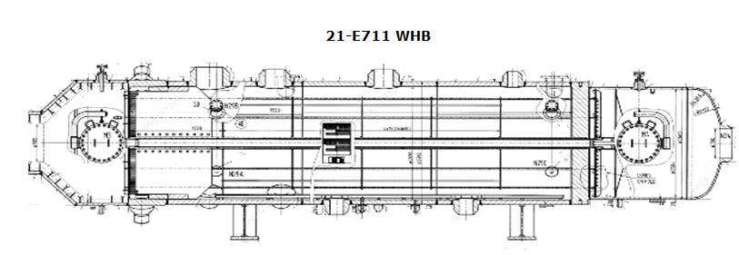
Waste heat Boiler Design Data
Design Data
Years in service | Since 2019
Steam generation, t/hr. | 194
Medium | Process gas in tube side / BFW-Steam mixture in shell side
Design pressure Kg/Cm²g | 36.4 Tube side / 146 Shell side
Design Temperature (°C) | 425 Tube side / 346 Shell side
Tube Size/Dimension | 31.8 mm OD x 3.2 mm - Thk, 9.90 m long
Tube Material | SA 213 Gr. T11
No. of tubes | 1164

Slide 6
polished, boiler feed & WH Boiler water quality and trends

Slide 7
Polished, BFW and WHB CONTROL LIMITS

Slide 8
polished, Boiler feed and WH Boiler water ph
Many of the Polished water pH numbers were above the upper target limits with few below the lower limit.
Poor control on BFW pH was observed until end of 2021 (pH target was 8.5 – 9.2 until October 2022 and then revised to 9.2 – 9.8 as per OEM recommendations).
Fluctuations in maintaining required WH boiler water pH was noticed, it dropped as low as ~ 4 in March 2020.

Slide 9
polished, Boiler feed and WH Boiler water conductivity
Polished water conductivity was well maintained except few spikes.
Fluctuations in maintaining desired boiler feed water conductivity was observed.
Majority of the conductivity numbers were very low in WH boiler water, especially after the tubes’ leak due to water loss.

Slide 10
Boiler feed and WH Boiler water silica
Most of the silica numbers in BFW and WH boiler water samples were within limits except few spikes.

Slide 11
Boiler feed water dissolved oxygen and DO scavenger residuals
All the BFW DO reported numbers were consistent @ 5 ppb.
Fluctuation in maintaining required DO scavenger residuals was observed with many readings below the lower target limit.

Slide 12
WH Boiler water po₄ residuals
Very poor control was observed on maintaining required PO₄ residuals of 2 – 6 ppm with many higher than the upper target limit.
Site was targeting to maintain 5 – 15 ppm PO₄ against the target of 2 – 6 ppm.

Slide 13
Boiler feed and WH Boiler water iron
  Only few iron readings were available for BFW and WH boiler’s samples.
  Most of the BFW iron numbers remained above the upper target limit of 0.01 ppm.
  All the reported iron numbers in WH boiler water samples were < 0.5 ppm.

Slide 14
evaluation of water data

Slide 15
polished water
pH:
    Good control on maintaining desired pH was observed with majority of the readings within limits.
    Lowest pH was recorded @ ~ 4.9 in early 2019.
Conductivity:
    Conductivity was also very well maintained with only few readings over 0.7 µS/cm limit.
    Maximum conductivity reached to 14.4 µS/cm in March 2020.

Slide 16
Boiler feed water
pH:
Many of the BFW pH readings were below the target limits until end of 2021, lowest pH was recorded @ 5.8 in October 2019.
Later, improved control was observed with majority of the pH readings within the revised limits of 9.2 – 9.8.
Maintaining required pH is very critical for smooth operation and ensuring asset integrity and reliability.
33% of BFW conductivity numbers were above the target limit of < 5 µS/cm.
All the reported BFW conductivity numbers were over the limit from late 2022 due to additional amine feed.
Most of the reported silica numbers were within target limits.
Dissolved Oxygen:
All the reported numbers were consistent @ 5 ppb that seems very unlikely.
Accuracy of the DO online data needs to be verified by the site.
Poor dissolved oxygen control could compromise required corrosion protection and might lead to localized corrosion, equipment failures and undesired production losses.
DO Scavenger Residuals:
Poor control was observed on maintaining required DO Scavenger residuals with 15% readings below the lower target limit of 0.5 ppm.
It is critical to always maintain required residuals to ensure proper dissolved oxygen removal.
Conductivity:
Silica:

Slide 17
WH Boiler water
pH:
14% readings were out of the target limits of 9.2 - 9.8 with majority of them below 9.2.
pH values were not representative of high phosphates.
Conductivity:
Major fluctuation was observed in conductivity control.
All the conductivity numbers were very low from March 2022 onwards after the tubes leak.
Conductivity numbers didn’t correspond to the CBD rates provided by the site.
Silica:
Majority of the reported silica numbers remained within target limits with few reported spikes.
Phosphates Residuals:
82% readings were out of the control limits of 2 - 6 ppm, mostly higher than the upper limit.
Target limit in the LIMS data was not consistent with the SMS-CC-11 requirements.
Iron:
All the reported numbers remained below 0.5 ppm.
IBD:
Issues were identified in conducting Intermittent Blowdown.
Frequency was less than required.
Adequate BD locations weren’t available.
Unavailability of IBD points at the hot end might be contributing to the solids’ accumulation only in that part of the boiler.

Slide 18
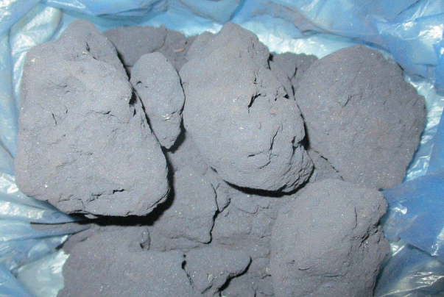
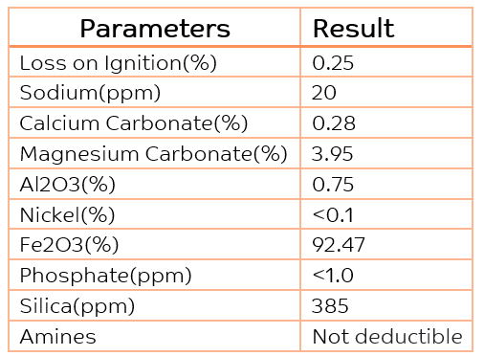
WH Boiler water, continued…
Deposit Sample and Its Composition:
      Minimal ignition loss confirms majority of deposits as inorganic solids.
      Very high iron oxide presence confirms accumulation of corrosion products.
      High silica and sodium composition, especially silica, indicates poor ion exchange performance during external treatment stage.
      Carbonate deposits represent possible hardness slippage through demineralized water to BFW.

Slide 19
recommendations
AND
Conclusion

Slide 20



Recommendations and Conclusion
RECOMMENDATIONS:
REVISION OF THE CONTROL LIMITS:
CONCLUSION:
Site to start conducting below tests and recommended initiatives
- Polished water:
Hardness
Sulfate
Silica
Elution study
Regular resin analysis
Regular resin top-ups and replacements
- BFW:
Conduct below tests with required frequency of the applicable SMS;
    Hardness
    Iron
    TOC
DO – ensure reliability of online analyzer, conduct cross checks
Improved control on DO scavenger residuals
Availability of standby injection pumps
Regular drawdowns
Regular deaerator’s performance tests
- WHB:
Better pH and conductivity control, especially for conductivity
BD optimization, ~ 100 COC for improved control - Energy, Chemicals and High-Quality Water optimization
Improved PO₄ control – Verification of the testing procedure
Availability of standby injection pumps
Regular drawdowns
IBD – follow-up discussions with OEM for having required IBD points
Regular IBD on daily basis
Target limits of below parameters should be revised by the site and water treatment vendor:
- BFW conductivity: 5 µS/cm from 15 µS/cm
- WHB PO4: 2 – 6 ppm from 5 – 15 ppm
- WHB silica: ≤ 1 ppm from ≤ 2 ppm
  Though there was room for improvement in the water quality, however it was very unlikely that it might have resulted in these tubes failure.
  Sample of the failed tubes should be removed for detailed analyses / failure investigation to find out the Root and Contributing Causes of the failure.

Slide 21
Thank you
Notes:
To select different Thank You options, go to HOME tab and click Layout button.

