Slide 1




JUBCOR
2024
CONFERENCE & EXHIBITION
INNOVATIVE SOLUTIONS FOR CORROSION CHALLENGES
Resolving Integrity Issues related to Dilution Steam Generator Exchangers in Olefin Plant
Presented By:
Hassan Al-Hammad
SABIC - KEMYA

Slide 2


outline
Background
Tubes Fouling and Upgrade from CS to DSS
Bottom Nozzle Cracking
Steam Traps Failure
Conclusion and Recommendation

Slide 3
background

Slide 4
background
KEMYA Dilution Steam Generation (DSG) system generates dilution steam at 7 barg in thermosiphon re-boilers (four parallel exchangers) to be used in the cracking furnaces and process water stripper.
Dilution steam exchangers in KEMYA (Four Dilution Steam Exchangers) and their outlet connected to (Dilution Steam Drum)
MP steam
Exchanger
Dilution steam
For furnaces
Dilution steam drum
Process water
DSG Exchangers
MP condensate
CW in
Exchanger
CW out
Waste water

Slide 5
Tubes Fouling and Upgrade from CS to DSS

Slide 6
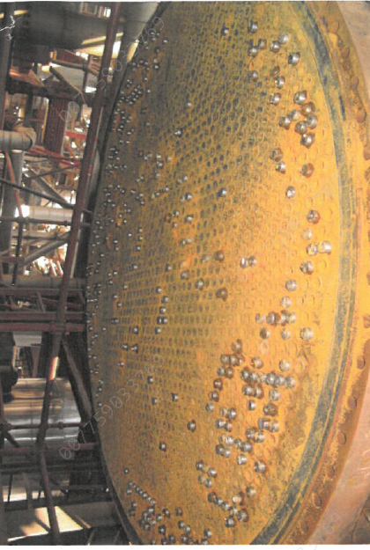
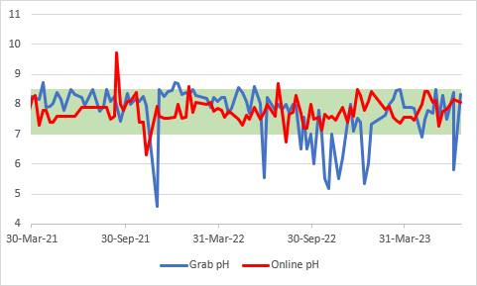
Tubes Fouling and Upgrade from CS to DSS
Original exchanger tubes are CS SA-179
Carbon Steel tube material is not suitable in this service
Corrosion under deposit damage mechanisms
Failed in 2-3 years life time with CS
online pH analyzer does no capture upsets in quench pH. Which may intensify corrosion in the downstream equipment.
Recommended to upgrade tubes to duplex stainless steel alloy 2205 material (UNS S 32205)
Four exchangers in this system, one of them is standby
Stand-by exchanger was not upgraded due to low BtC ratio (benefit to cost) and less demand compared to other exchangers
KD01
KD04

Slide 7
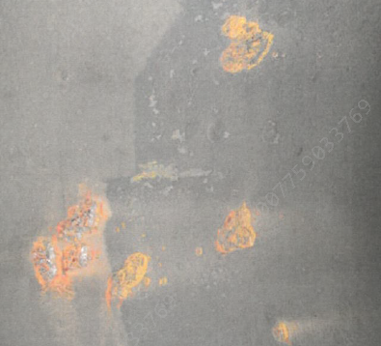
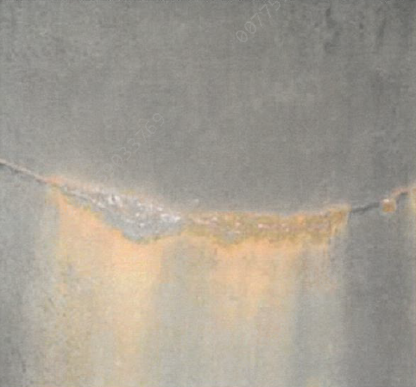
Tubes Fouling and Upgrade from CS to DSS
Corrosion in shell side
Corrosion near welds
Leaking tubes during testing
Corroded CS tubes after extraction in vendor workshop yard
Shell side: MP steam, tube side: process water, damage mechanisms: Sour Water Corrosion (Acidic) due to presence of H2S and organics

Slide 8
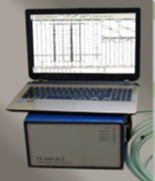
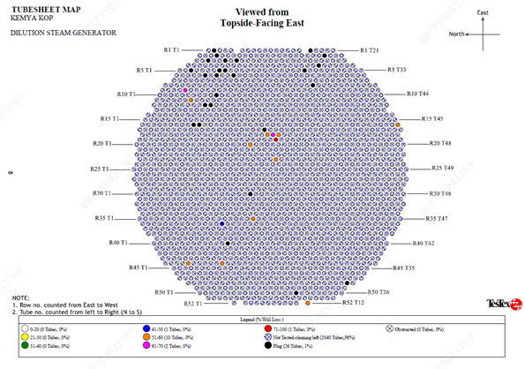
Tubes Fouling and Upgrade from CS to DSS
Orientation | Vertical
Tube Dimension | 25.4mm x 2.77mm x 6000mm
Tube Material | SA 179 (CS)
Total Tubes in Unit | 2080 Tubes
saturated eddy current inspection results
Waveform R-19 T-25 showing >70% Wall loss with pitting

Slide 9
Stand-by exchanger Bottom nozzle cracking

Slide 10
Stand-by exchanger nozzle cracking
Bottom head cracks found at the same drain nozzle in 2013
N8 2” Bottom Nozzle found crack in 2013
This stand-by exchanger tube still CS and not upgraded to DSS
This stand-by Exchanger is always used as spare while other three exchanger are under PM
Most of the time stand-by exchanger is working for Max 2 weeks only then isolated again. Except at the beginning of this year jan-2023 it was operated at the same time with other exchangers
Whenever stand-by exchanger under isolation it is kept under nitrogen blanket of 2 barg pressure measured every 3 month by operation. However last isolation there was no blinding ( only isolated by valves ) while valves expected to be passing

Slide 11
Stand-by exchanger nozzle cracking
Findings:
Repair Scope of Work:
Visual Inspection, DPT & UT has been conducted
Bottom Head : ( 60mm,40mm,30mm ) length with width 1-2mm ( 3 No’s ) Transverse Cracks observed from inner surface of head around nozzle periphery
Shear Wave UT completed and found depth of crack is 3mm max
Drain Bottom Nozzle 2” N8 found crack and pinhole on the weld joint externally
Heavy Deposits found internally on the bottom drain nozzle covering the cracks ( Corrosion under Deposits Damage Mechanism )
This stand-by Exchanger is having spare nature of this exchanger and very frequent operating and isolation ( Thermal Fatigue Damage Mechanism )
Passing Valves contribute nitrogen blanketing and accelerate corrosion process ( M6 Notification raised by operation )
Hydro jet cleaning activity
N8 Bottom drain Nozzle Replacement
Mechanical cleaning of tubes
Tube testing ( saturated eddy current test ) perfumed and found thickness reduction from 50% to 70 % Completed
Leak test by filling water to identify leaking tubes
Insert plug to stop the leak identified during leak test
Identified leaking to be tubes for plugged with approved WQCR and DPT conducted on tube sheet
Repeat the leak test after plugged leaking tubes
Hydro Test Shell side 17 bar and found satisfactory (At the design pressure due to tubes current condition)
Release for Box up from inspection side.

Slide 12
Steam Traps Failure

Slide 13
Steam Traps Failure
MP condensate outlet from dilution steam exchangers is a major challenge in DSG system.
The challenge is not related to process safety. However, it has sustainability and financial impacts.
The improvement from March to July 2023 is 705,352 SAR.
Frequent failures are seen in dilution steam exchangers steam traps. Which limit DSG performance and force the import of clean MP steam to the system.
It is recommended to upgrade the design to level control valves instead of steam traps to reduced dilution steam make-up.
Average MP steam Make-up to DSG (Ton/hr)
October-2022 | 14.11
November-2022 | 11.44
December-2022 | 7.69
January-2023 | 8.50
Februery-2023 | 13.78
March-2023 | 4.30
April-2023 | 3.30
May-2023 | 4.23
June-2023 | 1.51
July-2023 | 1.82

Slide 14
Conclusion and recommendation

Slide 15
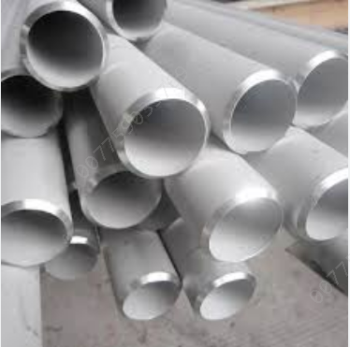
Conclusion and recommendation
Test stand-by exchanger current CS tubes and plug leaking tubes
Upgrade stand-by exchanger tubes from CS to DSS
Repair bottom nozzle
Upgrade all four dilution steam exchangers design to level control valves instead of steam traps.
Install NALCO monitoring system 3DTfDSS Technology.
A Visual inspection to be conducted for the dilution steam header (5 years PM, conducted last time in 2022 April)
Dilution steam exchangers outlet spool is dropped and cleaned with every exchanger cleaning every time and inspected visually.
KOP keeps the stand by heat exchanger blinded and under static nitrogen

Slide 16





JUBCOR
2024
CONFERENCE & EXHIBITION
YOUR LOGO
INNOVATIVE SOLUTIONS FOR CORROSION CHALLENGES
THANK YOU
Reach out.
Calle Cualquiera 123, Cualquier Lugar
phone
email

