Slide 1




JUBCOR
2024
CONFERENCE & EXHIBITION
INNOVATIVE SOLUTIONS FOR CORROSION CHALLENGES
Presented By: Hesham Alemary
Jubcor Presentation
Wastewater Contaminant Control-Nalco Water
PURATE™

Slide 2


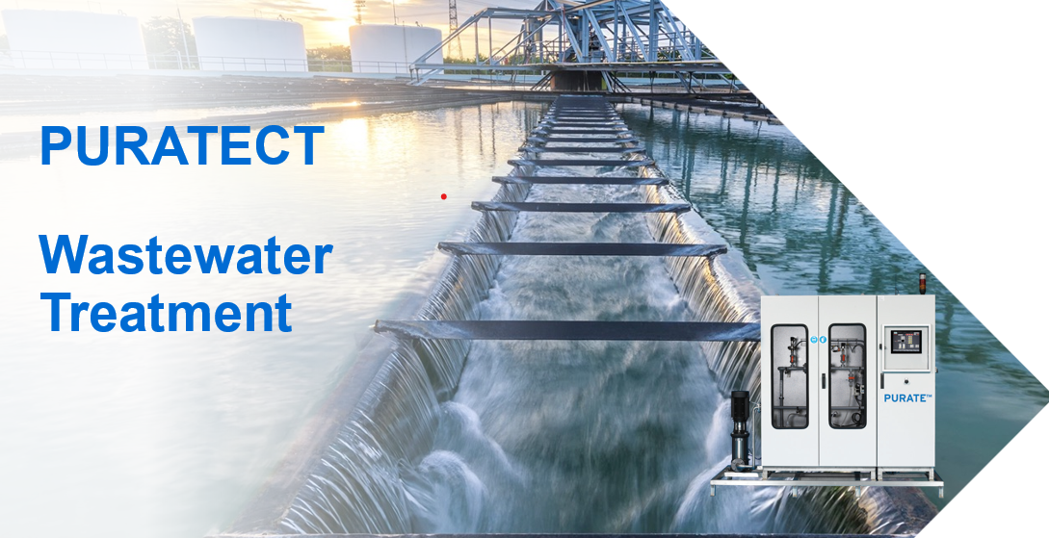


Agenda
Wastewater Challenges
Why Purate is Unique
Nalco Purate Technology
Contaminants Removal
Solution Development
Purate Value addition

Slide 3
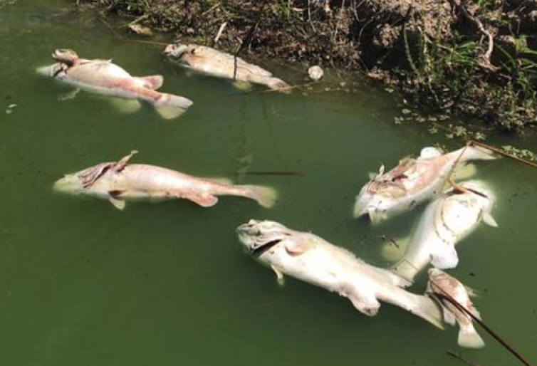
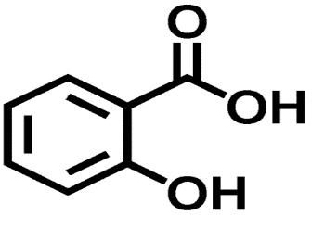

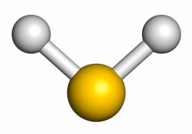
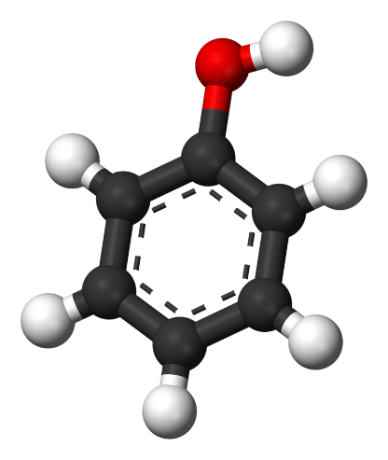
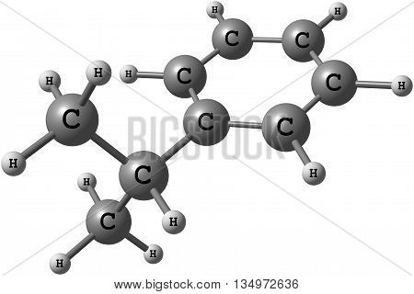
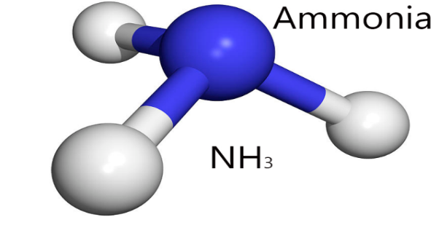

Why Care About Wastewater ?
It’s the law
Environmental awareness
  Sustainability
  Tightening effluent permits
Increase plant profitability
  WW upsets can result in decrease in production
What is the Purpose of Wastewater Treatment
Remove insoluble and soluble pollutants
Phenol
H2S
COD

Slide 4



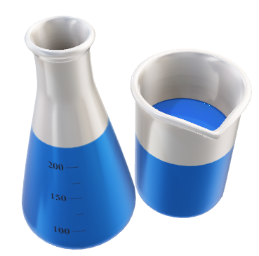
Wastewater System impact
Water
Cost
Environment
Total Operation Cost
High operation cost for diluting wastewater discharge.
Discharge limit protocol penalty cost
Production limitation, shutdown
Water reuse limitation, water loss.
Wastewater Quality
Compliance with discharge limits for Phenol, H2S and COD for different discharge streams.
Discharge water quality for water re-use ZLD, water & money saving.
Discharge limitation
No toxic element to the discharge streams.
Water saving
+
+

Slide 5

Wastewater Challenges Purate Contaminate Treatment
Phenol
H2S
COD
COD
Soluble and Insoluble COD in
Purate can react with the most soluble COD
Organic sulfides & Mercaptan (thiol)
Reduced sulfur (H2S, thiosulfates)
Cyanide & Thiocyanate
Nitrite & secondary amines (R2NH)
Iron & manganese
Lignin's
Phenol
Phenol is regulated in wastewater as it is corrosive, toxic and poses human health hazard.
It is present in crude oil but both volatile and water soluble
Phenol limits in effluent are very low on account of the toxicity
1-5 mg/l typical if discharging to sewer of third party WWTP (25ppm also seen)
H2S
Sulfides in wastewater are a safety hazard and may cause breaches of effluent permit.​
Sulfides are present in many industries, soluble and present in the water phase:
Sulfide limits in effluent are very low on account of the toxicity
1-5 mg/l typical if discharging to sewer of third party WWTP
+
+

Slide 6
Removal strategies
Phenols
Sulfides
Oxidation (non-selective)
  Biological wastewater treatment
  peroxide/Fenton
  ozone
Adsorption (effluent polishing)
  Activated carbon
Refinery Spent Caustic
  Often waste incinerated off-site
  Sometimes blended with wastewater
Oxidation (non-selective)
  Biological wastewater treatment
  Bleach (chlorination by products)
Precipitation with metals
Stripping (if concentrated); then back to process: Claus or sulfuric acid plant
Ethylene Spent Caustic
  Wet Air Oxidation well established
  Sewer discharge

Slide 7
ClO₂ Selective Reactivity
Reacts with:
Does not react with:
Phenols
Organic sulfides & Mercaptan (thiol)
Reduced sulfur (H₂S, thiosulfates)
Cyanide & Thiocyanate
Nitrite & secondary amines (R2NH)
Iron & manganese
Lignins
Spent Caustic
  >90% phenol reduction possible
  50% COD reduction achieved
  Ammonia, primary amines
  Al-kane, -kene, -kyne
  Alcohols, glycols, diols
  Aldehydes, ketones, ethers
  Organic acids
  Unsubstituted aromatics
  Nalco Cooling treatment programs e.g.
    Azoles
    Dispersants
    Phosphonates
    Quaternary amines

Slide 8
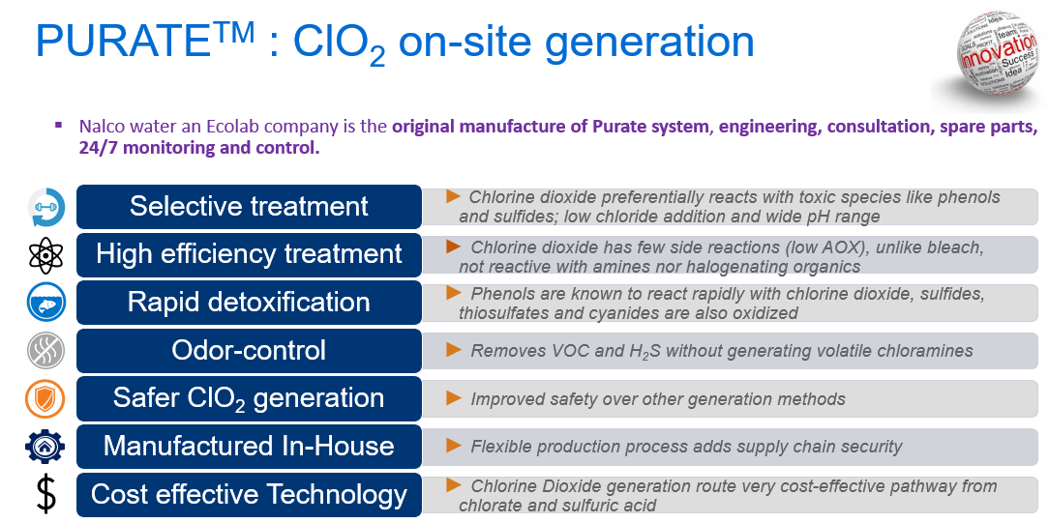

Slide 9

Purate™ Unit Details

Slide 10
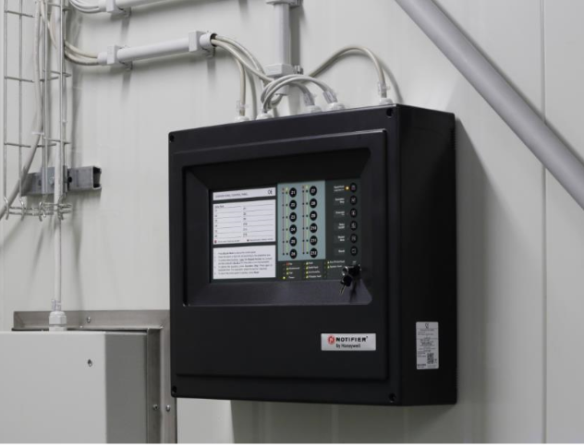
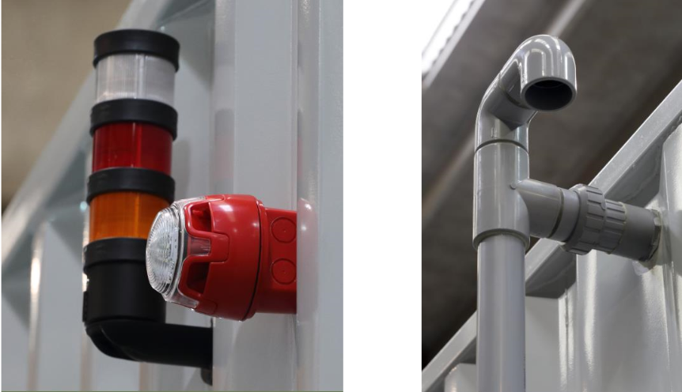
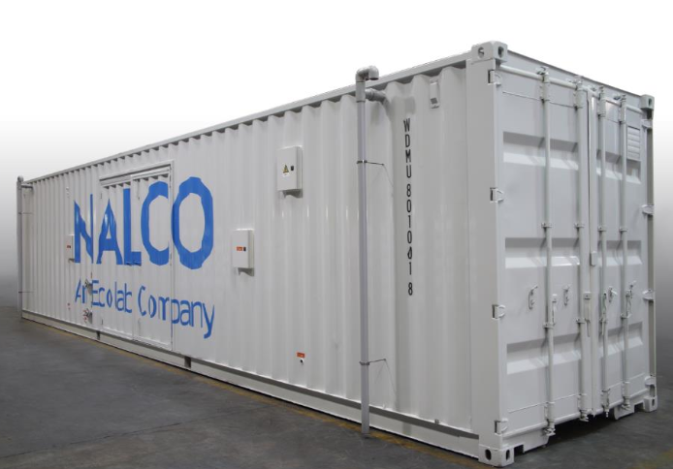
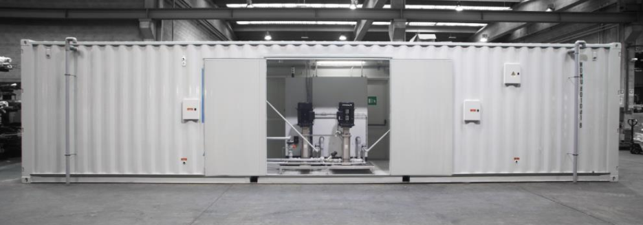
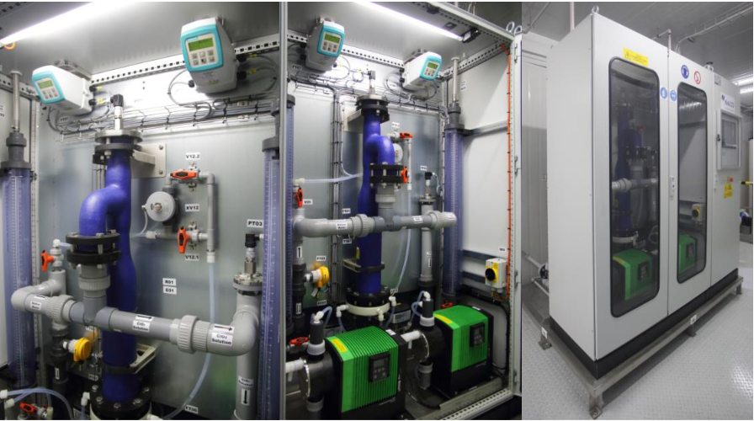
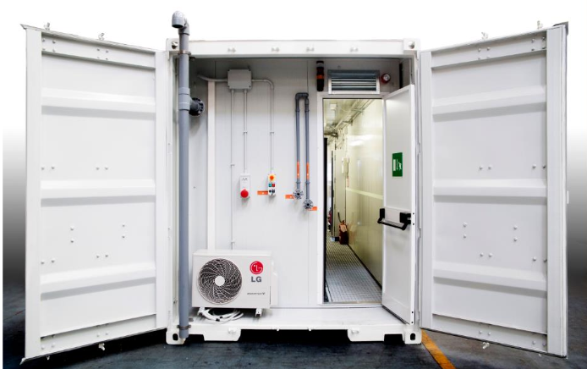
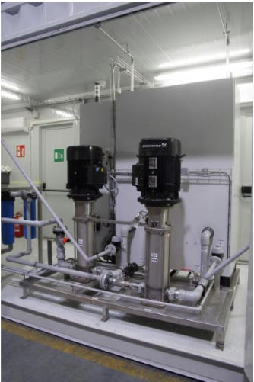
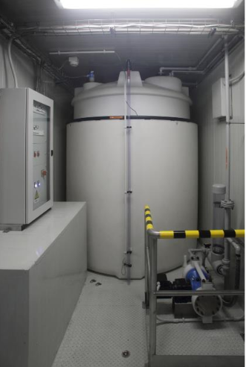
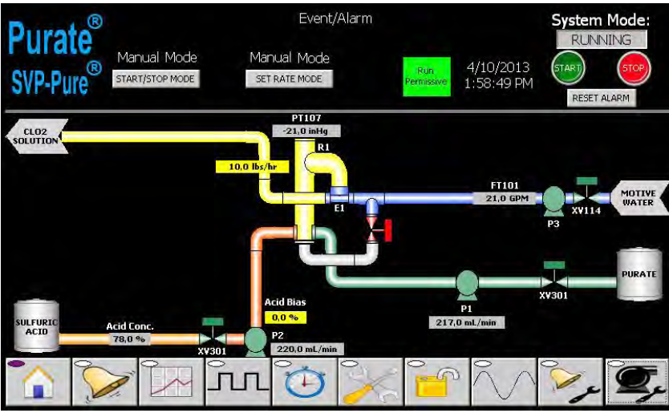
Nalco Water Purate system
40 Feet ClO₂ Production Container

Slide 11
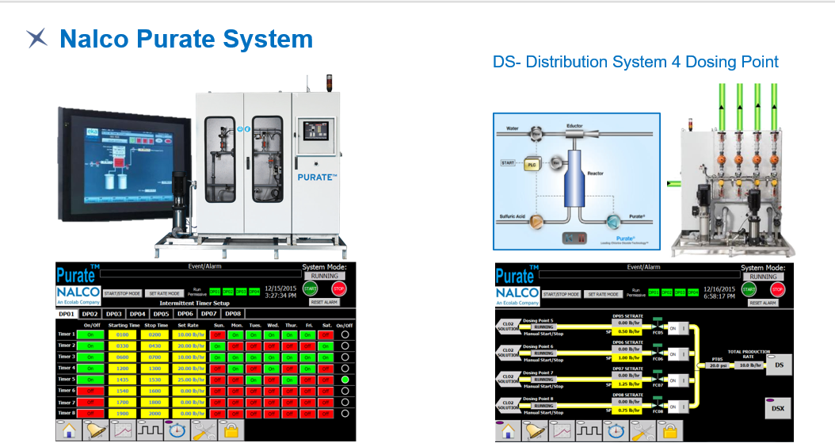

Slide 12

Purate™ Solution
Discovery Process

Slide 13
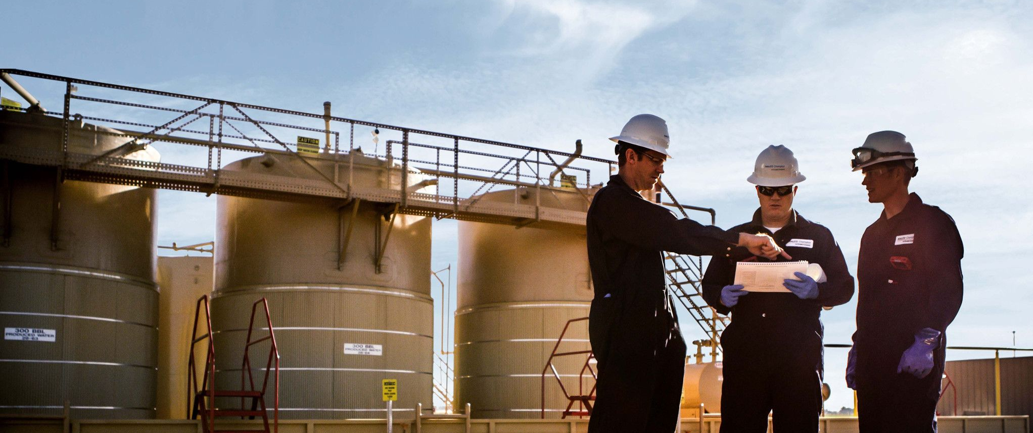
Partnering with Nalco Water
feasibility study to meet your site requirements
Multiple photos with text
Place your photos here
Consultancy and Lab studies
  Site Survey and wastewater analytics
  ClO₂ demand laboratory study
  Respirometry on treated effluent
  Modelling tool and mass balance
Solution implementation
  ClO₂ generator installation
  Additional dosing and control systems
On-site services
  Chemical delivery and system maintenance
  KPI monitoring for consistent value delivery

Slide 14
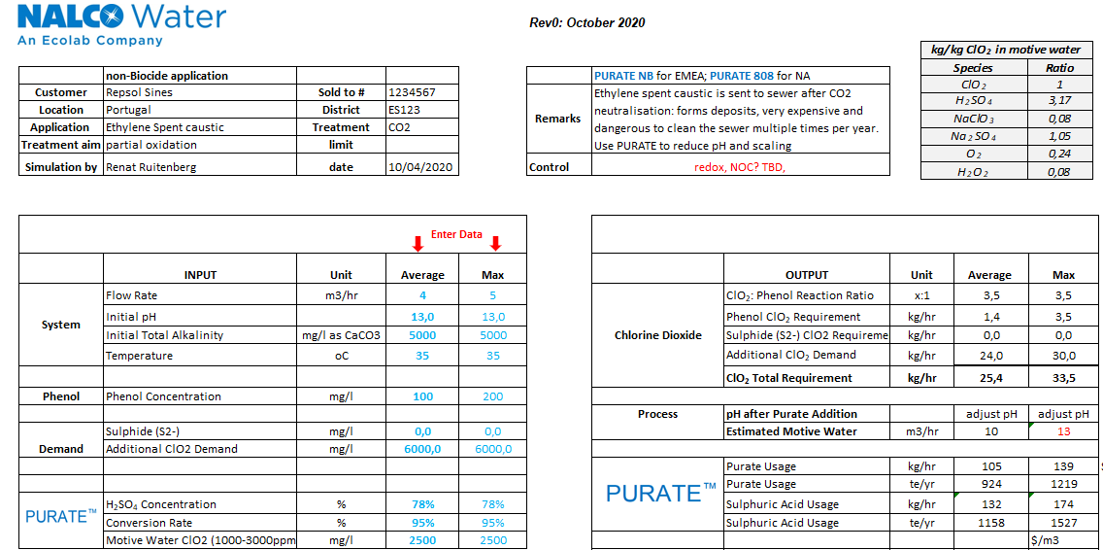
ClO2 Demand Excel Modelling tool
In development for ITCs to determine the treatment strategy
Key information and drivers input on top
Demand test result used as key input
  Excel model for application sizing
  Predicts phenol and sulfide demand
  Requires input from demand test for total
Motive water not always readily available in WW
  Model predicts the flow required
  PURATE side products listed
pH effect of excess acid incorporated
  3,15 kg of H₂SO₄ per kg of ClO₂
  Not as critical in cooling usually
Equipment sizing on max, opex on average:
  minimal and max ClO₂ output per generator
  Typically continuous treatment, sizing critical
ITC understanding of Process Flowsheet critical to find right dosing strategy

Slide 15
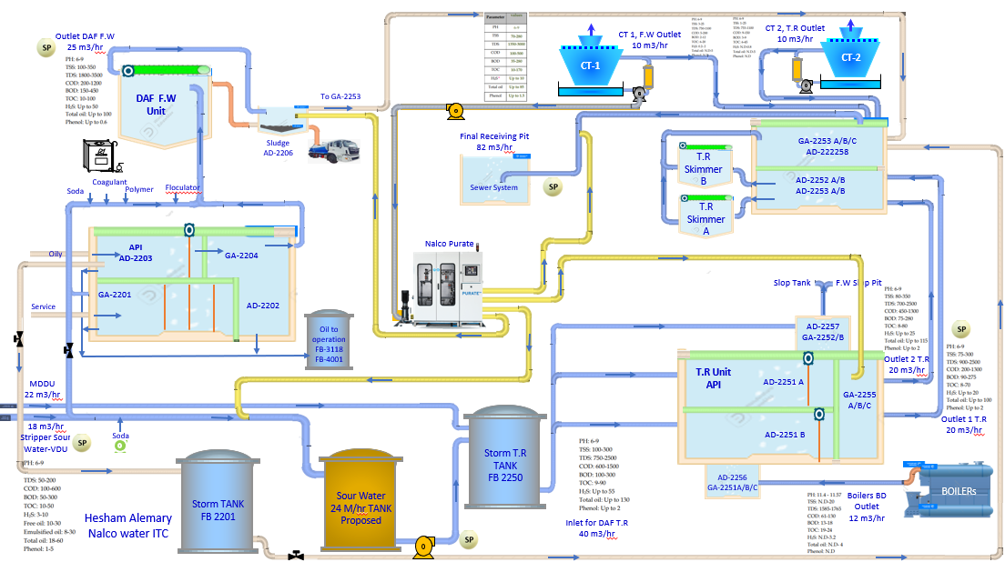
System diagram - running project

Slide 16
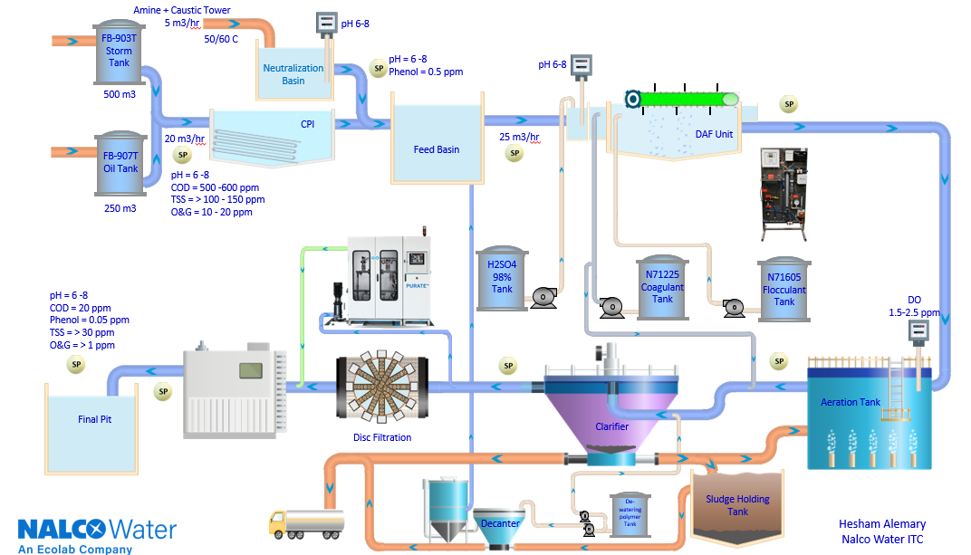
Flow diagram Example

Slide 17

Case Studies

Slide 18
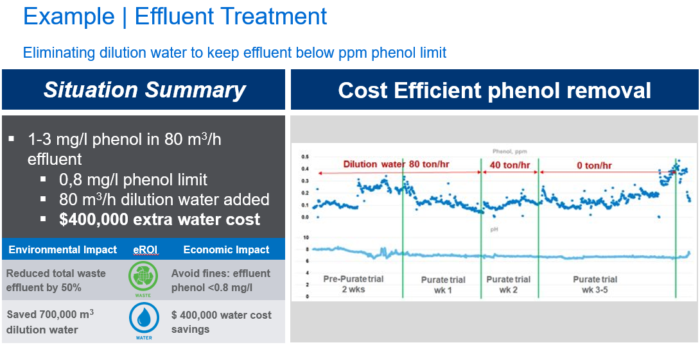

Slide 19
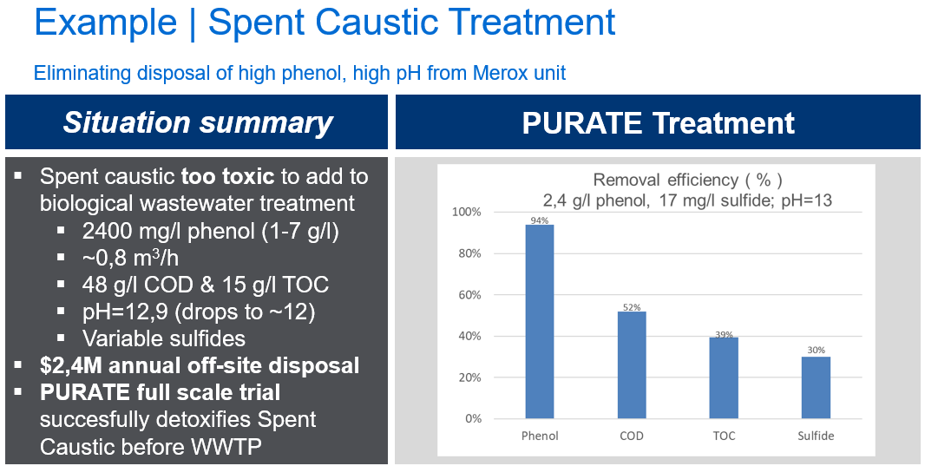

Slide 20



JUBCOR
2024
CONFERENCE & EXHIBITION
INNOVATIVE SOLUTIONS FOR CORROSION CHALLENGES
THANK YOU
Reach out. Hesham Alemary
Calle Cualquiera 123, Cualquier Lugar
phone
email
+966 558793332
halemary@ecolab.com

