Slide 1





JUBCOR
2024
CONFERENCE & EXHIBITION
INNOVATIVE SOLUTIONS FOR CORROSION CHALLENGES
Presented By:
Hamza Alam
Jubcor Presentation
AI-powered Visual Inspection for Facilities operating in Marine Environments

Slide 2

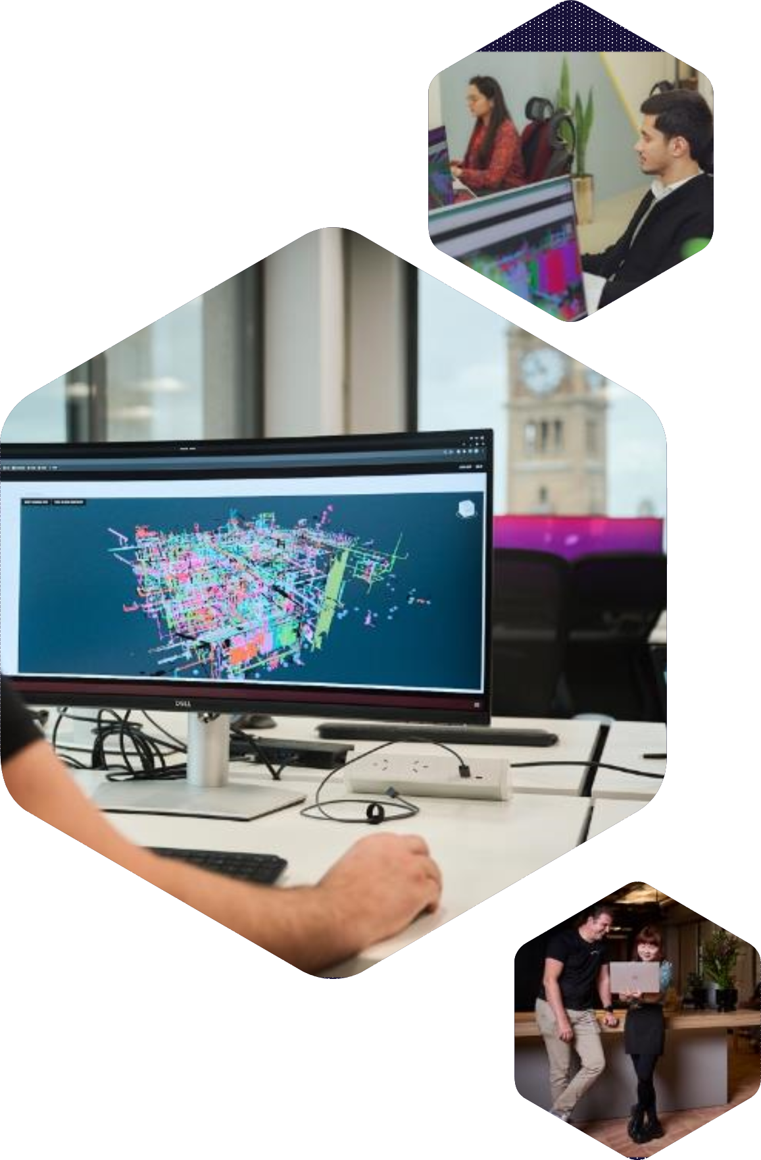

ABYSS SOLUTIONS
AI-powered Visual Inspection for Facilities operating in Marine Environments

Slide 3





Our Global Coverage
ABOUT ABYSS
200+
UK
Regional Office
Houston
Commercial Headquarters
Middle East and Subcontinent
Regional and Engineering office
Brazil
Regional Office
Sydney
R&D and Engineering
2014
2018
2019
2020
2022
2023

Slide 4



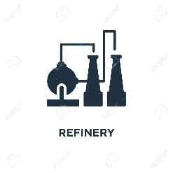





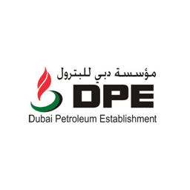


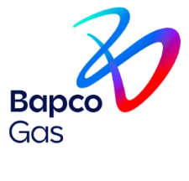
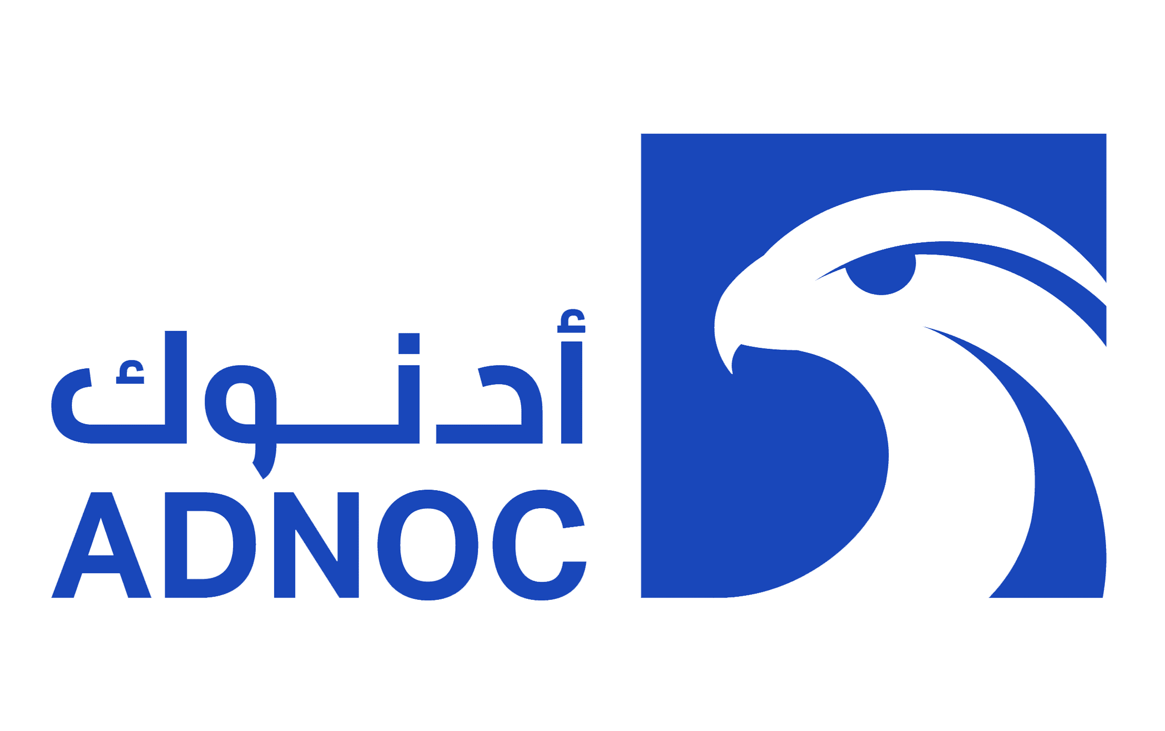
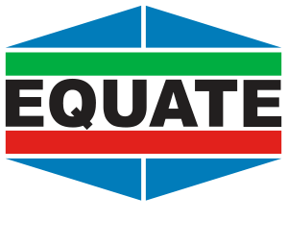
Current Deployments & Clients
ABYSS SOLUTIONS
1 Refinery
1 Platform
Commercially Deployed
TRL 9
10 Platforms
10 Flare Stacks
Commercially
Deployed
1 Refinery
1 Platform
Technology Approval
TRL 8
2 Platforms
Commercially Deployed
1 Platform
Commercial Pilot
1 Refinery
Commercially Deployed
TRL 9
3 Platforms
1 Refinery
Commercial Pilot
1 Gas Plant
Commercially Deployed
5 Marine Terminals
1 Gas Plant
Commercial Pilot
1 Platform
Commercial Pilot
1 Platform
1 Gas Plant
Commercially Deployed
1 Gas Plant
Commercial Deployment
1 Port
24 Berths
Commercial Pilot
1 Petrochem Plant Unit
Commercial Pilot
1 Platform
1 Gas Plant

Slide 5
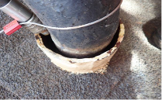
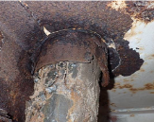
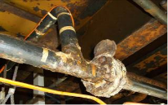
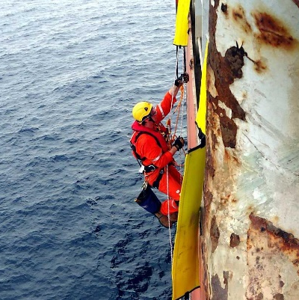
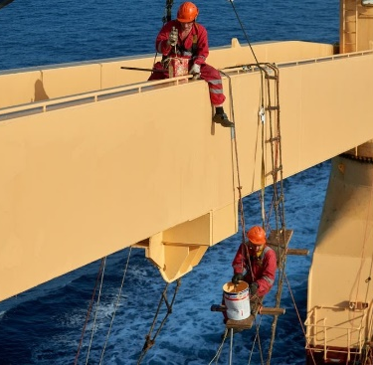
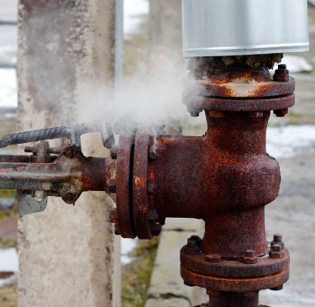
Inspections &
Maintenance Today
OUR SOLUTIONS
Access and coverage
Item was only inspected from above
Subjective Inspections
Item classed as CAT4
Actual: CAT2 to CAT1
Visual inspections are costly, inefficient, subjective and provide incomplete asset coverage
The process can lead to unnecessary painting/repairs & missed problem areas, which can result in costly repairs/replacements and a Reactive Maintenance regime
Increased risk of unplanned shutdowns and unnecessary planned shutdowns due to missed repairs

Slide 6
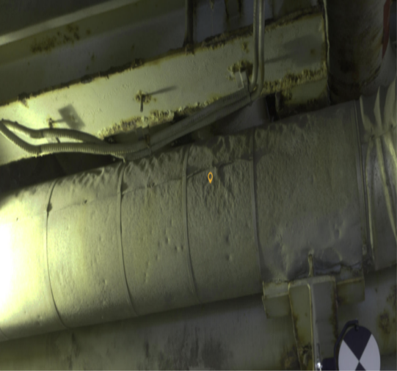
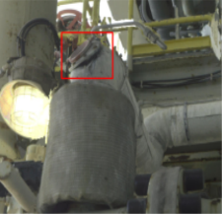
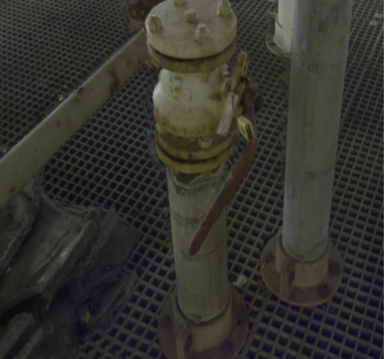
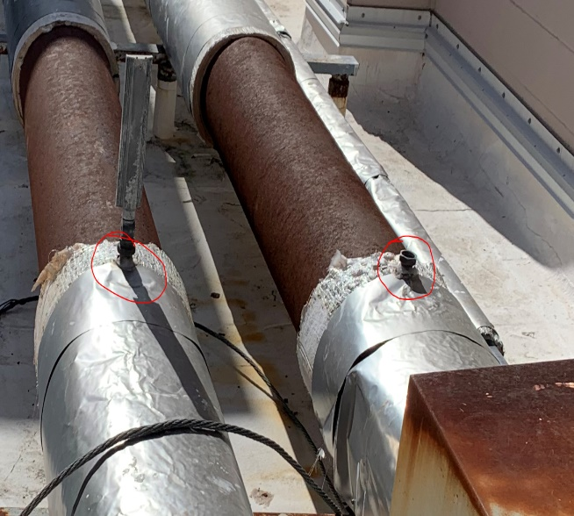
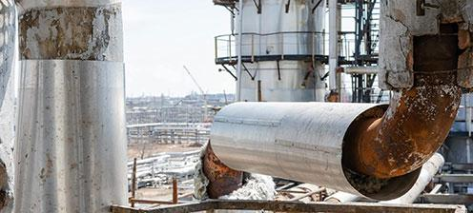
Challenges
OUR SOLUTIONS
Corrosion Under Insulation (CUI) approximates to 40–60% of piping maintenance expenditures
            10 % of Overall Maintenance expenditures
60-70% of issues are in the visually detectable susceptible locations
Targeted Early Inspections at scale required for CUI & CUPS

Slide 7

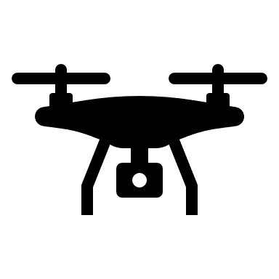

Maintenance Strategy using Abyss Fabric IR 4.0 Process
✅ Acquire
✅ AI-powered Analysis
⏩ Optimization
Laser Scan
First Layer
Second Layer
Third Layer
Inspection / Maintenance
Priority
(Severe, High, Medium, Low)
ML Corrosion detections in Abyss Fabric
Heavy
Moderate
Light
ISO- 4628-3
Blister Height Assessment
- SC1
- SC2
- SC3
Estimated wall loss =
Blister Height * 1/x
Maintenance Backlog Revamped
CTR Reduction
Remaining Useful Thickness
Severe Corrosion Instances, Blisters, Pits
Savings Generated
Inspection History
INPUT
Processing and Prioritization Framework
OUTPUT

Slide 8
Maintenance Strategy using Abyss Fabric IR 4.0 Process
✅ Acquire
✅ AI-powered Analysis
⏩ Optimization
Laser Scan
First Layer
Second Layer
Third Layer
Inspection / Maintenance
Priority
(Severe, High, Medium, Low)
ML Corrosion detections in Abyss Fabric
Heavy
Moderate
Light
ISO- 4628-3
Blister Height Assessment
- SC1
- SC2
- SC3
Estimated wall loss =
Blister Height * 1/x
Maintenance Backlog Revamped
CTR Reduction
Remaining Useful Thickness
Severe Corrosion Instances, Blisters, Pits
Savings Generated
Inspection History
INPUT
Processing and Prioritization Framework
OUTPUT

Slide 9
Maintenance Strategy using Abyss Fabric IR 4.0 Process
✅ Acquire
✅ AI-powered Analysis
⏩ Optimization
First Layer
Second Layer
Third Layer
Inspection / Maintenance
Priority
(Severe, High, Medium, Low)
ML Corrosion detections in Abyss Fabric
Heavy
Moderate
Light
ISO- 4628-3
Blister Height Assessment
- SC1
- SC2
- SC3
Estimated wall loss =
Blister Height * 1/x
Maintenance Backlog Revamped
CTR Reduction
Remaining Useful Thickness
Severe Corrosion Instances, Blisters, Pits
Savings Generated
Inspection History
INPUT
Processing and Prioritization Framework
OUTPUT

Slide 10
Maintenance Strategy using Abyss Fabric IR 4.0 Process
✅ Acquire
✅ AI-powered Analysis
⏩ Optimization
First Layer
Second Layer
Third Layer
Inspection / Maintenance
Priority
(Severe, High, Medium, Low)
ML Corrosion detections in Abyss Fabric
Heavy
Moderate
Light
ISO- 4628-3
Blister Height Assessment
- SC1
- SC2
- SC3
Estimated wall loss =
Blister Height * 1/x
Maintenance Backlog Revamped
CTR Reduction
Remaining Useful Thickness
Severe Corrosion Instances, Blisters, Pits
Savings Generated
Inspection History
INPUT
Processing and Prioritization Framework
OUTPUT

Slide 11
Maintenance Strategy using Abyss Fabric IR 4.0 Process
✅ Acquire
✅ AI-powered Analysis
⏩ Optimization
First Layer
Second Layer
Third Layer
Inspection / Maintenance
Priority
(Severe, High, Medium, Low)
ML Corrosion detections in Abyss Fabric
Heavy
Moderate
Light
ISO- 4628-3
Blister Height Assessment
- SC1
- SC2
- SC3
Estimated wall loss =
Blister Height * 1/x
Maintenance Backlog Revamped
CTR Reduction
Remaining Useful Thickness
Severe Corrosion Instances, Blisters, Pits
Savings Generated
Inspection History
INPUT
Processing and Prioritization Framework
OUTPUT

Slide 12
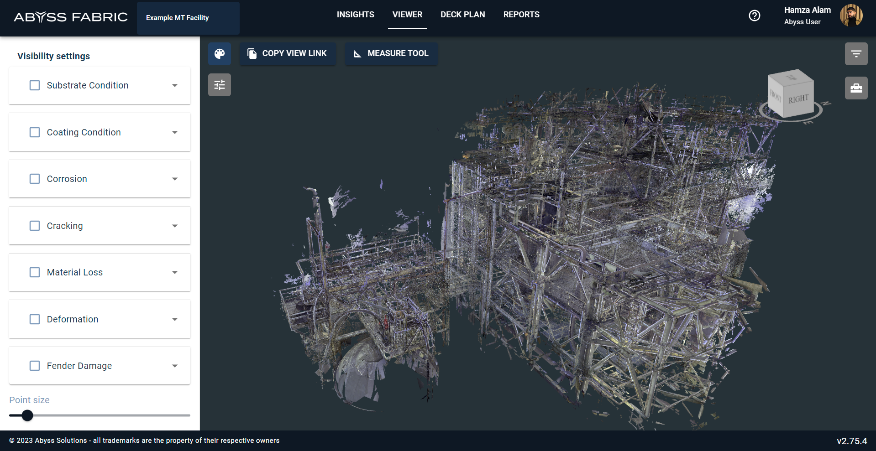

Slide 13
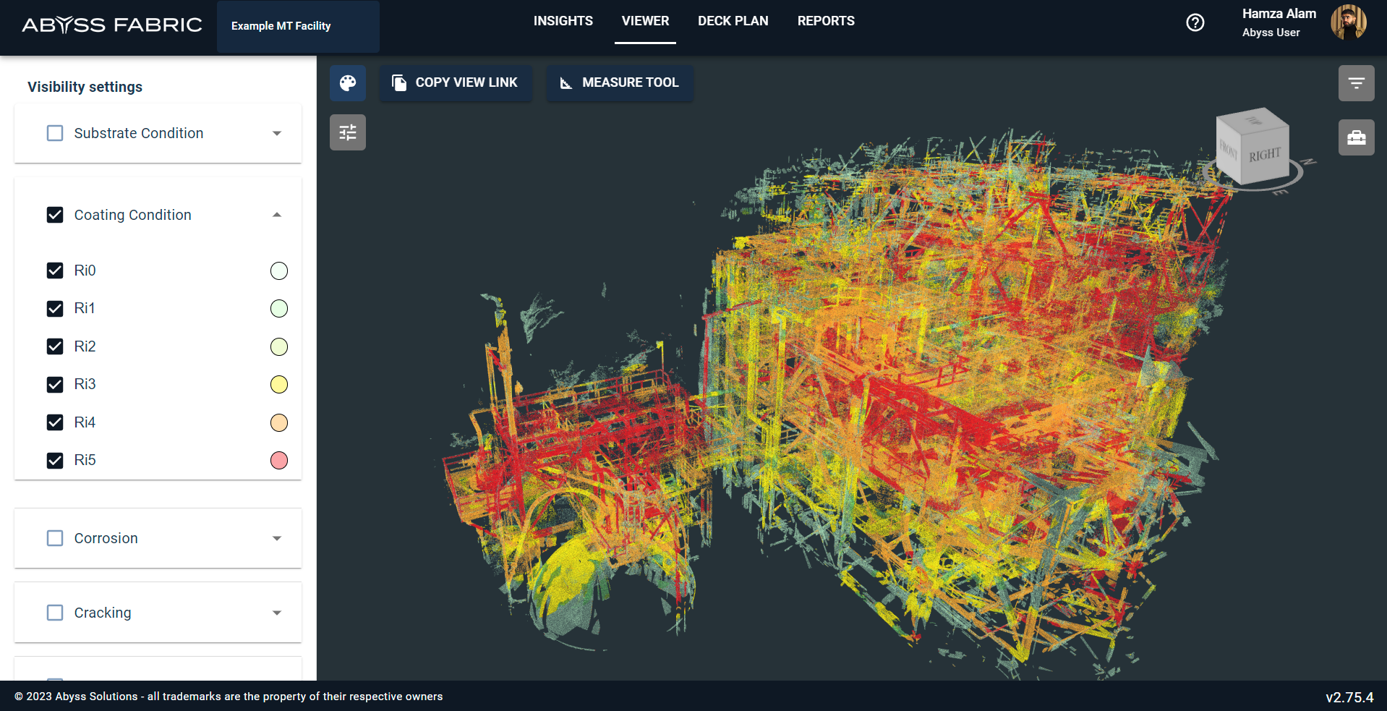

Slide 14
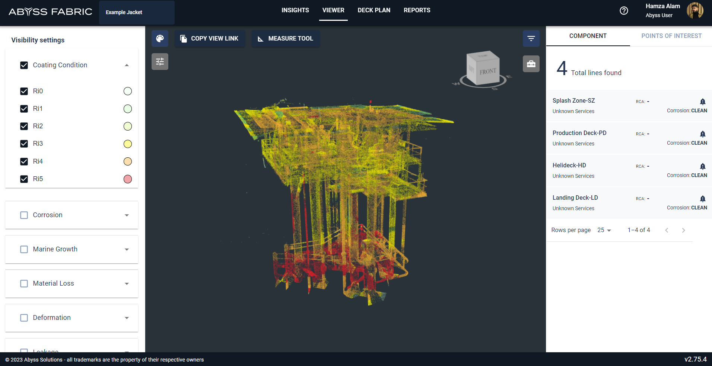
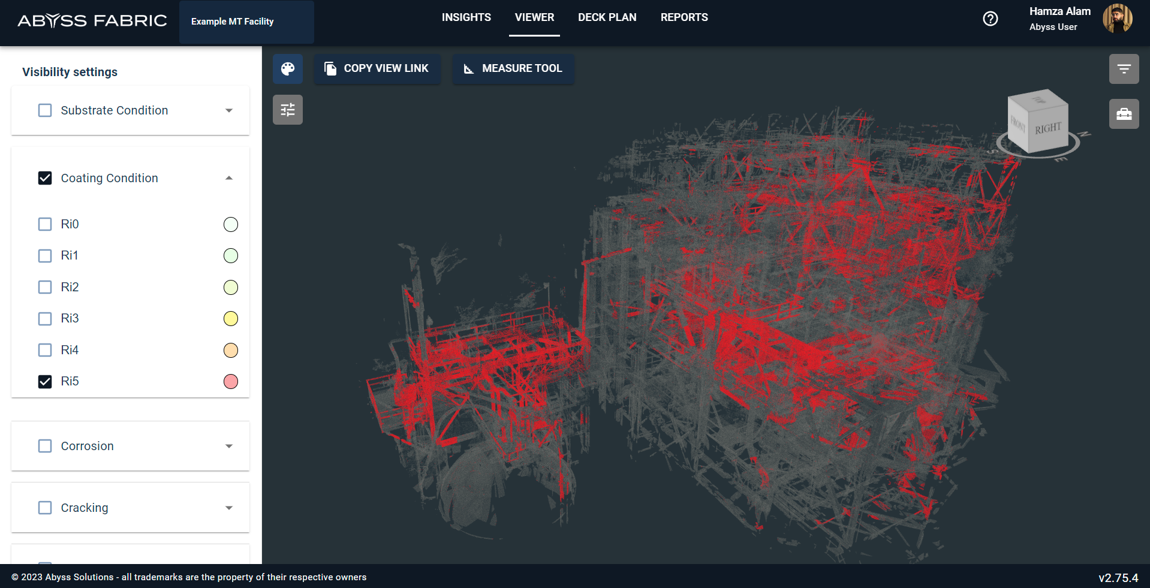

Slide 15
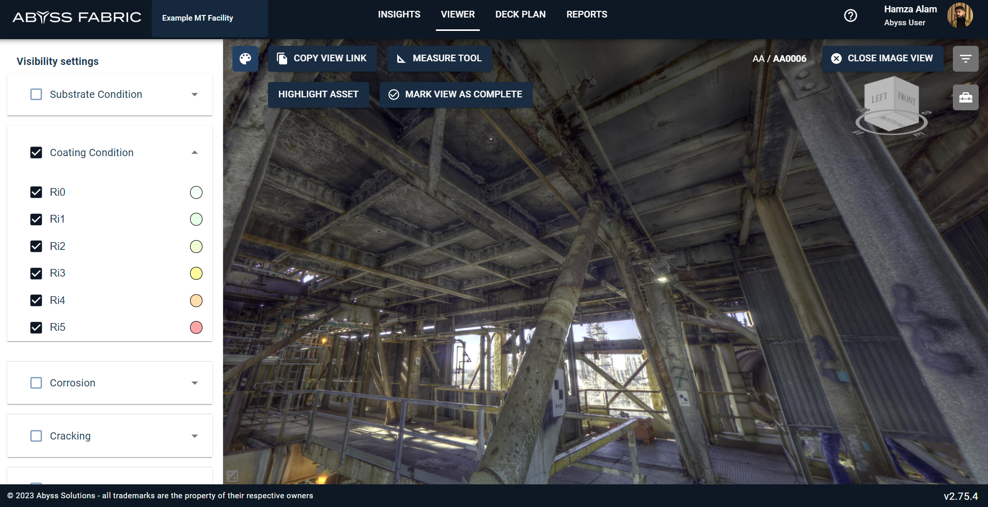

Slide 16
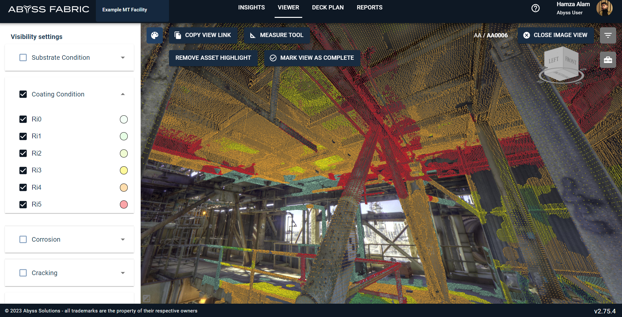

Slide 17
KEY STATISTICS
More coverage, less risk
Our proprietary inspection technology, Abyss Fabric, is at the forefront of the industry, enabling autonomous robotics to capture and analyze data at an unprecedented level
95%
94%
60%
35%
Up to 95%
coverage of asset
94% reduction
of persons on board (PoB)
60% reduction
in overall cost*
35% reduction
in risk (LoPC)
*Cost may be subject to change based on regional differences
Notes:
Fabric specific, realized numbers, not marketing numbers

Slide 18
Abyss Fabric
Case Studies
Notes:
MIS NAMED

Slide 19
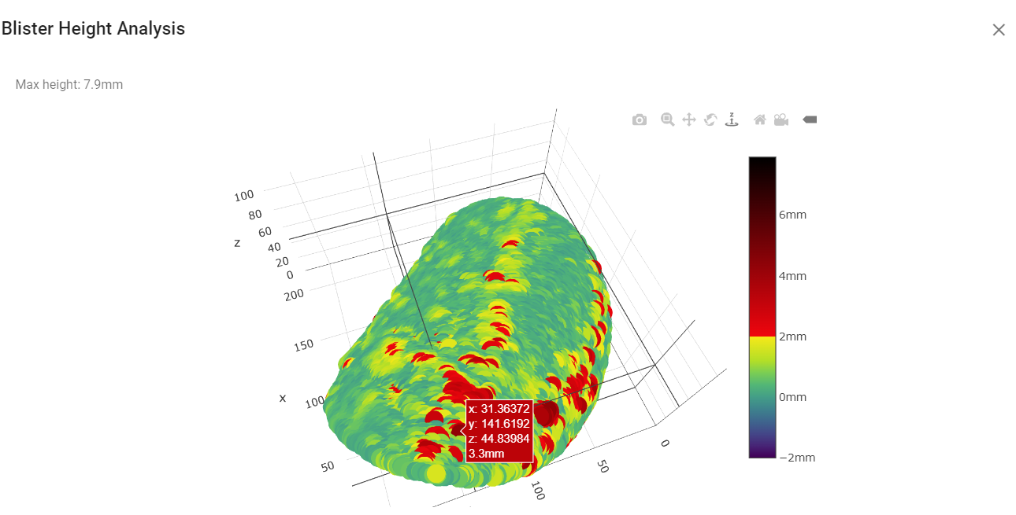
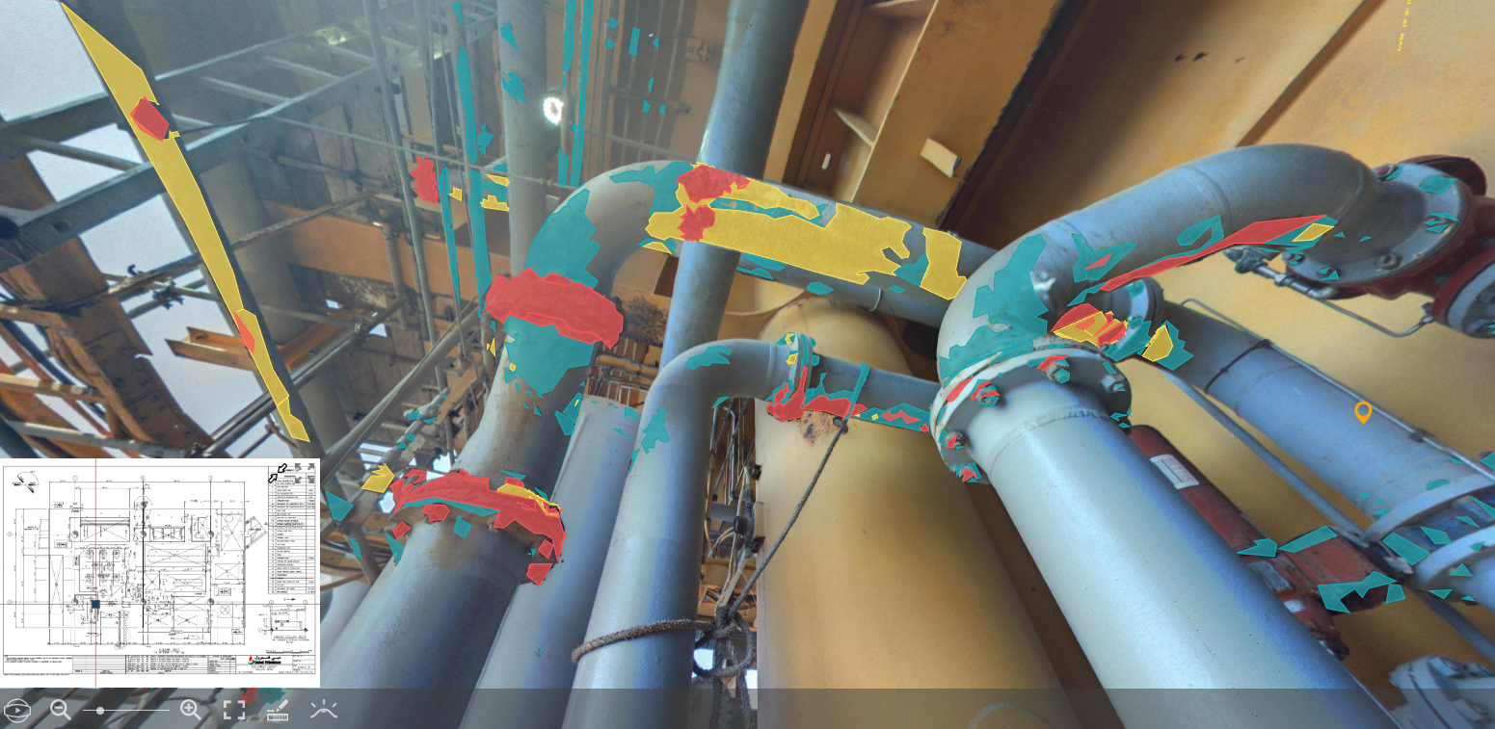
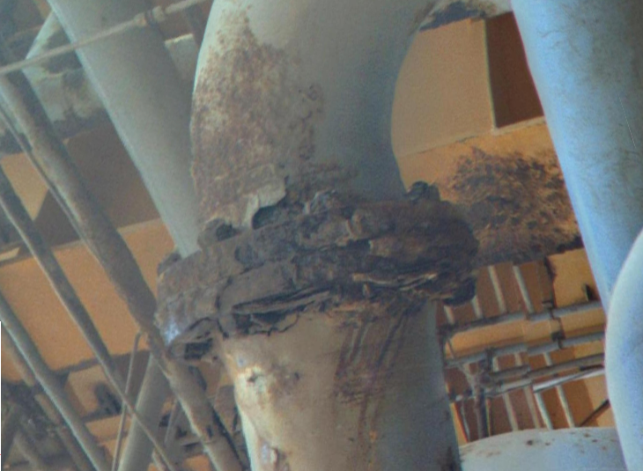
Offshore Facility in the GCC
CASE STUDY 1
This 8-inch line, undetected by traditional inspection methods, could have led to dire consequences if not timely identified by Abyss Fabric.
8’’ Line
Abyss Scanned 2022
Early Detection in Abyss Fabric
Early NDT
Part Replacement
Life extension of part
Clear planning and execution
Low cost
Leak Before 2023
Unplanned Shutdown
Emergency Mobilization
Unplanned Shutdown Costs
Environmental Damage
Non-compliance
High repair costs
Safety Risks
Notes:
Action slide : Javier insights that the example platform

Slide 20
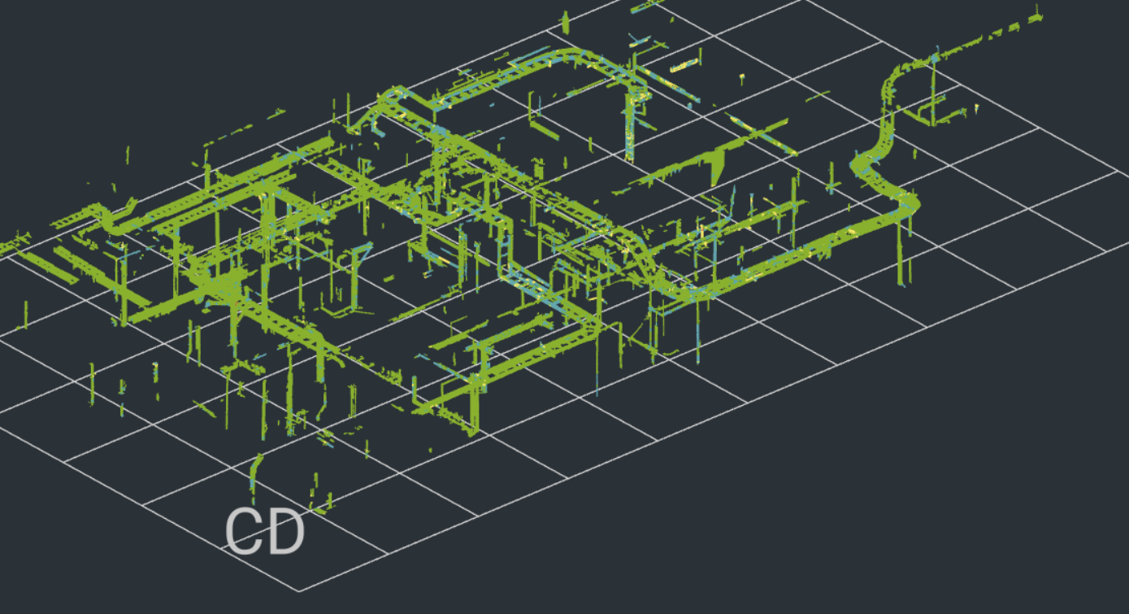

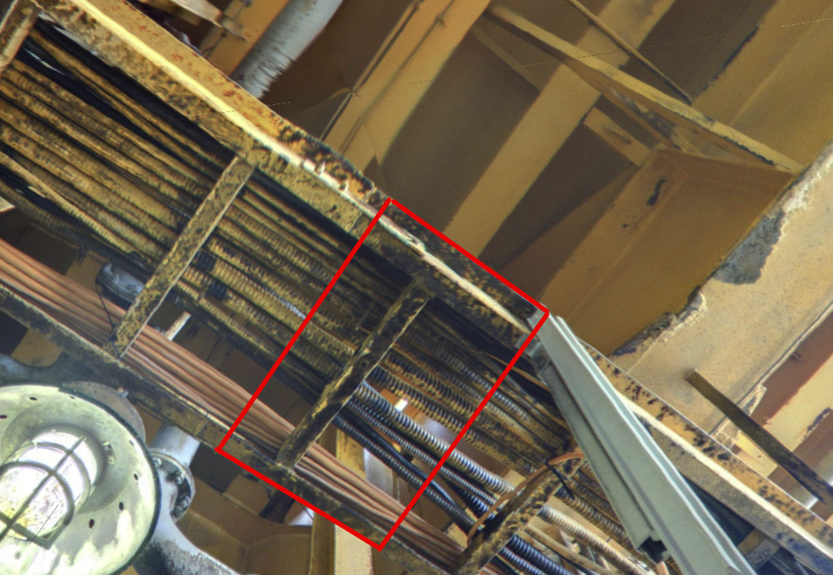
Corrosion Management for Structures
CASE STUDY 2
Streamlined Structural Inspections with Abyss Fabric 92% alignment with the ground truth (incl. the added value of quantification and 3D point cloud representation)
Traditional Survey | Abyss Digital Survey
Six inspectors deployed 365 Lower overall coverage No digital database No quantification of damage Subjective results | Single survey (7 days) Abyss captures all defects in a digital format Simplified Inspection Process Enhanced coverage Quantified scab height Paint Block Prioritization AI based detected
Limitation: Data Acquisition was not conducted for this purpose Projected 100% alignment if data was collected according to the requirement
Notes:
Action slide : Javier insights that the example platform

Slide 21

First Year Maintenance Savings
CASE STUDY 3
CAT3 Paint Items Transitioning to CAT2 Estimated to become replacements in 12-24 months | CAT2 Replacements Estimated time to failure 6-12 months
217 lines nominated for Paint, lines not scheduled for inspection in the next two years | 83 nominations for replacement, lines not scheduled for inspection in the next year
Painting all 217 Lines cost $4M USD and prevented replacements in the future | Replacing 83 nominated items totals $14.5M and avoid the cost of failure
Replacing these lines would have cost $38M USD | 83 lines nominated were associated to 12-15 major circuits per platform Tangible de-risk $1.2B
Notes:
Action slide : Javier insights that the example platform

Slide 22
Two Year Inspection Savings per Platform
CASE STUDY 4
Standard Visual Inspections (Client 2019 Campaign) Method: Physical Survey | Abyss Fabric First Year Setup (2020) Method: AI aided Desktop visual inspection | Abyss Fabric Reinspection & Reprioritization (2021-) Method: AI aided Desktop visual inspection
20% platform coverage | 95% platform coverage | 95% platform coverage
500 Lines Inspected | 3000 Lines Inspected | 3000 Lines Inspected
1.5M USD (GVI cost) ** given no POB delays and no scope deferrals and 100% work gets completed 120 PoB Days | 0.6M USD 20 PoB Days | 0.4M USD 20 PoB Days
Notes:
Action slide : Javier insights that the example platform

Slide 23
Coating Maintenance per Platform
CASE STUDY 5
Traditional 2021 Block Campaign 10C 12C 4P Spar Deck | Abyss Prioritization 2021 7P 8P 4P 5P
17%
16%
53%
60%
18%
Fewer low consequence lines painted
More lines painted
More high consequence lines painted
Fewer un-deteriorated lines painted
Fewer lines requiring MI inspection before painting
Notes:
Action slide : Javier insights that the example platform

Slide 24
Coating Maintenance per Platform
CASE STUDY 5
Traditional 2021 Block Campaign 10C 12C 4P Spar Deck | Abyss Prioritization 2021 7P 8P 4P 5P
17%
16%
53%
60%
18%
Fewer low consequence lines painted
More lines painted
More high consequence lines painted
Fewer un-deteriorated lines painted
Fewer lines requiring MI inspection before painting
Notes:
Action slide : Javier insights that the example platform

Slide 25
Facility Life Cycle
SUMMARY
Monitoring equipment condition over full part life cycle
Nominated for Paint by AF
Nominated for NDT by AF
Nominated for Replacement by AF
CAT3 Coating Degradation
CAT2 Replacement Required
CAT1 Nearing Failure
LOPC
$4-52M
New Installation
Equipment is newly installed or freshly remediated
Coating degrades with light and moderate corrosion
Component has degraded beyond paint remediation and requires replacement at earliest opportunity
Component has now degraded beyond acceptable wall loss limits. Replacement should be immediate
$10-20k Paint Remediation
$100-200k Planned Shutdown
$200-250k Unscheduled Replacement
Abyss Fabric enables regular monitoring & prioritization of remediation to avoid equipment slipping between categories

Slide 26
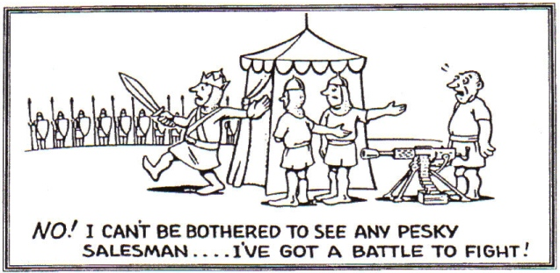

Slide 27



JUBCOR
2024
CONFERENCE & EXHIBITION
INNOVATIVE SOLUTIONS FOR CORROSION CHALLENGES
THANK YOU
Reach out at
971-54-736-3316
Operations Lead Hamza Alam
m.halam@abysssolutions.com.au

