Slide 1




JUBCOR
YOUR LOGO
2024
CONFERENCE & EXHIBITION
INNOVATIVE SOLUTIONS FOR CORROSION CHALLENGES
Presented By: Majeed Almashnawi
Jubcor Presentation
Development of Carbon-based Nanomaterials for Volatile Organic Compounds Adsorption

Slide 2


CONTENTS
01
Introduction
Water,pollutin, tratment ,objective
02
Experimental
Process,insturment, method
03
Results And Discussion
Figures ,data
04
Conclusion
Summary,Recommendation

Slide 3
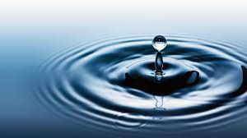
INTRODUCTION
Water is required for all living species to survive.
97% of water on the Earth is salt water ,only 3% us fresh water .
Globally, the issue of water scarcity and growing water consumption has become a severe concern.

Slide 4

POLLUTION
Contamination of the earth's environment with substances that endanger human health, quality of life, or the normal functioning of ecosystems.
Wrong substances in a Wrong quantity in the Wrong time and at the Wrong place.

Slide 5
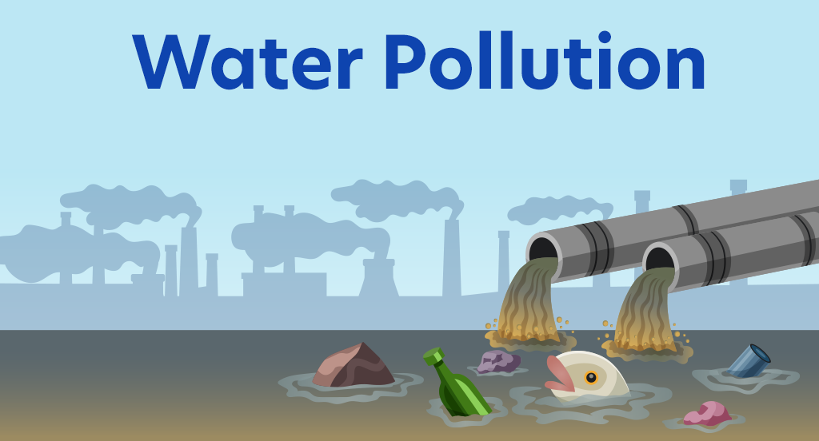
Water pollution
Water pollution is the contamination of water by foreign substance that degrades its quality.
Any chemical, biological, or physical alteration in water quality that harms living organisms or renders water unfit for desired usage.

Slide 6
SCOURCES OF POLLUTION
Agriculture
Municipal
Industrial
Mining
Military
commercial

Slide 7
WATER POLLUTANTS
Inorganic
Organic
Suspended Solid
Microorganism
Radionuclide
Thermal

Slide 8
WATER SCARCITY
Saudi Arabia and the other countries of the Gulf Cooperation Council (GCC) already classified by the United Nations as water-scarce nations.
The desert atmosphere of the Kingdom incumbents dealing with water as the 1st critical resource .
Water Scarcity is a situation where there is insufficient water to satisfy normal requirements SUPPLY DOES NOT MEET DEMAND

Slide 9
Waste Management
The increase in urban development, industrial activities and population and their standards of living, will generate more consumption and wastes.
Integrated Waste Management:
New methods of waste management considers waste products as resources. It can be through 4Rs concept (Reduce, Recycle, Reuse and Recover)

Slide 10
TREATMENT OF WATER
Depend
Quality of sources
Purpose
Classified
Drinking
Industrial
Level of treatment
Cost
Municipal
Agriculture

Slide 11
Volatile organic compounds in water
Volatile Organic Compounds (VOCs) are chemical compounds that evaporate rapidly and are soluble in water, originating from industrial operations, home items, fuel burning, and chemical accidents.
Monitoring and controlling VOCs in water is crucial to protect the environment and ensure safe drinking water supplies.
VOCs may have long term adverse effect to both humane and environmental

Slide 12
Source of VOCs in industrial wastewater
VOCs can be produced in industrial wastewater through:
Industrial Processes: VOCs are routinely released into wastewater during manufacturing, processing, or spillage.
Solvents and Cleaning Agents: Solvents and cleaning chemicals can evaporate and enter wastewater streams during equipment or surface cleaning activities.
Leaks and Spills : Due to equipment failures, pipeline ruptures, or inadequate containment systems.
Uncaptured Emissions: Due to poor equipment maintenance.
Biological Processes: Anaerobic digestion processes can produce VOCs,

Slide 13
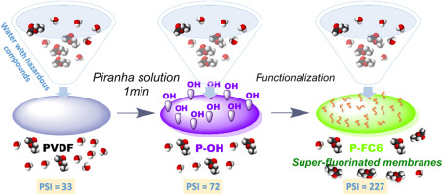
Carbon nanotubes, and activated carbon materials
carbon nanotubes, and activated carbon materials, have shown extraordinary adsorption capabilities, making them suitable candidates for VOC removal from water sources. Their distinct surface characteristics and porosity provide an abundance of adsorption sites, allowing for the effective collection of a wide spectrum of organic contaminants.

Slide 14
Research Objectives
To synthesize copolymer-modified CNT (PCNT).
To synthesize copolymer-modified carbon (PAMC) derived from palm shells.
To evaluate the adsorption performance with different concentrations of VOCs and different contact time and dosage of copolymer-modified CNT and copolymer-modified carbon.

Slide 15
Significance of the Study
The treatment of wastewater and industrial wastewater can save the environment and will provide clean approaches to reuse water.
This will be important for industries to recycle the used water in different industrial units.

Slide 16
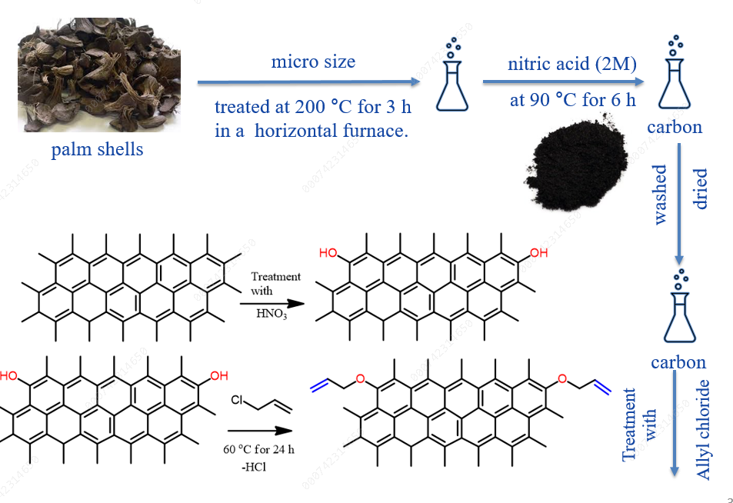
Preparation of activated carbon from palm shells:

Slide 17
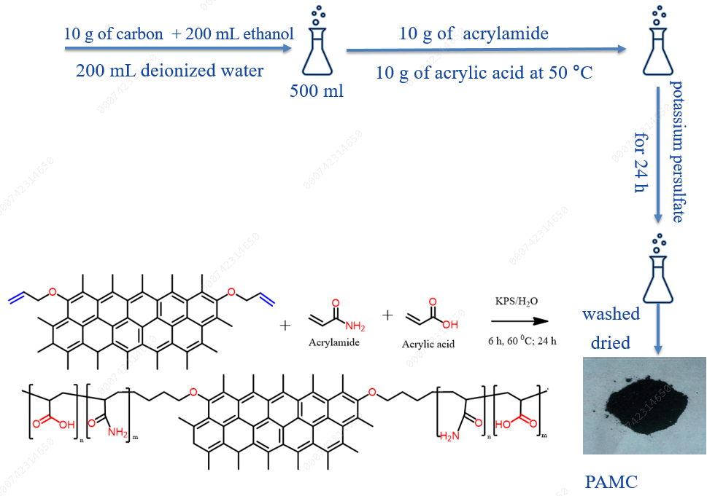
Synthesis of copolymer-modified carbon :

Slide 18

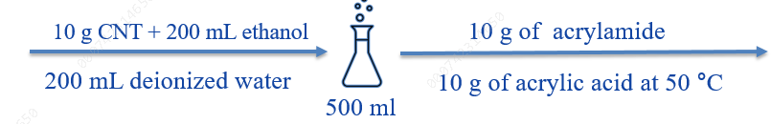
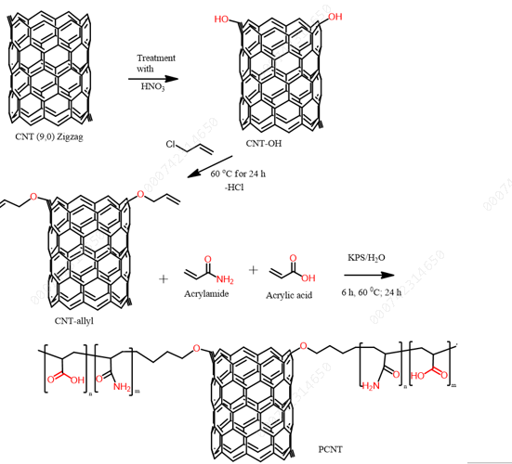
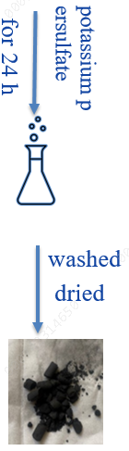

Synthesis of polymer modified CNT

Slide 19
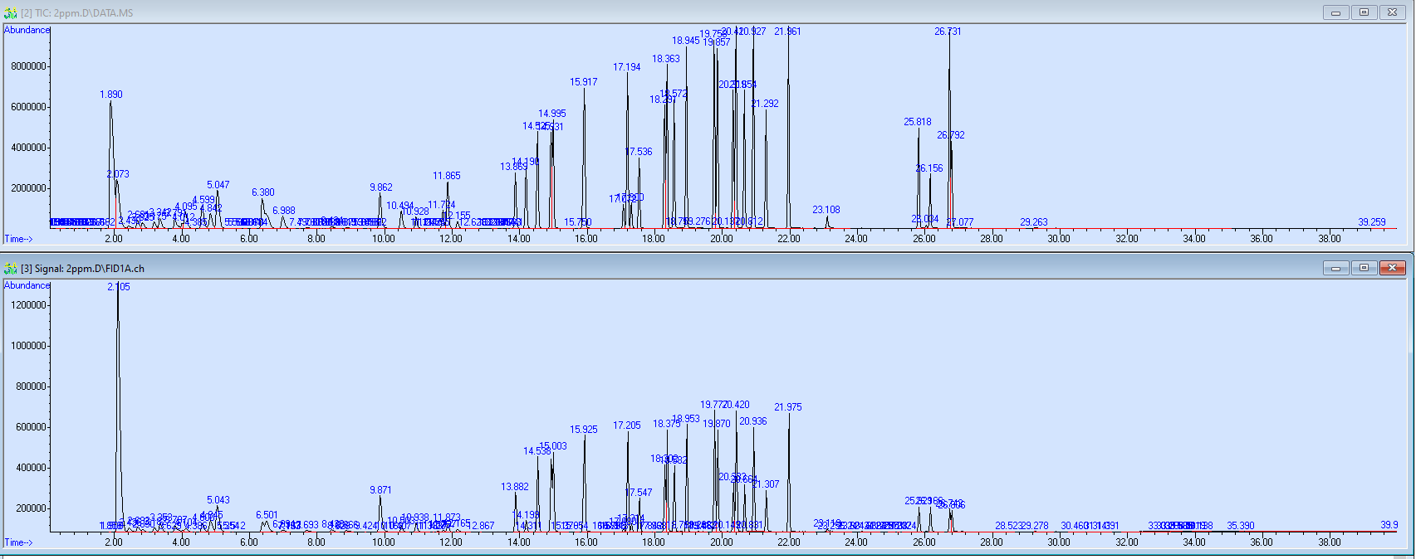
GC-Head Space
Chromatogram of a standard solution of VOCs.
A standard solution of 24 chlorinated volatile organic compound solvent analytes with HSS-GC-MS/FID.

Slide 20
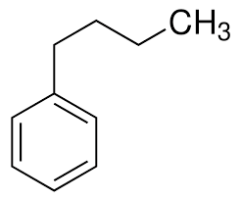
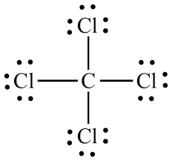
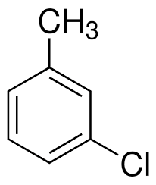
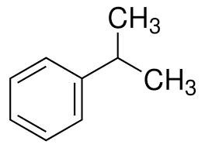
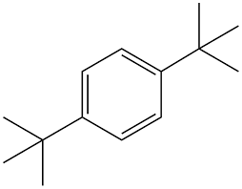
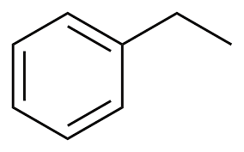
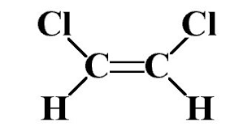
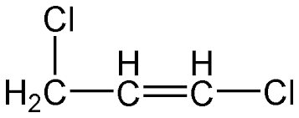
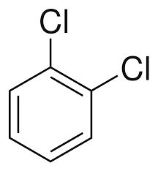
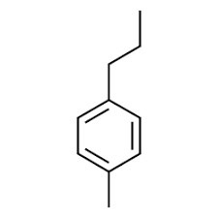
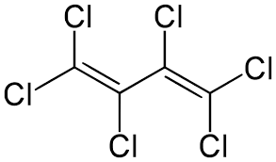
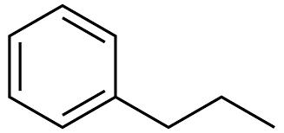
24 chlorinated volatile organic compound
24 chlorinated volatile organic compound
Butylbenzene
Carbon Tetrachloride
Chlorotoluene
Cumene
Dichloroethene
Dichloropropene
Dimethylethylbenzene
Ethylbenzene
Isocumene
Dichlorobenzene
Propyltoluene
Hexachlorobutadiene

Slide 21
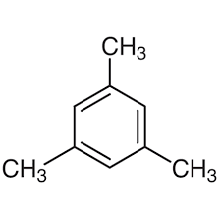
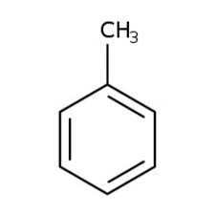
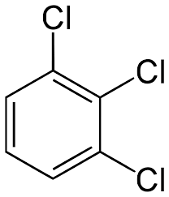
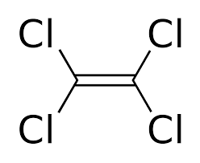
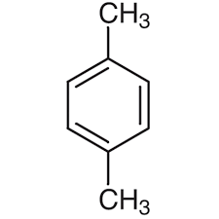
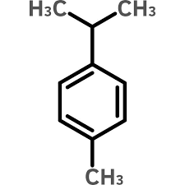
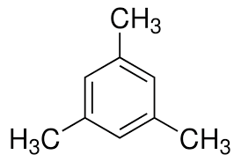
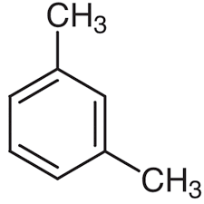
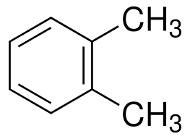
24 chlorinated volatile organic compound
24 chlorinated volatile organic compound
Trichlorobenzene
Trichlorobenzene
Toluene
Tetrachloroethylene
P-Xylene
Mesitylene
M-Xylene
Isopropyltoluene
O-Xylene

Slide 22
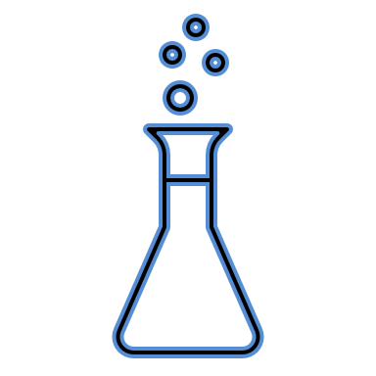
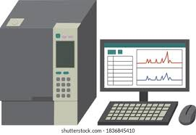
GC-Head Space
GC-Head Space
Water sample Preparation with polyacrylate-modified CNT :
2000 (μg/ml)
Take 10 ml samples after each 15 min
Diluted in 50 ml
1 g PCNT
placed on a shaker
24 chlorinated VOCs
2 (μg/ml)
GC
Take 10 ml samples after each 15 min
1 g PCNT
placed on a shaker
1.0 (μg/ml)
Take 10 ml samples after each 15 min
1 g PCNT
placed on a shaker
0.5 (μg/ml)
Take 10 ml samples after each 15 min
1 g PCNT
placed on a shaker
0.25 (μg/ml)

Slide 23
GC-Head Space
GC-Head Space
Water sample Preparation with polyacrylate-modified carbon :
2000 (μg/ml)
Take 10 ml samples after each 15 min
Diluted in 50 ml
1 g PAMC
placed on a shaker
24 chlorinated VOCs
2 (μg/ml)
GC
Take 10 ml samples after each 15 min
1 g PAMC
placed on a shaker
1.0 (μg/ml)
Take 10 ml samples after each 15 min
1 g PAMC
placed on a shaker
0.5 (μg/ml)
Take 10 ml samples after each 15 min
1 g PAMC
placed on a shaker
0.25 (μg/ml)

Slide 24
2 ppm solution with PCNT

Slide 25
2 ppm solution with PCNT
Substance | Concentration | Concentration after 15 min | Concentration after 30 min | Concentration after 60 min | Concentration after 90 min | Recovery %
Dichloroethene | 2 ppm | 1.25 | 0.65 | 0.42 | 0.31 | 75%
Dichloroethylene | 2 ppm | 1.20 | 0.86 | 0.65 | 0.36 | 70%
Dichloropropene | 2 ppm | 1.09 | 0.82 | 0.61 | 0.42 | 61%
Carbon Tetrachloride | 2 ppm | 1.22 | 0.98 | 0.75 | 0.52 | 58%
Toluene | 2 ppm | 1.18 | 0.94 | 0.71 | 0.48 | 59%
Tetrachloroethylene | 2 ppm | 0.74 | 0.52 | 0.35 | 0.28 | 62%
Ethylbenzene | 2 ppm | 1.09 | 0.73 | 0.55 | 0.37 | 67%
O-Xylene | 2 ppm | 1.06 | 0.71 | 0.53 | 0.36 | 66%
P&M-Xylene | 2 ppm | 1.05 | 0.70 | 0.53 | 0.36 | 66%

Slide 26
2 ppm solution with PCNT
Substance | Concentration | Concentration after 15 min | Concentration after 30 min | Concentration after 60 min | Concentration after 90 min | Recovery %
Cumene | 2 ppm | 1.00 | 0.56 | 0.43 | 0.28 | 72%
Chlorotoluene | 2 ppm | 0.89 | 0.64 | 0.47 | 0.33 | 63%
Isocumene | 2 ppm | 0.78 | 0.41 | 0.33 | 0.23 | 71%
Chlorotoluene | 2 ppm | 0.86 | 0.60 | 0.44 | 0.31 | 64%
Mesitylene | 2 ppm | 0.86 | 0.51 | 0.39 | 0.28 | 68%
Dimethylethylbenzene | 2 ppm | 0.90 | 0.32 | 0.39 | 0.26 | 71%
Trimethylbenzene | 2 ppm | 0.87 | 0.16 | 0.42 | 0.29 | 66%
Dichlorobenzene | 2 ppm | 0.77 | 0.55 | 0.39 | 0.28 | 63%
Propyltoluene | 2 ppm | 0.69 | 0.31 | 0.25 | 0.17 | 75%

Slide 27
2 ppm solution with PCNT
Substance | Concentration | Concentration after 15 min | Concentration after 30 min | Concentration after 60 min | Concentration after 90 min | Recovery %
Dichlorobenzene | 2 ppm | 0.77 | 0.57 | 0.40 | 0.29 | 62%
Isopropyltoluene | 2 ppm | 0.67 | 0.31 | 0.24 | 0.17 | 74%
Butylbenzene | 2 ppm | 0.47 | 0.19 | 0.15 | 0.11 | 77%
Trichlorobenzene | 2 ppm | 0.64 | 0.42 | 0.30 | 0.21 | 67%
Hexachlorobutadiene | 2 ppm | 0.36 | 0.13 | 0.09 | 0.08 | 79%
Trichlorobenzene | 2 ppm | 0.76 | 0.57 | 0.38 | 0.27 | 65%
The compounds that were tested on copolymer-modified CNT showed excellent desorption recoveries. When studying the recovery rates for 2 ppm volatile organic compounds (VOCs) in water using copolymer-modified CNT , it was discovered that the recovery rates ranged from 58% to 78% over a 90-minute period.

Slide 28
2 ppm solution with PAMC

Slide 29
2 ppm solution with PAMC
Substance | Concentration | Concentration after 15 min | Concentration after 30 min | Concentration after 60 min | Concentration after 90 min | Recovery %
Dichloroethene | 2 ppm | 1.49 | 1.13 | 0.72 | 0.35 | 83%
Dichloroethylene | 2 ppm | 1.55 | 1.29 | 0.99 | 0.55 | 73%
Dichloropropene | 2 ppm | 1.37 | 0.95 | 0.84 | 0.55 | 72%
Carbon Tetrachloride | 2 ppm | 1.50 | 1.26 | 1.07 | 0.69 | 66%
Toluene | 2 ppm | 1.42 | 1.12 | 0.07 | 0.06 | 97%
Tetrachloroethylene | 2 ppm | 0.80 | 0.68 | 0.28 | 0.28 | 86%
Ethylbenzene | 2 ppm | 1.25 | 0.91 | 0.71 | 0.44 | 78%
O-Xylene | 2 ppm | 1.18 | 0.83 | 0.65 | 0.42 | 79%
P&M-Xylene | 2 ppm | 1.23 | 0.88 | 0.69 | 0.44 | 78%

Slide 30
2 ppm solution with PAMC
Substance | Concentration | Concentration after 15 min | Concentration after 30 min | Concentration after 60 min | Concentration after 90 min | Recovery %
Cumene | 2 ppm | 1.08 | 0.73 | 0.54 | 0.34 | 83%
Chlorotoluene | 2 ppm | 0.98 | 0.71 | 0.57 | 0.37 | 81%
Isocumene | 2 ppm | 0.92 | 0.57 | 0.42 | 0.27 | 86%
Chlorotoluene | 2 ppm | 1.00 | 0.67 | 0.55 | 0.36 | 82%
Mesitylene | 2 ppm | 0.95 | 0.62 | 0.48 | 0.32 | 84%
Dimethylethylbenzene | 2 ppm | 0.93 | 0.64 | 0.44 | 0.29 | 86%
Trimethylbenzene | 2 ppm | 0.96 | 0.62 | 0.50 | 0.33 | 83%
Dichlorobenzene | 2 ppm | 0.91 | 0.58 | 0.49 | 0.33 | 84%
Propyltoluene | 2 ppm | 0.72 | 0.43 | 0.31 | 0.21 | 89%

Slide 31
2 ppm solution with PAMC
Substance | Concentration | Concentration after 15 min | Concentration after 30 min | Concentration after 60 min | Concentration after 90 min | Recovery %
Dichlorobenzene | 2 ppm | 0.92 | 0.60 | 0.50 | 0.34 | 83%
Isopropyltoluene | 2 ppm | 0.71 | 0.41 | 0.30 | 0.21 | 90%
Butylbenzene | 2 ppm | 0.50 | 0.26 | 0.20 | 0.14 | 93%
Trichlorobenzene | 2 ppm | 0.83 | 0.46 | 0.38 | 0.26 | 87%
Hexachlorobutadiene | 2 ppm | 1.45 | 0.98 | 0.89 | 0.62 | 69%
Trichlorobenzene | 2 ppm | 0.98 | 0.57 | 0.52 | 0.37 | 82%
The compounds tested on carbon showed excellent results in terms of desorption recoveries. When studying the recovery rates of volatile organic compounds (VOCs) in water using copolymer-modified carbon , it was discovered that recovery rates varied from 69 % to 97% over a 90-minute period

Slide 32
1 ppm solution with PAMC
Recovery rates ranged from 83% to 97% within 90 min.

Slide 33
1 ppm solution with PAMC

Slide 34
0.5 ppm solution with PAMC
Recovery rates ranged from 85% to 99% within 90 min.

Slide 35
0.5 ppm solution with PAMC

Slide 36
0.25 ppm solution with PAMC
The recovery rates for volatile organic compounds (VOCs) in water using conventional copolymer-modified carbon were consistently 99% for all compounds

Slide 37
0.25 ppm solution with PAMC

Slide 38
1 ppm solution with PCNT
The recovery rates of volatile organic compounds (VOCs) in water were tested using copolymer-modified CNT and ranged from 61% to 96% during 90 min.

Slide 39
1 ppm solution with PCNT

Slide 40
0.5 ppm solution with PCNT
The recovery rates for volatile organic compounds (VOCs) in water using conventional copolymer-modified CNT were over 80% for all compounds

Slide 41
0.5 ppm solution with PCNT

Slide 42
0.25 ppm solution with PCNT
The recovery rates for volatile organic compounds (VOCs) in water using conventional polyacrylate-modified CNT were consistently 99% for all compounds

Slide 43
0.25 ppm solution with PCNT

Slide 44
Conclusion
Activated carbon is a popular adsorbent for environmental applications, particularly in sample concentration and cleaning. Its high sorption capacity is due to its internal pore structure and surface area, which allows for the absorption of pollutants on a large surface area.
copolymer-modified carbon generally has a higher adsorption performance than polyacrylate-modified CNT especially for 24 compounds, in less time.
The increasing demand for accurate pollutant analysis is crucial for monitoring environmental contamination, ensuring ecosystem safety, and human health, making copolymer-modified carbon a vital tool in environmental research and monitoring.
Future work, to apply copolymer-modified carbon filter for treatment water specifically for industrial purposes to remove hydrocarbon before reuse or discharge water

Slide 45



JUBCOR
2024
CONFERENCE & EXHIBITION
YOUR LOGO
INNOVATIVE SOLUTIONS FOR CORROSION CHALLENGES
THANK YOU
Reach out.
Calle Cualquiera 123, Cualquier Lugar
0595003315
mjidalfifi1993@gmail.com

