Slide 1
JUBCOR
2024
CONFERENCE & EXHIBITION
INNOVATIVE SOLUTIONS FOR CORROSION CHALLENGES
Presented By:
Nausha Asrar, Ph.D
Fatma AlRadhi, Asma AlGhamdi and Abdurahman AlAnazi
WTIIRA, Saudi Water Authority
Al-Jubail, Kingdom of Saudi Arabia
Hydrogen Induced Cracking (HIC) of Low- and High-strength Alloys

Slide 2
Topics
Mechanism of Hydrogen Generation
Types of Hydrogen Assisted Cracking (HAC)
Mechanisms of HAC
Cases of Low- and High-strength Alloy HAC
Concluding Remarks
TENSILE STRESS
FeS
CATHODE (FeS)
HAIRLINE FRACTURE DUE TO H₂ AND TENSILE STRESS
SURFACE OF PIPE EXPOSED TO H₂S AND MOISTURE
MILLIONTHS
OF AN INCH
PIPE WALL
HARDNESS GREATER THAN 22 HR_{c}

Slide 3
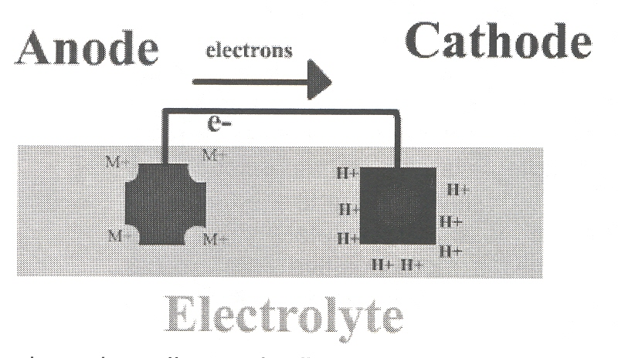
Hydrogen Generation
Anodic reaction (Oxidation)
Fe → Fe⁺⁺ + 2e⁻
Cathodic reaction (Reduction)
2H⁺ + 2e⁻ → H₂
Electrochemistry of Corrosion Reaction

Slide 4
Hydrogen Generation
In aqueous environment hydrogen atoms are produced on a metal surface by a corrosion reaction, cathodic protection, electroplating, or acid pickling
Some H atoms form hydrogen gas molecule and escape as gas bubbles
Under certain conditions protons (H⁺) enters into the metal → Blistering, Hydrogen Assisted Cracking (HAC), Hydrogen Embrittlement (HE).
Sulfide ions, phosphorus and arsenic compounds retard the formation of H₂ molecule at the metal surface, and increase the entry of hydrogen into the metal → Sulfide Stress Cracking (SSC).

Slide 5
Hydrogen Induced Cracking (HIC)
Hydrogen Blistering
Stress Oriented Hydrogen Induced Cracking (SOHIC)
Hydrogen Embrittelemnt (HE)
Hydrogen Assisted Cracking (HAC)
Sulfide Stress Cracking (SSC)
Hydrogen Induced Stress Cracking (HISC)
Sulfide Stress Corrosion Cracking (SSC)
All the same or different ?

Slide 6
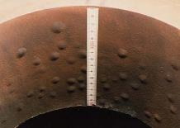
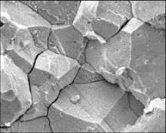
Hydrogen Assisted Cracking (HAC)
Hydrogen blistering
Hydrogen enters into low-strength ductile steels
Macroscopic defects (inclusions, lamination etc.) in the steel provide space for H₂ formation → pressure build up → Blistering
Hydrogen may be formed during cleaning, plating, corrosion etc.
Hydrogen Embrittlement (HE)
Influence of sustained load + H-charging → Material embrittlement
Internal HE - Hydrogen enters molten metal
Environmental HE – Absorbed by solid metal
W/o stress - blistering, internal cracking, hydride formation, reduced ductility
With stress - H interacts with the metal → subcritical crack growth → Fracture
Blistering
Hydrogen Embrittlement

Slide 7
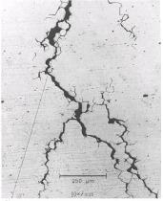
Hydrogen Assisted Cracking (HAC)
Hydrogen Assisted/Induced Cracking (HAC or HIC)
Absence of corrosion reaction (Polarized cathodically) → HAC
In presence of corrosion (Polarized anodically) → Hydrogen Assisted Stress-corrosion Cracking (HASC) or HISC
Sulfide Stress Cracking (SSC)
Combined action of stress and corrosion in presence of wet H₂S environment
Spontaneous brittle failures of steels and other high-strength alloys
Also called as sulfide cracking, sulfide corrosion cracking, sulfide stress corrosion cracking

Slide 8
Mechanism of HAC
The exact mechanism that causes hydrogen embrittlement in a metal are not clearly understood. There are currently three main contending theories: HELP, HEDE, and AIDE.
HELP – Hydrogen Enhanced Localized Plasticity
Resistance to dislocation movement (one of the main strengthening mechanisms in metals) is reduced due to localized softening that occurs when solute hydrogen collects around mobile dislocations
Lower stress required to move the dislocation (causing slip)

Slide 9
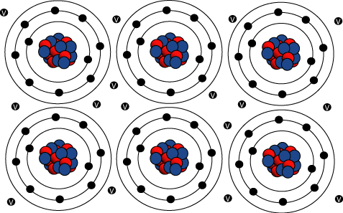
Mechanism of HAC
HEDE – Hydrogen-Enhanced Decohesion
In the HEDE mechanism, the hydrogen atoms accumulate within certain regions of the crystal lattice and reduce the cohesive energy of the metal matrix or at specific interfaces. This allows tensile separation (decohesion) to occur rather than the normal slip.
The weakening of the bonds is attributed to a decrease in the electron-charge density between metal-to-metal atoms as a result of the hydrogen.

Slide 10
Mechanism of HAC
AIDE – Adsorption-Induced Dislocation Emission
HELP + HEDE theories.
It postulates that hydrogen at the crack tip weakens the metal-to-metal bonds as described for the HEDE theory, but the actual crack growth is the result of localized dislocation slip as described by the HELP theory.
It is currently believed that the hydrogen ion is electrostatically charged directly into the cathode without first forming an adsorbed hydrogen atom.
Charging of the hydrogen into the metal is extremely powerful faradaic process and not just a diffusion process based upon the concentration differential of hydrogen at the sea water/metal interface.

Slide 11
Hydrogen Charging and HAC
HAC depends on:
How much hydrogen is charged
The mobility of the hydrogen within the metal
Where the hydrogen accumulates within the metal
How much hydrogen is charged into a metal depends on cathodic charge/protection
The mobility of the hydrogen and where it accumulates depends on the microstructure of the metal
BCC (ferritic) materials – High diffusivity low hydrogen adsorption capacity → More susceptible to HAC
FCC (austenitic) materials – Low diffusivity high hydrogen adsorption capacity → Less susceptible to HAC

Slide 12
Hydrogen Charging and HAC
Susceptibility of a given metal to HAC increases with;
increasing strength
inclusion content, and
cold work
These either provide traps in the microstructure for hydrogen to accumulate at or facilitate diffusion of hydrogen into the metal
The risk of hydrogen induced stress cracking (HISC) increases in most metals as the stress (residual and/or applied) increases

Slide 13
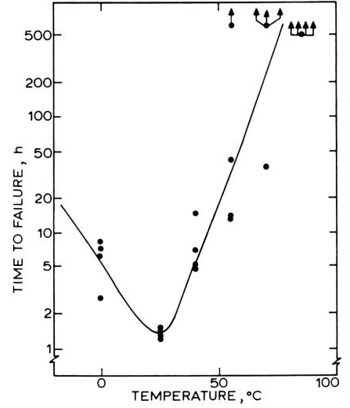
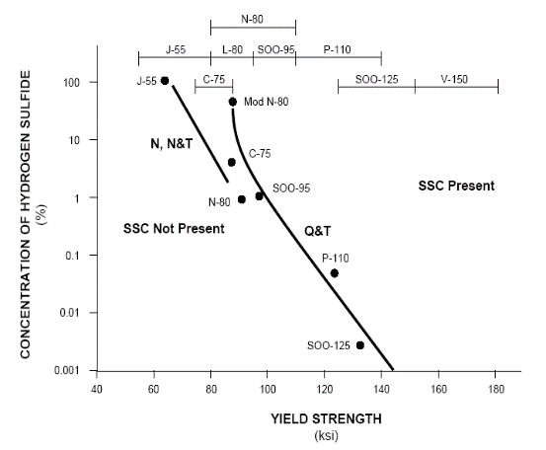
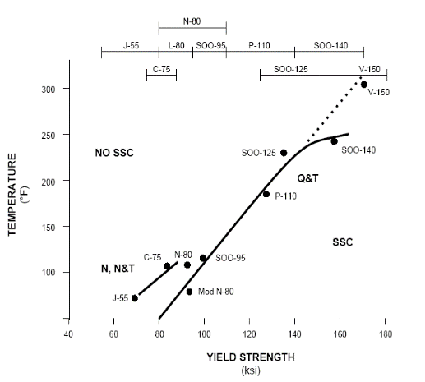
Important Info about HAC
Temperature Effect on SSC
Strength Effect on SSC
Temperature and Strength vs SSC
Low-alloy steels are most likely to crack (SSC) near ambient temperature
The stronger the steel, the less H₂S it can take, or the more cracking susceptible it becomes
Higher strength grades can be used at higher temperatures

Slide 14
HAC Cases of Low- and High-strength Alloys

Slide 15
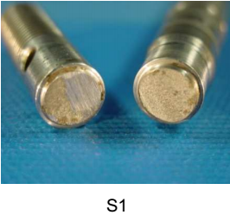
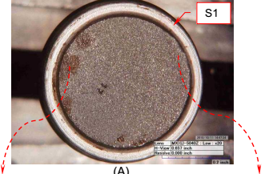
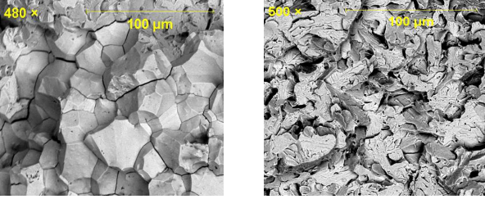
Hydrogen Embrittlement of a Stainless Steel Shaft
O&G drilling tool failure
SlimPulse main shaft transfers rotary motion from the motor to the impeller and restrictor
Failed during straightening for re-coating
Material - Stainless steel 17-4PH (H900 grade, Hardness HRc 35 - 41) - Alloy 17-4PH (UNS S17400), Type 630, is a chromium-nickel-copper precipitation-hardening martensitic stainless steel with an addition of niobium. 17-4PH combines high strength and hardness with good corrosion resistance.
SEM fractography
Isolated intergranular cracking
Brittle fracture via quasi-cleavage

Slide 16
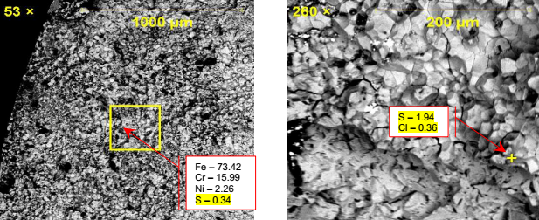
Hydrogen Embrittlement of a Stainless Steel Shaft
Material embrittled due to hydrogen diffusion
Bending load applied during the re-straightening process is likely to facilitate the propagation of pre-existing hydrogen induced cracking (HIC)
Presence of metal sulfides at the fracture surface – possible exposure to H₂S containing mud
High hardness (HRc > 33) material – Non-NACE compliant
For reliable operation - material must be compatible to the drilling fluid
EDS analysis identified S and Cl on fractured surface

Slide 17
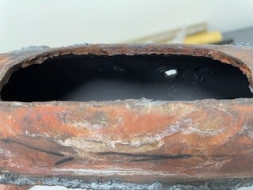
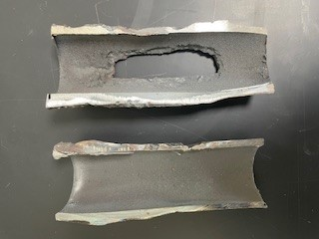
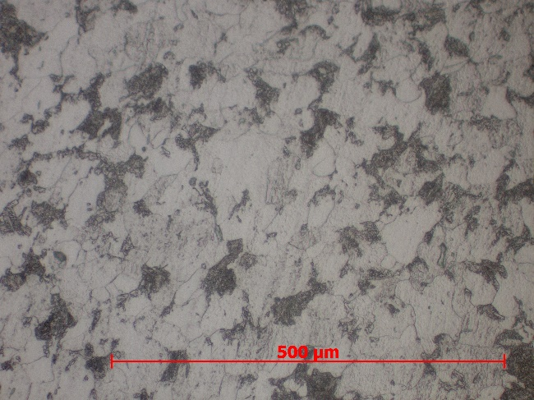
HAC of Carbon Steel Boiler Tube
Water-wall or riser tubes of the steam boiler of MSF desalination plant ruptured.
Boiler is a dynamic balance between heat flow from the combustion of a suitable fuel and steam formation. Seel tube is "heated" by the flame and simultaneously "cooled" by the fluid (steam, water or a mixture of steam and water) flow.
Material - Medium carbon steel ASTM A178 / SA178C.
Thick lip cracking, corrosion on the internal side, decarburized microstructure with intergranular cracking.
Tube of boiler No. 65
a) Tube of boiler No. 65
Thick lip random rupture of the boiler tube
Corrosion on internal surface
Microstructure showing typical ferrite and pearlite phases with signs of decarburization and grain growth.

Slide 18
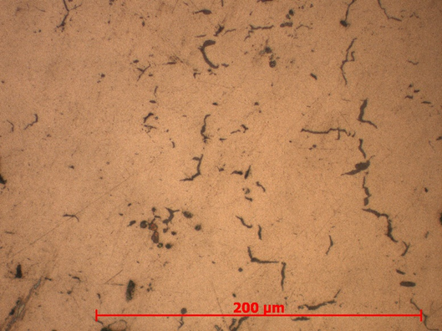
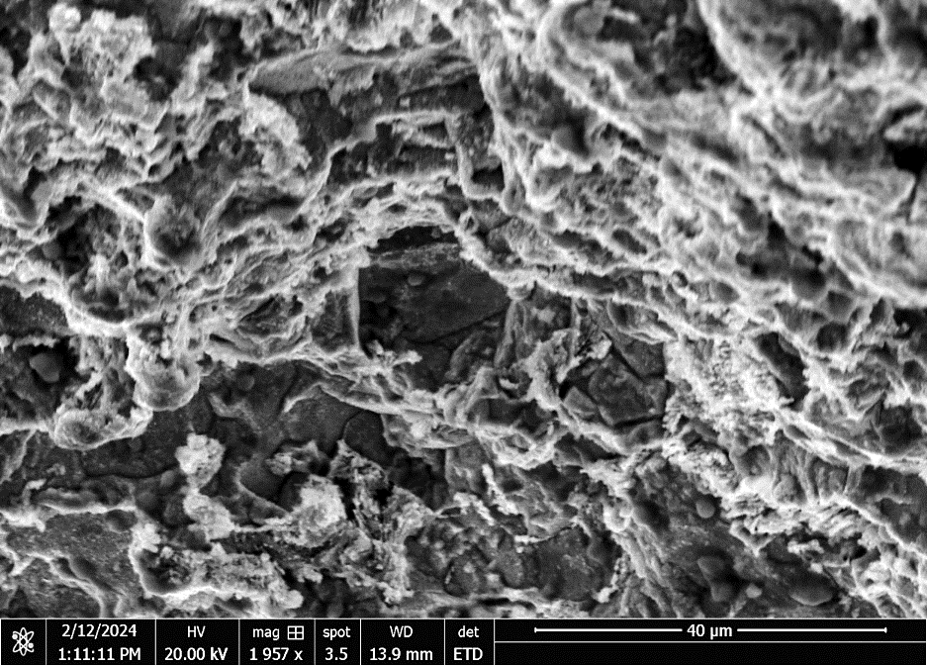
HAC of Carbon Steel Boiler Tube
When contaminants lower the boiler water pH sufficiently, the acid attack of the steel generates hydrogen.
Hydrogen diffuses into the metal and reacts with the carbon content to form methane gas. The large size and quantity of methane molecules will generate excessive pressure within the metal structure and result in micro-crack formation, causing a violent and sudden metal rupture.
Grain growth, thick lip fracture and random cracking feature seem the signs of hydrogen induced cracking mechanism.
Intensity and distribution of gas pressure is not uniform along the metal surface, resulting in the occurrence of failure at areas that can no longer withstand the internal pressure.
Ruptured sections usually retain their original thickness.
Metallograph showing
intergranular cracking
SEM picture showing sites of intergranular
cracking (arrow marked)

Slide 19
Concluding Remarks
NACE MR0175 compliant materials are resistant to SSC not to wet H₂S corrosion
Hydrogen charging depends on:
How much hydrogen is charged
The mobility of the hydrogen within the metal
Where the hydrogen accumulates within the metal
Susceptibility of a given metal to HAC increases with;
Increasing strength
Inclusion content
Cold work

Slide 20
Concluding Remarks
Compressive stress on ID surface can lower the initiation of cracking
In case boiler tubes presence of hard and adherent deposits facilitate the build up of hydrogen pressure within the deposit layer to penetrate the steel tube wall. Hydrogen reacts with the carbon content to form large molecules of methane gas, which generate excessive pressure within the metal structure and result in crack formation, causing a violent and sudden metal rupture.
Inspection and cleaning of the boiler tube per the design requirement and maintenance of the specified chemistry of feed water are the remedial measures to avoid HAC of boiler tubes.

Slide 21
JUBCOR
2024
CONFERENCE & EXHIBITION
INNOVATIVE SOLUTIONS FOR CORROSION CHALLENGES
THANK YOU
Reach out.
Phone: 056-389-1865
Email: nasrar@swcc.gov.sa

