Slide 1





Recent advances in understanding MIC and prevention strategies-A review
JUBCOR
YOUR LOGO
2024
CONFERENCE & EXHIBITION
INNOVATIVE SOLUTIONS FOR CORROSION CHALLENGES
Presented By: Dr. Azhar Alhasawi
And Dr. Ihsan Ul haq Toor
Jubcor Presentation
*R&D Principal Chemist, Halliburton
*Associate Professor, KFUPM

Slide 2


Outline:
The definition of MIC.
The cost of MIC.
Corrosion causing microorganism/ Microbial corrosion in metals.
Mechanism of biocorrosion: Ennoblement/role of biofilms.
Type of alloys affected by MIC.
Biocorrosion control strategies.
Monitoring Techniques .
The gaps in MIC research.
Conclusions and future perspectives.

Slide 3
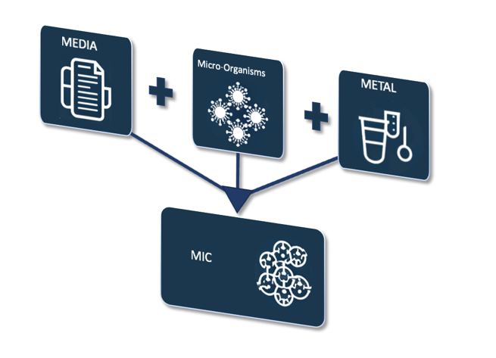
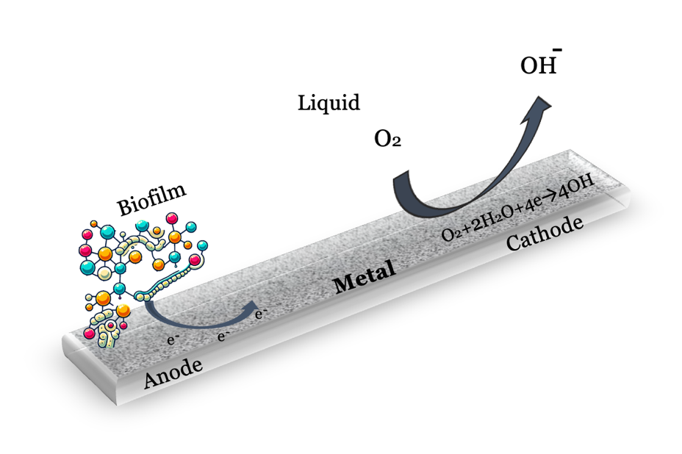
MIC Historical Perspective
Lavanya M (2021). J Bio- Tribo-Corros 7(3):1–9.

Slide 4
Economic impact of MIC
2020

Slide 5
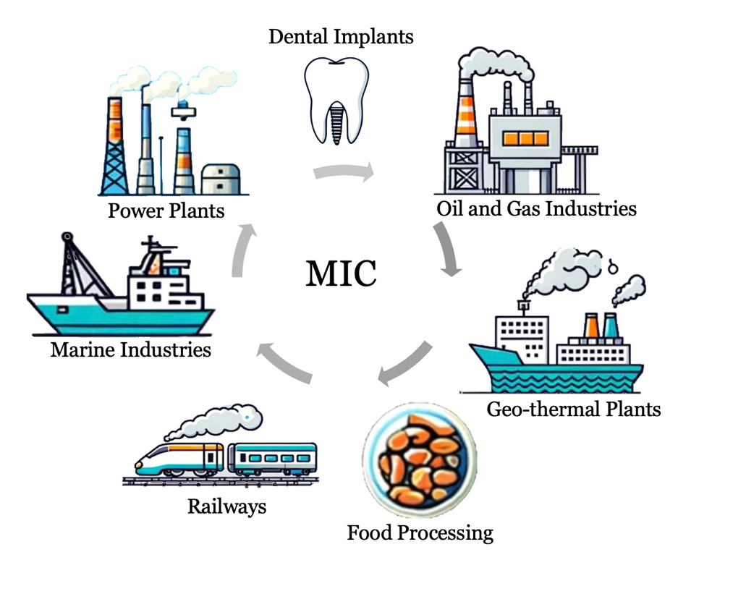
MIC Considerations in different industries

Slide 6
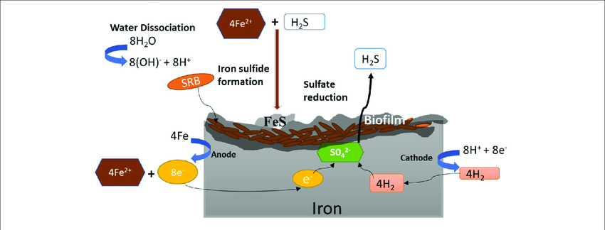
MIC types and corrosion mechanisms

Slide 7
The microbes involved in corrosion process.
Microbe name | Type | Trait | Effect | References
Sulfide reducers Desulvovibrio sp. Desulfomonas sp. | Anaerobic | Use H₂ to reduce SO₄²⁻ to S²⁻: precipitation of H₂S and FeS | Cathodic depolarization by hydrogen uptake, anodic depolarization by corrosive iron sulfides | Enning et al., 2012; Rao et al., 2000; Venzlaff et al., 2013; Wikieł et al., 2014
Iron oxidizers/manganese oxidizers Gallionella sp. Leptothrix sp. Mariprofundus sp. | Aerobic | Fe²⁺ to Fe³⁺ and Mn²⁺ to Mn³⁺: Iron oxide and manganese dioxide formation | Deposition of cathodically reactive ferric and manganic oxides | Lee et al., 2013; McBeth et al., 2011; Rao et al., 2000; Linhardt, 2010
Iron reducers Pseudomonas sp. Shewanella sp. Geothermobacter sp. | Aerobic | Reduce Fe³⁺ to Fe²⁺, manganese or iron oxide reduction | Reduction of iron and manganese oxides | Lee et al., 2013; Rao et al., 2000
Sulfide oxidizers Thiobacillus sp. | Aerobic | Oxidizes S²⁻ and SO₃²⁻ to H₂SO₄ | Acids corrode metal | Li et al., 2008
Acid producing bacteria and fungi Clostridium sp. Fusarium sp. Penicillium sp. Hormoconis sp. | Aerobic and anaerobic | Production acids, e.g., nitric acid, sulfuric acid, and organic acids | Dissolve iron, chelate copper, zinc and iron | Juzeliūnas et al., 2007; Little et al., 2001; Usher et al., 2014
Slime forming bacteria Clostridium sp. Bacillus sp. Desulfovibrio sp. Pseudomonas sp. | Aerobic and anaerobic | Production of extracellular polymeric substances (biofilm) | Exopolymers capable of binding metal ions | San et al., 2011; Stadler et al., 2008; Stadler et al., 2010
Nitrate reducing Halomonas titanicae | anaerobic | The extracellular electron transfer (EET) | Increasing the corrosion of two marine structural steels in an anaerobic seawater environment enriched with nutrients. | https://doi.org/10.1016/j.corsci.2023.111125 Lue et al., 2023
red-tide alga Phaeodactylum tricornutum and its symbiotic bacterium Bacillus altitudinis | anaerobic | Biofouling | The corrosion-biofouling-accelerated corrosion-deteriorated biofouling formed a vicious cycle. | https://doi.org/10.1016/j.jmst.2022.02.057 Dong et al., 2022

Slide 8
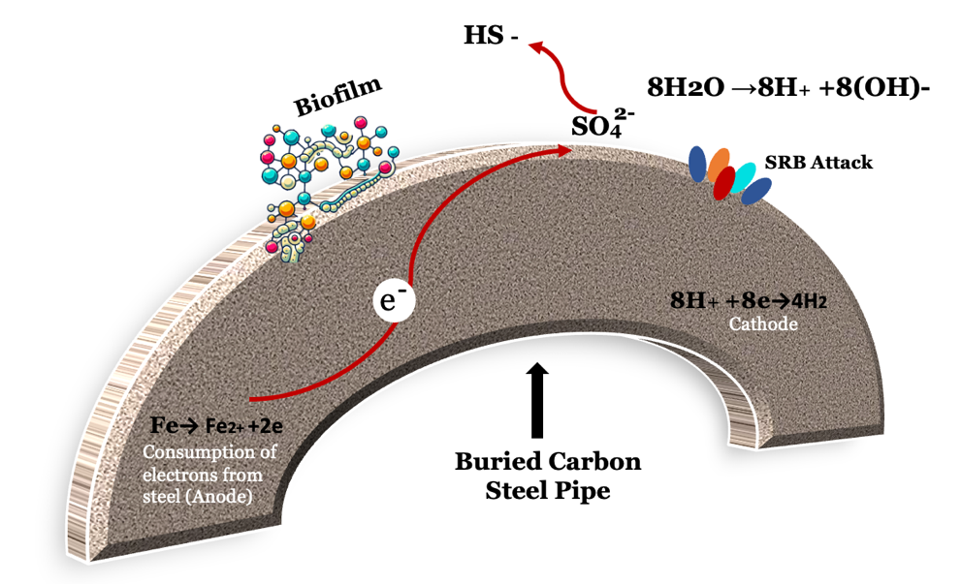
Material/MIC interactions
Carbon steel
Biofilm morphologies on the surface of steel
Costa. 2021. Microbial Corrosion in Titanium-Based Dental Implants: How Tiny Bacteria Can Create a Big Problem?
S. Lu et al (2023). Corros. Sci

Slide 9
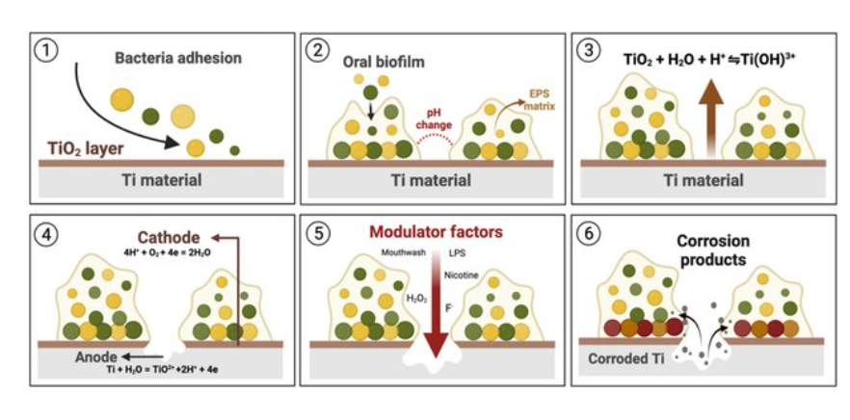
Material/MIC interactions
Titanium
Corrosion mechanism in Ti materials ( Costa, 2021 )

Slide 10
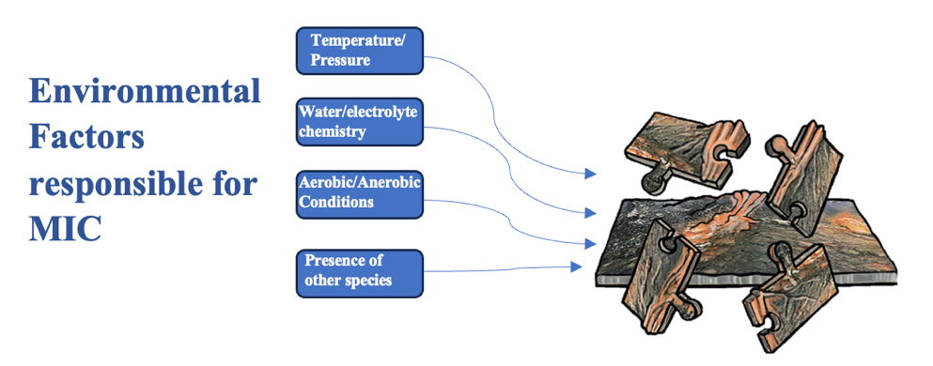
Environmental factors responsible for MIC

Slide 11
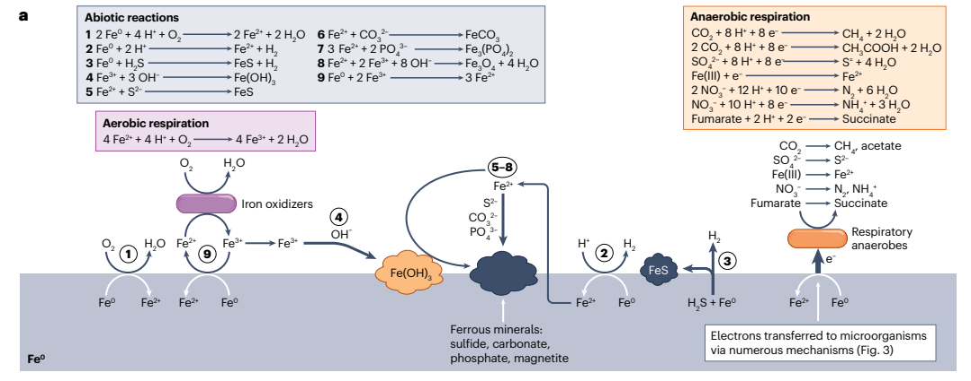
Environmental factors responsible for MIC
Dake Xu., et al (2023). Nature Reviews Microbiology. 21 (11)

Slide 12
MIC testing and monitoring
Micrbiology
Culture based methods
Plate counts
Microscopy
Light microscopy
Other methods
FTIR
ATR
Most probable number (MPN)
Test kits to enumerate MIC
2D or 3D optical tomography
Confocal laser microscopy
Electron microscopy
Atomic force microscopy
Scanning electron microscopy
DNA/RNA/ protein technique
Enzymatic methods
Metabolomics
XRD
EDX
surface profiling
Raman spectroscopy

Slide 13
MIC prevention strategies
Control Measure
Biocide
Protective coating
UV treatment
Cathodic protection
Corrosion inhibitors

Slide 14
MIC Monitoring
Weight loss
Electrical method
NDT techniques

Slide 15
Alternative MIC Monitoring Techniques
Alternative method for MIC monitoring from (Puentes-Cala, 2022)

Slide 16
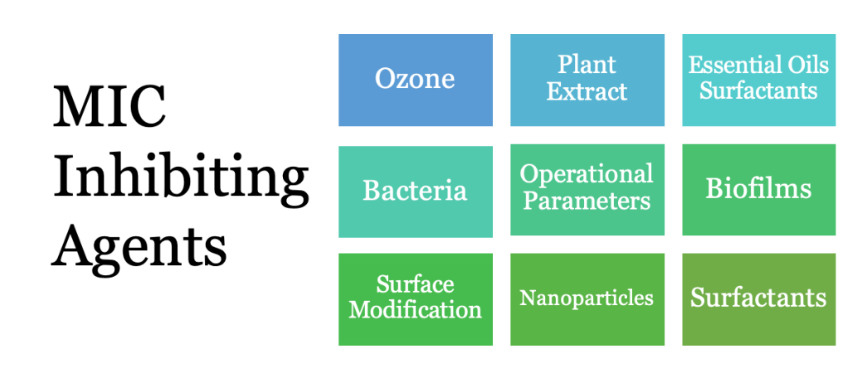
MIC Inhibiting Agents
Jana et al. ( 2022)

Slide 17
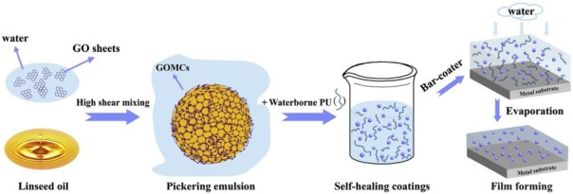
MIC Inhibiting Agents
Schematics of the formation of oil-containing graphene oxide microcapsules and the preparation of GOMCs/PU coatings. Juzeliūnas, et al. (2007).

Slide 18
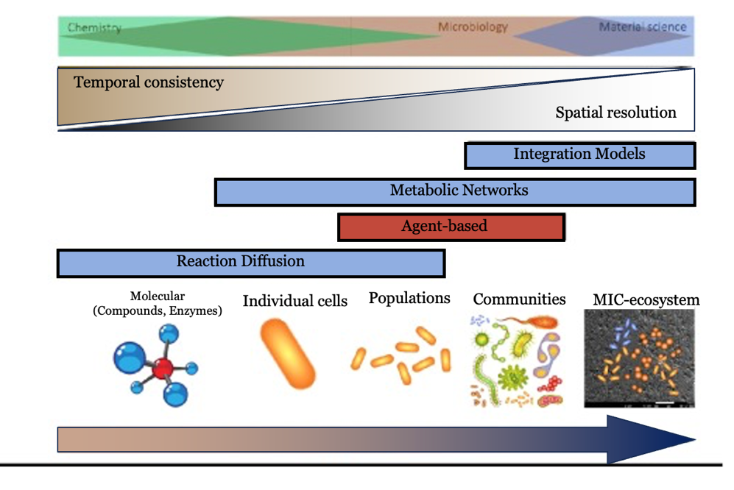
Simulation and data science tools (AI/ML)
Different type of models and their applicability to understand MIC at different scales. Deterministic models are highlighted in blue and non-deterministic models in red (Wolodko J., et al. NACE-2018-11398)
.

Slide 19



JUBCOR
2024
CONFERENCE & EXHIBITION
YOUR LOGO
INNOVATIVE SOLUTIONS FOR CORROSION CHALLENGES
THANK YOU
Reach out.
Calle Cualquiera 123, Cualquier Lugar
0564876020
Azhar-444@outlook.com
0558096194
ihsan@kfupm.edu.sa

