Slide 1




JUBCOR
2024
CONFERENCE & EXHIBITION
INNOVATIVE SOLUTIONS FOR CORROSION CHALLENGES
SCC of SS 321H pipe in high temperature service in Ethylene Cracker furnace
3rd Sept 2024
Presented By:
Karan Potnis
Sr. Static Engineer
Bachelor in Mech Production
17 years experience
Specialized in fired equipment

Slide 2

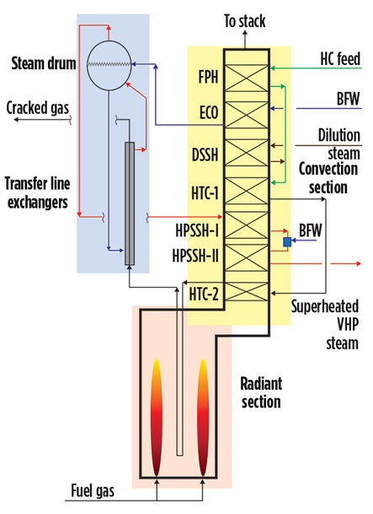

FURNACE DESIGN
FURNACE
PQE/TLE
SQE
Seven Pyro crack 1-1 furnaces
Six furnaces in operation & one standby
96 passes/96 LQE arranged in 8 modules with 12 outlet passes in each
192 inlet tubes per furnace

Slide 3
DAMAGE MECHANISMS
01
Creep
Carburization
02
03
Nitridation
Oxidation
Erosion in
Steam & BFW
04
06
PTASCC
CLSCC
Radiant & HTC 2 coils
Associated piping
Radiant & Convection
Radiant & Convection coils
Convection & Casing
Refractory
degradation
07
08
BFW corrosion
Sulfidation
09
10
Carbonic acid
corrosion
Flue gas dew
point corrosion

Slide 4
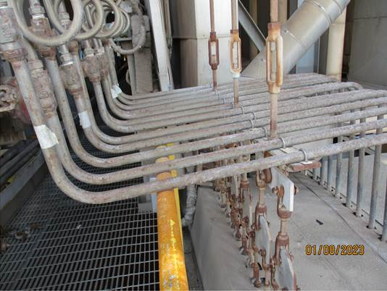
SCHEMATIC OF INLET PIPE & PG CONNECTION
Header
Spring hanger
Constant spring hanger
Pipe size | Material | Process | Oper. temp | Oper. press | Qty per furnace
2 inch (inlet pipe) | SS 321H | C2 C3/C4 | 649 °C | 1.83 barG | 192 (24x8)
¾ inch (PG line) | SS 321H | C2 C3/C4 | 649 °C (Insulated) Ambient (non insulated) | 1.83 barG | 192 (24x8)
¼ inch (analyzer tube) | SS 321H | C2 C3/C4 | Ambient | 1.83 barG | 8 (8x1)
PG
¾ “ PG pipe
¼” PT line
Laval nozzle
2 “ Inlet pipe
PG line fixed with U clamps
Grating
Spring Support
2 “ Inlet tube
Furnace roof
Pressure Guage
Indication of choking
Consideration for tube replacement
Inlet radiant tube

Slide 5
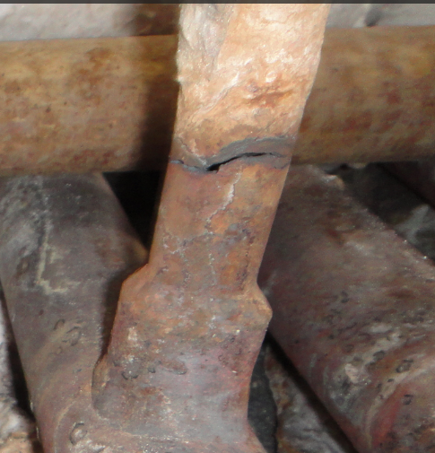
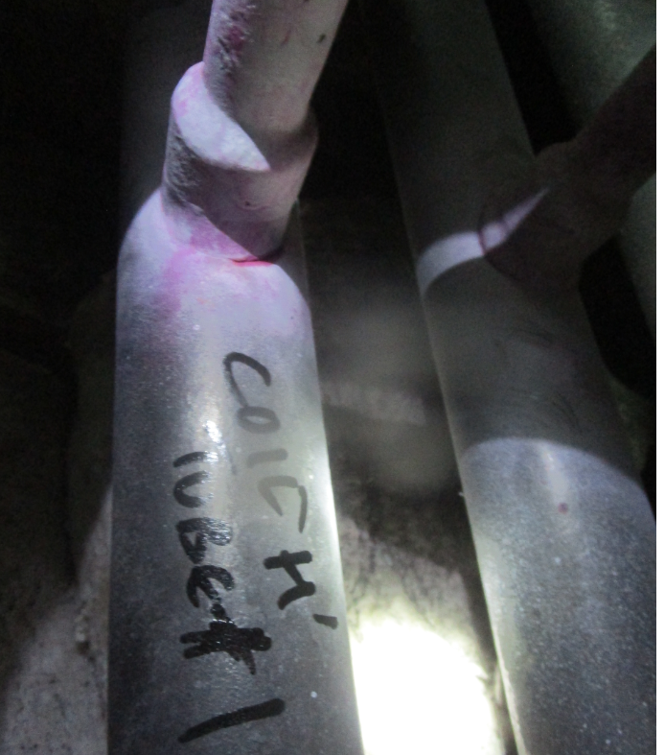
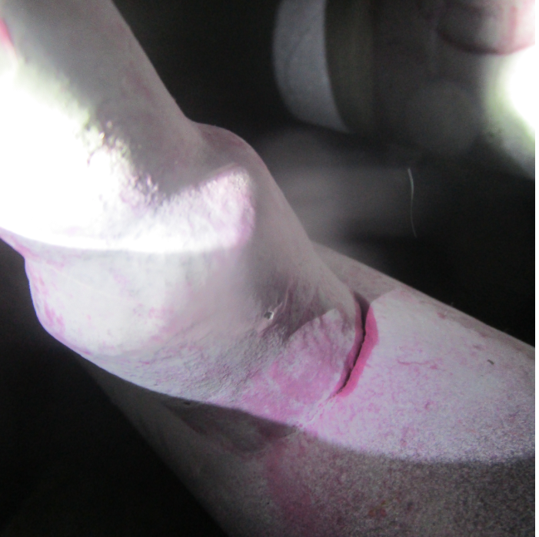
FAILURE LOCATION
Crack on parent material
Header
Spring hanger
PG
¼” PT line
Crack on weld joint
Closer view shows crack on weld toe
Spring Support
Furnace roof

Slide 6
FAILURE ANALYSIS
DPT on OD
OD crack
OD corrosion
Visual
Chemical
Through crack
Meet spec
Low magnification
Sulfur on ID
Chloride on OD
EDS
Rough surface
LAB TESTING
DPT
SEM
ID crack
Through crack
Intergranular crack
ID crack
Tensile
Macro
Within limit
Seamless pipe
DPT on ID
Hardness
IGC from inside
OD corrosion
Micro
Satisfactory

Slide 7
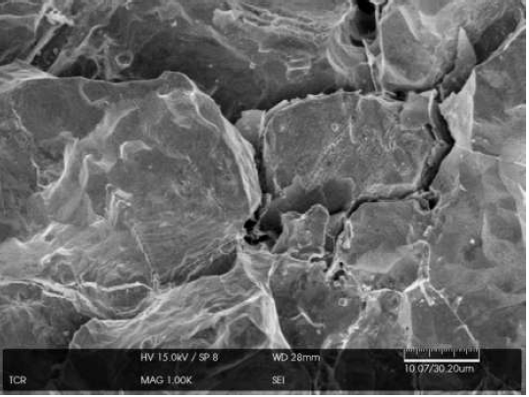
MICROSTRUCTURE ANALYSIS
Typical behavior of Polythionic acid stress corrosion cracking
ICG with grain dropping
Sulfur is present is stream with steam
ID intergranular cracking
along with grain dropping
SEM showing intergranular cracking on ID
Possible due to chloride from insulation
OD corrosion at insulation opening
Carbide precipitation at grain boundary
Sensitized steel operating at 650 degC
Carbide precipitation on grain boundary
OD corrosion

Slide 8

STRESS ANALYSIS
Constant spring hanger
Spring hanger
Header
Tube moves downward whereas the PG is not free to move
Stress point identified on the PG connection to 2” pipe
Rigidity increased as four PG pipes connected together
Overhung creates load on the weld joint
PG
¼” PT line
PG line fixed with U clamps
Spring Support
Rigid support
Stress point
Furnace roof

Slide 9
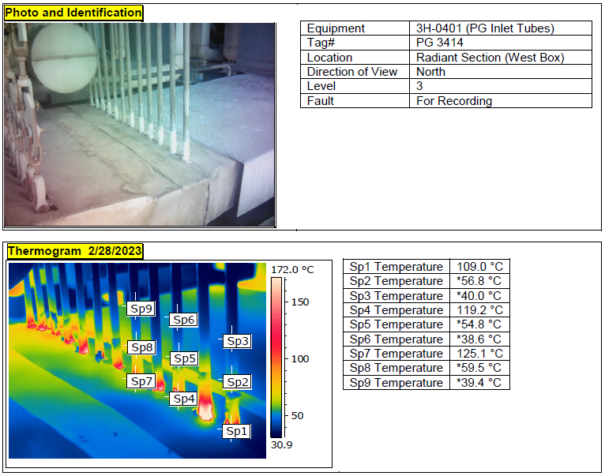
THERMOGRAPHY ASSESSMENT
Temperature drops from 600 degC to 120 degC
Sulfur condensation in PG pipe
Temperature drops from 125 degC to ambient
High thermal gradient

Slide 10
CRACK ASSESSMENT FAULT TREE
PG line cracking
Weld joint crack
Parent metal crack
SCC
Internal
(PTASCC)
External
(CLSCC)
Stress
Inadequate support
Tube additional expansion
PASCC: (Polythionic acid stress corrosion cracking)
API 571:
Intergranular SCC in sensitized austenitic stainless steels and some Ni alloys
Sulfide scale due to air and moisture creates sulfur acids causing PTA SCC.
Occurs during shutdowns or start-ups.
Assessment:
Sulfur in DMDS injection required for pre-sulfiding of the radiant coils.
Crack at the insulation opening location where temperature drops to ambient & condenses sulfur.
Stress due to the rigid system from improper supports.
Pipe material (SS321H) not stabilized which makes it more susceptible to PASCC.
CLSCC: (Chloride stress corrosion cracking)
API 571:
Surface cracking of 300 series SS and some nickel-based alloys under the combined action of tensile stress, temperature, and an aqueous chloride environment.
Temperature: 60°C to 205°C
Wet insulation
Assessment:
Chloride is present insulation.
Stress due to the rigid system from improper supports.
Moisture from ambient conditions during summer.
Primary cause of failure
PTASCC - Polythionic acid stress corrosion cracking
Contributing cause of failure
CLSCC – Chloride stress corrosion cracking

Slide 11
PARENT MATERIAL CRACKING
Parent metal crack
SCC
PASCC
Inadequate support
CLSCC
Chloride from Insulation
Moisture from atmosphere
Pipe not insulated completely
Tube & PG pipe connected together
Nonfunctional spring hanger
Not designed for
Coke/HSSB/Decoking
4 tubes connected to one hanger
Design deficiency
Pipe not stabilized
Not in specification
Sulfur condensation
Insufficient insulation
Moisture
Shutdown/
Maintenance/
steam condensate
Primary cause of failure
Contributing cause of failure
PASCC - Polythionic acid stress corrosion cracking
CLSCC – Chloride stress corrosion cracking
Control measures implemented
Aluminum foil installed

Slide 12
WELD JOINT CRACKING
Weld joint crack
Stress
Thermal shock
During trips/SD
Inadequate support
Residual
Welding
Nonfunctional spring hanger
Not designed for
Coke/HSSB/Decoking
Tube additional expansion
Tube overheating
Overweight
Tube choking
Tube choking
Impurities in recycle feed
PQE with hard coke
No PM for cleaning
4 tubes connected to one hanger
Tube & PG pipe connected together
Design deficiency
Flame impingement
Improper burner management
No PM for cleaning
Operational awareness
Primary cause of failure
Contributing cause of failure

Slide 13
CONCLUSION
PRIMARY CAUSE
CONTIBUTING CAUSES
Inadequate
PG support
Stress analysis
Design modification
Nonfunctional tube hangers
Stress analysis
Pipe not stabilized
Tube additional expansion
Design modification
Change spec to include stabilization treatment
Reduce tube choking
Burner management
Recycle feed impurity
PQE cleaning
Cleaning PM
Operation monitoring
Site modification
Replace all pipes with stabilized grade
New replacement with stabilize grade
Shift PG
Loosen U clamps

Slide 14
OPTION - 1
(Shift PG on top of vertical line)
Header
Spring hanger
Proposed position
Current position
Benefits
Shortcoming
Overhung stress elimination
Conclusion
Will eliminate the failure probability
No accessibility for monitoring & replacement
New grating will be required
Operator exposed to high temperature area
Not feasible
PG
PG
¾ “ PG pipe
Laval nozzle
2 “ Inlet pipe
Spring Support
2 “ Inlet tube
Furnace roof

Slide 15
OPTION – 2
(Shift the vertical line closer to grating & place PG on top of it)
Header
Benefits
Shortcoming
Overhung stress reduction
Conclusion
Requires replacement of inlet pipes
Not feasible
Will reduce the failure probability
Accessibility for replacement is a concern
Spring hanger
Current position
Proposed position
PG
PG
¾ “ PG pipe
Laval nozzle
2 “ Inlet pipe
Grating
Spring Support
2 “ Inlet tube
Furnace roof

Slide 16
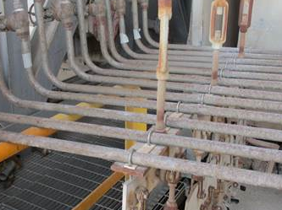
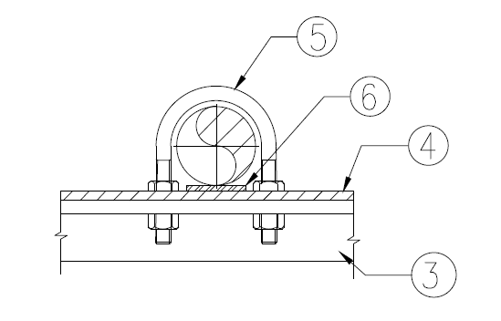

OPTION – 3
(Loosen U clamps)
Benefits
Shortcoming
Free movement will minimize the stresses on the socket weld joint
Conclusion
Weld joint stress on the socket joint still exist but will be reduced
Selected option
Immediate solution without major modifications
Verified with Spring Support consultant
Sketch only for understanding purpose
3 – Support plate
4 – PTFE sheet
5 – U clamp
6 – Not available on site
Space available for movement
Original - Rigid
Modified - Flexible

Slide 17





OUTPUT & PATHFORWARD
1 yr.: Zero leak
04
01
Output
Analysis & solution
Implementation & monitoring
Improved integrity & safety
Cost saving
2023:Analysis
Solution
2022:Monitoring
03
Leak tracking
02
2 yrs.:21 leaks
Monitor change
Stress analysis
Path forward
Replace affected pipe
Support modification

Slide 18
TAKEAWAY: SIMPLE IS BETTER
OPT 3
COMPLEX
SIMPLE
OPT 1
OPT 2
01
02
03
OPT 3 – LOOSEN CLAMP

Slide 19





JUBCOR
2024
CONFERENCE & EXHIBITION
INNOVATIVE SOLUTIONS FOR CORROSION CHALLENGES
Reach out.
+966 (13) 359 9317
potniskk@tasnee.com

